Slide 1

Algebra 1 Keystones
Eligible Content
Test Design
Performance Level Indicators

Slide 2
Algebra 1 Keystones
Eligible Content – Test Design – Performance Level Indicators
Ms. Clarkson
Ms. Hetrick
Ms. Sirio

Slide 3
Eligible Content
Eligible Content is the most specific description of the content that is assessed on the Keystone Exams. This level is considered the assessment limit and helps educators identify the range of the content covered on the Keystones.
The Assessment Anchors and Eligible Content are designed to enable educators to determine when they feel students are prepared to be successful in the Keystone Exams.
The Eligible Content is very specific to the subject area.

Slide 4
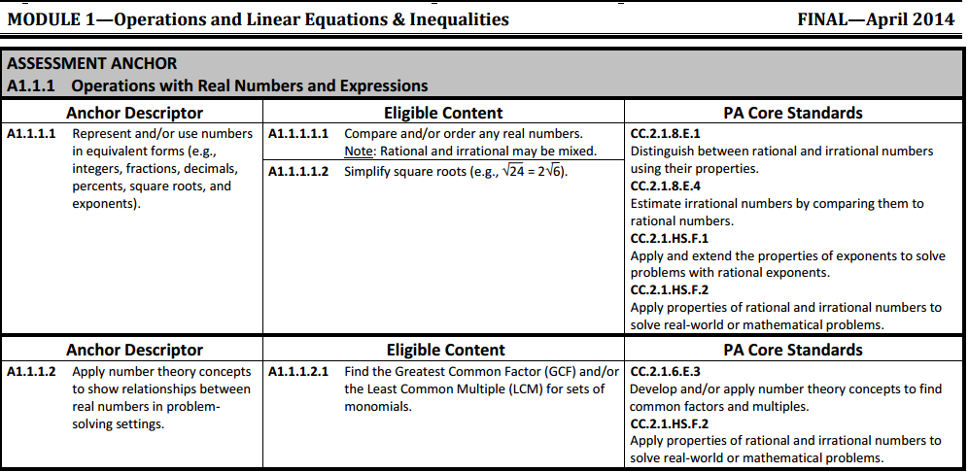
Eligible Content
The Assessment Anchor represents a category of subject matter.
The Anchor Descriptors provides further details that delineate the scope of the content covered in the Anchor.
One or more Eligible Content statements are unified under the Descriptor.
The Assessment Anchors are defined by the Eligible Content.
The PA Core Standards
correlate to the Eligible
Content

Slide 5
Test Design
Algebra 1 Keystone Test

Slide 6
Algebra 1 Keystone Exam
Assesses student’s mastery of Algebra 1 Assessment Anchors as defined by the Eligible Content.
The test is in two modules
  Module 1—Operations and Linear Equations & Inequalities
  Module 2—Linear Functions and Data Organization

Slide 7
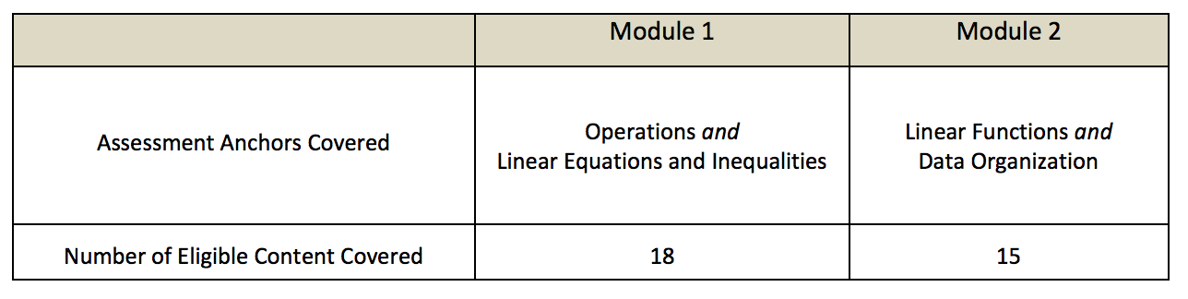
Test Design for Standards

Slide 8
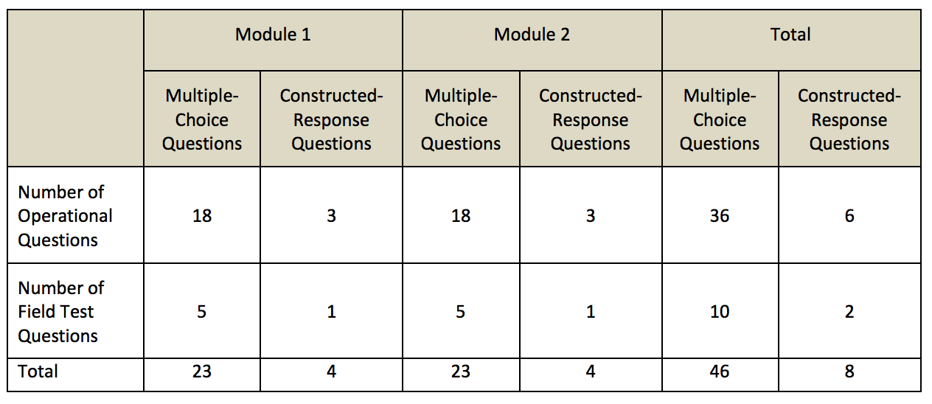
Breakdown of Question Types

Slide 9
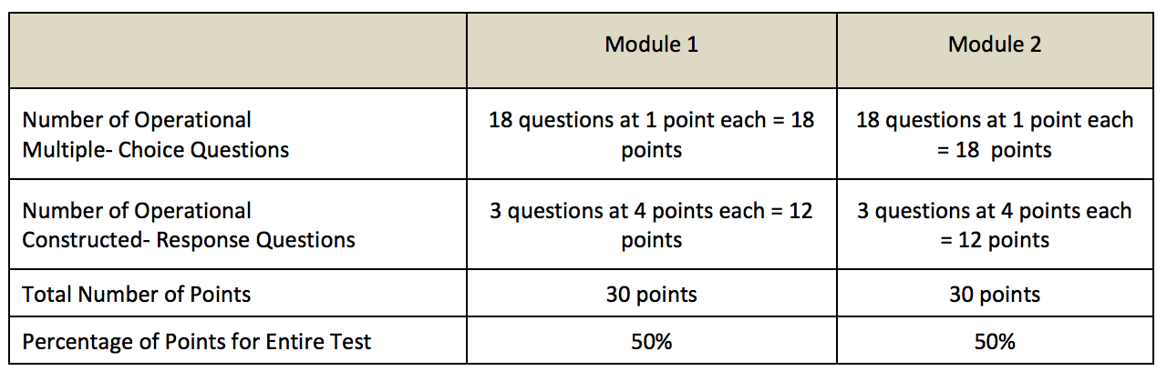
Breakdown of Points

Slide 10
Constructed Response
Constructed response means the student must arrive at their own answer.
There are two types of constructed response:
  Scaffolding Completion Questions
  Extended Scaffolding Completion Questions
Both types of questions are scored on a scale ranging from 0 to 4 points.

Slide 11
Scaffolding Completion Questions
Questions that elicit two to four distinct responses from a student
Some examples of student responses may be: 5 gallons, vertex at (5, 11), or y = 3x + 9.
A designated answer space/box is provided for each part of each question.
No extraneous work is scored.
Partial credit may be awarded for qualifying responses.

Slide 12
Extended Scaffolding Completion Questions
Questions that require students to respond with extraneous work or explanation for some part of the question.
For example, student may be asked to “Show all of your work,” or “Explain why the curve is not a parabola,” or “What is the error in Jill’s thinking?”
Question-specific scoring guidelines are used by scorers to award credit, including partial credit, for responses.

Slide 13
Performance Level Indicators
Algebra 1 Keystones

Slide 14
Proficient
An Algebra I student performing at this level demonstrates an understanding of the skills, concepts, and procedures in Algebra I and is able to model and solve real-world problems.
Algebra I Keystones Performance Level Descriptors
Advanced
An Algebra I student performing at this level demonstrates an in-depth understanding of the skills, concepts, and procedures in Algebra I and is able to model, analyze, solve, and evaluate complex problems, including real-world problems.
Basic
An Algebra I student performing at this level solves simple mathematical problems by applying fundamental skills and procedures in Algebra I.

Slide 15
A student at this level is able to do the following:
• Orders and simplifies real numbers.
• Identifies multiple representations of rational numbers.
• Evaluates expressions with exponents, roots, or absolute values.
• Simplifies expressions using non-negative exponential values.
• Performs operations on and simplifies polynomial expressions (up to monomials multiplied by trinomials).
• Factors polynomial expressions with no more than two factors.
• Solves and graphs multistep linear equations or inequalities with integer coefficients and constants.
• Solves and graphs linear equations and inequalities.
• Identifies the solutions of systems of equations and inequalities.
• Solves systems of equations by graphing.
• Identifies the domains and ranges of relations given in ordered pairs and tables.
• Graphs linear functions given equations, sets of ordered pairs, or tables.
• Identifies and computes the rates of change (slopes) of lines.
• Identifies and computes the y-intercepts of lines.
• Writes slope-intercept forms of linear equations when given the graph or the slope and the y-intercept of lines.
• Writes point-slope forms of linear equations when given the graph or the slope and a point.
• Draws and identifies lines of best fit for scatter plots.
• Identifies and finds the ranges, quartiles, and interquartile ranges given a box-and-whisker plot.
• Answers questions based on displayed data.
• Finds probabilities for compound events with replacement.
Algebra I Keystones Performance Level Descriptors
Possible applications
Basic
An Algebra I student performing at this level solves simple mathematical problems by applying fundamental skills and procedures in Algebra I.

Slide 16
Proficient
An Algebra I student performing at this level demonstrates an understanding of the skills, concepts, and procedures in Algebra I and is able to model and solve real-world problems.
A student at this level is able to do the following:
• Orders and simplifies real numbers written as expressions.
• Uses multiple representations of real numbers.
• Uses properties of exponents to simplify terms.
• Uses estimations in problem-solving situations.
• Performs operations on and simplifies polynomial expressions (up to binomials multiplied by binomials).
• Factors polynomial expressions.
• Solves and graphs multistep linear equations or inequalities and absolute value equations.
• Writes, solves, graphs, and interprets linear equations and inequalities in problem-solving situations.
• Solves systems of equations.
• Interprets graphical representations of systems of two linear inequalities.
• Interprets solutions to problem-solving situations.
• Recognizes functions and identifies the domains and ranges of relations given in ordered pairs and tables.
• Converts between multiple representations of linear functions.
• Describes, computes, and/or uses the rates of change (slopes) of lines.
• Describes, computes, and/or uses the y-intercepts of lines.
• Writes slope-intercept or point-slope forms of linear equations when given the graph, two points, or the slope and a point.
• Identifies the equations for lines of best fit for scatter plots.
• Makes predictions from lines of best fit for scatter plots.
• Calculates the ranges, quartiles, and interquartile ranges given data or data displays.
• Analyzes data, makes predictions, and answers questions based on displayed data.
• Finds probabilities for compound events.
Algebra I Keystones Performance Level Descriptors
Possible applications

Slide 17
Algebra I Keystones Performance Level Descriptors
Possible applications
A student at this level is able to do the following:
• Uses estimations to make predictions in problem-solving situations.
• Performs multistep operations on and simplifies polynomial expressions.
• Simplifies rational algebraic expressions.
• Solves and graphs absolute value inequalities.
• Uses and identifies properties to justify steps in equation-solving processes.
• Writes and solves systems of equations in problem-solving situations, and interprets the results.
• Writes, solves, and graphs systems of linear inequalities in problem-solving situations, and interprets the results.
• Recognizes functions, and identifies the domains and ranges of relations given in graphs, ordered pairs, and tables.
• Interprets, describes, computes, and/or uses the rates of change (slopes) of lines.
• Interprets, describes, computes, and/or uses the intercepts of lines.
• Writes standard forms of linear equations when given the graph, two points, or the slope and a point.
• Writes the equations for lines of best fit for scatter plots and makes predictions.
• Calculates and interprets the ranges, quartiles, and interquartile ranges given data or data displays.
• Analyzes data, makes predictions, and answers questions based on multiple displays of data.
Advanced
An Algebra I student performing at this level demonstrates an in-depth understanding of the skills, concepts, and procedures in Algebra I and is able to model, analyze, solve, and evaluate complex problems, including real-world problems.

