Slide 1


Key to Literature
McKrell, Smith, Patrick

Slide 2

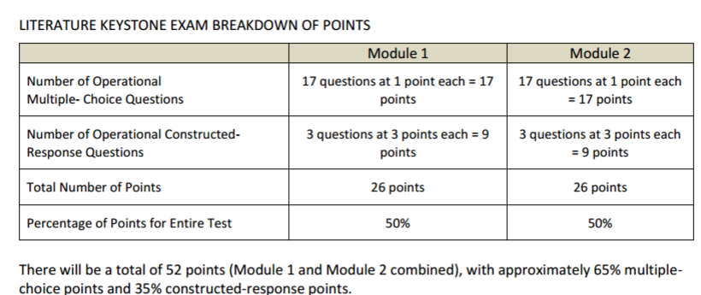
Test
Design
2 Day Test
Fiction
Non fiction

Slide 3
What’s key?
Non fiction articles: include a written lead- in with background info.
Add vocab. keys for context clues, but have focus vocab. in multiple choice questions to test understanding.
In multiple choice assessments try to use related concepts with the “best” answer.

Slide 4
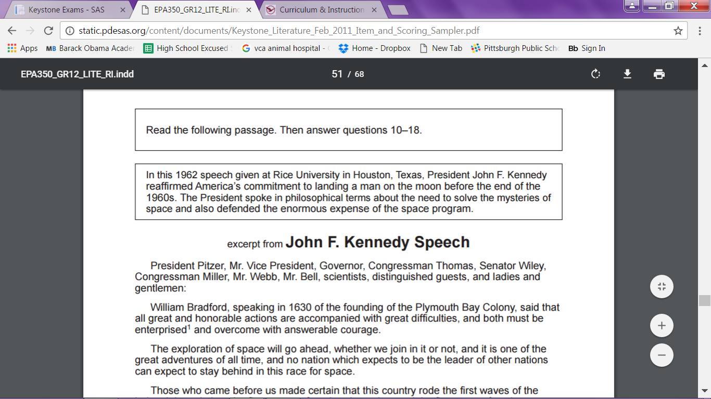

Slide 5
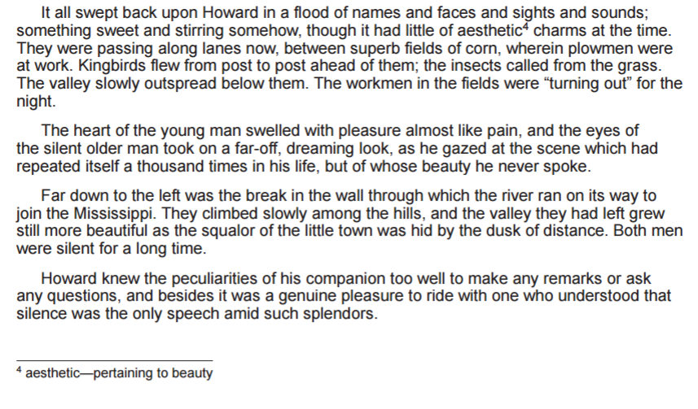
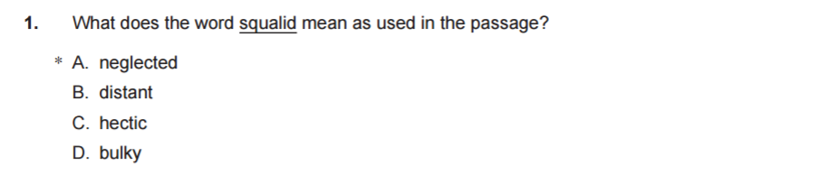

Slide 6
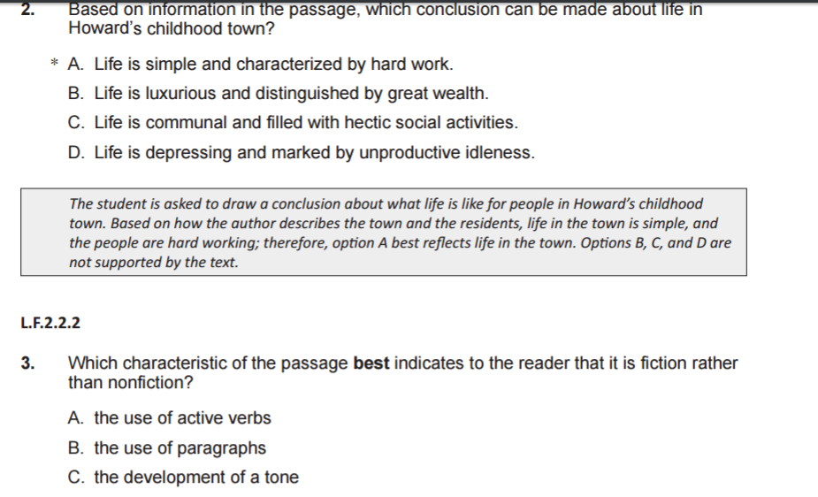

Slide 7

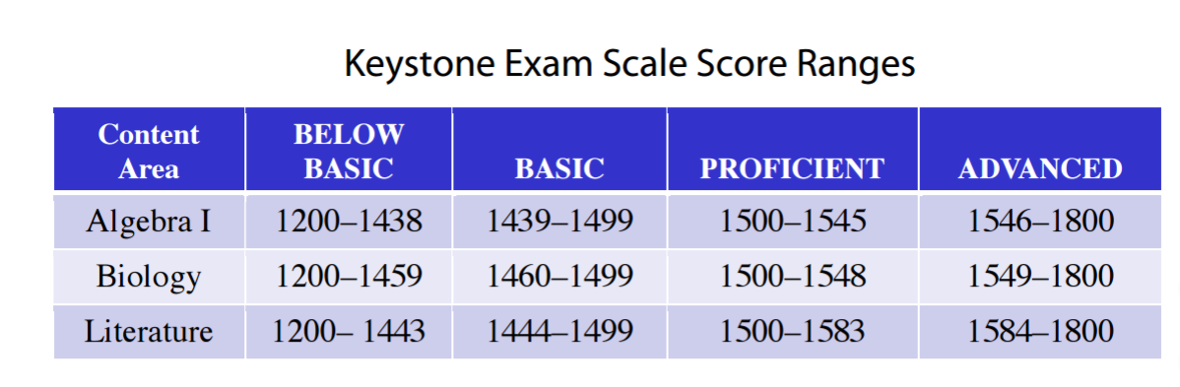
Scoring

Slide 8
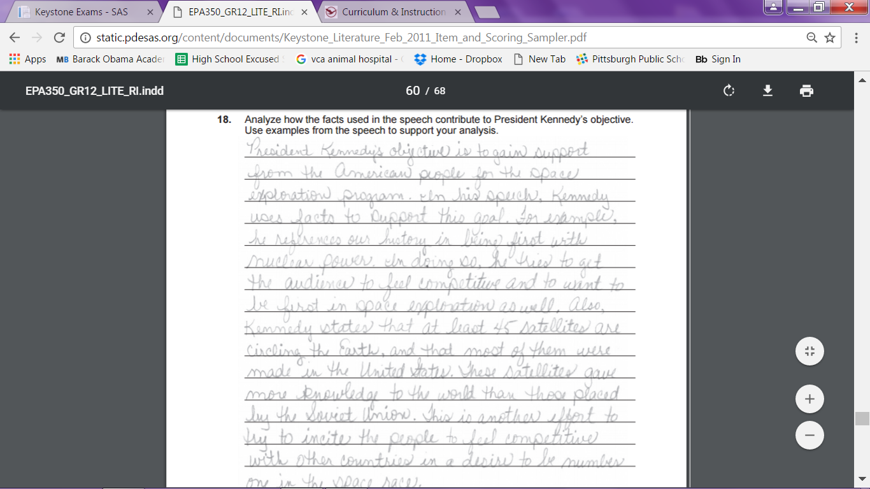
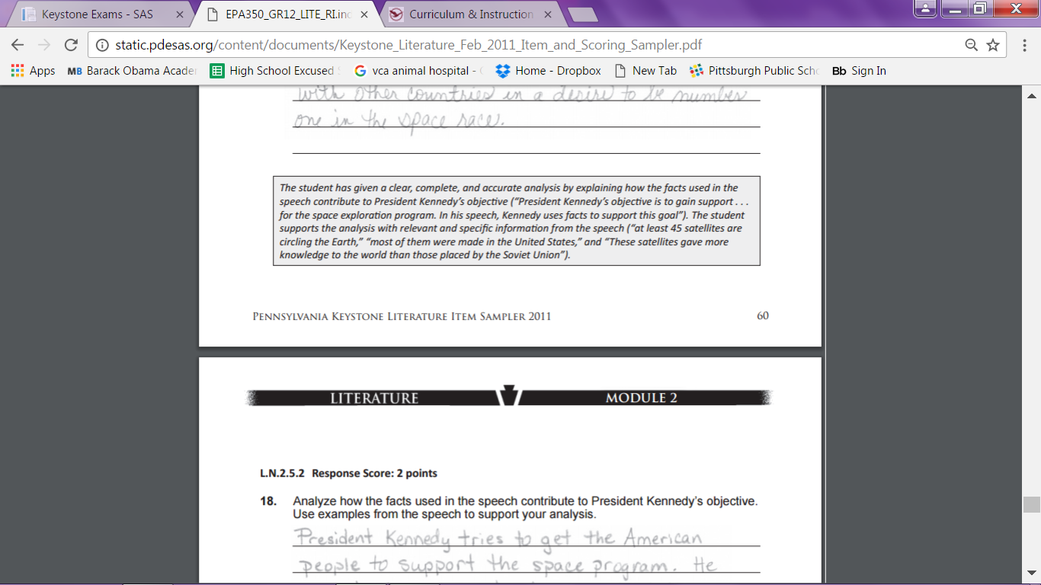

Slide 9
What’s key?
In discussing score range, be sure to relate to content, since range varies.
Weight short response questions higher than multiple choice
Make sure rubrics are utilized

Slide 10

Eligible
Content
From Nonfiction Module
Identifying Author’s Purpose
Citing evidence/ Support claims
Analyzing the value of a resource

Slide 11

What’s key?
Author’s Purpose
Create strategies to analyze intention
Look at form prior to reading
Discuss content/intention: through language, design, etc.
What does this like in your class?

Slide 12
What’s key?
Citing evidence/
support claims
Encourage verbal or written claims to be supported with reasoning details and evidence in writing.
What does this like in your class?

Slide 13
What’s key?
Value of a resource
Distinguish between essential and non essential info.
How do you know that something is a fact? (bias)
What does this like in your class?

