Slide 1
What: Get started with Classroom 365
Why: It can help us to better connect with our students, and lots of people wanted to learn about Google Classrooms, which we will not be using next year.
How: Log into your accounts through your email invitation.
Try to edit a document collaboratively
Try to access content in the community library.

Slide 2
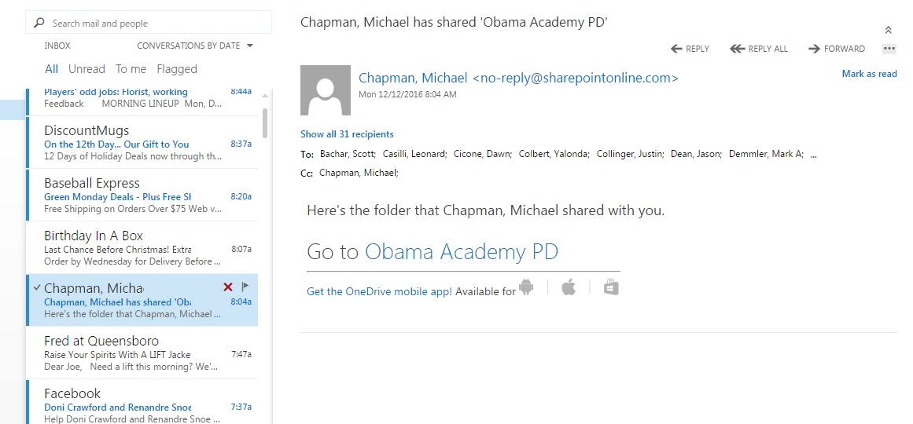

Slide 3
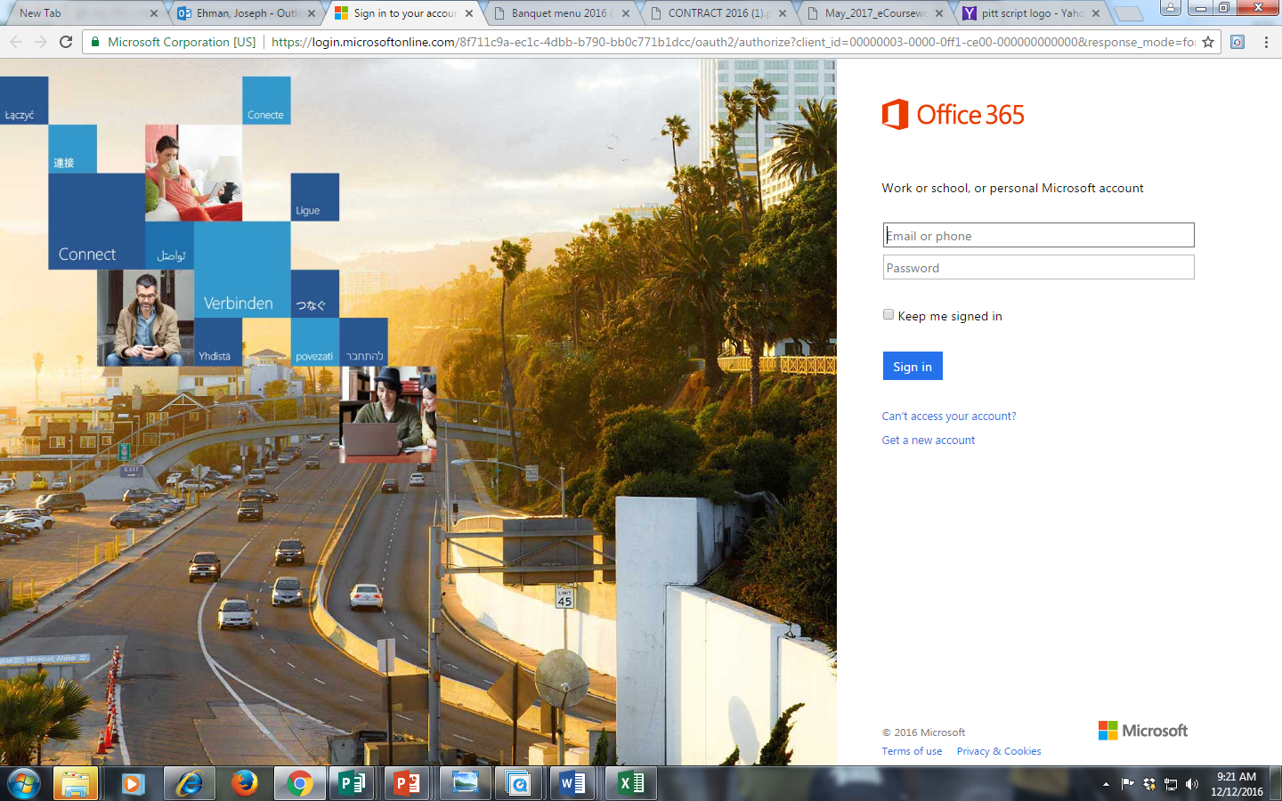

Slide 4
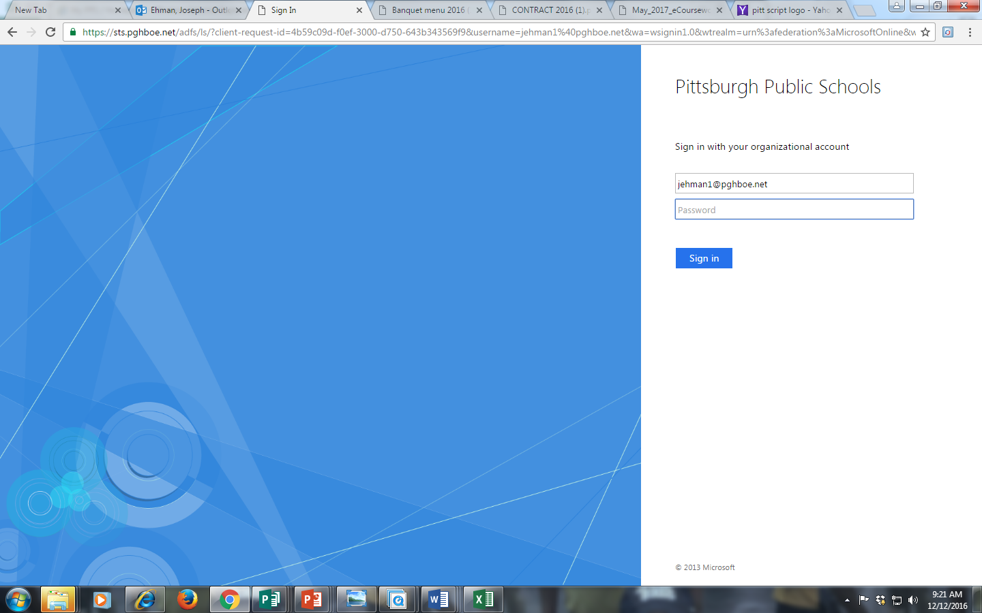
Use your current PPS login

Slide 5
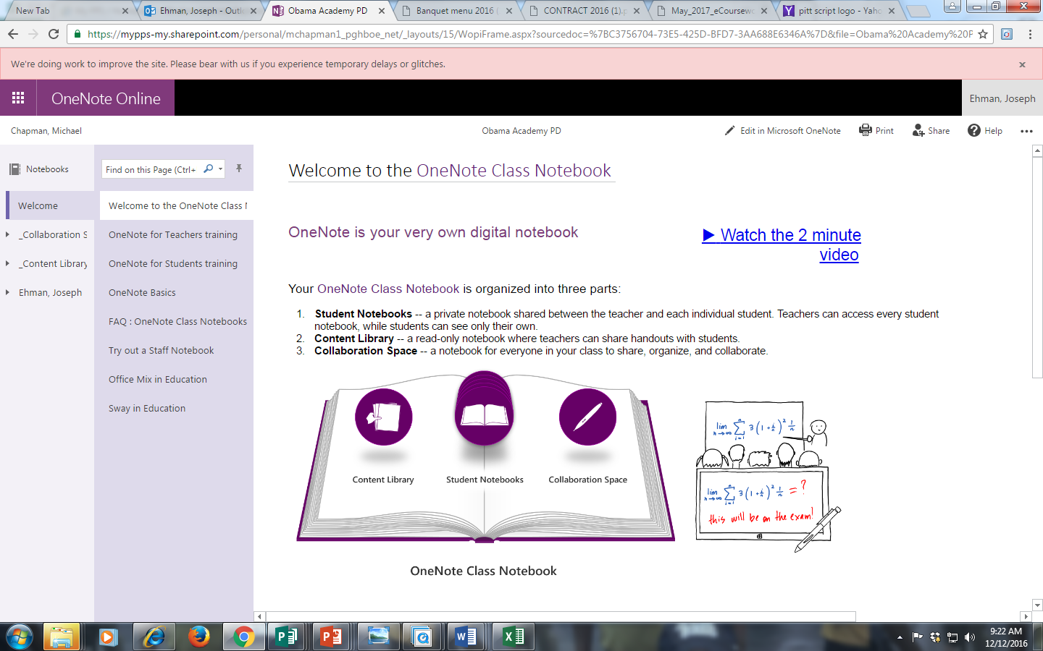
Click on Collaboration First

Slide 6
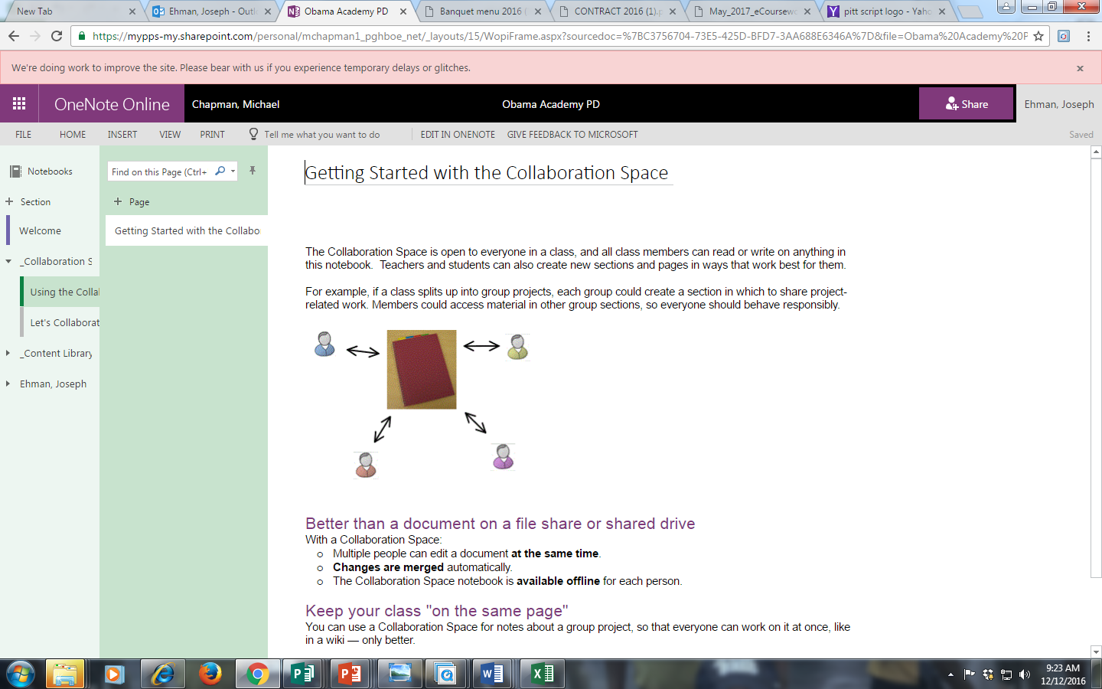
Go to Let’s Collaborate Tab

Slide 7
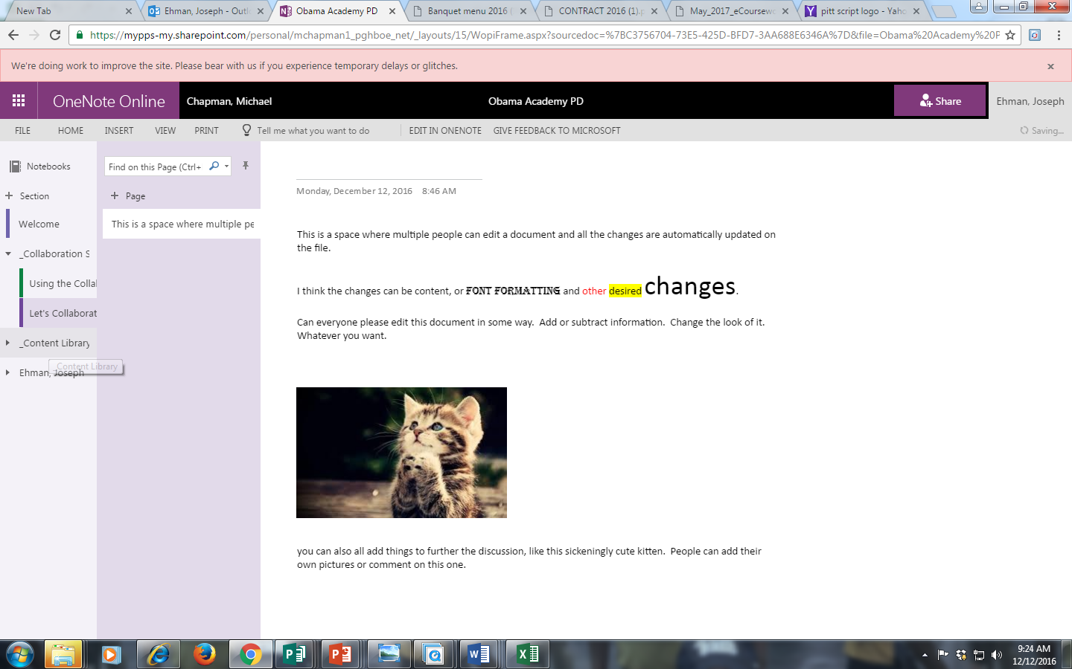
After editing, click on Content Library

Slide 8
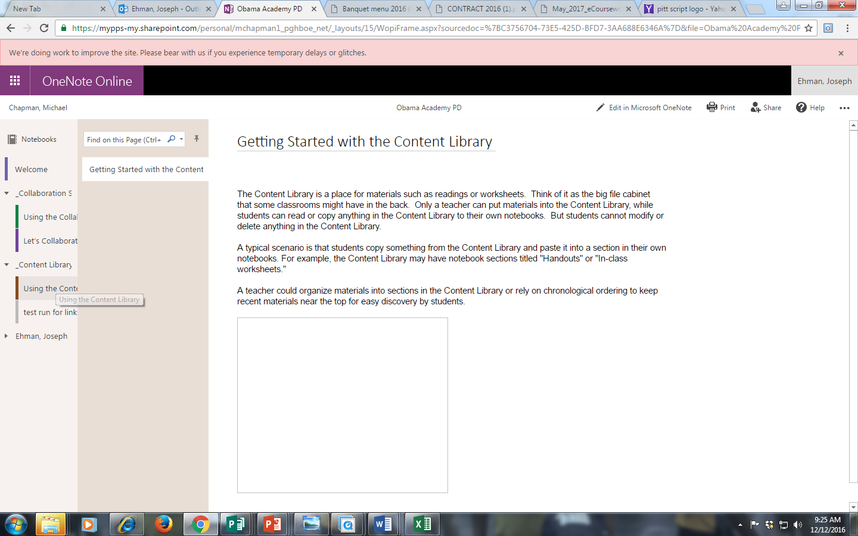
Now click on Test Run

Slide 9
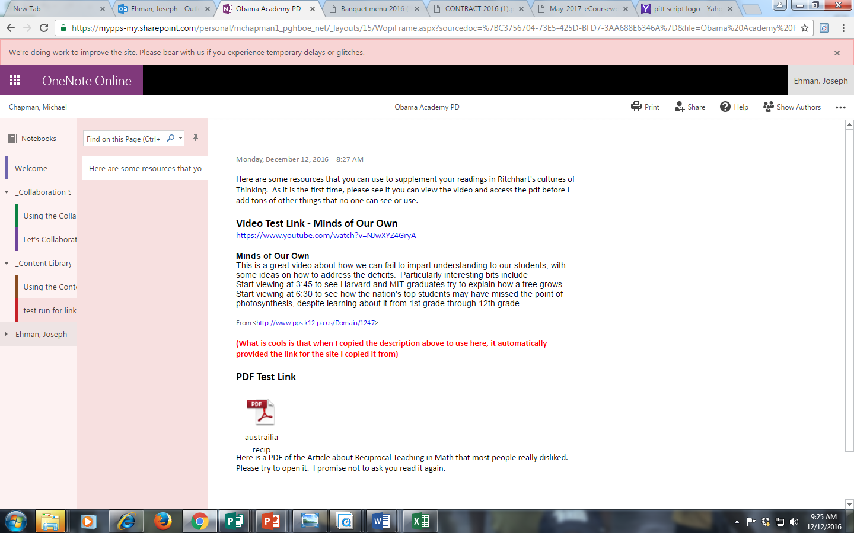
Please try to access the video and see the pdf.

