Slide 1
What: Incorporate Ritchhart’s theory of Modeling (chapter 5) to our work dedicated to improving student achievement.
Why: The Children Are Watching.
How: Complete Reciprocal Teaching Activity based on Mathematics Reciprocal teaching article
Share strategies that we attempted recently
Don’t forget pps.k12.pa.us/ibworld2

Slide 2
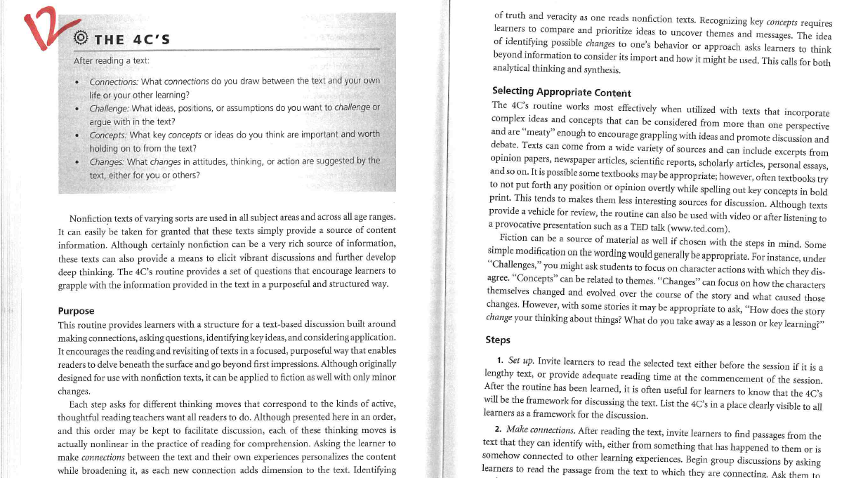

Slide 3
