Slide 1
What: Incorporate Ritchhart’s theory of Modeling (chapter 5) to our work dedicated to improving student achievement.
Why: The Children Are Watching.
How: review the different types of modeling that can be used in the classroom
see reciprocal teaching in action
try some reciprocal teaching ourselves
Don’t forget pps.k12.pa.us/ibworld2

Slide 2
Think of Students as Apprentices
Dispositional Apprenticeship: being a role model of thinking and learning
Cognitive Apprenticeship: making our thinking visible
Gradual Release of Responsibility: modeling for independence
Interactive Modeling: learning from examples, practice and reflection

Slide 3
Dispositional Apprenticeship: being a role model of thinking and learning.
Principled
Reflective
Inquiring
Caring
Knowledgeable
Thinking
Open Minded
Communicator
Risk Taker
Balanced

Slide 4
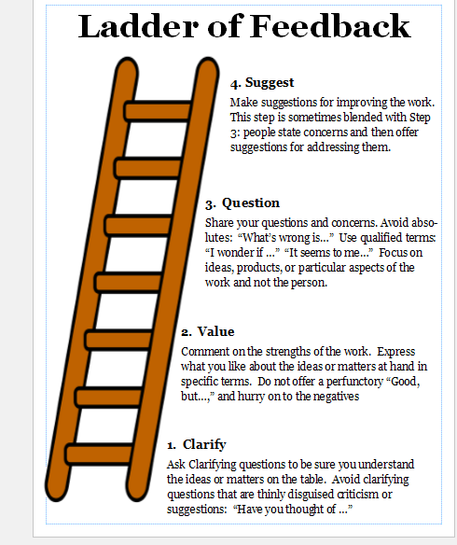
Cognitive Apprenticeship: making our thinking visible

Slide 5
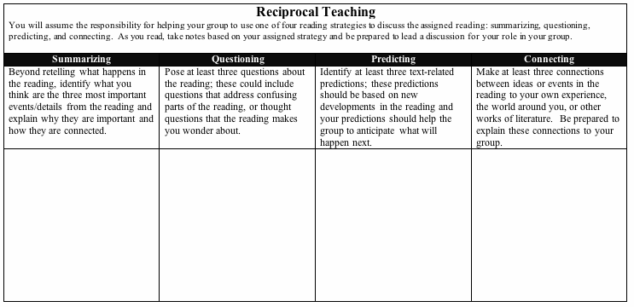
Gradual Release of Responsibility: Modeling for Independence
Reciprocal Teaching- read in groups, with each person taking on one of these roles.
http://raisingthebar.wested.org/resource/reciprocal-teaching-high-school

Slide 6
Interactive Modeling: learning from examples, practice and reflection

Slide 7
Progression from looser structure to increasingly focused
Dispositional Apprenticeship: being a role model of thinking and learning
Cognitive Apprenticeship: making our thinking visible
Gradual Release of Responsibility: modeling for independence
Interactive Modeling: learning from examples, practice and reflection

