Slide 1
What: Incorporate Ritchhart’s theory of Modeling (chapter 5) to our work dedicated to improving student achievement.
Why: The Children Are Watching.
How: discuss the different types of modeling that can be used in the classroom
see if any of the previously learned thinking routines can apply to this model
Don’t forget pps.k12.pa.us/ibworld2

Slide 2
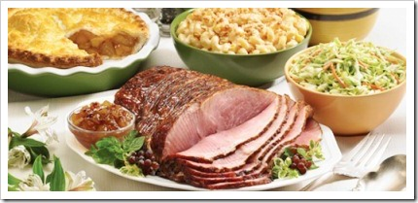
My colleague was invited to an Easter dinner with friends. Sitting down to an exquisitely laid table, the guests all expressed their approval as the hostess placed an amazingly glazed ham in the center of the table. The hostess remarked how she had baked it using her grandmother’s recipe faithfully.

Slide 3
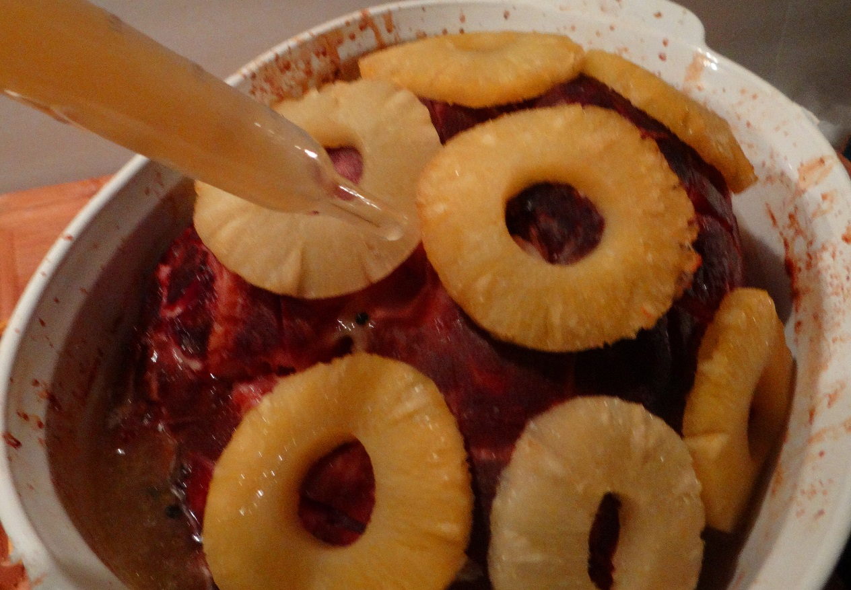
The hostess went into vivid detail about the process: cutting off the ends of the ham, carefully scoring it and studding it with cloves, roasting it slowly, and of course the basting of it every fifteen minutes.

Slide 4
My colleague then asked, “So why did you cut off the ends of the ham?”
The hostess slowly replied, “I’m not quite sure. I got the recipe from my mother.”
Her mother chimed in, “I’m not sure either. I just remember watching my mother fix this every Easter. I wrote down everything exactly as she did it, since she didn’t work from a recipe.”

Slide 5


After dinner was over, a call to grandmother resolved the group’s quandary.
“Oh, I always cut off the ends of the ham because the pan I had at the time was never big enough for the whole ham.”

Slide 6
Think of Students as Apprentices
Dispositional Apprenticeship: being a role model of thinking and learning
Cognitive Apprenticeship: making our thinking visible
Gradual Release of Responsibility: modeling for independence
Interactive Modeling: learning from examples, practice and reflection

Slide 7
Dispositional Apprenticeship: being a role model of thinking and learning.
Principled
Reflective
Inquiring
Caring
Knowledgeable
Thinking
Open Minded
Communicator
Risk Taker
Balanced

Slide 8
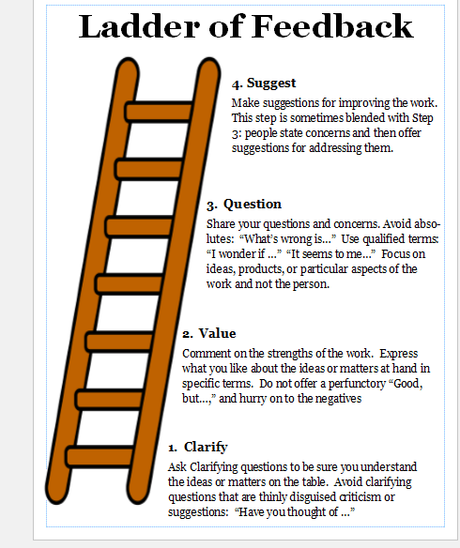
Cognitive Apprenticeship: making our thinking visible

Slide 9
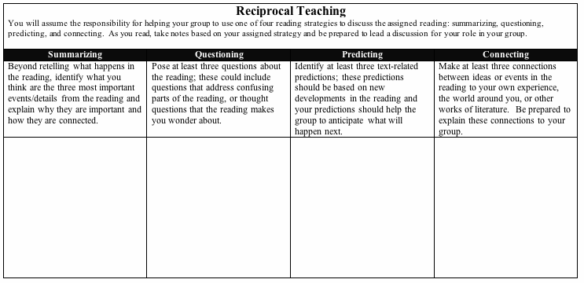
Gradual Release of Responsibility: Modeling for Independence
Reciprocal Teaching- read in groups, with each person taking on one of these roles.
http://raisingthebar.wested.org/resource/reciprocal-teaching-high-school

Slide 10
Interactive Modeling: learning from examples, practice and reflection

Slide 11
Progression from looser structure to increasingly focused
Dispositional Apprenticeship: being a role model of thinking and learning
Cognitive Apprenticeship: making our thinking visible
Gradual Release of Responsibility: modeling for independence
Interactive Modeling: learning from examples, practice and reflection

