Slide 1
What: Contextualize the work we have done so far, and the work that is to come.
Why: There was a driving theme behind what we have done, and reasons for what I have covered, although I have not made them as clear as I would have liked.
How: discuss google classrooms
Command Term Check
Contextualize the work
Don’t forget pps.k12.pa.us/ibworld2

Slide 2
Expectations
Changing the focus of classes to thinking
Approaches to Learning
Language
Time
Modeling
Opportunities
Making thinking visible
Thinking routines/ Keystone strategies
Routines
Interactions
Environment

Slide 3
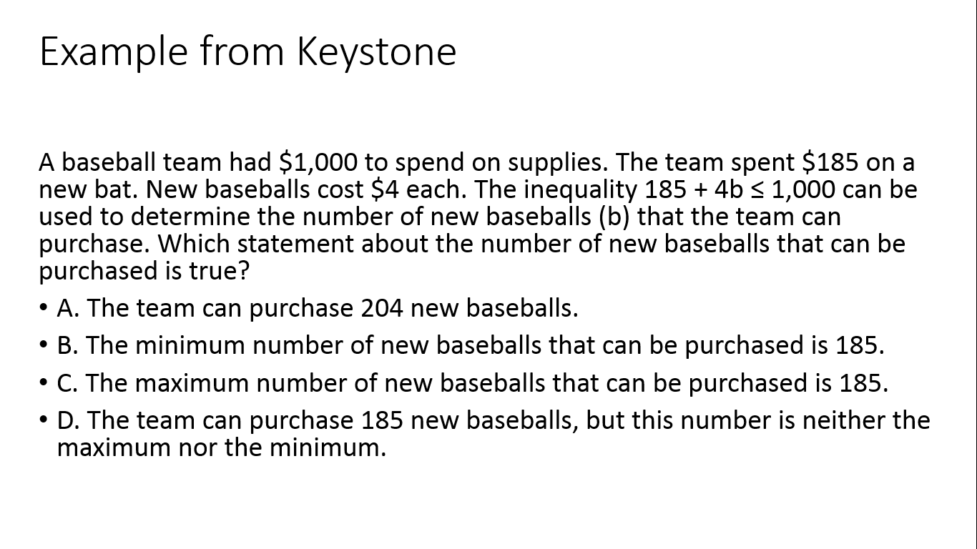

Slide 4
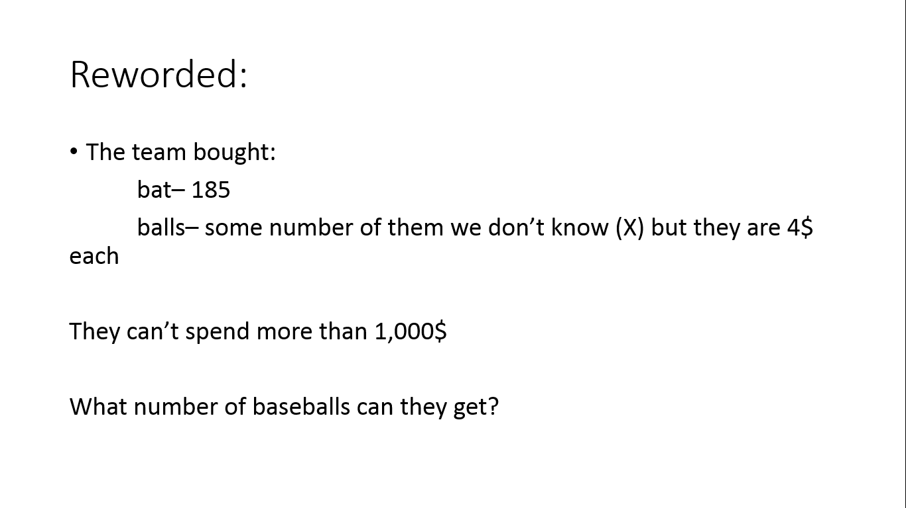

Slide 5
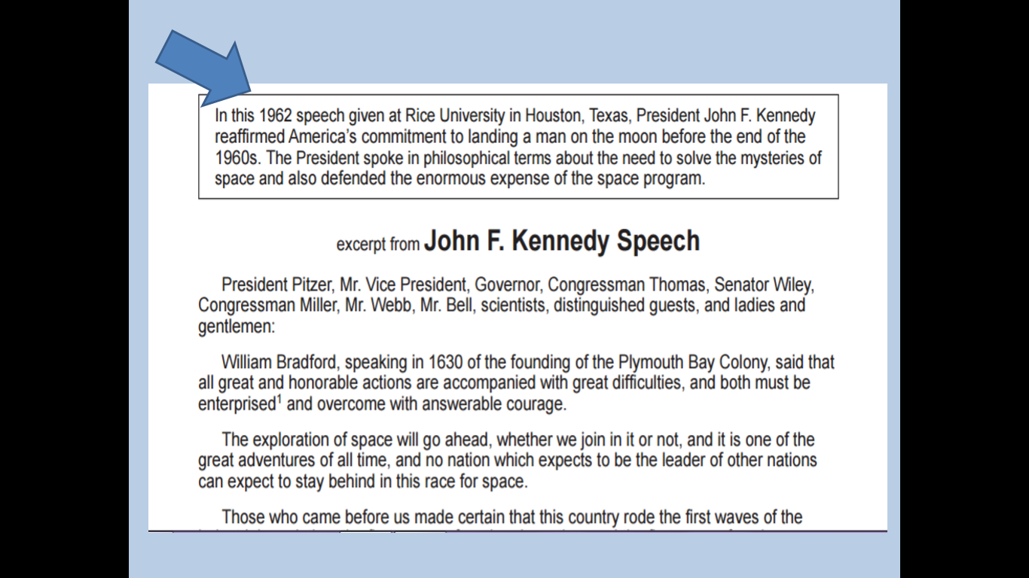

Slide 6
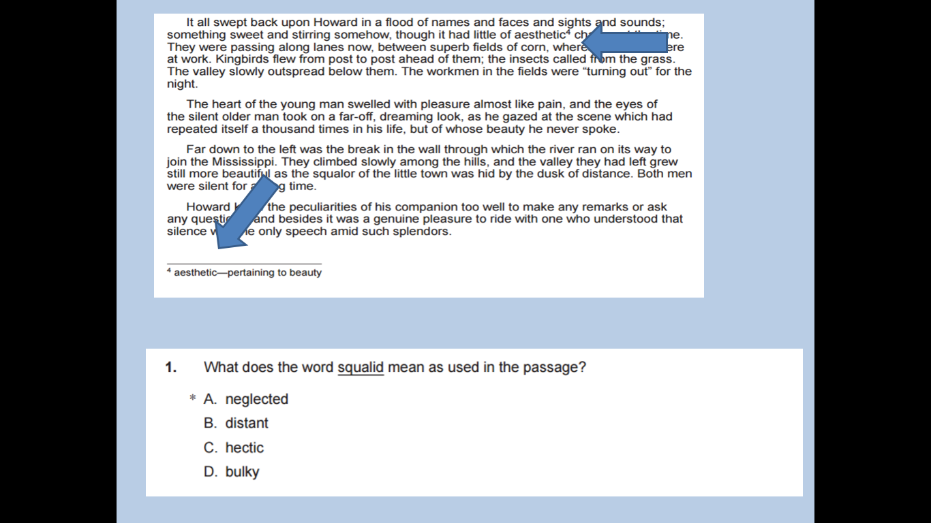

Slide 7
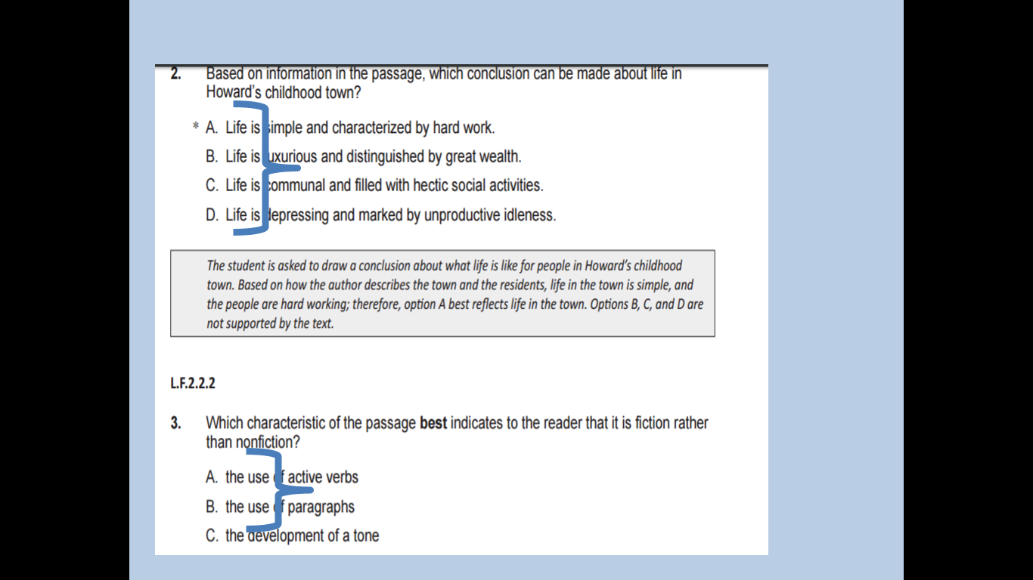

Slide 8
Keystone Results
2016 % Proficient and Advanced Algebra
White: 96.6%
African American: 70%
2016 % Proficient and Advanced Literature
White 96.3%
African American: 84%
2016 % Proficient and Advanced Biology
White 88.9%
African American 39.5%

Slide 9
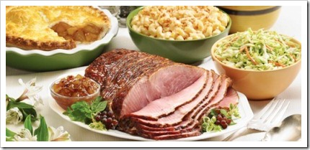
My colleague was invited to an Easter dinner with friends. Sitting down to an exquisitely laid table, the guests all expressed their approval as the hostess placed an amazingly glazed ham in the center of the table. The hostess remarked how she had baked it using her grandmother’s recipe faithfully.

Slide 10
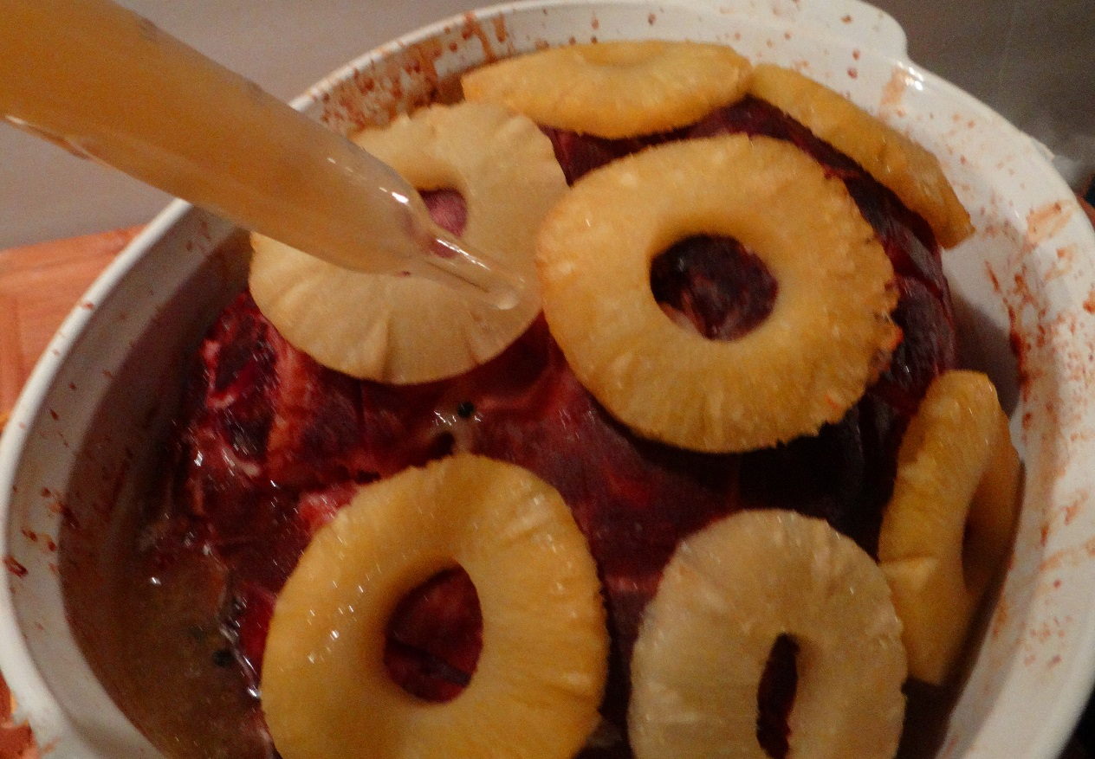
The hostess went into vivid detail about the process: cutting off the ends of the ham, carefully scoring it and studding it with cloves, roasting it slowly, and of course the basting of it every fifteen minutes.

Slide 11
My colleague then asked, “So why did you cut off the ends of the ham?”
The hostess slowly replied, “I’m not quite sure. I got the recipe from my mother.”
Her mother chimed in, “I’m not sure either. I just remember watching my mother fix this every Easter. I wrote down everything exactly as she did it, since she didn’t work from a recipe

Slide 12
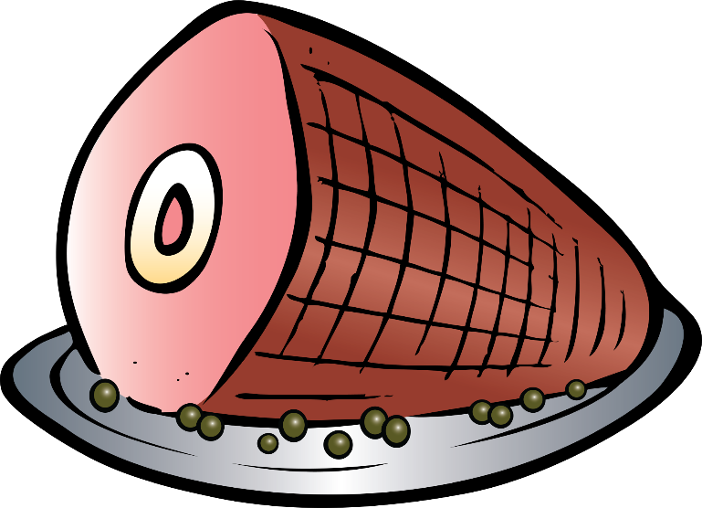
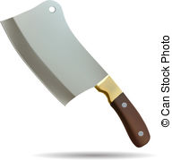
After dinner was over, a call to grandmother resolved the group’s quandary.
“Oh, I always cut off the ends of the ham because the pan I had at the time was never big enough for the whole ham.”

