Slide 1
What: Explore Approaches to Learning in the DP and MYP contexts to see how they advance the development of a school culture dedicated to thinking and understanding.
Why: Thinking routines are a great way to create a culture of understanding, unless they are systemized, they run the risk of becoming simply cool activities. IB Approaches to Learning help to provide context and structure to the routines.
How: Compare MYP and DP Approaches to Learning
Explore MYP and DP specific ATL materials on ibo.org
Take routine from last week’s lesson and relate it to
one of the ATL groups

Slide 2
Through ATL in IB programmes, students develop skills that have relevance across the curriculum that help them “learn how to learn”. ATL skills can be learned and taught, improved with practice and developed incrementally. They provide a solid foundation for learning independently and with others. ATL skills help students prepare for, and demonstrate learning through, meaningful assessment. They provide a common language that students and teachers can use to reflect on, and articulate on, the process of learning.
MYP: Principles into Practice pp.20

Slide 3
General ATL | MYP ATL Skills
Communication | Communication
Social | Collaboration
Self-Management | Organization Affective Reflection
Research | Information Literacy Media Literacy
Thinking | Critical Thinking Creative Thinking Transfer
Approaches to Learning

Slide 4
How does the thinking routine that you chose last week fit into the ATL skills chart?
General ATL | MYP ATL Skills
Communication | Communication
Social | Collaboration
Self-Management | Organization Affective Reflection
Research | Information Literacy Media Literacy
Thinking | Critical Thinking Creative Thinking Transfer

Slide 5
Go to ibo.org and sign into the Online Student Center (OCC)
If you don’t have your OCC log in, use mine.
School Code: 5652
Username: michaelc
Password: 86455

Slide 6
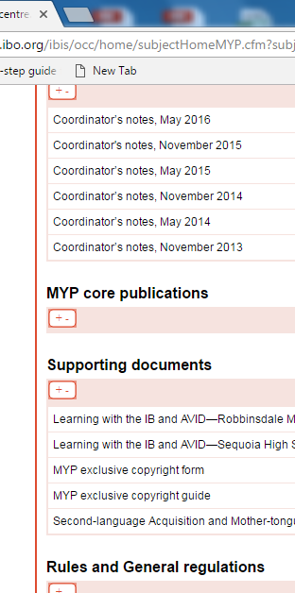
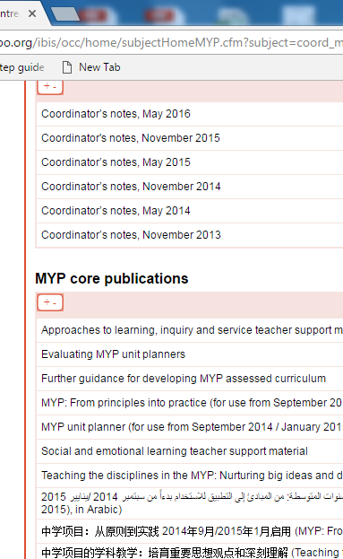
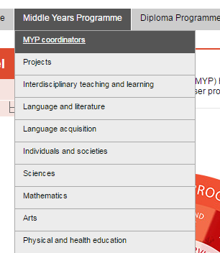
Scroll down to MYP core publications
Open 1st publication, Approaches to learning, inquiry and service teacher support materials
MYP Techers - Click on MYP Coordinators Tab under
Middle Years Programme

Slide 7
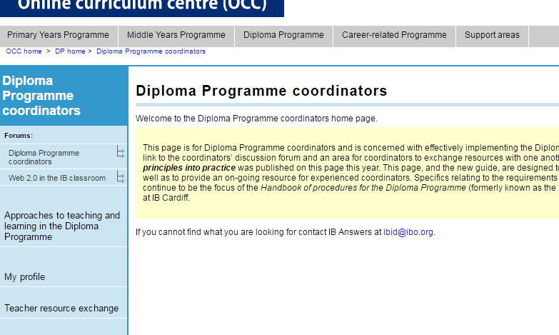
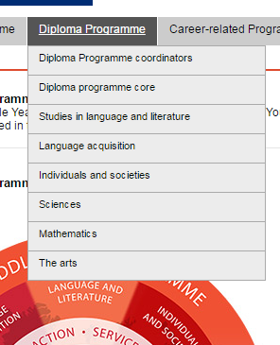
On the left hand side of the page, click on Approaches to teaching and learning in the Diploma Programme
DP Techers - Click on DP Coordinators Tab under
Diploma Programme

Slide 8
Find an activity or practice on your OCC site and then explain why you would or would not use it. Your justification must include reference to what we have learned so far with Cultures of Thinking and developing understanding in students.

Slide 9
Expectations
Learning vs. Work
Understanding vs. Knowledge
Deep vs. Surface Learning
Independence vs. Dependence
Growth vs. Fixed Mindset
Routines
Make learning Visible
Provide Structure and scaffolding for thinking skills

