Slide 1

Laboratory

Slide 2
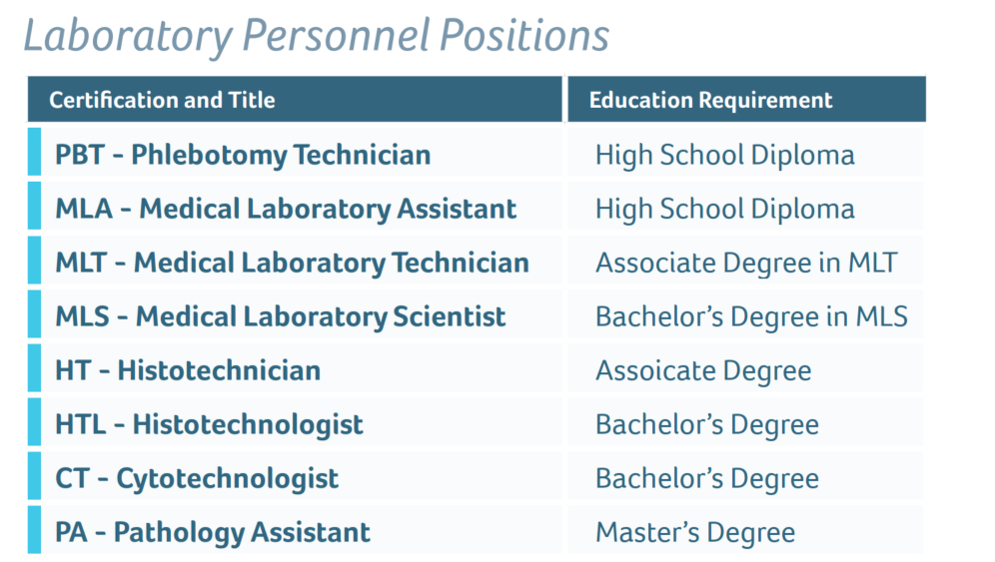
Educational Requirements

Slide 3
Salary Ranges
Phlebotomist: Min:$16.32/hr……Max: $21.22/hr $33,945-$44,137/year
Medical Laboratory Assistant: Min: $16.64/hr……..Max: $21.93/hr $38,771-$58,156/year
Med Lab Tech: Min: $21.53/hr……Max: $32.30/hr $44,782-$67,184/year
Med Lab Scientist: Min: $26.98/hr…..Max: $40.47/hr $56,118-$84,177/year
Histotechnician: Min: $24.94/hr…..Max: $37.41/hr $51,875-$77,812/year
Histotechnologist: Min: $20.92……Max: $31.73/hr $43,513-$65,998/year
Cytotechnologist: Min: $29.18/hr……Max: $43.77/hr $60,694-$91,041/year

Slide 4
Educational Assistance
-Tuition Reimbursement $310/ credit hour max of $3,510 per Calander year must be an employee.
Scholarship& Loan Forgiveness
Degree | Amount | Work Agreement
Medical Lab Technology | $13,000 | 2 years full-time 4 years part-time
Medical Lab Scientist | $15,000 | 2 years full-time 4 years part-time

