Slide 1

CCHS #165 SRO Roles and Responsibilities
A summary of a community effort SY21-22

Slide 2
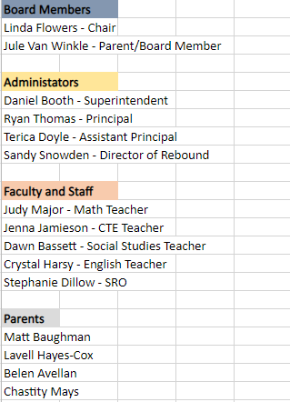
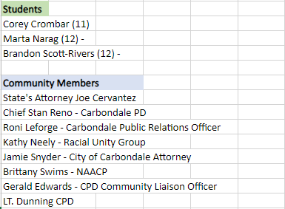
Committee Members

Slide 3
Creating the SRO Purpose
In 5 meetings, ranging 1.5 – 2 hours, CCHS #165 leadership facilitated conversations and worked collaboratively with all stakeholders to:
Establish meeting norms to structure productive and transparent dialogue across each meeting, ensuring all stakeholders had a voice in what they were (and were not)
Discuss the rationale of Carbondale’s SRO, identifying the position’s pros and cons, and how to maximize the SRO’s effectiveness
Create an SRO purpose statement with identified themes of safety, education, and community relations
Articulate, with appropriate detail, the SRO role

Slide 4
Project Outcomes
As a result of this approach:
The stakeholder group solidified the CCHS #165 roles and responsibilities
The total engagement took one less meeting than anticipated
Anecdotal feedback indicated that participants felt heard, even when their first impression was to remove the SRO position from the school community

Slide 5
Next Steps
Board acceptance of report
Submission to the City of Carbondale for drafting of a new agreement to be approved by the Board.

