Slide 1
SIH Cardiovascular Services
March 7, 2024

Slide 2
Cardiovascular Services
Treatment of heart and blood vessel diseases
Includes
  Medical management
  Non-Invasive Cardiology
  Invasive Cardiology
  Heart Failure management
  Administration

Slide 3
Medical Management
Cardiology offices/clinics
  Care provided by: Physicians, Advanced Practice Providers (APPs - Nurse Practitioners, Physician Assistants), RNs, LPNs, Medical Assistants
  Manage patient’s acute and chronic cardiovascular diseases
  Coordinates care with the patient’s primary care provider (PCP)
  Ensures safe follow up from hospital stays
Acute Care (Hospital) management
  Care provided by: Physicians, APPs, RNs, Patient Care Technicians (PCTs), Unit Coordinators
  Manage acute cardiovascular needs (Heart Attacks, Heart Failure, Heart Rhythm issues, etc)

Slide 4
Non-Invasive Cardiology
Inpatient and Outpatient cardiac testing
  Inpatient – Hospital; Outpatient – Come in for test only
  Performed by Cardiac sonographers, Cardiovascular Technicians, Radiologic Technologists
  Herrin Hospital and Memorial Hospital of Carbondale have cardiac testing departments and teams
  Cardiologist or Radiologist interpret the images and results of tests
Cardiac rhythm monitors
  Worn by patient to continuously detect changes in heart rhythms
  Data is sent to server
  If life-threatening event, patient is notified to seek emergent care immediately

Slide 5
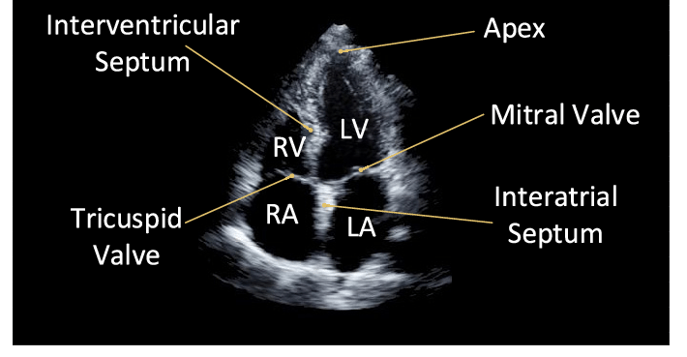
Non-Invasive Cardiology cont.

Slide 6
Invasive Cardiology
Cardiac Cath Lab
  Care provided by Cardiologists, Electrophysiologists, Vascular Surgeons, RNs, Anesthesiologists, CRNAs,and Special Procedures Technologists
  Diagnose and fix blockages in coronary arteries and other veins and arteries in the body
  Also correct structural issues in the heart, such as heart valves and areas prone to clotting
Cardiac Clinical Decision Unit
  Care provided by RNs and Patient Care Technicians (PCTs)
  Prepare patients for their cardiac cath procedure and recover them after
Cardiovascular Operating Room/Hybrid Room
  Care provided by Cardiac Surgeons, Vascular Surgeons, Anesthesiologists, CRNAs, APPs, Perfusionists, RNs, and Surgical Technicians.
  Perform open heart surgeries and vascular surgeries in an OR setting

Slide 7
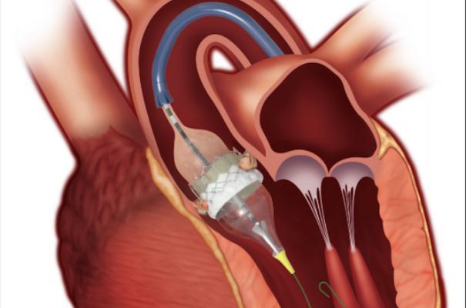
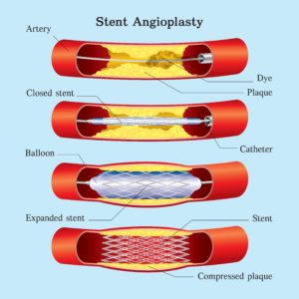
Invasive Cardiology cont.

Slide 8
Heart Failure Management
Cardiac Management Center
  Care provided by APPs, RNs, LPN, and Office Coordinator
  Help patients manage the symptoms of heart failure and help prevent them from having to be hospitalized
  Also provides treatment in the clinic, such as IV medications to eliminate extra water in the body
Heart Failure Navigation
  Oversees the care of patients with heart failure in the hospitals
  Ensures appropriate treatments are being ordered and carried out
  Coordinates the transition of the patient from the hospital to home to their follow up appointments
Heart Failure device and program management
  Oversight of heart failure detection devices and programs (such as our Scale Program)

Slide 9
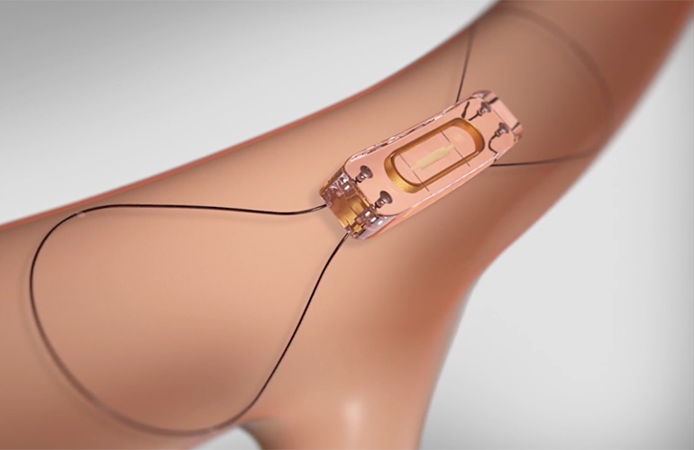
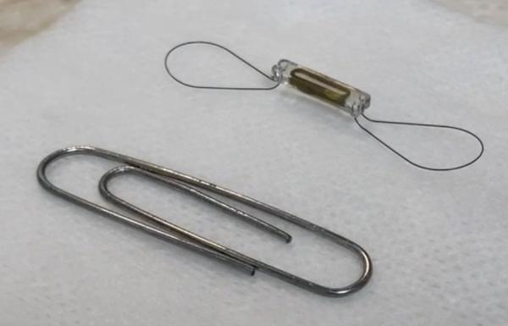
Heart Failure Management cont.

Slide 10
Administration and Support
Management/Directors
  Department managers – Supports the departments and oversight of clinical/business aspects
  Practice managers – Supports the physician practices and provides oversight of clinical/business aspects
  Director – Sets strategy for service line, supports clinical needs, and oversight of business aspects of service line
Education
  Cardiac Educator – Oversees education and training of RNs within service line
  Clinical Resource Coordinator – Plans Cath Lab cases and oversight of education/training of special procedures technologists
Quality
  Abstractors - Audits and interprets documentation to ensure quality standards
  Coordinators – Coordinate programs such as STEMI/STAT Heart and Structural Heart

Slide 11
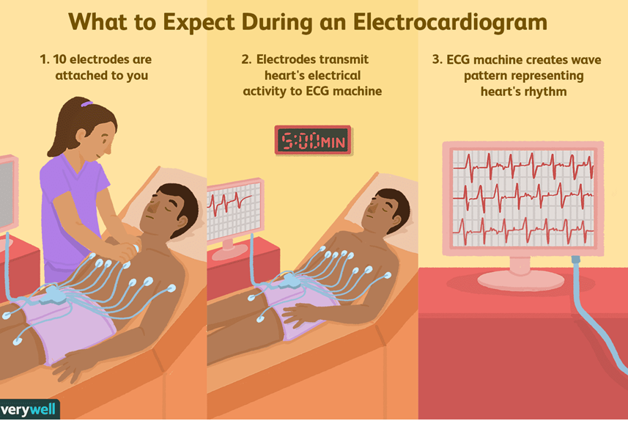
Cardiovascular Technician
$17.00/hr - $23.80/hr
Minimum education – High school diploma and on-the-job training
Performs EKGs, Supports Stress Tests, and Places Heart Monitors

Slide 12
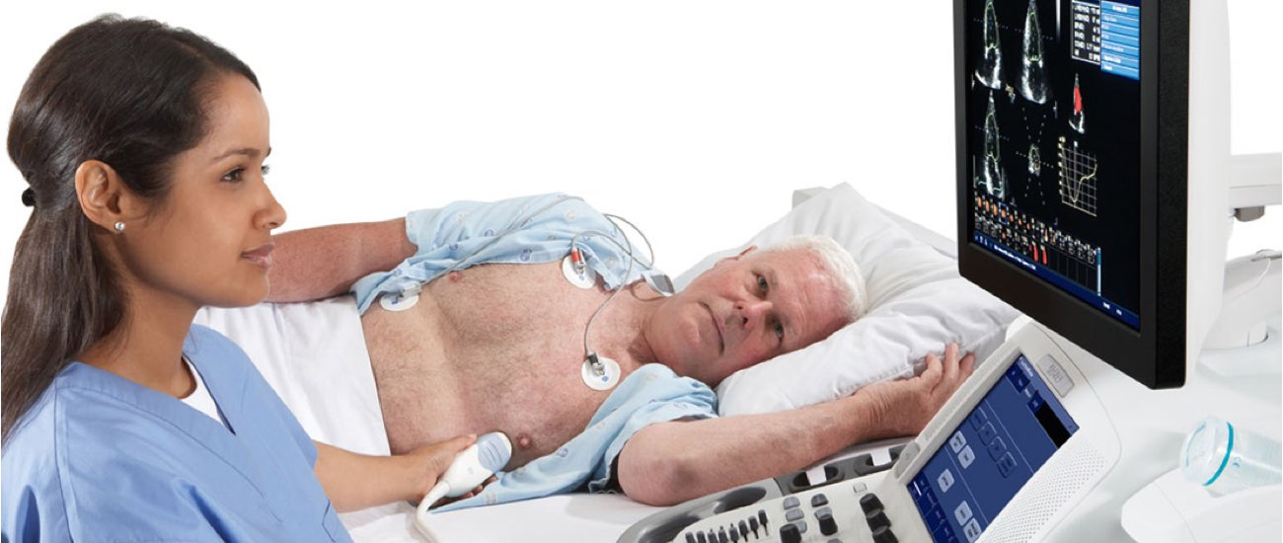
Cardiac Sonographer
$30.95/hr - $46.43/hr
Minimum education – Associates Degree in Sonography
Performs ultrasound imaging of the heart and supporting structures

Slide 13
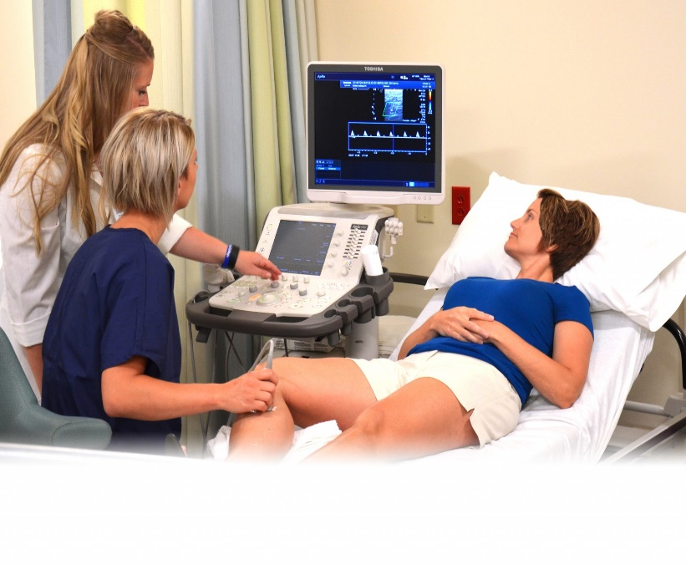
Vascular Sonography
$30.95/hr - $46.43/hr
Minimum education – Associates Degree in Sonography
Performs ultrasound imaging of blood vessels throughout the entire body

Slide 14
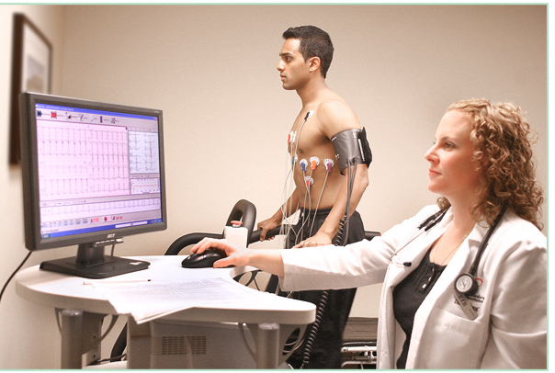
Stress Testing and Procedures RN
$29.36/hr - $46.12/hr
Minimum education – Associates Degree in Nursing
Supervises and performs stress testing and supports cardiac procedures

Slide 15
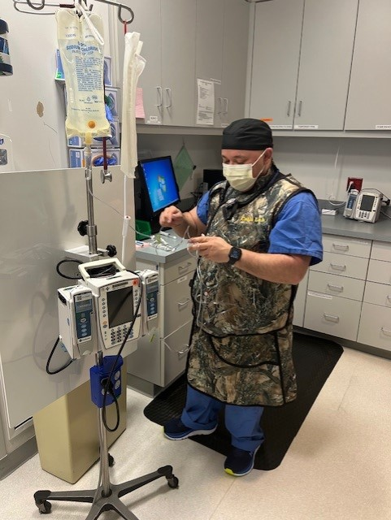
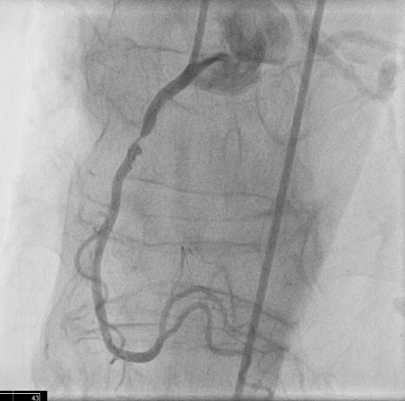
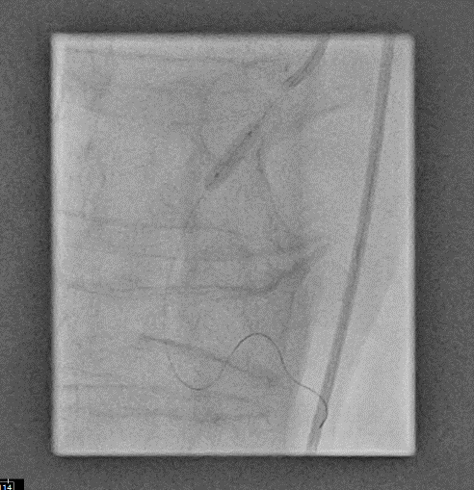
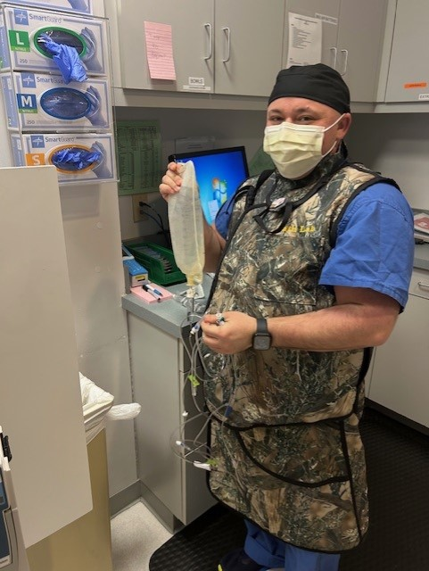
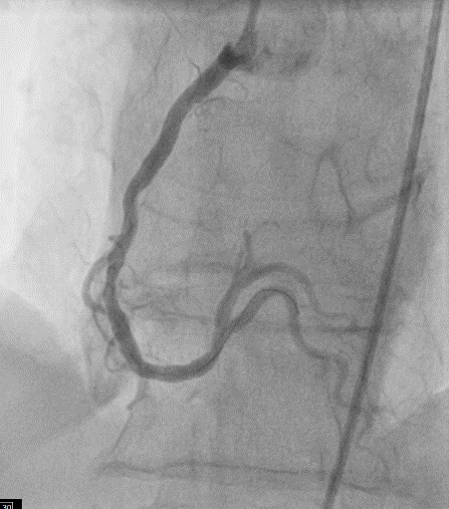
Cath Lab RN
$29.36/hr - $46.33/hr
Minimum education – Associates Degree in Nursing
Oversees the care of the patient during procedure

Slide 16
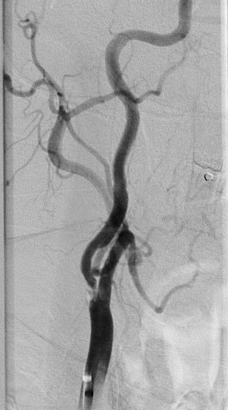
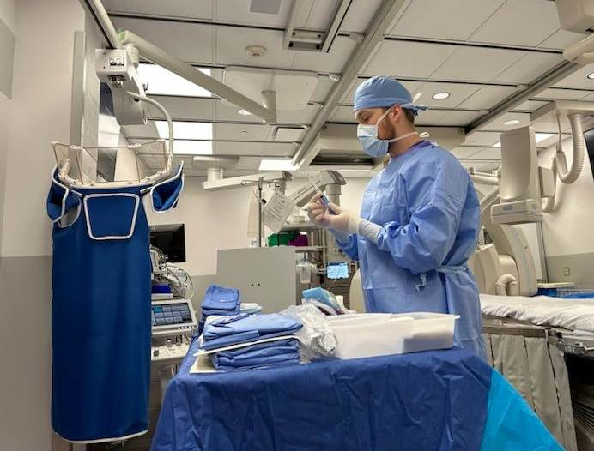
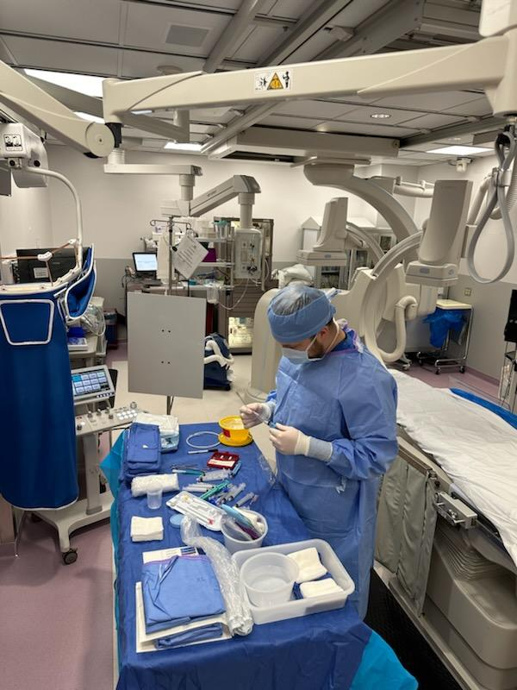
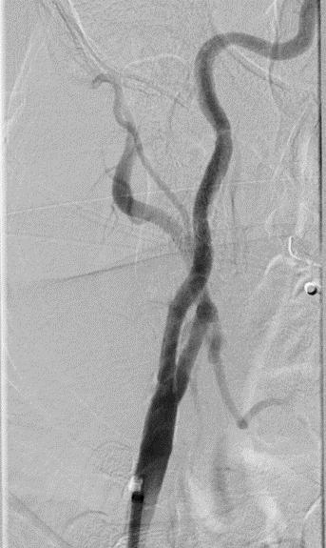
Cath Lab Special Procedures Technologist
$29.36/hr - $46.33/hr
Minimum education – Associates degree in Radiology Technology
Assists cardiologist with procedure and manages the x-ray machine during

Slide 17
Cath Lab Prep and Recovery RN and PCT
RN
  $29.36/hr - $46.12/hr
  Minimum education – Associates Degree in Nursing
  Prepares patient for procedure, administers medications, assess patient for unforeseen issues that may impede their procedure
  Recovers patient after cath procedure, administers medications, assesses access site and other physical responses to the procedure, ensures safe discharge home
PCT
  $17.34/hr - $26.01/hr
  High school diploma and Certified Nurse Assistant (CNA) certificate
  Assists RNs to prepare the patient for their procedure and recovery after

Slide 18
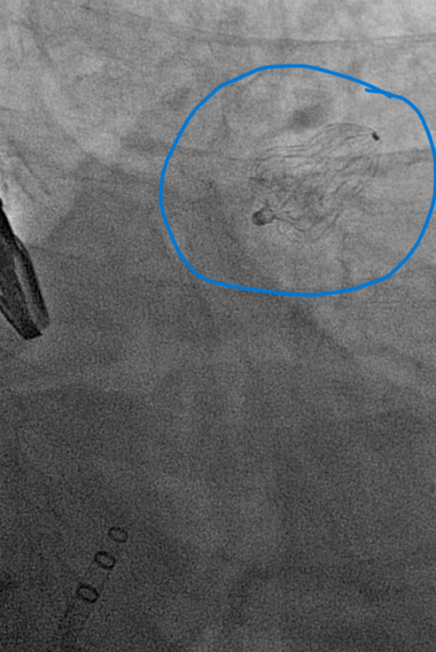
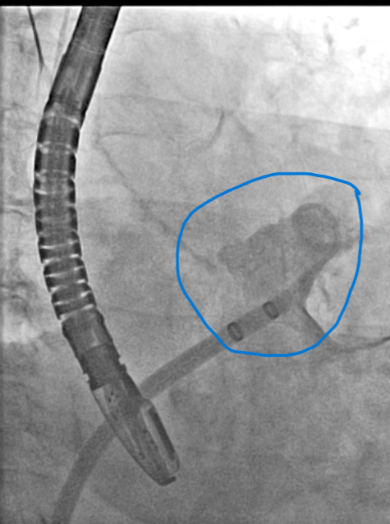
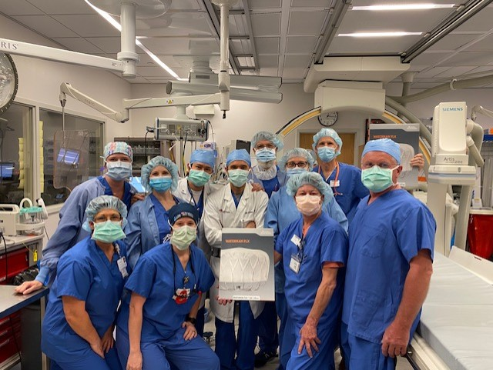
Collaboration and Teamwork
Before
Watchman
After Watchman

Slide 19
So why Healthcare and Why SIH?
We get to take care of people and do what we can to help them feel better
Many different paths you can take
If you want to change what you do, it is relatively easy
Great benefits right away
Work will pay for you to go further your education
SIH continues to do everything we can to care for the health and well-being of the communities we serve

Slide 20
Questions?

Slide 21
Cardiology Service Line Roles, wage ranges and minimum education
Role | Wage Range | Minimum Education
RN | $29.36-$46.33/hr | Associates Degree in Nursing
Special Procedures Technologist | $29.36-$46.33/hr | Associates Degree in Radiology Technology
Cardiac Sonographer | $30.95-$46.43/hr | Associates Degree in Sonography
Vascular Sonographer | $30.95-$46.43/hr | Associates Degree in Sonography
Patient Care Technician | $17.34-$26.01/hr | High school diploma and CNA Certificate
Cardiovascular Technician | $17.00-$23.80/hr | High school diploma
LPN | $20.50-30.50/hr | 1-year LPN program
Medical Assistant | $17.00-$23.80/hr | 4-6 month MA program
Office Coordinator | $16.00-$25.00/hr | High school diploma

