Slide 1

SRO Agreement Review Committee
1/10/22
4:30-6:00

Slide 2
Agenda
Welcome + Introductions
4:30 pm-4:45pm
Solidify SRO Responsibilities
4:45pm-5:45PM
Closing
5:45pm-6:00pm

Slide 3
Objectives
Today, we will…
Orient ourselves back to the SRO roles and responsibilities and finalize the draft in small groups
Articulate what the SRO will not be at Carbondale
Finalize the SRO roles and responsibilities

Slide 4
norms
In order to maximize our limited time together, we should agree upon norms we can all support. We will work together to finalize the norms this committee will commit to throughout our time together.
Participate fully, minimizing distractions
Seek to understand by focusing on active listening
Solutions first
Critique ideas, not people
Ensure all voices are heard
Start on time; end on time
Two minute warnings during group time so conversations can wrap up
Confidentiality – No social media posts, only share general direction of the group with others

Slide 5
Clarifying Purpose
With the Purpose Statement top of mind, we want to complete the SRO responsibilities description through thought partnership on the draft document and by identifying what the position is not. As we conclude this collaborative effort, we also want to reflect on our experience through this process.

Slide 6
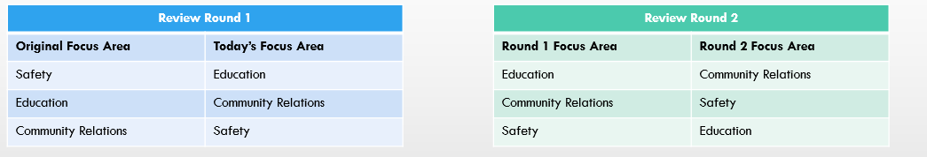
SRO Responsibilities review
Step 1. Split into the small groups from the December meeting, focused either on: safety, education, and community relations. Take note of the focus area you will transition to for Review Round 1:
Step 2. (10 min) As a group, first share ‘Round the Horn what you like about the responsibilities description for your focus area, and then what tweaks you might make. Ensure one team member captures any recommended tweaks to the description.
Step 3. (30 min) Repeat Step 2 with the next Focus Areas listed. Following this step, you will have reviewed both of the focus areas you did not initially draft in December. Share all notes with Superintendent Booth.

Slide 7
SRO Responsibilities
(20 min) As a team, we want to ensure the effort articulating what the SRO will be and do fulfills the Purpose Statement. As a last step in the drafting process, we want to state clearly what the position does NOT do at Carbondale Community High School. Individually, read the following statement, then discuss at tables anything you would add or shift in the description:
The CCHS position does not:
Contribute to the school to prison pipeline through actions
Assign disciplinary consequences to students

Slide 8
Reflection and CLosing
10 Minutes

Slide 9
Reflection
Reflect on the journey this group has made through the 21-22 school year.
Four people share their thoughts with the group on the process:
I used to think…. Now I think (know)
I learned………..from this process
I liked……..about this committee

Slide 10
Next steps
Submit Recommendations to the Board for Review
Submit cchs recommendations to the city for composition of an updated SRO agreement
Take final agreement to the Board for approval
Implement agreement and continue to update as needed

Slide 11


