Slide 1
Health Information and Medical Coding
February 29, 2024
Chris Froemling, RHIA, CCS, CPC
Senior Coding Manager
Southern Illinois Healthcare

Slide 2
Southern Illinois Healthcare
Consists of:
Hospitals
  Memorial Hospital of Carbondale
  Herrin Hospital
  St. Joseph Memorial Hospital
  Harrisburg Medical Center
Medical Group
  Multiple Clinics/Provider Offices
  Urgent Care Centers
Rehabilitation Centers
Cancer Institute
Breast Center

Slide 3
Clinical Roles
Respiratory Therapists
Physical Therapists
Occupational Therapists
Speech Therapists
Surgery Technicians
Radiology Technicians
Laboratory Technicians
Social Workers
Pharmacists
And More!
Physicians
Nurse Practitioners
Physician Assistants
Nurse Anesthetists
Nurses

Slide 4
Non-Clinical Roles
Health Information
**CODING**
Compliance Officers
Privacy Officers
Information Technology
Cancer Registry
Clinical Documentation Improvement Specialist
Environmental Services
Dietary
Engineering/Maintenance
Materials Management
Quality Improvement
Human Resources
Administration
Finance

Slide 5
Coding Department
4 Emergency Coders
5 Surgery Coders
3 Ancillary Coders
1 Office Procedure Coder
3 Specialty Office Coders
4 Family Practice Office Coders
1 Urgent Care Center Coder
4 Charge Abstractors
8 Per Diem Coders
1 Senior Manager
3 Managers
1 Lead
2 Coding Educators
1 Denials Specialist
7 Inpatient Hospital Coders
2 Interventional Radiology Coders
2 Observation Coders
Total = 52 Positions

Slide 6
What is Medical Coding?
Video
Standardized way of capturing and classifying information about a patient.
Diagnosis – illness or injury
Procedure – what is done to care for the patient
Every healthcare setting
Several different coding/classification systems

Slide 7
Purpose of Medical Coding
Reimbursement
  Numerous payers use codes to process claims
    Government and private
  Codes = payment
  Without payment, no care for anyone
Improvement of patient care
  Reporting system for research, statistics, data analysis
  Information is key to improving clinical practices

Slide 8

Employment for Coding Professionals
Healthcare Systems
Physician Offices
Clinics
Hospitals
Long Term Care
Surgery Centers
Home

Slide 9
Benefits
Remote work, if desired
Nationwide – IL, MO, KY, TN, VA, MI, GA, TX, CO, OR
Flexible scheduling
    No mandatory weekends
    No mandatory evenings/nights
Job security
Career advancement
Health insurance
Paid vacation
Paid holidays
Continuing education
Salary
No face-to-face contact with patients

Slide 10
Future of Health Information
Employment is projected to grow 8% from 2022 to 2032 (faster than average).
Source: U.S. Bureau of Labor Statistics (BLS)
Circumstances that are affecting job growth:
  Aging population = more medical services, more claims, more data to manage
  Widespread use of electronic health records = more data to analyze and manage
  Complex reimbursement methods

Slide 11
Grow Your Career
Steps to Success:
Medical Coding certificate program
Health Information Technology associate degree – RHIT credential
Health Information Management bachelor degree – RHIA credential
Master degrees in Health Informatics or others

Slide 12
Coding Certifications
American Academy of Professional Coders
CPC - Certified Professional Coder
COC - Certified Outpatient Coder
CIC - Certified Inpatient Coder
CRC - Certified Risk Adjustment Coder
Specialty credentials for expert coders
American Health Information Management Association
CCA – Certified Coding Associate
CCS – Certified Coding Specialist
CCS –P – Certified Coding Specialist – Physician-based

Slide 13
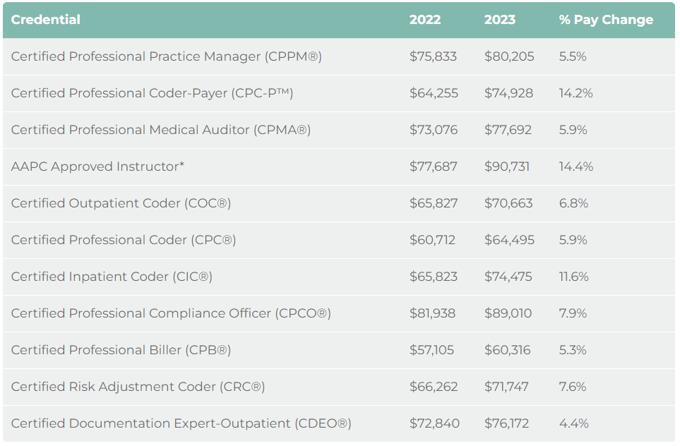
Salary Survey – AAPC Credentials
Source: Medical Billing And Coding Salary - AAPC

Slide 14
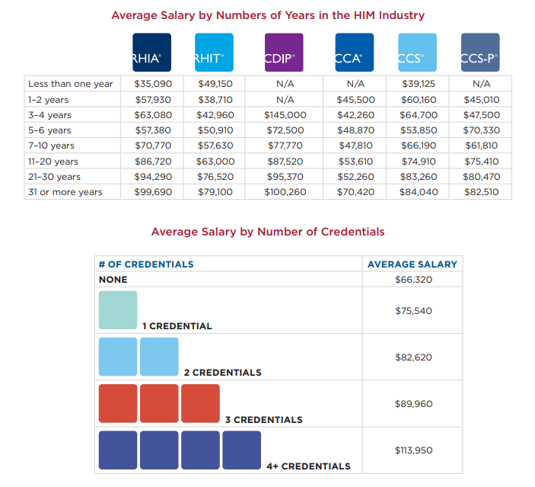
Salary Survey (2019) – AHIMA Credentials
Source: salary-survey-report.pdf (ahima.org)

Slide 15
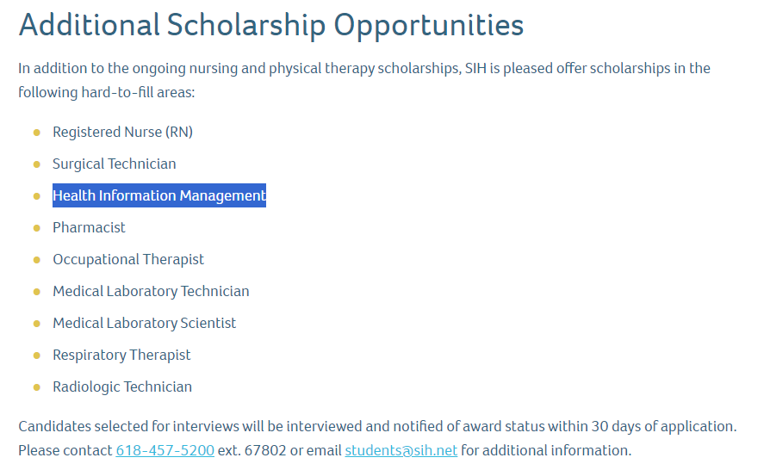
SIH Scholarship Opportunities
Program related expenses paid for scholarship recipients.
When pass the RHIT certification exam, recipient is guaranteed a position.
Link: Scholarship Programs | Southern Illinois Healthcare (sih.net)

Slide 16
Is Medical Coding for Me?
It may be if you:
Want to work in healthcare, but not directly with patients.
See yourself in a career that is continually evolving and offers a lot of job security.
Have an aptitude for science but also like business.
Enjoy a challenging, fast paced working environment.
Enjoy working with physicians and administrators.
Want a career where you can choose your work setting.

Slide 17
Codes are Everywhere!
United Healthcare Commercials
https://www.youtube.com/watch?v=lQ3vNftrQHk
  Chuck Norris Lunch
https://www.youtube.com/watch?v=ZUr6kBJWbHY
  Lab Partner
  Guess That Code
  https://www.youtube.com/watch?v=mW9OJvyjsa4
  https://www.youtube.com/watch?v=yKYwr31s4bk
  https://www.youtube.com/watch?v=hCRvm2VSWaM

Slide 18
For Future Reference
Websites:
http://www.ahima.org/careers/healthinfo

