Slide 1
SIH ITS
Cyber Security
Taylor Calloni
ITS Cyber Security Engineer

Slide 2
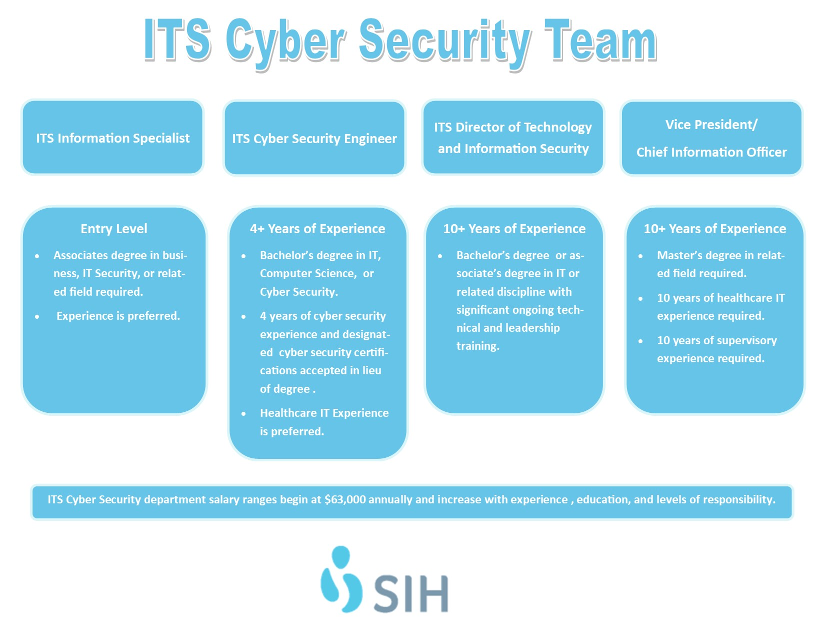

Slide 3
Career Duties
Incident Response
Vulnerability Management
Honey Pot creation
Firewall/VPN Administration
Network Segmentation
Email Security
Security Training/Testing
Policy creation/enforcement

