Slide 1
SIH
Rehabilitation

Slide 2

SIH Rehab Hospitals & Outpatient Clinics
Herrin Hospital
Memorial Hospital of Carbondale
St. Joseph Memorial Hospital
Harrisburg Medical Center
10 Outpatient Therapy Clinics

Slide 3
OUTPATIENT REHABILITATION CLINICS
Energy/Herrin
Marion
Marion East
Harrisburg
West Frankfort
Cancer Center (Carterville)
Carbondale
Anna
Murphysboro
Eldorado
There is a location to fit every patients needs

Slide 4
Inpatient Rehab Facility
Located inside Herrin Hospital, the Inpatient Rehab Center is an intense inpatient program that helps patients return to a more functional lifestyle after an illness or injury.
Patients must qualify for 2 out of the 3 therapies, Physical, Occupational or Speech therapy and be able to tolerate up to 3 hours of therapy a day.

Slide 5
Skilled Care at
St. Joseph Hospital and Harrisburg Medical Center
A short-term skilled nursing and Rehab program that allows the patient additional care needed to recover after a debilitating illness or surgery while staying closer to home.

Slide 6
SIH Rehabilitation
Job Opportunities
Physical Therapist
Occupational Therapist
Speech Language Pathologist
Athletic Trainer
Occupational Therapy Assistant
Physical Therapy Assistant

Slide 7
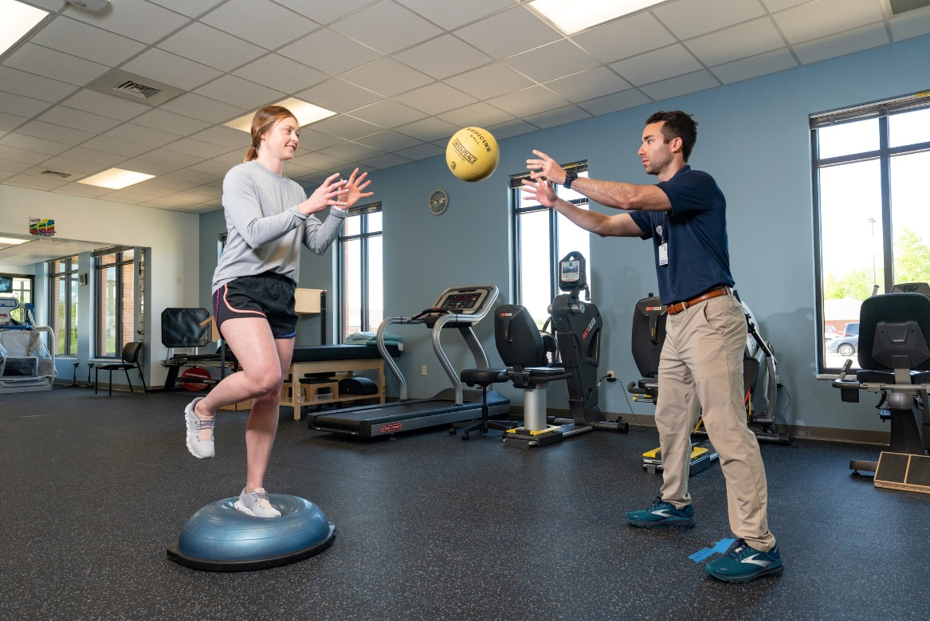
Scholarship Programs
The SIH Scholarship Program brings together college scholarship money with hands-on work opportunities.
Qualified applicants are eligible for money to cover tuition, lab fees, books and educational supplies.
Physical Therapy Scholarship
Occupational Therapy Scholarship

Slide 8
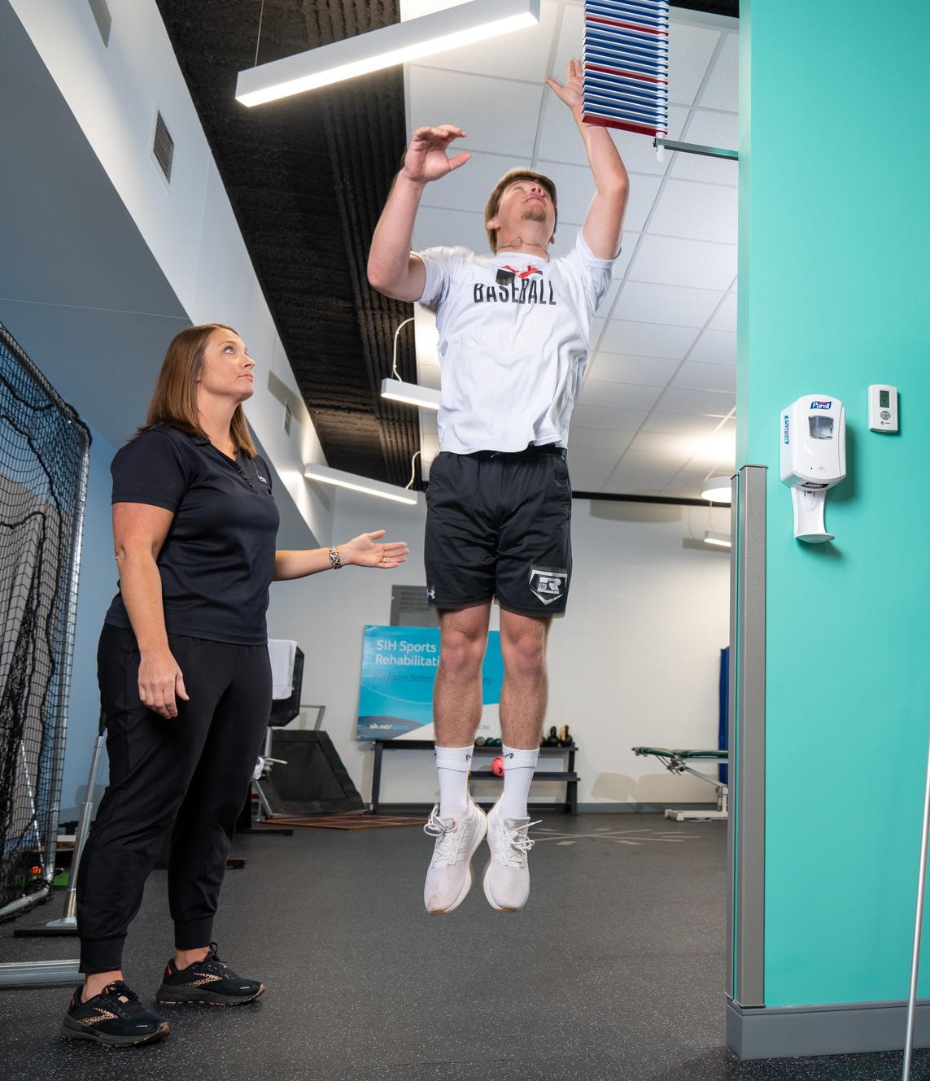
Loan Forgiveness Program
The SIH Loan Forgiveness Program is designed for current SIH employees that have completed an educational program in an area that has been designated as “hard to fill”
Eligible Programs/Majors:
Occupational Therapist
Physical Therapist

Slide 9
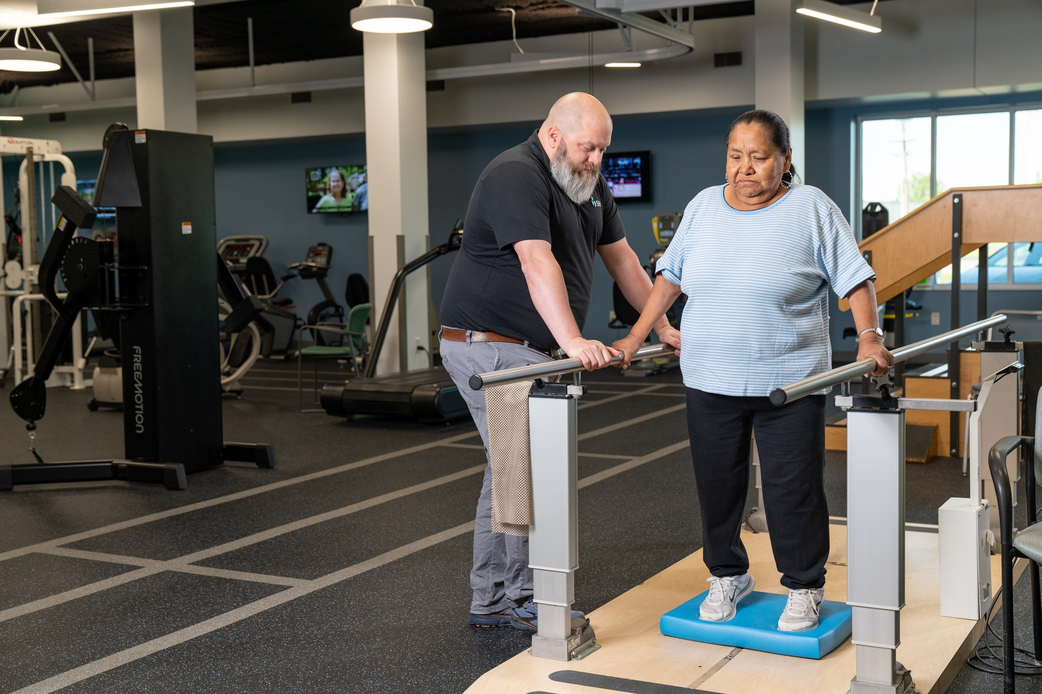
Tuition Reimbursement
SIH encourages its employees to purse educational opportunities.
Our tuition assistance program makes funds available to qualified employees who satisfactorily complete job-related courses.
Reimbursement amounts may not exceed $130 per credit hour for any undergraduate or graduate course, with a maximum of nine credit hours per academic calendar segment
Full Time employees will receive 100% reimbursement

Slide 10
Physical Therapists
  Degree Requirements:
  Doctor of Physical Therapy degree
  Salary:
  Starting @ $77,000
  What is a Physical Therapist
  Physical Therapists are movement experts who improve quality of life through prescribed exercise, hands-on care, and patient education. They diagnose and treat individuals of all ages, from newborns to people at the end of life. Many patients have injuries, disabilities, or other health conditions that need treatment. Physical therapists examine each person and then develop a treatment plan to improve their ability to move, reduce or manage pain, restore function, and prevent disability.

Slide 11
Occupational Therapists
  Degree Requirements:
  Master of Occupational Therapy degree
  Salary:
  Starting @ $74,000
  What is an Occupational Therapist
  Occupational Therapists are skilled health care professionals who have a strong knowledge of a person’s psychological, physical, and social makeup to evaluate and treat a variety of conditions. Life is made up of occupations-everyday activities and Occupational Therapists help keep people at their highest level of function.

Slide 12
Speech Language Pathologists
  Degree Requirements:
  Masters degree in Speech-Language Pathology
  Salary:
  Starting @ $72,000
  What is a Speech Language Pathologist
  A speech-language pathologist, also referred to as a speech therapist, evaluates and treats speech, language and swallowing difficulties, which may have resulted from trauma, stroke, hearing loss, developmental delay, birth abnormalities and emotional problems in individuals of all ages, from infants to the elderly.

Slide 13
Occupational Therapy Assistants
  Degree Requirements:
  Associates degree in Occupational Therapy Assistant Program
  Salary:
  Starting @ $49,000
  What is an Occupational Therapy Assistant
  Occupational therapy is a vibrant, growing profession that makes it possible for people to achieve independence and to enjoy life to its fullest. By choosing a career as an occupational therapy assistant, you will make a difference. You will be able to improve the lives of people, from newborns to the very old.

Slide 14
Physical Therapy Assistants
  Degree Requirements:
  Associates degree in Physical Therapy Assistant Program
  Salary:
  Starting @ $49,000
  What is a Physical Therapy Assistant
  A physical therapy assistant is a rehabilitative healthcare professional who works under the direction of a physical therapist to administer care. Physical therapy assistants work to help patients regain mobility after an injury, surgery, or illness. They provide exercises to help relieve pain, overcome physical disabilities, and increase motion for patients of all ages. They also observe patients in all stages of treatment to facilitate their journey toward wellness.

Slide 15
Athletic Trainers
  Degree Requirements:
  Master’s degree in Athletic Training
  Salary:
  Starting @ $49,000
  What is an Athletic Trainer
  Athletic trainers provide health care to high school and college students, industrial workers, and professional athletes who incur work or sports-related injuries. They diagnose and treat injuries and illnesses of the muscle and bone. They also provide preventative education and treatment and design rehabilitation programs.

