Slide 1

Goal 2 Action team Update

Slide 2
Goal 2: Promote an environment that is respectful, innovative, inclusive, and supportive
Strategy 4: Reimagine opportunities to advance student life skills, address student social emotional needs, and improve student behaviors and attendance.
Champion: Terica Doyle
Co-Champion: Mandy McKee
Action Team Members: Mark Albertini, Alejandro Ruiz, Melanie Nelson, Jimi Bradley, Amy Prudencio, Caitlin Klaybor, C.J. Buss, Garrick Haywood, Krystal Kill

Slide 3
Goal 2 Action Plan
Terrier Time
  Develop a plan where teachers will check in with every student at least once per week to discuss the theme of the week – grades, attendance, discipline.
PBIS
  Develop a process to utilize PBIS incentives within Terrier Time and school-wide.
  Develop a process to reward students on a monthly, quarterly, and semesterly basis
Safety
  Investigate effective surveys for students, staff, and families to learn perceptions about student safety and social emotional needs.

Slide 4
Goal 2 Key Performance Indicators (KPIs)
Attendance – Percentage of students meeting or exceeding 91% attendance rate
Student Behaviors – Percentage of students with 5 or fewer behavior referrals per semester
Tardiness – Percentage of students with 3 or fewer tardies each quarter.
In-School Suspension (ISS) – Number of ISS issued.
Out-of-School Suspension (OSS) – Number of OSS issued.

Slide 5
KEY Performance Indicators – semester 1 data
Attendance
Goal – 75% of students with 91% attendance rate or better
Current – 70.8% of students with 91% attendance rate or better
9th Grade – 72%
10th Grade – 72%
11th Grade – 70%
12th Grade – 69%
*We were hitting this target until November when flu season hit.

Slide 6
KEY Performance Indicators – semester 1 data
Student Behaviors
Goal – 82.5% of students with 5 or fewer referrals
Current – 86.6% of students with 5 or fewer referrals
9th Grade – 84%
10th Grade – 84%
11th Grade – 90%
12th Grade – 89%
*ALL GRADE LEVELS MET THIS GOAL FIRST SEMESTER!!!!!

Slide 7
KEY Performance Indicators – semester 1 data
Tardiness
Goal – 76.3% of students with 3 or fewer tardies
1st Quarter – 79.6% of students with 3 or fewer tardies
9th Grade – 78.8%
10th Grade – 81.9%
11th Grade – 78.3%
12th Grade – 79.5%
*ALL GRADE LEVELS MET THIS GOAL FIRST QUARTER!!!!

Slide 8
Discipline Referral Data
739 (72%) students had 0 or 1 disciplinary referral 1st semester
883 (87%) students had 0 – 5 disciplinary referrals 1st semester
579 (57%) students had 0 or 1 tardy 1st semester
We want to celebrate our students that do the right thing all day, every day!!!!

Slide 9
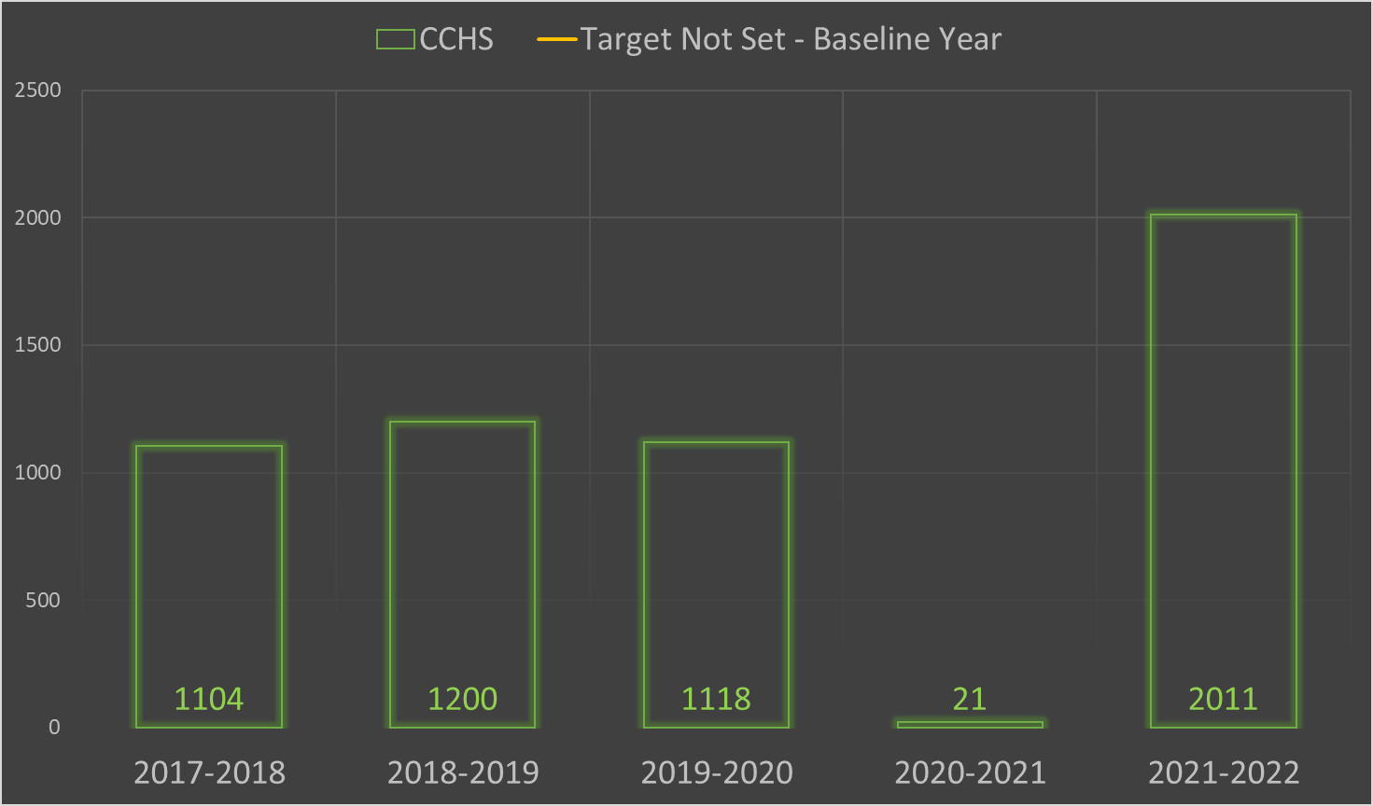
In school suspension data

Slide 10
KEY Performance Indicators – semester 1 data
In-School Suspension
Goal – No Target Set – Baseline Year
1st Semester Total – 619 (on pace for 38% decrease from last school year)
9th Grade – 240
10th Grade – 194
11th Grade – 93
12th Grade – 92
* Unique Students – 173
(This means that 173 students had 619 referrals that resulted in an in-school suspension.)

Slide 11
KEY Performance Indicators – semester 1 data
In-School Suspension
Unique Students to ISS = 173 of 1020 students served an ISS first semester
Black Students = 105 of 298 black students served an ISS first semester
White Students = 42 of 500 white students served an ISS first semester
Hispanic Students = 5 of 85 Hispanic students served an ISS first semester

Slide 12
KEY Performance Indicators – semester 1 data
In-School Suspension (ISS)
Top Infractions leading to ISS:
Failure to Serve Detention (40%)
Multiple Tardies (17%)
Insubordination (9%)
  Ex. Refusing to turn in a cell phone when asked by a staff member.
*No other area accounted for more than 6% of infractions leading to ISS.

Slide 13
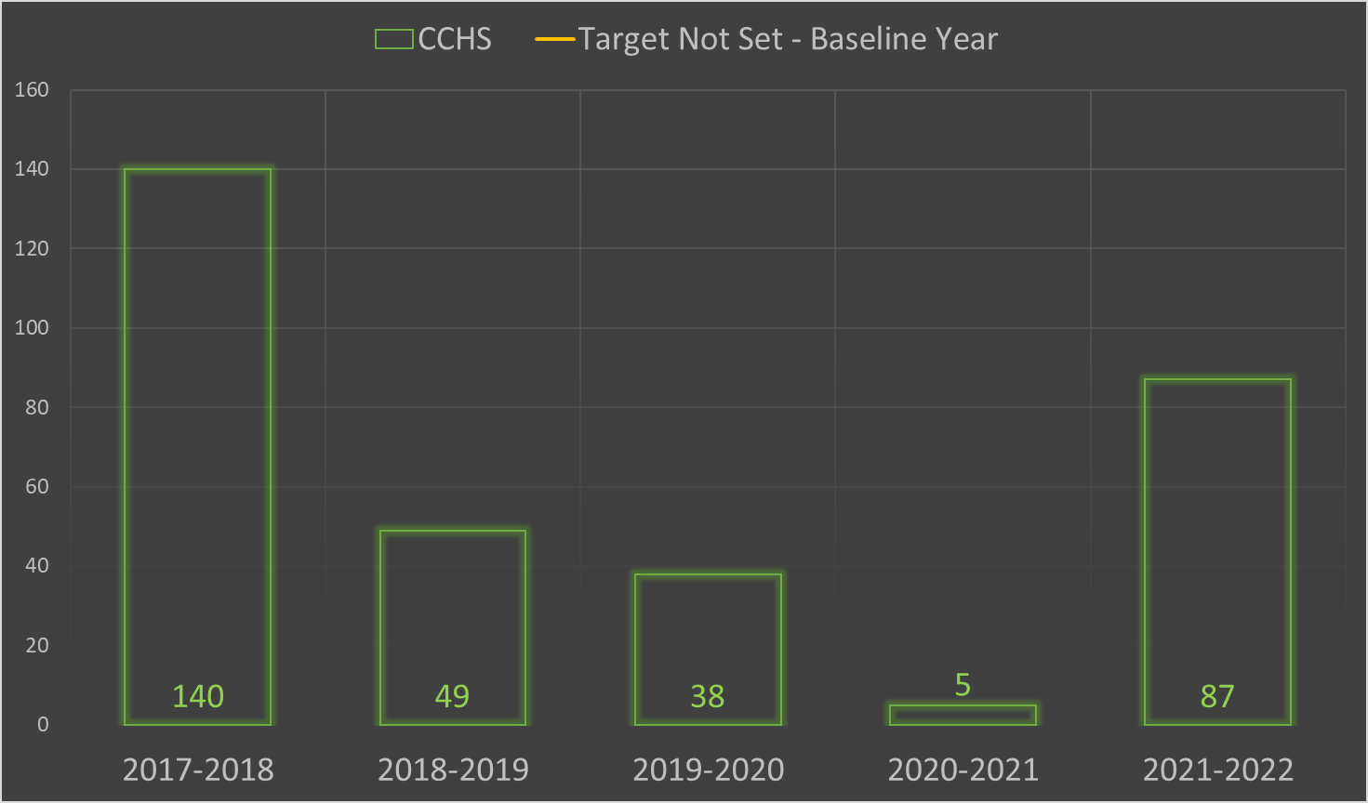
Out of school suspension

Slide 14
KEY Performance Indicators – semester 1 data
Out-of-School Suspension
Goal – No Target Set – Baseline Year
1st Semester Total – 59 total (2021-22 = 87)
9th Grade – 23
10th Grade – 20
11th Grade – 8
12th Grade – 8
*Unique Students – 51
(This means that 51 students had 59 referrals that resulted in an out of school suspension.)

Slide 15
KEY Performance Indicators – semester 1 data
Out-of-School Suspension
Unique Students to OSS = 51 of 1020 students received OSS first semester
Black Students = 31 of 298 black students received OSS first semester
White Students = 12 of 500 white students received OSS first semester
Hispanic Students = 3 of 85 Hispanic students received OSS first semester

Slide 16
KEY Performance Indicators – semester 1 data
Out-of-School Suspension
Top Infractions leading to OSS:
Fighting (51%)
Aggression (22%)
No other area higher than 8%

Slide 17
School wide Goals Definition
School Wide Goals focus on improving grades, attendance and discipline. They assist the District in achieving Key Performance Indicators and are communicated to students through Terrier Time. Class competitions are held to incentivize students to improve.

Slide 18
School-wide Goals
GPA – 70% of students with 2.75 GPA
Attendance - 75% of students with a 91% attendance rate or better
Discipline Referrals – Less than 5700 disciplinary referrals
  20% Reduction from last school year
Tardiness – Less than 7500 tardies
  25% Reduction from last school year

Slide 19
School-Wide Goals
GPA
Goal – 70% of students have a 2.75 GPA or higher
Current – 60.5% of students had 2.75 or better GPA Semester 1
Current – Average Semester 1 GPA = 2.87

Slide 20
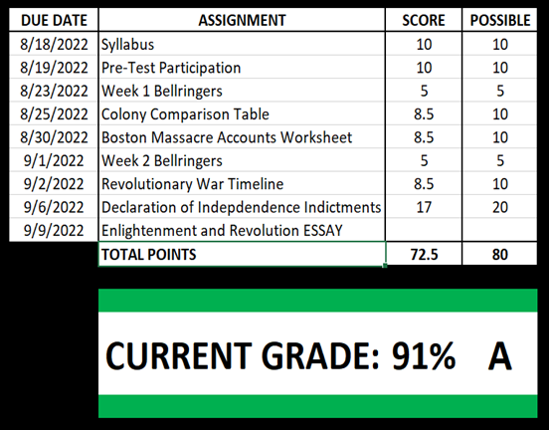
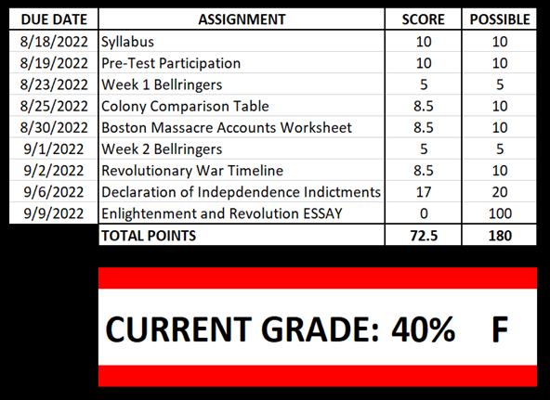
Impact of a ZERO in the Gradebook
U.S. HISTORY GRADE
BEFORE THE ESSAY
U.S. HISTORY GRADE
AFTER MISSING THE ESSAY

Slide 21
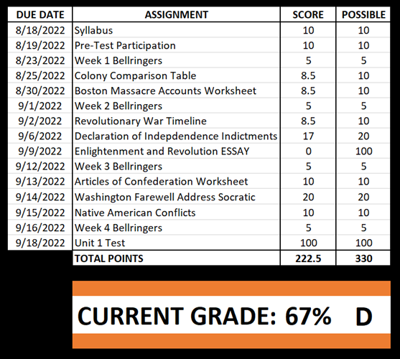
Impact of a ZERO in the Gradebook
U.S. HISTORY GRADE 2 WEEKS LATER…
EVEN WITH A PERFECT TEST SCORE, THE MISSING ESSAY STILL HAS A HUGE IMPACT

Slide 22
School-Wide Goals
Attendance
Goal – 75% of students have a 91% attendance rate or higher
Current – 69.3% of students have a 91% attendance rate or higher
We were hitting this target until November when flu season hit us hard.

Slide 23
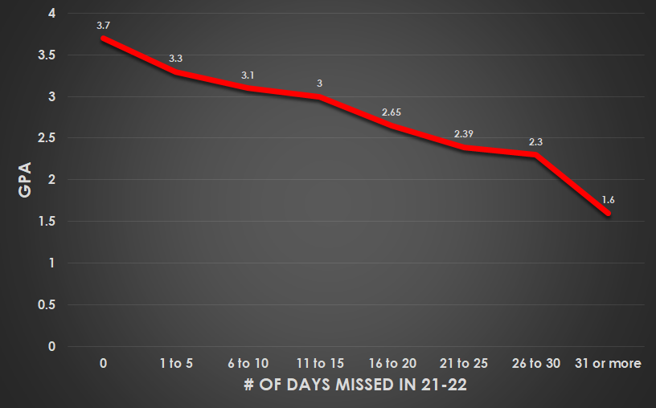
GPA vs Attendance Graph
ATTENDANCE GOAL OF 91% = NO MORE THAN 15 DAYS MISSED
4 = A
3 = B
2 = C
1 = D
0 = F

Slide 24
School-Wide Goals
Disciplinary Referrals
Goal – Less than 5700 disciplinary referrals
1st Semester Total – 2691
Pace – 32/day = 5606 total

Slide 25
School-Wide Goals
Disciplinary Referrals
Top Referrals 1st Semester (of 2691 total)
Multiple Tardies (804)
Failure to Serve Detention (402)
Out of Assigned Area (319)
Electronic Device Violation (241)

Slide 26
School-Wide Goals
Discipline Referrals
739 (72%) students had 0 or 1 disciplinary referral 1st semester
883 (87%) students had 0 – 5 disciplinary referrals 1st semester
579 (57%) students had 0 or 1 tardy 1st semester
We want to celebrate our students that are doing the right thing!!!!

Slide 27
School-Wide Goals
Tardiness
Goal – 7500 or fewer tardies this school year
  25% Reduction from last school year
1st Semester Total – 4248
Pace – 50/day = 8850 total
Before new clocks/bells - Q1 tardies/day = 53.8
After new clocks/bells – Q2 tardies/day = 46.9
Approximately 1/3 of all tardies occur 1st hour

Slide 28
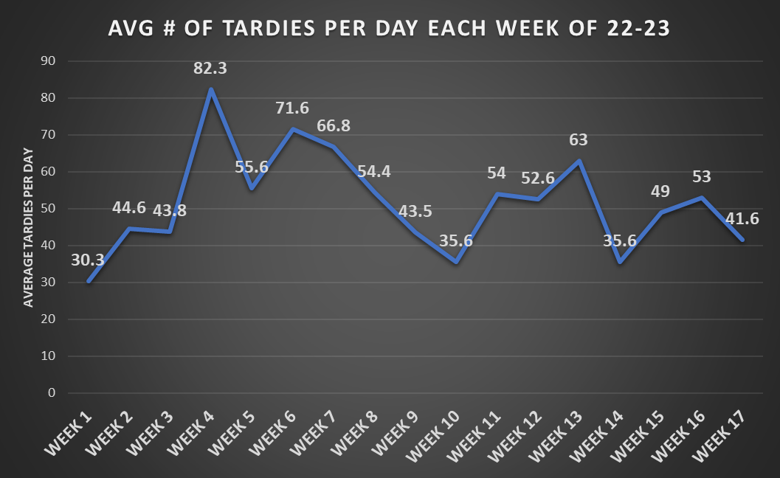

Slide 29
School-Wide Goals
Tardiness
1 – 2 Tardies to a Class = Warning
3 – 4 Tardies to a Class = 1 Detention
5 – 7 Tardies to a Class = 2 Detentions
8+ Tardies to a Class = 1 Day of ISS
All tardies apply to individual classes.
All tardies reset at the semester.

Slide 30
Summary of School-Wide Goals
Our school-wide goals are year-long goals, we are at the halfway point.
On pace to reach behavior goal
On pace to reach tardy goal
Need work on attendance goal
Need work on GPA goal

Slide 31

Terrier Pride Class Competitions
Week 1 – Attendance – Class with best overall attendance WINS!
Week 2 – Tardies – Class with the least number of tardies WINS!
Week 3 – Disciplinary Referrals – Class with the least number of referrals WINS!
Week 4 – GPA – Class with the highest GPA WINS!
The class with best overall score in the four categories after four weeks wins the class party!

Slide 32
Moving Forward…
Goal 2 Team next steps:
9th Grade Support Team
Analyze our current supports – 9th Grade Orientation, Summer Enrichment, Tier 2/3 Monitoring, Articulation, Class Meetings, 9th Grade Terrier Time Teachers
Communicate with similar school districts on 9th grade support.
Survey current 9th/10th students for feedback on their experience transitioning to high school.
Survey current 9th/10th families for feedback on their experience transition to high school.

Slide 33
Moving Forward…
Goal 2
Discipline Team
Analyze our current discipline policies for updates and improvements.
  tardy policy
  failure to serve detention policy
  cell phone policy
Communicate with similar school districts on discipline policies.

Slide 34
How the community Can help
When healthy, encourage students to attend school: Attendance Matters!
School begins at 8:25. Assist students in getting to school on time each day.
  When students attend school and turn in their work, they pass classes!
Connect following school rules to preparing students for life
  Ex. Cell phone, dress code, promptness
  Communicate student and family needs to administration, counselors, or social workers. We are here to help!

