Slide 1

A Safe and Caring School
Notes:
Today staff will review our district policy on harassment. They main objectives of today’s lesson are:
Explain that we all need to use safe and caring behaviors to have a school be a safe and caring place.
Define Harassment
Define our policy in regard to harassment
Teach and/or review the STOP, WALK & TALK student response strategy.
Encourage students to report harassment.
Teach or reteach your School Wide Behavioral Expectations.
Inform students of their rights and responsibilities in regard to harassment
Review our 3 step process for responding to unsafe or unwelcome behavior witnessed or experienced

Slide 2

The time is always right to do what is right.
Martin Luther King Jr.
Notes:
The students outcomes for this PPT. are:
Students will understand it is their right to learn in a safe and caring environment and their responsibility to learn and demonstrate behaviors that will create a safe and caring school.
-Students will review the definition of harassment
-Students will review Board Policy 105
-Students will review STOP WALK TALK
-Students will review school wide behavioral expectations
Students will review the consequences for harassment
Students will review how to respond if harassment occurs (to self or others)
Students will review school wide expectations and be encouraged to use them to prevent harassment

Slide 3
http://www.greater-mn-online.org/events.asp
What is Harassment?
Behaviors or words based on protected class status
That are hurtful, unwelcome
or unwanted
That have the
purpose or effect
of interfering with a
student’s learning environment
Are severe, persistent or pervasive
And are directed at a person
or group based on
Sex
Race, Color, National Origin
A
g
e
Religion or Creed
Marital or Family Status
Disability
Sexual Orientation
Economic Status
Notes:
Definition of Harassment – Walk thru 5 elements-Go through each category of protected class
Harassment is not an isolated event, not a thoughtless remark or
mistake – but typically patterns of behavior that significantly change the environment for the student..
Often many months before a report and significant consequences for the victim. However, harassment can be a one time event.

Slide 4
Board Policy 105
The purpose of this policy is to maintain a learning and working environment
that is free from harassment and violence on the basis of
Every Student and Staff Member
is Protected by this policy
Sex
Race, Color, National Origin
A
g
e
Religion or Creed
Marital or Family Status
Disability
Sexual Orientation
Economic Status
Notes:
On the basis of: “and then you see all those familiar boxes.
Remind students that as people we all belong in multiple boxes – these protections,
policies and commitments apply to EVERY employee and
EVERY student.

Slide 5
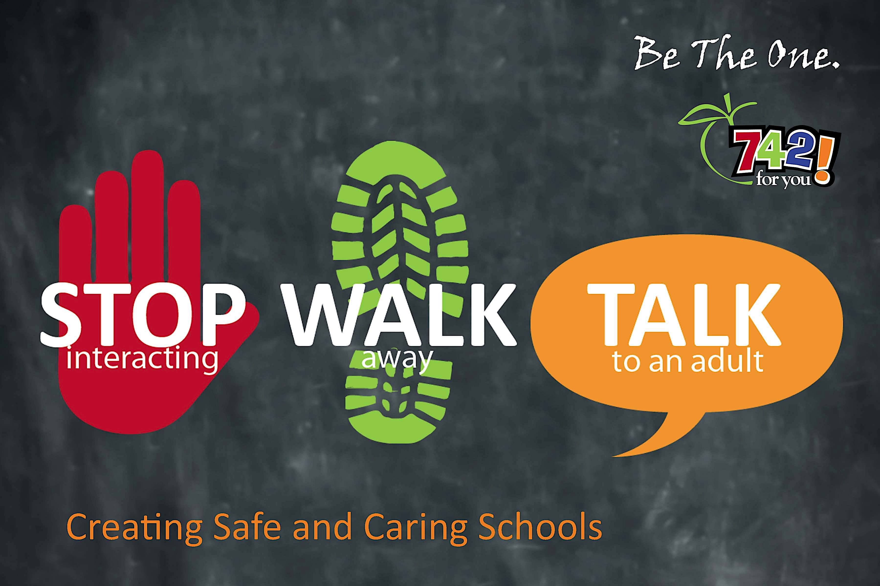
Be the One to Take Action
Comply with Board Policy 105 at all times
Report behavior
that may violate
Board Policy105 to adults in your school using the STOP WALK & TALK response strategy
Notes:
Students and staff must be compliant at all times! –Teach students they have a responsibility to use STOP WALK & TALK to report harassment to an adult at school when they witness or experience it.

Slide 6

When You Talk To Someone
Reports will be treated confidentially
Your principals will
investigate reports
Retaliation or reprisal
will not be tolerated
Prompt and appropriate consequences will be taken according to the District 742 Code of Conduct to stop the harassment.
Notes:
Assure students we want to know about harassment and we will investigate all reports.

Slide 7
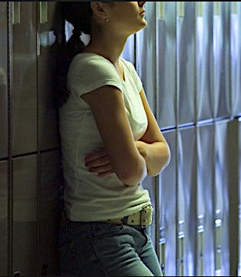
What will happen if you harass someone?
You will get an office referral
Your parents/guardian will be called and will have to come in for a meeting with the principal
Consequences will follow according to the Code of Conduct
Be aware… out of school harassment reports will be investigated if the behaviors interfere with learning.
Notes:
The objective of this slide is to be sure students understand how serious harassment is what the consequences for harassment are according to our code of conduct.
Review the Code of Conduct Consequences for Harassment so students know what the consequence for harassment is.

Slide 8
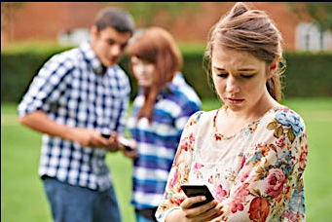
Remember
when you witness or experience unsafe or unwelcome behavior…
Notes:
Review the 3 step response strategy we want students to use when they witness or experience unsafe or unwelcome behavior. Remember to tell students if they don’t feel comfortable saying STOP proceed right to step 2 and 3.

Slide 9
Our Expectations
Behave in a safe and caring manner.
Follow our school’s expectations.
Show respect for all students and families of our school.
Report violations of Board Policy 105 to an adult at your school using the STOP, WALK & TALK response.
Notes:
Summarize our district’s expectations in regard to harassment. Use the box to have students write in your school’s 3-5 behavioral expectations.

Slide 10

“Cultural differences should not separate us from each other, but rather cultural diversity brings a collective strength that can benefit all of humanity.”
- Robert Alan Silverstein
Notes:
Conclude the lesson with a reminder that students have the opportunity to be
teachers for one another as they share their experiences, identity stories,
and cultural contexts. Cultural Competency makes them better prepared to live and work in a diverse world.

Slide 11
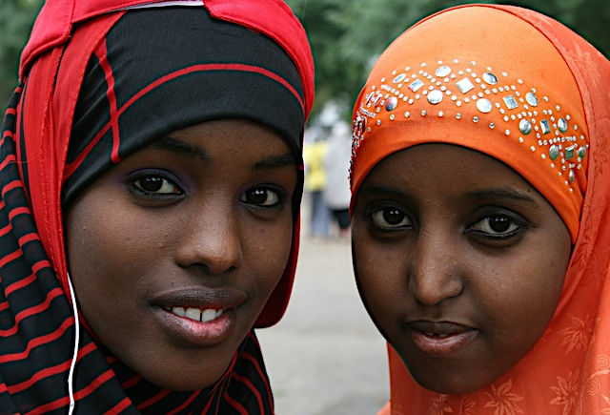
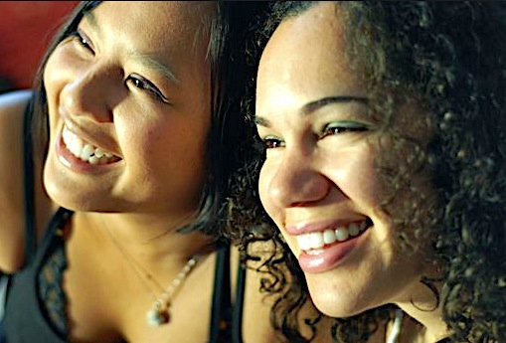

Everyone has the right to feel safe and welcome at school!
Notes:
Remind students that the Board Policy that you just covered means that in our schools ALL students are welcome and can expect to be treated in a safe and caring manner.

