Slide 1

A Safe and Caring School
Notes:
Today staff will review our district policy on harassment. They main objectives of today’s lesson are:
Explain that we all need to use safe and caring behaviors to have a school be a safe and caring place.
Define Harassment
Define our policy in regard to harassment
Inform students of their rights and responsibilities in regard to harassment
Review our 3 step process for responding to unsafe or unwelcome behavior witnessed or experienced

Slide 2
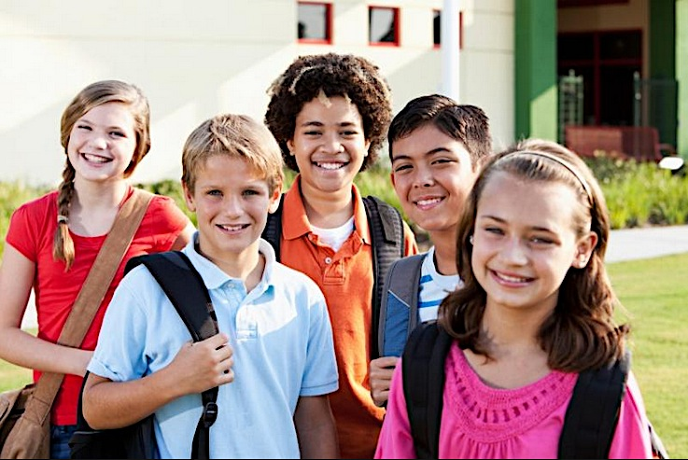
The time is always right to do what is right.
Martin Luther King Jr.
Notes:
The students outcomes for this PPT. are:
Students will understand it is their right to learn in a safe and welcoming environment and learn behaviors that will help us fulfill our mission to build safe and caring schools.
Students will review the definition of harassment
Students will review Board Policy 105
Students will review the consequences for harassment
Students will review how to respond if harassment occurs (to self or others)
Students will review school wide expectations and be encouraged to use them to prevent harassment

Slide 3
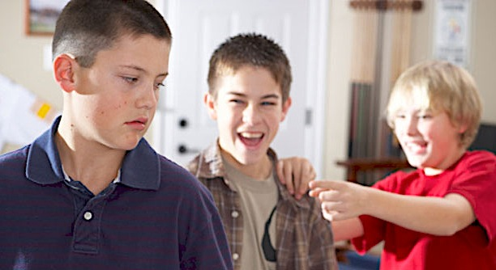
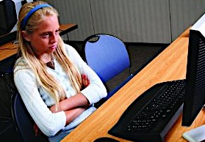
Harassment always hurts and it is always wrong behavior
Harassment is….
  Words or behavior
  Related to Protected Class Status
  Unwelcome
  Disruptive to the ability to work or learn
  Severe, persistent or pervasive
Notes:
Definition of Harassment – Walk thru 5 elements. Harassment hurts all of us, not just the target of the incident.
Harassment is not an isolated event, not a thoughtless remark or
mistake – but typically patterns of behavior that significantly change the environment for the student..
Often many months before a report and significant consequences for the victim. However, harassment can be a one time event.

Slide 4
Board Policy 105
Every Student
is Protected by this policy
The purpose of this policy is to maintain a learning and working environment
that is free from harassment and violence on the basis of…
Sex
Race, Color, National Origin
A
g
e
Religion or Creed
Marital or Family Status
Disability
Sexual Orientation
Economic Status
Notes:
Review Board Policy 105:
Remind students that as people we all belong in multiple boxes – these protections,
policies and commitments apply to
EVERY student.

Slide 5
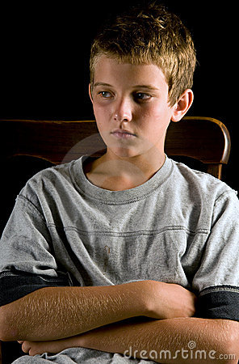
What will happen if you harass someone?
You will get an office referral
Your parents/guardian will be called and will have to come in for a meeting with the principal.
More severe consequences may happen according to the Code of Conduct
Notes:
This slide is to let students know how serious harassment is and what will happen if they choose to harass someone. Review the Code of Conduct Consequences for Harassment so students know what the consequence for harassment is.

Slide 6
Take Action
Every Student is Protected
Comply with this
policy at all times
Report behavior
that may violate
Board Policy105
Report concerns to your principals, teachers or counselors
Out of school behaviors will be considered if
they impact your
school life
Sex
Race, Color, National Origin
A
g
e
Marital or Family Status
Religion or Creed
Disability
Sexual Orientation
Economic Status
Notes:
Remind students they have a responsibility to report harassment to an adult ( principal, a teacher, a counselor or staff member) when they witness or experience it.

Slide 7
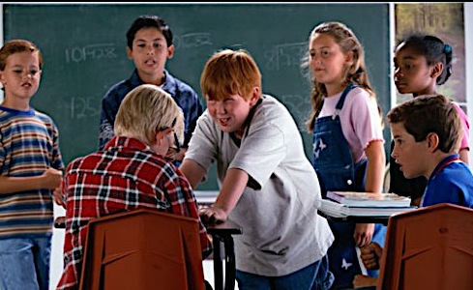

When you see or experience unsafe or unwelcome behavior…
Notes:
Review the 3 step response for what to do when students witness or experience unsafe or unwelcome behavior. Students should STOP say stop and stop the interaction. WALK away. Go TALK to an staff member.

Slide 8
When You Talk To Someone
Every Student is Protected
Reports will be treated confidentially
Your school will
investigate reports
Retaliation will not be tolerated and must also be reported
Prompt and appropriate consequences will be taken according to the District 742 Code of Conduct to stop the harassment
Race, Color, National Origin
Sex
A
g
e
Marital or Family Status
Disability
Religion or Creed
Sexual Orientation
Economic Status
Notes:
Assure students we want to know about harassment and we will investigate all reports.

Slide 9

The ABC’s of Avoiding
Harassment
  Awareness
    Be aware of how our words, actions and practices impact others
  Belonging
    Be inclusive and inviting
  Compassion
    Be kind and caring
  Differences
    Be open to other perspectives
  Everyone
    Treat everyone with dignity and respect
Notes:
Encourage students do behave in an inclusive manner.

Slide 10
Show respect for all students and families of our school.
Behave in a safe and caring manner.
Stand up against harassment & bullying…Use our STOP WALK and TALK response.
Follow our school’s behavior expectations.
Notes:
Personalize the district policy to your school. Review how using your school’s 3-5 school wide expectations will help prevent harassment at your school.
Encourage students to be the one to use STOP WALK and TALK and help others use it as well!

Slide 11
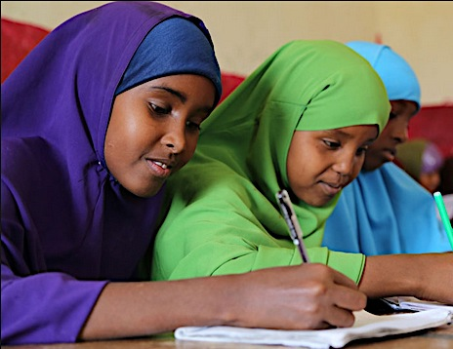
Everyone has the right to feel safe and welcome at school!
Notes:
Remind students that in our schools ALL students are welcome and can expect to be treated with respect.

