Slide 1

A Safe and Caring School
Notes:
Today staff will review our district policy on harassment. They main objectives of today’s lesson are:
Explain that we all need to use safe and caring behaviors to have a school be a safe and caring place.
Define Harassment
Define our policy in regard to harassment
Inform students of their rights and responsibilities in regard to harassment
Review our 3 step process for responding to unsafe or unwelcome behavior witnessed or experienced

Slide 2

You can help make your school and a safe and caring place!
Notes:
Encourage students to set the example of safe and caring behavior for the younger students in the school.

Slide 3
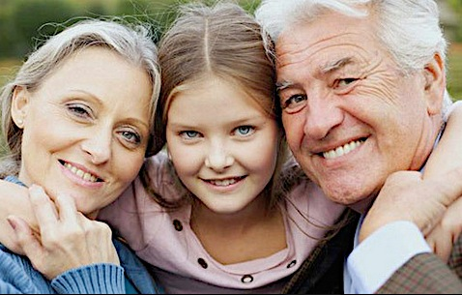
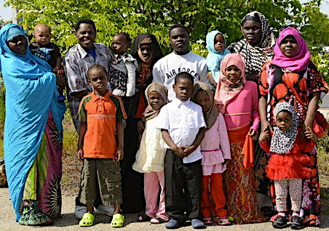
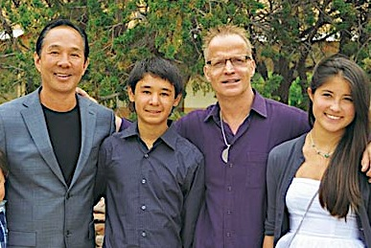
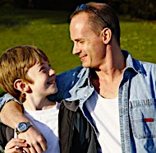


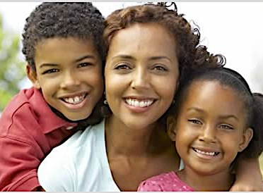
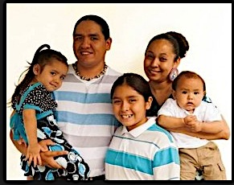
Say only nice things about…
Another person’s family
The holidays a person celebrates
The place where a person lives
How a person learns
How a person looks
Notes:
These are the things that define us as people and when these are attacked they hurt us the most. Each of these touch on protected class.

Slide 4
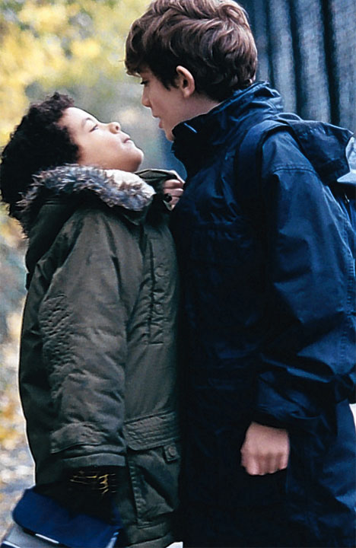
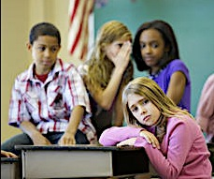
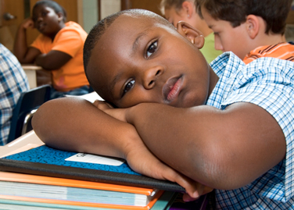
Harassment
Is words or actions that hurt, embarrass or make someone feel unwelcome or unsafe.
Intentionally hurts someone because of who they are or because they are different from you.
Is uncaring behavior that hurts us all.
Notes:
This slide defines harassment in age appropriate language.

Slide 5
What is Harassment?
Behaviors or words
That are unwelcome
or unwanted
That are intended to hurt
Are mean and threatening
And are directed at a person or group because of
who they are
Boy
Race or Skin Color
G
i
r
l
Religion
Family Beliefs and Customs
Disability
Who You Love
How Much Money Your Family Has or Doesn’t Have
Notes:
Definition of Harassment – Walk thru 5 elements-Explain to students that harassment is a special kind of bullying that is based on these differences.
Harassment is not an isolated event, not a thoughtless remark or
mistake – but typically patterns of behavior that significantly change the environment for the student..
Often many months before a report and significant consequences for the victim. However, harassment can be a one time event.

Slide 6
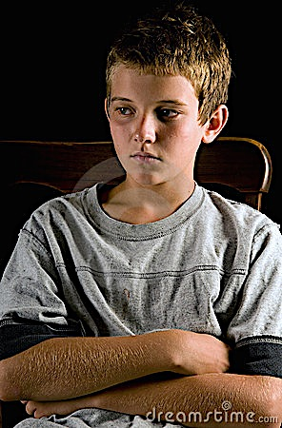
What will happen if you harass someone?
You will get an office referral
You will have to talk to the principal
Your parents/guardian will be called and will have to come in for a meeting with the principal.
Notes:
This slide is to let students know how serious harassment is and what will happen if they choose to harass someone. Review the Code of Conduct Consequences for Harassment so students know what the consequence for harassment is.

Slide 7

What Should You Do?
If you experience or see unsafe or unwelcome behavior it is your responsibility to talk to an adult about it.
Use STOP, WALK & TALK
Notes:
Remind students they have a responsibility to talk to an adult if they witness or experience harassment. Teach STOP WALK TALK. Encourage students to use it and remind them if they are not comfortable saying stop, just walk away and talk to an adult about what happened.

Slide 8
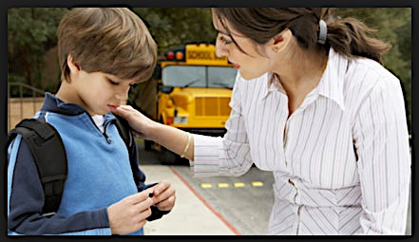
Please Report
Harassment
You will be doing the right thing
You will be thanked for talking about it
Your Principal will investigate every report
You don’t have to be afraid that it will get worse
Adults at school will help to stop the harassment
Notes:
Assure students we want to know about harassment and we will help the harassment stop.

Slide 9
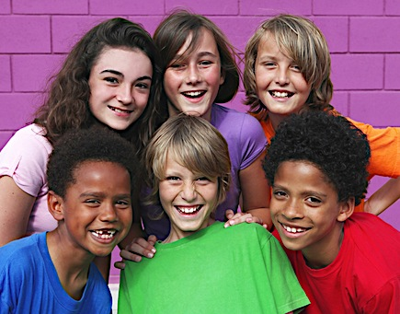
Our School’s Expectations
Behave in a safe and caring way
Talk to adults about unsafe or uncaring behavior at your school.
Use STOP WALK TALK
Notes:
Summarize our district’s expectations in regard to harassment. Review your school’s 3-5 school-wide expectations. Have students tell you what they are. Write them in the space provided. Talk about how following your school-wide expectations will help eliminate behaviors that hurt people and instead will create a school that is safe and caring.

Slide 10
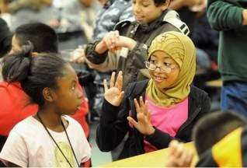
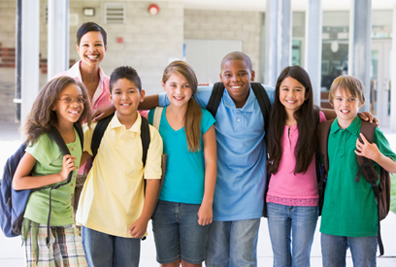
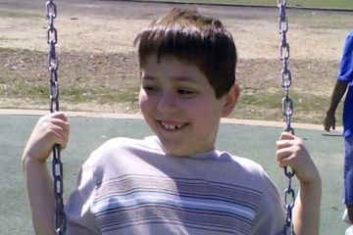
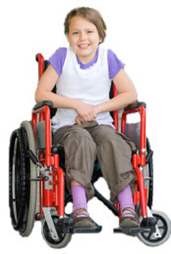
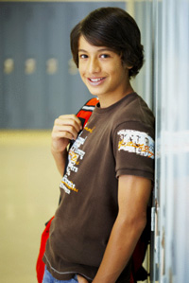
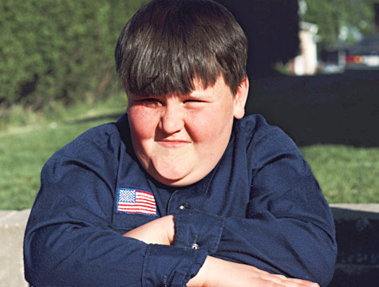
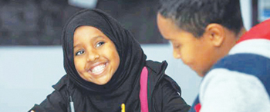
Everyone has the right to feel safe and welcome at school!
Notes:
Remind students that in all District 742 schools ALL students are welcome and deserve a safe and caring place to learn.

