Slide 1

A Safe and Caring School
Notes:
Today you will teach the district harassment lesson for the age level you teach. Thank you for your participation in this district effort!
.

Slide 2
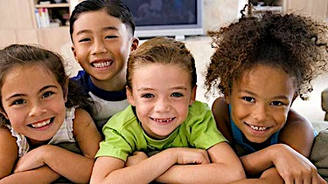

You can make others feel safe
and welcome at school.
Let’s learn how!
Notes:
The students outcomes for this PPT. are:
Students will learn that in order to learn in a safe and caring school we all need to behave in safe and caring ways.
Students will understand it is their right and their responsibility to learn in a safe and caring environment.
Students will review the definition of harassment
Students will review the consequences for harassment
Students will review how to respond if harassment occurs (to self or others)
Students will review school wide expectations and be encouraged to use them to prevent harassment and create a safe and caring school.

Slide 3

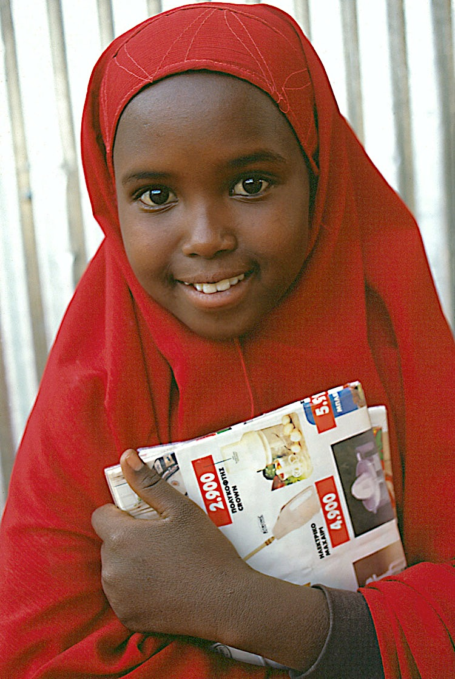
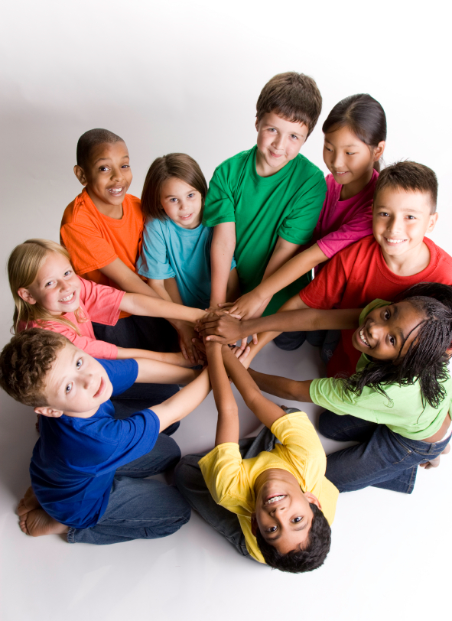
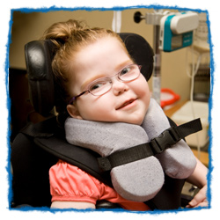
Girl
Boy
Say and Do Only Nice Things!
Special Needs
Race,
Skin Color
Notes:
Who we are needs to be validated and valued for us to feel safe and welcome at school. It is a student’s right to be safe and welcomed at school. (Board Policy 105) How we are born into the world is not our choice. How a person looks, how they learn, the color of their skin, the language they use at home are all things that define who we are. Teach students directly they need to say only nice things about who a person is.
This and the next few slides will help students understand protected class in an age appropriate manner.

Slide 4
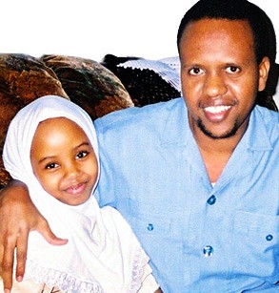
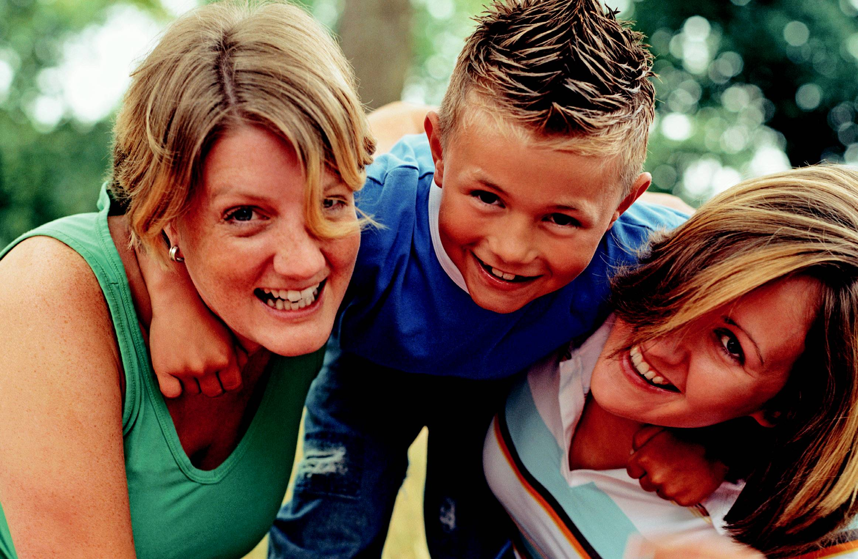
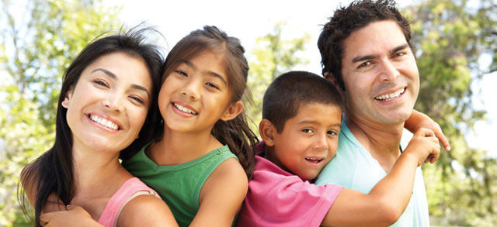
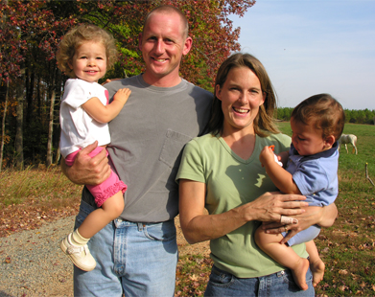
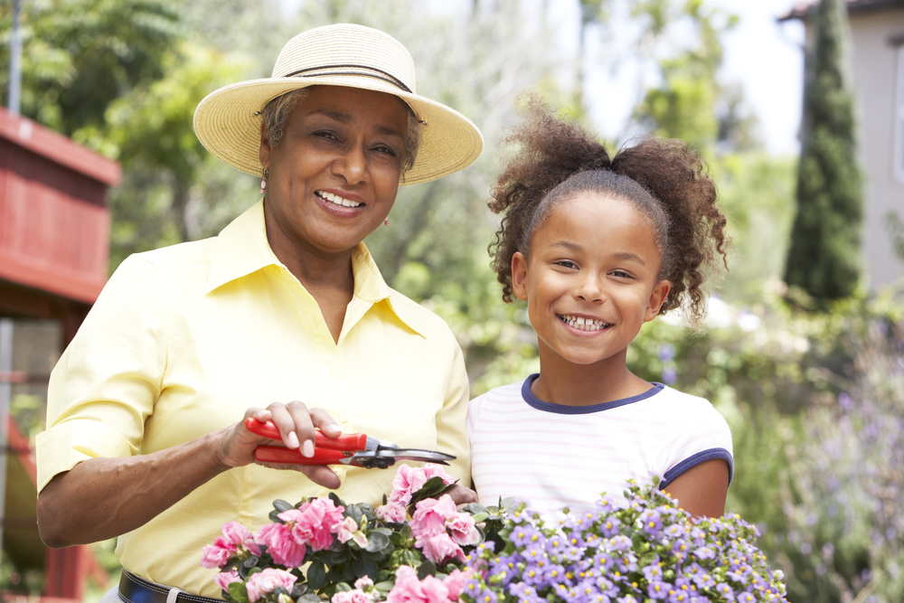
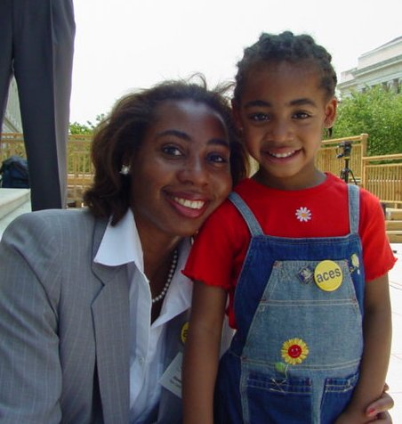
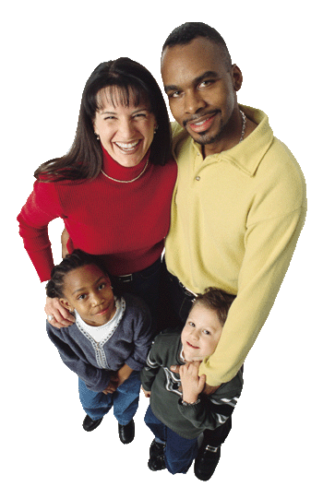
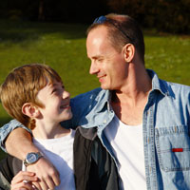
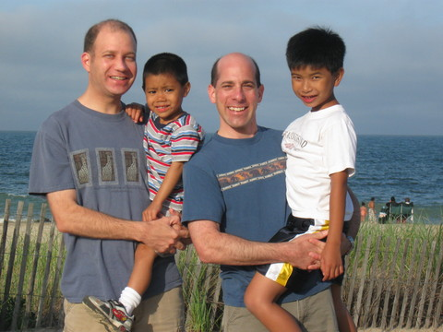
Say only nice things about another person’s family
Notes:
Who a student is begins with their family. Example: Some children have two daddies taking care of them, some have a mom and a dad, some have have a grandma that cares for them. Some children have two mommies. Some children live with foster parents, some live with just their dad or just their mom. Our families are different and all of them are important and we love them. Encourage students to be accepting of another student’s type of family because family are the people we love. It important that students know they should only say nice things about another person’s family.

Slide 5

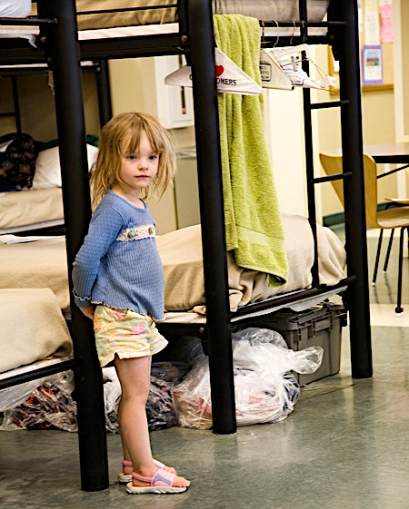

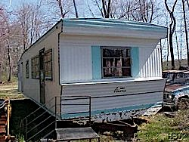
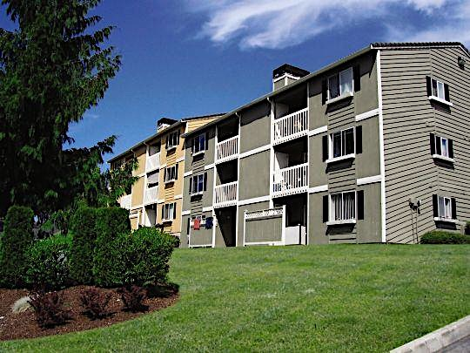
motel
shelter
Say only nice things about where a person lives
house
apartment
mobile home
Notes:
We all have some place where we go at night. This is our home. Homes can be very different. Some children live in a house, some live in a trailer or mobile home, some children live in an apartment, or a motel and sometimes our family can be without a place to live and so we live for awhile in a shelter or with relatives or friends. Home is important because it houses the people we love. Encourage students to be accepting of where someone lives because it is where their family spends time together.

Slide 6
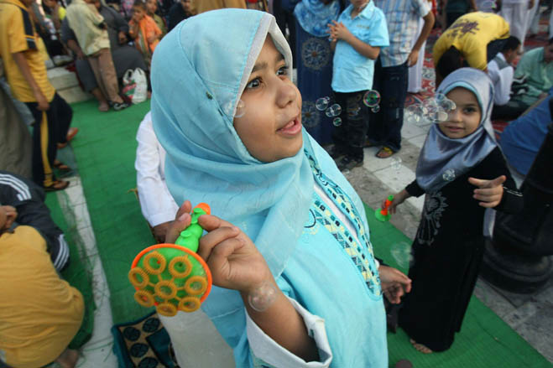
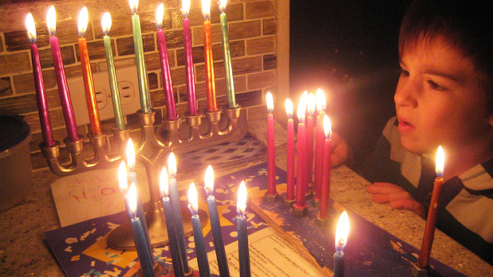
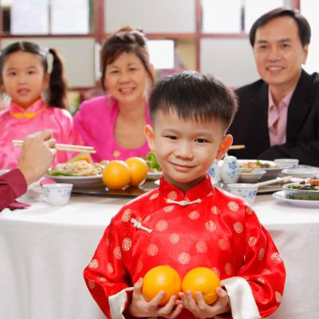
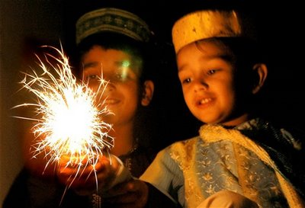
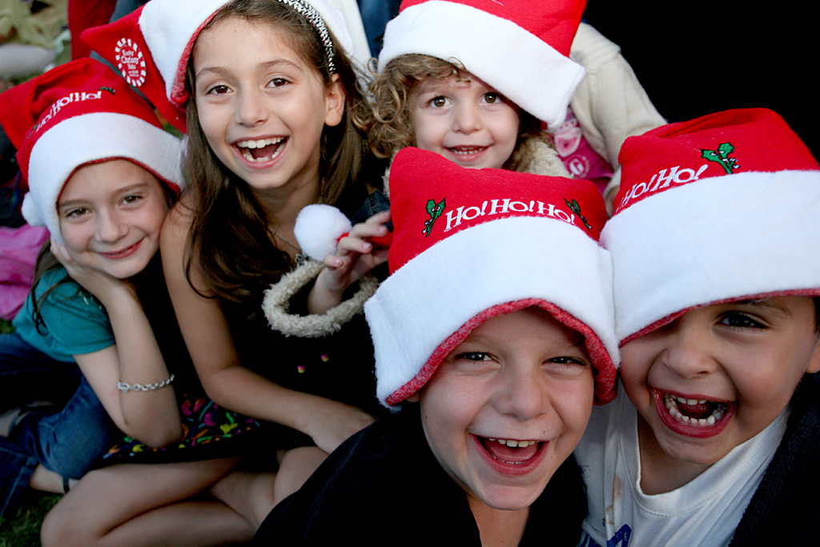
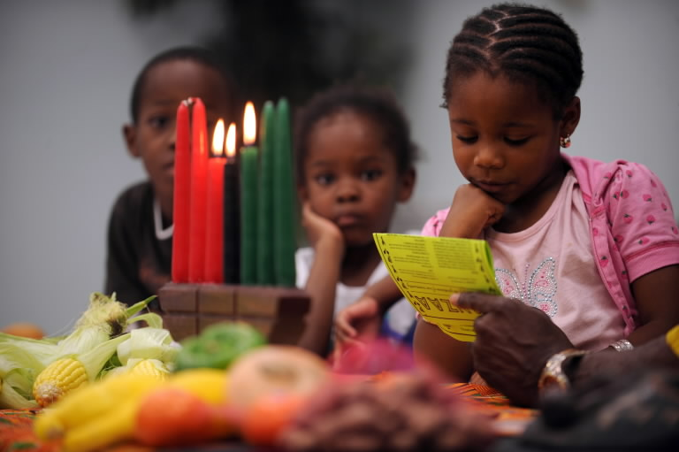
Chinese New Year
Eid the end of Ramadan
Hanukah
Say only nice things about the special days a person celebrates with family
Christmas
Kwanzaa
Diwali
Notes:
The wonderful holidays and celebrations we have in our families are sometimes based on our religion or where we go to church. These special times are important to students and different for each family based on their beliefs. (Example: Not everyone celebrates Christmas or Eid or Kwanzaa.) Encourage students to learn about special things others celebrate that they don’t.

Slide 7
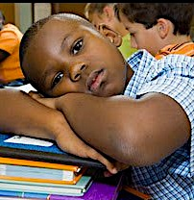
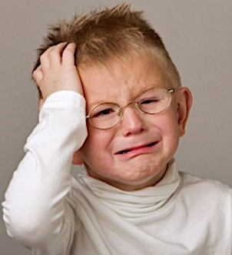
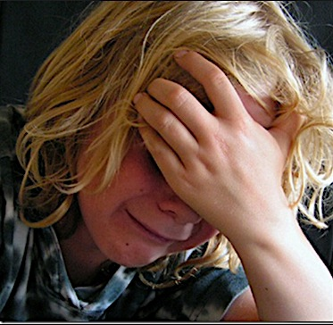
Saying or doing mean things to someone because they are different than you is called Harassment.
Harassment makes others feel sad, left out and not ok.
Harassment makes others feel unsafe and unwelcome.
Harassment
Is wrong.
Is against our rules.
Hurts us all.
Notes:
This slide addresses what we don’t want to happen and how students feel as a result of being harassed. It is hard to define harassment for our younger students. They understand being mean and we need to help them understand that when they are mean to someone based on who they are (protected class status that the previous slides addressed) it is harassment.
We are making an attempt to define harassment even for our youngest students.

Slide 8
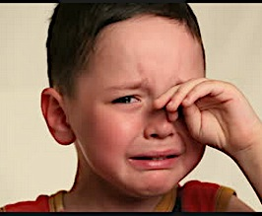
What will happen if you harass someone?
You will get in trouble and have an office referral.
You will have a consequence.
Your parents/guardians will be called and will have to meet with the principal.
Notes:
This slide is to let students know that harassment is serious and inform them what will happen if they choose to harass someone.

Slide 9
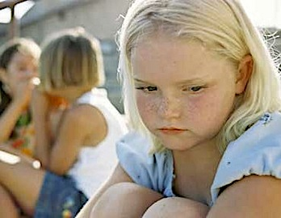

If you see or experience unsafe or unwelcome behavior…
Interacting
Notes:
Directly Teach the 3 step response to students. This is what we want students to do if they witness or experience unsafe, uncaring or unwelcome behavior. Students should say STOP or STOP the interaction. WALK away. Go TALK to a staff member.

Slide 10

When You Talk to an Adult
About Harassment
You will be doing the right thing
You will be thanked for talking to the adults about it
Your principal will find out more
The adults will help make it stop
Notes:
Assure students we want to know about harassment and we will investigate all reports.

Slide 11
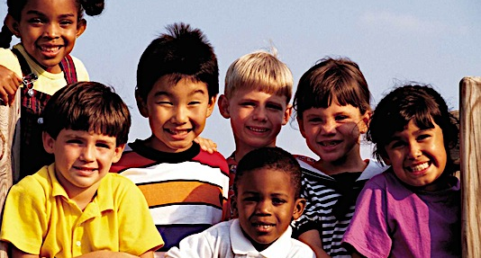
Help make our school a safe and caring place to learn!
Follow our school’s expectations:
Say and do nice things
Make everyone feel safe & welcome
Use STOP WALK TALK if you see or experience harassment
Notes:
Personalize the district policy to your. Review your school’s 3-5 school wide expectations and how using them will help prevent harassment at your school. Ask students what they are and write them in the box.
Encourage students to say and do only nice things at school.
Let them know that when they do that they make others feel safe and welcome at school.
When we all feel safe and welcome we can learn more.
Encourage the use of STOP WALK and TALK if they experience or see or hear unwelcome, uncaring or unsafe behavior!

Slide 12
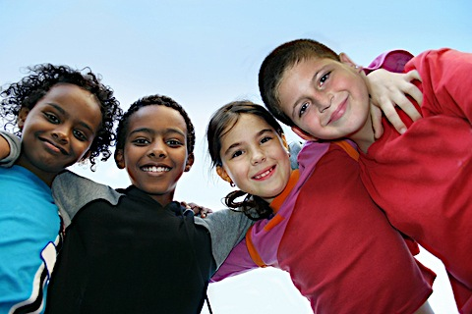
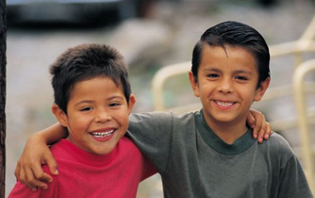
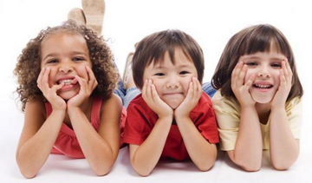
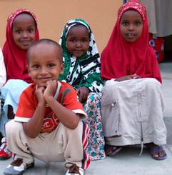
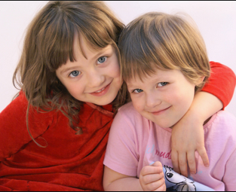
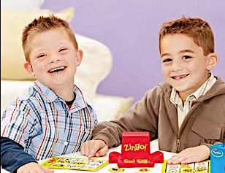

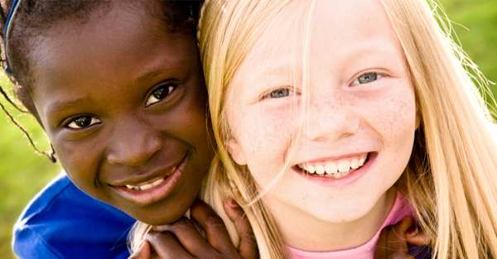
Everyone has the right to feel safe and welcome at school!
Notes:
Remind students that in our schools ALL students are welcome and can expect to be treated with kindness. When we all behave in a safe and caring way our school will be a safe and caring place to learn!

