Slide 1

Safe and Caring
Notes:
Today staff will review our district policy on harassment. They main objectives of today’s lesson are:
When we behave in safe and caring ways we create a safe and caring place to learn.
Define Harassment
Define our policy in regard to harassment
Inform students of their rights and responsibilities in regard to harassment
Teach our 3 step process for responding to unsafe, uncaring or unwelcome behavior witnessed or experienced

Slide 2

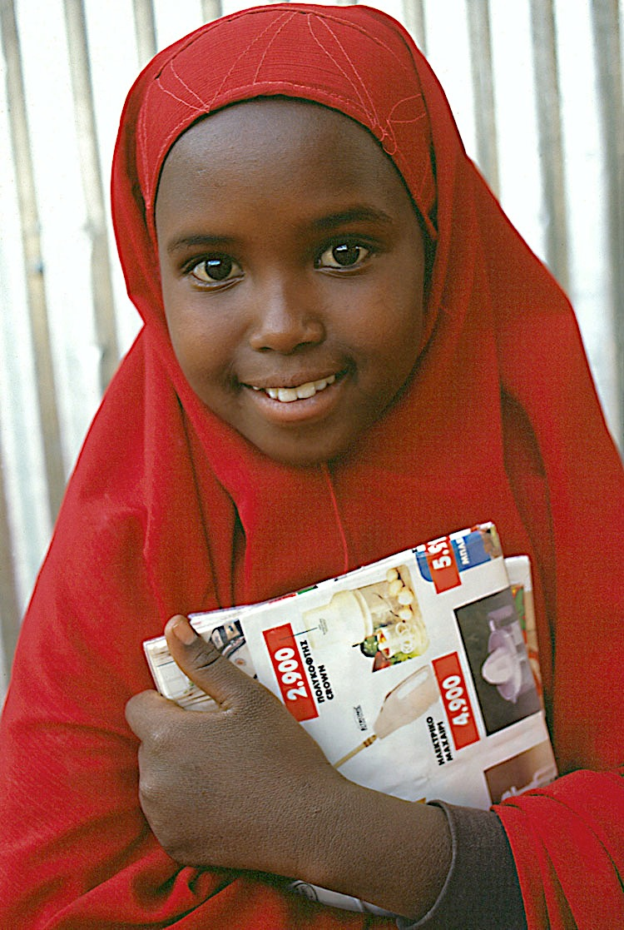
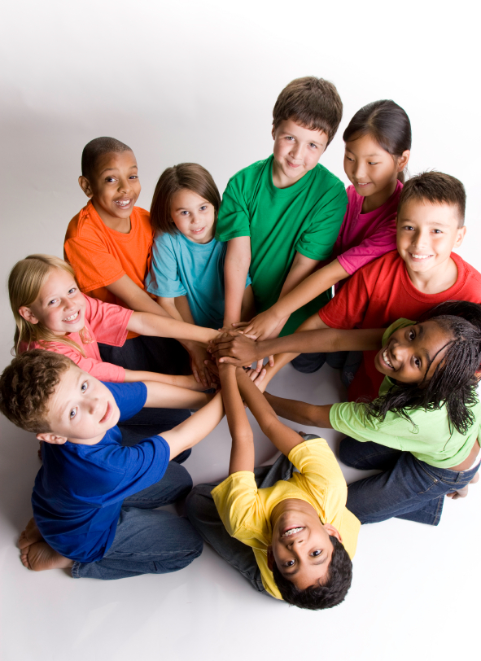
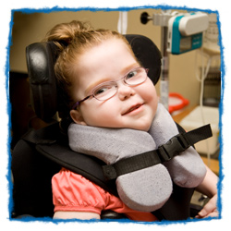
Girl
Boy
Say and Do Only Nice Things!
Special Needs
Race,
Skin Color
Notes:
Who we are needs to be validated and valued for us to feel safe and welcome at school. It is a student’s right to be safe and welcomed at school. (Board Policy 105) How we are born into the world is not our choice. How a person looks, how they learn, the color of their skin, the language they use at home are all things that define who we are. Teach students directly they need to say only nice things about who a person is.
This and the next few slides will help students understand protected class in an age appropriate manner.

Slide 3
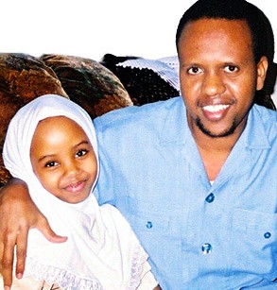
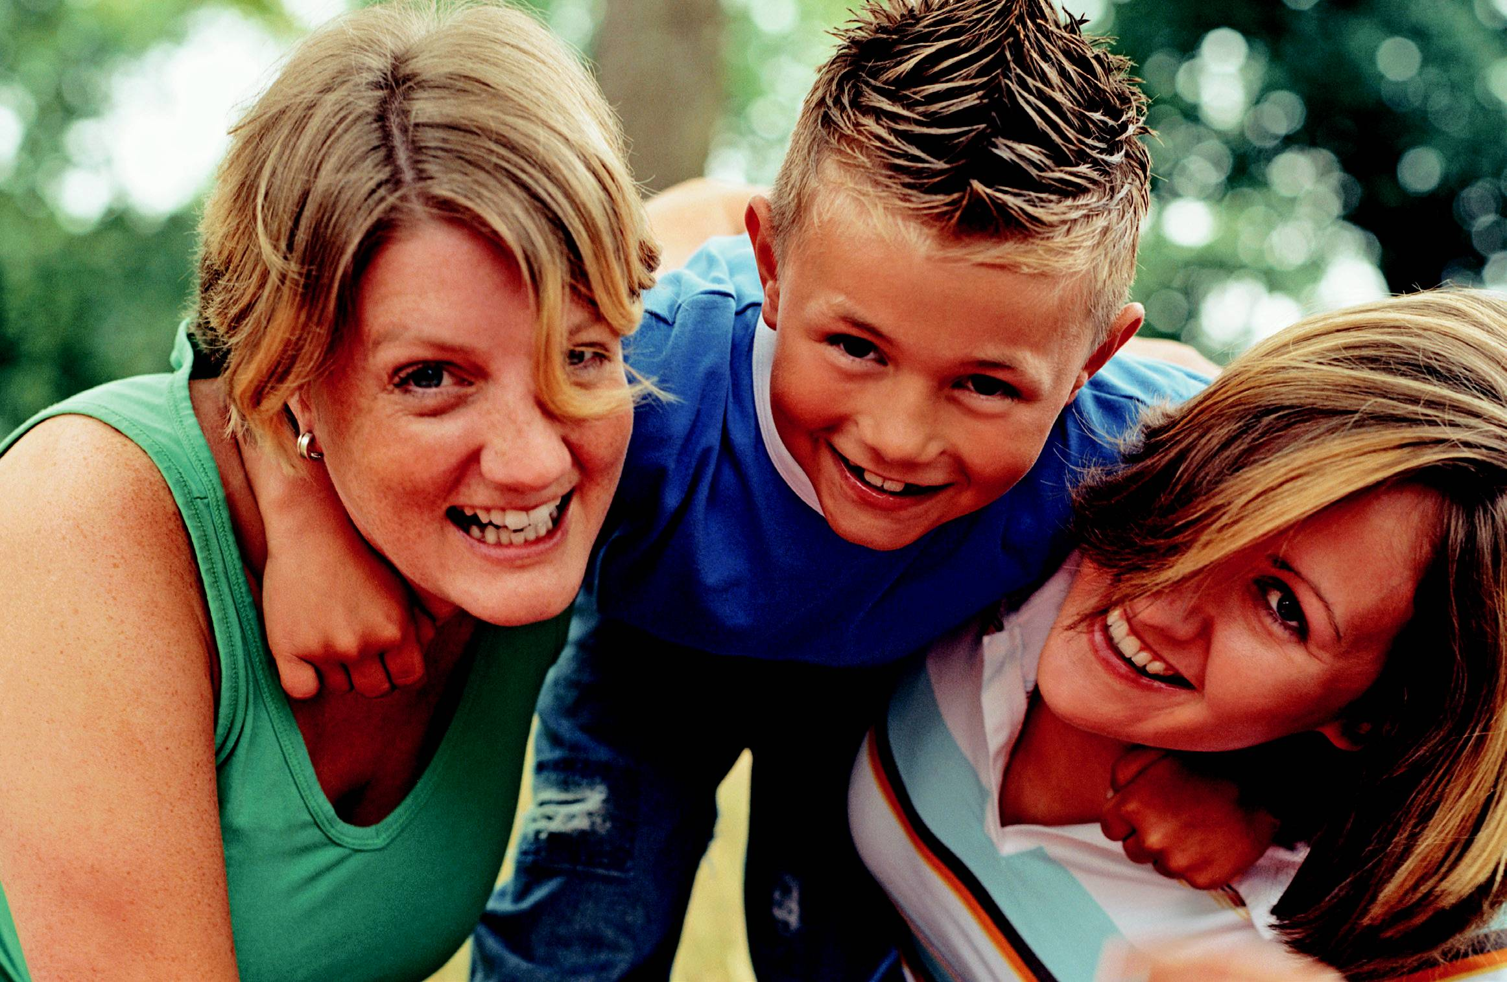

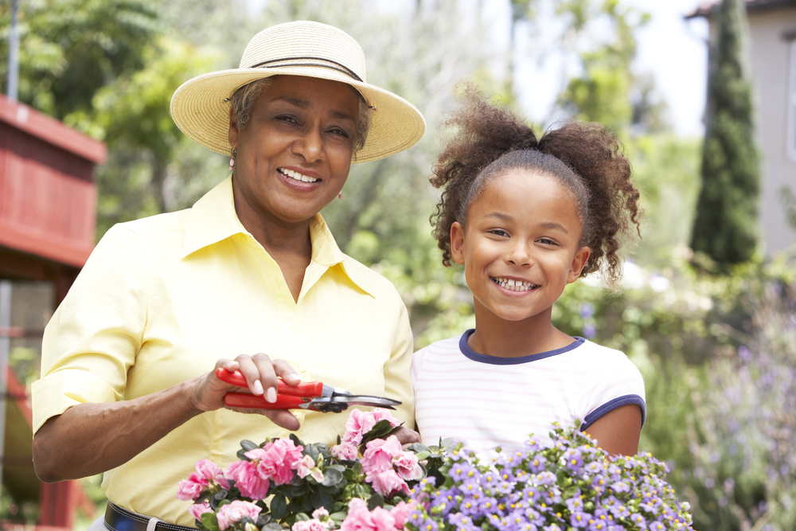
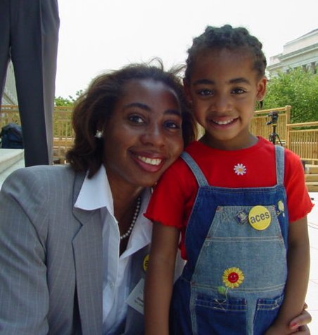
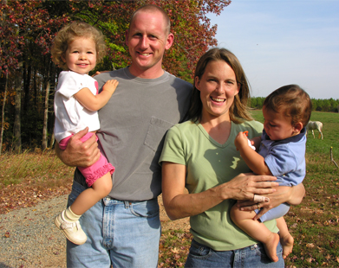
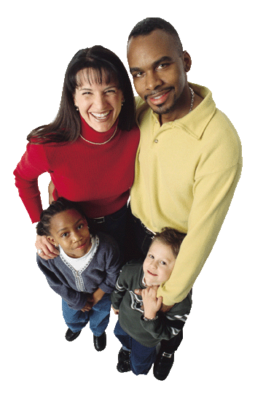
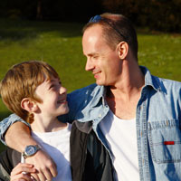
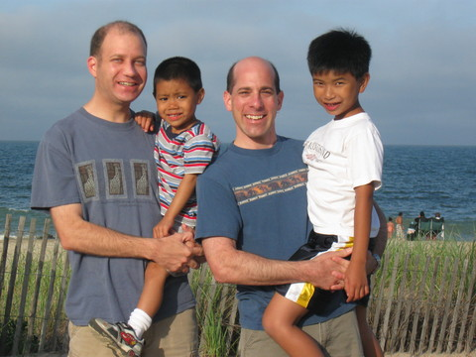
Say only nice things
Family
Notes:
This slide can be used to talk about our families differences. Example: Some children have two daddies taking care of them, some have a mom and a dad, some have have a grandma that cares for them. Some children have two mommies. Some children live with foster parents, some live with just their dad or just their mom. All of our families are different and all of them are important and we love them. Teach students to only say nice things about another person’s family.

Slide 4
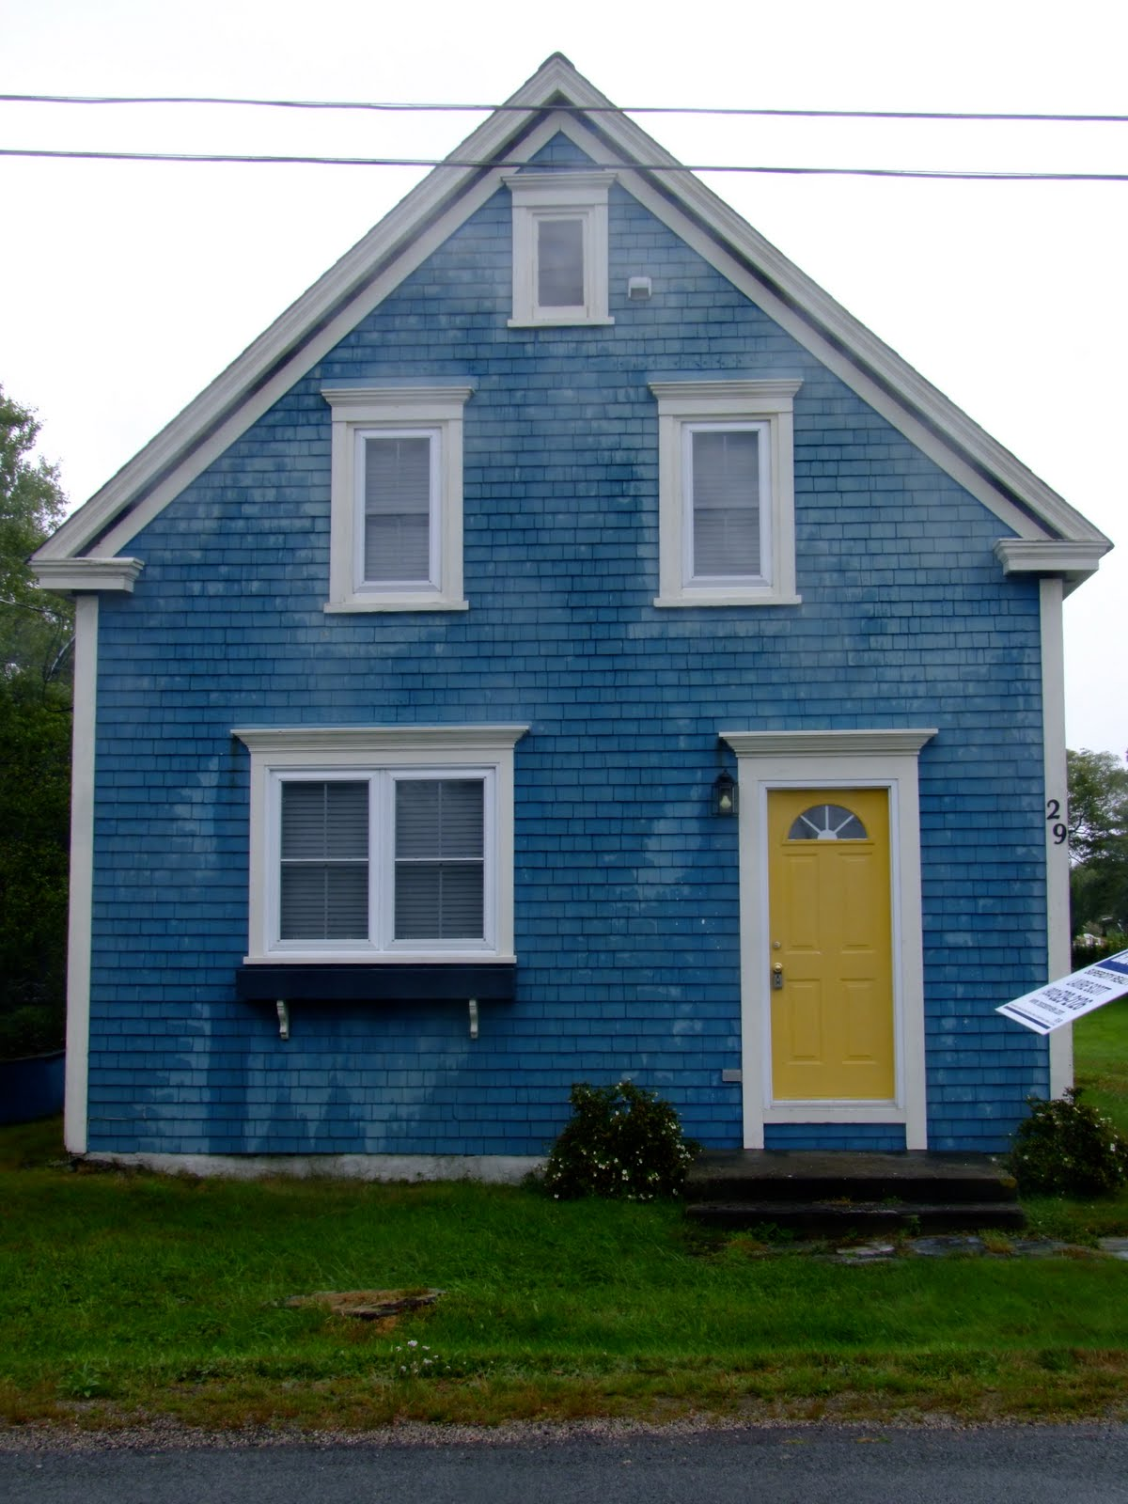
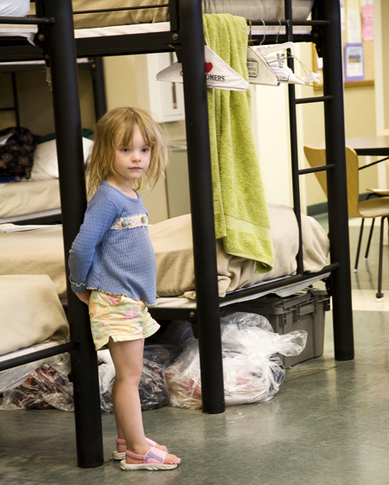
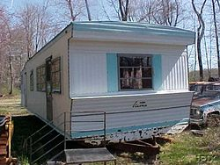
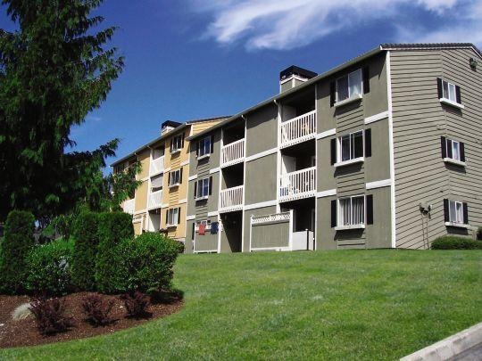
house
shelter
Where you live
mobile home
apartment
Say only nice things
Notes:
This slide can be used to open a discussion for students on (economic status) in an age appropriate manner. We all have some place where we go at night. This is our home. Homes can be very different. Some children live in a house, some live in a trailer or mobile home, some children live in an apartment, sometimes our family can be without a place to live and so we live for awhile in a shelter or a hotel. Teach students to only say nice things about where a person lives.

Slide 5
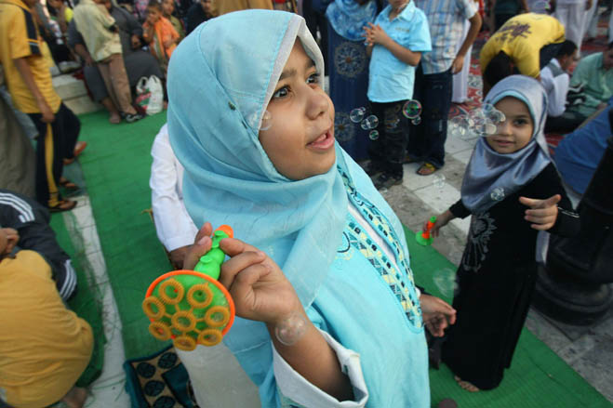
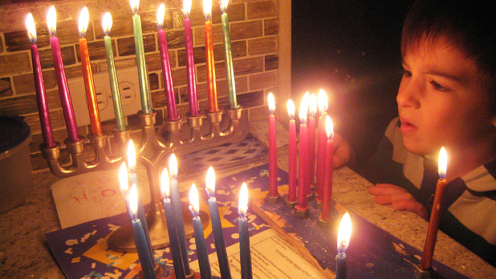
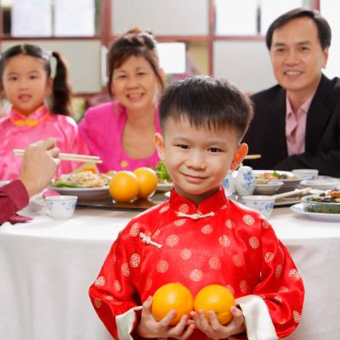
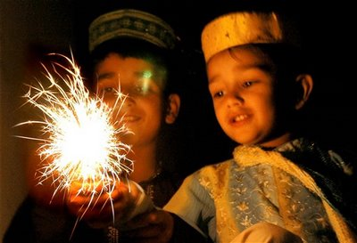
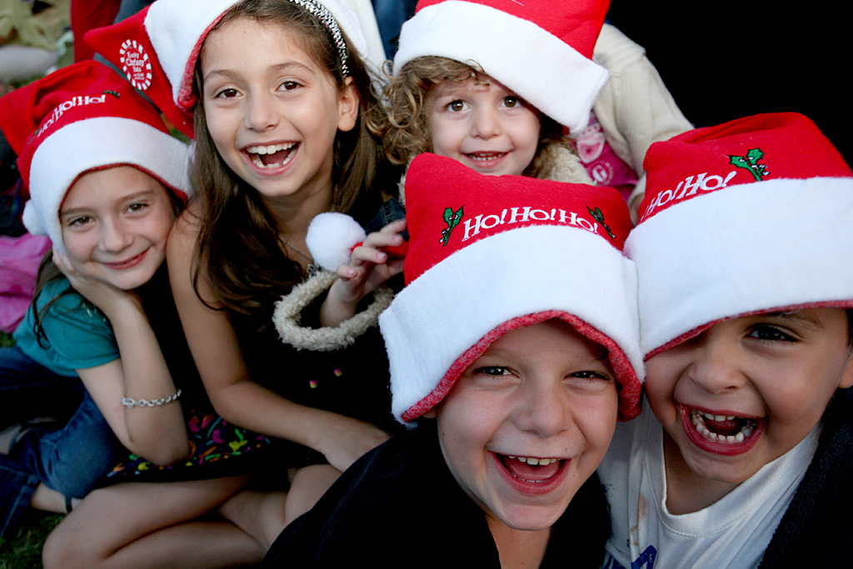
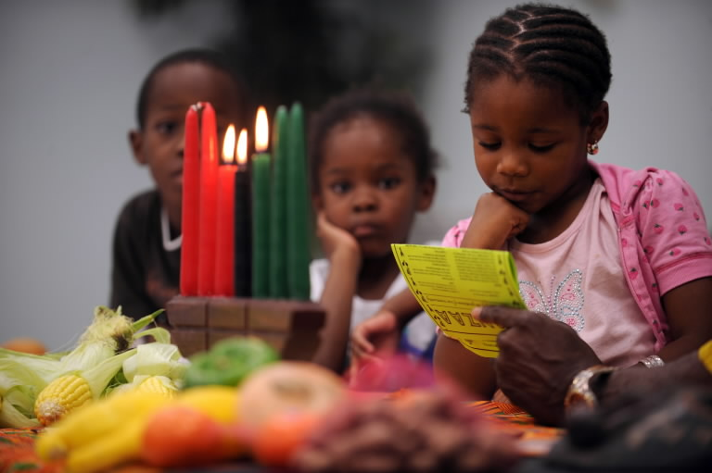
Chinese New Year
Eid the end of Ramadan
Hanukah
Holidays/Special Days Celebrated
Say only nice things
Christmas
Kwanzaa
Diwali
Notes:
This slide is can be used to talk about the wonderful holidays and celebrations we have in our families based on our religion or where we go to church. These are special times for each participant. Important to families and different for each family based on their beliefs. (Example: Not everyone celebrates Christmas or Eid or Kwanzaa.) Teach students to say only nice things about the special days or holidays a person celebrates.

Slide 6
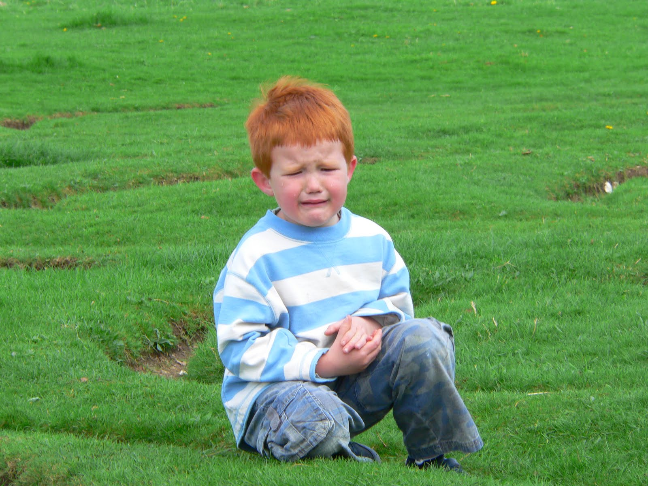
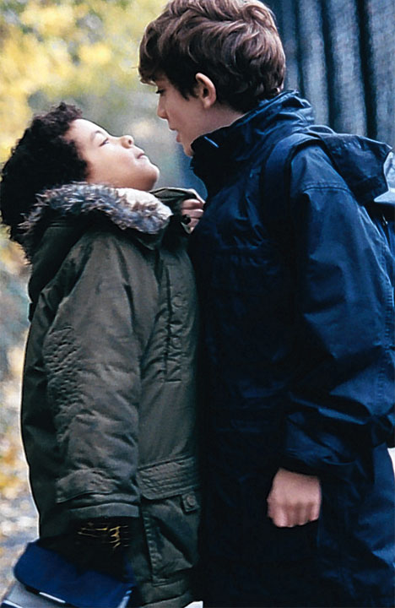
Harassment
Harassment is saying or doing something mean to someone because they are different that makes them feel sad, scared or left out.
Notes:
After teaching students how to show that they care about others by saying only nice things about who they are, this slide teaches students what we don’t want and what that is called when we say and do mean things based on who a person is.

Slide 7
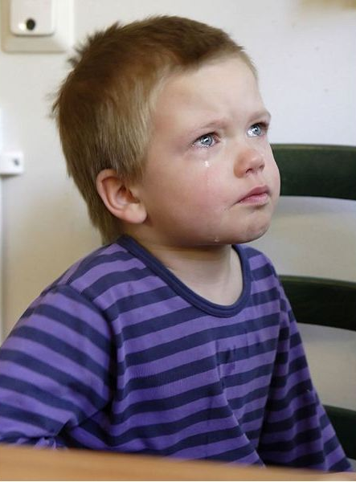
What will happen if you harass someone
You will get an office referral
You will have to talk to the principal
Your parents/guardian will be called and will have to come in for a meeting with the principal.
Notes:
This slide is to let students know how serious harassment is and what will happen if they choose to harass someone.

Slide 8


What To Do
Notes:
Teach students that we want them to tell the adults at school when they witness or experience it unsafe, uncaring or unwelcome behavior. Teach STOP WALK TALK. Model it, Have students Practice it. Encourage them to use it and remind them if they are not comfortable saying stop just walk away and tell an adult what happened.

Slide 9
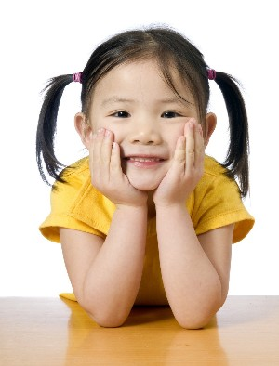
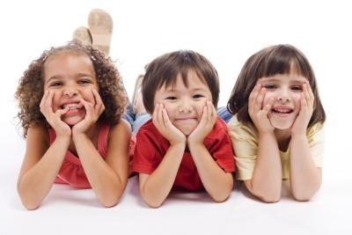
Our Expectations
Say and do safe and caring things
Use STOP WALK TALK
At our school we are
Notes:
Summarize our district’s expectations in regard to harassment. Write in and review your school’s 3-5 PBIS expectations in the box after the words “At our school we are”

Slide 10
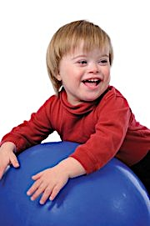
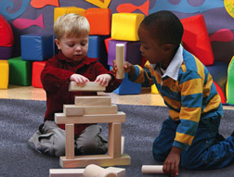
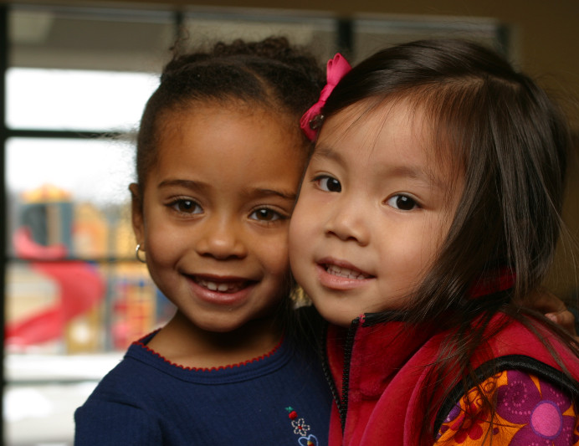
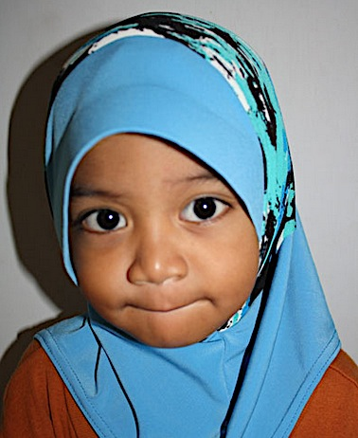
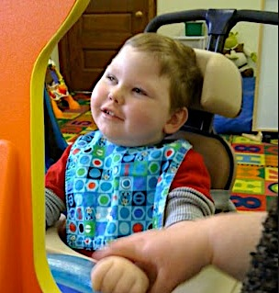

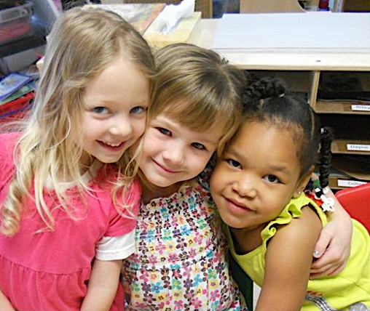
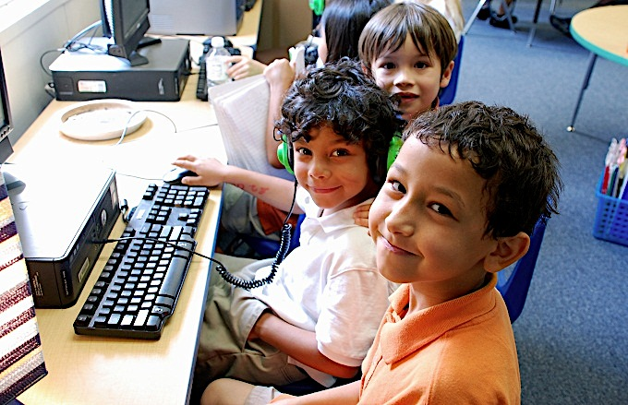
Everyone has the right to feel safe and cared for at school!
Notes:
Teach students that in our schools ALL students are welcome and can expect to be treated with kindness. When we all behave in a safe and caring way our school will be a safe and caring place to learn!

