Slide 1
Our Lady of Mercy School
PERSONAL SAFETY EDUCATION (PSE) OVERVIEW & UPDATE for Parents and Guardians

Slide 2
Outline
Background on Policy Development
ADW Child Protection Policy (CPP)
Personal Safety Education (PSE) Updates

Slide 3
I. Background
School Board Child Abuse and Neglect Policy
  1993- All schools were required to develop and implement student training at the local level
  Designed to promote awareness of the indicators of child abuse and neglect

Slide 4
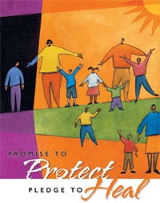
United States Conference of Catholic Bishops
Charter for the Protection of Children and Young People
  Revised in 2005
  Article 12: To Protect the Faithful
  “Dioceses are to maintain safe environment programs which the diocesan bishop deems to be in accord with Catholic moral principles. They are to be conducted cooperatively with parents, civil authorities, educators, and community organizations to provide education and training for children, youth, parents, ministers, educators, volunteers, and others about ways to make and maintain a safe environment for children and young people.”

Slide 5
Safe Environment
Adult “Code of Conduct”
Continued Education/Training
Training programs for children and young people should include age appropriate materials pertaining to personal safety

Slide 6
II. ADW Policy
Builds on 1986 policy
Adopted in 2003 with oversight by the Child Protection Advisory Board
Updated in March 2007 and JULY 2013
All children have a right to be safe and protected from harm in any and all environments- home, school religious institutions, neighborhoods and communities.

Slide 7
Policy: Education
Children and young people shall attend scheduled training/classroom sessions
Age appropriate abuse prevention education programs are available at both the elementary, middle and secondary level
Such program shall be provided annually to children in all grades of every parochial elementary school in the Archdiocese as well as children participating in religious education programs.

Slide 8
III. Personal Safety
In 2004, Child Lures Prevention Program was mandated for all schools, but today, integrated curriculum is used to teach the Child Protection Policy standards into Religion or Health-based classes.

Slide 9
III. Personal Safety Education
7 Key Standards
Basic safety skills
Recognition of dangerous and abusive situations
Appropriate and inappropriate physical contact and other inappropriate boundary violations
Ability to say “no” to unwanted situations
Ability to identify a trusting adult with whom to speak
6. Importance of disclosure if inappropriate or unwanted actions are directed to self or others
7. Recognition that abusive situations are never the fault of the child
8. Ability to safely interact with technology, including the internet and mobile devices

Slide 10
Age-Appropriate
Standard: Students will demonstrate ability to recognize and respond appropriately to dangerous and abusive situations.
Sample Benchmarks:
  Quiz
  Scenarios/Role Play
  Essay

Slide 11
III. Personal Safety
Each year the Catholic Schools Office and the Office of Catechesis collaboratively reviewed their existing safe environment programs for children and seek the best programs and curricula that enhance child protection protocols and lessons.
  Circle of Grace and Teaching Touching Safety are two examples of shared lesson plans that may be used.

Slide 12
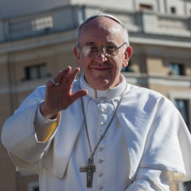
III. Personal Safety
Pope Francis continually urges families to spend time together and discuss sensitive issues of abuse, love, and forgiveness.
Pope Francis describes the Church’s mission as “respecting each of God’s creatures, which means protecting people, showing loving concern for each and every person, especially children.”

Slide 13
III. Personal Safety
Program Objectives for the Updated PSE:
  To further align the Personal Safety Education curriculum with Catholic Doctrine.
  To encapsulate materials in Spanish for diverse population served in schools.
  To incorporate Internet Safety through the addition of an 8th Standard in the PSE.
  To integrate resources for curriculum mapping of the PSE Standards.
  To make additional resources financially feasible for implementation.
  To provide an effective mode of communicating and monitoring PSE.

Slide 14
III. Personal Safety
Integrated curriculum that meets the Personal Safety Education standards uses lesson plans from
  Teaching Touching Safety
  Child Lures Prevention Program
  Circles of Grace
  Theology of the Body for Middle School Students
  Creating Safe and Sacred Places for Young Adolescents

Slide 15
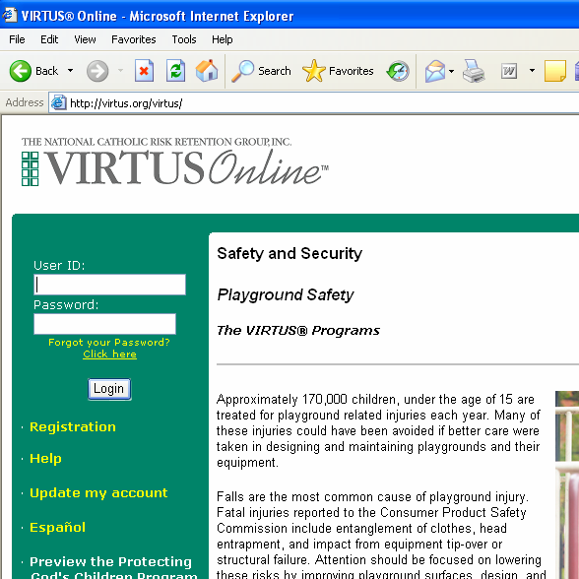
O N L I N E
Teachers access materials through Virtus Website:
  Curriculum Standards
  Archdiocesan Forms
  Sample Lesson Plans
  Power Point Training

Slide 16
Implementation
Parents and Guardians Education Night is held at the school.
Teachers create PSE “Age Appropriate” lessons plans utilizing available resources on www.Virtus.org and instruct students.
Document and maintain all lesson plans
Principal reports status update to the Archdiocese every year.

Slide 17
Contact INFO
For additional information or questions, please contact:
Deborah Thomas, Principal
dthomas@olom.org
301-365-4477

