Slide 1


Notes:
Welcome everyone. Introduce yourself. If you have time, have participants introduce themselves. Your call.

Slide 2

Ask A Question,
Save A Life.
QUESTION.
PERSUADE.
REFER.
Notes:
Read only. Slowly, so the QPR sinks in.

Slide 3
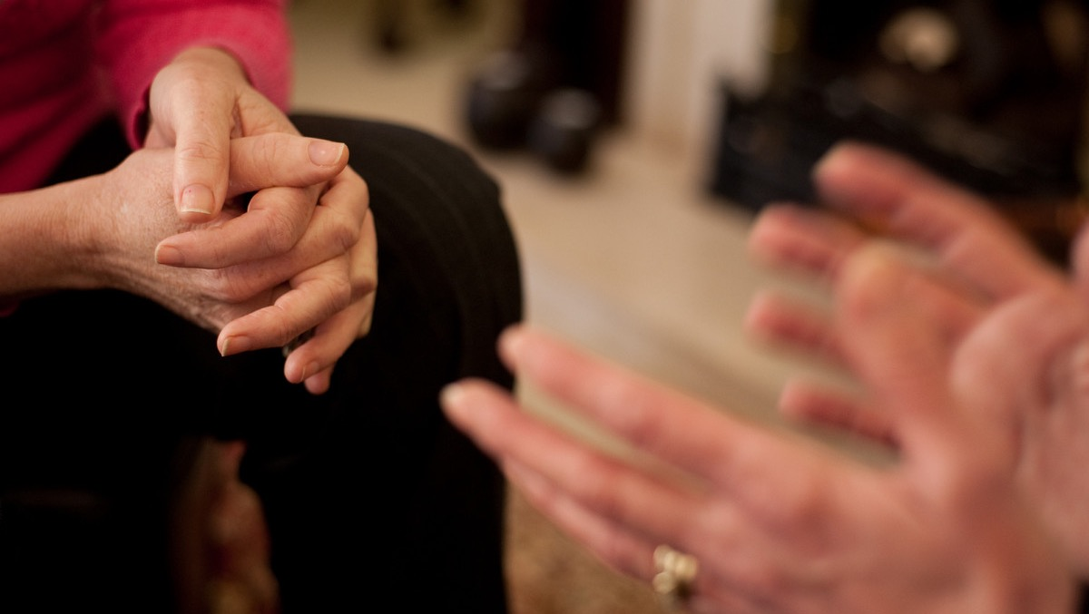
What is the
Purpose of QPR?
QPR is not intended to be a form
of counseling or treatment.
QPR is intended to offer hope
through positive action.
Notes:
QPR is not treatment. If questions come about liability for using the intervention, say “More than 3 million people have been trained over the past two decades with no report of incidents or lawsuits.” Good Samaritan laws appear to be protect gatekeepers who intervene in an attempt to save a life.

Slide 4
Suicide Myths & Facts

Slide 5

MYTH 6
Once a person decides to complete suicide, there is nothing anyone can do to stop them.
MYTH 2
Asking a person about suicide will only make them angry and increase the risk of suicide.
MYTH 1
No one can stop a suicide, it is inevitable.
MYTH 4
People considering suicide keep their plans to themselves.
FACT 6
Suicide is the most preventable kind of death, and almost any positive action may save a life.
MYTH 5
Those who talk about suicide,
do not do it.
FACT 5
People who talk about suicide may try, or even complete, an act of self-destruction.
MYTH 3
Only experts can prevent suicide.
FACT 3
Suicide prevention is everybody’s business, and anyone can help prevent the tragedy of suicide.
FACT 2
Asking someone directly about suicidal intent lowers anxiety, opens up communication and lowers the risk of a suicide attempt.
FACT 4
Most people considering suicide communicate their intent sometime during the week of preceding their attempt.
FACT 1
If people in a crisis get the help they need, they may never be suicidal again.
Notes:
There are many more myths and facts about suicide than these. But these have been chosen as effective in combating many pre-existing false beliefs.
Preventing a suicide attempt is as good an outcome as we can hope for because we don’t know if a suicide attempt will lead to death. The method or means used in a suicide attempt will have a bearing on whether the outcome is fatal or not.

Slide 6



Slide 7
Suicide Clues and Warning Signs
Notes:
We use the word “clues” because many people communicating their desire to attempt suicide use hints and oblique language (or discoverable clues) about their intentions. Suicide warning signs may be sent to multiple people in the person’s social network, to only a few, perhaps to only one person, or even no one. Research on this question is ongoing and many questions cannot be answered with any accuracy.

Slide 8

Take All
Signs Seriously.
The more clues and
signs observed,
the greater the risk.

Slide 9




Direct
Verbal Clues
Indirect Verbal Clues
Behavioral Clues
Situational Clues

Slide 10


Direct Verbal Clues
“I’ve decided to kill myself.”
“I wish I were dead.”
“I’m going to commit suicide.”
“I’m going to end it all.”
“If (such and such) does not happen, I’ll kill myself.”
Notes:
These are verbatim quotes (with the last one to be left open for insertion of a risk of some kind) were made by people who went on to die by suicide. Thus, the word “commit” as used here, is from a deceased person who spoke of suicide using this choice words. The preferred term to describe suicide death is now, “died by suicide.”

Slide 11

Indirect Verbal Clues
“I’m tired of life, I just can’t go on.”
“My family would be better off without me.”
“Who cares if I’m dead anyway.”
“I just want out.”
“I won’t be around much longer.”
“Pretty soon you won’t have to worry about me.”
Notes:
Your tutorial on suicidal communications will have covered this indirect expressions of suicidal desire or intent.

Slide 12

Behavioral Clues
Any previous suicide attempt
Acquiring a gun or stockpiling pills
Co-occurring depression, moodiness, hopelessness
Putting personal affairs in order
Giving away prized possessions
Sudden interest or disinterest in religion
Drug or alcohol abuse, or relapse after a period of recovery
Unexplained anger, aggression and irritability
Notes:
There could be many, many behaviors that constitute pre-suicide attempt conditions or observations. We can’t possibility list them all. One worth mentioning is sleep deprivation or sleep disturbance with inability to get or stay asleep. The risk factor list is long, and growing. Just remember, suicide occurs in contexts, and knowing the context can help better understand the why behind someone begins to think about suicide as solution.

Slide 13


Situational Clues
Being fired or being expelled from school
A recent unwanted move
Loss of any major relationship
Death of a spouse, child, or best friend
—especially if by suicide
Diagnosis of a serious or terminal illness
Sudden unexpected loss of freedom/fear of punishment
Anticipated loss of financial security
Loss of a cherished therapist, counselor
or teacher
Fear of becoming a burden to others
Notes:
Again, many more situations that we can list could set in motion thinking about suicide. These are some of the more obvious.

Slide 14
Suicide Questions

Slide 15

Tips for Asking the Question
        If in doubt, don’t wait. Ask the Question!
        If the person is reluctant, be persistent.
        Talk to the person alone in a private setting.
        Allow the person to talk freely.
        Give yourself plenty of time.
        Have your resources handy: the QPR Card,
        phone numbers, counselor’s name
        and any other information that might help.
1
2
3
4
5
6
Notes:
Privacy is a rare commodity these days. Thus, getting someone into a private setting is critical to full disclosure of suicidal thoughts, feelings, and plans.

Slide 16

REMEMBER:
How you ask the question is less important than that you ask it.

Slide 17
Less Direct Approach
“Have you been unhappy lately?”
“Have you been very unhappy lately?”
“Have you been so very unhappy lately that
you’ve been thinking
about ending your life?”
“Do you ever wish you
could go to sleep and
never wake up?”
The QPR Institute offers a 3-step intervention plan.
Q
P
R
Direct Approach
“You know, when people are as upset as you seem to be, they sometimes
wish they were dead.
I’m wondering if you’re feeling that way, too?”
“You look pretty miserable, I wonder if you’re thinking about suicide?”
“Are you thinking about killing yourself?”
QUESTION
PERSUADE
REFER
Approach:
Direct or Indirect
Identifying questions to avoid
How do you persuade someone to stay alive?
How and to whom will you refer the person you just helped?
How you apply these steps will determine
the intervention’s outcome.
Notes:
Less direct approach: Easy way into a tough question.
Direct approach: Read and elaborate if you wish. Acknowledge fear and anxiety about asking this more difficult question.

Slide 18
IMPORTANT:
If you cannot ask the question, find someone who can.

Slide 19

How not to ask the suicide question:
“You’re not thinking of killing yourself, are you?”
“You wouldn’t do anything stupid would you?”
“Suicide is a dumb idea. Surely you are not thinking
about suicide?”
Notes:
We never pass judgement on a person thinking about suicide and we never tell them to not tell us the truth.

Slide 20

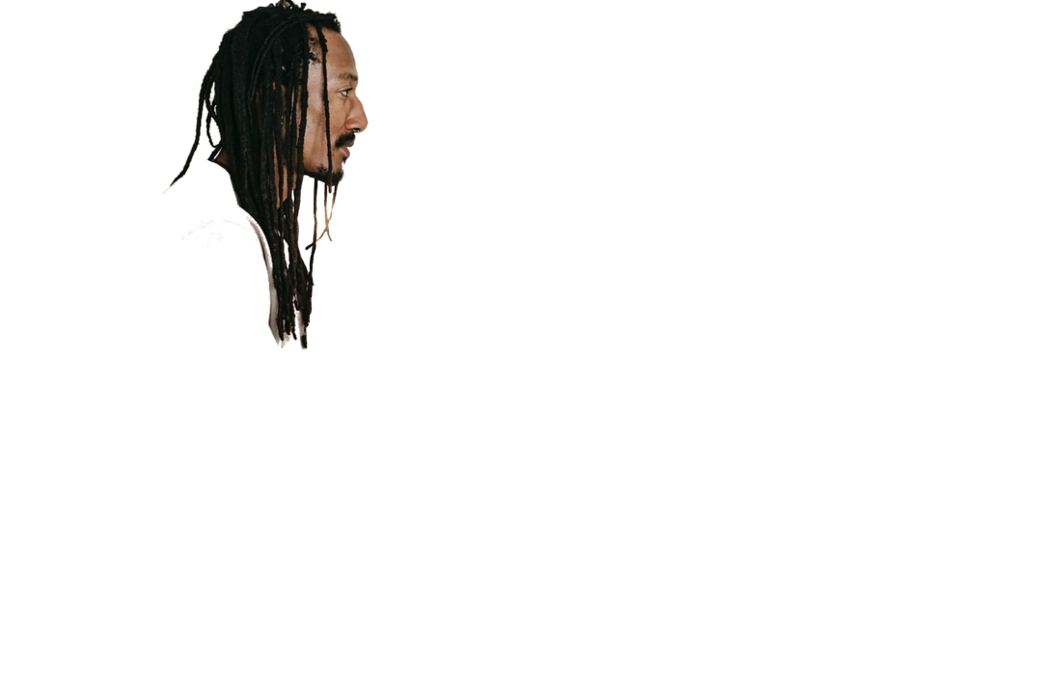
P
Persuading Someone
to Stay Alive
Listen to the problem and give them your full attention.
Remember, suicide is not the problem, only the solution to a perceived insoluble problem.
Do not rush to judgment.
Offer hope in any form.
PERSUADE
Notes:
Active listening is a defined skill set. If people don’t know how to do this, training is available online and elsewhere. It is the most critical of skills to master to help people in distress.

Slide 21


Then, ASK:
“Will you go with me to get help?”
“Will you let me help you get help?”
“What can we do to keep you safe for now?”
Notes:
Please note; “Will you promise me not to kill yourself until we have found help?” is NOT a no-suicide contract historically used by health professionals. No-suicide contracts have been found to be ineffective in preventing suicide attempts and deaths by suicide. Friends, co-workers, and family members ask for and make promises to each other routinely to assure a behavioral commitment to some future action. For example, “Will you promise to go to church with me this weekend?” is not a contract to go church; it is an ask for a pledge of commitment to do something into the future. Contracts have specific duties and obligations specified in the language of the contract. Promises to do. Do we have research to support this postion? No. But we all have experiences with making and keeping promises.

Slide 22

R
REFER
Suicidal people often believe they cannot be helped, so you may have to do more.
Notes:
It is not always possible to get a referral to a professional. There are places in the world where a professional referral is simply not available, or the person will simply never go to a mental health or other professional. This is where you will have to be creative. In every culture, every village, every social system there are “go to” people who may be able to help someone in severe distress. Clergy can do wonders here, and they are much more available that mental health professionals.

Slide 23

Referral Options
    The best referral involves
    taking the person directly to someone who can help.
    The next best referral is getting
    a commitment from them to accept help, then making the arrangements to get that help.
    The third best referral is to give referral information and try to get a good faith commitment not to complete or attempt suicide.
⬇⬇⬇
⬇⬇
⬇
Notes:
It is not always possible to get a referral to a professional. There are places in the world where a professional referral is simply not available, or the person will simply never go to a mental health or other professional. This is where you will have to be creative. In every culture, every village, every social system there are “go to” people who may be able to help someone in severe distress. Clergy can do wonders here, and they are much more available that mental health professionals.

Slide 24
Any willingness to accept help at some time, even if in the future, is a good outcome.
Notes:
Encourage gatekeepers to step up and take charge if need be. They need to be encouraged to be bold. Lives are stake.

Slide 25
REMEMBER:
Since almost all efforts to persuade someone to live instead of attempt suicide will be met with agreement and relief, don’t hesitate to get involved or take the lead.
Notes:
Encourage gatekeepers to step up and take charge if need be. They need to be encouraged to be bold. Lives are stake.

Slide 26

Pro Tips for Effective QPR
Offer encouragement, such as:
  “I want you to live”
  “I’m on your side... We’ll get through this.”
Get others involved. Ask the person who else might help.
  Family. Friends. Brothers. Sisters. Pastors. Priest. Rabbi. Bishop. Physician.

Slide 27

More Pro Tips
Join a team. Offer to work with clergy, therapists, psychiatrists or whomever is going to provide the counseling or treatment.
Follow up with a visit, a phone call or a card, and in whatever way feels comfortable to you.
Let the person know you care about what happens to them. Caring may save a life.
Notes:
Again, sometimes counseling and treatment may not be available. In which case, the gatekeeper must improvise!

Slide 28

REMEMBER
When you apply QPR, you plant the seeds of hope.
Hope helps prevent suicide.
Notes:
We’re done here. Ask for questions. Be the last one to leave the room.

