Slide 1
Family-School-Community Partnerships
Norwood
January 22, 2021
Darcy Hutchins, Ph.D.
Director | Family, School and Community Partnerships

Slide 2

What is Family-School-Community Partnering?
Linked to Learning
Intentional
Inclusive
Integrate and
Elevate
Proactive vs
Reactive
Sustainable
Realistically
Optimistic
Committed
Research-Based
Measurable
Beyond Random Acts
Context vs Content Expertise
Notes:
This slide represents the current trends in FSCP research and practice. This is not an exhaustive list.

Slide 3
Student, Staff, and Family Outcomes
Student Outcomes
Increased attendance and higher reading comprehension.
Improved homework completion and enjoyment.
Staff Outcomes
Increased respect for families’ strength and efforts.
Greater readiness to involve all families in new ways.
Family Outcomes
Increased awareness of student progress and how to help students do better.
Increased feeling of ownership of school.

Slide 4


CONTINUUM OF IMPACT
Parent training events
Goal-setting talks
Celebrations
Family help on administrative tasks
Relationship building
Regular, personalized communication
Fundraisers
Parent resource rooms
Back to school night
Academic partnering
Family support services
Interactive homework
Positive phone calls home
Home visits
Potlucks
Ongoing communications
Performances & showcases
Generic school newsletters
Data sharing
Modeling of learning support strategies
Notes:
5 minutes
There are no “right answers,” but here is how we look at these strategies in terms of impact on student success.
The family engagement activities that schools often engage in are school-wide, not learning-focused, and require families to come to the school.
“Numbers of participants” is what gets recognized – rather than the increase in a parent’s ability to play the five roles.
If families are being asked repeatedly to come to school but are not getting anything that will help them with what they most care about – educating their individual child, then schools often see the undesired effect of families choosing NOT to attend school events because they feel like their time is wasted.
Ask: What similarities do you notice between the schoolwide impact strategies? What do you notice about the activities on the higher impact side of the chart? What do they have in common? So what can we infer about high impact family engagement?
Emphasize: (Prompt if they don’t say: 1) teacher-led; 2) learning-focused; 3) individualized; 4) they either build relationships or support academic partnering; 5) most of them don’t require the family to come to the school

Slide 5
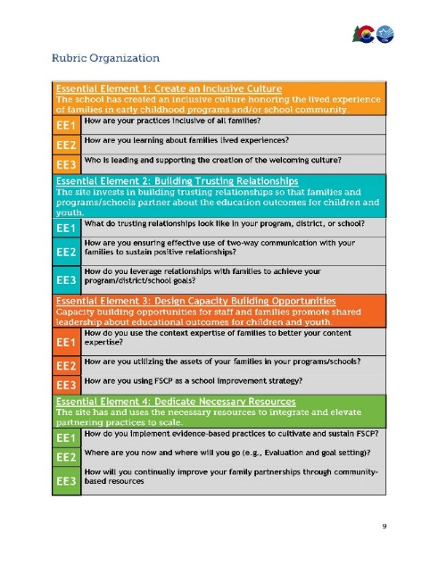
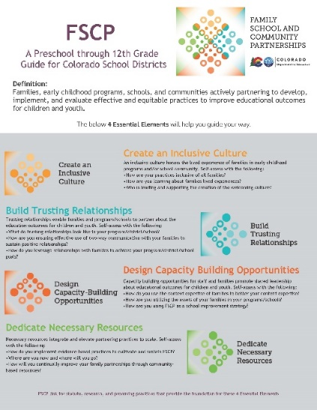


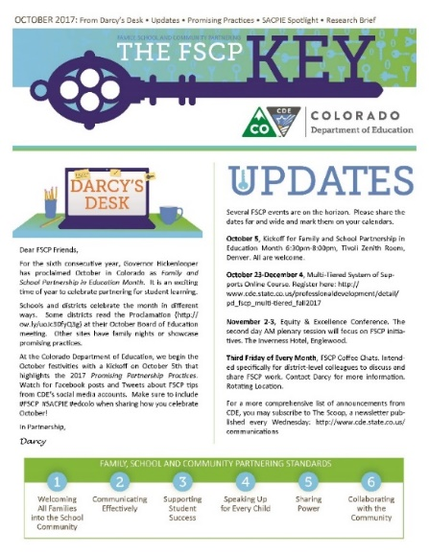




Available Colorado Resources

Slide 6
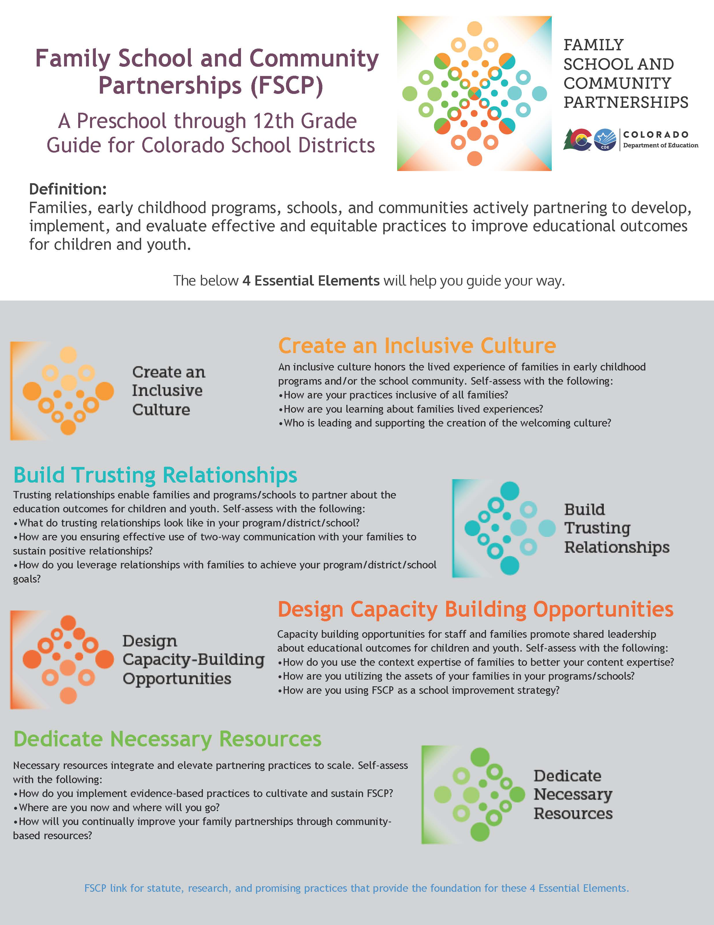
CO FSCP Framework for Districts and Schools
Definition
Families, early childhood programs, schools, and communities actively partnering to develop, implement, and evaluate effective and equitable practices to improve educational outcomes for children and youth.

