Slide 1


Churchville-Chili CSD
Capital Project Update
Board Of Education Meeting
June 25, 2024

Slide 2
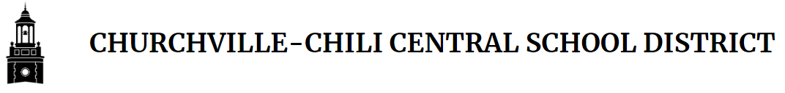
Current Capital Projects
Capital Improvement Project Phase 6-2
  MS Renovations, Turf Baseball & Softball, Tennis Courts, Buffalo Road Entry, Transportation Bus Parking Lot, MS Bus Loop
2023/2024 Capital Outlay CES Floors
  Staff Lounge, Classrooms 301, 303, 306, 307, 307A, & Office 309A

Slide 3
Phase VI Project Budget
Phase VI Construction Project is approximately 33% complete
Construction Contingency Budget $ 3,369,829
Change Order Total (May 2024) $ 853,311
Remaining Construction Contingency $ 2,516,518
Project Team is following approximately $180,768 in potential issues pending approval:
Overall Phase VI Project Budget
INCIDENTAL BUDGET $ 11,332,254
CAPITALIZED INTEREST/DANSY $ 3,887,503
CONSTRUCTION CONTINGENCY $ 3,369,829
PHASE VI-1 PROJECT CONTRACTS $ 4,862,980
PHASE VI-2 PROJECT CONTRACTS $ 31,628,666

Slide 4
Capital Improvement Projects
Schedule Update
Capital Improvement Project Phase 6-2:
  Area D Classrooms (3524, 3522, 3520, 3518, 3516, 3514)
    Complete installation of new windowsills
    Complete flooring installation
    Complete install of new appliances (washer, dryer, stove, refrigerator)
    Complete final cleaning
  Site
    Complete softball field flat drain install
    Begin softball field concrete curb install
    Complete setting of tennis court fence posts
    Continue HS entry/exit way work

Slide 5
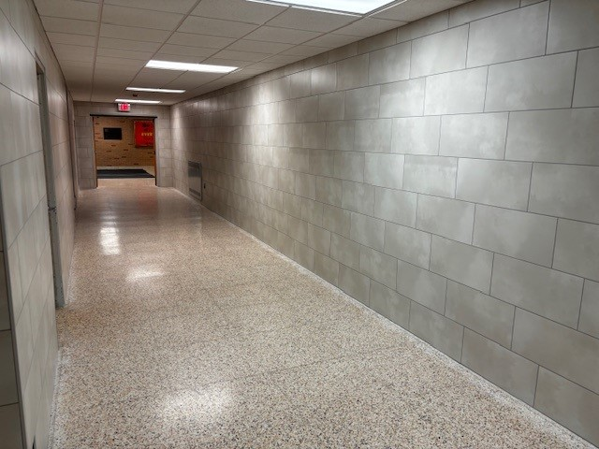
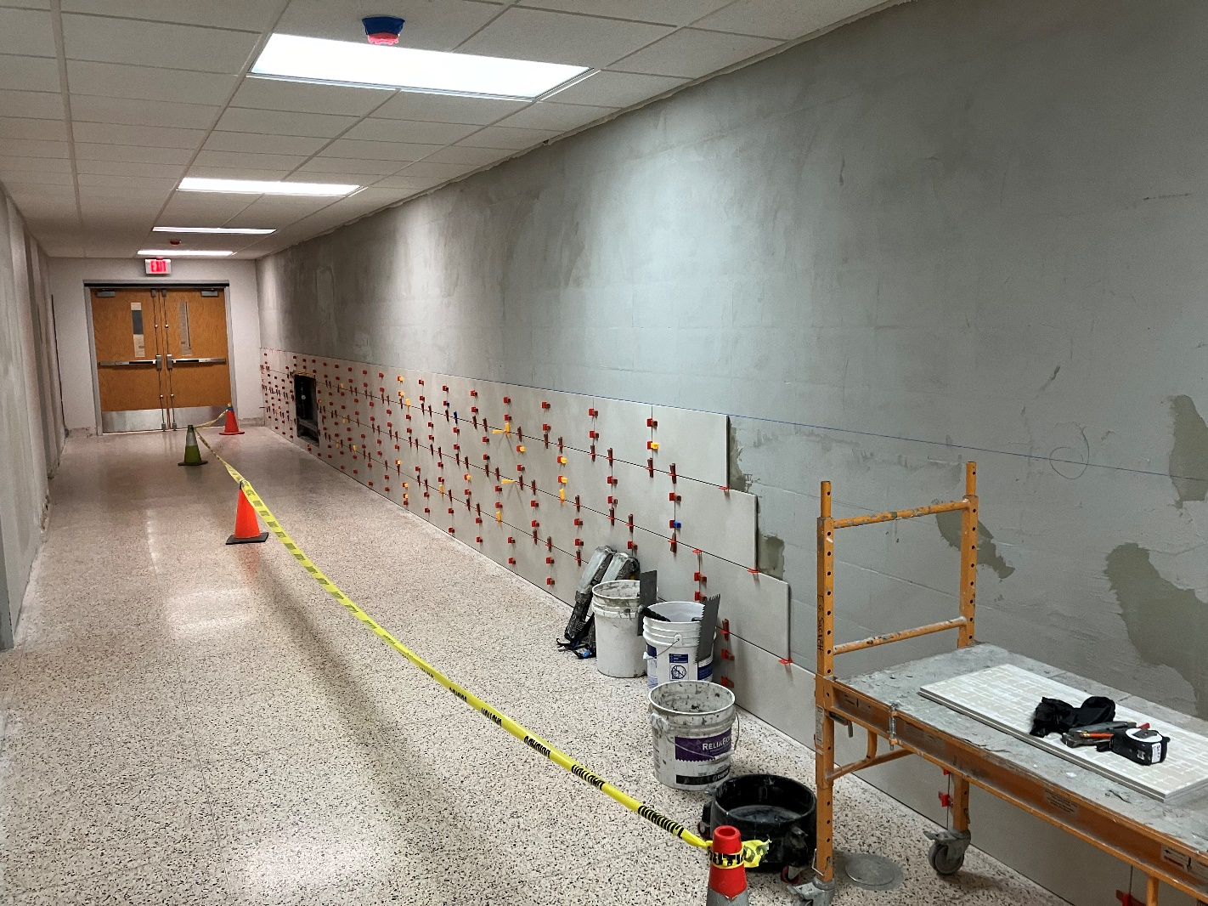
Corridor 3800 Wall Tile
Corridor 3800 Wall Tile

Slide 6
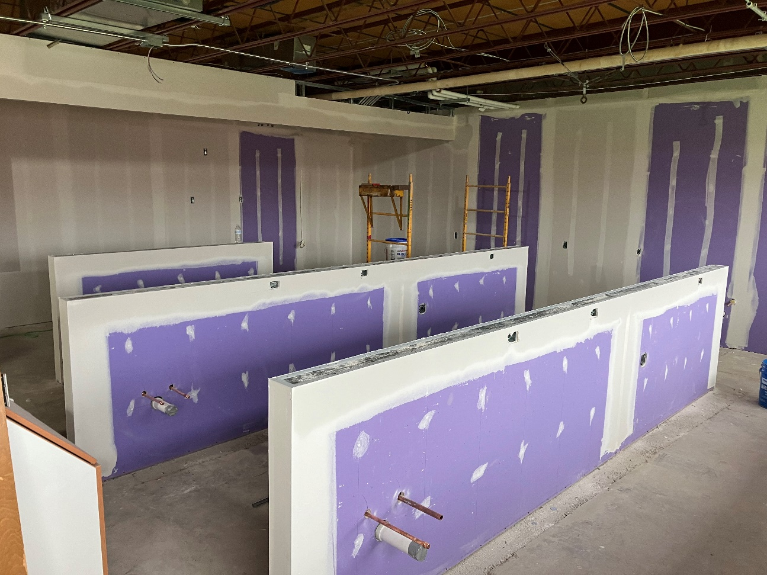
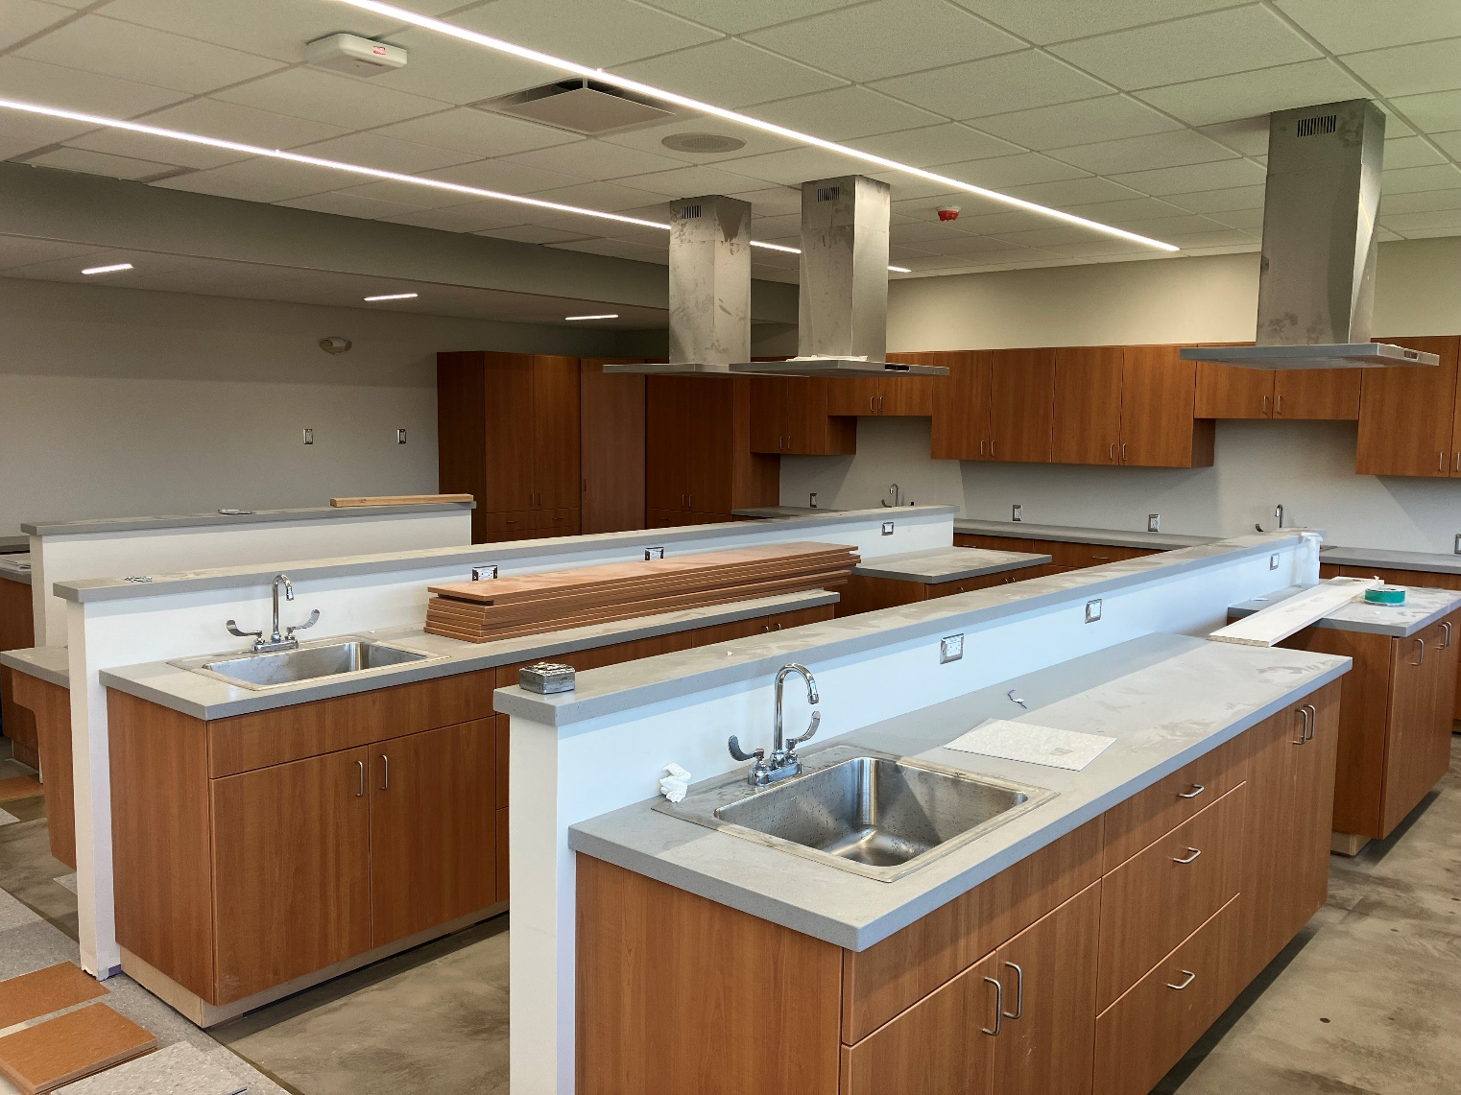
FACS Room Drywall
FACS Room Millwork, Sinks, & Hoods

Slide 7
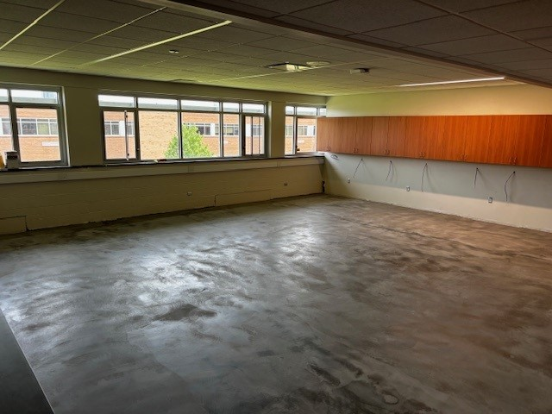
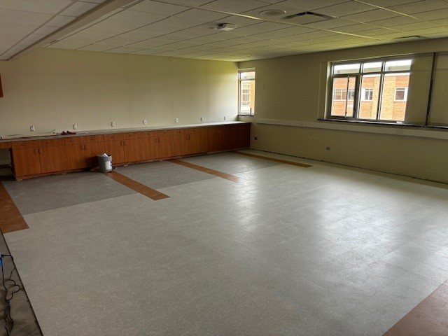
Area D Classroom Floor Prep
Area D Classroom Flooring

Slide 8
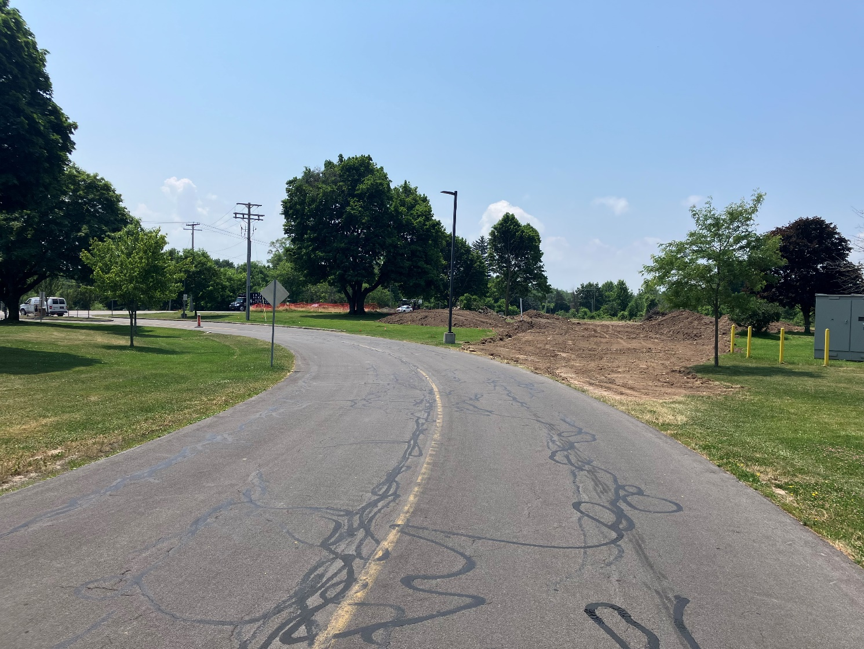
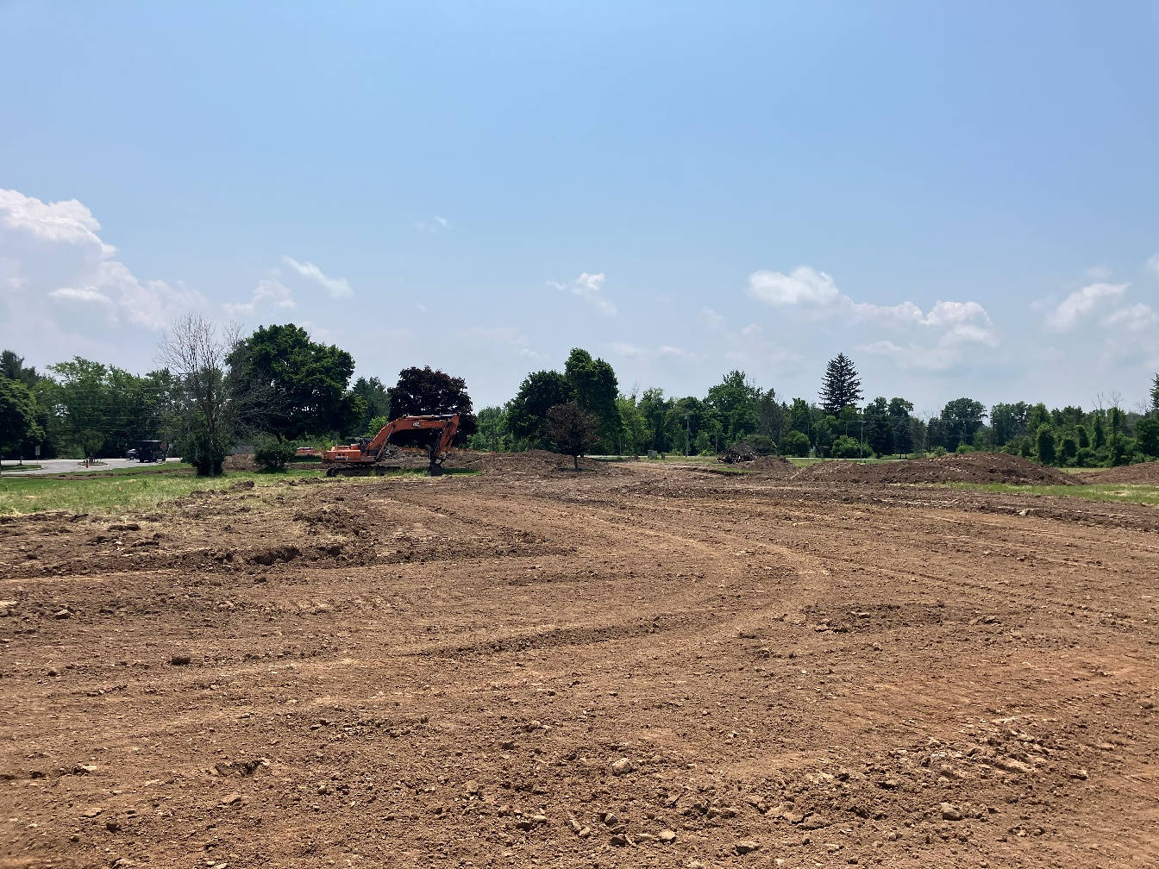
HS New Entry/Exit Topsoil Removal
HS New Entry/Exit Topsoil Removal

Slide 9
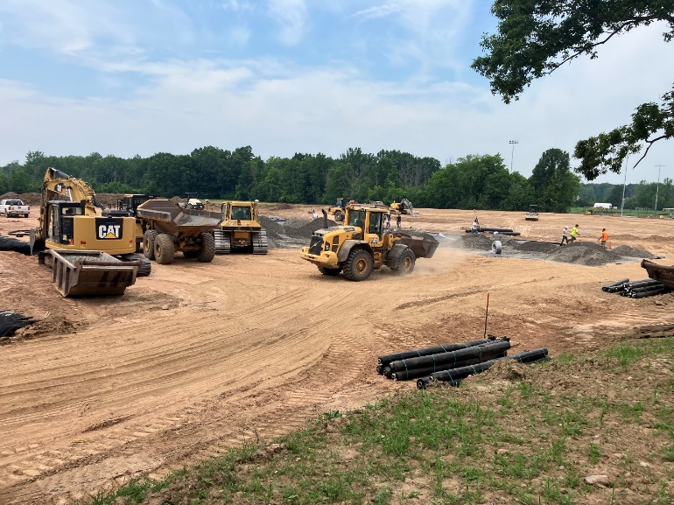
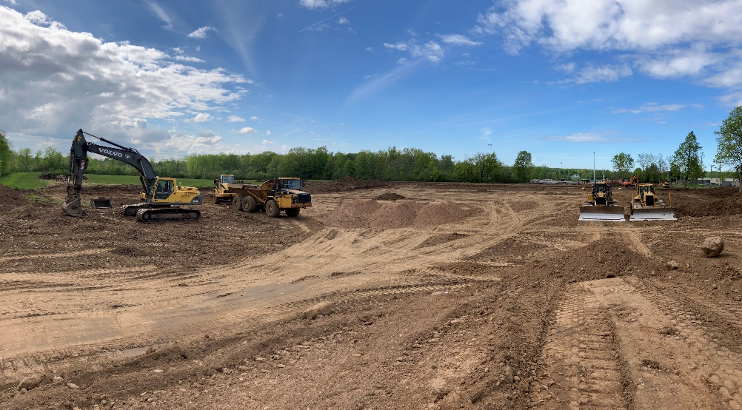
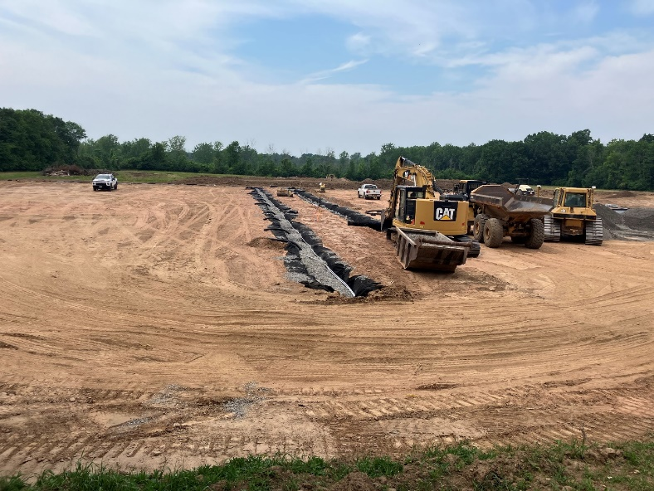
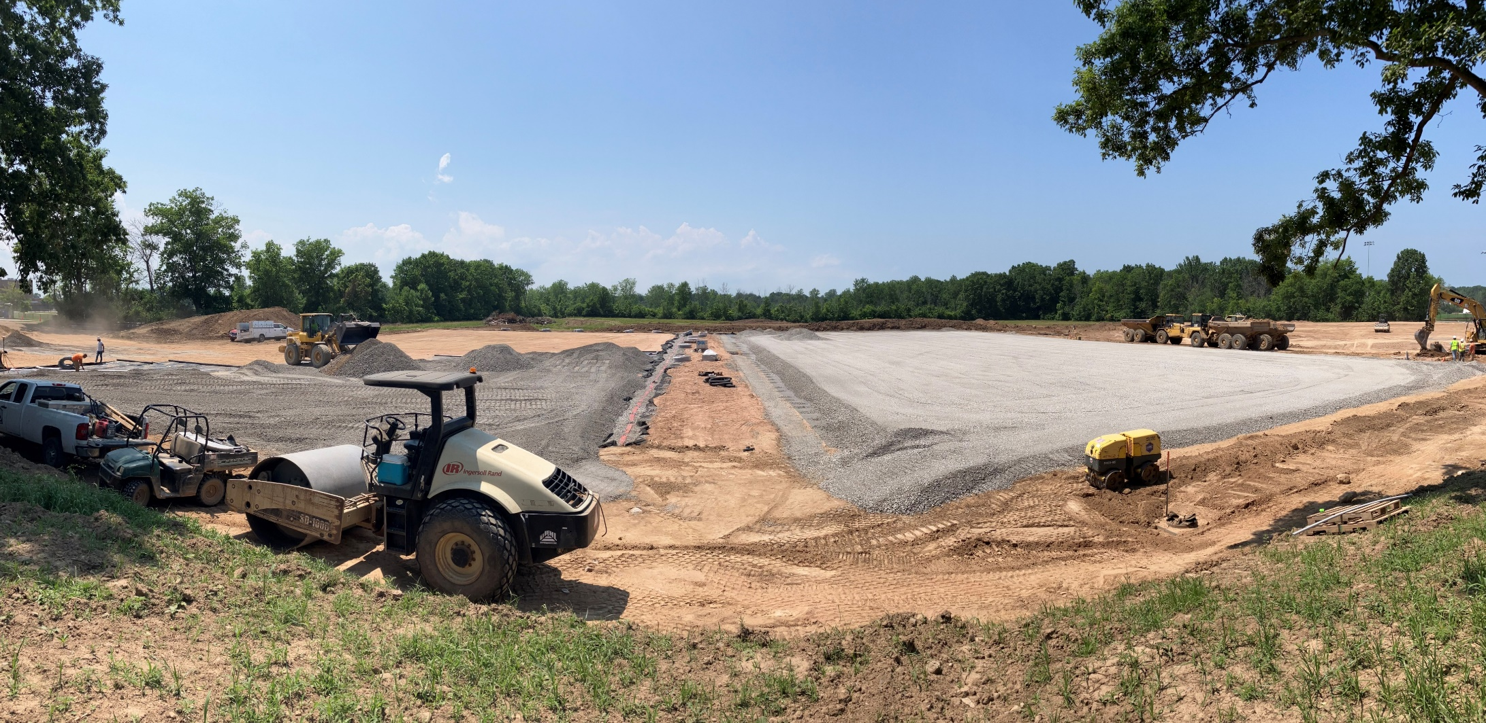
Tennis Court Area
Underground Electric
Tennis Court Stone
Tennis Court Grading
Tennis Court Stone Subbase

Slide 10
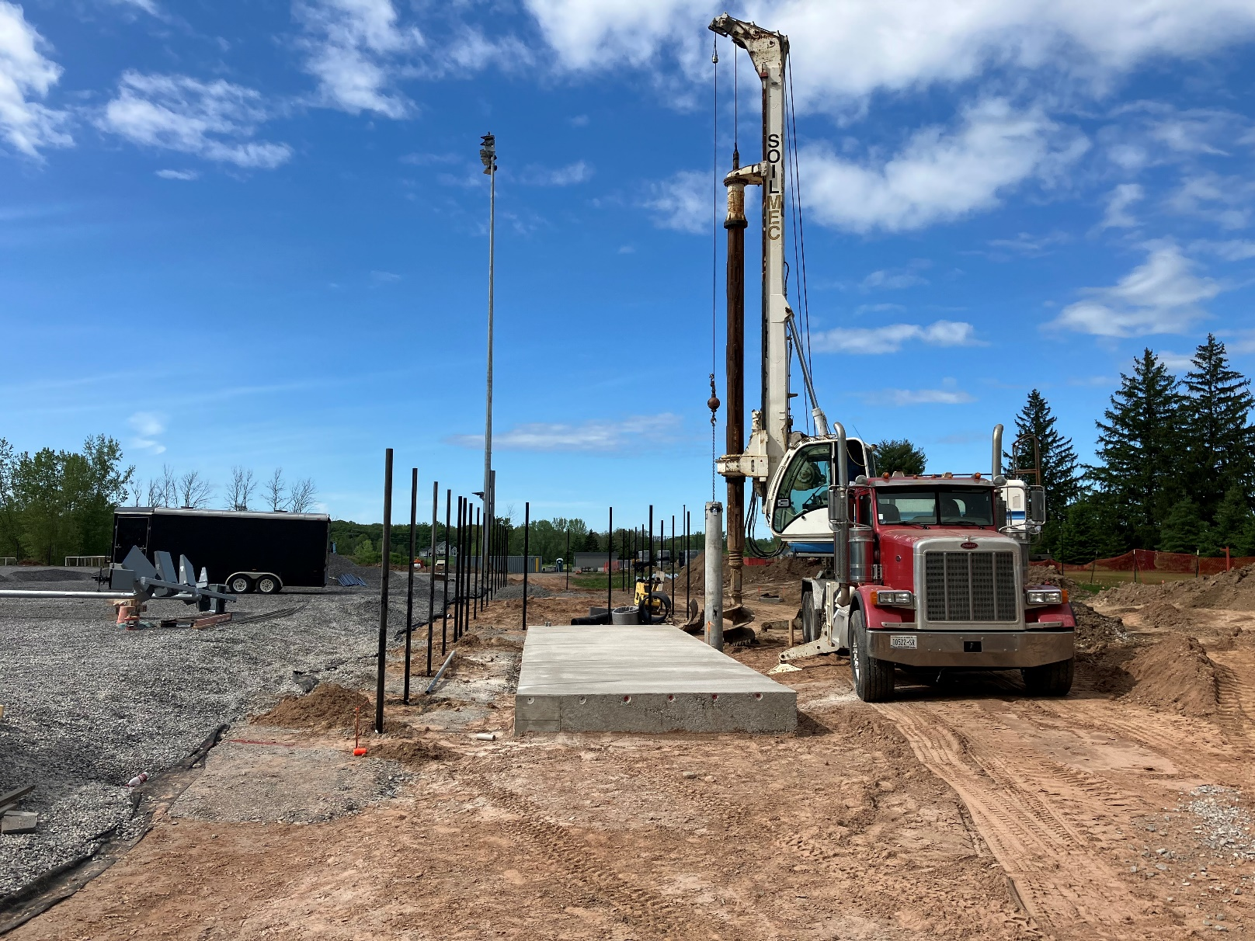
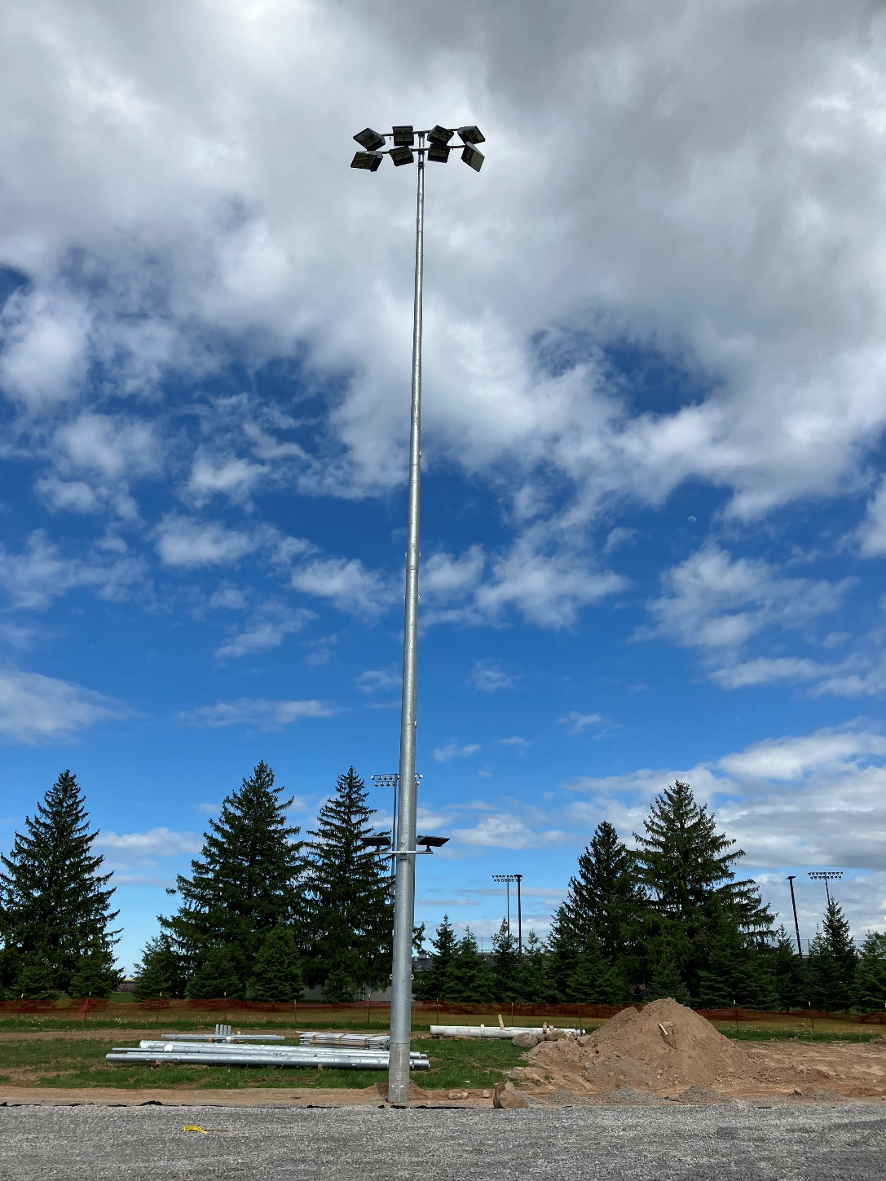
Baseball Field Athletic Lighting Drilling
Baseball Field Athletic Lighting

Slide 11
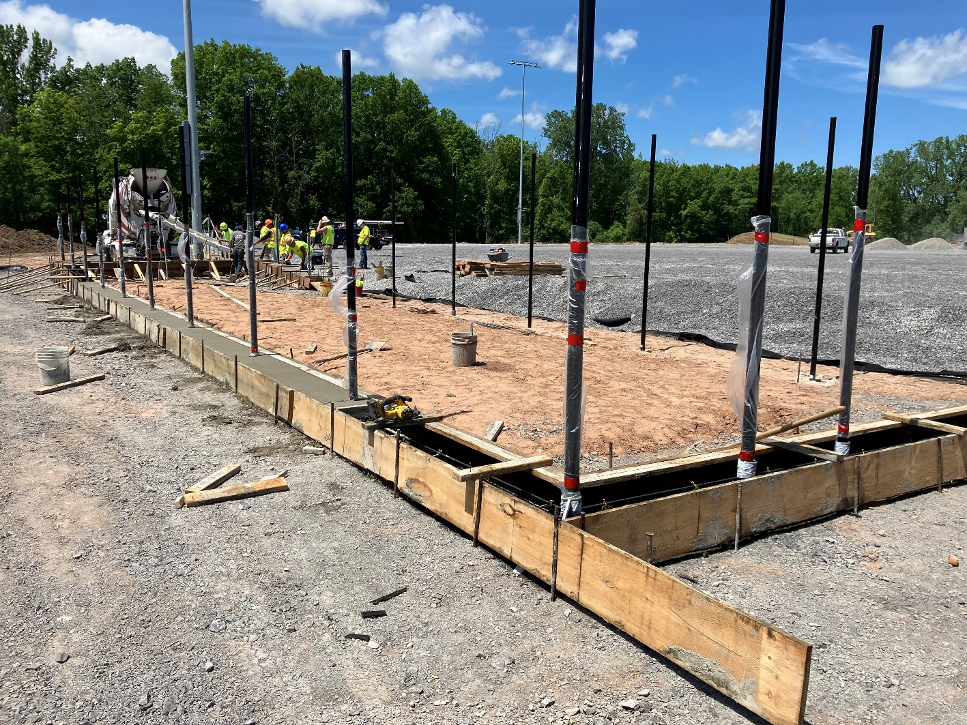
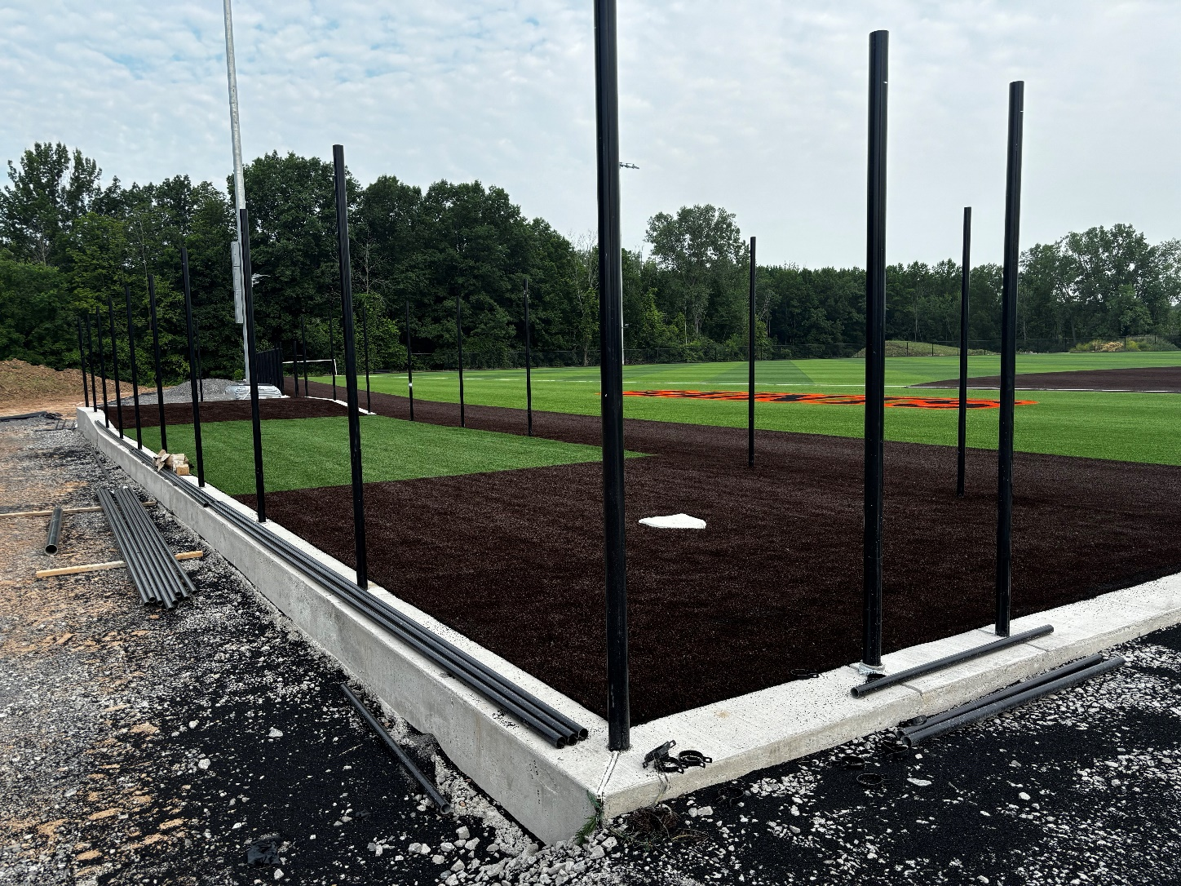
Baseball Field Bullpen Foundation
Baseball Field Bullpen

Slide 12
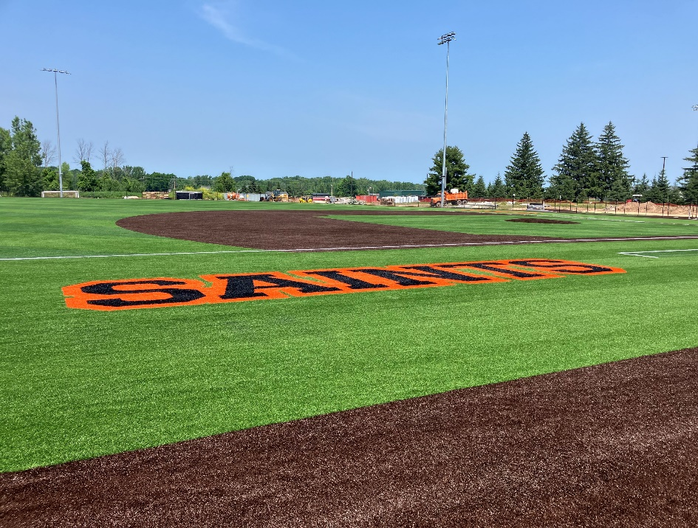
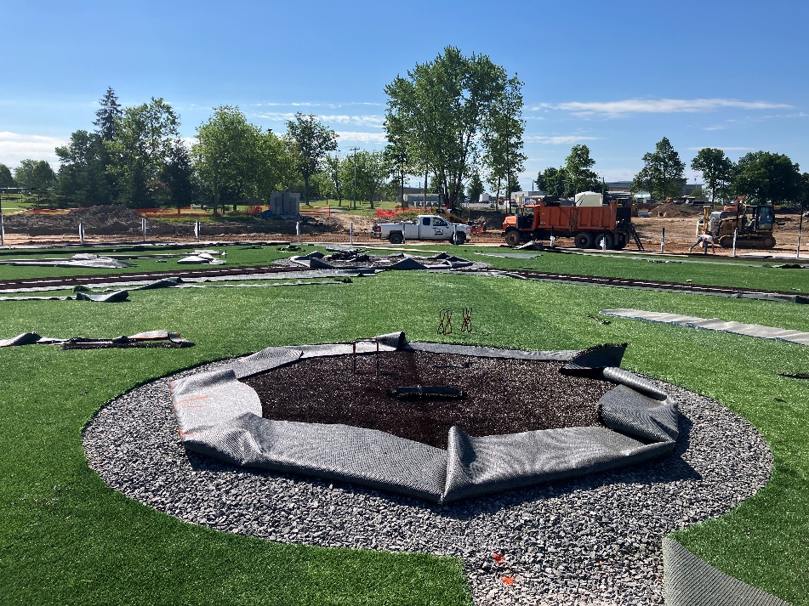
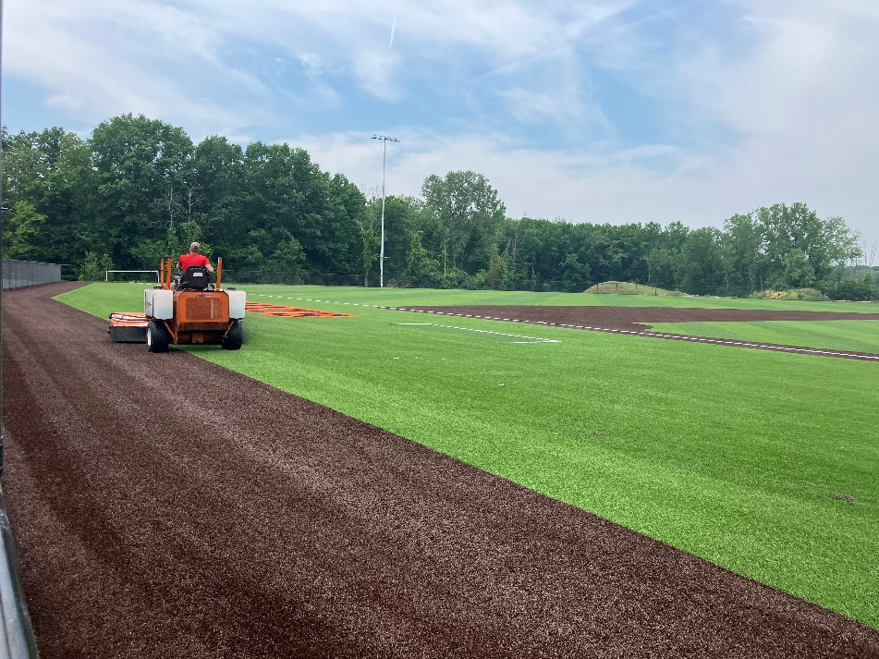
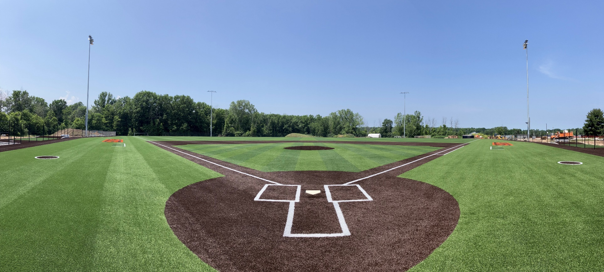
Baseball Field Decals
Baseball Field Pitching Mound
Baseball Field Infill Grooming
Baseball Field Turf

Slide 13
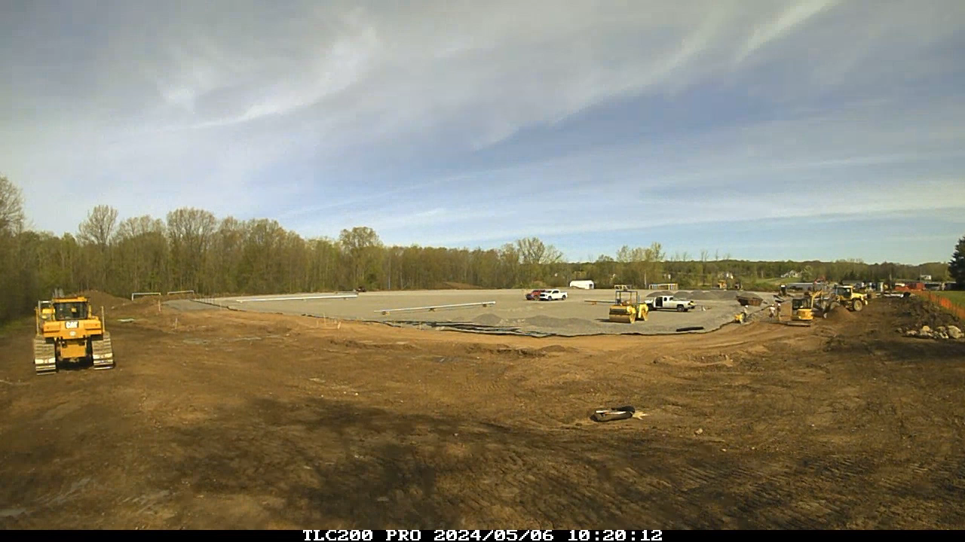

Slide 14
QUESTIONS

