Slide 1


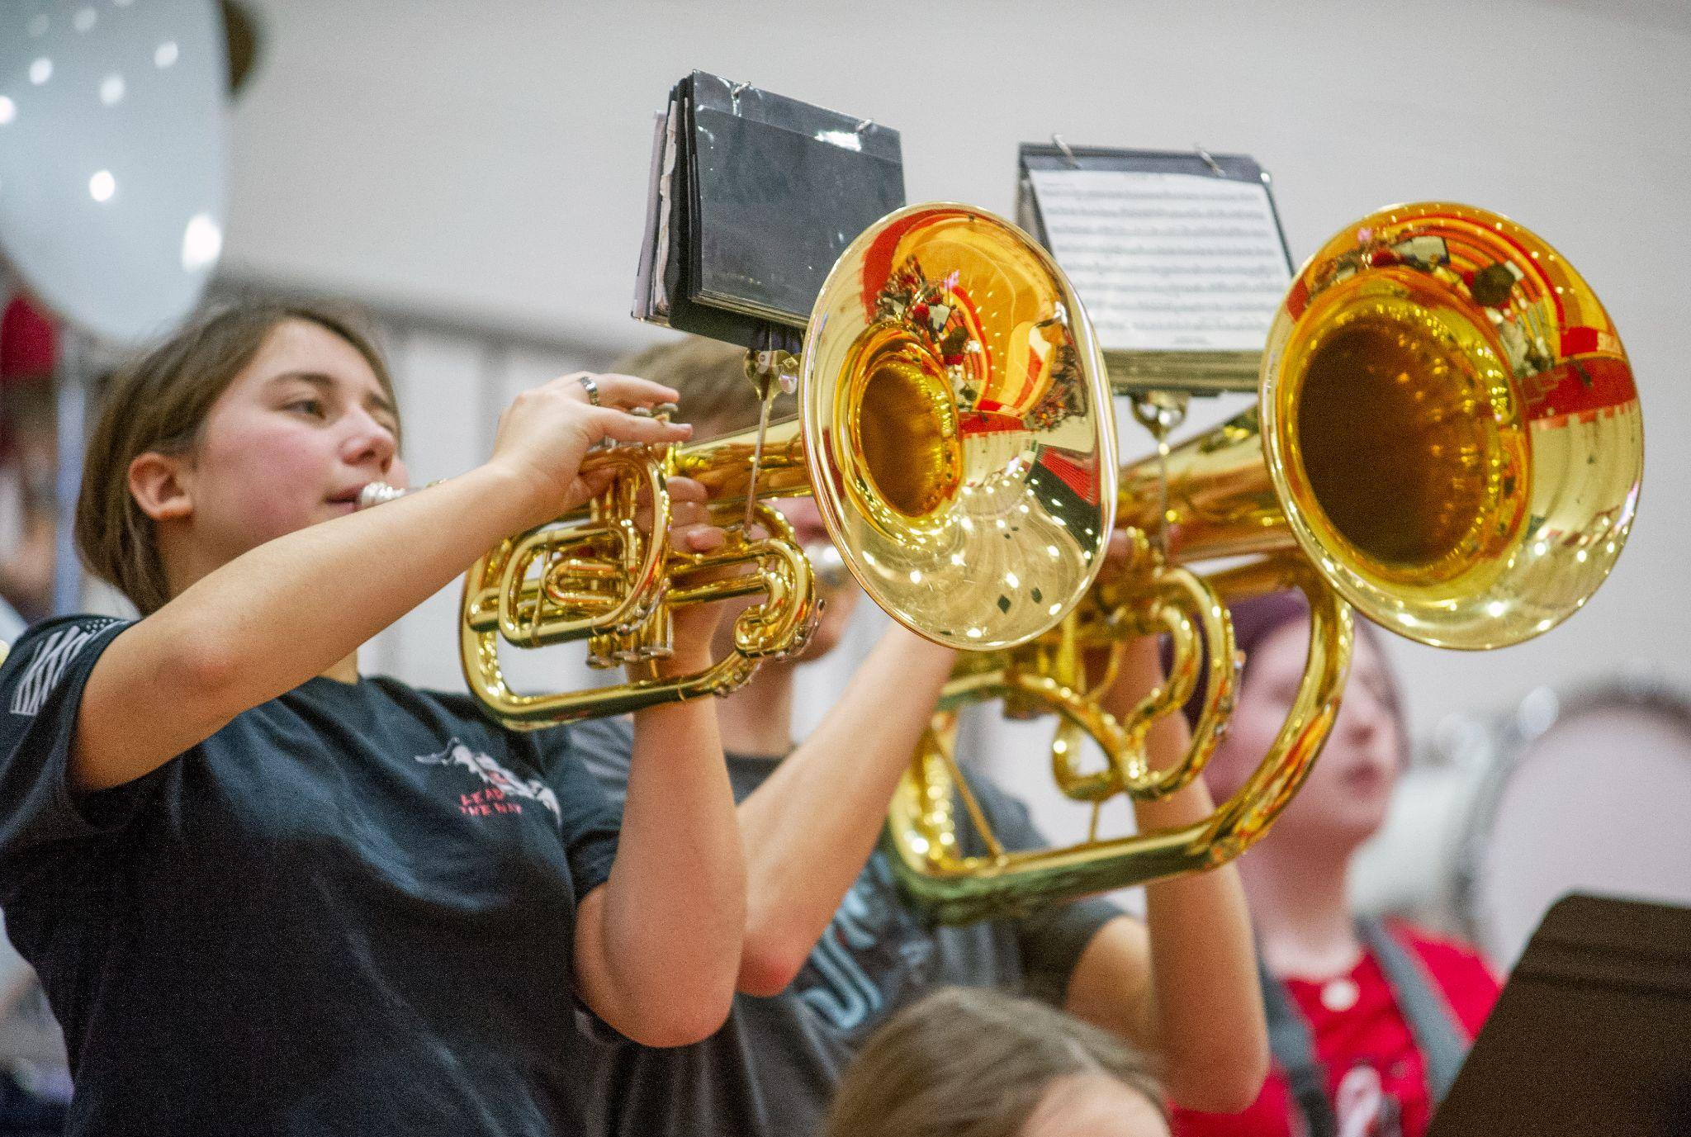

Equity Update
May 16, 2023
Dr. Ben Gauyan, Assistant Superintendent
Kelly Parsons, Asst. Director of Covid Recovery

Slide 2
Equity Update
OUR PROMISE
Every student in the Stanwood-Camano School District is empowered to learn in an inclusive setting and is prepared for the future of their choice.

Slide 3

Educational Equity
We as a district will place equity at the center of all decision making and planning, ensuring that all students and staff have a voice and the resources they need to thrive academically, socially and emotionally in our schools.

Slide 4
Educational Equity
We as a district will place equity at the center of all decision making and planning, ensuring that all students and staff have a voice and the resources they need to thrive academically, socially and emotionally in our schools.

Slide 5
Equity Update
Representation in hiring
School Equity plans for 23-24
Kindergarten Fair
Equity Symposium

Slide 6
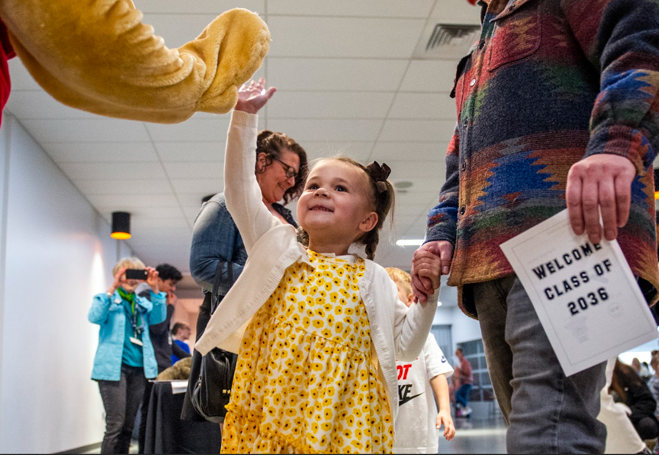

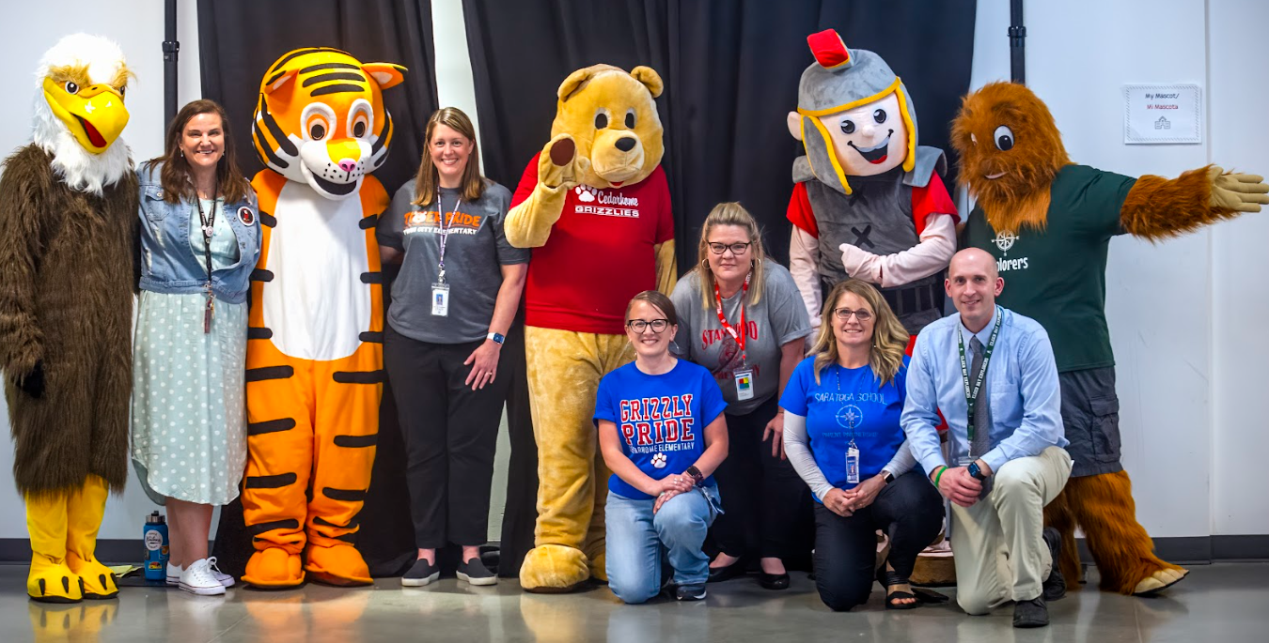

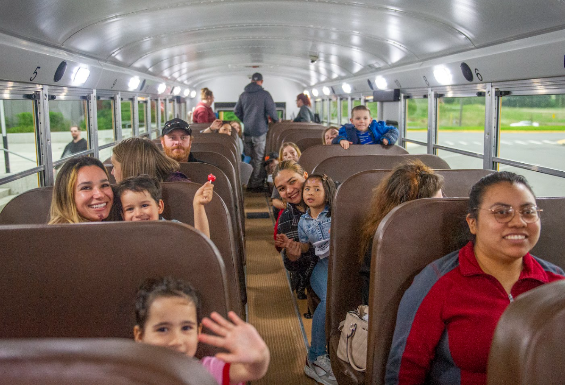

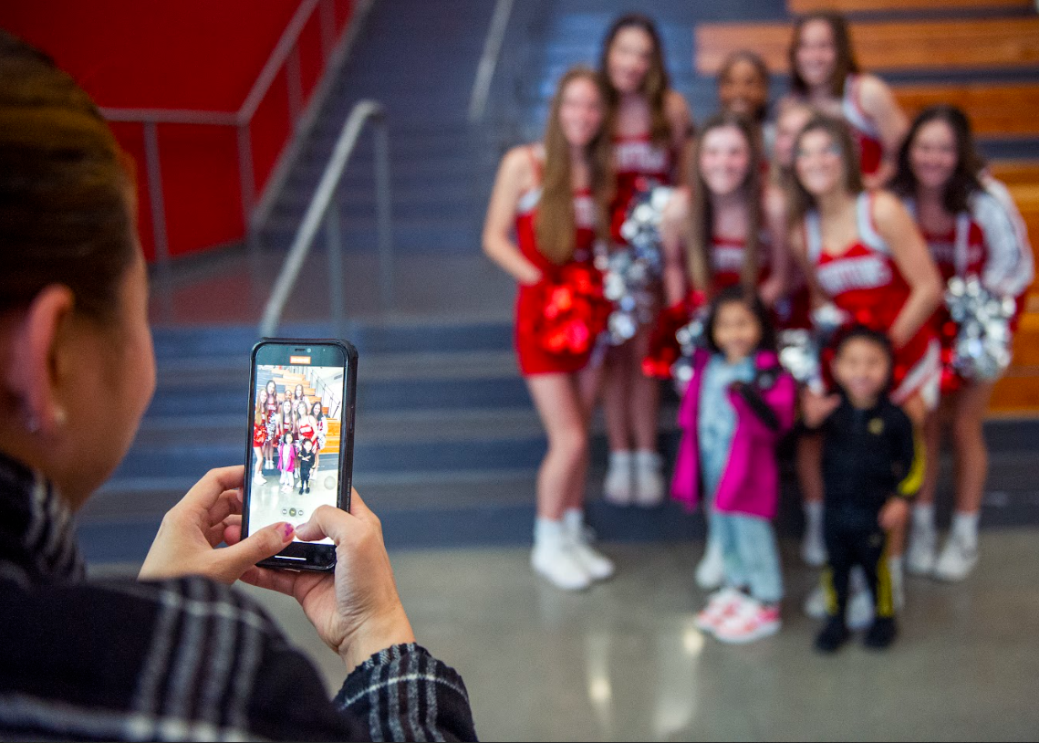
Kindergarten Fair

Slide 7
Kindergarten Fair
Quick facts:
131 passports passed out
25+ high school volunteers
Who was there:
  Sno-Isle library
  SRC
  YMCA
  Transportation
  Nutrition Services
  Health Services
  Registration
  Principals
  Face painting

Slide 8
Making it better:
Yearly commitment for spring 2024
Gathering feedback
Running announcements during the event
Getting on the calendar sooner than later

Slide 9

Feedback
The aspects of the Kindergarten Fair that I found most supportive was welcoming the families and children so everyone felt welcome.
Safety was spoken to our kids who have never been in a bus
The mascots. They were lively and full of energy. Meeting the principals and any staff able to talk to parents and future students.
The layout and the different booths to go to was nicely laid out
I thought that it was a great idea to give parents the opportunity to register their kids up for kindergarten on the spot because that gave them the chance to get any questions they had answered.

Slide 10
Vision of the Equity Symposium
What if an organization had an opportunity to learn from each other with a focus on equity?

Slide 11

5 “W’s” of the Equity Symposium

Slide 12
5 “W’s” of the Equity Symposium
Why: To continue living out policy 0100
Who: District staff
What: Sharing instructional practices and pedagogy for……
When: August 31, 2023
Where: Stanwood High School

Slide 13

March 29, 2023
De-escalation
ACES
Elevating Student Voice
Building Positive Relationships with Students
Effects of Social Emotional Learning on Language Acquisitions

Slide 14
Draft Agenda
Superintendent Welcome/Message
Self-selected presentation | Panel
Panel | Self-selected presentation
Building directed time

Slide 15
Possible presentations
SCSD’s Equity Story Through Data
Talking Circles
Funds Of Knowledge Of Students And Families
MLL Instructional Model
Importance And Why Inclusion
Building Relationships With Students And Families
Restorative Practices

Slide 16
What’s next
Request for Proposals
Planning for Logistics prior to August 31
Planning for similar experiences on October 20 and March 27

Slide 17
Questions?

