Slide 1

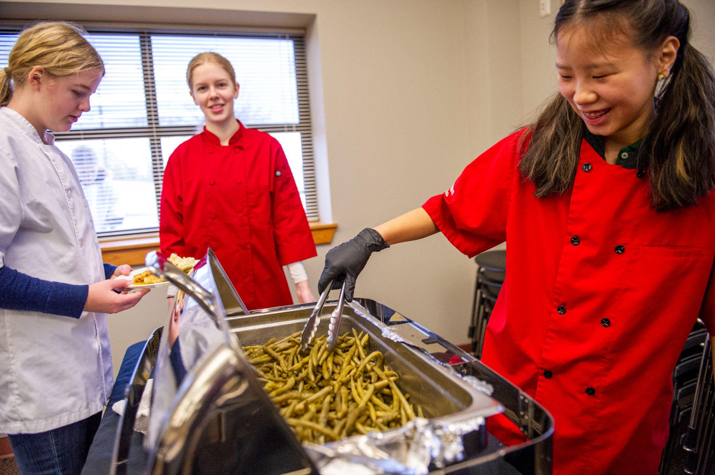
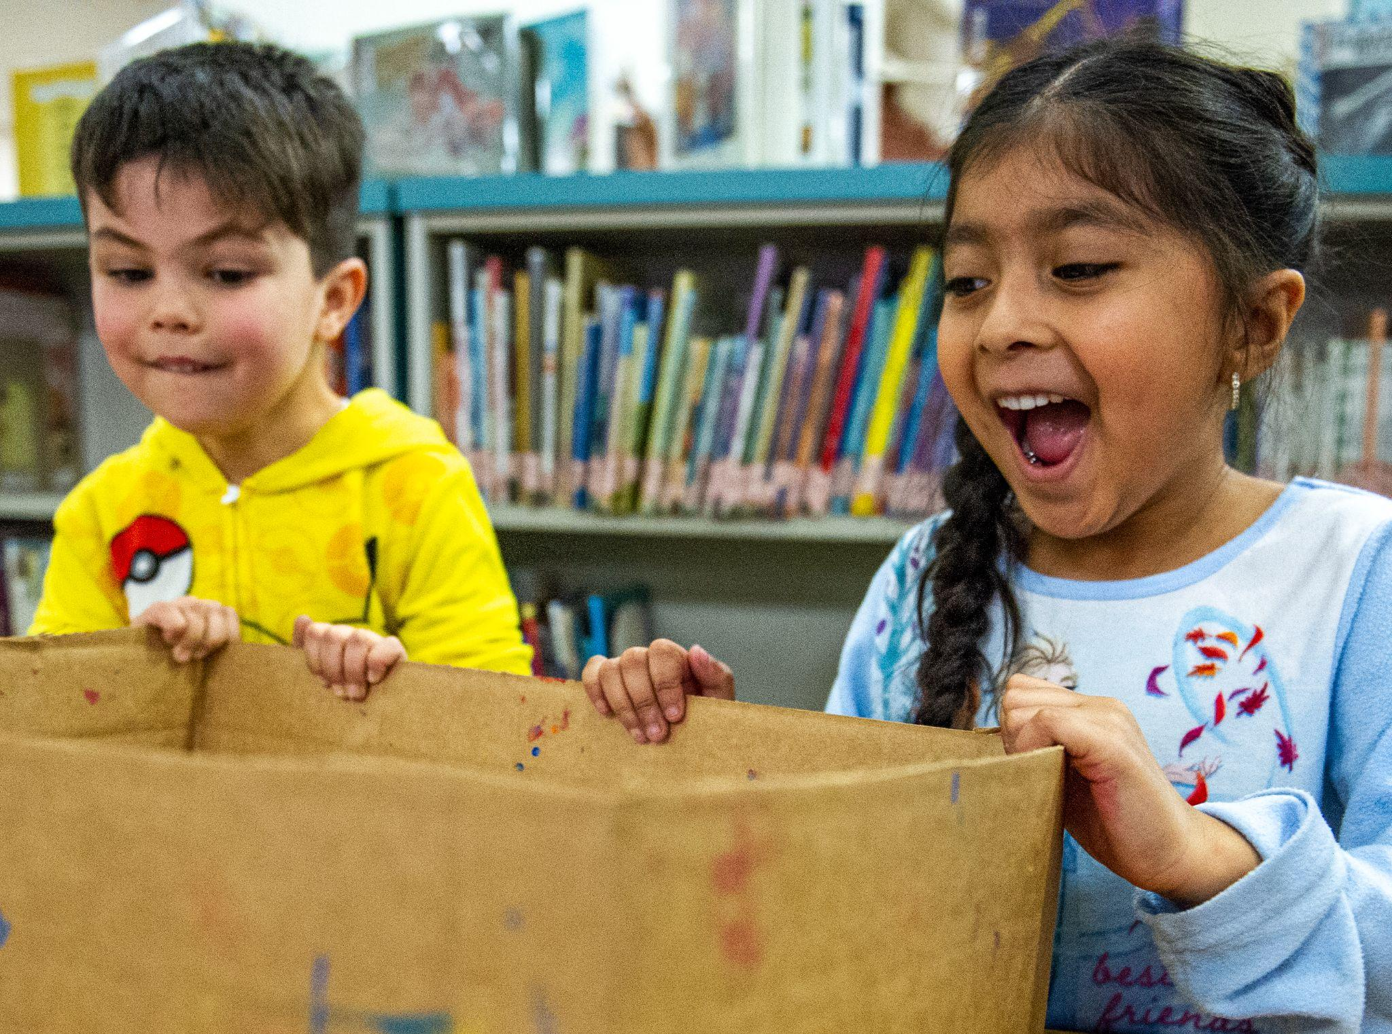

Utsalady Elementary Board Presentation
May 2023

Slide 2
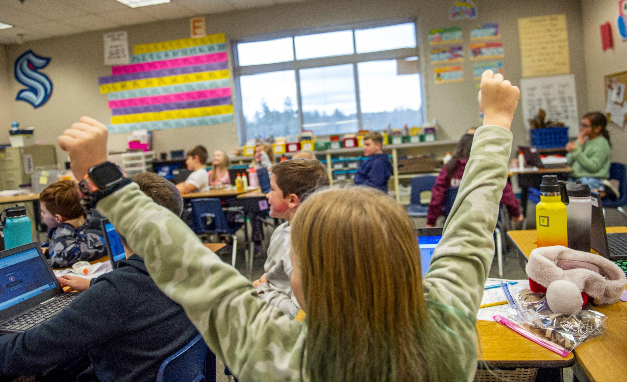

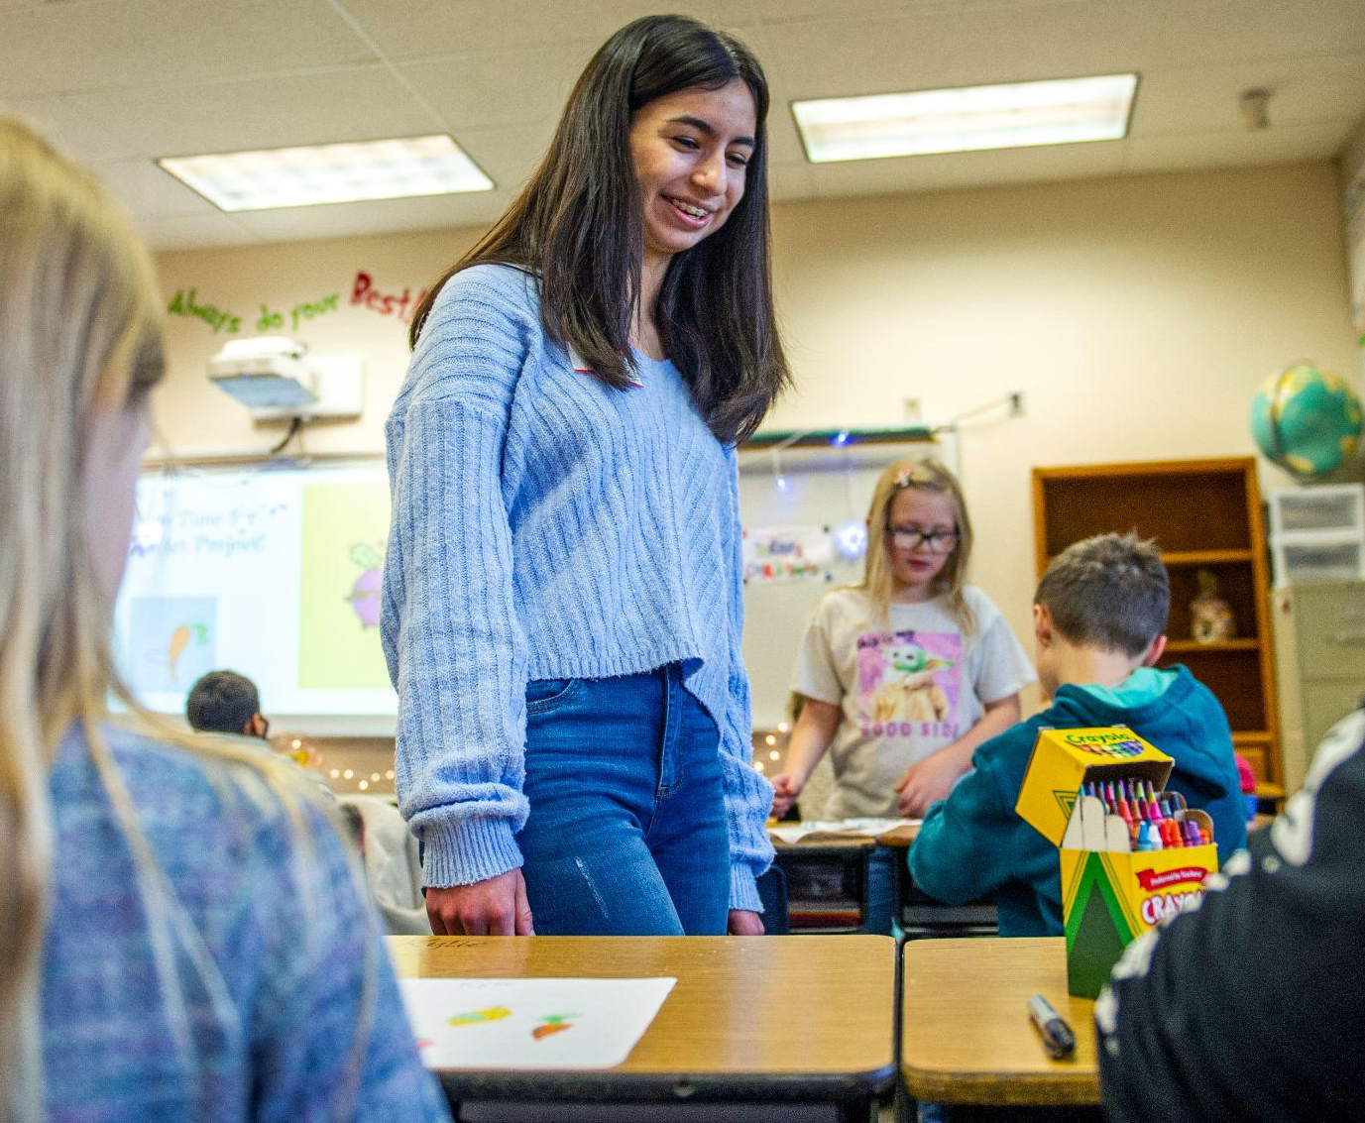
OUR PROMISE
Every student in the Stanwood-Camano School District is empowered to learn in an inclusive setting and is prepared for the future of their choice.

Slide 3
Our AAP Goals (Students will…)
Mathematics
Persevere in problem-solving to build stamina
Use math talk and number talks to develop confidence and flexibility with concepts
Understand number and operations in base ten and operations and algebraic thinking
English/Language Arts (ELA)
Improve reading foundational skills; improving phonemic awareness and closing gaps in phonics learning
Improve reading comprehension in order to read, write and discuss reading
Engage in complex writing tasks including:
using complex vocabulary, text features and appropriate conventions in writing

Slide 4
Our AAP Goals (Students will…)
Multi-Tiered Systems of Support (MTSS) Academic
Increase awareness of their own styles of learning and student differences
Know and identify their own personal strengths
Learn how to seek assistance in multiple settings
Multi-Tiered Systems of Support (MTSS) Behavior
Feel safe and valued in all settings
Participate in developing a positive classroom culture
Participate in inclusive environments

Slide 5
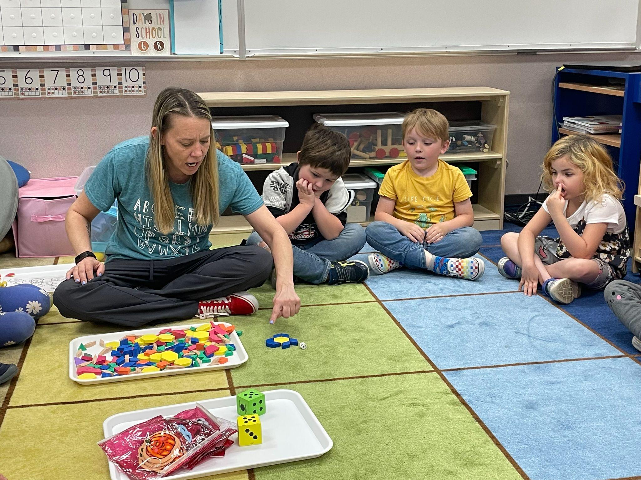
Progress Toward our Goals (Students have…)
Mathematics
Made sense of math tasks and
demonstrated perseverance in
solving them
Used discussion sentence stems
during number talks

Slide 6
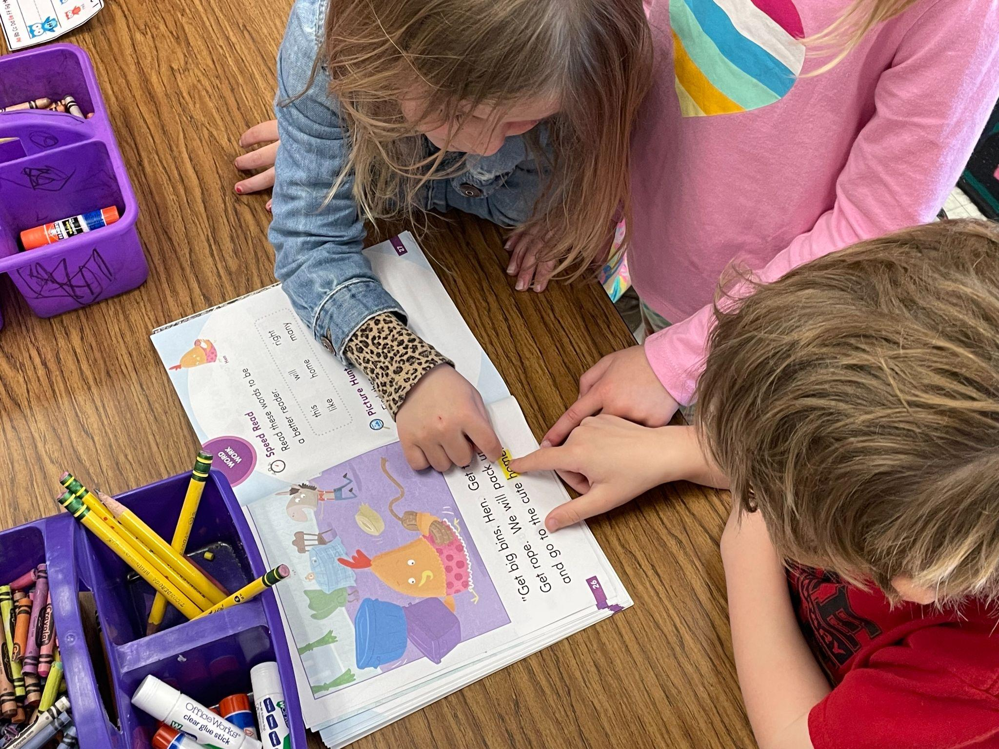
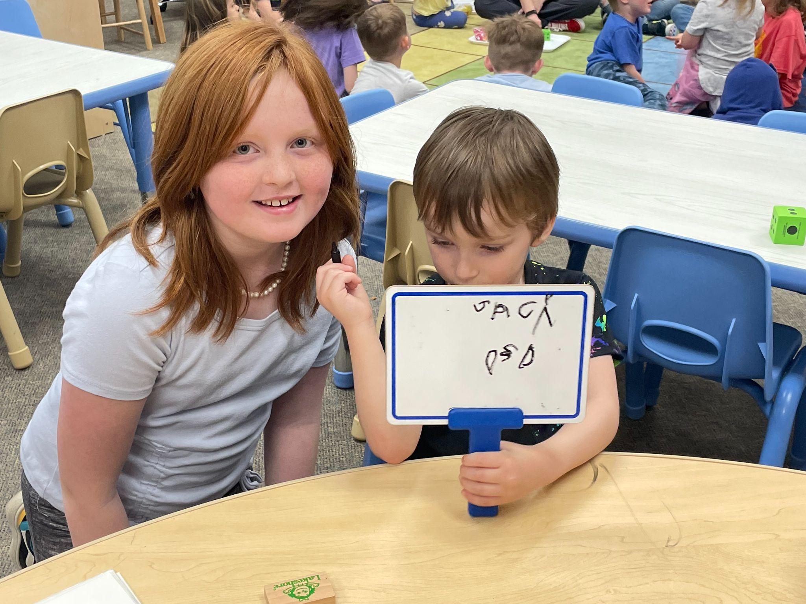
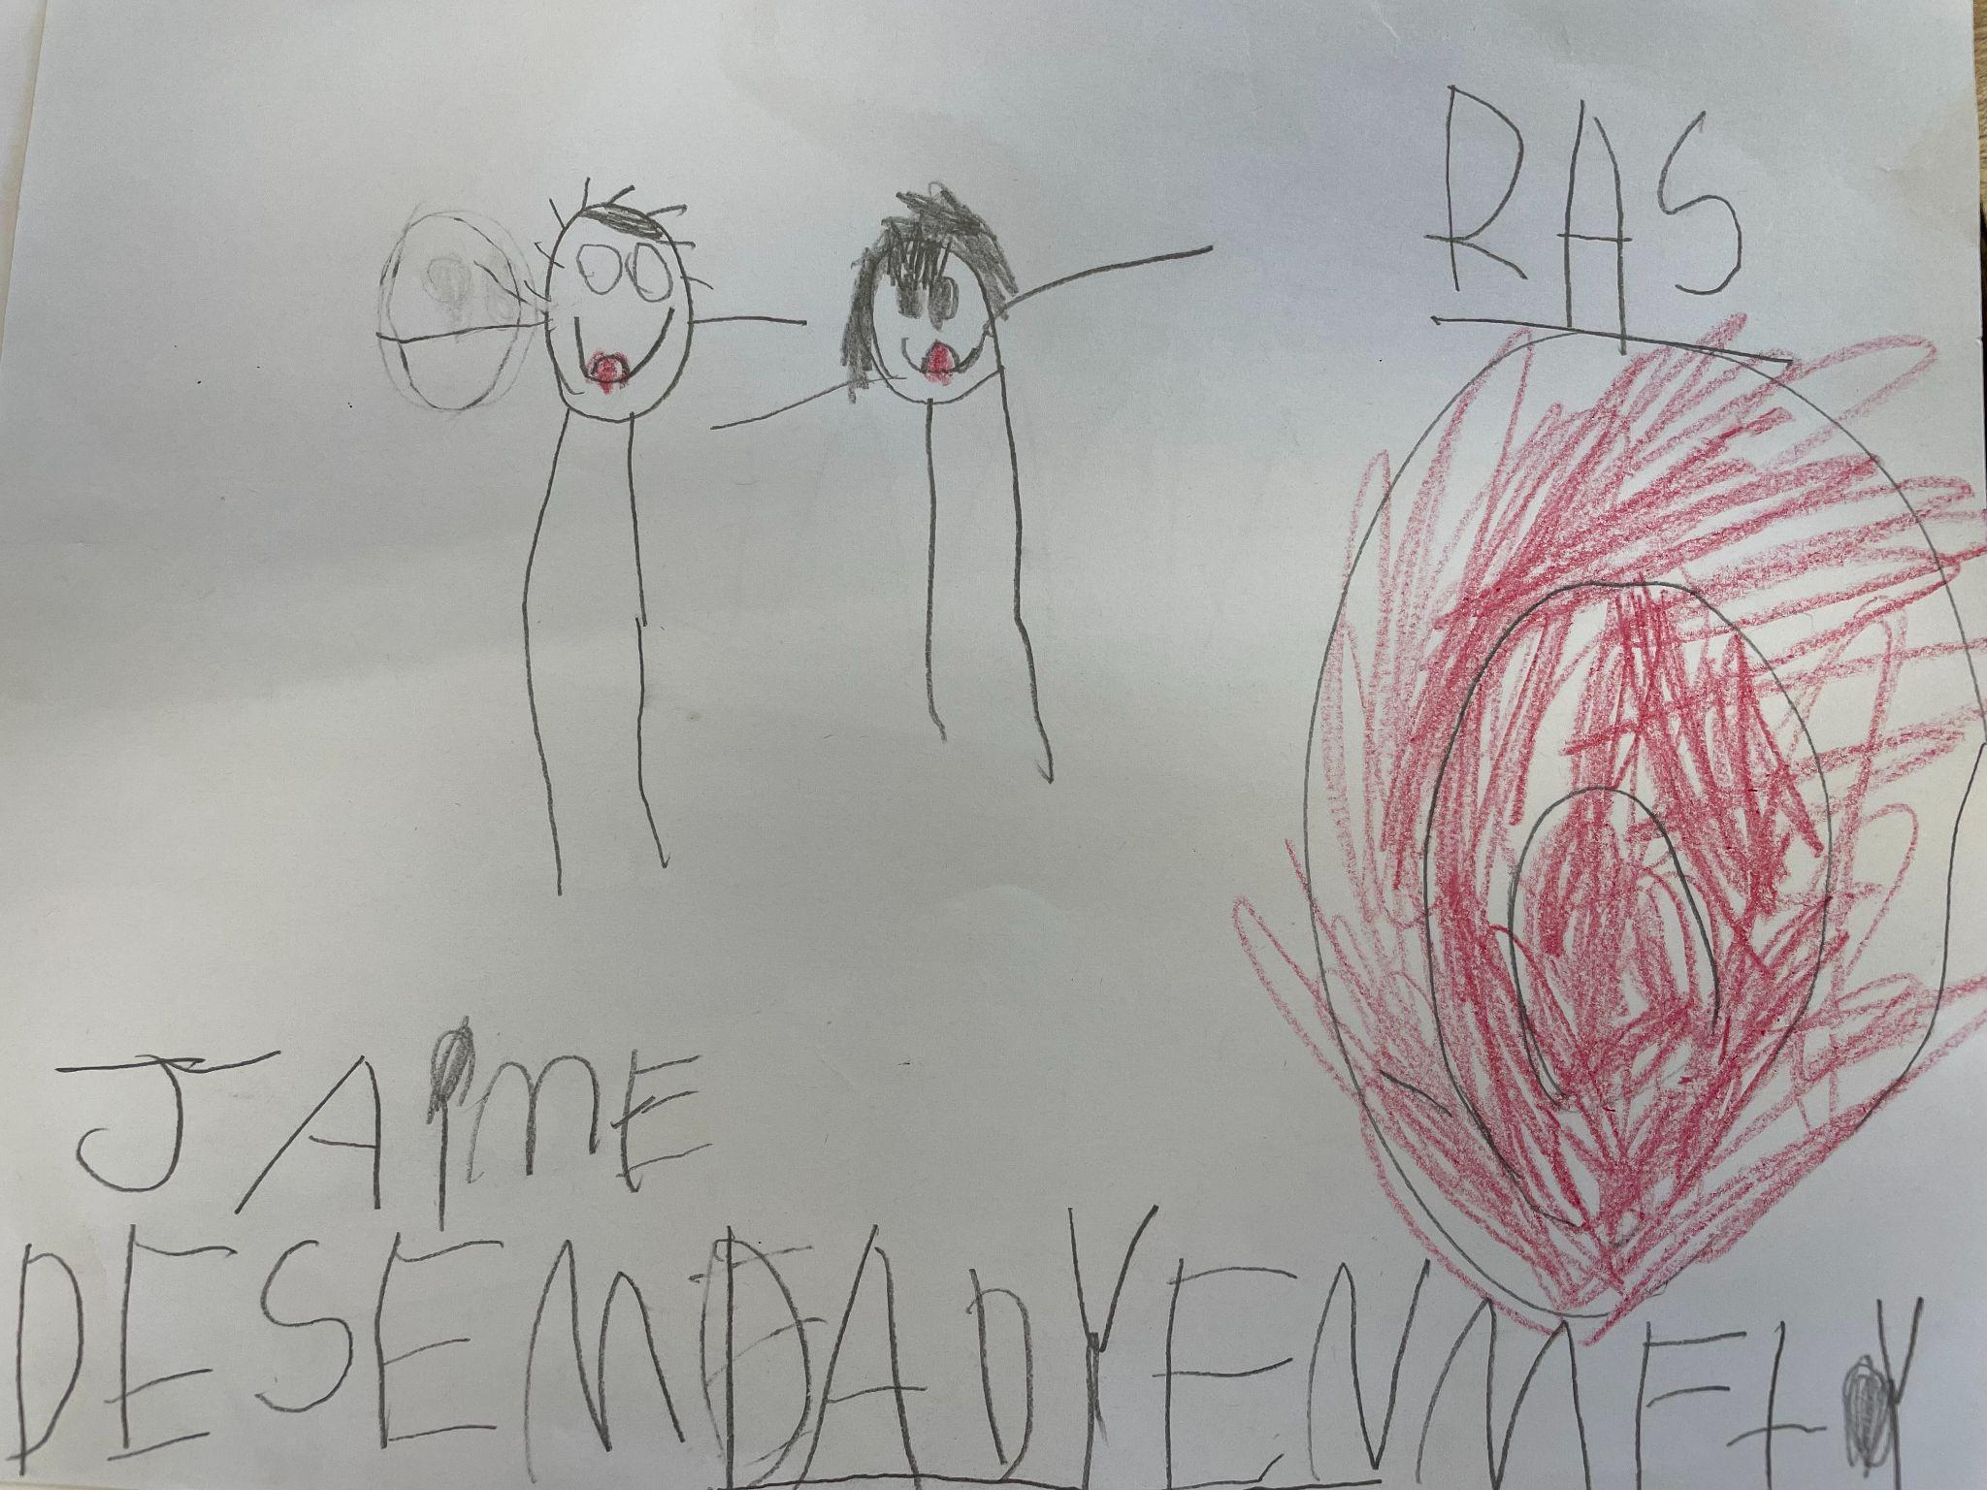
Progress Toward our Goals (Students have…)
English Language Arts (ELA)
Developed skills in:
foundational reading skills phonemic
awareness and closing gaps in phonics learning
reading comprehension
Developed skills in complex writing tasks including:
using complex vocabulary, text features and appropriate conventions in writing

Slide 7
Progress Toward our Goals (Students have…)
MTSS
Participated in inclusive environments
Set individual learning goals and
marked progress toward those goals

Slide 8
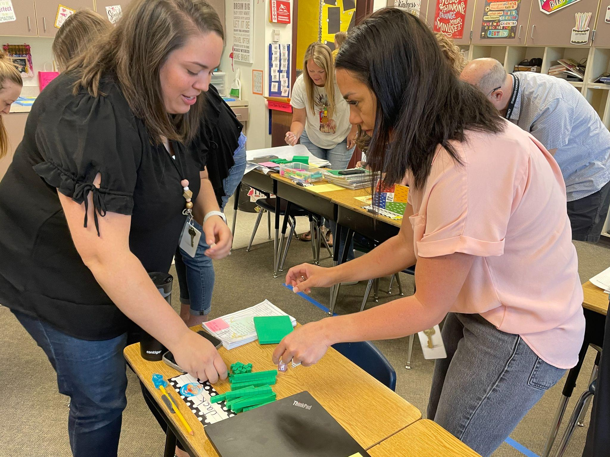
Our AAP Strategies and Progress Toward
Math
Staff will:
collaborate to review, modify, and adjust pacing
collaborate to identify standards and instruction
provide differentiated instruction
provide instruction in problem solving
Staff have:
used number talks to support student discussions
differentiated instruction based on student data

Slide 9
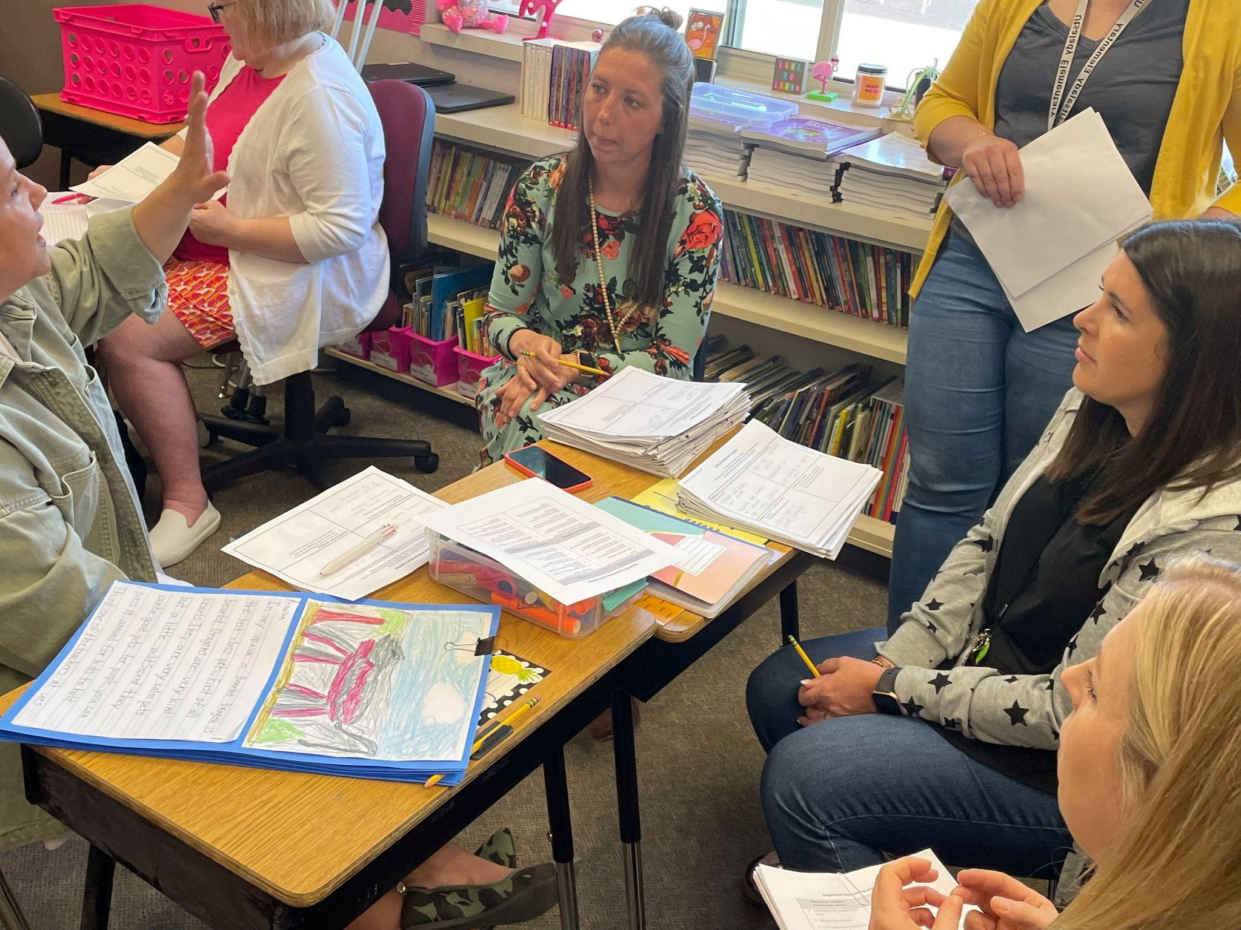
Our AAP Strategies and Progress Toward
ELA (English Language Arts)
Staff will:
plan for methods to provide direct instruction in foundational skills
work in teacher teams to review, modify, and adjust pacing guides
provide small group reading and writing instruction
monitor and track progress of students
Staff have:
participated in curriculum mapping
provided small group instruction
reviewed student work using protocols

Slide 10
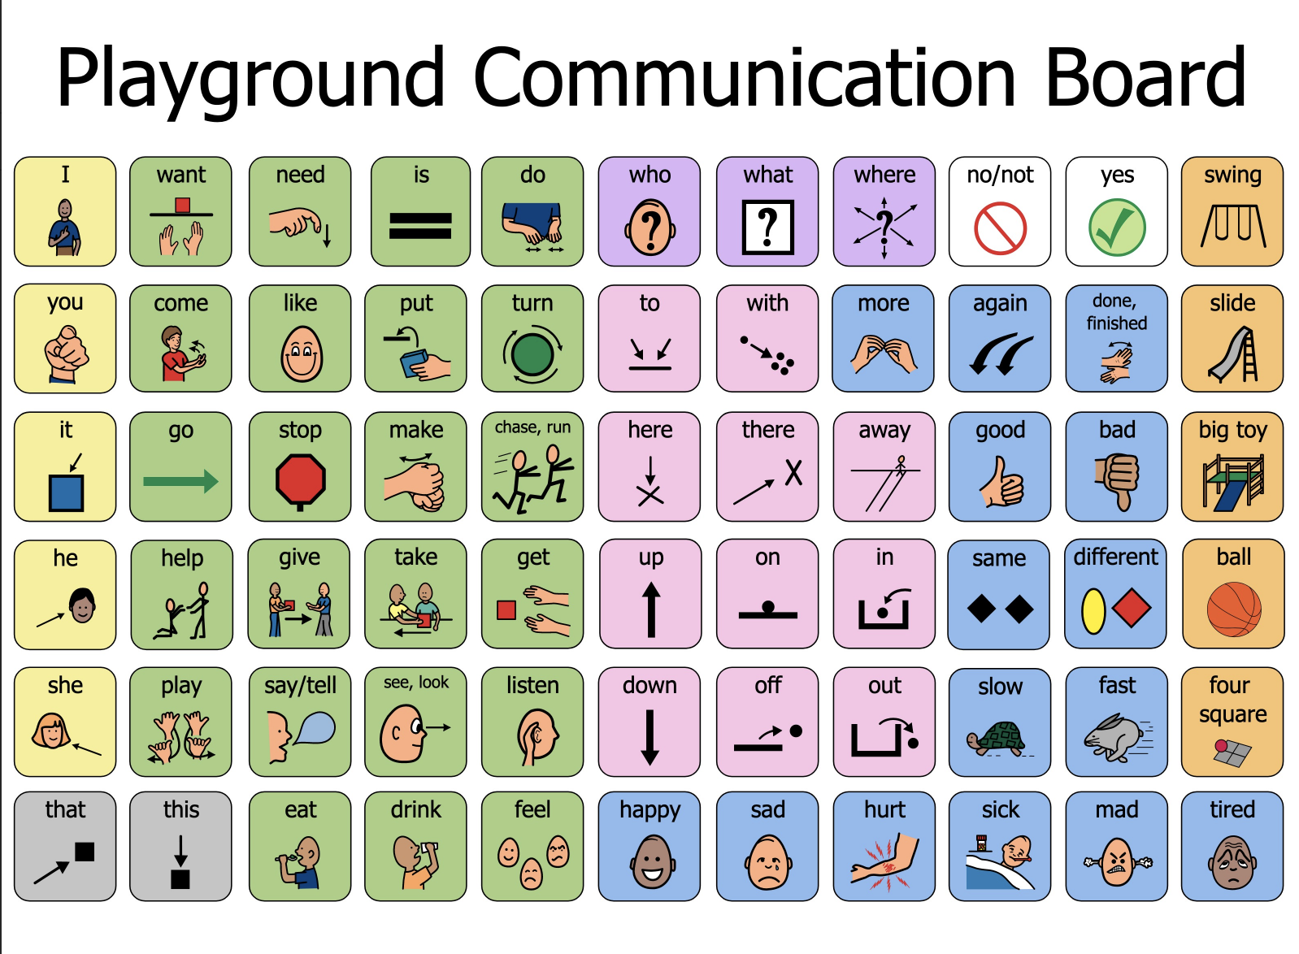
Our AAP Strategies
Multi-Tiered Systems of Supports (MTSS) - Academic and Behavior
Staff will:
meet for MTSS meetings
work in grade-level teams to review data
provide meaningful access to lessons
provide creative groupings and choice
Staff have:
attended MTSS meetings to determine access points for all learners
planned inclusive morning meetings using visuals and student devices
collaborated with Special Education and General Education Teachers
participated in site visits to Ruby Bridges Elementary

Slide 11
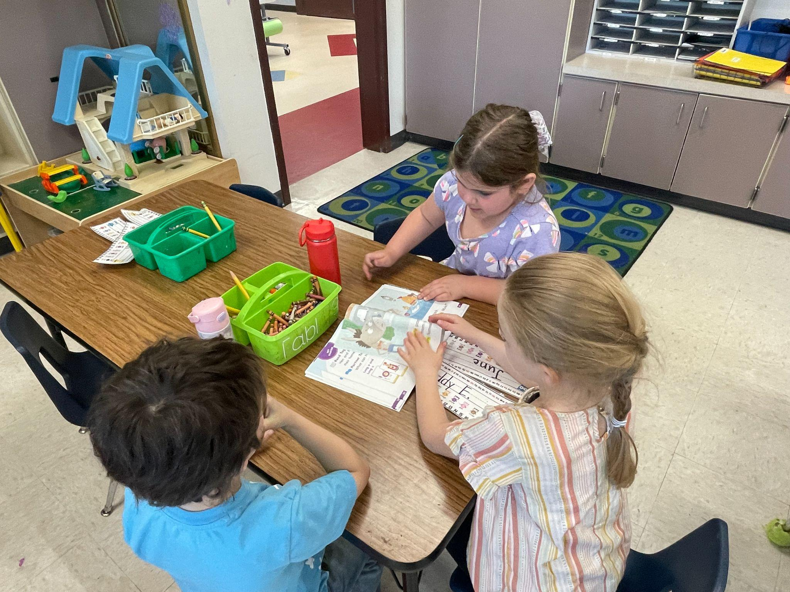
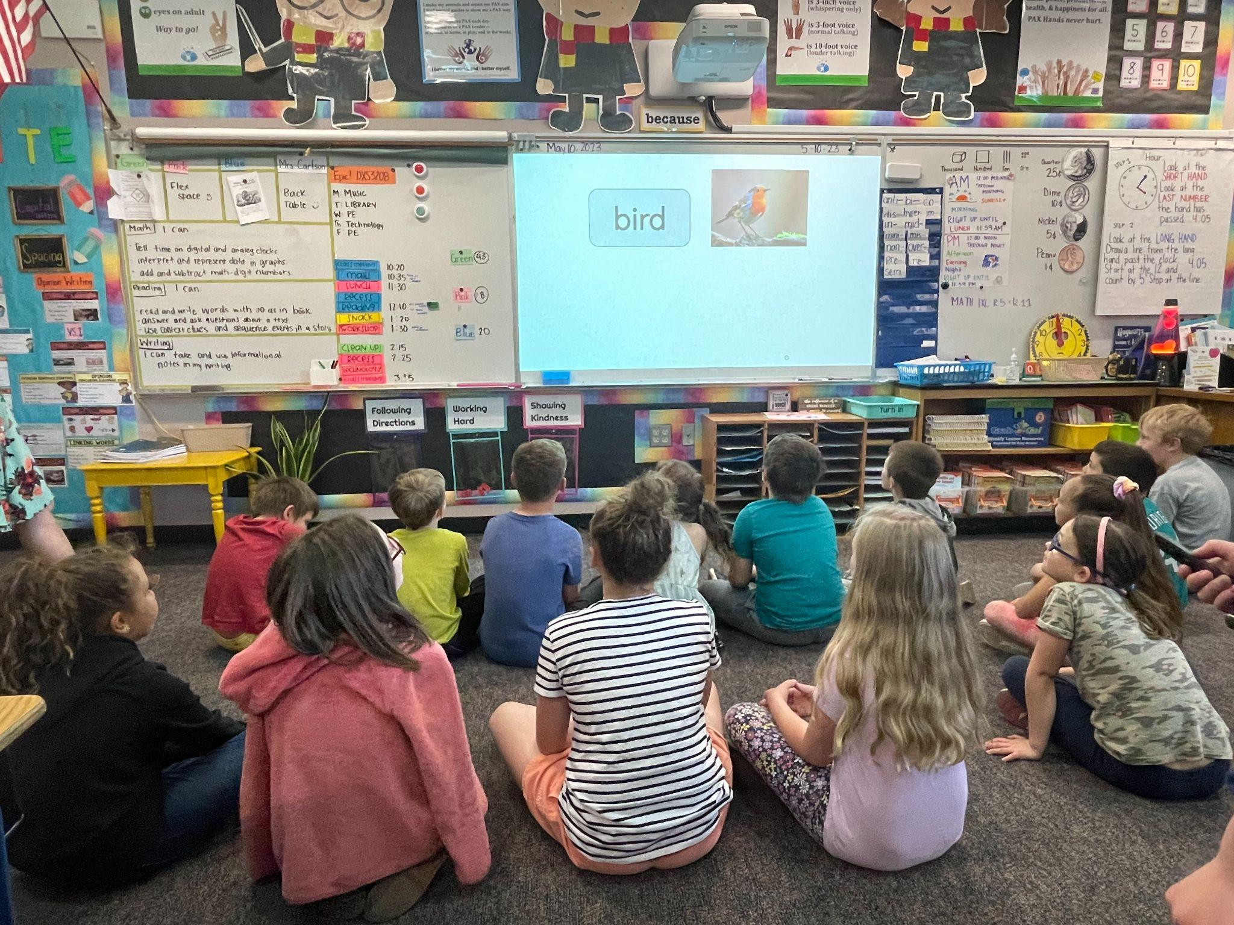
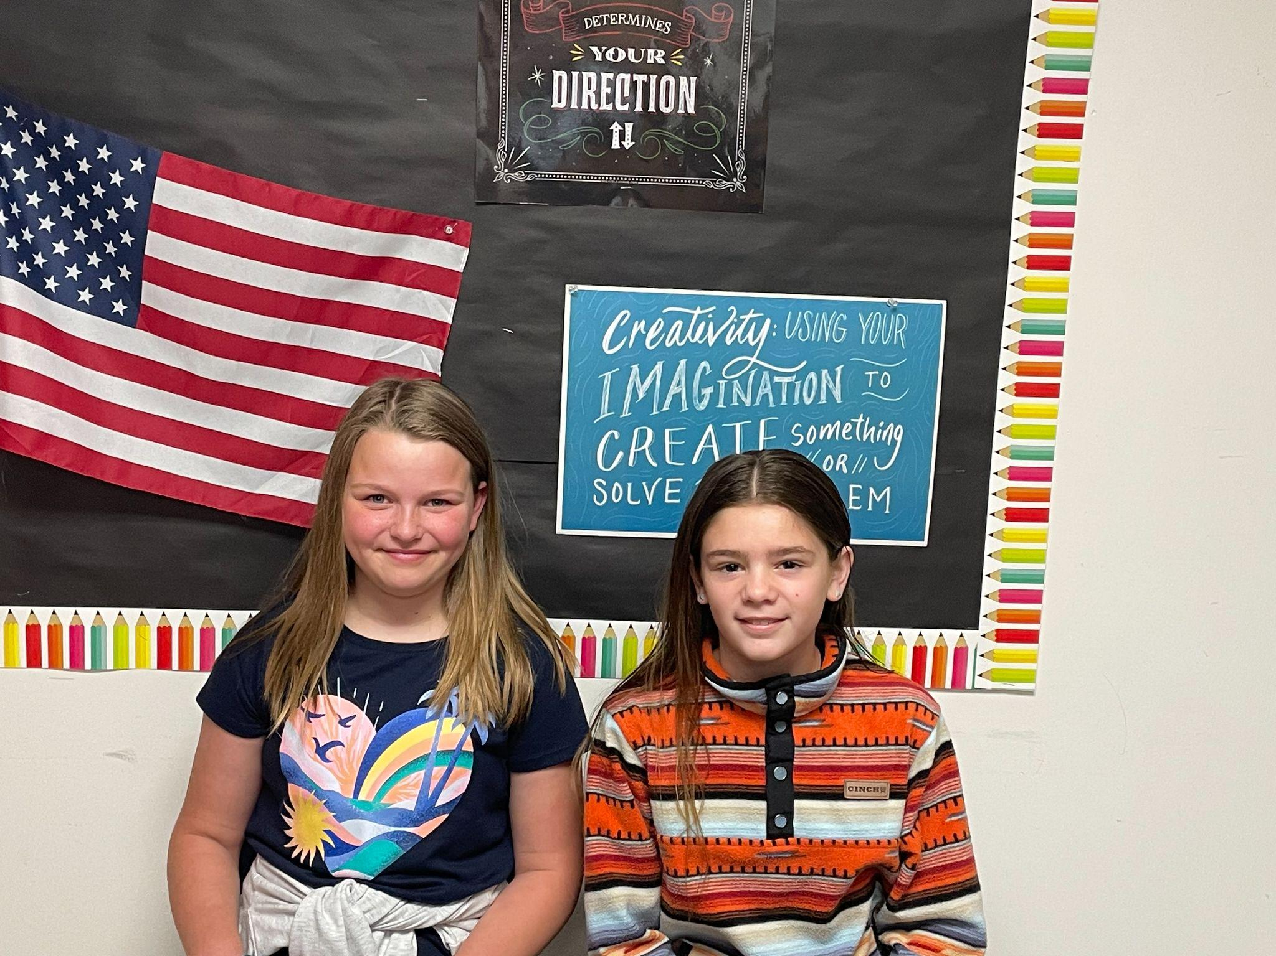
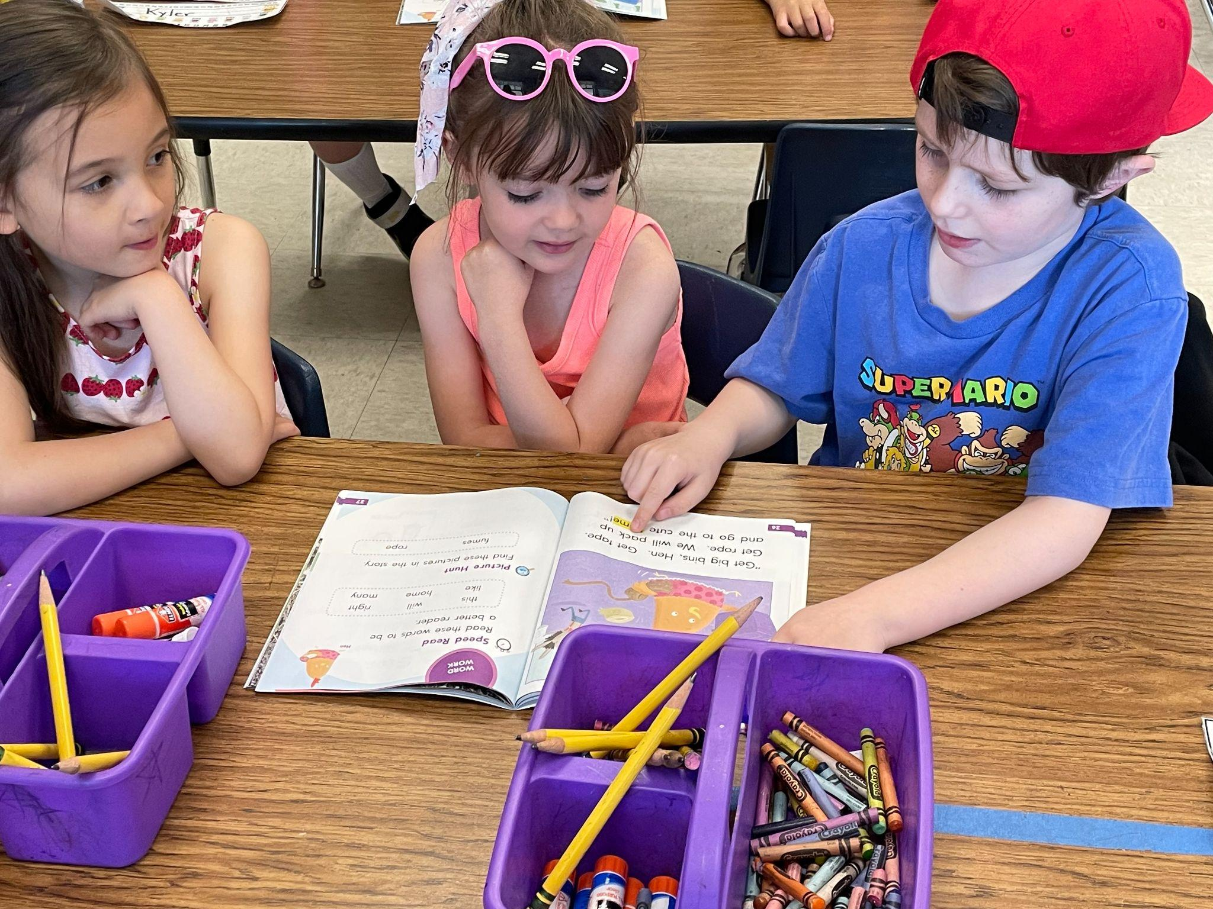

Slide 12
Questions?

Slide 13
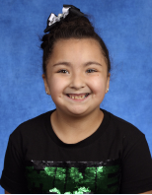
Utsalady Elementary: Shining Star
Emma Garner
4th Grade
Mrs. Patrick
Mrs. Bachand

