Slide 1

Lincoln Academy Board of Directors
2016-17 Forecast
Finance Committee Summary
The Mission of Lincoln Academy is to help students attain their highest social and academic potential through an academically rigorous, content-rich educational program in a safe, orderly, and caring environment.

Slide 2
Introduction to Finance Committee
Jeff Baucum; Board of Directors – Treasurer (parent)
    jeffbaucum@lincolnacademy.net
Janelle Johnson; Principal
Cindie Poulter; Business Manager
Nathan Alley – Member at large (parent)
Rohe Eshbaugh - Member at Large (parent)
Jeanne Coyle – DSS Director (consultant)

Slide 3
Purpose
To provide to the Board of Directors a final projected budget for 2016-17 and a 5 year forecast for consideration.
Vote on proposed budget

Slide 4
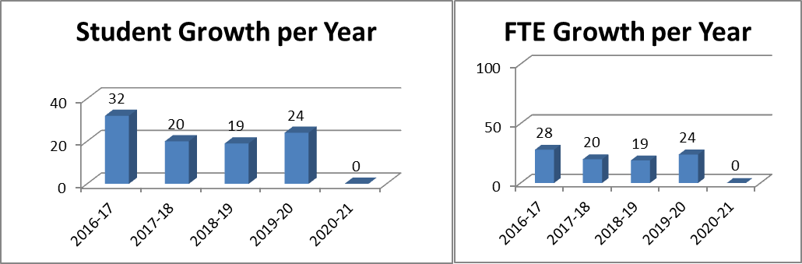
Primary Model Assumption
Student Growth: Growth will occur naturally through Kindergarten as the expanded class sizes move into the higher grade with final FTE count of 720.
Student attrition is built into the budget at grade levels 7th (2) and 8th (6). Several classes are estimated at a lower student count than current enrollment.

Slide 5
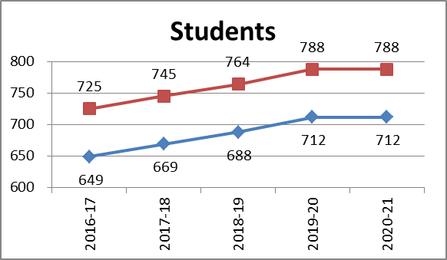
Total Students
Lincoln will see the end of the plan student growth during the 2019-20 school year. After that year, revenues will be dependent on PPR and Mill Levy adjustments by the state and district.

Slide 6
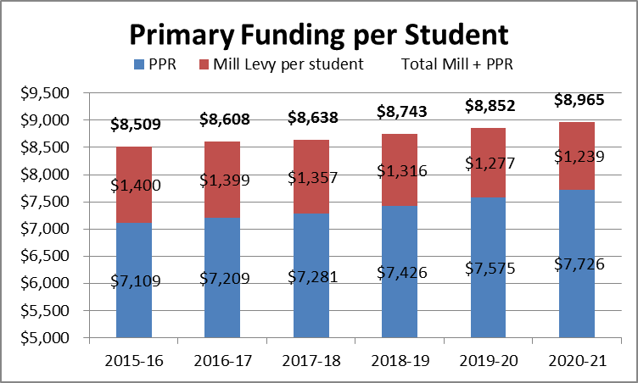
Primary Model Assumption
Per Pupil Revenue (PPR) Growth: Year 1: 1.8%; Year 2: 1.0%; Year 3-5: 2.0%.
    Note the 1.5% is based on expected full PPR payment for 16-17
Mill levy is projected at $1,399 per student for 2016-17; Rate decreases each subsequent year by 3% to account for growing student and charter student populations. Continue equal payments from Jeffco are presumed.

Slide 7
Staffing Model Assumptions
Staffing growth of one teacher and one EA per new class over each of the next 4 years.
Staff salaries raises modeled to be grow by 2% in years 1-5.
Salaries increasing by $247k including raises for 2016-17 (8.3%).
Benefits: As percent of salary - growing 0.8% in 2016-17 to 23.97%; Forecasted to grow additional 0.9% in years 2-5.
Salaries as % of total expenses ratio:
(used to determine amount of costs that are going to overhead)
- 52.8% in 2016-17 (Best practice: 60%-70%)

Slide 8
Staff Growth Details
5th Grade Teacher + 5th grade educational assistant (1.5 FTE)
Full-time DSS teacher (1.0 FTE)
Full time front office support (1.0 FTE)
2 EA positions at .5 FTE each
New Technology maintenance role
Spanish Teacher increasing from 0.3 FTE to 0.81 FTE with scope increasing from 2nd to 8th grade.
Library position increasing from 0.8 FTE to 1.0 FTE.
New staff cost: $233k annually

Slide 9
LA Teacher Salaries
Projected Staff raises to average 2% across the school – approximately $61k.
  Note: The goal of the finance & operational teams is to support our teachers at 90% or higher of market based rates.
  Projected to be at 80% of district with budgeted salary levels
  JA Elementary and Woodrow Wilson are giving 3% raises in 2016-17.
  LA teachers are slightly behind on acknowledging years of service due to freeze in prior years.
Discussion on Salary Structure
A strong salary structure provides for:
Pros: Better slotting; Fairness between staff; EA support
Cons: Falling back in market vs district and other charter schools. Top level may be under funded.

Slide 10
Primary Model Assumption
Individual expense accounts have growth of 2.0% for inflation or based on student growth as appropriate.
Costs have been trended on last year run rates plus inflation
Operating income needs to cover operating expense plus provide for future capital requirements.
$1.35M in loan is offset by the expenditures of $1.475 in modular purchase and installation.
  Note: $1.35M was not included on the 5 year forecast to keep key fiscal metrics clean. However, overall impact to the margin will need to be closely monitored.

Slide 11
Primary Model Assumption
Building Fund Contingency: None moving forward.
Loan: $1.35 million over 5 years at 5.5% interest. $3.9k in yearly payments and $200k in total interest cost to LA depending on payment schedule
No building contingency funds for Years 1 & 2; $50k budgeted in years 3-5.
NO BEST Grant funding

Slide 12
Modular Costs
The $1.5M in project costs is expected to cover the:
Purchase of modular units
Infrastructure costs
Grounds and additional facility costs (IT, equipment, etc)
Currently unexpected infrastructure costs
Current Cost per New Student: $16,000
Funding:
LA will need to pull between $150 – 250k from Operational Funds to supplement the gap between the loan proceeds and actual costs of the Modular costs. A review is underway to determine the impact through account methods upon the 2016-17 margins.

Slide 13
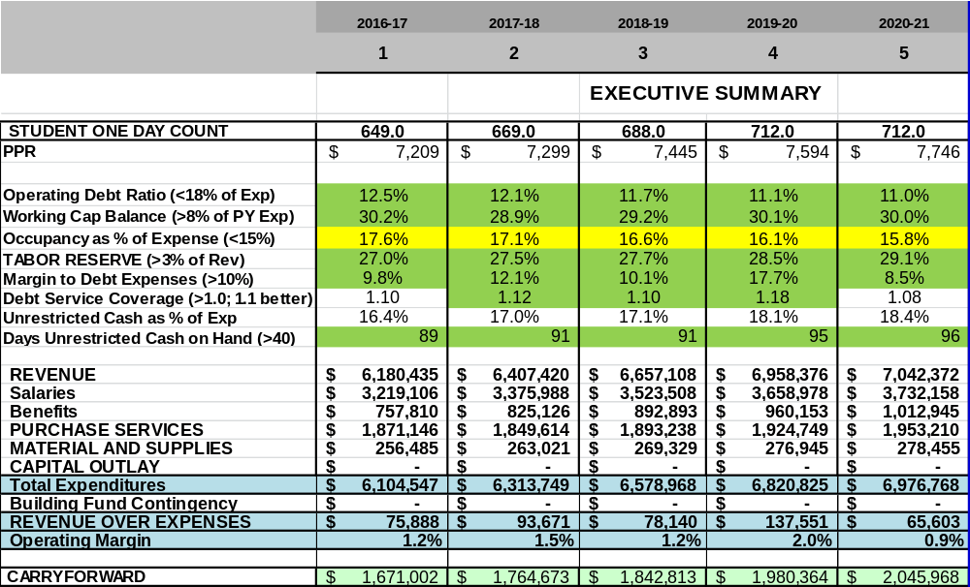
Financial Ratios
Several significant Ratios will be monitored for operating and bond purposes:

Slide 14
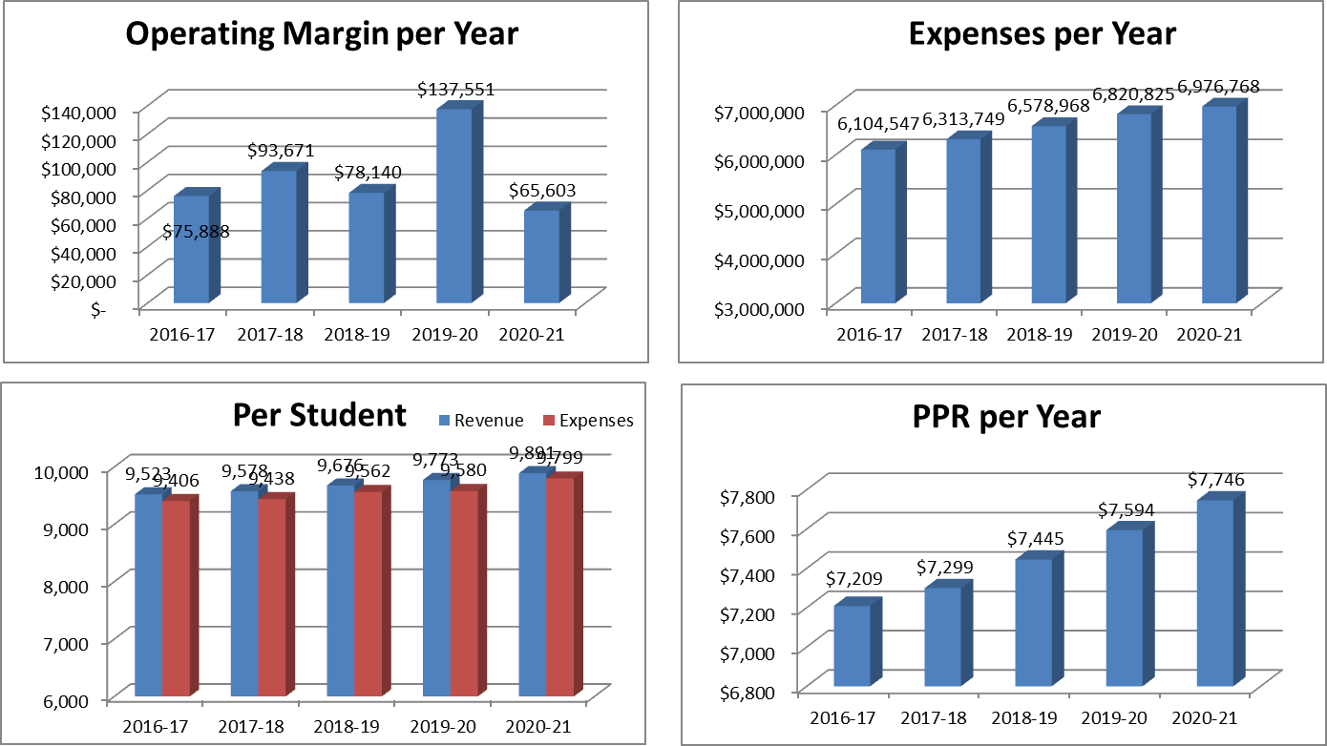
Additional Fiscal Trended Metrics

Slide 15
Risk Points
$1.5M Modular purchase & installation costs creates a debt burden that will impact fiscal planning for future years and generations of students. The additional $310k in annual debt costs will limit LA flexibility toward other initiatives and goals.
Student count: If actual LA FTE is 5 fewer students than projected, the margins would be impacted by $43,000
Teacher salary: The forecast provides for limited salary raises in each year of the budget. New Jeffco salary levels may rise higher than LA can afford in future years.
Teacher staff increases: Significant number of new positions proposed for 2016-17 creating a large increase in salary costs.
Money Pit: Our facilities and property require continual ongoing maintenance and upkeep. The next two year do not allow for property improvement budget within the operational expenses.
Low margins prevent any significant innovation in operations or financial support of leadership vision.
PPR funding and equalization may change negatively in future years.

Slide 16
Budget Opportunities
Increase student class sizes – Higher FTE = higher state funding
    [Not first choice – space issue – learning impacts]
Capital spending: Live with what we got – reduce overall building funding & facility expenditures.
Modular unit provides for key space and student growth
Fund Raising or Grant support
PPR growth! Mill levy Growth!

Slide 17
Initiatives for Consideration
Lower Class sizes
Facility upgrades outside of space planning
IT Development
Second Language or Additional Specials
Science Expansion
High School preparation strategy
Others………

Slide 18
Overall Impression
Overall, the committee has submitted a 5 year plan that is focused on staff growth and moves the Mill Levy additional funding from building contingency to Loan payments. The overall risk is higher than in prior years due to increased debt load, narrow margins and salary commitments.
The forecasted 5 year fiscal model represents a budget where expenses grow slightly faster than revenues . Where the PPR and Mill levy funding present areas of opportunity (and some uncertainty), the FTE levels and maintaining desired levels of teachers compensation, present areas of risk for the fiscal strength of our school. Year 5 represents the end of the student expansion period and future funding of initiatives from that point will be required to come more from operational saving than revenue enhancements. This budget does not provide significantly for contingency plans for capital purposes and less so for operational contingency.
Our administrative team has demonstrated their diligence in consistently monitoring operating expenses and demonstrated creativity in meeting operating. However, looking at the five year projection, we should consider if Lincoln will have sufficient operating margin to allow for flexibility toward initiative and strong fiscal stewardship.

Slide 19
Charter School Closures
• There are five primary reasons for charter closures – financial (41.7 percent), mismanagement (24 percent), academic (18.6 percent), district obstacles (6.3 percent) and facilities (4.6 percent).
• Most charter schools that close for financial or operational deficiencies do so within the first five years, or within their first charter contract.
            2011 Center for Education Reform

