Slide 1

Lincoln Academy Board of Directors
2018-19 Forecast
Finance Committee Summary
The Mission of Lincoln Academy is to help students attain their highest social and academic potential through an academically rigorous, content-rich educational program in a safe, orderly, and caring environment.

Slide 2
Introduction to Finance Committee
Jeff Baucum; Board of Directors – Treasurer (parent)
    jeffbaucum@lincolnacademy.net
Janelle Johnson; Principal
Cindie Poulter; Business Manager
Nathan Alley – Member at large (parent)
Trey Johnson - Member at Large (parent)
Jeanne Coyle – DSS Director (consultant)

Slide 3
Purpose
To provide to the Board of Directors a projected budget for 2018-19 via the 5 year forecast for consideration.
Give input on proposed budget and possible direction on margin and funding direction.

Slide 4
Primary Model Assumption
Student Growth: Growth will occur naturally through Kindergarten as the expanded class sizes move into the higher grade with final FTE count of 788 for 2018-19.
Student class size is capped at 28 for grades 2-8.
Student attrition is built into the budget for grade levels 7th and 8th.

Slide 5
Total Students
Lincoln will see the end of the plan student growth during the 2019-20 school year. After that year, revenues will be dependent on PPR and Mill Levy adjustments by the state and district.

Slide 6
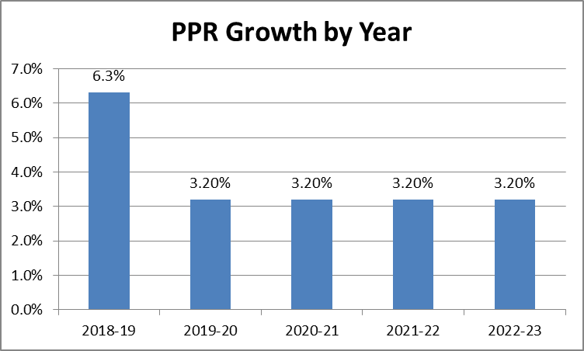
Primary Model Assumption
Per Pupil Revenue (PPR) Growth: Year 1: 6.3% based on state funding projections; Year 2-5: 3.2% based on prior year growth averages.
Mill levy is projected at $1,407 per student for 2017-18; Rate decreases each subsequent year by 3% to account for growing student and charter student populations. Continue equal payments from Jeffco are presumed.

Slide 7
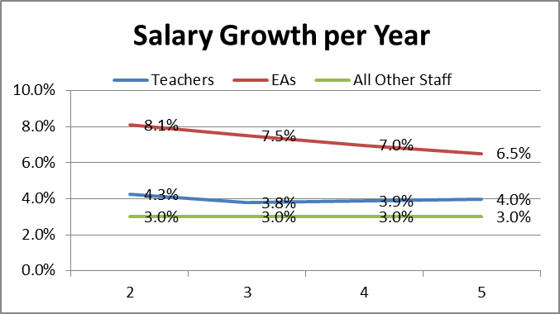
Staffing Model Assumptions
Staffing growth of one teacher and one EA per new class over each of the next 2 years.
Teacher salaries have been adjusted to meet Board approved new compensation schedule.
EA salaries were adjusted this year to account for the increase in the minimum wage requirements.
Other Staff Salaries were budget to increase by 3.0% to match Teacher and EA Growth as well as Cost of Living in Jeffco.

Slide 8
Staffing Model Assumptions
Salaries increasing by $236k including raises for 2018-19 (5.3%).
Benefits: Budget at an increase of 22% for 2018-19 to 29.4% of salaries.
[Need more detail]
Salaries as % of total expenses ratio:
(used to determine amount of costs that are going to overhead)
- 52.6% in 2018-19 (Best practice: 60%-70%)

Slide 9
Staff Growth Details
7th Grade Teacher + 7th grade educational assistant (2.0 FTE)
Full-time DSS – Special ED (1.0 FTE)
Reduction of 1.0 FTE Teacher (Spanish)
Add 0.5 FTE PK teacher (supported by additional fees)
Add 0.5 Music
Less: $102k from Grandfathers benefits elimination
Add: $18k for Additional Elective payments
Add: $30k for EA switch from PT to FT
Add: $168k for projected Bonus to all Staff (matched in CY)
Increase for new Teacher Compensation funding: $213k

Slide 10
Staff Growth Details
Impact of Minimum Wage for EA:
Increased EA salary schedule to match $11.10 per hour requirement for 2019 for entire year [Steps 1&2 impacted]
Adjusted all other EA steps to 90% of the 2016-17 Jeffco district schedule
Future years will need additional funding with minimum wages increasing to $12.00 in 2020. Estimated 40% of our EA will see the additional salary support over the next three years.

Slide 11
Primary Model Assumption
Individual expense accounts have growth of 2.0% for inflation or based on student growth as appropriate.
Costs have been trended on last year run rates plus inflation
Pre-payments on $1.35M loan will continue in 2018-19 (year 4) with a projected $180k pre-payment per year for the next 2 years. Remainder of loan will be made within the monthly interest heavy payments.

Slide 12
Primary Model Assumption
Building Fund Contingency: None moving forward.
Loan: $1.35 million over 5 years at 5.4% interest.
Facility contingency funds for Years 2 to 5 at $50k to $75k (yrs 3-5)
2018-19 includes $375k for fire alarm upgrade. Highly likely that a portion of this expense will roll into the 2019-20 school year.
Additional $15k per year has been included to update curriculum starting in Kindergarden.

Slide 13
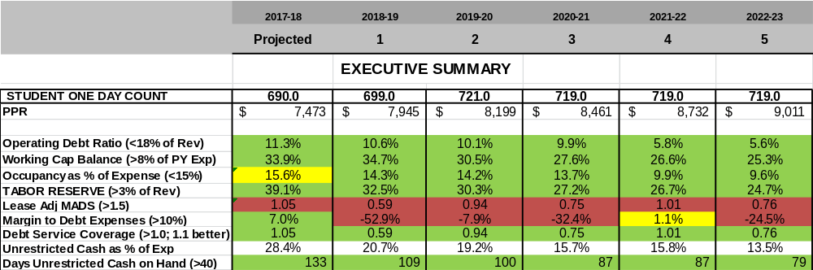
Financial Ratios
Several significant Ratios will be monitored for operating and bond purposes:
    Days Cash on Hand
    Debt Coverage
    Margin

Slide 14
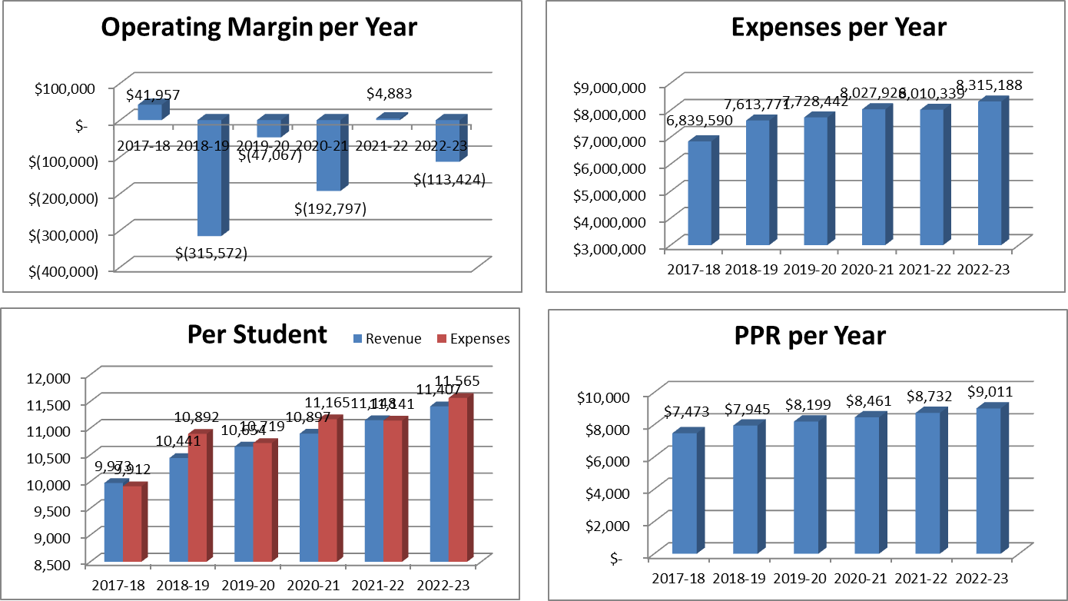
Additional Fiscal Trended Metrics

Slide 15
Risk Points
$310k in annual debt costs on new loan will limit LA flexibility toward other initiatives and goals.
Student count: If actual LA FTE is 5 fewer students than projected, the margins would be impacted by $47,000
Teacher salary: The forecast provides for prescribed salary raises in each year of the budget. New Jeffco salary levels may rise higher than the 2% incorporated into the step plan.
Teacher staff increases: Proposal has minimal staffing increase for year 2. LA has traditionally underestimated staffing needs specifically in the support areas (DSS, facility, Admin).
Money Pit: Our facilities and property require continual ongoing maintenance and upkeep. The next few year allow for limited property improvement budget within the operational expenses.
Low / negative margins prevent any significant innovation in operations or financial support of leadership vision.
PPR funding and Mill equalization may be impacted by Jeffco policies.

Slide 16
Budget Opportunities
Increase student class sizes – Higher FTE = higher state funding
    [Not first choice – space issue – learning impacts]
Capital spending: Live with what we got – reduce overall building funding & facility expenditures.
Fund Raising or Grant support or Bond funding
PPR growth! Mill levy Growth!

Slide 17
Initiatives for Consideration
Maintaining competitive compensation level for staff
Lower Class sizes
Facility upgrades outside of space planning
IT Improvement
Second Language or Additional Specials
Science Expansion
High School preparation strategy
Others………

Slide 18
Overall Impression
Overall, the committee has submitted a 5 year plan that is focused on implementing several Board of Director initiatives including Teacher Salary compensation, Fire Alarm and Debt repayment. Increased funding from the state legislature will support some of those projects. Overall, this has lead to a fiscal model with negative margins particularly in 2018-19 due to the capital requirements needed for Fire Alarm upgrades. The next two years will be the most vulnerable due to paying down the final two years of the modular loan. However, strong cash reserves built up over the past four years will allow Lincoln Academy to manage through this period without any impact to our teaching mission. The overall risk present in this five year plan is higher than in prior years due to increased debt load (for two years), negative margins and increased salary commitments.
The forecasted 5 year fiscal model represents a budget where expenses grow faster than revenues . Where the PPR and Mill levy funding present areas of opportunity (and some uncertainty), the FTE levels and maintaining desired levels of teachers compensation, present areas of risk for the fiscal strength of our school. Year 3 represents the end of the student expansion period and future funding of initiatives from that point will be required to come more from operational saving than revenue enhancements. This budget does not provide significantly for contingency plans for capital purposes and less so for operational contingency.
Our administrative team has demonstrated their diligence in consistently monitoring operating expenses and demonstrated creativity in meeting operating. However, looking at the five year projection, we should consider if Lincoln will have sufficient operating margin to allow for flexibility toward initiative and strong fiscal stewardship.

Slide 19
Charter School Closures
• There are five primary reasons for charter closures – financial (41.7 percent), mismanagement (24 percent), academic (18.6 percent), district obstacles (6.3 percent) and facilities (4.6 percent).
• Most charter schools that close for financial or operational deficiencies do so within the first five years, or within their first charter contract.
            2011 Center for Education Reform

