Slide 1

Lincoln Academy Board of Directors
Infrastructure Funding
The Mission of Lincoln Academy is to help students attain their highest social and academic potential through an academically rigorous, content-rich educational program in a safe, orderly, and caring environment.

Slide 2
Infrastructure Refinancing
Purpose: To approve the method of financing the infrastructure project made necessary due to City of Arvada pulling lands from Lincoln property
The city of Arvada is expanding 72nd Avenue to accommodate four lanes of traffic and need to purchase a small portion of Lincoln property for this effort.
Lincoln uses this land as collateral for our $7M Bonds Issuance (Debt service). Bond agreement dictates that this negative impact on our asset (property) must be:
  a) Approved by the current Bond Holders, or
  b) Debt needs to be refinanced to redefine collateral
Additionally, extensive infrastructure work will be required on the property to accommodate new traffic patterns and asphalt update. (See previous Facilities reports for more information)
Finance council reviewed several options for refinancing and will be asking for a Board decision / approval.

Slide 3
Basic Assumptions
Infrastructure work is required and Board will approve full scope of $2M for that project.
Financing decisions need to be made during the March BoD meeting to meet required timelines for infrastructure project.

Slide 4
Key Strategic Decisions Points
Risk Assumption -how much does LA want to accept in risk?
  Protect Downside vs Flexibility
  Interest Rates fluctuations
Operational Budget impact - what is the opportunity cost (+/-) for debt expense?
  What would reduced debt payment allow LA to fund?
  What would increase debt payment prevent LA from funding?
Overall Cash outlay
  Short term vs Long term; Time value of money
Debt Flexibility- Ability to raise funds for future capital projects (ie: New building)
  Will Lenders & Debt construct provide for easier capital raise in 5 yrs, 10 yrs, etc?

Slide 5
Funding Options
Bond Refinancing
  Full funding of Project
  Partial funding of Project
Bank Refinancing
  Full Funding of Project
Self Funding with Smaller Bank Loan

Slide 6
Current Bond Information
Size $7.2M
Total Cash Outlay from 3/2021: $10.3M
Supported by Moral Obs Program - backed by State at A rating to reduce the interest percentage
Collateral is property at 72nd and Oak but excluding property containing Modulars
Runs through 03/01/2043
Interest Rate from 3.5% (small amount) to 5.0%. Majority above 4%.

Slide 7
Bond Refinancing
Modular Property will be added to provide additional collateral. Bond holders will expect all sources of income to be included. Removing strip of land taken for Road expansion.
Covered by Moral Obs again - A rating (3.61%) [vs BBB- rating (4.15%)]
10 year call feature
Paid off in 03/01/2056
Bond proceeds will be used to cover prior bond holders first (escrow account)

Slide 8
Option 1: Bond - Full Project Coverage
Refinancing will fund old bond debt plus an additional $2,000,000 to cover Infrastructure costs
Rate: 3.61%
Loan Size: $9,360,028
Duration: 03/2056
Cash Outlay: $16.8M
Interest Cost: $7,868,000
Issuance Cost: $322,500
New Money: $2,000,000
Timeline: Issuance by Early-Mid April
Days Cash on Hand Year 1: 148
  Cash includes 5B funding and Sale of Land proceeds

Slide 9
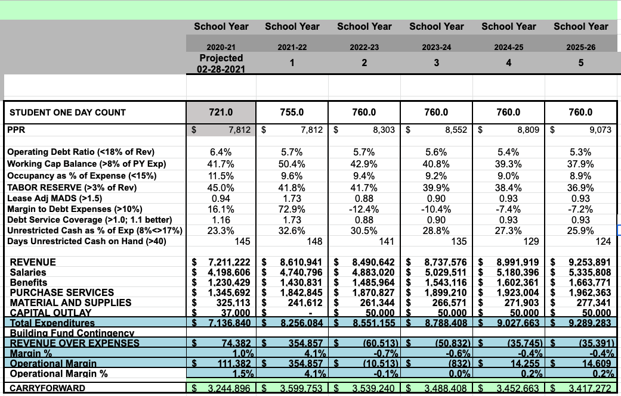
5 Year Metrics - Bond w/ $2M

Slide 10
Considerations - Bond w/ $2M
Pros
Long term stability
Reduced interest rates
Cover entire Infrastructure payment
Boost Cash Carryforward by $1M
Concerns
Additional 13 years to current debt payments
$2.7M in additional costs to future LA administrations
Small increase in annual budget costs (~$20k)
Debt Flexibility
Additional obligations require Debt test: Confirming that new debt will not change rating. Moral Obs program already requires this. Less subjective method.
10 yr call feature but can be reduced to 5 or 7 for additional cost (0.1-0.2% increase to interest)
Additional Considerations
Additional $1M Cash can be used to
  a) Start our capital fund dedicated to new building or
  b) support Covid financial impacts over a SHORT time

Slide 11
Option 1b: Bond - Partial funding
Refinancing will fund old bond debt plus an additional $1M to cover Infrastructure costs. Lincoln will fund $1M out of Cash Carryforward to cover infrastructure costs.
Rate: 3.61%
Loan Size: $8,360,028
Duration: 03/2056
Cash Outlay: ~$15.4M
Interest Cost: ~$7.2M
Issuance Cost: $322,500
New Money: $1,000,000
Timeline: Issuance by Early-Mid April
Days Cash on Hand Year 1: 106
  Cash includes 5B funding and Sale of Land proceeds

Slide 12
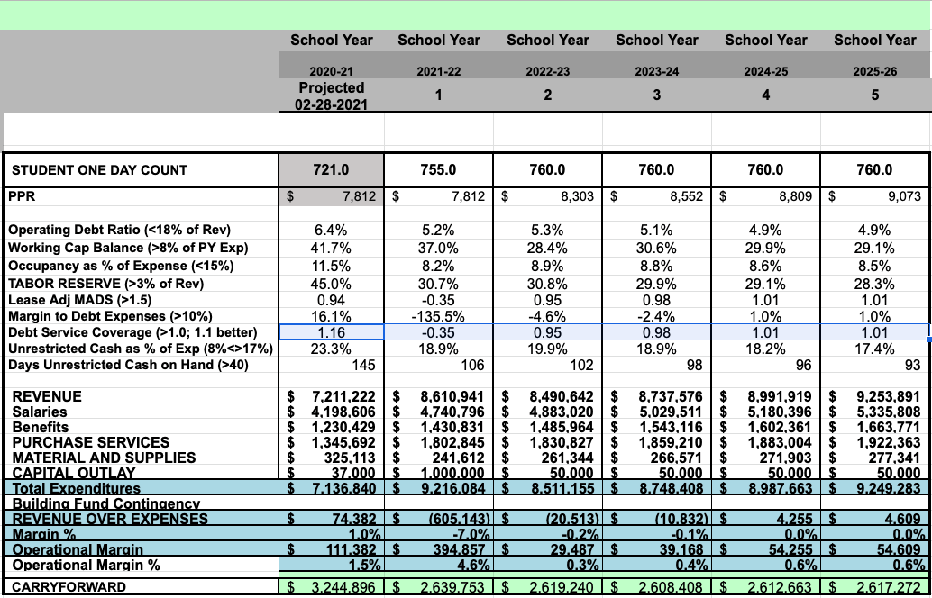
5 Year Metrics - Bond w/ $1M & $1M from LA

Slide 13
Considerations - Bond w/ $1M & $1M from LA
Pros
Long term stability
Reduced interest rates
Cover 50% Infrastructure payment
Small reduction in annual budget costs (~$20k)
Concerns
Additional 13 years to current debt payments
$5.4M in additional costs to future LA administrations
Significant drawdown from Carryforward
Debt Flexibility
Additional obligations requires Debt test: Confirming that new debt will not change rating. Moral Obs program already requires this. Less subjective method.
10 yr call feature but can be reduced to 5 or 7 for additional cost (0.1-.2% increase to interest)

Slide 14
Option 2: Bank - Full funding
Refinancing will fund old bond debt plus an additional $2M to cover Infrastructure costs.
Debt will be a 10 year loan based on a 25 year amortization with large balloon payment due 3/31
NEED TO VERIFY
Rate: 3.5%
Loan Size: $9,360,028
Duration: 03/2031
Cash Outlay: ~$1.4M
Interest Cost: $Unknown due to balloon payment
Issuance Cost: $250,000
New Money: $2,000,000
Timeline: Issuance by Early-Mid April
Days Cash on Hand Year 1: 143
  Cash includes 5B funding and Sale of Land proceeds

Slide 15
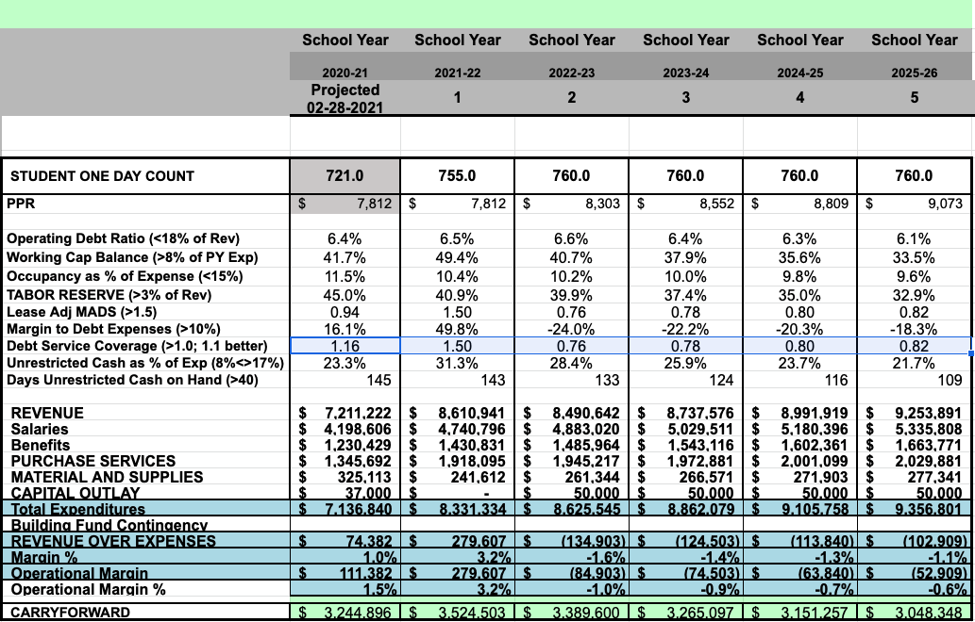
5 Year Metrics - Bank Full Funding

Slide 16
Considerations - Bank Full Funding
Pros
Reduced interest rates
Cover entire Infrastructure payment
Boost Cash Carryforward by $1M
Ability to pay down debt early (similar to Mortgage)
Single investor - ability to raise funds depending on relationship and portfolio
Concerns
Balloon Payment at end of 10 years.
  Will require additional refinancing (2nd round) with risk of higher interest rates and additional refinancing cost
~$4M in additional costs to future LA administrations
Larger increase in annual budget costs (~$100k)
Exclusivity with Bank as Primary debt source - can be more subjective determination of approval for additional debt.
Debt Flexibility
Based on relationship and lender portfolio, additional debt approval could be easy or difficult
Bank could provide additional capital funding utilizing flexible options and methods

Slide 17
Option 3: Self Funding with Smaller Bank Loan
Finance necessary infrastructure cost through $1M bank loan and $1M from Cash Carryforward
NEED TO VERIFY
Rate: 3.5%
Loan Size: $1,000,000
Duration: 03/2031
Cash Outlay: $1,200,000
Interest Cost: $200,000
Issuance Cost: ~$100,000
New Money: $1,000,000
Timeline: Issuance by Early-Mid April
Days Cash on Hand Year 1: 97
  Cash includes 5B funding and Sale of Land proceeds

Slide 18
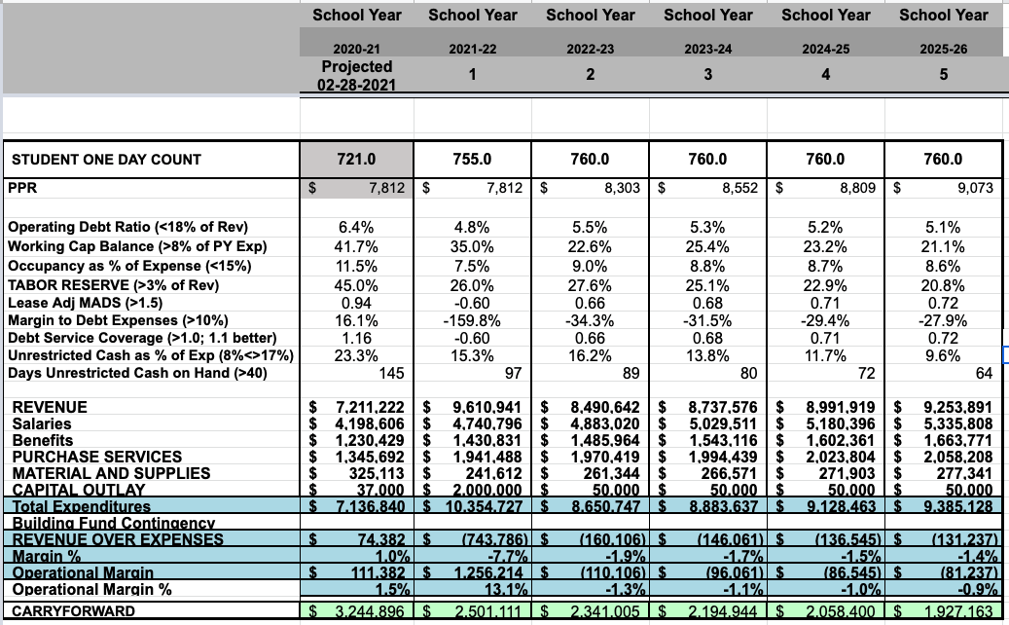
5 Year Metrics - Self Funding with Smaller Bank Loan

Slide 19
Considerations - Self Funding with Smaller Bank Loan
Pros
Reduced interest rates
Cover $1M of infrastructure costs (50%)
Ability to pay down debt early (similar to Mortgage)
Single investor - ability to raise funds depending on relationship and portfolio
Lower debt footprint may create ability to raise more funding than other options in future
Lower total cash outflow
Concerns
Larger increase in annual budget costs ($120k)
Reduction in Cash Carryforward
Ability to get Bond Holder approval for property collateral loss
Debt Flexibility
Most flexible due to small size and ability to pay off immediately.

Slide 20
Additional Factors
Short Term
Covid Funding - how quickly will it return? Can we absorb short term pain for long term advantage

Slide 21
Option Comparison
Funding Options | Risk Assumption | Annual Operational Budget Impact | Change in Overall Cash Outlay; Days Cash on Hand | Debt Flexibility
Bond - $2M | Stable rates | $20k decrease in margin | $6.8M 143 | Limited based on S&P Rating but quantitative
Bond - $1M | Stable rate with Larger Carryforward Draw Down | $20k increase to margin | ~$5.4M 106 | Limited based on S&P Rating but quantitative
Bank - $2M | 10 Yr Balloon Payment; APR uncertainty | $100k decrease in margin | ~$4.0M + 143 | High/Low based on Bank decisions
Self Funding with Smaller Bank Loan - $1M | Set Funding but largest operational impact | $120k decrease in margin | $2.2M + 97 | High with ability to pay off early
Bond - $1.75M | Stable rates | No Impact | $6.2M 138 | Limited based on S&P Rating but quantitative

Slide 22
Decision For Board
Need to agree to additional debt structure
Select Debt Option
Motion: Board of Directors approves that Lincoln Academy issues debt via a bond issuance used to refinance the current Bond debt plus an additional amount such that future annual debt costs will match current annual debt cost, but not to exceed $2.0M in total new debt issuance.

