Slide 1

Lincoln Academy Board of Directors
2021-22 Budget Forecast
Finance Committee Summary
The Mission of Lincoln Academy is to help students attain their highest social and academic potential through an academically rigorous, content-rich educational program in a safe, orderly, and caring environment.

Slide 2
Introduction to Finance Committee
Jeff Baucum: BoD Treasurer (parent)
    jeffbaucum@lincolnacademy.net
Janelle Johnson: Principal
Lindsey Tomsick, Assistant Principal
Lori Woods: Operations Manager
Cindie Poulter: Business Manager
Larisa Rogers: Business Specialist
Jeanne Coyle: DSS Teacher

Slide 3
Purpose & Goals
To provide to the Board of Directors a projected budget for 2021-22 school year along with a 5 year forecast for consideration.
Give input on proposed budget and possible direction on margin and funding direction.
Goals
Provide high level fiscal metrics for assessment of strength of budget and financial stability
Match fiscal expenditures with LA primary goals, mission and vision

Slide 4
Budget Strategy
Prioritized assigning resources directly toward student success – classroom and student care / learning
Conservative Revenue forecasts
Moving back to pre-Covid staffing plan
Limited COLA increases
Mindful of individual expense lines - reducing built in contingencies
Limited to needs - No wish list items in Budget

Slide 5
Back to Student In-Person Impact
Classrooms will move back to 27-28 student each
Re-alignment of FTEs to In-person vs Remote
Not budgeting for remote learning due to extremely small demand
  less than 2% of our projected student enrollment for next year asked for remote learning
CARES funding has allowed for smaller Material budget (1 year impact) such as Chrome purchases

Slide 6
Primary Model Assumption
Student Count 2020-21
Grade | Number Currently Enrolled 2020-21 | Projected Class Size for 2021-22 | Number Currently Enrolled for 2021-22
K | 78 | 88 | 88
1 | 84 | 88 | 88
2 | 80 | 84 | 84
3 | 80 | 84 | 84
4 | 83 | 84 | 84
5 | 81 | 84 | 84
6 | 84 | 84 | 84
7 | 79 | 84 | 84
8 | 77 | 75 | 77
Totals | 726 | 755 | 757*
*Increased enrollment of 2 students will increase revenue over proposed budget.

Slide 7
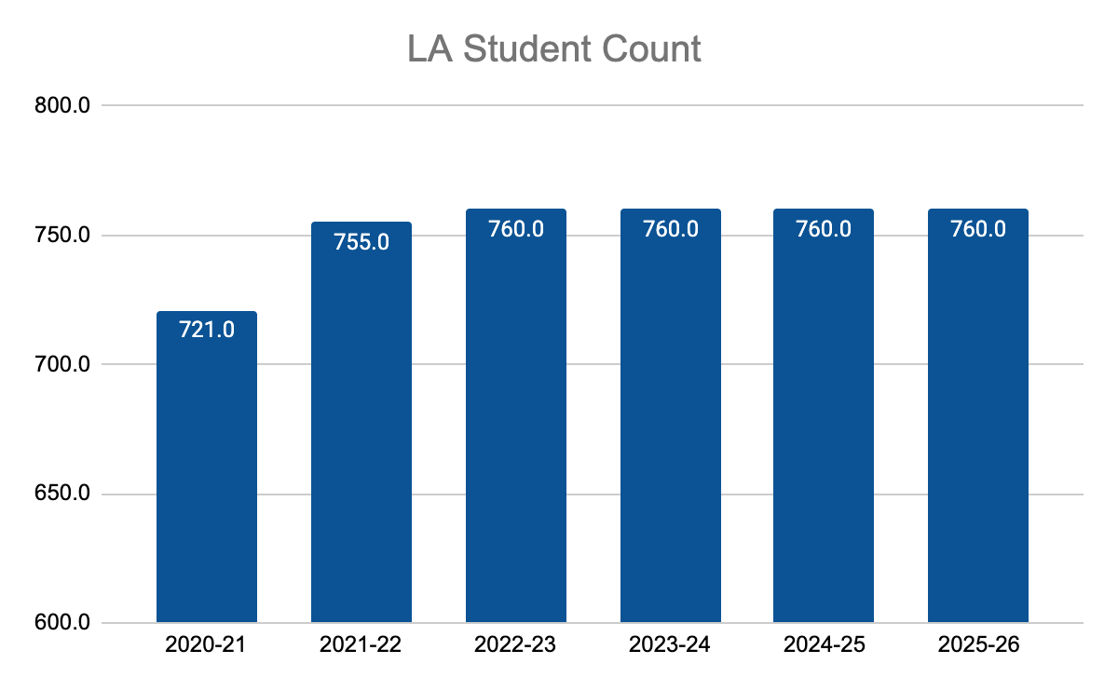
Primary Model Assumption – 5 Yr Trending
Growth is capped at 760 for all grades
2021-22 will have all Kindergarten students full day - increasing student FTE count.
Student classes return to 27-28 students.

Slide 8
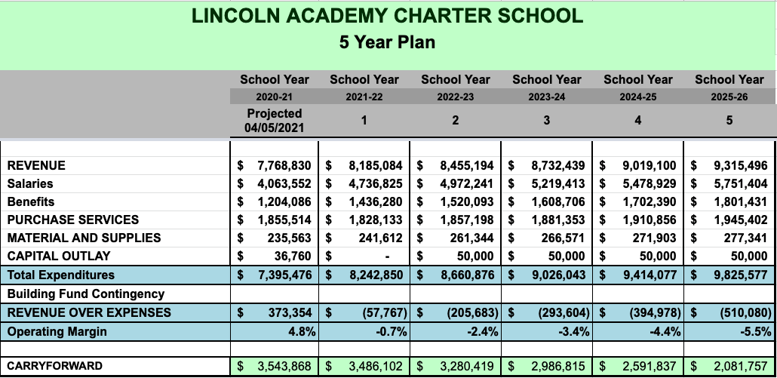
Budget Overview
Budget excludes Bond Refinance Funds and Sale of Land Funds and additional ESSER fund reimbursement

Slide 9
Current School Finance Recommendations
School year 2021-22 has significant uncertainty for final funding assumption that will be impacted by State Budget decisions and economic recovery.
KEY Assumption: PPR will grow from current year by 1.0%
  Jefferson County Public School: Is running budgets of -5%, -3% and 2%
KEY Assumption: Mill Levy funding per student will stay flat
Both PPR and Mill Levy funding will increase in 2021-22 due to growth in Student Count

Slide 10
Possible Revenue Opportunities
Governor Polis is education friendly – support for higher PPR from State. LA impact unknown
Approved Fed COVID bill for $130B sets up 2nd Round of CARES funding with additional flexibility. LA impact unknown
ESSER – 2nd Round funding of $276k is available; Operations team is using funding this year and next year based on reimbursement rules

Slide 11
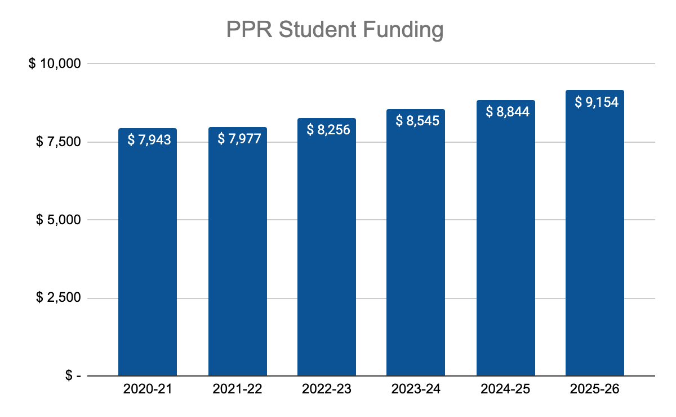
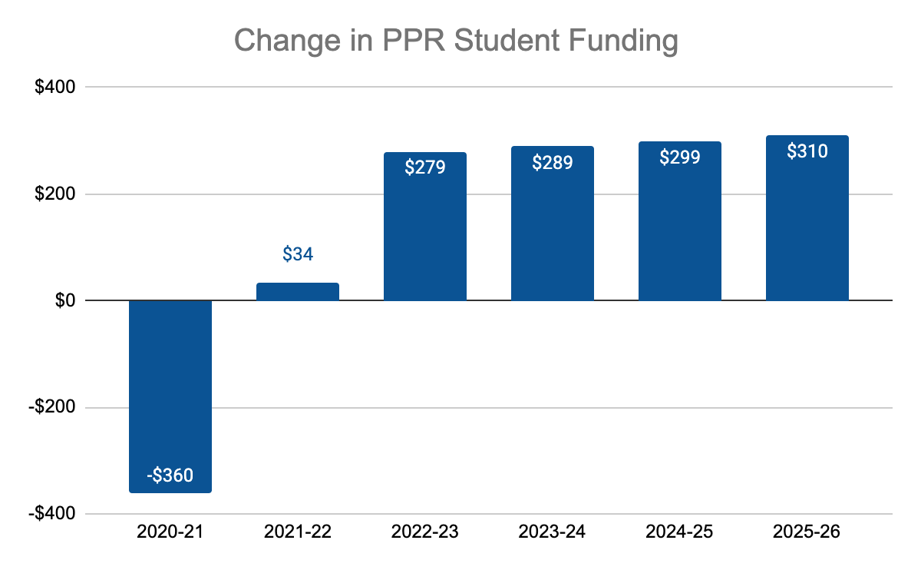
Primary Model Assumption
Revenue
Per Pupil Revenue increase from $7,943 per student to $7,977 representing a ~1% increase.
PPR Years 2-5: Increase of 3.5%;
Mill Levy funding is budgeted to be flat in Year 1; Increase 3.5% in Years 2-5

Slide 12
Staffing Model Assumptions
Goal: To keep our staff salaries in a competitive market range while maintaining an operational margin.
Budget honors designed salary steps in 2021-22
Budget for 2.0% COLA in Yr 1
  Note: Employees will have and additional 0.5% of their salary taken for PERA starting next year.
Forecasting for 5% increase in total salary compensation Years 2-5
  Note: 5% increase is a projection of designed salary steps and COLA increases.
Beginning EA salaries were raised to account for the increase in the minimum wage requirements.
Benefits budgeted with historical utilization by staff as model
Pre-COVID staffing plan: 94.78 FTE, 109 Head count
Proposed 2021-22 staffing plan: 98.73 FTE, 109 Head count

Slide 13
Staff Growth Details
Budget Adds - Job Descriptions | FTE Impact
Full Day Kinder | 0.32
Music Teacher (rather than elective only) | 0.35
PreK/Leopard Care Director | 0.06
Operations Manager to F/T | 0.27
K-4 Instructional Coach to 0.8 | 0.17
In house sub | 0.15
Financial Secretary | 0.10
5-8 Instructional Coach F/T | 1.00
IT Support | 1.00
Mental Health | 1.00
SPED 5-6 | 1.00
Executive Director | 1.00

Slide 14
Salary Breakdown
Category | Amount of Change | % of Growth
FTE adds / Adjustments Including ED | $292,526 | 6.67%
Steps (Teachers & EA) | $85,520 | 1.95%
Previously Covid covered Salaries | $87,048 | 1.97%
COLA (2% for all employees) | $69,482 | 1.59%
Flex Benefits Impact on Salaries | $7,976 | 0.18%
Total | $526,600 | 12.5%

Slide 15
Primary Model Assumptions - non-Salary budget accounts
Individual expense accounts have been modeled off a full year of in-person trends and expectations.
Reduced budget contingency from several accounts based on current operational expenses.
Forecasted 2.0% inflation on purchased services and materials in Years 2-5.
Year 2-5: $50k capital expenditures budgeted

Slide 16
Financial Ratios
Several significant fiscal Ratios will be monitored through the year:
    Operational Margin: (0.7%)
    Margin (with capital outlay): (0.7%)
    Days Cash on Hand: 143
    Debt Coverage: 0.88
    Carry Forward: $3.1M

Slide 17
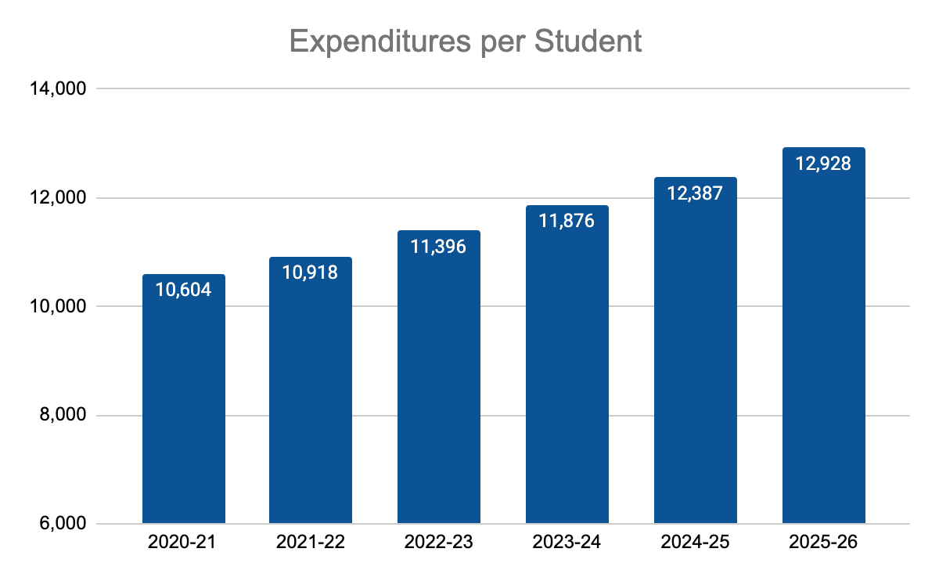
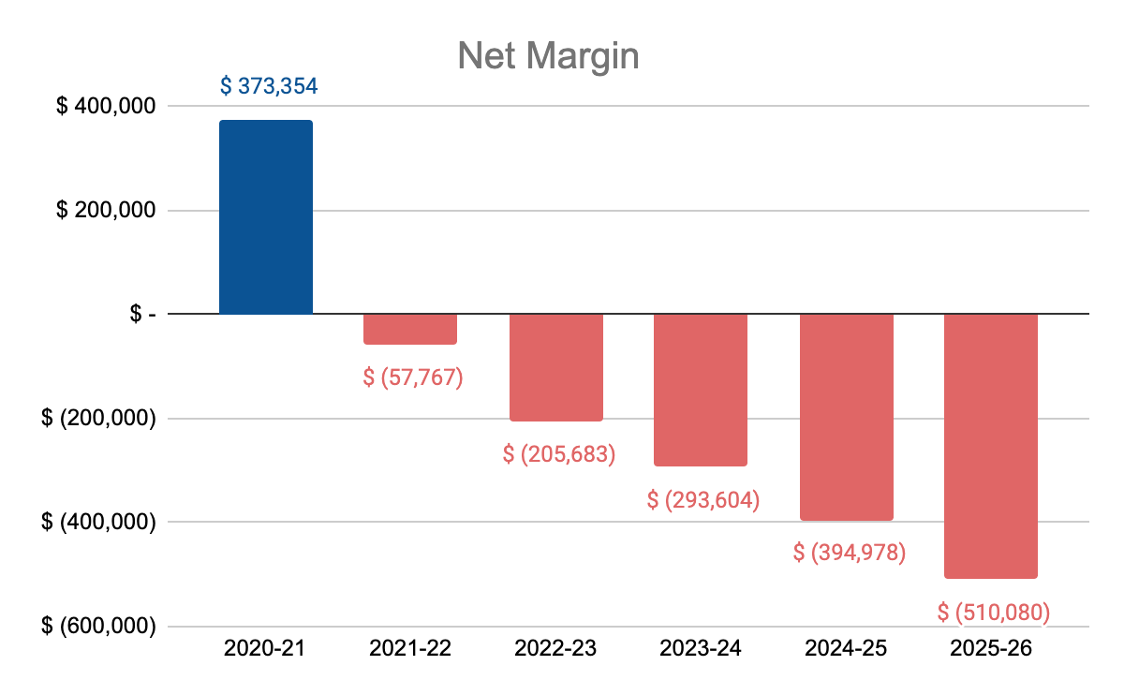
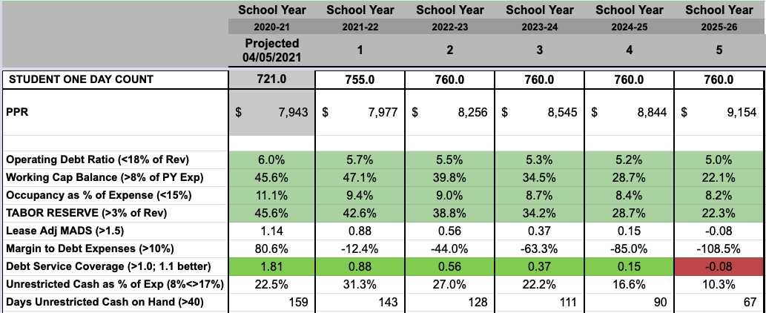
Financial Ratios – 5 Yr

Slide 18
Budget Expense Reduction and First Added Resources
In preparation of either lower PPR / Mill Levy or additional funding opportunities, the operations team has prepared a list of areas where the budget could be cut and where additional funds could be spent.
First Added Resources:
  COLA Increases or Bonuses
  Mental Health
  Facilities
  HR Consultant Support
  Educational Assistants
  MS Math Teacher
  Deferred Maintenance
  Math Curriculum
First Reduced Resources:
  COLA Increases or Bonuses
  FTEs
Educational Assistants
Restructuring Specials
Limiting MS Electives
ALP
Instructional Coaches
ESSER and CARES funds provide increased funding to allow for operations that support closing student academic gaps due to COVID.

Slide 19
Risk Points
Extended economic downturn could keep state funding at lower levels.
PPR forecast may be too optimistic.
Student count: If actual LA FTE is 5 fewer students than projected, the margins would be impacted by $50,000
Money Pit: Our facilities and property require continual ongoing maintenance. The next few years allow for limited property improvement budget within the operational expenses. $0 budget in capital improvements for 2021-22 because we are planning to use refinance proceeds and sale of land proceeds for capital improvements
Low / negative margins prevent any significant innovation in operations or financial support of leadership vision.

