Slide 1

Out of Focus
How ADHD Affects the Whole Child
Presented by Arrione Clarke, MSW, LCSW
Behavioral Health Clinician Supervisor
March 21, 2024

Slide 2

Welcome!
*Disclaimer: The content of this training is intended for educational purposes only and should not be used for any diagnostic considerations in children or adults. *

Slide 3

Learning Objectives
In today’s presentation we will:
Discover the fundamentals about the ADHD diagnosis and common misunderstandings
Review informative statistics and DSM-V diagnostic criteria
Identify the presentation of symptoms in males vs. females
Understand the impacts on the child
Acquire strategies and tips to promote student success

Slide 4

Pop Quiz!
What Do You "Really" Know About ADHD?

Slide 5
True or False:
If a child is diagnosed with ADHD, this only means, they are unable to control themselves.

Slide 6
False:
“ADHD—is a brain-based disorder that affects about one in ten school-aged children.”

Slide 7
True or False:
The median age of onset for children with severe ADHD is 6 years old.

Slide 8
FALSE:
The median age of onset for children with severe ADHD is 4 years old.

Slide 9
True or False:
ADHD is a common disorder of childhood, which the individual will eventually grow out of.

Slide 10
False:
“ADHD symptoms continue into adulthood for more than half of those who have it in childhood.”

Slide 11
True or False:
Adult ADHD cases make up about 4.4% of the total prevalence of the disorder.

Slide 12
True:
Adult ADHD cases make up about 4.4% of the total prevalence of the disorder in ages 18-44 years old.

Slide 13
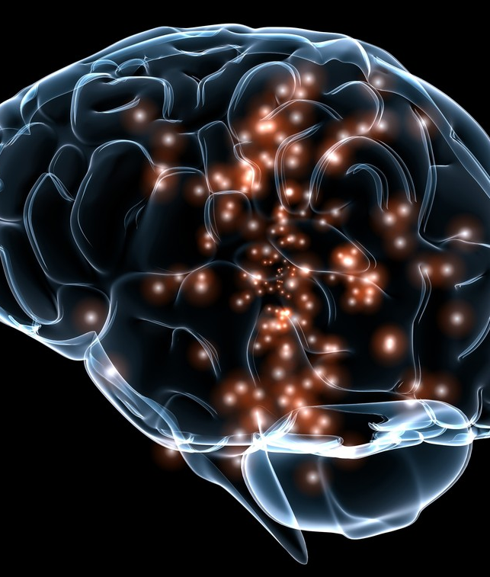
Part 1
A Deep Dive into
Attention Deficit Hyperactivity Disorder
This Photo by Unknown Author is licensed under CC BY-SA-NC

Slide 14

Case Study
Meet Fred…

Slide 15
Fred is a 5th-grade student at Wonderworks Elementary School. He exhibits the characteristics of ADHD.
In Ms. Marks’ class, he is frequently inattentive, and off-task requiring redirection. He submits incomplete worksheets and assignments, even though the answers he does complete are correct.
He also talks out of turn, interrupts other students when they talk, and sometimes offers them rude comments.

Slide 16
In Class
Fred is required to sit apart from his peers, closest to the teacher’s desk, and can only join the other students during specials, and at lunch he if is behaving.
At times he will do inappropriate things to get a reaction from the other students. This behavior often gets Fred into trouble, and verbally reprimanded by Ms. Marks. On occasion, the teacher will ask Fred to sit in the hallway for a few minutes until he can, “Collect himself, and rejoin the class.”

Slide 17
Ms. Marks' Reaction
Ms. Marks sends Fred’s parents daily progress reports, and often expresses her discontent with him stating, “He’s so smart, but is wasting his time choosing to be the class clown.” The teacher has also made a referral to the school counselor, Mr. Abraham, for additional support.

Slide 18
Parents' Response
His parents recently requested a full psychological evaluation for him, as they have expressed concerns about his lack of ability to complete assigned tasks at home, appearing aloof and frequently misplacing important items. After the evaluation, Fred’s parents scheduled an annual physical check-up and discussed his behaviors with his pediatrician.

Slide 19
Parents' Response Continued…
Fred’s doctor has prescribed him to take 18 mg of Concerta for the first week, with subsequent increases for the first 3 weeks. His parents admit that they have been inconsistently administering the medication, due to Fred’s frequent complaints of stomach aches.
During a recent meeting with Ms. Marks and Mr. Abraham, Fred’s parents were encouraged to seek therapy or behavioral coaching to help Fred learn essential skills to help him better manage his symptoms. A comprehensive list of resources was provided to them, and they declined stating that Fred did not need therapy and believed that “He just has to try a little harder, and he’ll be okay.”

Slide 20
DSM V Diagnostic Criterion
Please note:
The information outlined in this training should by no means substitute a formal evaluation by a licensed medical professional.
Self-diagnosing or the diagnosing of others is HIGHLY discouraged.
The Diagnostic and Statistical Manual of Mental Disorders-5th Edition defines Attention Deficit Hyperactivity Disorder
As:
A persistent pattern of inattention and/or hyperactivity-impulsivity that INTERFERES with the functioning of development is characterized by the following features.
Inattention: 6 or more of the symptoms have been present for at least 6 months.
Hyperactivity (fidgeting often leaves seat, often runs about, unable to play quietly, often on the go, often talks excessively)
Impulsivity (often blurts out answers, often has trouble waiting turn, often interrupts or intrudes others, several symptoms present before 12 years, symptoms present in 2 or more settings, CLEAR evidence that symptoms interfere with functionality, symptoms don't occur during a psychotic disorder)

Slide 21
Statistics
Severe Cases: 4 years old
Moderate Case: 6 years old
Mild Cases: 7 years old
General age of onset for diagnosable cases

Slide 22
Dx by Race/Ethnicity

Slide 23
Approx. 30 %
% of Children Who'll Retain the DX into Adulthood
Age 13-18 years, 8.7%
Prevalence of ADHD among U.S. adolescents
50%
% of Adolescent Severe Impairment Cases
Nearly 3x as many males are affected
Impact on males vs. females

Slide 24
Potential Causes
Precise causes are still unknown
Strong neurobiological basis
In some instances, genetics may contribute
Prenatal complications
Postnatal brain injury

Slide 25
Debunking Myths
Here are 9 common myths about ADHD

Slide 26
Myth # 1
ADHD only affects kids.

Slide 27
FALSE
If an individual is diagnosed with ADHD during childhood, they may struggle with symptoms into adolescence and adulthood.

Slide 28
Myth # 2
ADHD is just an excuse for bad behavior.

Slide 29
FALSE
Attention Deficit Hyperactivity Disorder is a neurological disorder which impacts the development of the brain.

Slide 30
Myth # 3
Children with ADHD are just lazy.

Slide 31
FALSE
Children with ADHD want to perform well. However, they are prone to become discouraged and resistant to learning once they've developed a mindset that they are, IRRITATING, LAZY, BAD, and DUMB.

Slide 32
Myth # 4
Words don't really matter.

Slide 33
FALSE
By the time a child is 10 years old, they have received 20,000 more negative words and messages in comparison to their peers.

Slide 34
Myth # 5
Children with ADHD only receive negative messages from their peers.

Slide 35
FALSE
Parents and educators are culprits too. Kids often receive these negative messages from both parents and teachers.

Slide 36
Myth # 6
Kids with ADHD can't learn new concepts.

Slide 37
FALSE
Kids with ADHD need the adults in their lives to help them identify and harness their strengths to enhance learning opportunities.

Slide 38
Myth # 7
It's not that hard to manage the symptoms of ADHD.

Slide 39
FALSE
A child diagnosed with ADHD may experience difficulty with executive functioning skills and maintaining focus.

Slide 40
Myth # 8
Medication is the only way to help a child with ADHD.

Slide 41
FALSE
There are a variety of treatment options including prescription medication, behavioral training, coaching, and therapy that have been proven effective to help manage the symptoms of ADHD.

Slide 42
Myth # 9
If a child has ADHD, they can't have any other diagnosis.

Slide 43
FALSE
Oftentimes, the clinical features of ADHD may overlap with other conditions. It is not uncommon for a child diagnosed with ADHD to exhibit symptoms of other disorders (i.e., Autism Spectrum Disorder, Learning, Tic, Depressive, Mood, Anxiety, and Conduct disorders).

Slide 44
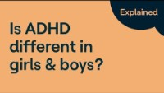
Battle of the Sexes

Slide 45
Check-in w/Fred
Fred & ADHD
When looking at the diagnosis of ADHD there are three main characteristics that individuals showcase. These characteristics are inattention, hyperactivity, and impulsivity. If we are to look at the case of Fred, we see that he is suffering from inattention based on his incomplete worksheets and difficulty managing his focus.

Slide 46
Students suffering from ADHD may miss items on a worksheet even when it is clear (as in Fred’s case) that they have the skills needed to complete the items correctly (Smith & Tyler, 2010). Due to his inattention, Fred gets distracted and does not focus for long enough to complete each item.
He may have the inability to focus on the smaller details of a task or pay attention to the wrong features of the tasks which causes him to turn in incomplete assignments (Smith & Tyler, 2010). In the description given of Fred, there do not seem to be signs of hyperactivity, but this characteristic may or may not be present to confirm a diagnosis of ADHD.

Slide 47
Fred is, however, showing signs of impulsivity in the form of talking out of turn, interrupting, and offering rude comments. He cannot control his responses to the environment, a classic characteristic of ADHD (Smith & Tyler, 2010).
He is blurting things out before thinking and as a result, may also be suffering from decreased social acceptance, however, this is not stated in Fred’s description. Fred’s inattention and impulsive behavior occur when he is asked to focus on a specific task or when he is not the center of attention. The behavior appears to allow him to gain teacher, peer, and administrator attention and to escape too difficult tasks.

Slide 48

Part 2
Impacts on the Child

Slide 49
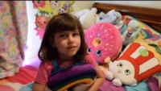
ADHD from a Child’s Perspective

Slide 50
Self-Esteem
A child or adolescent diagnosed with ADHD might experience challenges that negatively impact their self-concept.
These children may see themselves as incapable and compare themselves to their peers or siblings.
The frequency of negative messaging they receive may reinforce this idea, and lead to the effects of a destructive cycle.
  “I think, therefore, I am.” – Rene Descartes

Slide 51
Rejection Sensitivity Dysphoria (RSD)
RSD is an intense emotional pain related to rejection, criticism, or a feeling of failing short of expectations.
It is a component or sub-type of ADHD emotional dysregulation
It is not an official condition of ADHD
It is not a mood disorder- but its characteristics may mimic common disorders
May present with catastrophic emotional responses to the anticipated withdrawal of love, approval, and respect
A deep and profound sense of shame over loss of self-control
Always has a clear trigger from a source that matters
Flashes on hot, instantaneously
Short in duration (less than 1-2 hours)
Can linger even though the intensity fades
Physical symptoms run their course quickly
Can have many daily

Slide 52
Peer Relationships
Children with ADHD may often struggle to develop and maintain relationships with their peers
Other children may be prone to label them as bad or annoying
Non-ADHD children may have difficulty understanding why their ADHD peers “won’t behave”
Children with ADHD may have difficulty with social interactions because of executive functioning deficits

Slide 53

Co-Morbidities
Co-existing Conditions Infographic

Slide 54
Academic Success
Understand, because ADHD impacts the executive functioning of the brain, students may struggle to complete tasks that require them to:
Plan
Organize time and materials
Make decisions
Transition between activities
Control emotions
Learn from past mistakes

Slide 55
Organizational Skills
Fails to give close attention to details or makes careless mistakes
Has difficulty sustaining attention
Does not appear to listen
Struggles to follow through with instructions
Has difficulty with organization
Avoids or dislikes tasks requiring sustained mental effort
Loses things
Is easily distracted
Is forgetful in daily activities

Slide 56
Check-in w/Fred #2
Fred’s Behavior and Peer Interactions
Ms. Mark has decided to move Fred’s desk closest to hers so that she can quickly respond to any observed inappropriate behavior. Fred sits alone and is prohibited from joining a group table with his peers.
Sometimes, Fred will toss things on the floor, up in the air, or across the room. The other students laugh, and this makes him feel good. Whenever Ms. Mark corrects his behavior, Fred feels deeply embarrassed and becomes more withdrawn.

Slide 57
Whenever it’s time to line up for specials or lunch, several classmates protest about standing next to Fred in line. “He’s always getting in trouble. I don’t want to get in trouble too.” Exclaimed a peer. While in Art class, Fred was verbally reprimanded by Mr. Tyler because he didn’t wait for his table to be called on to gather their supplies for the assignment. Subsequently, Mr. Tyler made Fred’s table go last.
A peer at his table remarked, “You always get us in trouble. I hate it when you sit with us.”
Fred remained quiet for the duration of the class.

Slide 58

Part 3
Helping Students to Succeed

Slide 59


ADHD as a Superpower
“I thought I was broken. [But] Once you find your gift, you'll be prolific. ADHD is my superpower.”
-Steven Sharp Nelson, The Piano Guys

Slide 60
Discovering Strengths
How do we help our students learn to tap into their capabilities?
Turn, Talk, and Share

Slide 61
Are we creating opportunities for them to identify their strengths? If so, how? If no, why not?
Turn, Talk, and Share

Slide 62
Digital Well-Being
Neurodivergent kids are prone to overuse technology
Technology is not going away
The adults must learn to help kids become "Digitally Nutritious“
Some parents are digital immigrants
Most kids are digital natives
Many teens don't love social media (more of them are listening to podcasts)

Slide 63
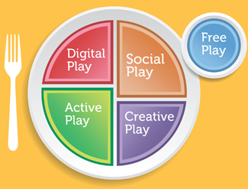

Set limits in the home or classroom around screen use
Increase opportunities for movement
Create opportunities for other forms of play
Individualize strategies to the unique needs and interests of the child

Slide 64
Digital Well-Being Cont’d
Select games that practice executive functioning skills:
1. Emotional Management
2. Organizational skills
3. Memory
LW4k.com: This is an educational platform that uses live and self-guided online classes that leverage popular video games as a teaching tool.
Age Range: 6- 13
Target symptoms: Executive function and SEL
Cost: $5.00 per class

Slide 65
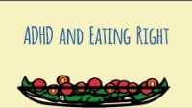
Nutritional Considerations

Slide 66
Interventions
Understand there is NO cookie-cutter recipe that will work for all students.
Interventions should be tailored to the individual child’s needs.

Slide 67
A Multimodal Approach
Cognitive Behavioral Therapy
Skills Training
Behavioral Training/Coaching
Psychological
Counseling
Classroom interventions
Music therapy

Slide 68

Creative Inspiration
  Try using music to help activate the brain
    “Research shows that pleasurable music increases the brain’s dopamine levels.”
    “Music exists in time with a clear beginning, middle, and end. That structure helps an ADHD child plan, anticipate, and react.”
    Baroque Classical Musical is helpful
      Handel
      Bach
      Vivaldi
This Photo by Unknown Author is licensed under CC BY-NC

Slide 69

Parent Support
  Break down large tasks into smaller ones
  Avoid multi-step instructions
  Use a timer to help your child develop time management skills
  Use a chart (chores/tasks)
  Get creative
  Keep it simple
  Build routines
  Be patient
  Collaborate with your child’s teacher

Slide 70
Common Rx
Take longer to start working (approx. 4 weeks)
May work for up to 24 hours
May be prescribed when stimulants don’t work, or side effects are intolerable
Stimulants
Ritalin
Concerta
Vyvanse
Adderall
Non-Stimulants
Strattera
Qelbree
Clonidine
Guanfacine
Most common medications
Effective in 70-80% of children
Work by increasing certain neurotransmitters in the brain

Slide 71
Behavior Training
Considerations:
Children with ADHD are functioning at about 30% below their chronological age in comparison to their same-age peers.
When working with children under the age of 12, refrain from asking them "Why?" They'll struggle to tell you but can give you the “What” or “How”.
Good opening with the student:
  Tell me 3 good things about you.
  If you could wish for 3 things in the world, what would they be?
Reference:
Dr. Alan Graham
Psychologist/ADHD Coach
ACP Consultants, CHADD International Conference on ADHD, 2023

Slide 72

Behavior Training Cont’d
Remember…Kids learn by doing
Things to Try
  Cards with character strengths
  VIA character strengths
  Sensory bottles for timers
  Diane McClean's YouTube channel
  Escape rooms
VIA Character Strengths Quiz

Slide 73
Fred’s Conclusion
Fred continued to struggle throughout the rest of the school year. His grades suffered, and he struggled immensely to pull through 5th grade.
With 6th grade on the horizon, Fred has expressed feelings of worry and uncertainty about going to middle school. “I just don’t think I’m smart enough. I always get in trouble, and nobody likes me. I don’t want to go 6th grade.”

Slide 74
Fred’s Conclusion
Fred’s case is not unusual. There are lots of children just like Fred, sitting in our classrooms every day.
With everything we know and have learned, how can we help Fred to successfully transition to middle school?

Slide 75
Summary
Wrapping it All Up

Slide 76
We Learned…
Fundamentals about the ADHD diagnosis and common misunderstandings
Statistics and DSM-V diagnostic criteria
The presentation of symptoms in males vs. females
Developed an understanding of the impacts on the child
Acquired strategies and tips to promote student success

Slide 77

Questions??

Slide 78

Thank You!

Slide 79
Contact Info
Arrione Clarke, MSW, LCSW
Behavioral Health Clinician Supervisor
arclarke@dallasisd.org
972-581-4186

