Slide 1




DISD CAREER INSTITUTE WEST
COMMUNITY MEETING REUNIÓN DE LA COMUNIDAD
February 28th, 2024

Slide 2








Opening
Summer 2024
Bidding
2023
2024
2025
2026
Fall 2023 - Spring 2024
Winter 2024 - 2026
Design
Construction
Summer 2024
Demolition
*Contingent to Zoning & City Permitting Approvals
DISD CAREER INSTITUTE WEST
Tentative Schedule | Calendario tentativo

Slide 3
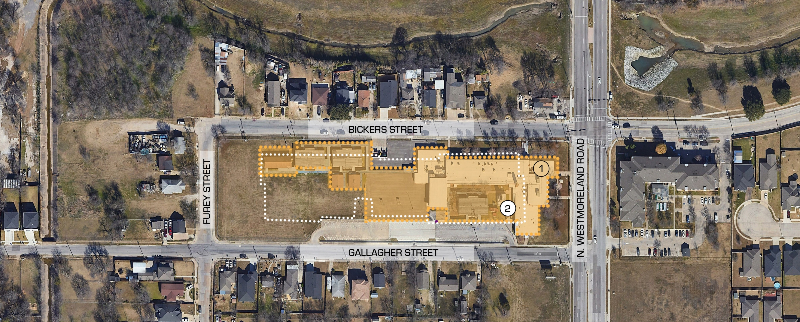

1
Existing DESA School
Building Area: Ground Floor | 82,697 SF
Building Area: Second Floor | 63,704 SF
Total Building Area | 146,401 SF
Acrage of Site | 5.224 Acres
Square Footage of Site | 227,544 SF
Lot Coverage | 36.4%
2
Proposed School Footprint
DISD CAREER INSTITUTE WEST
Existing Conditions | Condiciones Existentes

Slide 4
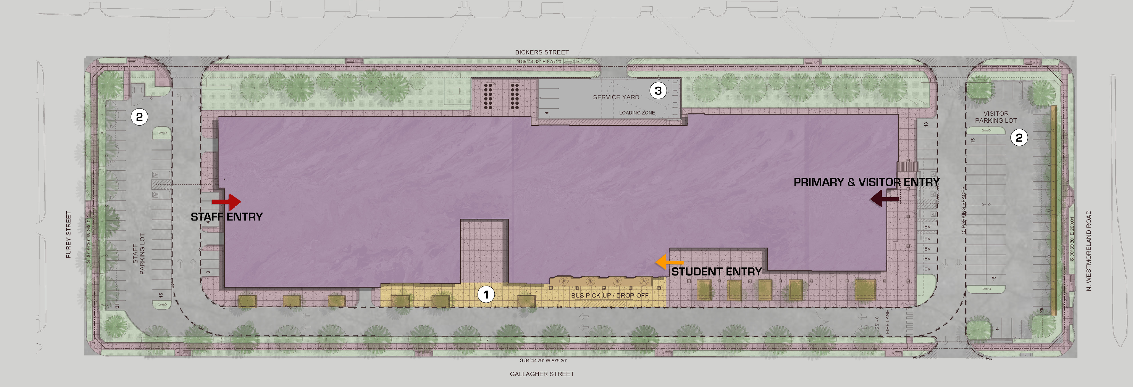


Description | Proposed Conditions
Anticipated Enrollment (By grade) 9th Grade: 25% 10th Grade: 25% 11th Grade: 25% 13th Grade: 25% | Anticipated Enrollment (By grade) 200 200 200 200
Total: 100% | Total: 800
Daily Start/End Schedule | >Start: 9:00 AM >End: 4:20 PM
Approximate Percentage of Students Travelling by Mode Other Than Drop off/Pick up/Bus | 0%
Approximate Percentage of Students Remaining after Dismissal Time | 0%
Percentage of Students to use Bus Drop off/Pick up Service | 100%
Student Entry
Primary & Visitor Entry Staff Entry
Bus Drop Off Zone
Visitor & Staff Parking Lot Service Yard
DISD CAREER INSTITUTE WEST
Site Plan | Plan del Sito

Slide 5
DISD CAREER INSTITUTE WEST
Development Plan | Plan de Desarrollo
Zoning Community Meeting February 28th, 2024

Slide 6
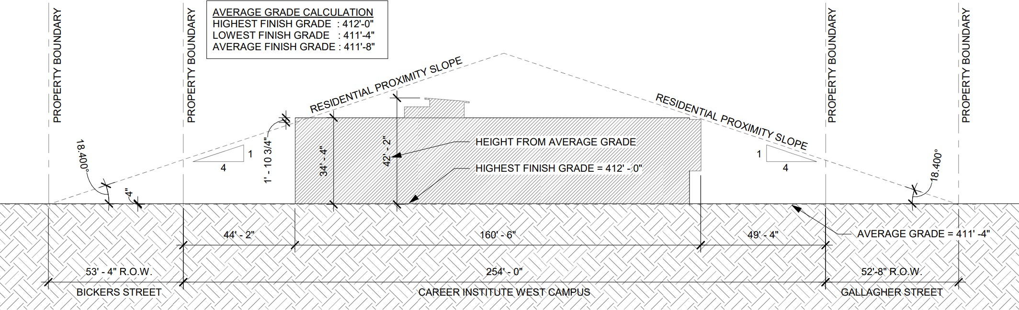
Height Permitted | 75’
Height Proposed | 40’
Stories Permitted | 3
Stories Proposed | 2
DISD CAREER INSTITUTE WEST
Residential Proximity Slope| Pendiente de Proximidad Residencial
Zoning Community Meeting February 28th, 2024

Slide 7
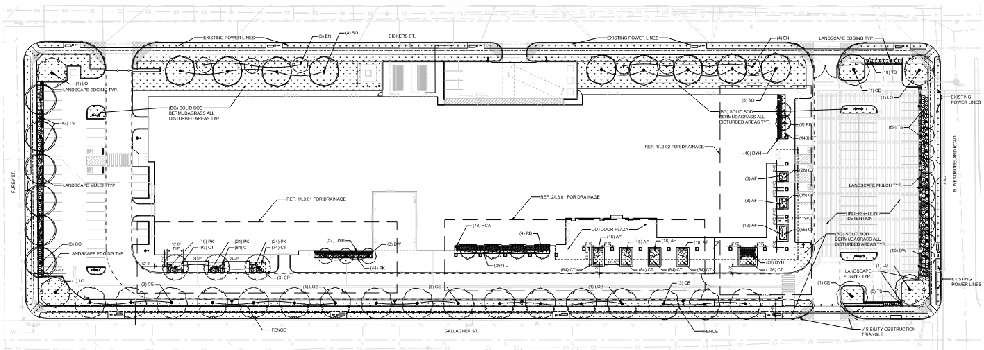
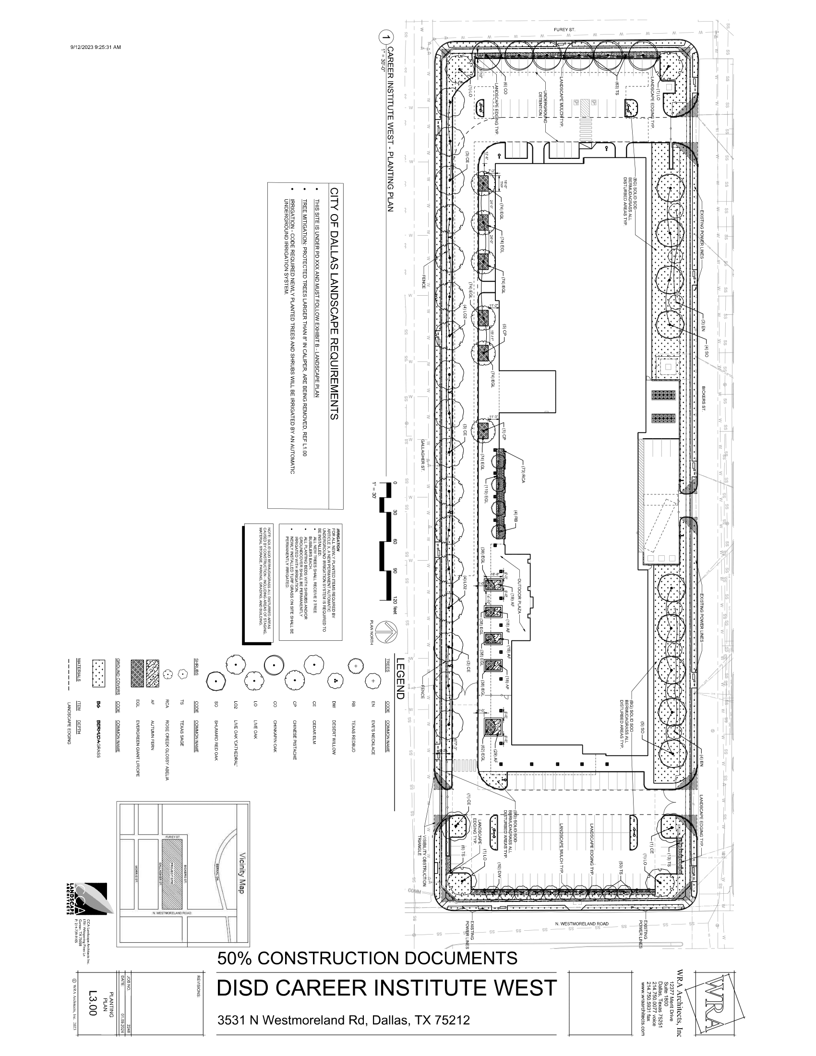
DISD CAREER INSTITUTE WEST
Landscape Plan | Plan Paisajístico
Zoning Community Meeting February 28th, 2024

Slide 8
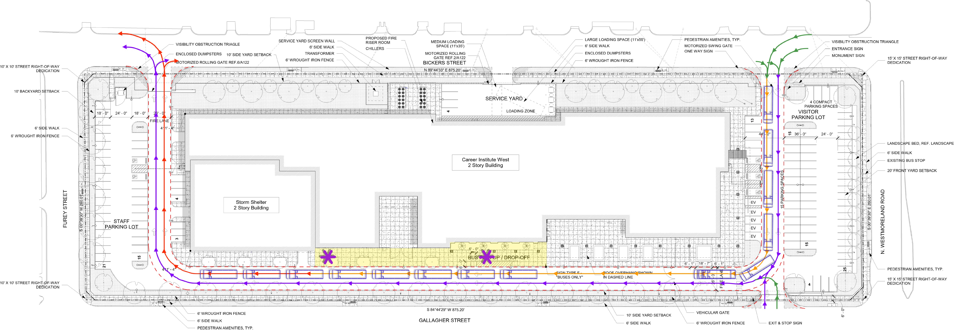


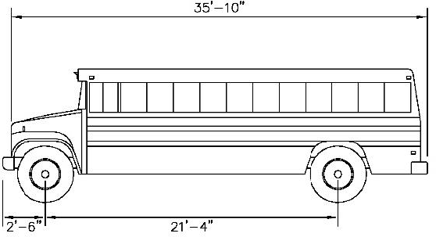
Bus Drop Off Zone Staff Member Inbound Bus Queue
Outbound Bus Queue Outbound Staff/Visitor Lane Inbound Traffic
Width : 96.0 inches
Track : 96.0 inches
Lock to Lock Time : 6.0 inches
Steering Angle : 37.6 inches
Student Group | Dismissal time and number of students | Vehicular Demand Queue
9th - 12th Grade | 12:00 AM - 800 Students 04:20 PM - 800 Students | Provided: 18 School Buses Required: 18 School Buses Provided: 18 School Buses
DISD CAREER INSTITUTE WEST
Traffic Management Plan | Plan de Gestión del Tráfico
Zoning Community Meeting February 28th, 2024

Slide 9
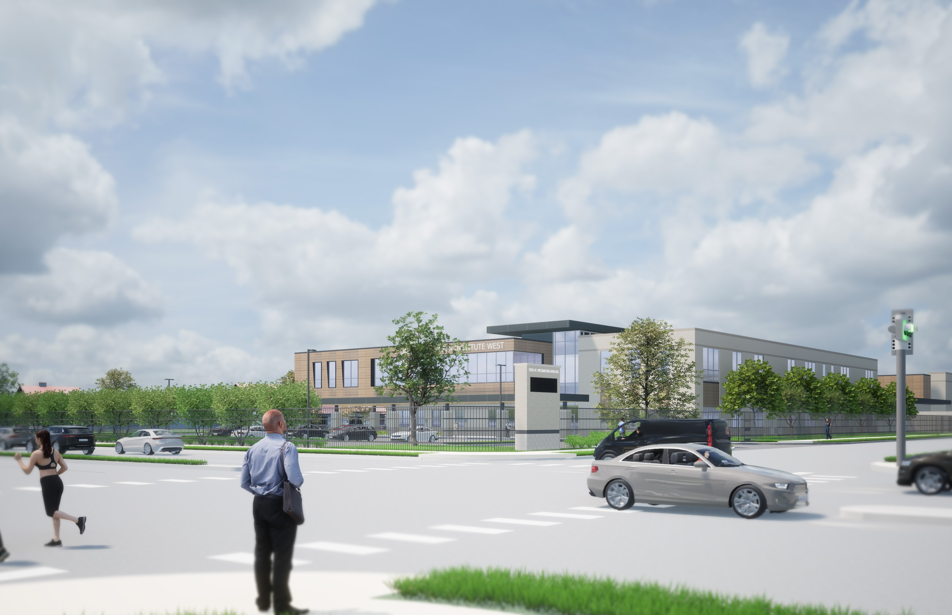
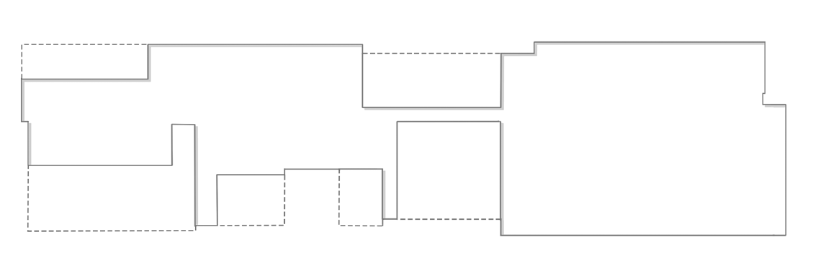


North East Corner | Esquina Noreste

Slide 10
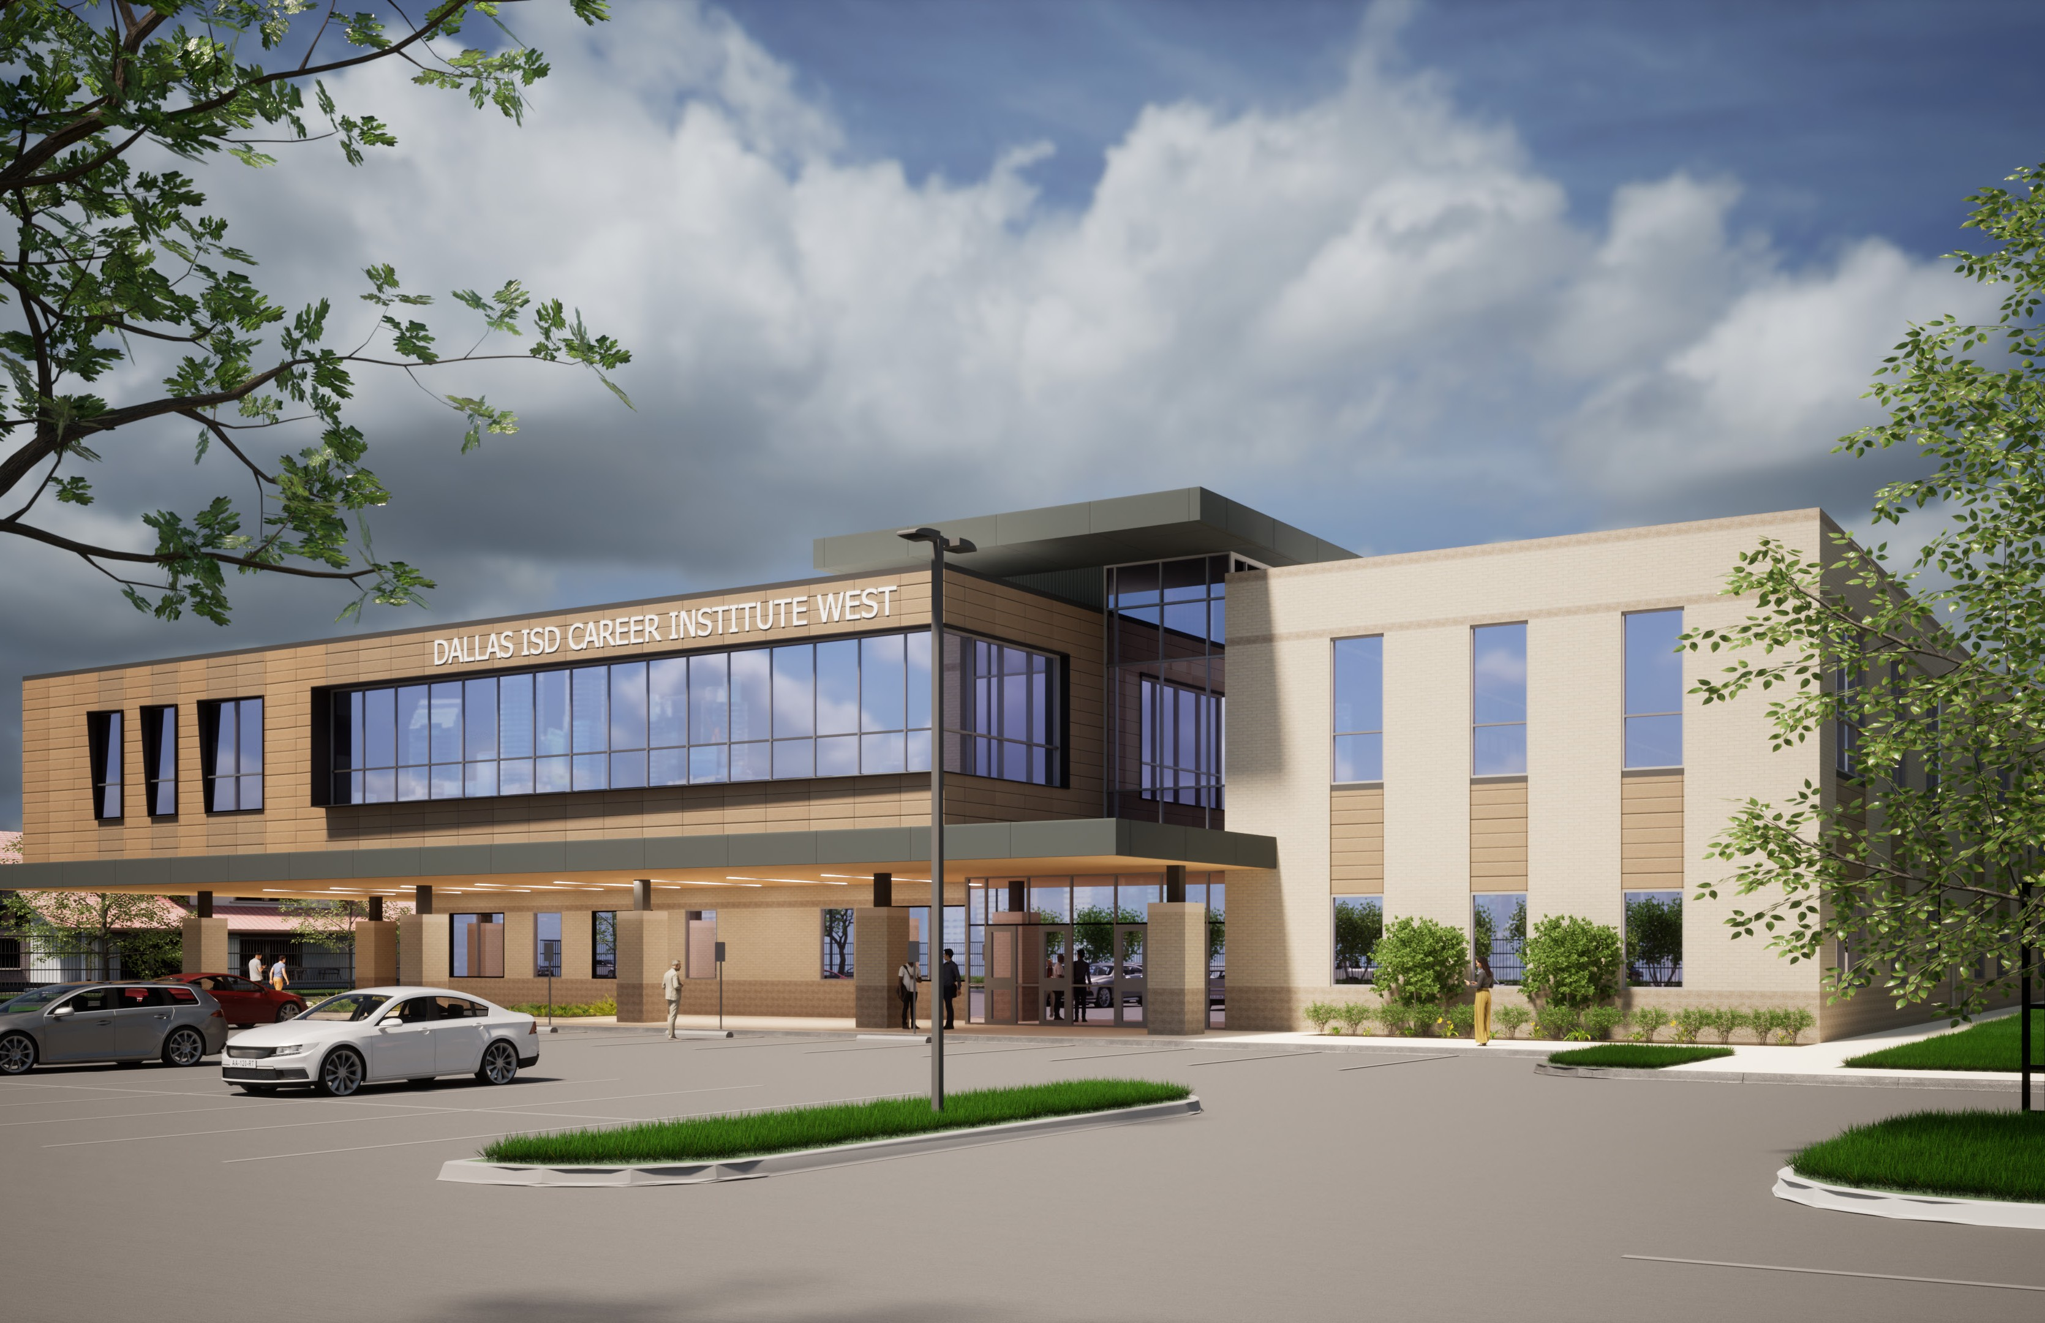
North East Corner | Esquina Noreste

Slide 11
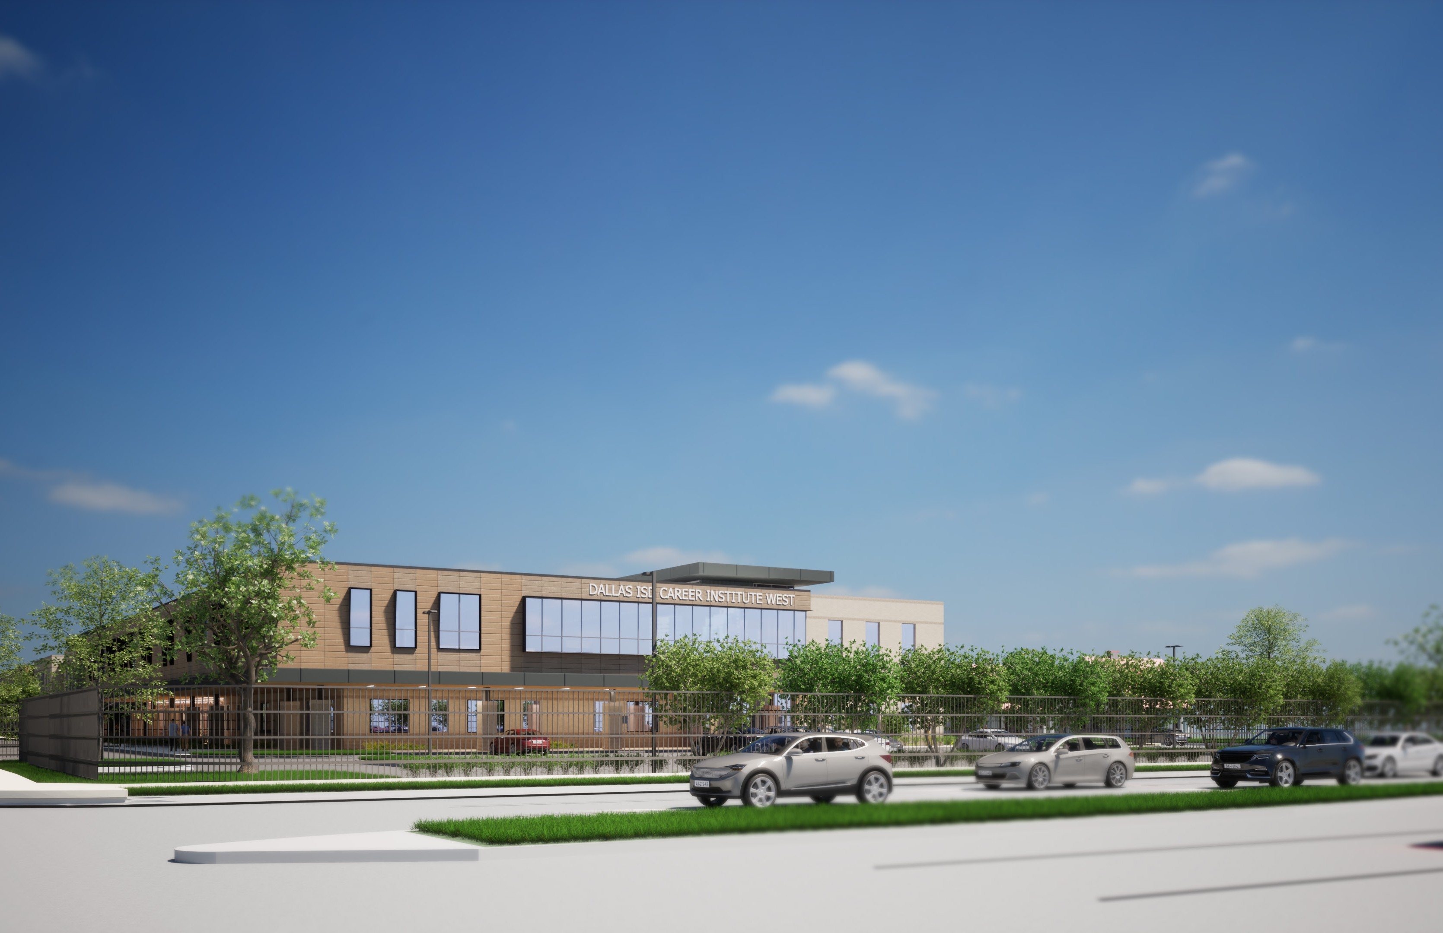
South East Corner | Esquina Sureste

Slide 12
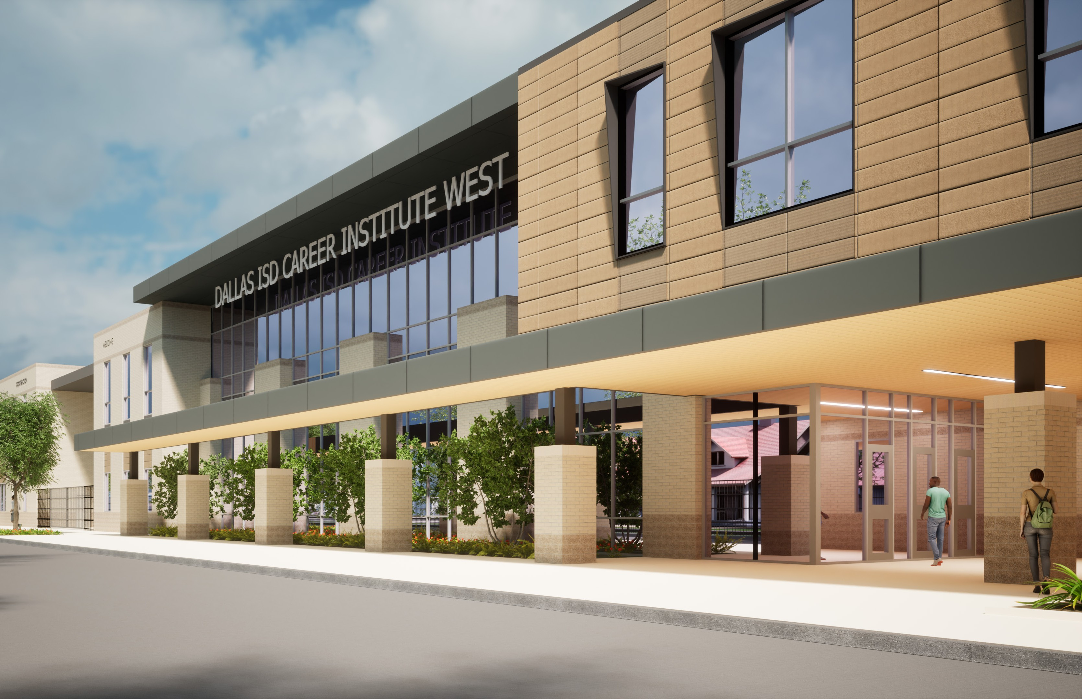
Cafeteria | Cafetería

Slide 13
DISD CAREER INSTITUTE WEST
THANK YOU /GRACIAS QUESTIONS? /PREGUNTAS?
February 28th, 2024

Slide 14
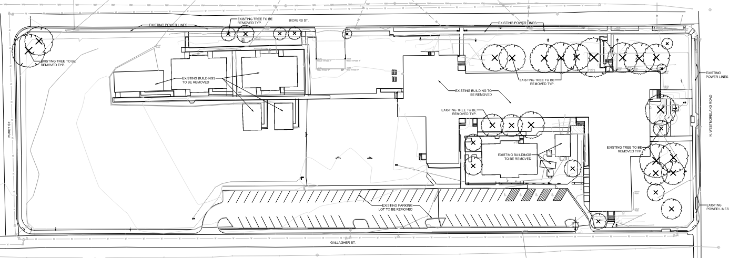
Existing Trees | 33
Proposed Trees | 67
DISD CAREER INSTITUTE WEST
ExistingTrees | Arboles Existentes
Zoning Community Meeting
February 28th, 2024

Slide 15
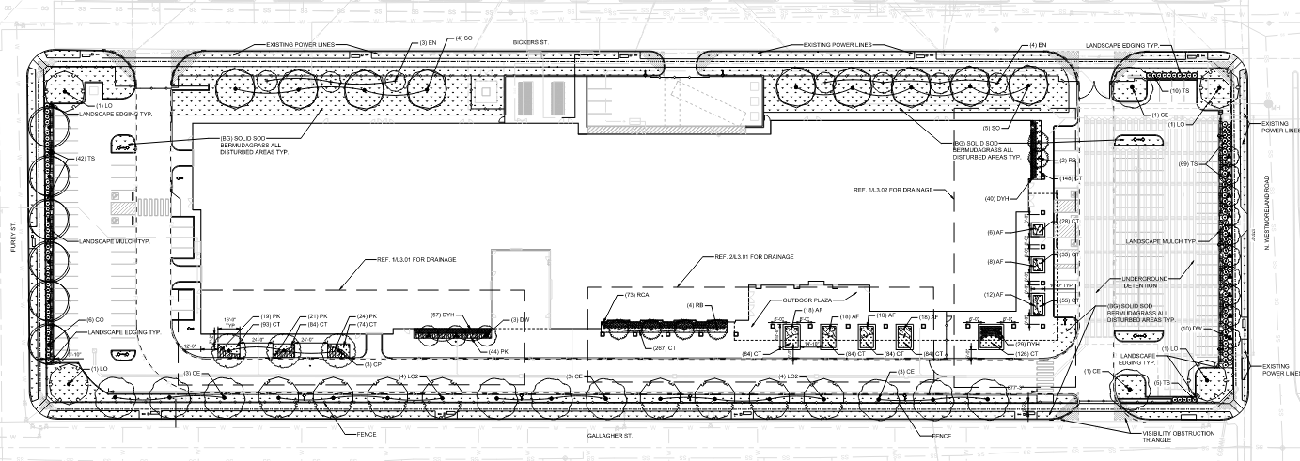
Existing Trees | 33
Proposed Trees | 67
DISD CAREER INSTITUTE WEST
Proposed Trees | Arboles Propuestos
Zoning Community Meeting
February 28th, 2024

