Slide 1
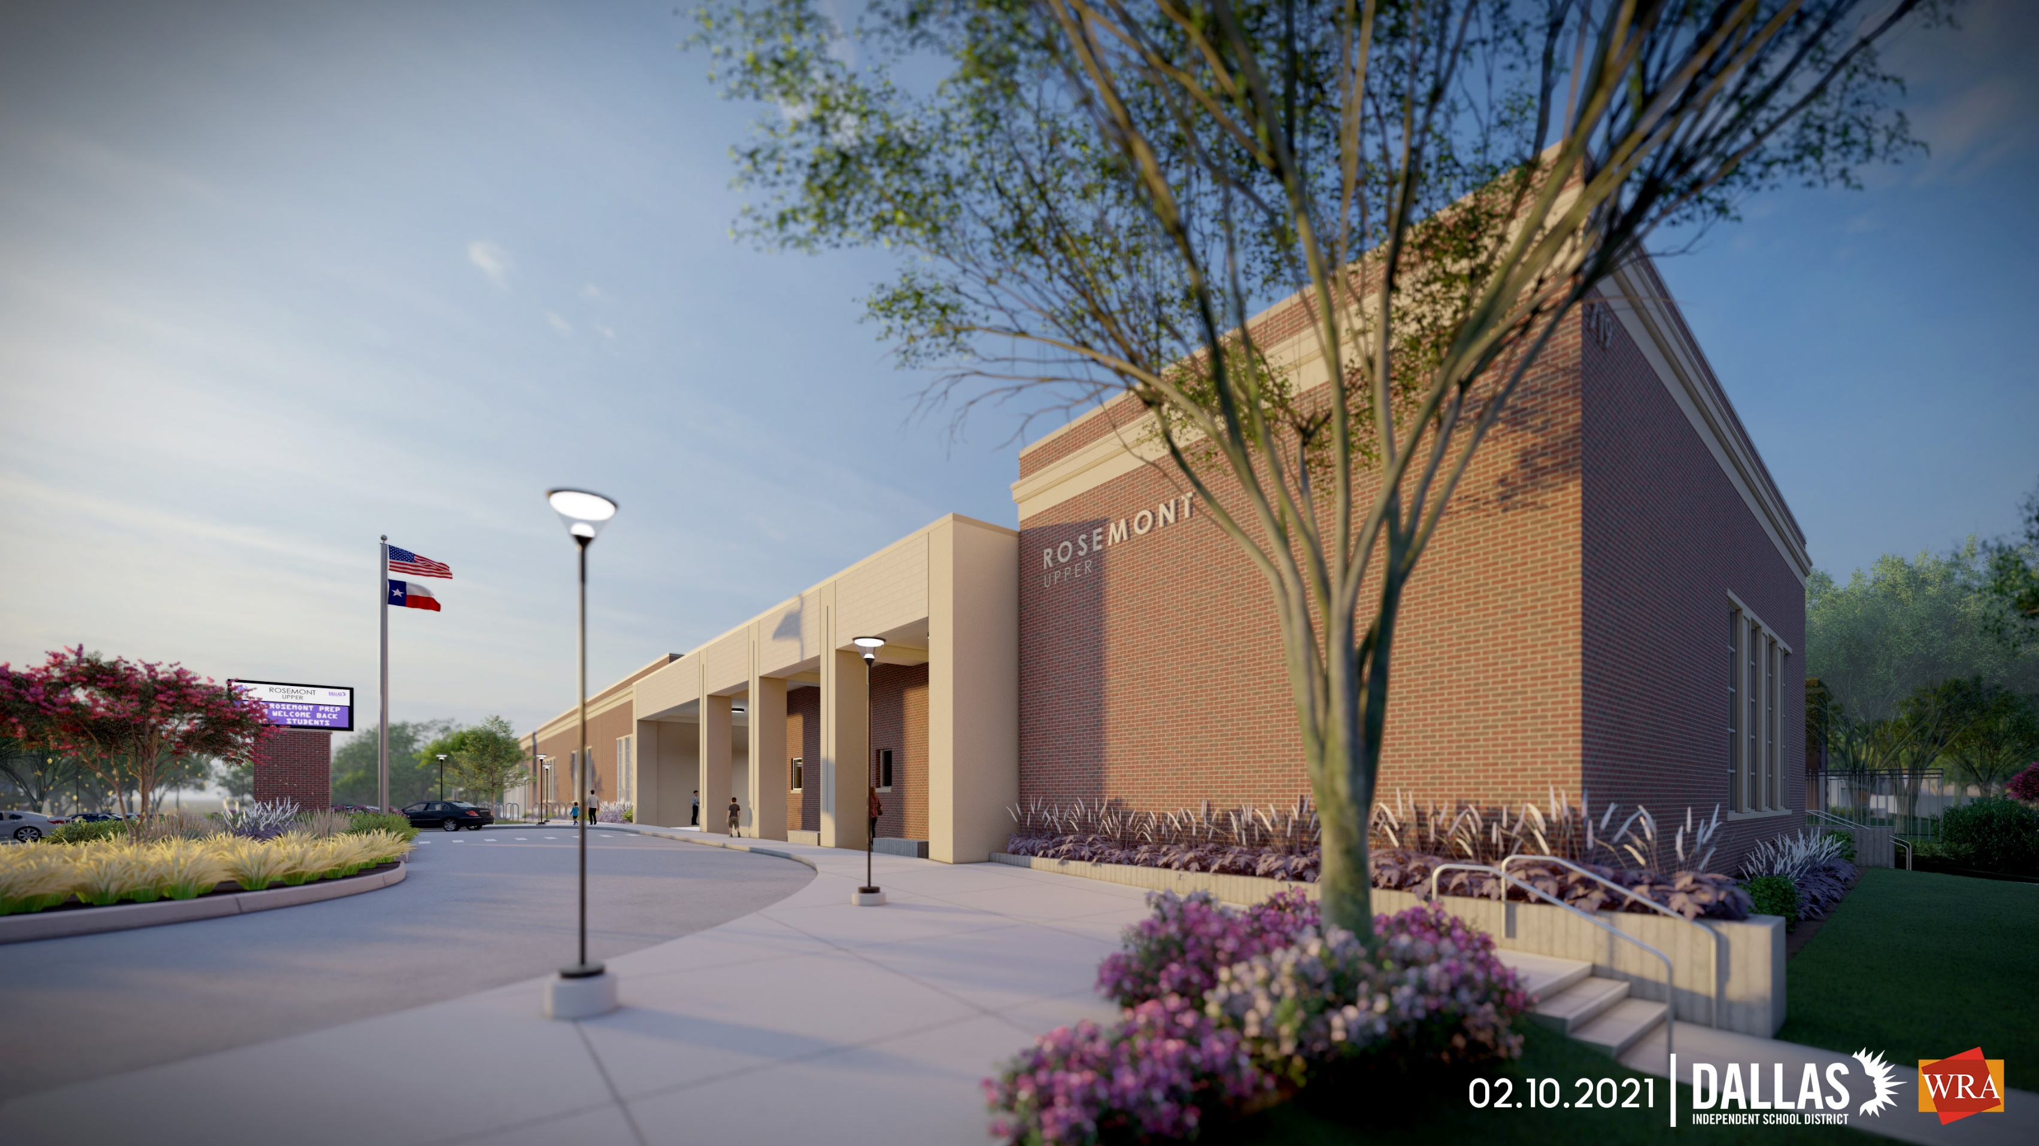


DISD Rosemont Upper - Community Meeting – 10/03/2023

Slide 2
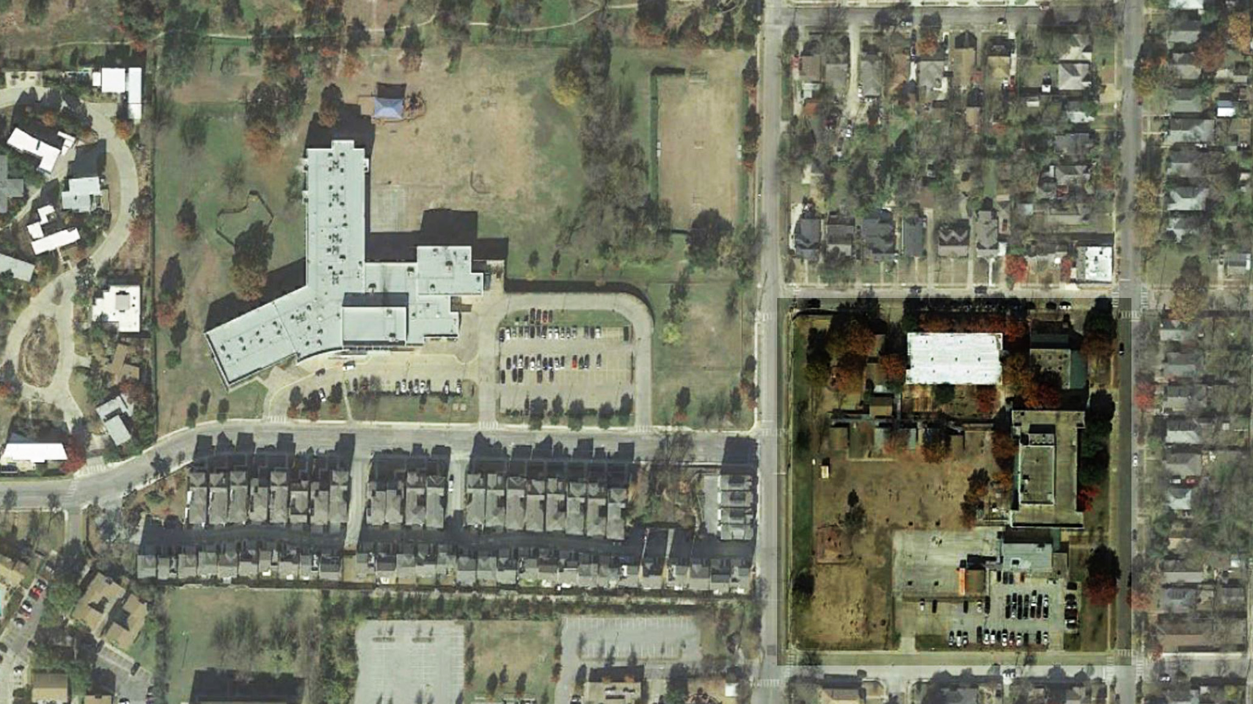

n

Slide 3
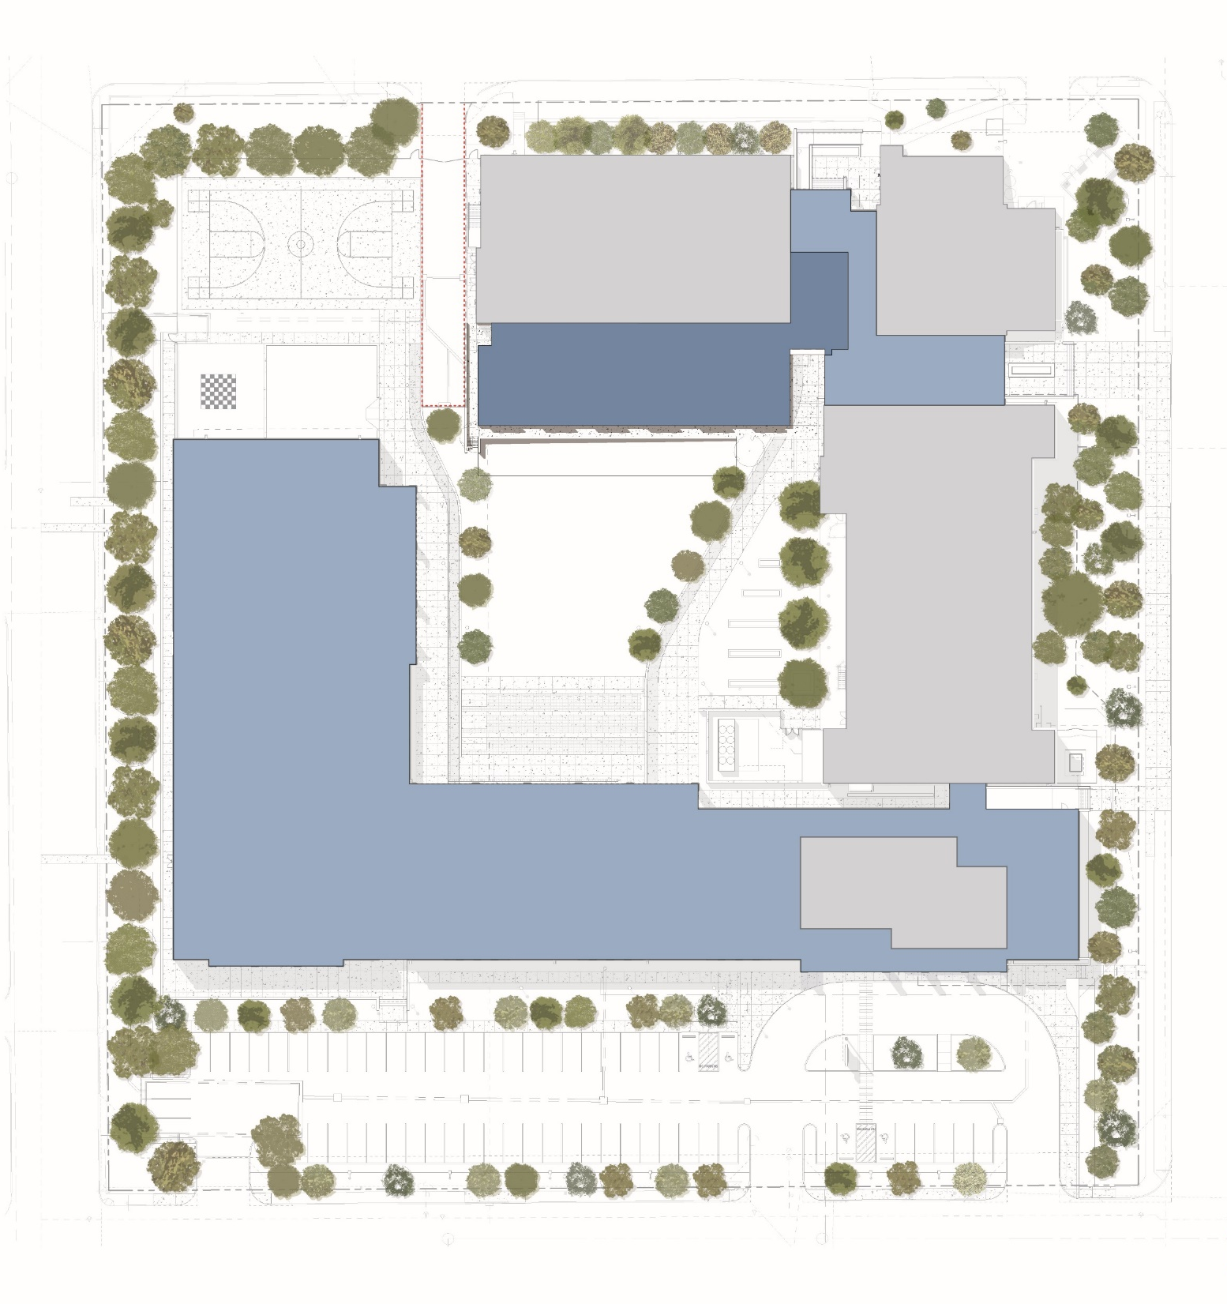
EXISITNG
EXISITNG
EXISTING BUILDING
PHASE 1 BUILDING
PHASE 2 BUILDING
6 CLASSROOM
ADDITION
EXISITNG
PHASE 1
UNDER CONSTRUCTION
EXISITNG

Slide 4
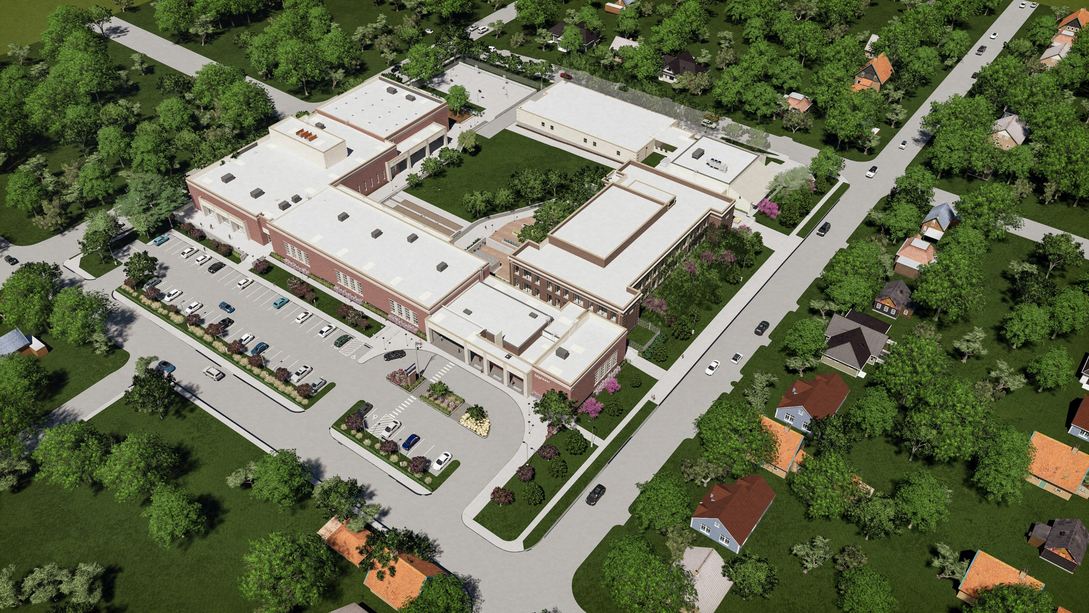
DRAFT

Slide 5
DRAFT

Slide 6
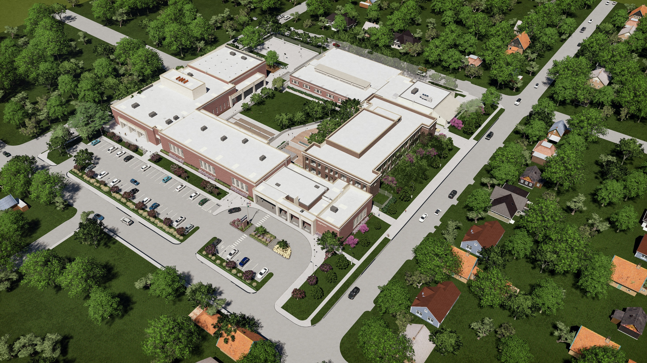
DRAFT

Slide 7
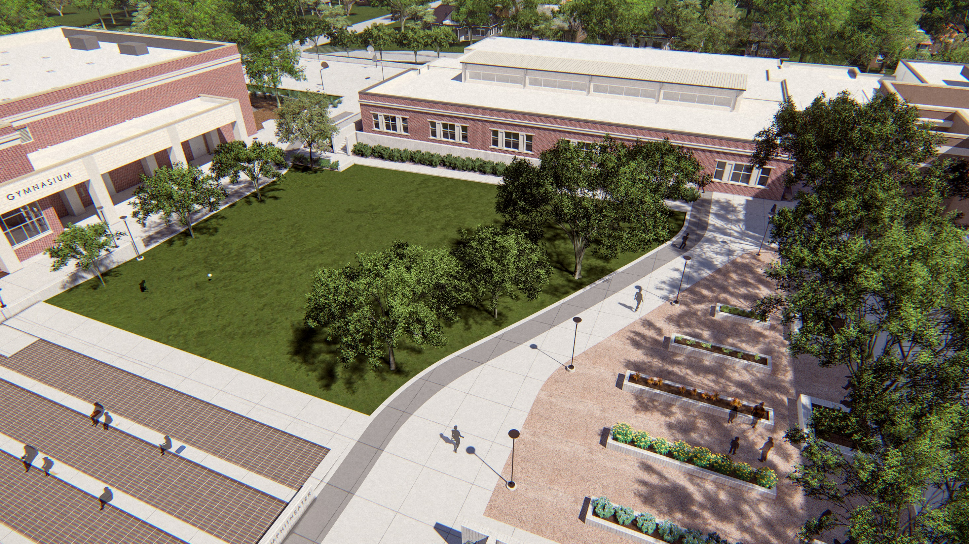
DRAFT

Slide 8
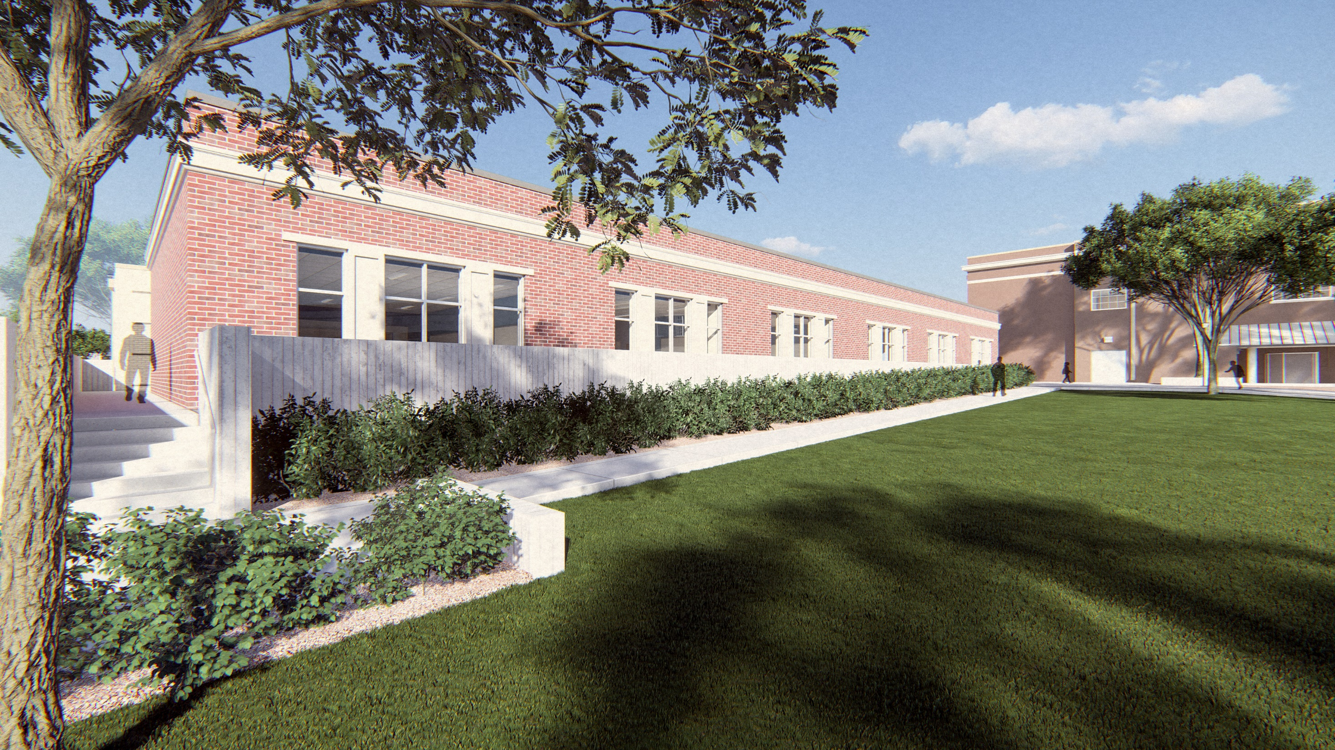
DRAFT

Slide 9
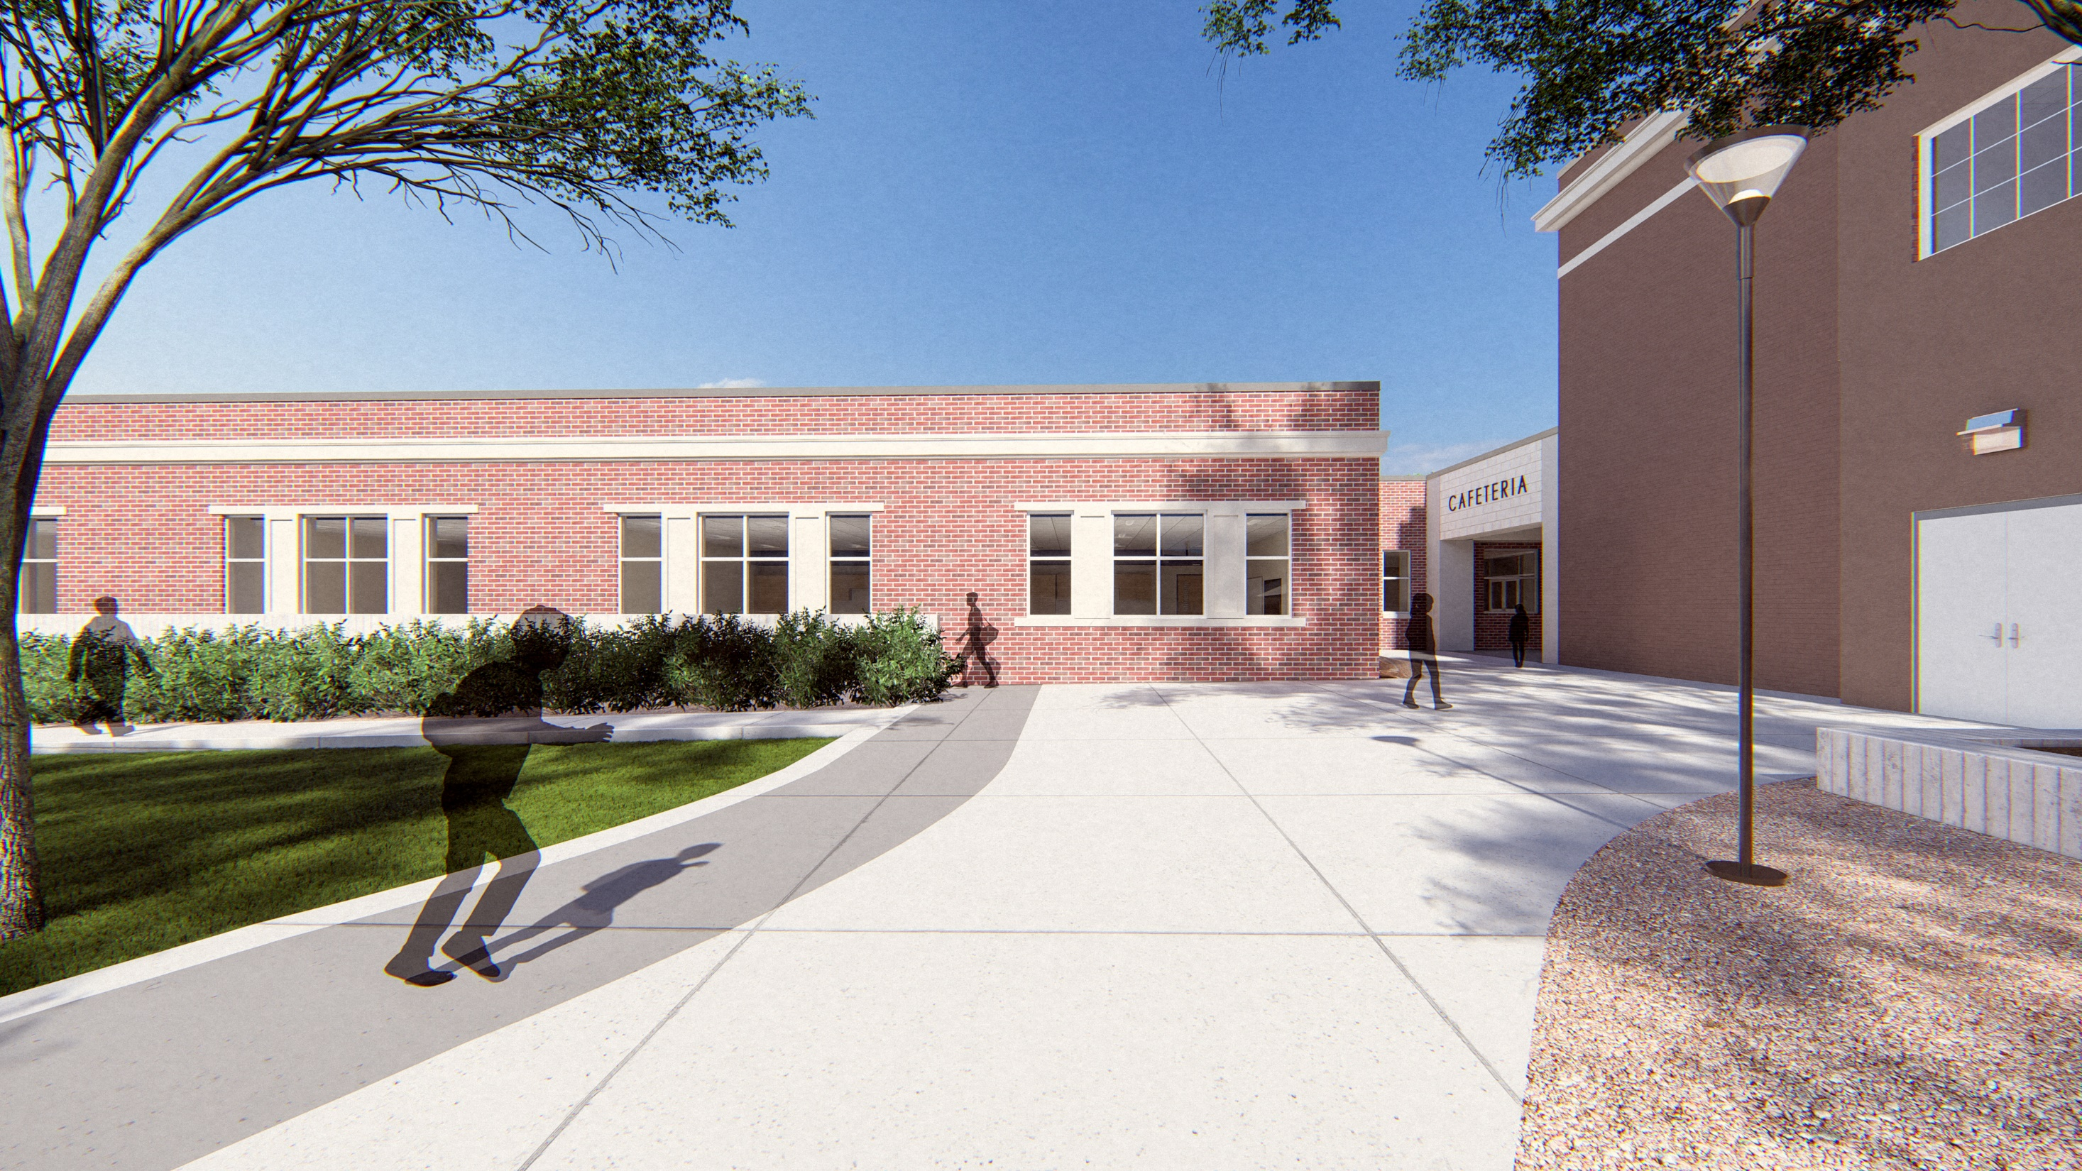
DRAFT

Slide 10
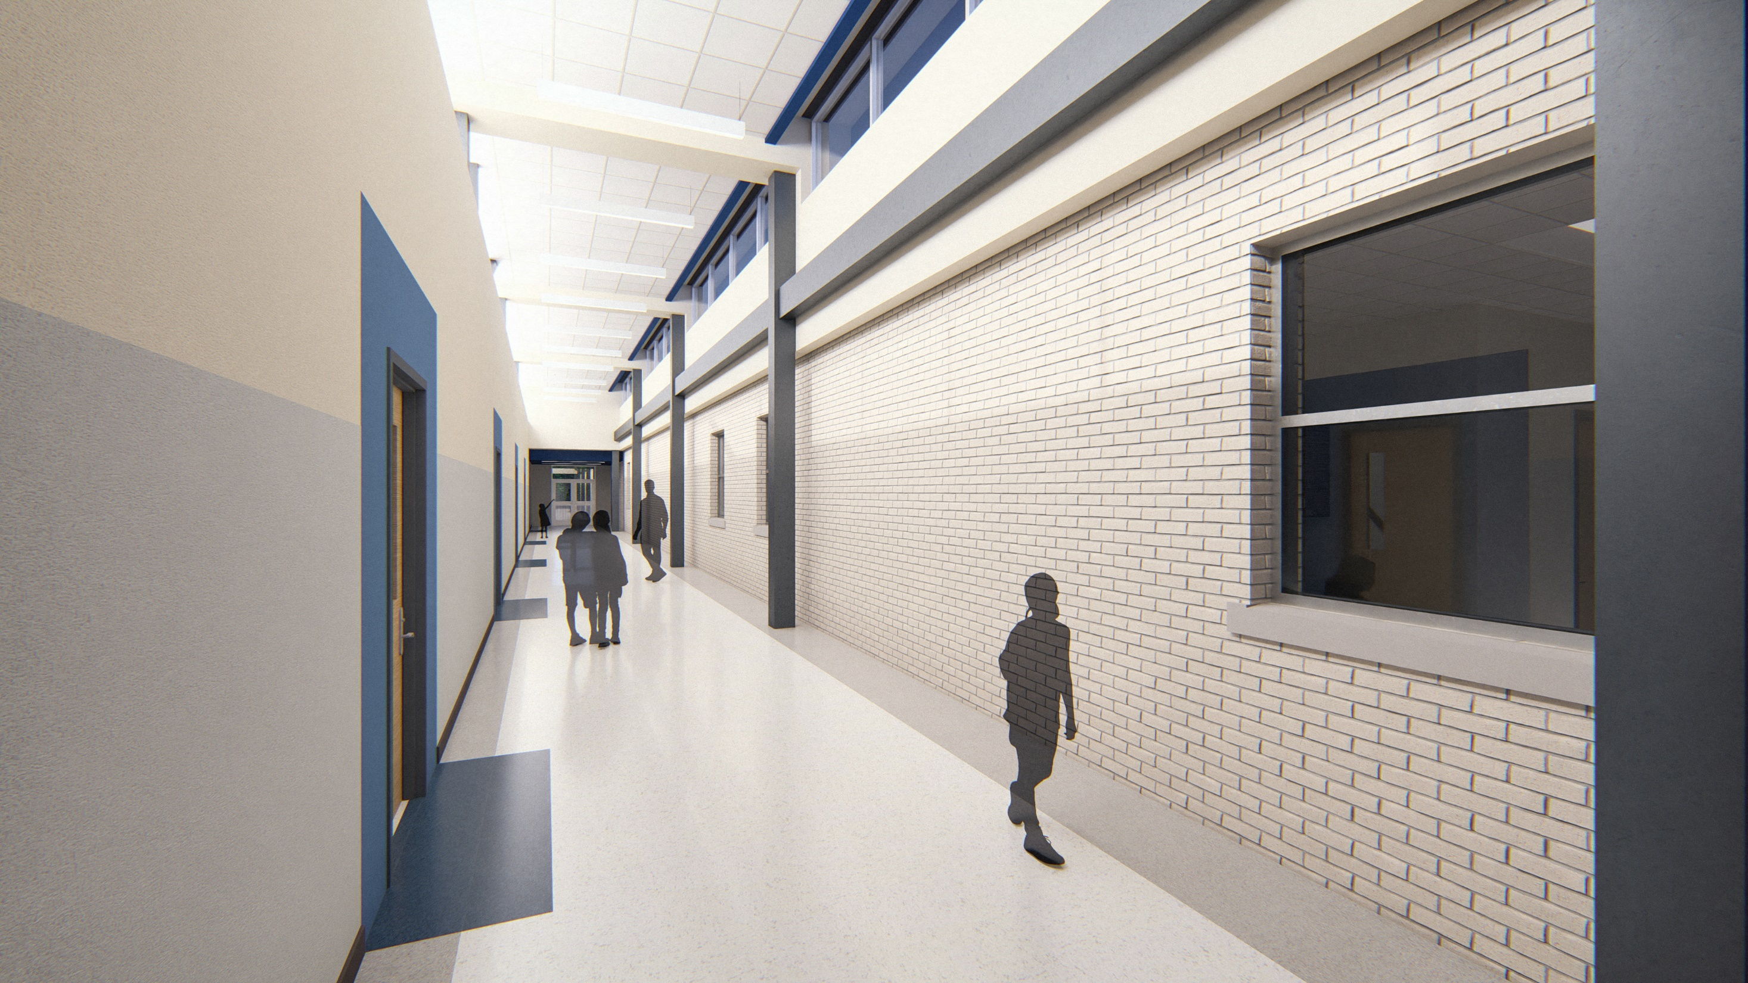
DRAFT

Slide 11
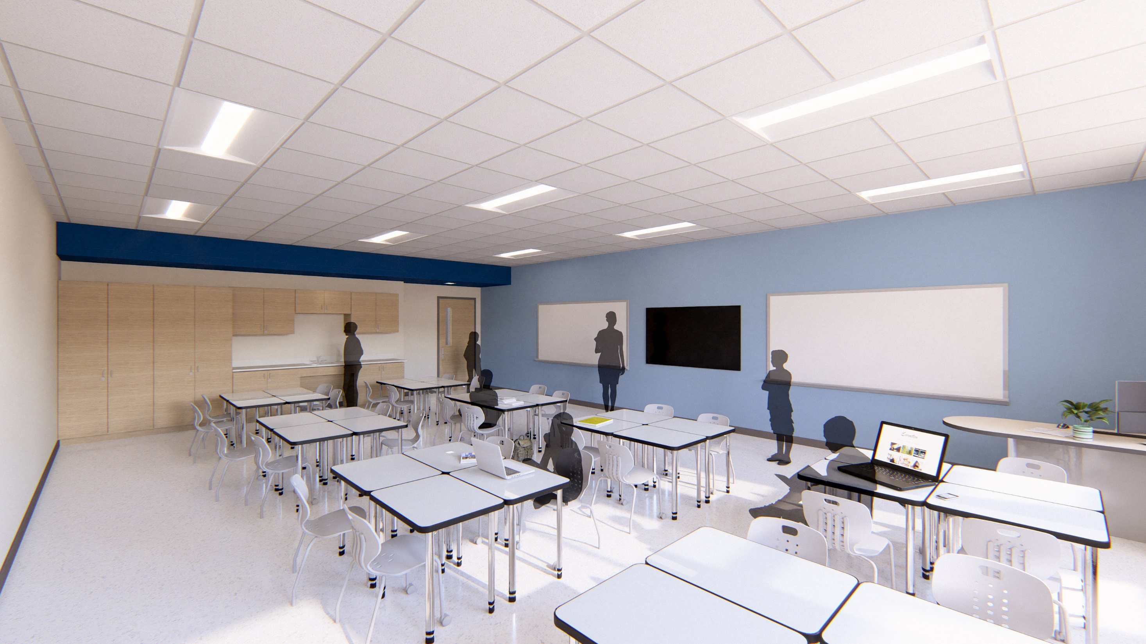
DRAFT

Slide 12
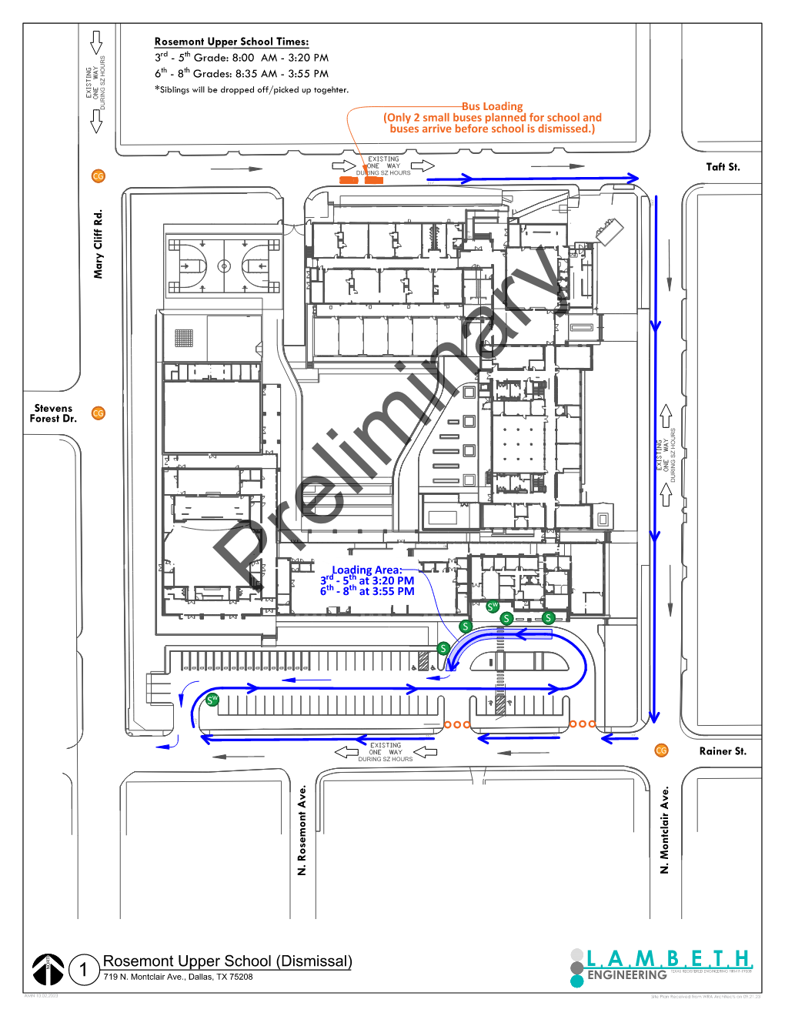
Traffic Management Plan
EXISITNG
EXISITNG
6 CLASSROOM
ADDITION
EXISITNG
PHASE 1
UNDER CONSTRUCTION
EXISITNG

Slide 13
DISD Rosemont Upper - Community Meeting – 10/03/2023

