Slide 1

Meeting No. 3
Midland Freshman High School
April 20, 2023
BOND PLANNING COMMITTEE

Slide 2
Welcome & Agenda
Superintendent Welcome
Committee Charge
Questions/RFI Follow Up
Outcomes for Meeting
Teaching & Learning and Grade Configuration
  Table Discussion
  Consensus
Facility Implications
  Table Discussion
  Consensus
Communication/RFI’s
Next Steps
MISD Bond Planning Committee
Notes:
Superintendent, Sheri

Slide 3
Planning Committee Charge
Review the recommendations made by the Long-Range Facility Planning Committee, as a result of their extensive study of the comprehensive facilities assessment, demographic data, and anticipated academic programs.
Review options for existing, renovated and/or new facilities, and their implications for student enrollment, innovative instructional programs, modern learning requirements, technology and educational specifications, staffing, operational effectiveness and fiscal responsibility.
Develop and recommend to the Midland ISD Board of Trustees a Bond Plan that addresses student learning environments for the next 5 years, and prepares the district for future enrollment growth, evolving instructional programs, and preventive maintenance.
MISD Bond Planning Committee
Notes:
Sheri

Slide 4
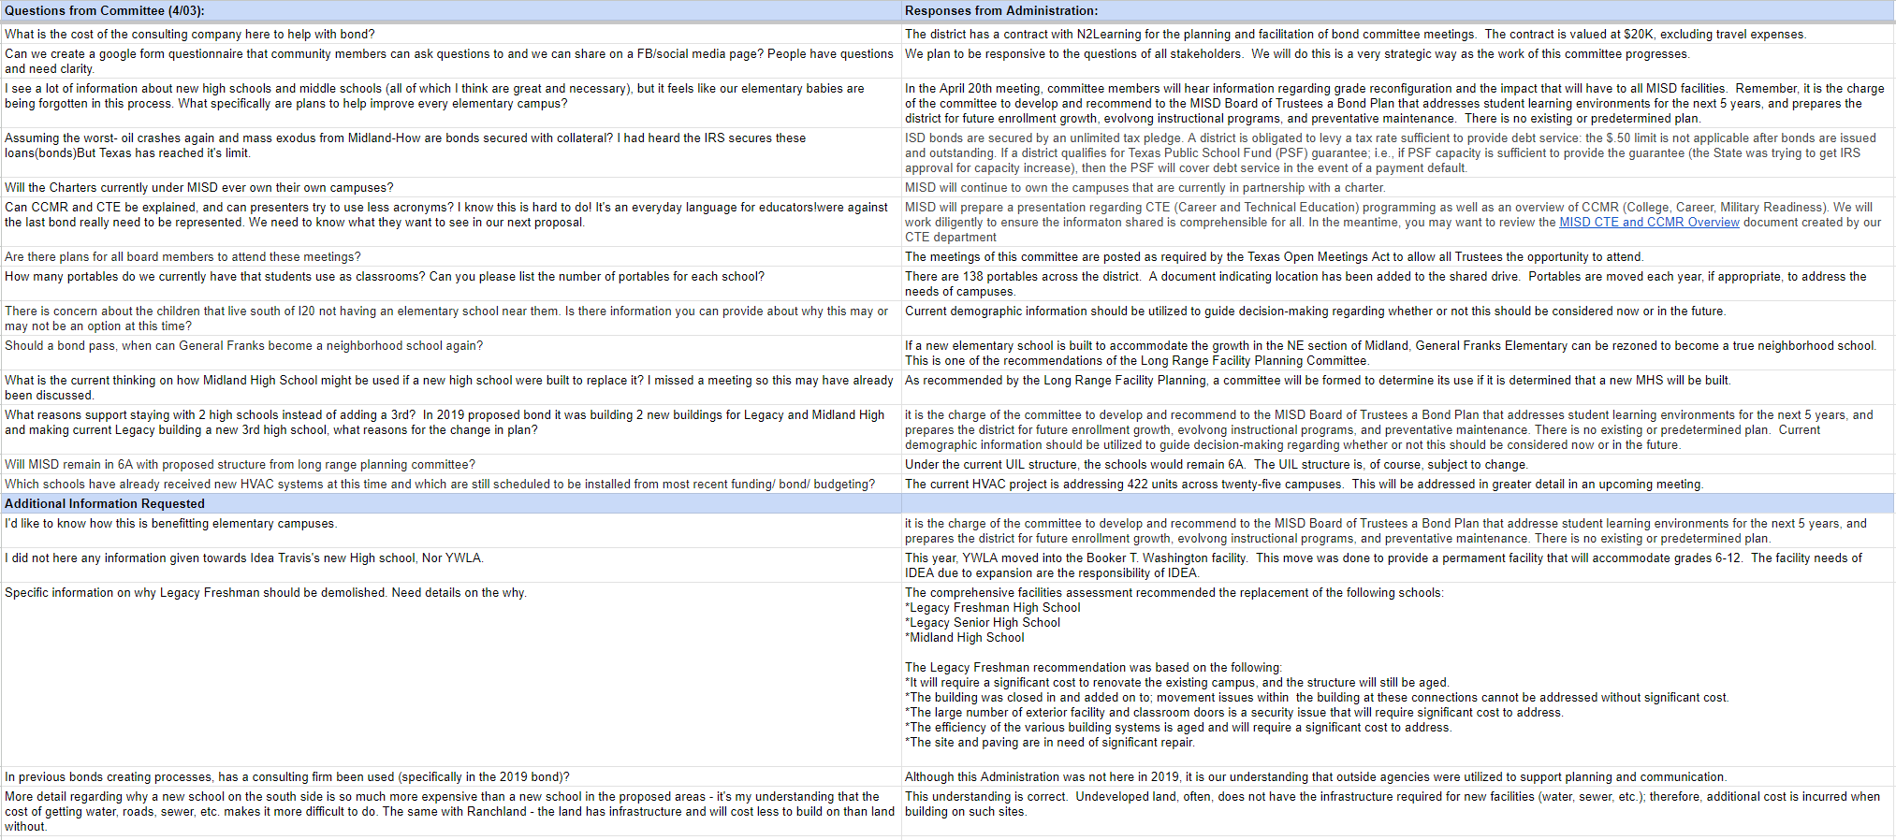
Questions/RFI’s
MISD Bond Planning Committee
Notes:
Sheri/Staff

Slide 5
Outcomes
Develop consensus on the grade configuration changes.
Develop consensus on the best option for the high school plan.
MISD Bond Planning Committee
Notes:
Ken

Slide 6
Teaching & Learning/Grade Configuration
Presentation
Table Discussion/Q & A
Consensus work
MISD Bond Planning Committee
Notes:
Staff

Slide 7


Grade Reconfiguration
Bond Planning Committee
April 20, 2023
www.midlandisd.net

Slide 8
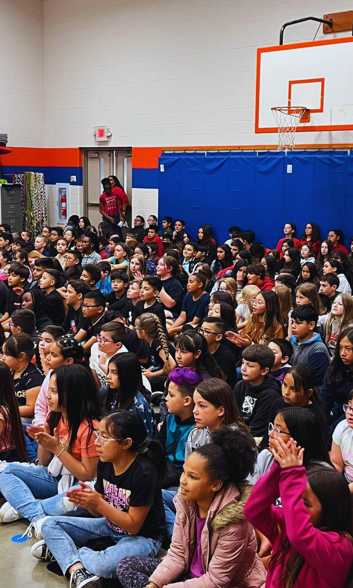
Objectives
Review current grade level configurations
Discuss rationale and benefits to reconfiguration
Questions and Answers
www.midlandisd.net

Slide 9
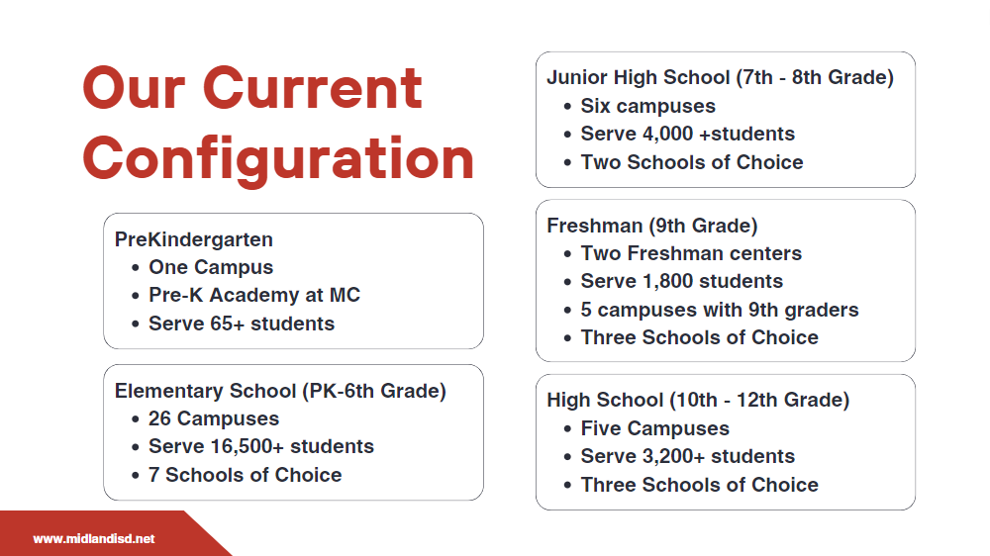

Slide 10

Our Opportunity
As a community, we have the opportunity to explore an alternate model for grade configuration to better meet the needs of our students.
PK-5th Grade
Middle Schools
6th - 8th Grades
High Schools
9th - 12th Grades
Schools of Choice
www.midlandisd.net

Slide 11

Benefits to Academics
Grade configuration impacts student outcomes in many ways
Consistency for students
Reduction of student transitions from school to school
Expanded course options (core and electives - Ex. Career and Technical Education)
Student developmental levels
Sense of belonging and investment in the school culture
www.midlandisd.net

Slide 12

Benefits to Academics
Continued...
Allows for teacher specialization
Professional Learning can be vertically aligned
Expansion of Pre-K opportunities (3 and 4 year olds)
www.midlandisd.net

Slide 13

Additional Benefits
Co-curricular and Extra-curricular Activities
Access
Investment
Transportation
Efficiency
Students will have access to more co and extra-curricular options.
Teachers and coaches can begin to invest in the development of students.
There will be a reduction in the need of transportation between schools and facilities.
Current staffing would be utilizing more effectively and efficiently.
www.midlandisd.net

Slide 14

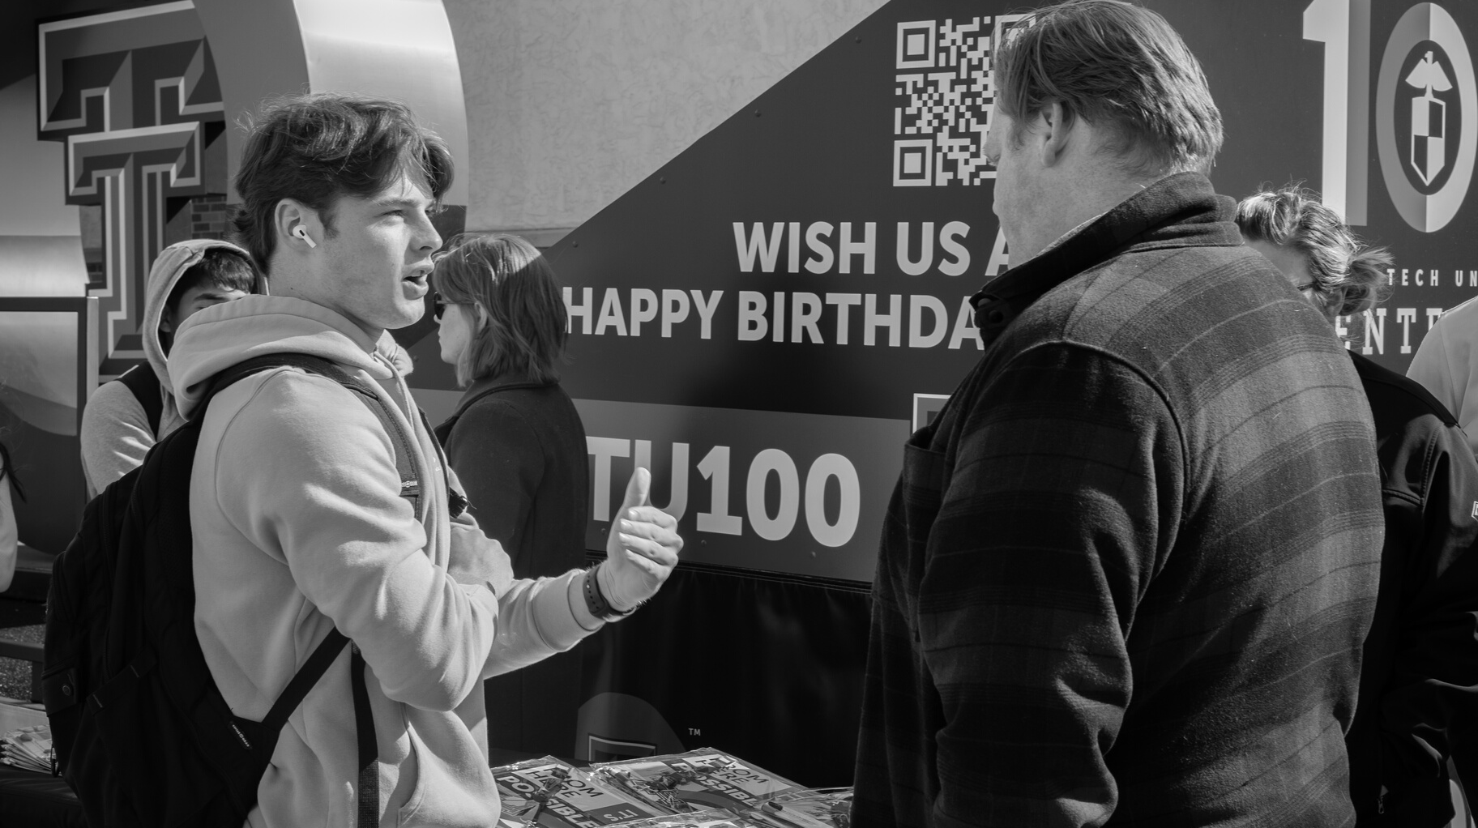


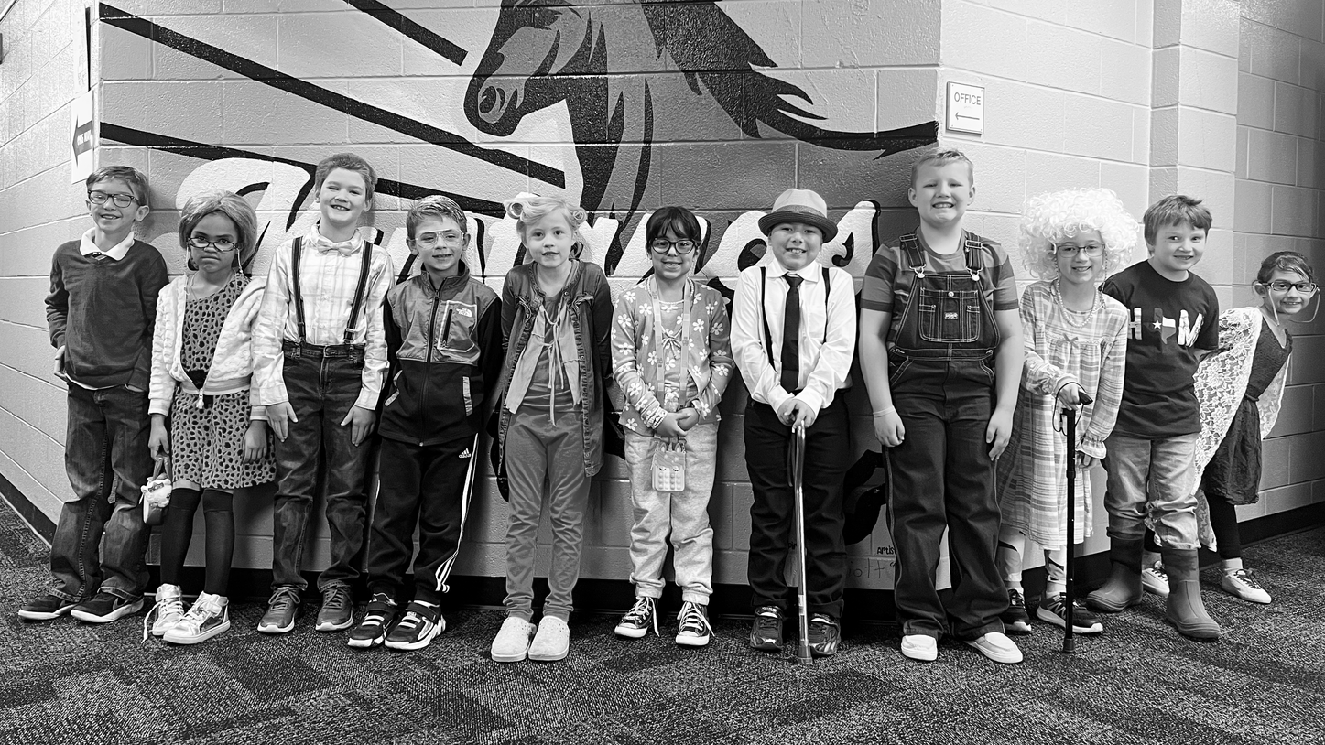
Questions
www.midlandisd.net

Slide 15

www.midlandisd.net/survey
Complete survey by scanning QR code or visiting link below.

Slide 16
High School Options
Presentation
Table Discussion/Q & A
Consensus work
MISD Bond Planning Committee
Notes:
Terry Hoyle

Slide 17


Midland ISD Bond Planning
Facility Capacity Assessment
April 20, 2023

Slide 18
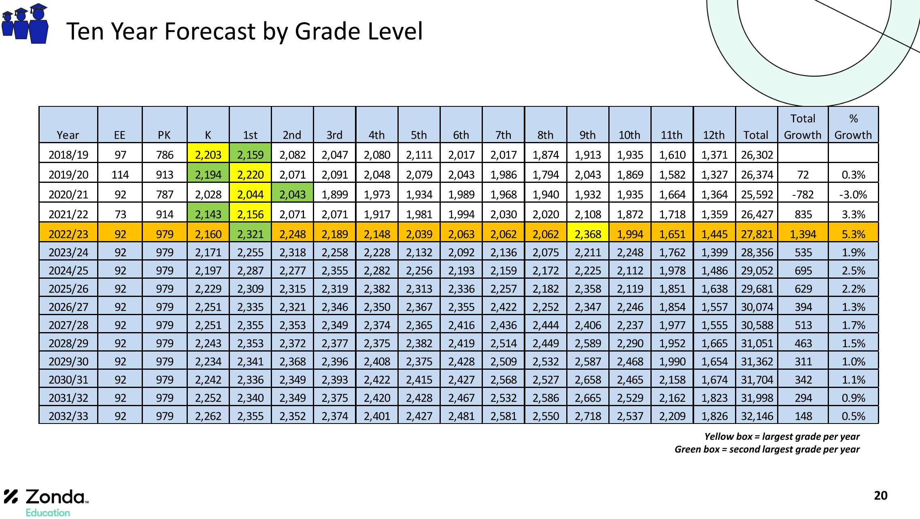
14%
48%
41%

Slide 19
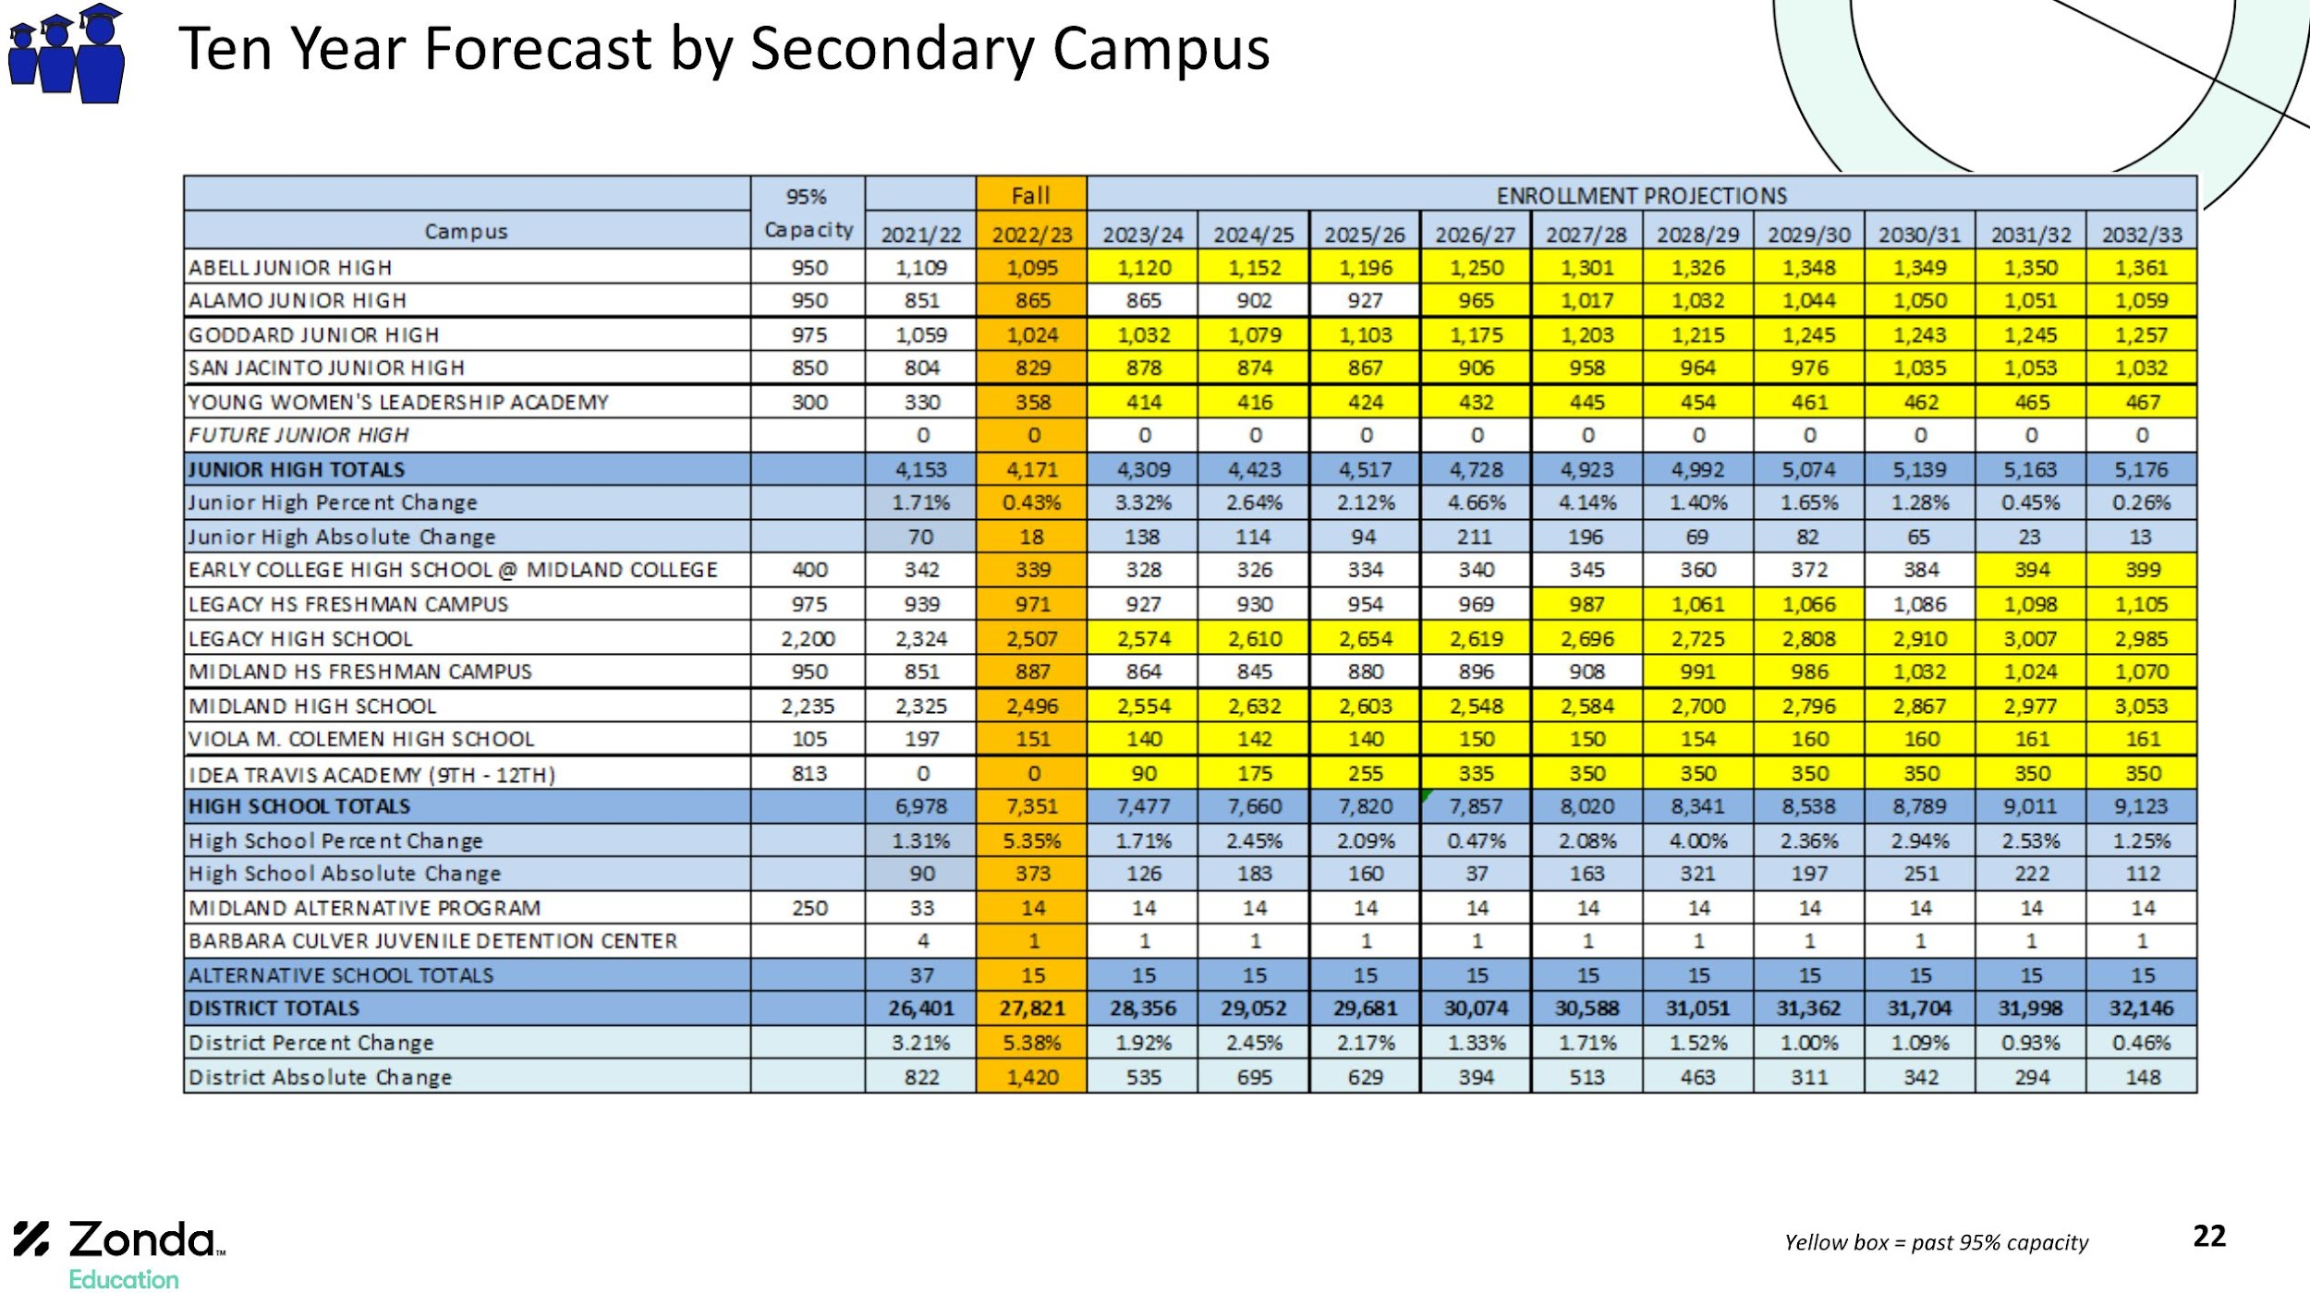
Bond Election
New
ES
New
HS
Campus Modifications

Slide 20
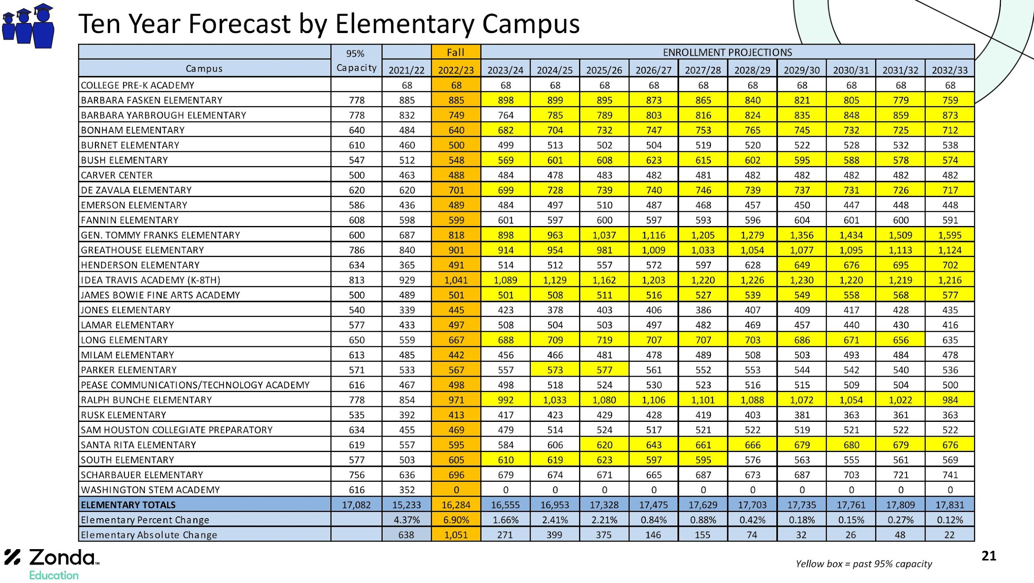

Slide 21
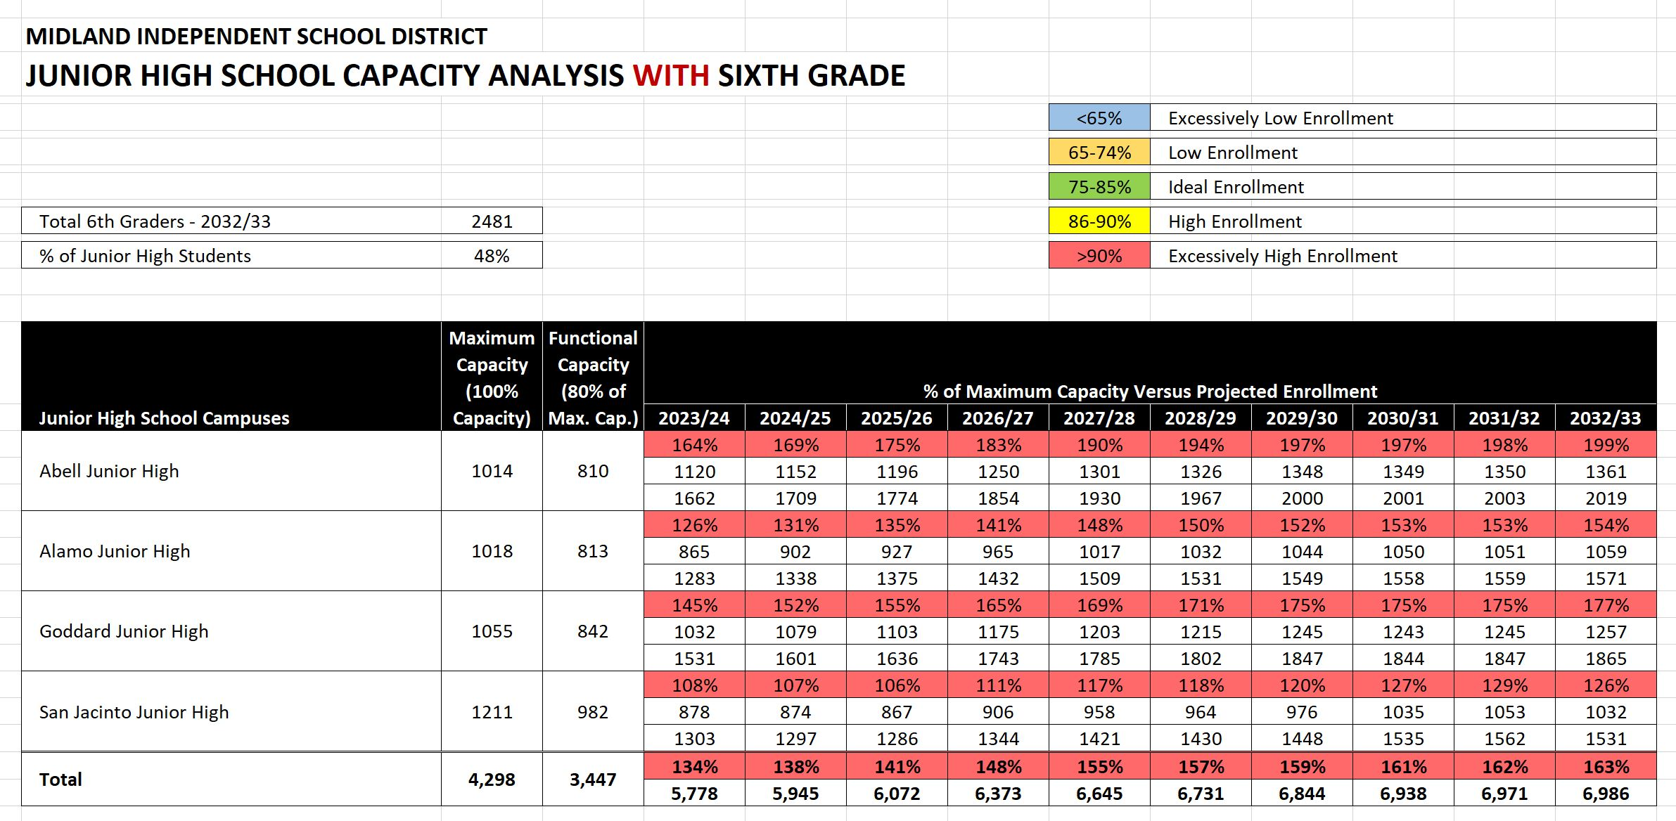

Slide 22

High Schools

Slide 23
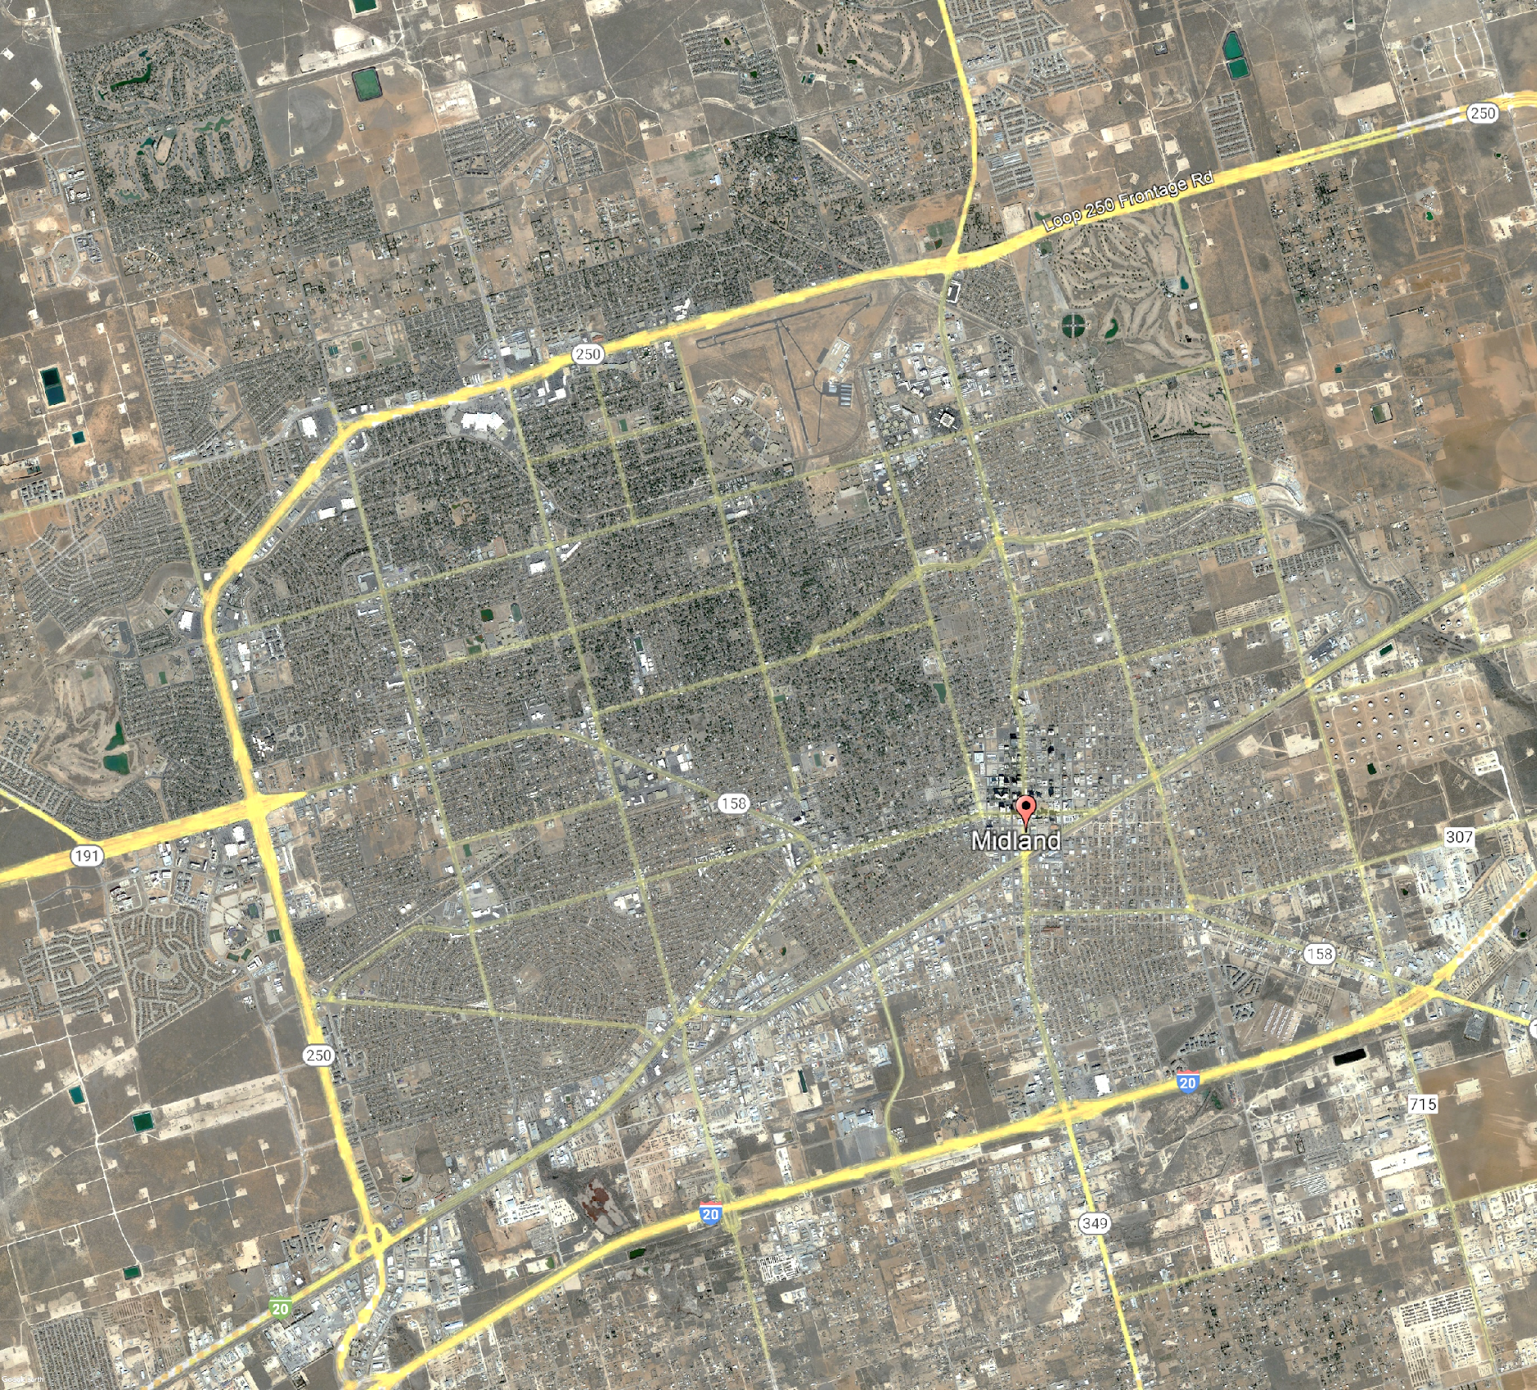
High Schools
Recommendations Don’t Include Schools of Choice in the Capacity Assessment.
Legacy Freshman
Legacy High
Midland High
Midland Freshman

Slide 24
High Schools
Recommendations Don’t Include Schools of Choice in the Capacity Assessment.
Legacy Freshman
ExcessivelyLow Enrollment
<60%
Low Enrollment
60-69%
Ideal Enrollment
70-80%
High Enrollment
81-85%
Excessively High Enrollment
>85%
Legacy High
Midland High
Midland Freshman
Based on 2032/33 Enrollment Projections and a 75% Functional Capacity

Slide 25
High Schools
Recommendations Don’t Include Schools of Choice in the Capacity Assessment.
Legacy Freshman
Legacy High
Functional Capacity:
75%
Midland High
LEGACY FRESHMAN
91%
1105
LEGACY
HIGH
108%
2965
MIDLAND FRESHMAN
89%
1070
MIDLAND
HIGH
105%
3058
Midland Freshman
Based on 2032/33 Enrollment Projections and a 75% Functional Capacity

Slide 26
Option 1A (2 New High Schools)
Steps:
Construct New Legacy High School on New Site.
Construct New Midland High School on New Site.
Move Legacy Freshman and High School Students to New Legacy High School.
Move Midland Freshman and High School Students to New Midland High School.
New HS
Legacy Freshman
Legacy High
Functional Capacity:
75%
Midland High
LEGACY FRESHMAN
91%
1105
LEGACY
HIGH
108%
2965
MIDLAND FRESHMAN
89%
1070
MIDLAND
HIGH
105%
3058
New HS
Midland Freshman
Based on 2032/33 Enrollment Projections and a 75% Functional Capacity

Slide 27
Option 1A (2 New High Schools)
Steps:
Construct New Legacy High School on new site.
Construct New Midland High School on new site.
Move Legacy Freshman and High School Students to New Legacy High School.
Move Midland Freshman and High School Students to New Midland High School.
New MHS
Functional Capacity:
75%
4200 Capacity
4200 Capacity
LEGACY FRESHMAN
0%
0
LEGACY
HIGH
0%
0
MIDLAND FRESHMAN
0%
0
MIDLAND
HIGH
0%
0
NEW
LEGACY
73%
4070
NEW MIDLAND
74%
4128
New LHS
2032 Projected Capacity

Slide 28
Option 1B (Maintain Legacy High School Campus)
Steps:
Reconstruct Legacy High School on Current Site.
Construct New Midland High School on New Site.
Move Legacy Freshman and High School Students to Reconstructed Legacy High School.
Move Midland Freshman and High School Students to New Midland High School.
New MHS
Legacy Freshman
Reconstruct
Legacy High
Functional Capacity:
75%
Reconstruct Midland High
LEGACY FRESHMAN
91%
1105
LEGACY
HIGH
108%
2965
MIDLAND FRESHMAN
89%
1070
MIDLAND
HIGH
105%
3058
Midland Freshman
Based on 2032/33 Enrollment Projections and a 75% Functional Capacity

Slide 29
Option 1B (Maintain Legacy High School Campus)
Steps:
Reconstruct Legacy High School on Current Site.
Construct New Midland High School on New Site.
Move Legacy Freshman and High School Students to Reconstructed Legacy High School.
Move Midland Freshman and High School Students to New Midland High School.
New MHS
Reconstructed Legacy High
Functional Capacity:
75%
4200 Capacity
4200 Capacity
LEGACY FRESHMAN
0%
0
LEGACY
HIGH
0%
0
MIDLAND FRESHMAN
0%
0
MIDLAND
HIGH
0%
0
NEW
LEGACY
73%
4070
NEW MIDLAND
74%
4128
2032 Projected Capacity

Slide 30
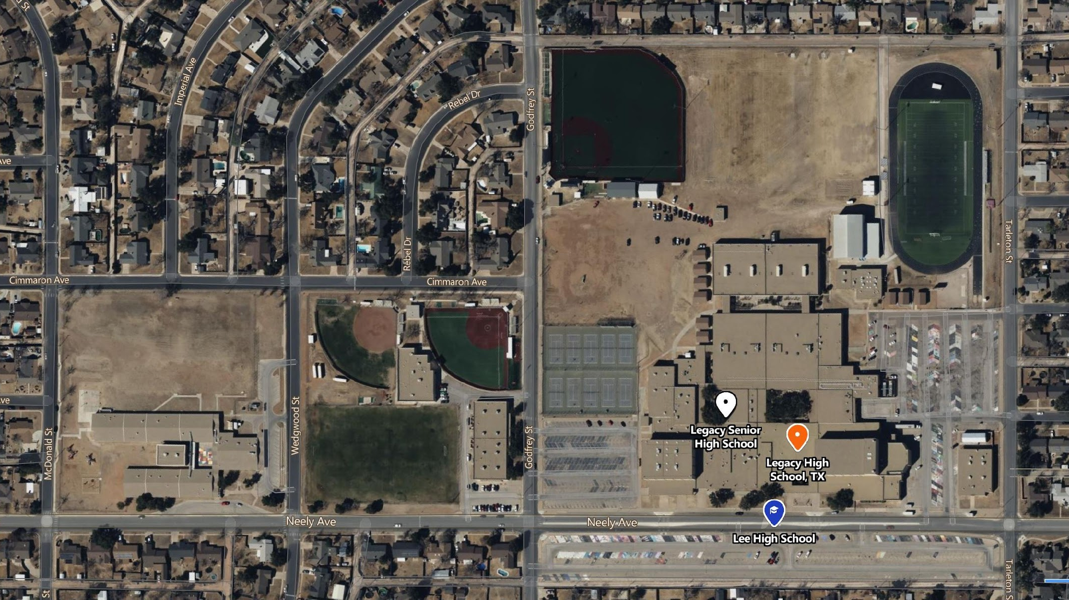
BUILDABLE AREA
BUILDABLE AREA
PARKING
BASEBALL FIELD
PARKING
PARKING
TENNIS COURTS
SOCCER FIELD
Legacy High School
New High School on Existing Site Option
PARKING

Slide 31
PLAYFIELDS/ COURTS
PARKING
BUILDABLE AREA
PARKING
PLAYFIELDS
PARKING
BUILDABLE AREA
PARKING
Legacy High School
New High School on Existing Site Option
PARKING

Slide 32
Option 1C (Maintain Legacy and Midland High School Campuses)
Steps:
Reconstruct Legacy High School on Current Site.
Reconstruct Midland High School on Current Site.
Move Legacy Freshman and High School Students to Reconstructed Legacy High School.
Move Midland Freshman and High School Students to Reconstructed Midland High School.
Legacy Freshman
Reconstruct Legacy High
Functional Capacity:
75%
Reconstruct Midland High
LEGACY FRESHMAN
91%
1105
LEGACY
HIGH
108%
2965
MIDLAND FRESHMAN
89%
1070
MIDLAND
HIGH
105%
3058
Midland Freshman
Based on 2032/33 Enrollment Projections and a 75% Functional Capacity

Slide 33
Option 1C (Maintain Legacy and Midland High School Campuses)
Steps:
Reconstruct Legacy High School on Current Site.
Reconstruct Midland High School on Current Site.
Move Legacy Freshman and High School Students to Reconstructed Legacy High School.
Move Midland Freshman and High School Students to Reconstructed Midland High School.
Reconstructed Legacy High
Functional Capacity:
75%
Reconstructed Midland High
4200 Capacity
4200 Capacity
LEGACY FRESHMAN
0%
0
LEGACY
HIGH
0%
0
MIDLAND FRESHMAN
0%
0
MIDLAND
HIGH
0%
0
NEW
LEGACY
73%
4070
NEW MIDLAND
74%
4128
2032 Projected Capacity

Slide 34
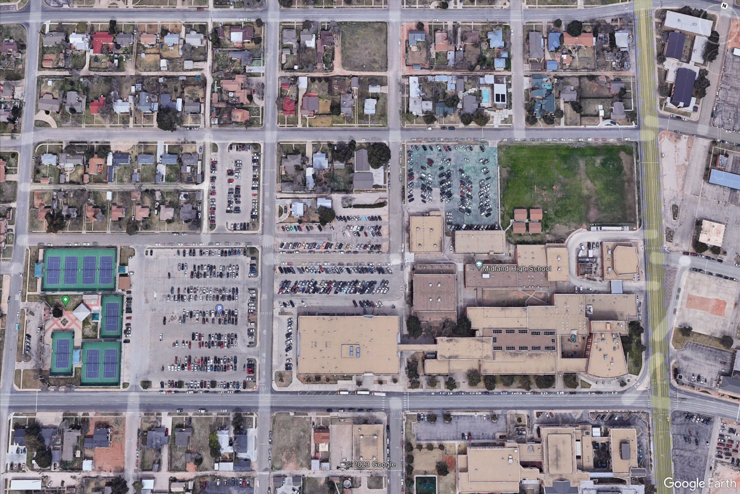
Buildable Area –
150,000 sqft Footprint
Buildable Area
75,000 sqft
Footprint
Midland High School
New High School on existing site

Slide 35
DEMO
DEMO
Midland High School
New High School on existing site

Slide 36
Proposed 3 Story Academics/Admin/Media/Cafeteria
PHASE 1
Proposed Athletics/
Fine Arts
PHASE 1
Proposed
Parking Garage
PHASE 1
Midland High School
New High School on existing site

Slide 37
Proposed 3 Story Academics/Admin/Media/Cafeteria
PHASE 1
Proposed Athletics/
Fine Arts
PHASE 1
DEMO
Proposed
Parking Garage
PHASE 1
Midland High School
New High School on existing site

Slide 38
Proposed 3 Story Academics/Admin/Media/Cafeteria
PHASE 1
Proposed Athletics/
Fine Arts
PHASE 1
Athletics
PHASE 2
Proposed
Parking Garage
PHASE 1
DEMO
Midland High School
New High School on existing site

Slide 39
Proposed 3 Story Academics/Admin/Media/Cafeteria
PHASE 1
Proposed Athletics/
Fine Arts
PHASE 1
Athl/
FA
PHASE 2
Proposed
Parking Garage
PHASE 1
DEMO
Athletics
Fine Arts
PHASE 2
Midland High School
New High School on existing site

Slide 40
Proposed 3 Story Academics/Admin/Media/Cafeteria
PHASE 1
Proposed Athletics/
Fine Arts
PHASE 1
Athl/
FA
PHASE 2
PARKING
Proposed
Parking Garage
PHASE 1
Athletics
Fine Arts
PHASE 2
Midland High School
New High School on existing site

Slide 41
Proposed 3 Story Academics/Admin/Media/Cafeteria
PHASE 1
Proposed Athletics/
Fine Arts
PHASE 1
Athl/
FA
PHASE 2
PARKING
Proposed
Parking Garage
PHASE 1
PLAYFIELDS
Athletics
Fine Arts
PHASE 2
Midland High School
New High School on existing site (alternative)

Slide 42
High Schools
Q & A

Slide 43

www.midlandisd.net/survey2
Complete survey by scanning QR code or visiting link below.

Slide 44

Requests for Information
Committee members generate and record questions and or requests for information (RFI’s) on the electronic form. A link to this form will be emailed in a meeting recap. You may also use the QR code below.
Staff review questions/RFI’s for clarification.
Responses will be shared with committee members before next meeting.
MISD Bond Planning Committee
Notes:
Ken

Slide 45
Next Steps
Review and reflect on the information presented today
Send any additional questions, comments or RFIs to using the link or to:
Kellie Spencer at kellie.spencer@midlandisd.net
Next meeting May 4, Yarbrough Elementary
Shake hands and be friendly!
MISD Bond Planning Committee
Notes:
Ken

