Slide 1

Meeting No. 4
Yarbrough Elementary
May 4, 2023
BOND PLANNING COMMITTEE

Slide 2
Welcome & Agenda
Superintendent Welcome
Committee Charge
Questions/RFI Follow Up
Recap of Decisions from April 20th
CTE Programming and Impact to High Schools
Review of Projected Enrollment
Middle Schools
Elementary Schools
Communication/RFI’s
Next Steps
MISD Bond Planning Committee
Notes:
Superintendent, Sheri

Slide 3
Planning Committee Charge
Review the recommendations made by the Long-Range Facility Planning Committee, as a result of their extensive study of the comprehensive facilities assessment, demographic data, and anticipated academic programs.
Review options for existing, renovated and/or new facilities, and their implications for student enrollment, innovative instructional programs, modern learning requirements, technology and educational specifications, staffing, operational effectiveness and fiscal responsibility.
Develop and recommend to the Midland ISD Board of Trustees a Bond Plan that addresses student learning environments for the next 5 years, and prepares the district for future enrollment growth, evolving instructional programs, and preventive maintenance.
MISD Bond Planning Committee
Notes:
Sheri

Slide 4
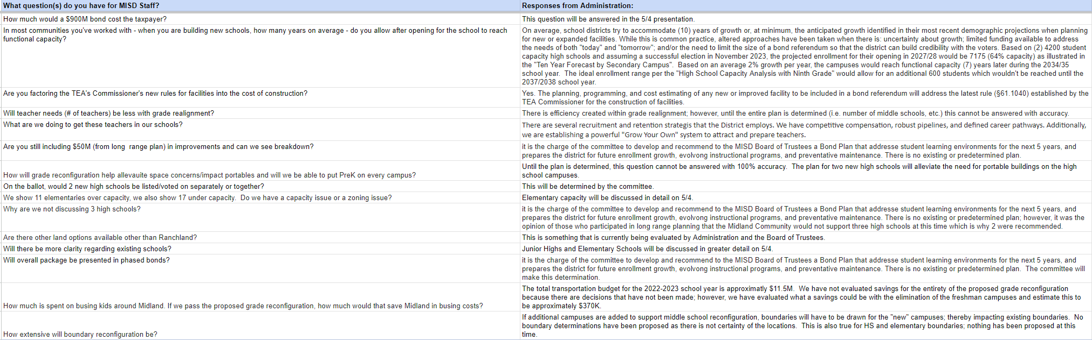
Questions/RFI’s
MISD Bond Planning Committee
Notes:
Sheri/Staff

Slide 5
Recap of April 20th Decisions
Grade Reconfiguration
  PK - 5th
  6th - 8th
  9th - 12th
New Legacy High School
New Midland High School
MISD Bond Planning Committee
Notes:
Ken

Slide 6
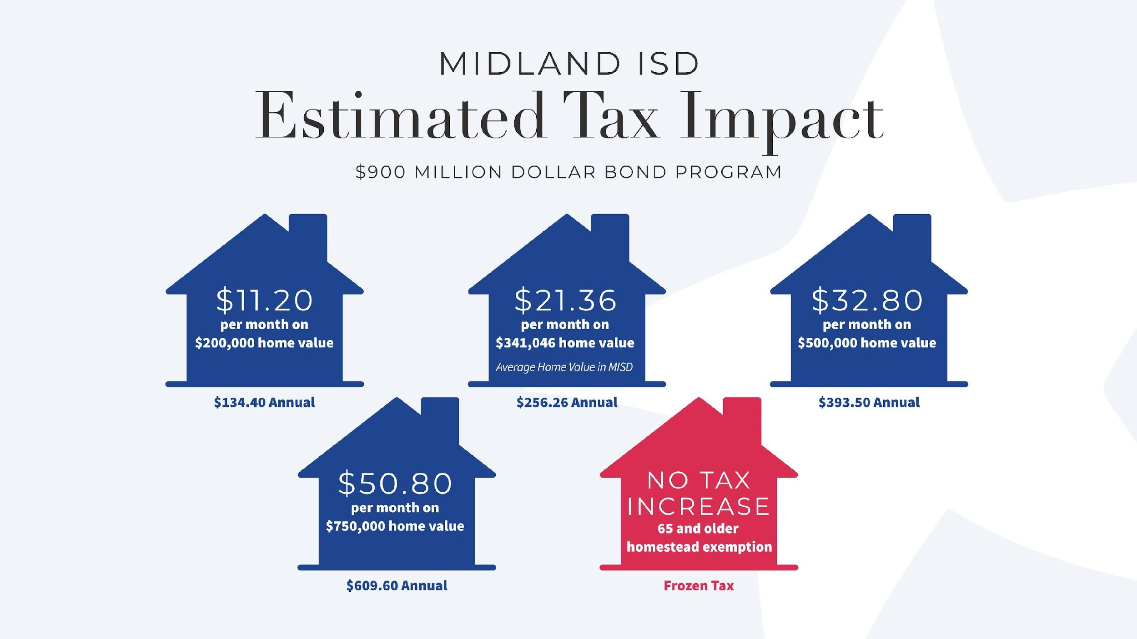

Slide 7
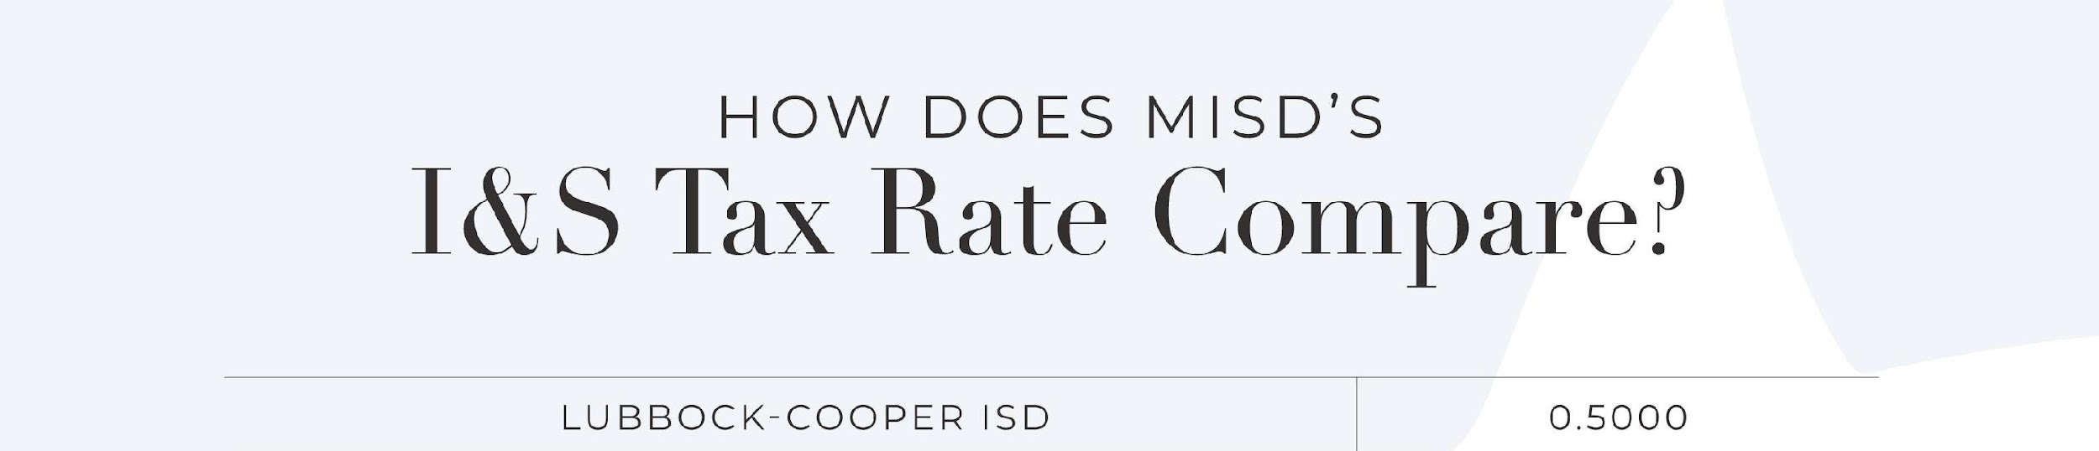
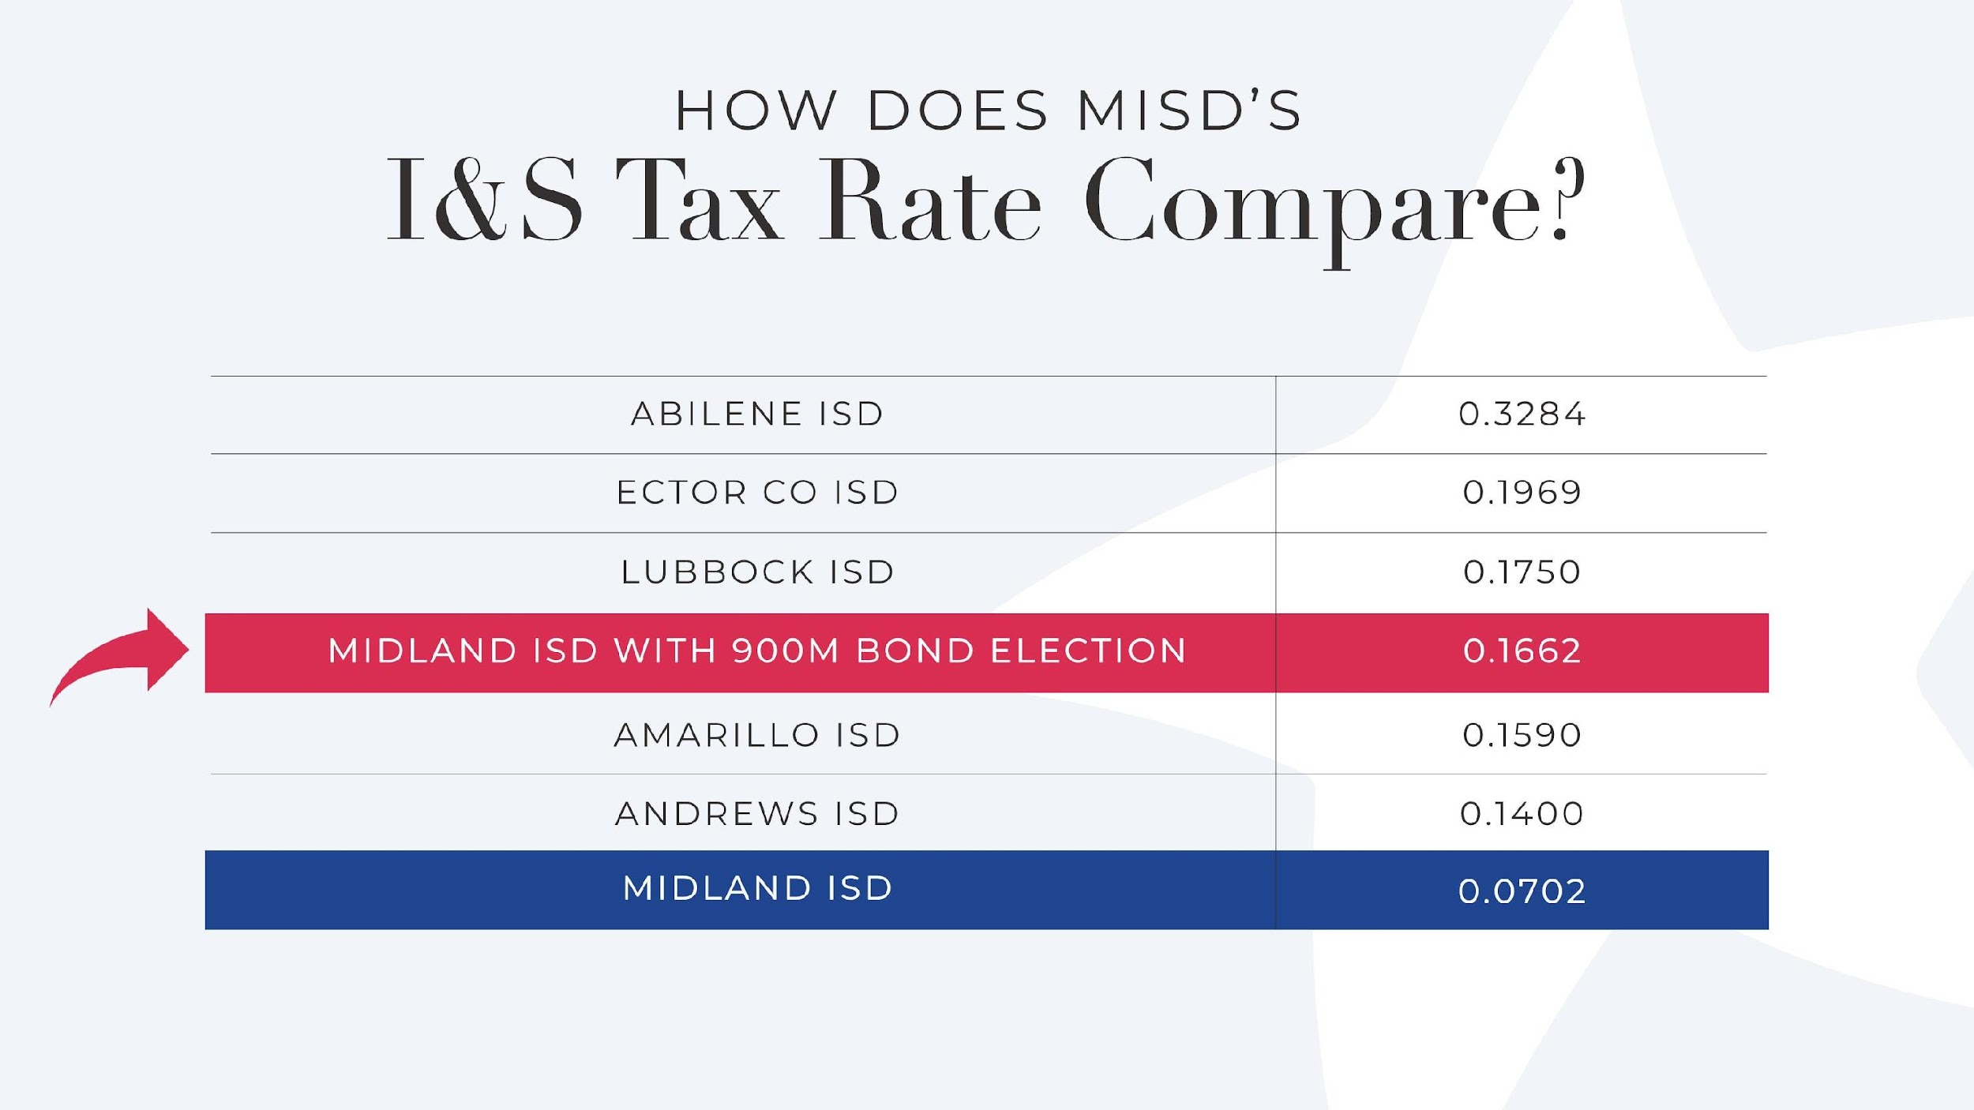

Slide 8


Slide 9
Midland ISD
Career & Technical Education
Thursday, May 4, 2023

Slide 10
Turn and Talk
What do you think of when you hear “CTE”?

Slide 11


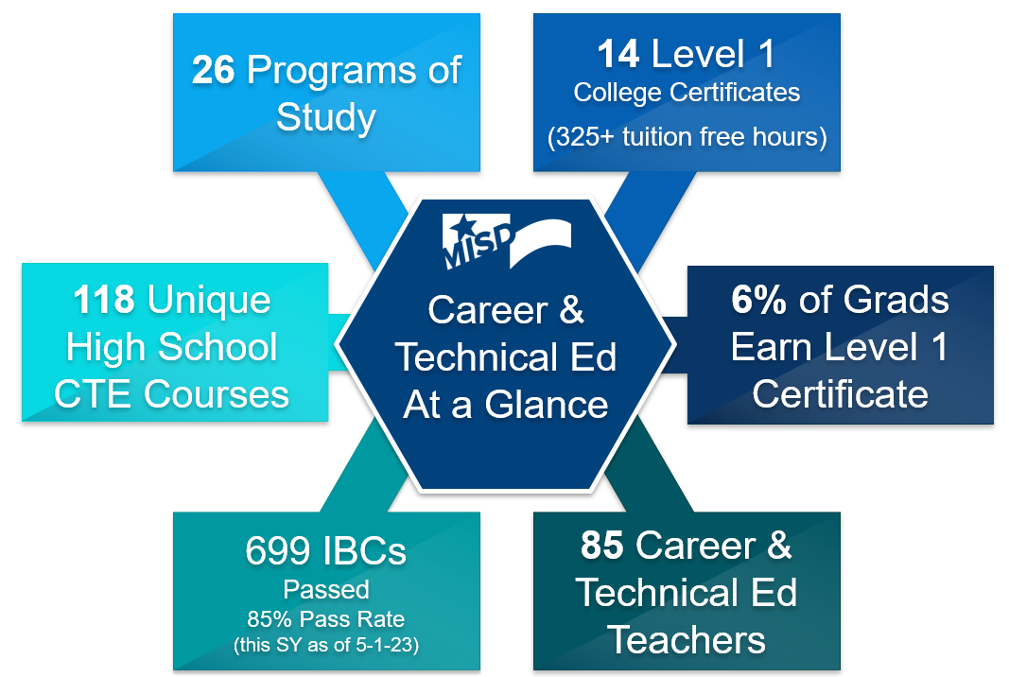





Slide 12
CTE Enrollment
Current Student Enrollment for 9-12 CTE Classes = 5,458
5 High Schools Coleman High ECHS@MC Legacy High Midland High YWLA (9th Grade ‘22-’23) | 7185 Students | 76 % of Enrollment = CTE
897 students are enrolled in a CTE dual credit course leading to a Level 1 Certificate CTE dual credit is 16% of MISD overall CTE enrollment 9-12

Slide 13
Program of Study
A program of study is a comprehensive, structured approach for delivering academic and career and technical education (CTE).
Texas currently has 53 approved programs of study for career and technical education.
Midland ISD currently has 26 programs of study for career and technical education.
53
26

Slide 14
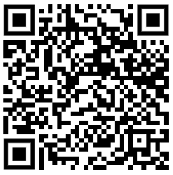
Midland ISD Programs of Study
ACCOUNTING AND FINANCIAL SERVICES | ENGINEERING
ADVANCED MANUFACTURING & MACHINERY | ENGINEERING CADD DUAL
ANIMAL SCIENCE | GRAPHIC DESIGN AND MULTIMEDIA ARTS
AUTOMOTIVE TECHNOLOGY | HEALTHCARE PATIENT CARE TECHNICIAN
AUTOMOTIVE PAINT & BODY | HEALTHCARE EMT
BUSINESS MANAGEMENT- DUAL | HEALTHCARE PHARMACY TECHNICIAN
BUSINESS MAN. NON-DUAL | HVAC and SHEET METAL
COSMETOLOGY AND PERSONAL CARE SERVICES | LAW ENFORCEMENT FIREFIGHTER
CYBERSECURITY | LAW ENFORCEMENT
CULINARY ARTS | LODGING AND RESORT MANAGEMENT
DIESEL AND HEAVY EQUIPMENT | OIL AND GAS EXPLORATION AND PRODUCTION
DIGITAL COMMUNICATIONS | TEACHING & TRAINING
EMERGENCY SERVICES | WELDING

Slide 15
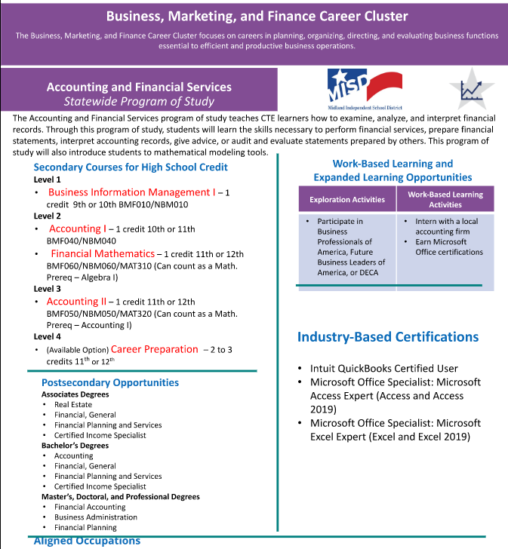
POS Example
Accounting and Financial Services is one Midland ISD Program of Study
Accounting and Financial Services is in the Business, Marketing, and Finance Career Cluster

Slide 16
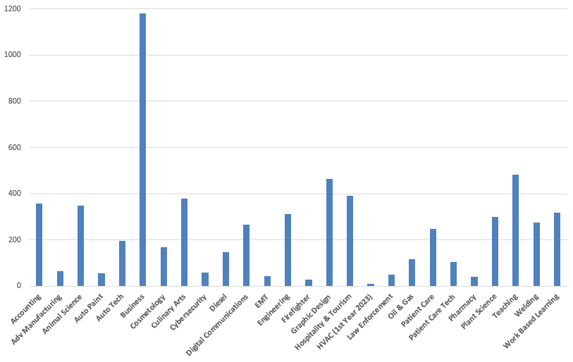
Enrollment by
Program of Study
Comprehensive Schools
Grades 9-12

Slide 17
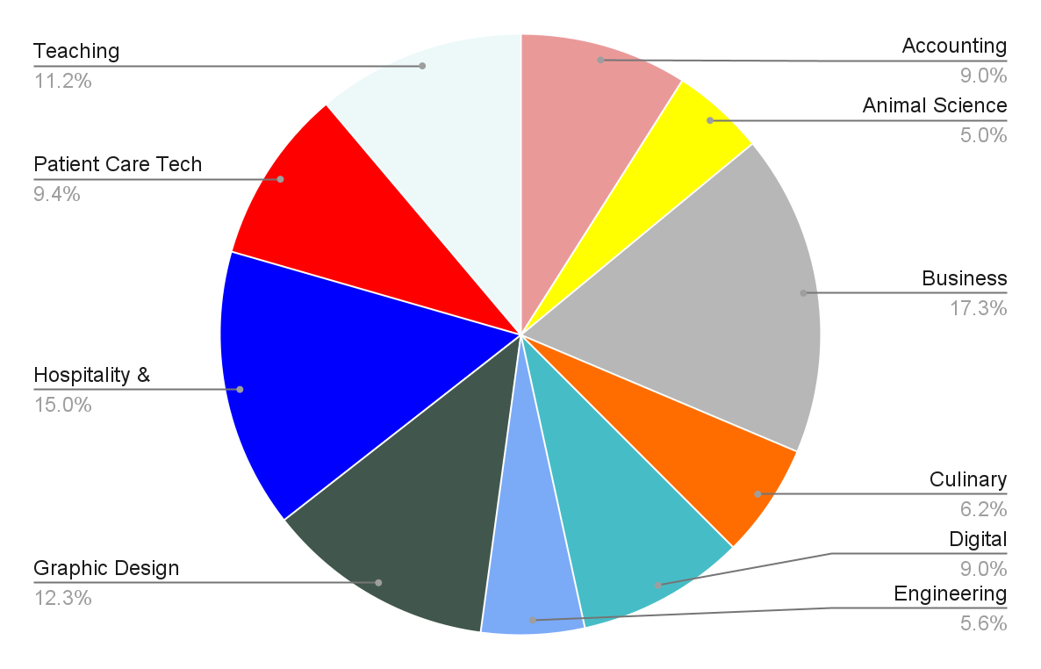
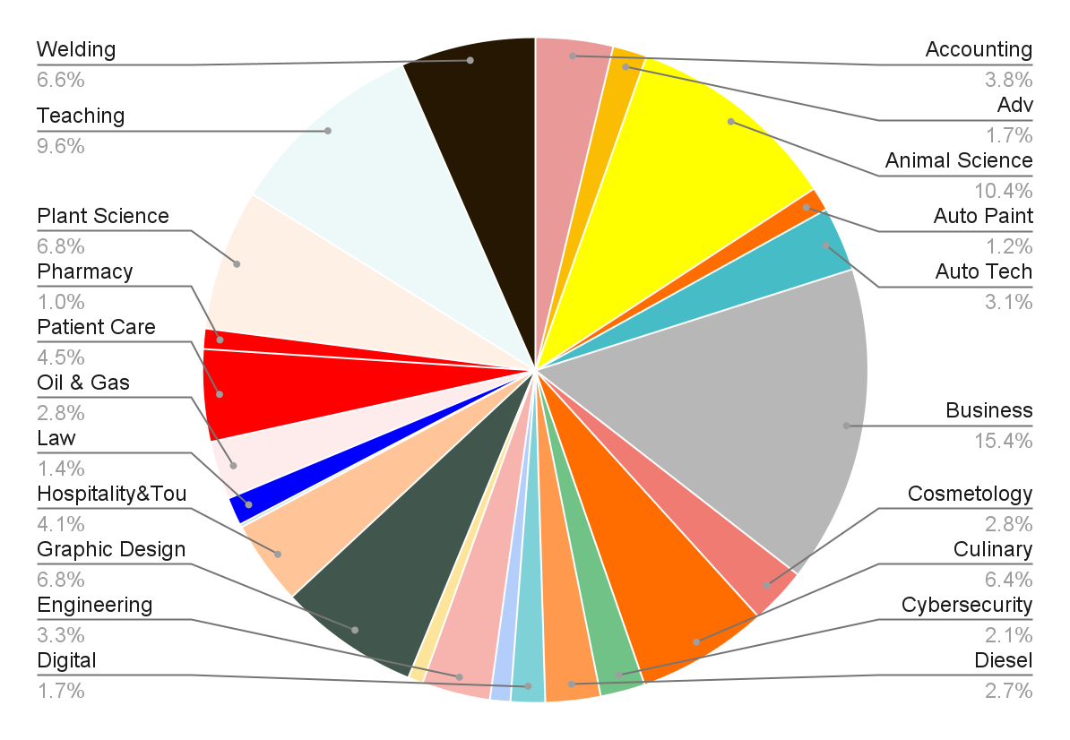
Programs of Study by Feeder- Legacy
Legacy Freshman
Legacy High

Slide 18
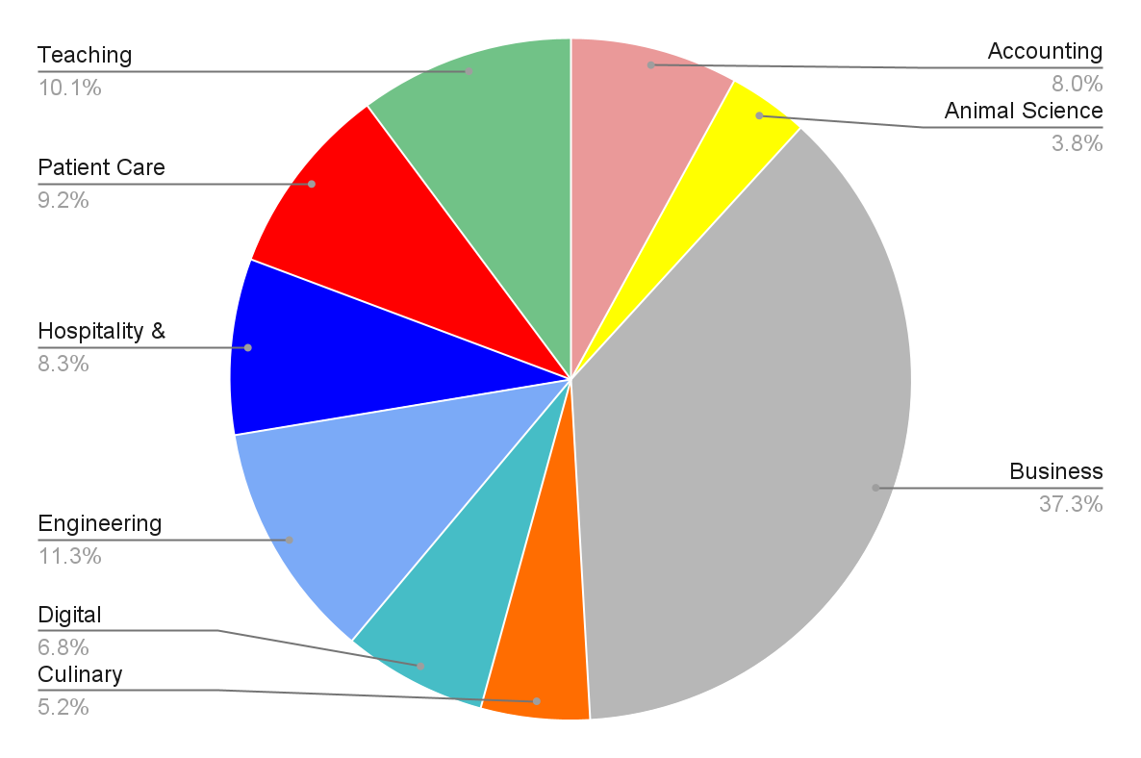
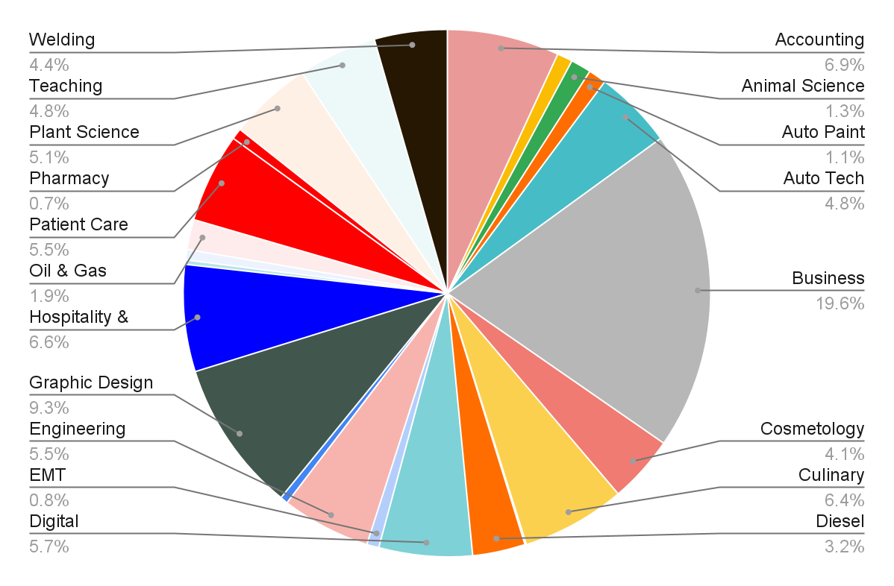
Programs of Study by Feeder - Midland
Midland Freshman
Midland High

Slide 19
Alignment to Permian Basin Targeted Occupations
Accountants | General Managers(Business Mgmt) | Pharmacy Technicians
Auto Body | HVAC | Phlebotomists
Auto Service | CDL Truck Drivers | Physical Therapist Assistants
Bookkeeping | Industry Mechanics(Oil&Gas) | Plumbers/Pipefitters
Diesel Specialist Bus/Truck | LV Nurses (In Development) | Police and Sheriff Officers(Law)
Carpenter | Machinists | Radiologic Tech
Computer Support | Maintenance Workers | Registered Nurses
Construction Managers | Managers/Supervisors(Bus Mgmt) | Rotary Drill Operators, (Oil&Gas)
Correctional Officer | Mechanical Drafters | Roustabouts, (Oil&Gas)
Dispatchers | Medical Assistants | Service Unit Operators, (Oil&Gas)
Electrical Power-Line | Medical Secretaries | Solar Photovoltaic Technician
Electricians | Occup Health & Safety (Oil&Gas) | Surgical Technologist
EMT | Operators (Equipment) | Teachers
Firefighters | Petroleum Pump Operators(Oil&Gas) | Welders/ Cutters

Slide 20
Midland College - Midland ISD Partnership
ATC
Automotive Technology
Automotive Paint & Body
Computer Drafting (CAD)
Emergency Medical Tech
Energy Technician
Patient Care Technician
Pharmacy Technician
Welding II
Cogdell Center
Diesel
Harris Field
Firefighter
MC Main Campus
Cybersecurity
HVAC (Heating, Ventilation, Air Conditioning)
Welding I
Law Enforcement

Slide 21
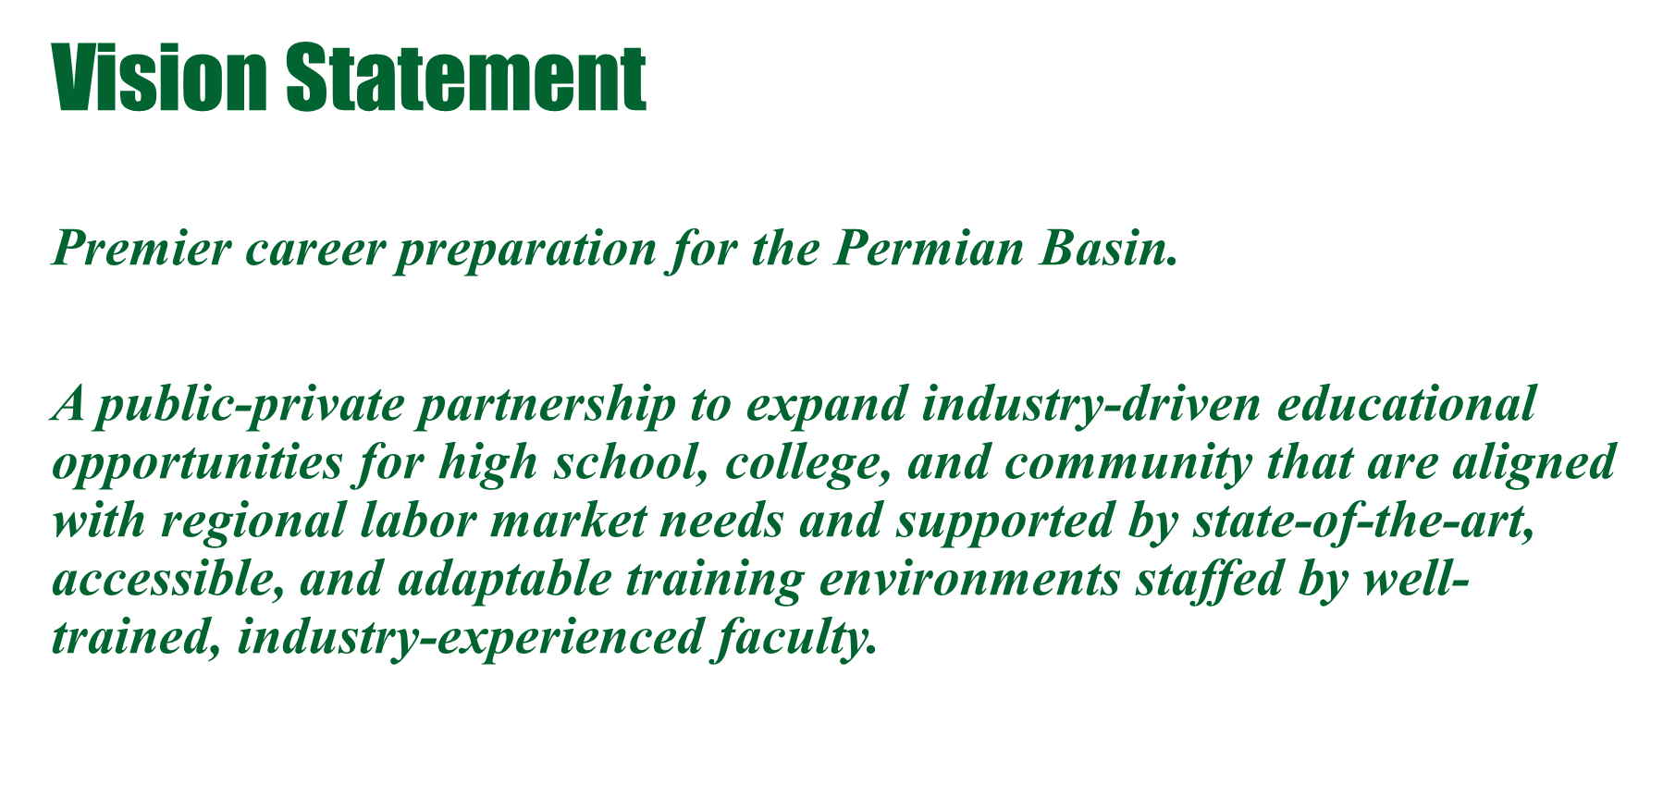
Midland College - Midland ISD Partnership

Slide 22
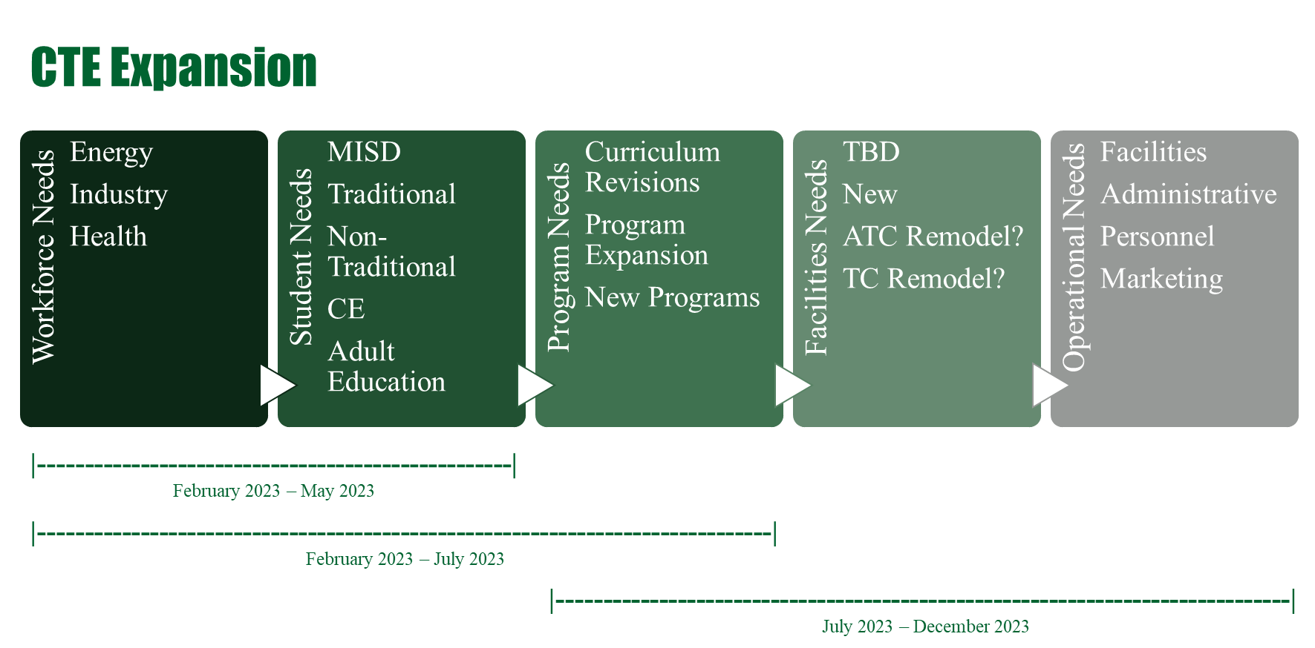
Midland College - Midland ISD Partnership

Slide 23
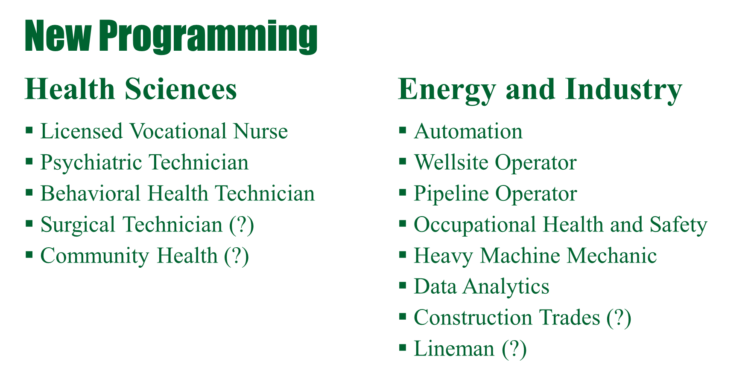
Midland College - Midland ISD Partnership

Slide 24
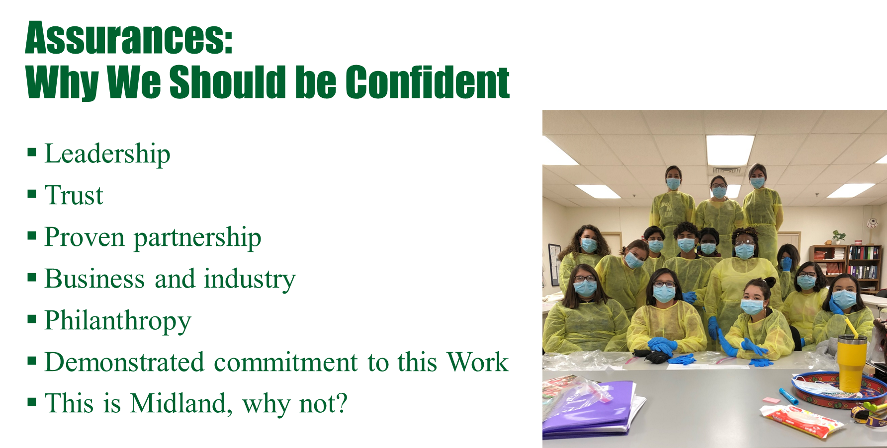
Midland College - Midland ISD Partnership

Slide 25
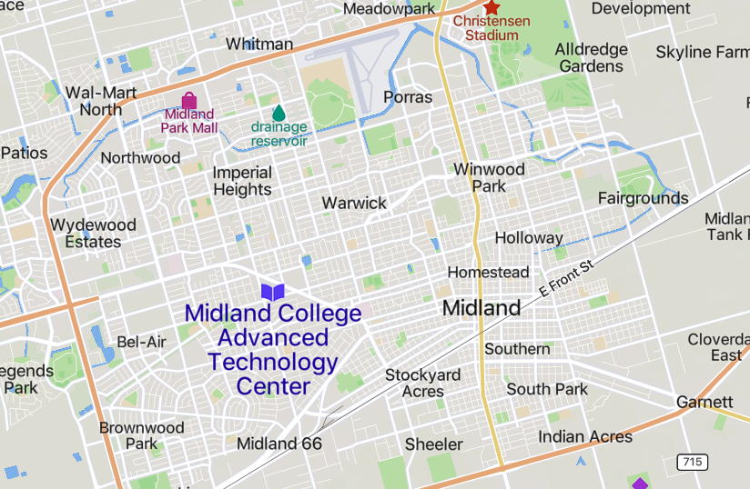



CTE Dual Credit Sites
ATC- MC
Cogdell-MC
Coleman HS
Harris Field- COM/MC
Main Campus- MC
Legacy HS
Legacy Freshman
Midland HS
Midland Freshman
MC
LFHS
LHS
Coleman
Harris Field
MHS
Cogdell
MFHS

Slide 26
Activity: Start, Stop, Keep
What should we START?
What should we STOP?
What should we KEEP?

Slide 27
Group Activity- Instructions
Individual (2 Minutes)
Using Sticky Notes…
List what you would like for MISD CTE to…
  Start?
  Stop?
  Keep?
Please Label Sticky Notes with Start, Stop and Keep!
2. Discussion (2 Minutes)
Identify a Table Leader
Use the activity template to collect themes for…
  Start?
  Stop?
  Keep?

Slide 28
Group Activity- Instructions
3. Table Leaders
Use the Start, Stop, and Keep posters to relocate sticky notes.
  Tables 1-4
  Tables 5-8
  Tables 9-12
4. Gallery Walk -“Priority Dots”
Using the dots provided…
Review the Gallery of Start, Stop, and Keep Posters.
Add a dot to posted actions that resonate with you!

Slide 29
Midland ISD CTE Areas of Focus
Increasing College & Career Ready Graduates
  Program of Study Completers
  Industry Based Certificates
  TSIA 2 Math and ELAR Success
  Guidance & Counseling for Career Planning
Increasing Work-Based Opportunities
Supporting CTE Teachers
Improving Physical Spaces including Industry Equipment, Technology and Related Furniture

Slide 30



Midland ISD Bond Planning
Facility Capacity Assessment
May 4, 2023

Slide 31
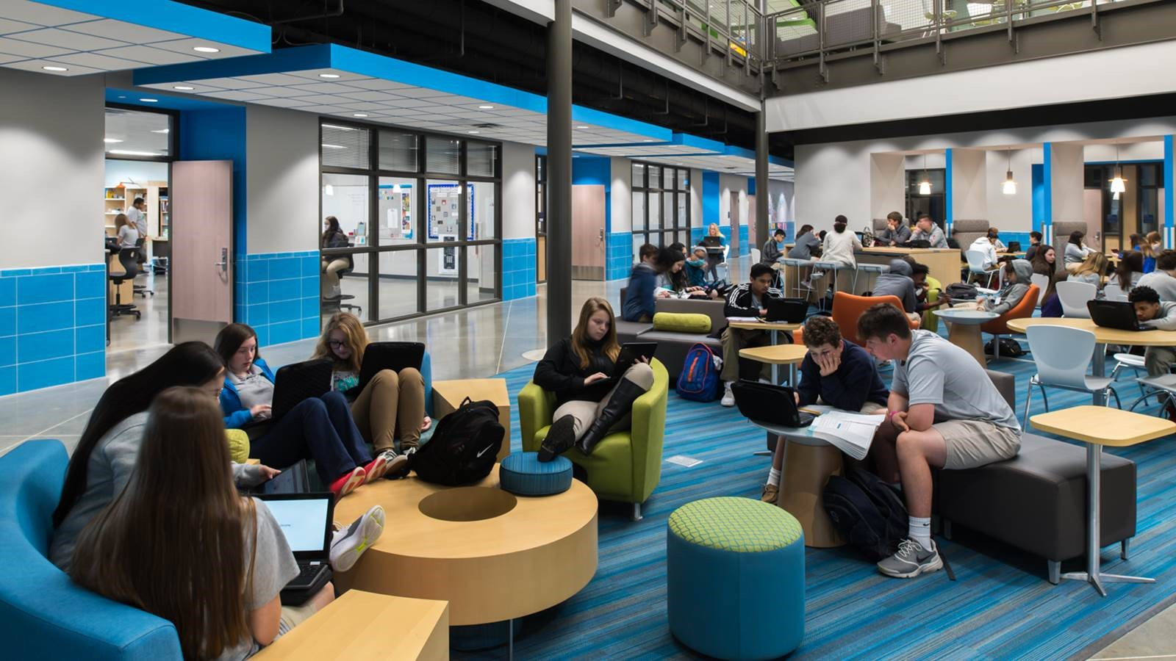
Demographics and Tax Implications

Slide 32
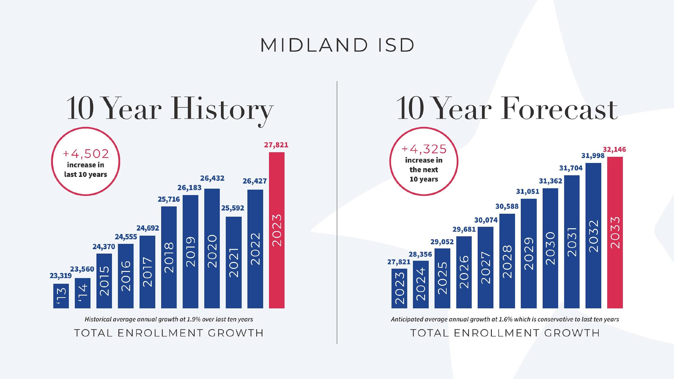

Slide 33
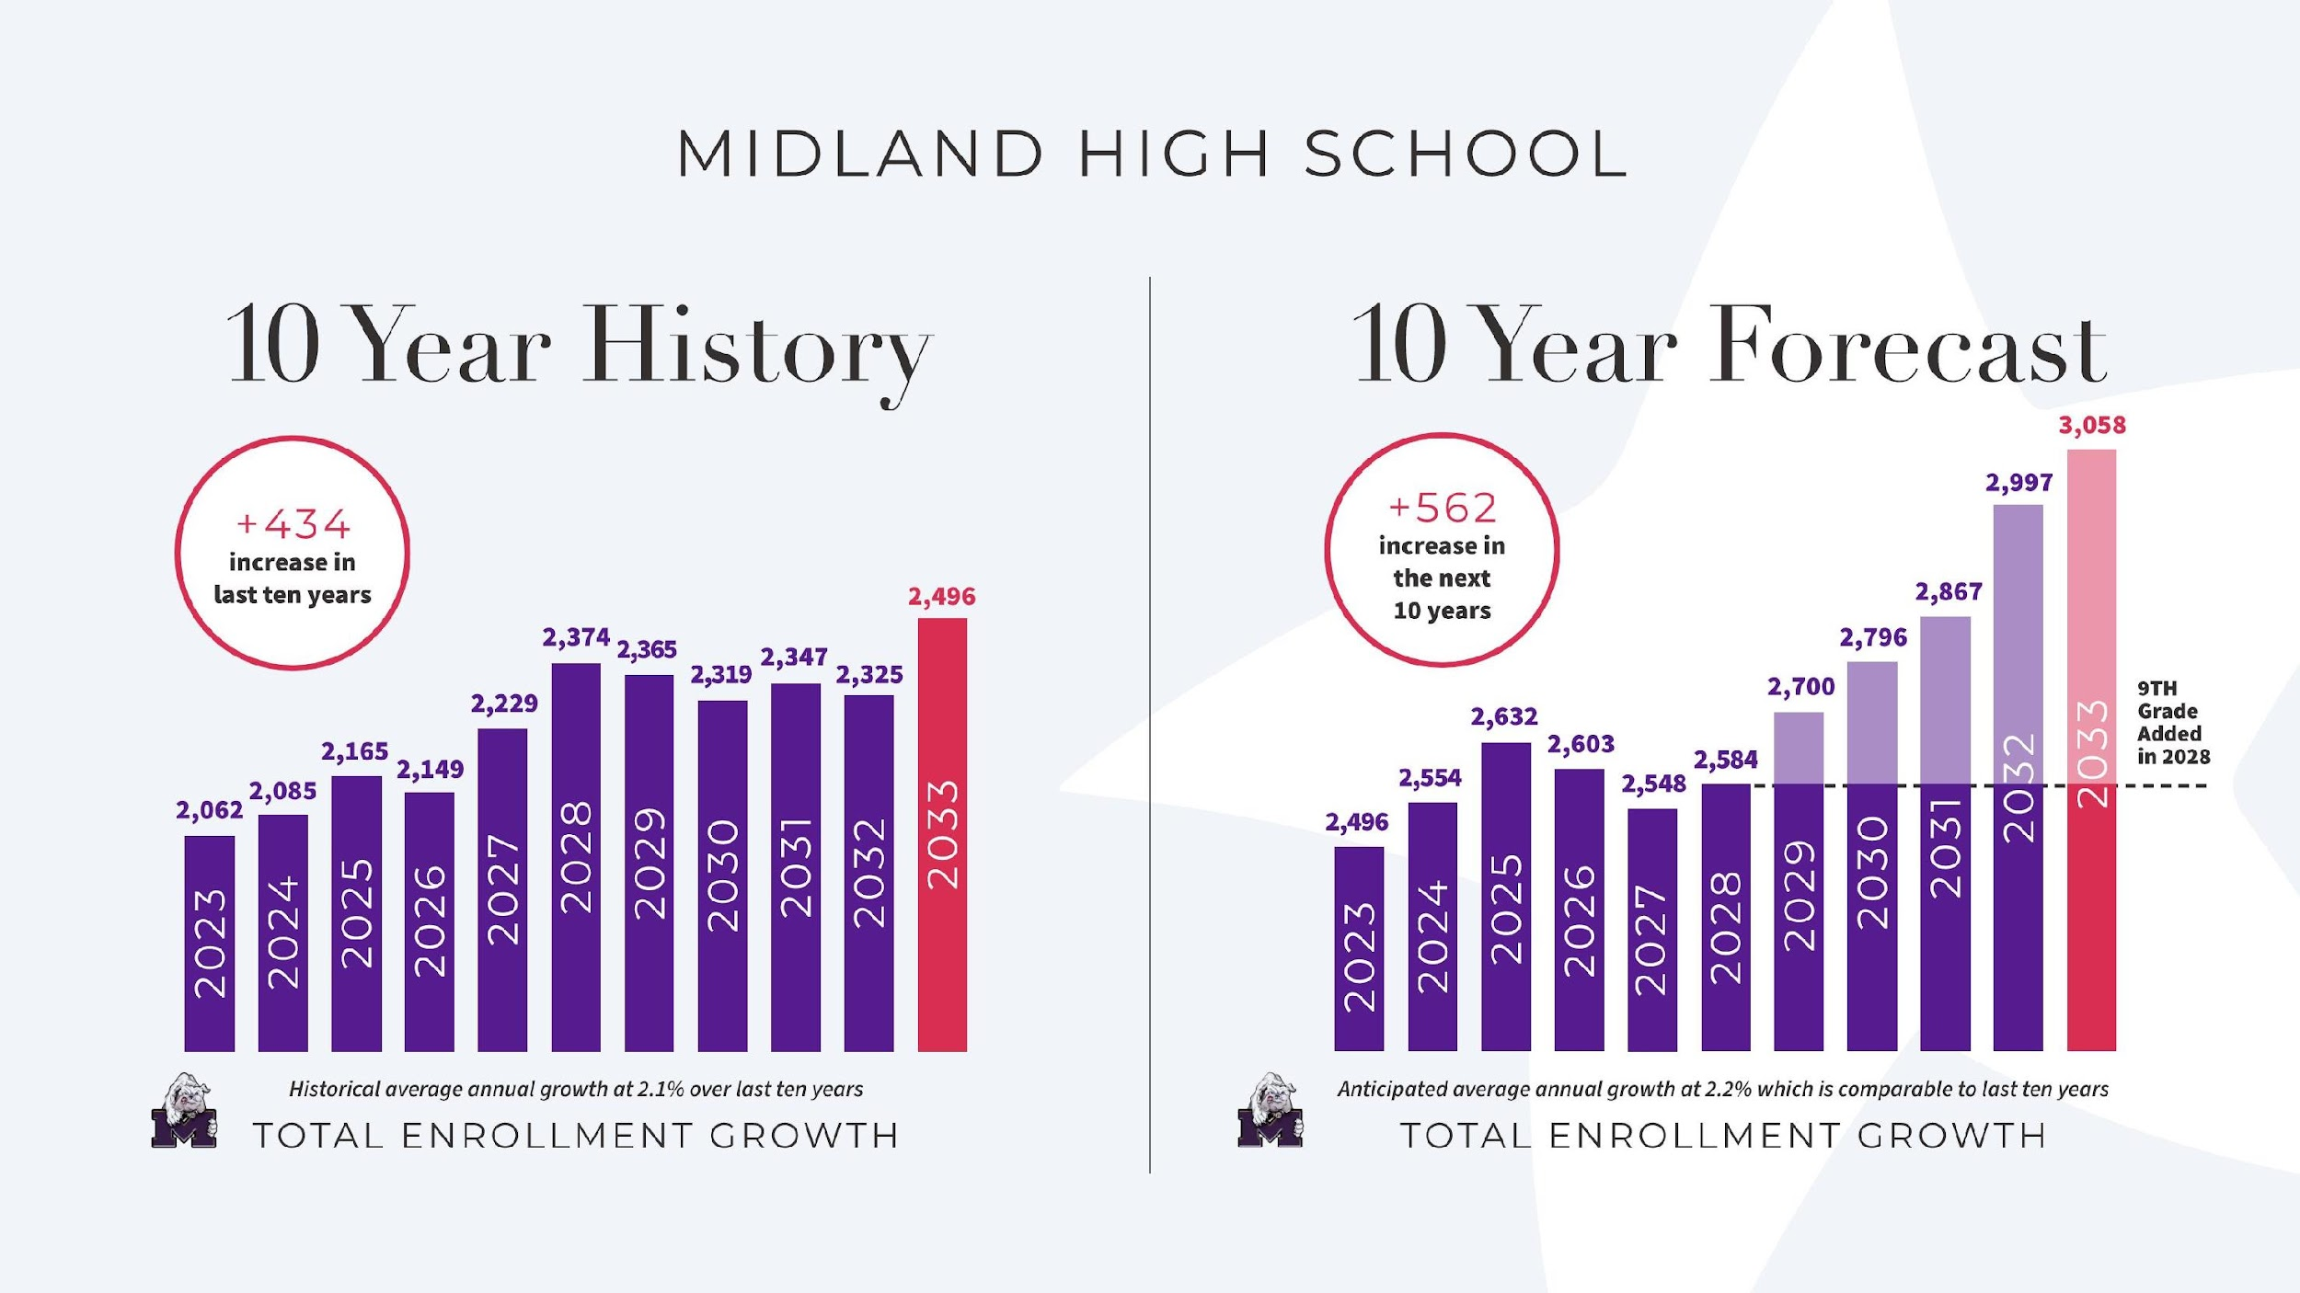


(GRADES 10-12)
3 2
2023
2021
2019
2022
2018
2015
2017
2020
2014
2016
2013

Slide 34
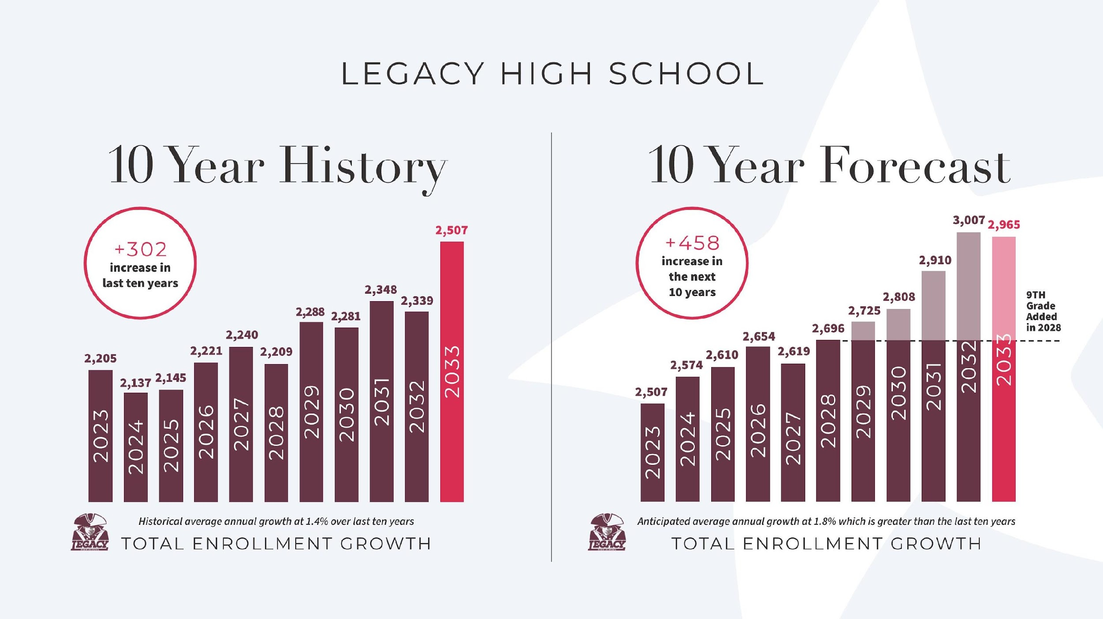

(GRADES 10-12)
2023
2021
2019
2022
2018
2020
2013
2015
2017
2014
2016

Slide 35
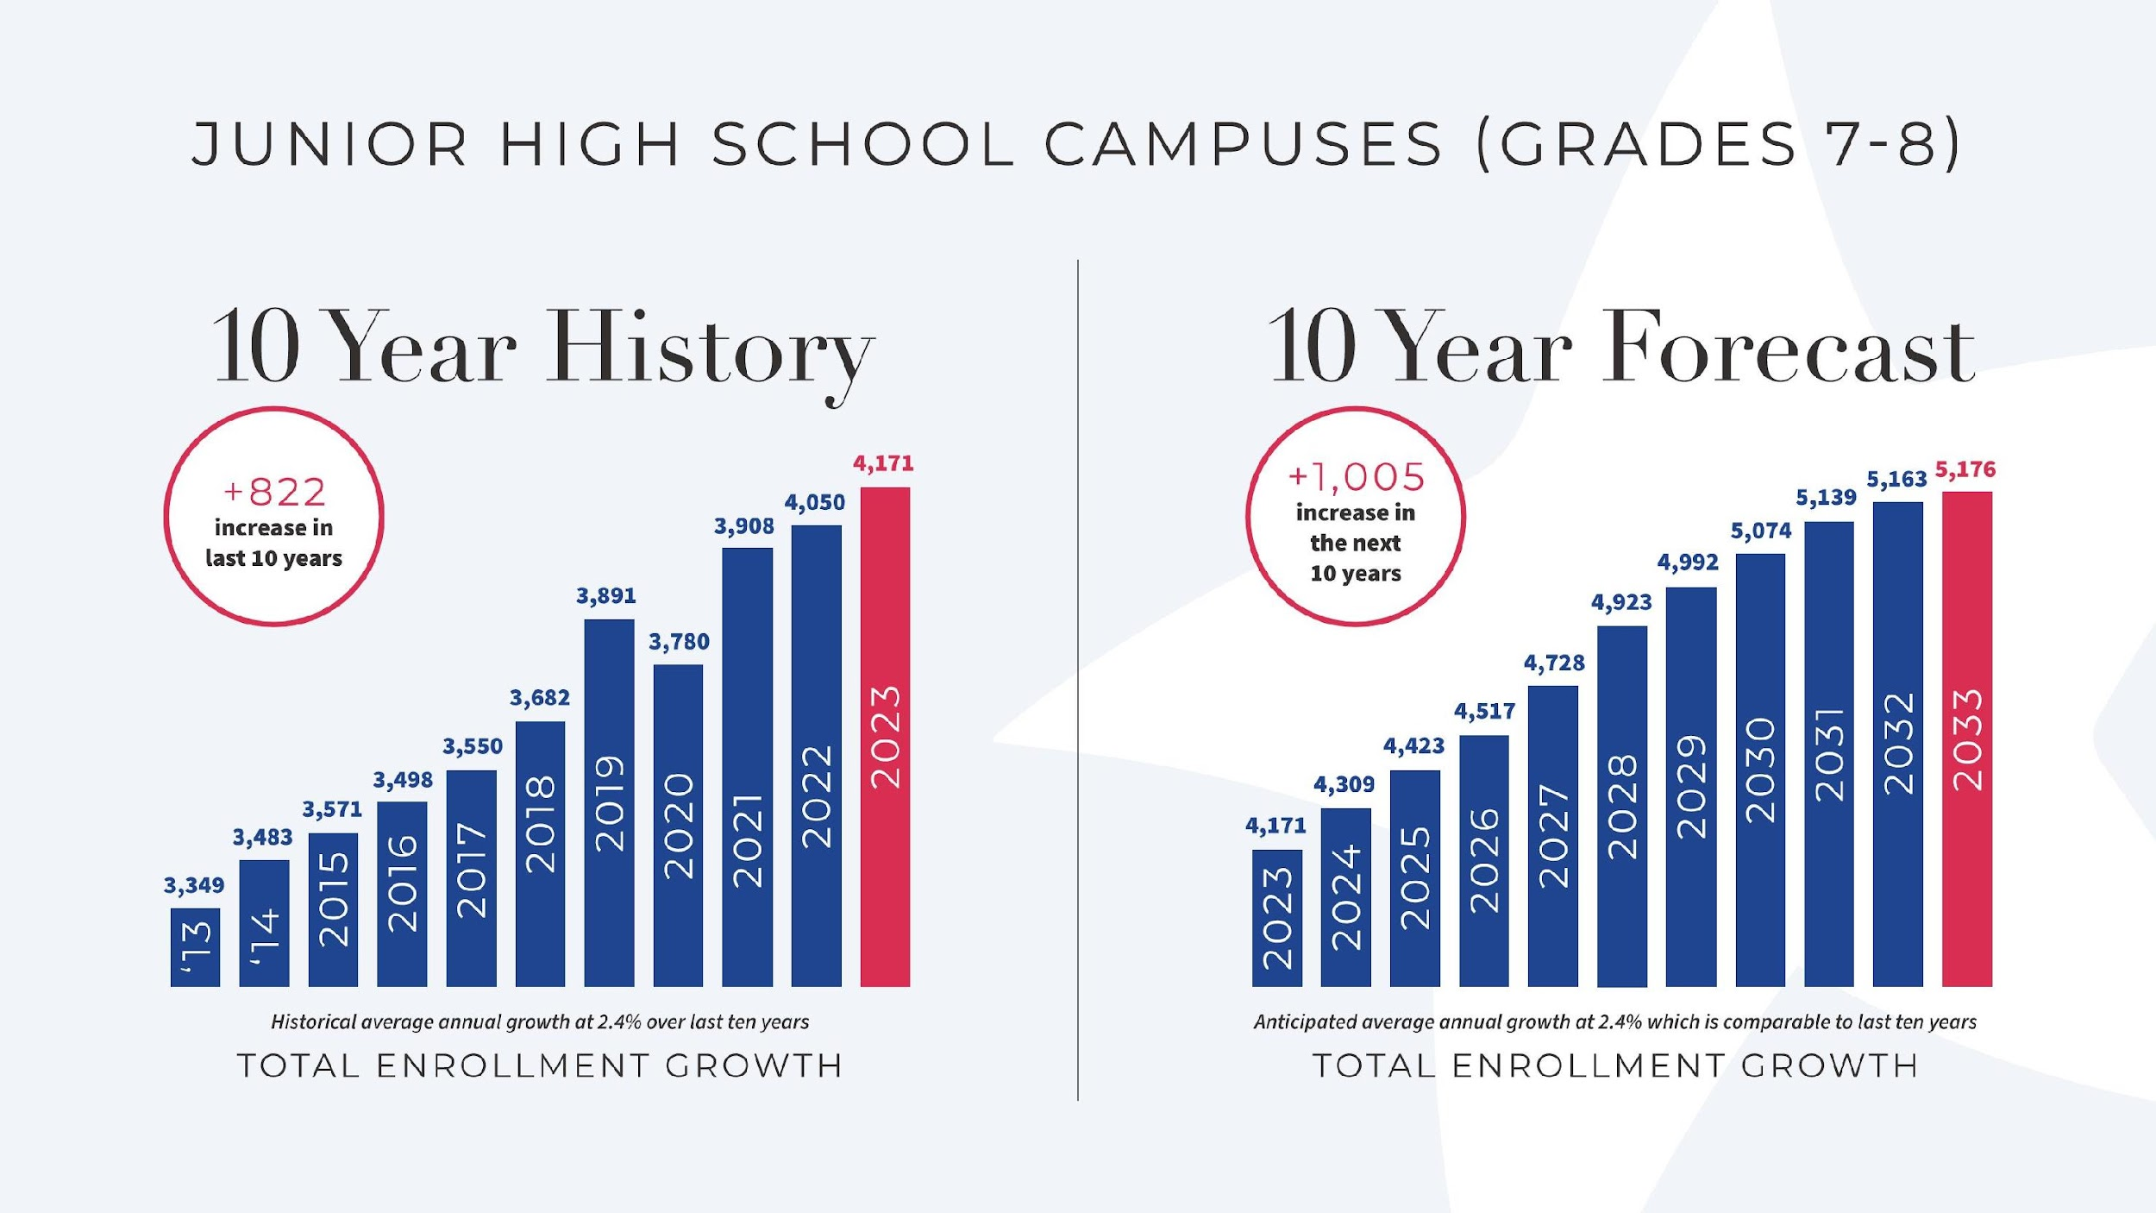

Slide 36
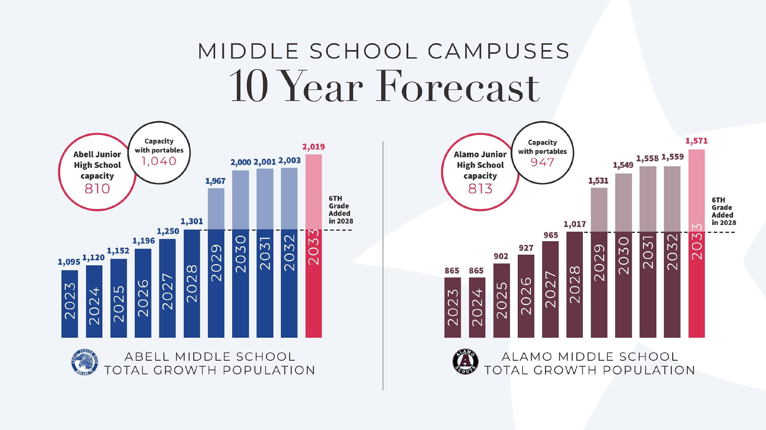

Slide 37
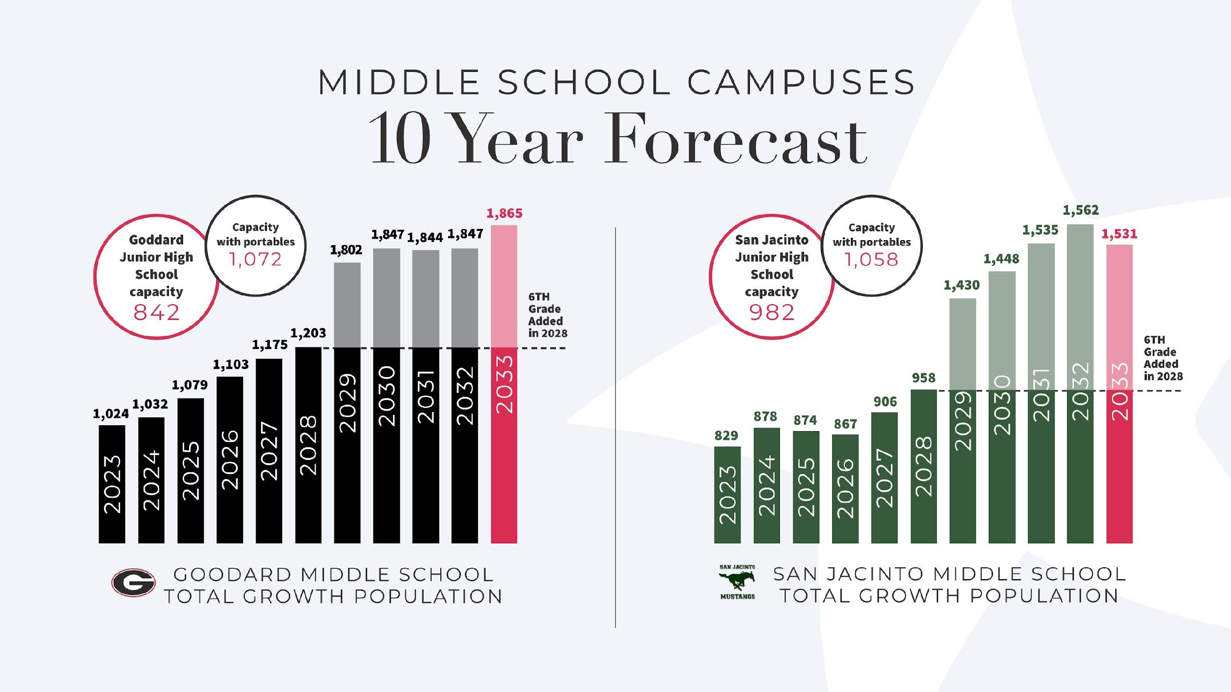




Slide 38
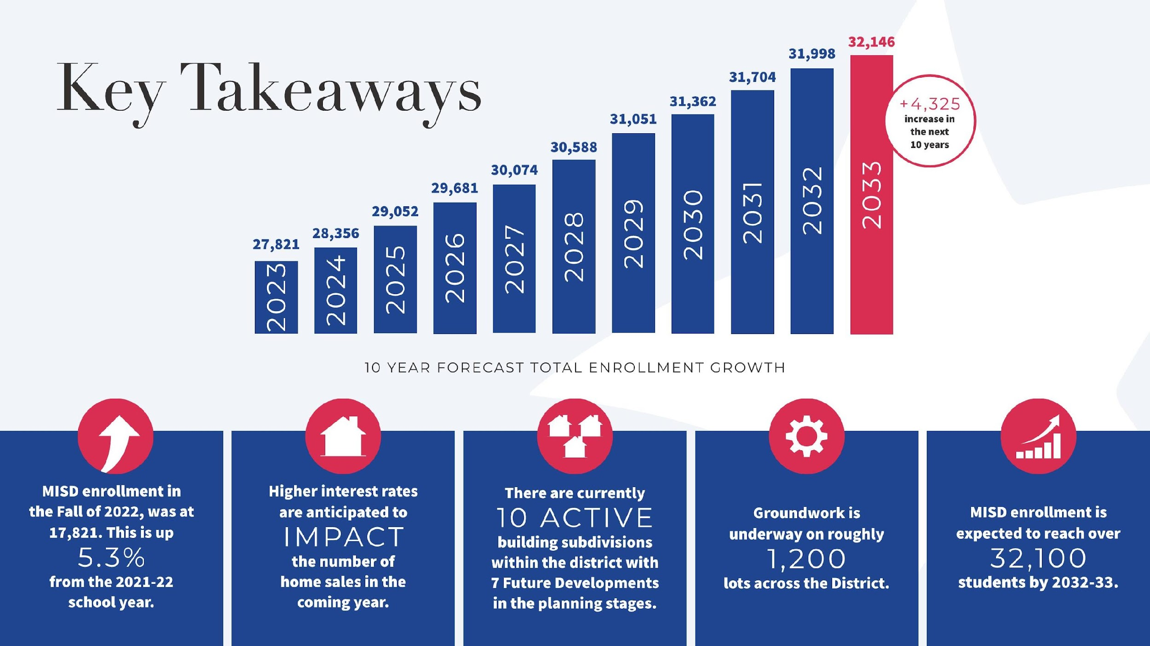
2

Slide 39
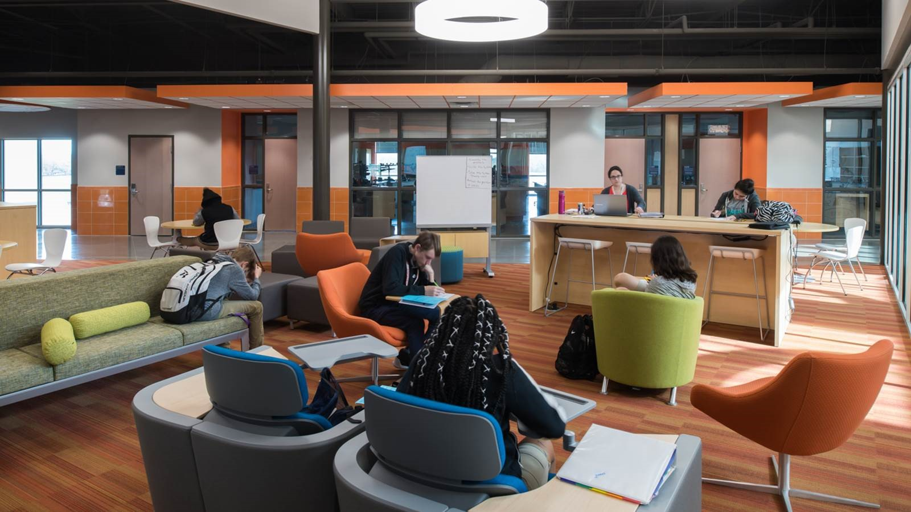
Middle Schools Capacity Analysis

Slide 40
Campus Deficiency Rating
(Cost to Eliminate Deficiencies as a % of the Value of the Building)
Midland High School
Legacy Freshman High School
Legacy High School
Midland Freshman High School
54
47
27
22

Slide 41
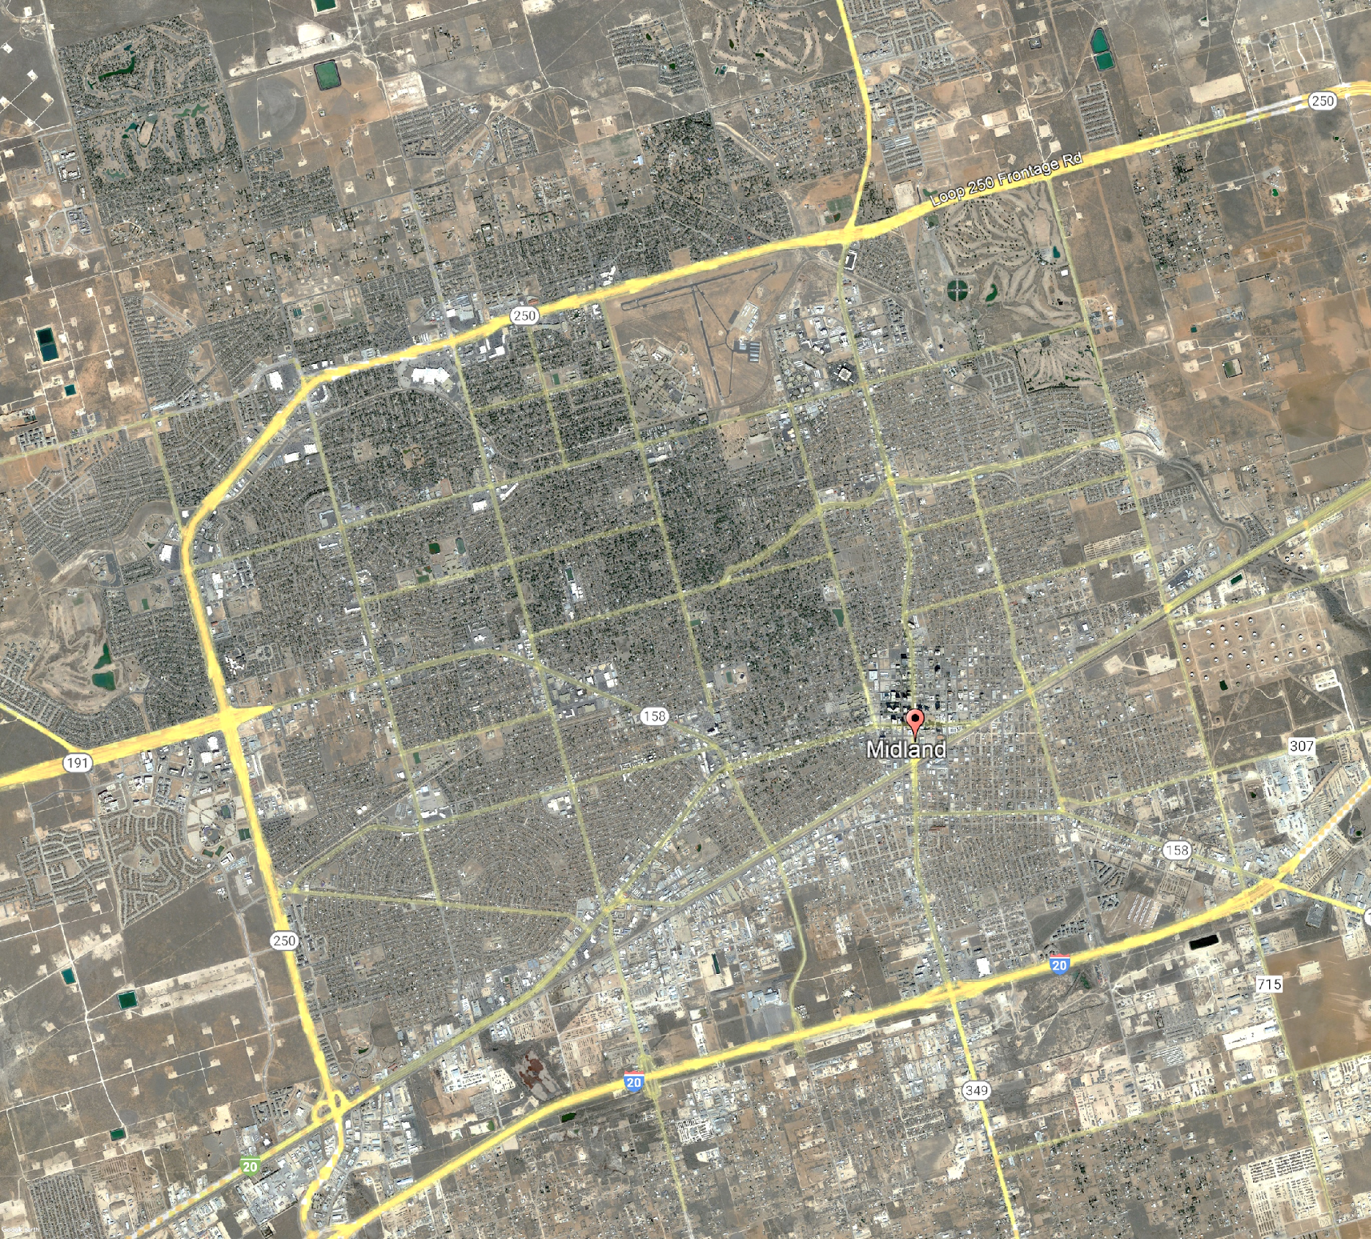
Middle Schools
Analysis does not include the following school(s) of choice.
Campus | 2023/24 / 2032/33 Enrollment | Functional Capacity
Young Women’s Leadership Academy | 414 / 467 | 616
IDEA Travis Academy | 454 / 530 | 775
Goddard
Abell
San Jacinto
Alamo

Slide 42
Middle Schools
With 6th Grade
Does Not Include Schools of Choice
Goddard
Goddard
Abell
Abell
San Jacinto
San Jacinto
Functional Capacity:
80%
Alamo
Alamo
ABELL
199%
2019
ALAMO
154%
1571
GODDARD
177%
1865
SAN
JACINTO
130%
1531
Based on 2032/33 Enrollment Projections and a 80% Functional Capacity

Slide 43
Option 1A (Convert Legacy High and Midland Freshman Campus)
With 6th grade
Steps:
Rezone existing junior high schools while maintaining current feeder patterns.
Convert Midland Freshman Campus to middle school.
Convert Legacy High School to middle school.
Goddard
Goddard
Convert LHS to MS
Abell
Abell
San Jacinto
San Jacinto
Functional Capacity:
80%
Alamo
Alamo
ABELL
199%
2019
ALAMO
154%
1571
GODDARD
177%
1865
SAN
JACINTO
130%
1531
Convert MFHS to MS
Based on 2032/33 Enrollment Projections and a 80% Functional Capacity

Slide 44
Option 1A (Convert Legacy High and Midland Freshman Campus)
With 6th grade
Steps:
Rezone existing junior high schools while maintaining current feeder patterns.
Convert Midland Freshman Campus to middle school.
Convert Legacy High School to middle school.
Goddard
Goddard
Converted
LHS to MS
Abell
Abell
San Jacinto
San Jacinto
Functional Capacity:
80%
810 Capacity
(1,040 with Current Portables)
813 Capacity
(947 with Current Portables)
842 Capacity
(1,072 with Current Portables)
1020 Capacity
940 Capacity
(1,017 with Current Portables)
Alamo
Alamo
2206
Capacity
ABELL
103%
1048
ALAMO
103%
1052
GODDARD
103%
1091
SAN
JACINTO
89%
1050
Converted MFHS
to MS
98%
1255
Converted
LHS to MS
56%
1489
Converted MFHS to MS
2032 Projected Capacity

Slide 45
Option 1B (Convert Midland High & Legacy High to Middle Schools)
With 6th grade
Steps:
Rezone existing junior high schools while maintaining current feeder patterns.
Convert Legacy High School to middle school.
Convert Midland High School to middle school.
Goddard
Goddard
Convert LHS to MS
Abell
Abell
San Jacinto
San Jacinto
Functional Capacity:
80%
Convert MHS
to MS
Alamo
Alamo
ABELL
199%
2019
ALAMO
154%
1571
GODDARD
177%
1865
SAN
JACINTO
130%
1531
Based on 2032/33 Enrollment Projections and a 80% Functional Capacity

Slide 46
Option 1B (Convert Midland High & Legacy High to Middle Schools)
With 6th grade
Steps:
Rezone existing junior high schools while maintaining current feeder patterns.
Convert Legacy High School to middle school.
Convert Midland High School to middle school.
Goddard
Goddard
Converted
LHS to MS
Abell
Abell
San Jacinto
San Jacinto
Functional Capacity:
80%
Converted
MHS to MS
810 Capacity
813 Capacity
810 Capacity
813 Capacity
842 Capacity
982 Capacity
Alamo
2206 Capacity
Alamo
2332 Capacity
ABELL
80%
810
ALAMO
80%
813
GODDARD
80%
842
SAN
JACINTO
80%
982
Converted MFHS
to MS
54%
1572
Converted
LHS to MS
71%
1967
2032 Projected Capacity

Slide 47
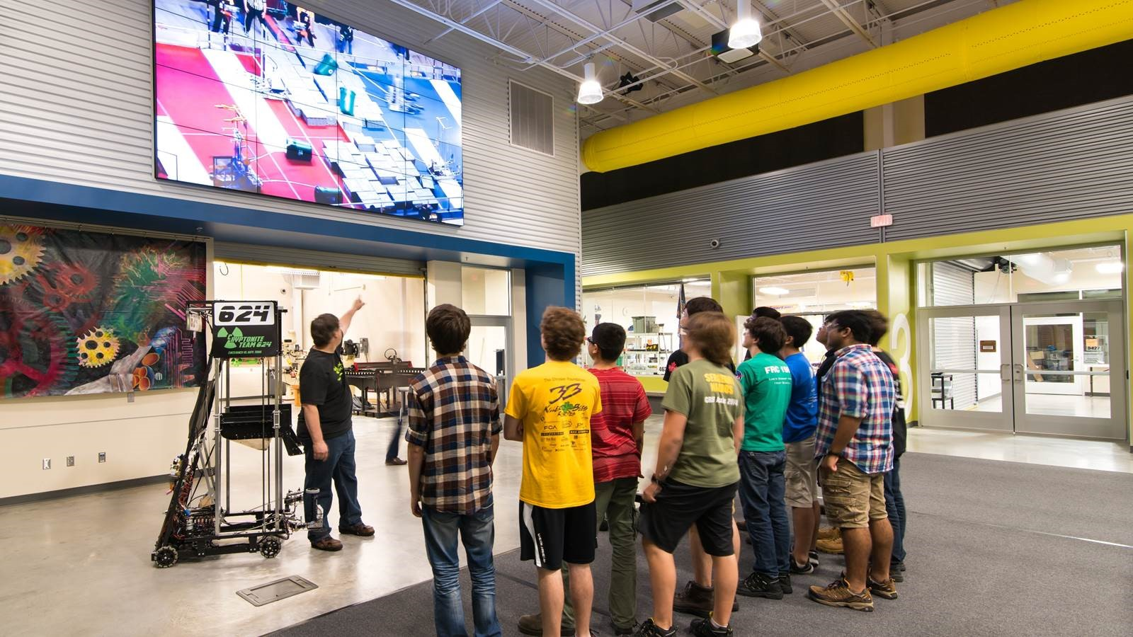
Decision Point

Slide 48

Decision Point

Slide 49
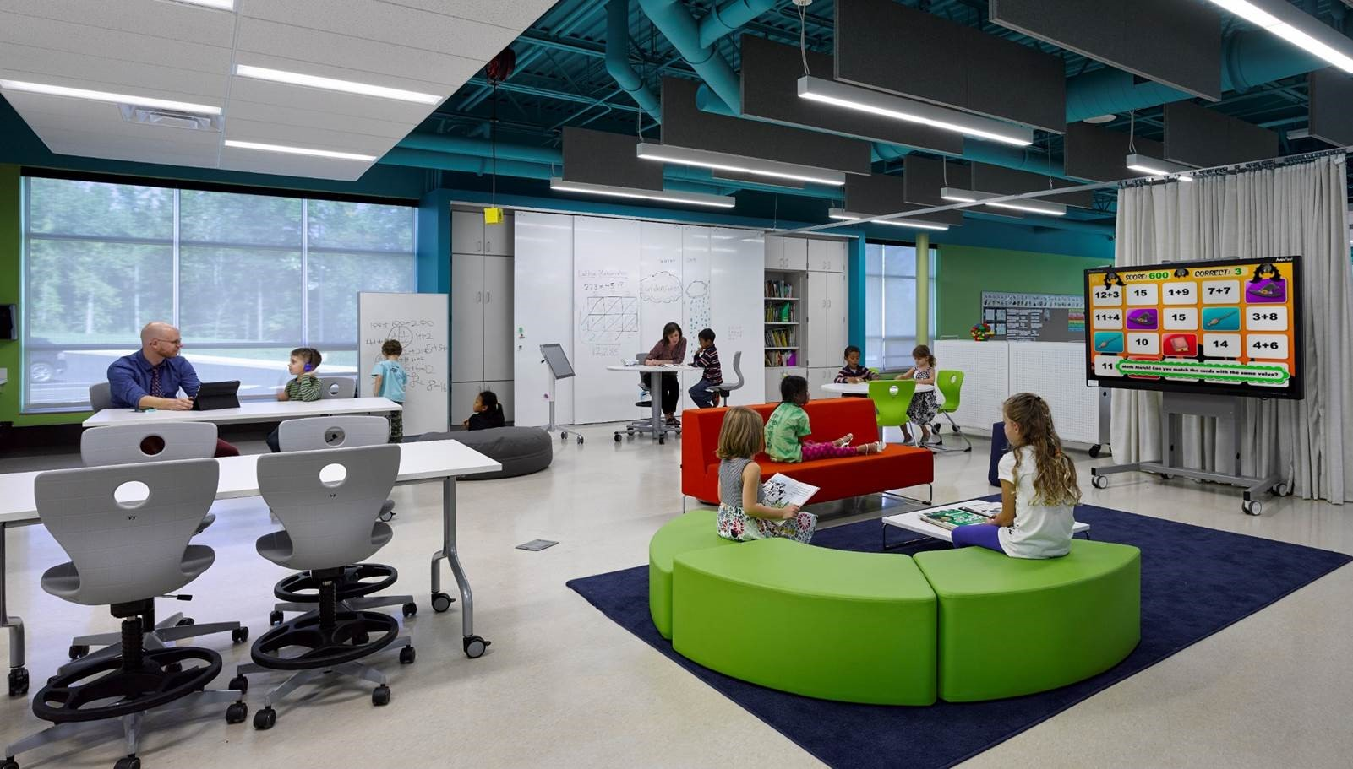
Elementary Schools Capacity Analysis

Slide 50
Elementary Schools
Analysis does not include the following schools of choice:
Fasken
Santa Rita
Campus | 2023/24 / 2032/33 Enrollment | Functional Capacity
Carver Elementary | 416 / 415 | 455
IDEA Travis Academy | 765 / 893 | 775
Bowie Fine Arts Academy | 431 / 496 | 572
Milam International Academy | 392 / 411 | 676
Pease Academy | 428 / 430 | 537
Bunche Elementary | 853 / 846 | 736
Houston Prepatory | 412 / 449 | 620
Greathouse
Emerson
Parker
Fannin
Rusk
Franks
Bush
De Zavala
Scharbauer
Bonham
Lamar
Ralph Bunche
Jones
South
B. Yarbrough
Long
Henderson
Burnet

Slide 51
Elementary Schools
Without 6th Grade
Does Not Include Schools of Choice
Fasken
Santa Rita
Fasken
Greathouse
Greathouse
Emerson
Emerson
Parker
Parker
Fannin
Fannin
ExcessivelyLow Enrollment
<75%
Low Enrollment
75-84%
Ideal Enrollment
85-95%
High Enrollment
96-100%
Excessively High Enrollment
>100%
Rusk
Franks
Rusk
Bush
Bush
De Zavala
Scharbauer
Bonham
Lamar
Lamar
Ralph Bunche
Jones
South
B. Yarbrough
Jones
Long
Long
Henderson
Burnet
Burnet
Based on 2032/33 Enrollment Projections and a 90% Functional Capacity

Slide 52
Option 1 (New Elementary School)
Without 6th grade
Steps:
Construct new 750 capacity elementary in NE part of district.
Rezone other campuses to improve efficiency.
New ES
Fasken
Santa Rita
Fasken
Greathouse
Greathouse
Emerson
Emerson
Parker
Parker
Fannin
Fannin
ExcessivelyLow Enrollment
<75%
Low Enrollment
75-84%
Ideal Enrollment
85-95%
High Enrollment
96-100%
Excessively High Enrollment
>100%
Rusk
Franks
Rusk
Bush
Bush
De Zavala
Scharbauer
Bonham
Lamar
Lamar
Ralph Bunche
Jones
South
B. Yarbrough
Jones
Long
Long
Henderson
Burnet
Burnet
Based on 2032/33 Enrollment Projections and a 90% Functional Capacity

Slide 53
Option 1 (New Elementary School)
Without 6th grade
Steps:
Construct new 750 capacity elementary in NE part of district.
Rezone other campuses to improve efficiency.
New ES
Fasken
Santa Rita
Fasken
Greathouse
Greathouse
Emerson
Emerson
Parker
Parker
Fannin
Fannin
Rusk
Franks
Rusk
Bush
Bush
Functional Capacity:
90%
De Zavala
Scharbauer
Bonham
Lamar
Lamar
Ralph Bunche
Jones
South
B. Yarbrough
Jones
Long
Long
ALL CAMPUSES
86%
Henderson
Burnet
Burnet
2032/33 Projected Capacity

Slide 54
Option 2 (Rezone all schools)
Without 6th grade
Steps:
Rezone all campuses to improve efficiency and avoid new construction.
Fasken
Santa Rita
Fasken
Greathouse
Greathouse
Emerson
Emerson
Parker
Parker
Fannin
Fannin
ExcessivelyLow Enrollment
<75%
Low Enrollment
75-84%
Ideal Enrollment
85-95%
High Enrollment
96-100%
Excessively High Enrollment
>100%
Rusk
Franks
Rusk
Bush
Bush
De Zavala
Scharbauer
Bonham
Lamar
Lamar
Ralph Bunche
Jones
South
B. Yarbrough
Jones
Long
Long
Henderson
Burnet
Burnet
Based on 2032/33 Enrollment Projections and a 90% Functional Capacity

Slide 55
Option 1 (New Elementary School)
Without 6th grade
Steps:
Rezone all campuses to improve efficiency.
Fasken
Santa Rita
Fasken
Greathouse
Greathouse
Emerson
Emerson
Parker
Parker
Fannin
Fannin
Rusk
Franks
Rusk
Bush
Bush
Functional Capacity:
90%
De Zavala
Scharbauer
Bonham
Lamar
Lamar
Ralph Bunche
Jones
South
B. Yarbrough
Jones
Long
Long
ALL CAMPUSES
92%
Henderson
Burnet
Burnet
2032/33 Projected Capacity

Slide 56

Decision Point

Slide 57
Decision Point

Slide 58
Potential Timeline of Improvements
Scope | Start | Complete
Bond Referendum (November 2023 or 2024) | August 2023 | November 2023
Planning of New High Schools* | January 2024 | April 2025
Construction of New High Schools | August 2025 | March 2028
Convert Freshman and/or Senior High School Campuses to Middle Schools** | May 2028 | August 2028
*Dates assume a November 2023 bond election
** Assumes earliest move-in with minimal remediation and/or cosmetic improvements or improvements in previous summers

Slide 59

Requests for Information
Committee members generate and record questions and or requests for information (RFIs) on the electronic form. A link to this form will be emailed in a meeting recap. You may also use the QR code below.
Staff review questions/RFIs for clarification.
Responses will be shared with committee members before next meeting.
MISD Bond Planning Committee
Notes:
Ken

Slide 60
Next Steps
Next meeting June 1 at Bunche Elementary
  Cost of Decisions
  Financial Impact
  Fine Arts
  Deferred Maintenance
MISD Bond Planning Committee
Notes:
Ken

