Slide 1
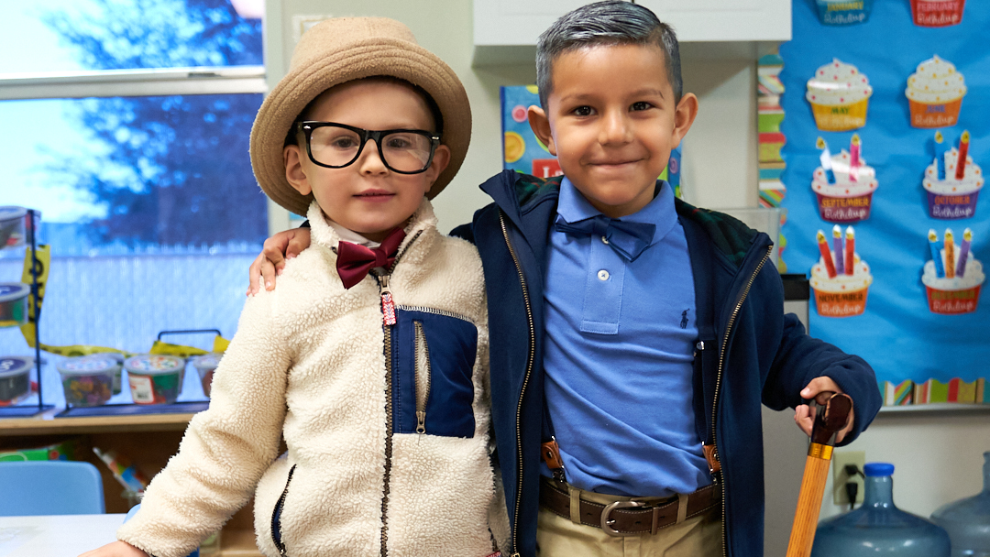


Midland ISD
Bond Planning
COMMITTEE PRESENTATION
June 20, 2023
Notes:
Dr. Howard: 5 minutes then introduce Cody

Slide 2
Recap of Work
INFORMATION RELATED TO SOUTHERN PORTION OF MISD
PRE-K BENEFITS AND IMPLICATIONS ON ELEMENTARY SCHOOLS
PROJECTS UPDATE
SURVEY RESULTS
DEVELOPING THE BOND PROGRAM (PROPOSITIONS)
Notes:
Dr. Howard: 5 minutes then introduce Cody

Slide 3
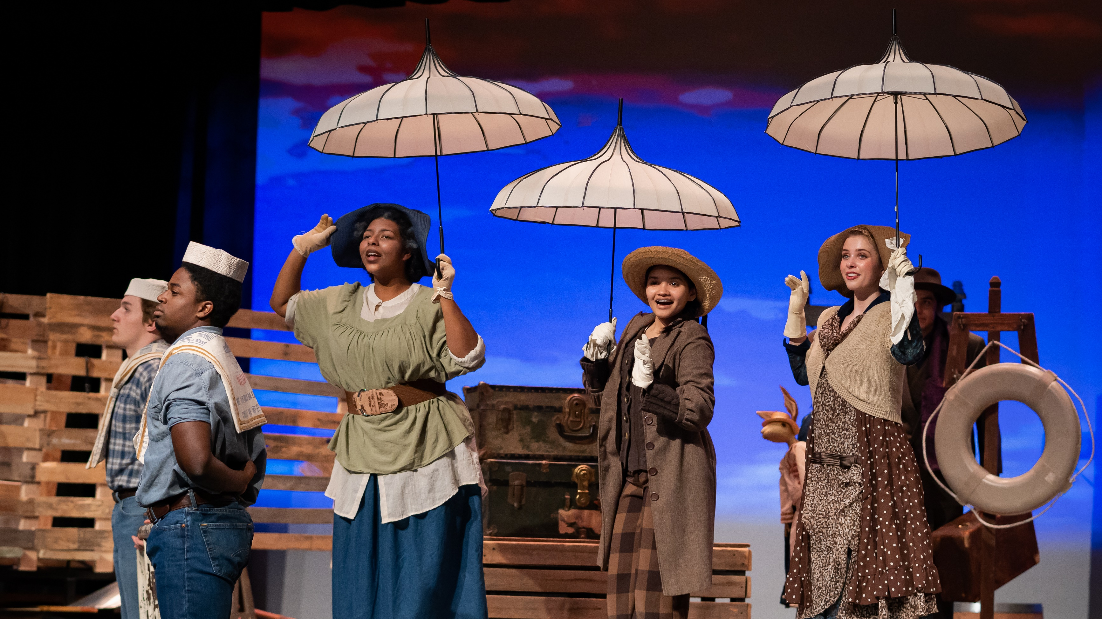
Elementary Review
Solutions to Address Southern District Concerns
Notes:
Cortney: 5 minutes

Slide 4

Southern District Solutions
District is working with our demographer to extend existing school boundaries further south to alleviate travel time on buses for students.
District is actively searching for land in the southwest part of the county, approximately 20 acres, to designate as a future elementary build.
District has identified 16 hazardous intersections south of Interstate 20 and is currently working with Midland County to improve bus stops and add street lighting.

Slide 5
Pre-K Data and Info.

Slide 6
Pre-K
MISD has 24 out of 26 campuses serving Pre-K students with at least one classroom.
Franks and Bowie do not currently serve Pre-K due to space constraints.
There are 54 monolingual classrooms and 11 bilingual classrooms across the district .
With grade reconfiguration, MISD could potentially serve:
1,000 more Pre-K-4 Students (in addition to 1,000 already served)
1,000 Pre-K-3 Students
The state requires early childhood education be provided to qualifying students.
Expansion of Pre-K would provide Pre-K seats for three and four-year-olds that do not qualify.

Slide 7
Projects Update
Notes:
Terry: 10 minutes

Slide 8
High School Campus Solutions
Original Scope and Size Assumptions:
Minimal CTE classes
No new programs or additional square footage for dining added
690,000 square feet
Current Scope and Size Assumptions:
Expanded dining to serve all 9th graders during one lunch period
Serves current trends in teaching and learning
Provides state-of-the-art spaces to support programs
Balance of CTE spaces to be provided at both high schools and Midland College
790,000 square feet

Slide 9
Update on HS Budgets/Schedules
Original Assumption Costs:
$900,000,000 In today’s dollars
Updated Assumption of Costs:
2-years inflation at 5% each year and 5% contingency
Summer 2028 move-in
Increased square footage
Full technology infrastructure and equipment
Full furnishings, fixtures, equipment
Assumes no off-site improvement costs
$1,077,200,000

Slide 10
New High School Campuses
Impact to Attendance Zones:
No Changes
Scope of Work:
(2) 4200 student capacity high schools.
Midland High School site to be located at 1600 E Wadley Avenue.
Legacy High School site to be located at Thomason Dr. and Tradewinds Blvd. intersection.
COST IMPACT: $1.077B | TAX IMPACT: $27.61 per mo.

Slide 11
Projects Update
NOVEMBER 2023 ELECTION
Scope | Original Projected Cost | Current Projected Cost
(2) NEW HIGH SCHOOLS | $900,000,000 | $1,077,200,000
MIDDLE SCHOOL ADDITIONS AND RENOVATIONS | $224,400,000 | $225,300,000
NEW ELEMENTARY SCHOOL | $59,700,000 | $57,000,000
RENOVATIONS FOR AGING FACILITIES | $260,200,000 | $260,200,000
SAFETY, SECURITY, AND ACCESSIBILITY | $41,800,000 | $58,700,000

Slide 12

Questions

Slide 13
Early Survey Results
Over 1,900 people responded to the survey.
Notes:
Cody: 30 minutes with Q&A

Slide 14
Measuring Opinions:
1400
5.
The district is steadily growing and needs a plan to address rising student enrollment.
1200
1000
(1,923 Total Responses)
800
600
6.
Classrooms and common spaces throughout the district are overcrowded.
400
200
(1,927 Total Responses)
Strongly Disagree
Unsure
Strongly Agree
Over
82%
Agree to Strongly Agree on both topics
Notes:
61% of the over 82% also answered that they vote all the time in bond elections.

Slide 15
Measuring Opinions:
1600
The district needs to address maintenance and renovations for aging facilities.
1400
7.
1200
1000
(1,936 Total Responses)
800
Good schools in Midland contribute to a quality workforce.
600
12.
400
200
(1,932 Total Responses)
Strongly Disagree
Unsure
Strongly Agree
90%
66%
Agree with #7 but only Agree with #12
Notes:
70% of the 90% answered that they vote all the time in bond elections.

Slide 16
Measuring Opinions:
1400
8.
The district should consider building a new elementary school.
1200
1000
(1,927 Total Responses)
800
9.
New high schools should be built to replace aging Legacy and Midland High Schools and handle growth due to adding 9th graders.
600
400
200
(1,931 Total Responses)
Strongly Agree
Strongly Disagree
Unsure
55%
76%
Only
Agree with #8 but Agree with #9

Slide 17
Should the district construct two new high schools to replace Midland HS and Legacy HS and repurpose the old ones? Explain.
"In their current locations both schools cannot grow or expand. Even the freshman campuses are struggling. Not to speak of the Jr Highs."
"Both facilities are outdated, even with upgrades in maintenance and other facilities needs they are still inadequate, hazardous and ill-equipped."
"We are in desperate need of campus that can house our students. The rapid growth continues to overcrowd classes."
"Yes. New facilities needed to house 9-12."

Slide 18
Measuring Opinions:
Students in MISD schools are being educated in safe and modern learning spaces.
1400
10.
1200
1000
800
600
400
(1,930 Total Responses)
200
40%
Disagree or Strongly Disagree
Strongly Disagree
Unsure
Strongly Agree
Notes:
70% of the 90% also answered that they vote all the time in bond elections. Then 69% of the 76% answered that they vote all the time in bond elections.

Slide 19
Measuring Opinions:
Overall, how would you rate the condition of the existing school buildings, facilities, properties and grounds of MISD.
1400
13.
1200
1000
800
600
400
(1,932 Total Responses)
200
45%
Poor
Unsure
Excellent
Rated conditions of MISD schools as Poor

Slide 20
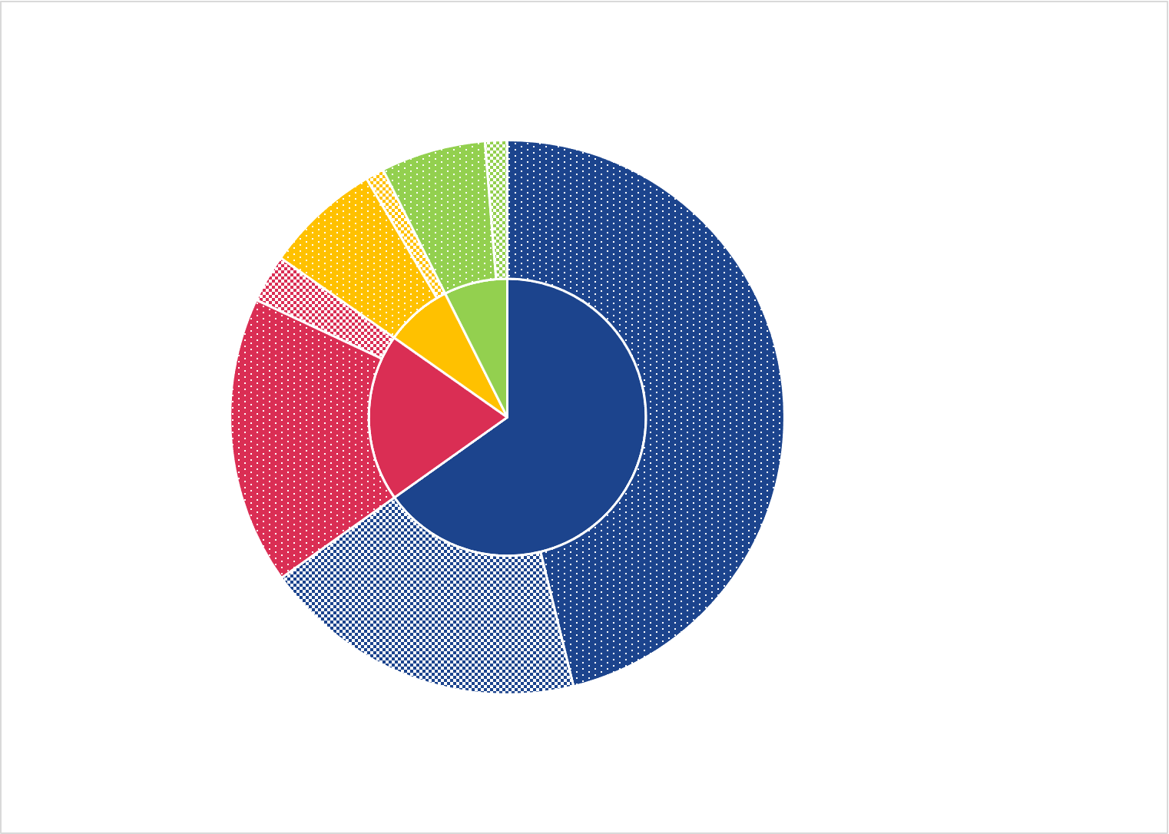
Voting Demographics at a Glance
How often do you vote in school bond elections?
2%
1%
6%
7%
75%
All the time
3%
Currently have kids enrolled in the district
8%
Some of the time
8%
Rarely
19%
16%
46%
65%
Never
25%
Have no kids enrolled in the district
(1,934 Total Responses)
19%
Notes:
The inner circle is a pie chart of responses to question #14 of the survey. Using the responses to question #14 as filter criteria, the outer circle directly correlates their voting frequency to question #2: Do you have children currently enrolled in Midland ISD? (question #14 and possible answers on the slide).

Slide 21
Questions
Notes:
HAVE GROUP TO DISCUSS THE FINDINGS AT THEIR TABLE AND THEN SHARE OUT

Slide 22
Voting Preferences:
27%
Multiple
propositions
20.
Do you prefer a bond with one or multiple propositions and choices?
Single
proposition
(1,919 Total Responses)
73%
8%
Knowing that construction costs will likely continue to increase over time, when should MISD consider calling its next bond election?
4%
November 2023
21.
May 2024
24%
52%
November 2023
(1,913 Total Responses)
May 2024
12%
MISD does not
need a bond

Slide 23

Decision Point
SINGLE PROPOSITION?
MULTIPLE PROPOSITIONS?
Notes:
DISCUSS AS A GROUP AT THEIR TABLES AND THEN VOTE

Slide 24
Decision Point
NOVEMBER 2023 BOND ELECTION?
MAY 2024 BOND ELECTION?
Notes:
DISCUSS AS A GROUP AT THEIR TABLES AND THEN VOTE

Slide 25

Opinion of Projects:
Please tell us how strongly you support or oppose the projects listed below:
0
1
2
3
4
5
Do Not Support
Not Sure
Strongly Support
15.
16.
17.
18.
19.
2 new high schools to replace overcrowded & aging Midland & Legacy.
Renovations & additions
at middle schools to accommodate growth.
A new ES to meet elementary enrollment growth.
Maintenance and renovations of all aging facilities.
Safety, security, & ADA accessibility projects at every campus.
1400
1200
1000
800
600
400
200
70%
80%
63%
86%
88%

Slide 26
Opinion of Impact:
(per month for avg. homeowner - $341,000 avg. home value)
22.
900
ALL PROJECTS: 2 New HS, MS renovations, new ES, Upgrades to Aging Facilities, Safety & Security
($47/month)
800
700
23.
600
2 New High Schools, MS renovations, Upgrades to Aging Facilities, Safety & Security
($45/month)
500
400
24.
2 New High Schools, MS additions
& renovations, new ES, no districtwide renovations
300
($37/month)
200
100
25.
2 New High Schools and
MS renovations
0
($35/month)
Strongly Oppose
Unsure
Strongly Support
66%
Opposed doing the bare minimum of $9/month = nothing new, only maintenance. Continue purchasing portables out of operations budget.

Slide 27
Questions
Notes:
HAVE GROUP TO DISCUSS THE FINDINGS AT THEIR TABLE AND SHARE OUT

Slide 28
Decision Point
WHAT IS TO BE INCLUDED IN THE BOND REFERENDUM?

Slide 29
Cost and Tax Implications
NOVEMBER 2023 ELECTION
Scope | Cost | Tax Increase per Month
(2) NEW HIGH SCHOOLS | $1,077,200,000 | $27.61
MIDDLE SCHOOL OPTION 1B (6 CAMPUSES) | $225,300,000 | $7.53
INCREASED CAPACITY | $141,300,000 | $4.85
MFHS AND LHS RENOVATION | $84,000,000 | $2.81
NEW ELEMENTARY SCHOOL | $57,000,000 | $1.90
RENOVATIONS FOR AGING FACILITIES (PRIORITY 1-4) | $260,200,000 | $8.69
MECHANICAL, ELECTRICAL, PLUMBING (PRIORITY 1) | $41,000,000 | $1.37
INTERIOR IMPROVEMENTS (PRIORITY 2) | $136,500,000 | $4.56
SITE IMPROVEMENTS (PRIORITY 3) | $61,400,000 | $2.05
BUILDING EXTERIOR (PRIORITY 4) | $21,300,000 | $.71

Slide 30
Cost and Tax Implications
NOVEMBER 2023 ELECTION
Scope | Cost | Tax Increase per Month
SAFETY, SECURITY, AND ACCESSIBILITY (PRIORITY 1-3) | $58,700,000 | $1.96
ACCESSIBILITY (PRIORITY 1) | $19,200,000 | $.64
SECURED VESTIBULES, ACCESS CONTROL, INTERCOM, RADIO READERS (PRIORITY 2) | $35,500,000 | $.63
CAMERAS (PRIORITY 3) | $4,000,000 | $.13
TOTAL: | $1,678,400,000 | $47.69

Slide 31
BOND EXERCISE TABLE – OPTION 1
Scope | Cost | Tax Increase per Month
PROPOSITION A | $1,678,400,000 | $47.69
(2) NEW HIGH SCHOOLS | $1,077,200,000 | $27.61
MIDDLE SCHOOL ADDITIONS & RENOVATIONS | $225,300,000 | $7.53
NEW ELEMENTARY SCHOOL | $57,000,000 | $1.90
DISTRICTWIDE RENOVATIONS FOR AGING FACILITIES | $260,200,000 | $8.69
SAFETY, SECURITY, AND ACCESSIBILITY | $58,700,000 | $1.96
PROPOSITION B | $1,678,400,000 | $47.69
(2) NEW HIGH SCHOOLS | $1,077,200,000 | $27.61
MIDDLE SCHOOL ADDITIONS & RENOVATIONS | $225,300,000 | $7.53
NEW ELEMENTARY SCHOOL | $57,000,000 | $1.90
DISTRICTWIDE RENOVATIONS FOR AGING FACILITIES | $260,200,000 | $8.69
SAFETY, SECURITY, AND ACCESSIBILITY | $58,700,000 | $1.96

Slide 32
Next Steps
Committee representatives develop recommendation for Board of Trustees at the July 17th meeting.
Present recommendation to the Board of Trustees at the July 25th Board Meeting.

Slide 33

Thank You!

