Slide 1
Community Support Round Table
7.12.23

Slide 2
Agenda
District Highlights
Long Range Planning Committee/Bond Planning Committee
Q&A
Potential Next Steps

Slide 3
District Highlights
Overview

Slide 4
Entry Plan
Phase I: Pre-Entry – December
Phase II: Entry – January-April
Phase III: Planning – May-August

Slide 5
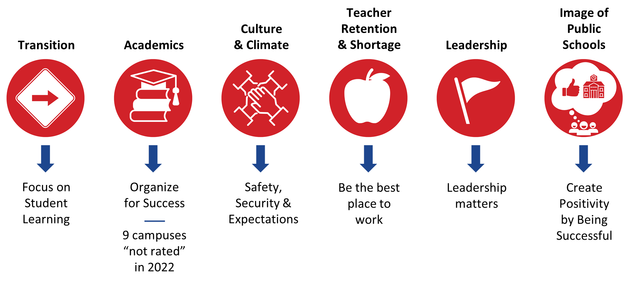
Areas of Focus

Slide 6
Listen, Learn, & Lead Meetings
What is working well? Key Findings
Positive Culture & Climate
Accountability & High Expectations
Communications
New Discipline Approach
Pay and Benefits
Opportunity Culture is going well at several schools, in addition to the staff wellness program
Many schools reported that having helpful systems for accountability. Setting high expectations has led to positive results in the classroom
Communication between departments, parents and staff, and campus wide comms were listed as going well for several of the schools
Discipline expectations have been set and empowered teachers to better manage classrooms
District provides competitive pay and benefits that meet the cost of living needs to Midland

Slide 7
Listen, Learn, & Lead Meetings
What are our areas of improvement? Key Findings
Training
Transportation & Safety
Curriculum Consistency
Attendance
Substitute Teachers
Increase training across multiple functions including administrative support, life skills, new teacher training, technology, and certifications
Transportation is time consuming leading to loss of instructional time and increased duty time. Safety concerns around non-secured entrances, open concept campuses, and procedures (dismissal)
Curriculum Consistency - Curriculum consistency across the district, teacher input on curriculum choices and updates, and teacher training on the curriculum
Hold parents accountable for student attendance. Incentivize teacher attendance.
There is a need for more substitute teachers. Lack of coverage and availability of substitutes.

Slide 8
Who We Serve

Slide 9
MISD at a Glance
Student
Demographics
Projected Enrollment 2023-24: 28,125
39 Campuses
46 Languages
Race/Ethnicity
Hispanic: 65.89%
White: 22.19%
African American: 6.86%
Asian: 2.42%
Two or more races: 2.28%
American Indian: 0.23%
Pacific Islander: 0.13%
Other Statistics
Economically Disadvantaged: 55.33%
Gifted & Talented: 4.36%
Special Education: 10.27%
Emergent Bilingual/English Learners: 17.32%
Notes:
the enrollment number needs to match the projected enrollment number we are using for this year - and stay the same throughout the year. How many actual employees do we have staffed for? (Brandon)

Slide 10
Who We Are

Slide 11
Teaching & Learning
Overview

Slide 12
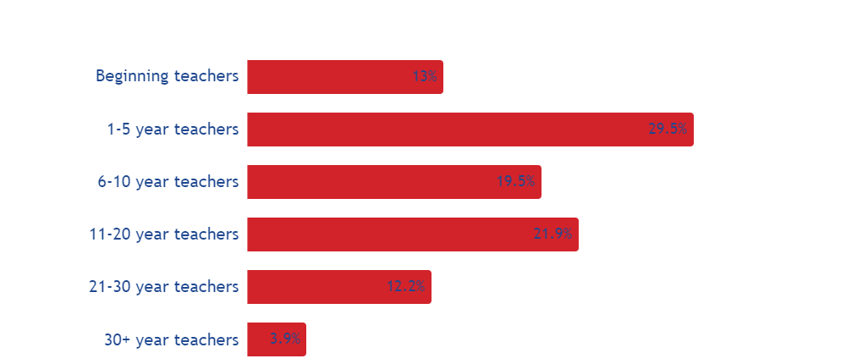
MISD Teacher Experience
Source: Fall PEIMS SNapshot 22-23 of Teacher Experience

Slide 13
Key Data Points
PreK
  24 out of 26 campuses serving PreK students with at least one classroom
  Expansion of PreK would provide seats for three and four-year-olds that do not qualify.
  Currently serve 1,000 four year olds and less than 100 three year olds.
  Grade reconfiguration and partnerships could expand these figures significantly
  37% of students are Kindergarten ready
  Math: PreK students exceeded the district’s goal (92%; Goal was 91%)
  Phonological Awareness: Exceeded this district’s goal (86%; Goal was 82%)
  Growth related to targeted coaching and professional development provided by Early Childhood Development and an outside Early Childhood consultant
CTE
  MISD currently offers 26 programs of study - Welding and Health Sciences most sought after
  Over 325 hours of free college tuition
  699 Industry based certifications were earned by MISD students in the 22-23 school year
  7,185 students were enrolled in CTE courses in the 22-23 school year. (76% of students)

Slide 14
Key Data Points
CCMR
  Class of 2021 - 45% of students were CCMR met
  Class of 2022 - 54% of students were CCMR met
  Class of 2023 - Early projections - 77% of students were CCMR met
MISD serves over 2,000 6th and 2,000 9th grade students each year
44% of 3rd graders are on grade level in Reading
  New literacy initiative
  Structured Literacy approach starting with explicit phonics instruction in primary grades.
Talent strategy
  Personalized professional learning and coaching for teachers
  Implementation of Teach Like A Champion (funded by Abell-Hanger Foundation)

Slide 15
EOC Improvements
Meets Level:
Improved from last year in 4 out of 5 areas
English I, English II, Biology, and U.S. History
Only 1 point decline from last year in Algebra I as did the state
Outpaced the state increases in Biology and U.S. History
Approaches Level:
Improved from last year in 3 of 5 areas
Algebra I, Biology, and U.S. History
No change with English II.
Outpaced the state increased in 3 of 5
Algebra I, Biology, and U.S. History

Slide 16
Human Capital

Slide 17
Staffing by the Numbers
3,448
1,440
630
365
318
76
21
Teachers
Auxiliary staff
Professional support staff
Educational aides
Campus administrators
Superintendent & Executive Leadership
2,850
Total number
of positions available
Total number
of positions currently filled
7%
598
Total number
of positions currently vacant
As of 7.12.23

Slide 18
Financial

Slide 19
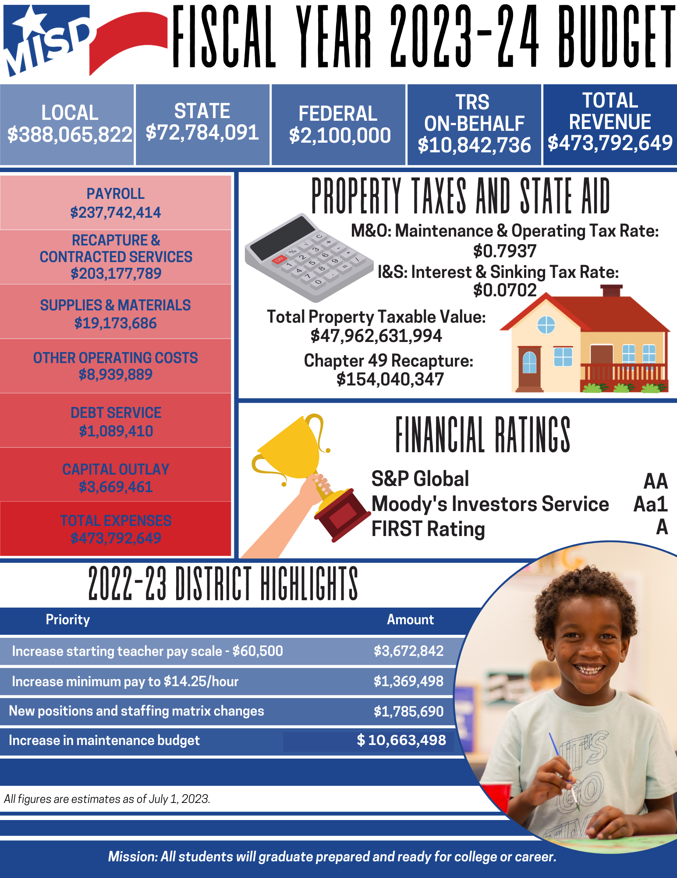
Formula Transition Grant
•Created by the state in 2019 for districts to transition from old school law to the new school law under HB3
•The transition grant is only a five-year program
•MISD received about $55 million last school year, about 24% of all grant funding available for the entire state
•MISD expects to receive an estimated amount of $55 million this school year
•Grant program ends in 2023-24

Slide 20
Operations

Slide 21
Completed and Upcoming Projects
Franks ES Office renovation
Phase III Reverse Osmosis project
Generator upgrade for IT at LHS
LED lighting upgrade for Memorial Stadium and LHS and MFHS parking lots
New fencing at MHS and Alamo
Resurface parking lots at LHS, MFHS, and teacher parking lot at MHS
New irrigation installation at South, Scharbauer, Henderson, Milam and Long
LHS Auditorium renovation (paint and flooring)
New fuel pumps for Transportation
New classroom/student furniture for 13 campuses across the district
Elevator upgrades
District-wide boiler and chiller replacements
Operations Budget Improvements
2022-23: $7,000,000
2023-24: $12,000,000
Capital Projects: $25,000,000

Slide 22
Communications

Slide 23
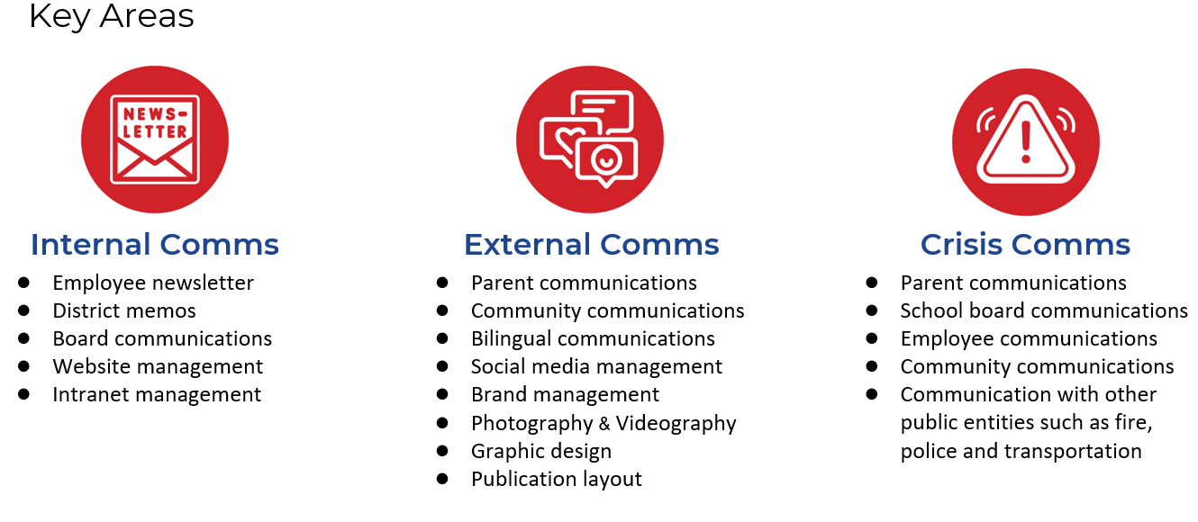
Areas of Focus

Slide 24
Leadership

Slide 25
Areas of Focus
Campus Culture & Climate
Executive Director of School Leadership
Leadership Summit
Holdsworth Center
Principal Fellows
Aspiring Principals Academy

Slide 26
Strategic Plan
Overview

Slide 27


Strategic Plan Themes
Student Experience
Grow & Develop Staff
Engage & Act
We foster safe and innovative learning spaces where students engage in rigorous and relevant experiences, preparing them for meaningful opportunities post graduation.
Our retention and recruitment practices promote professional growth that yields and rewards high-impact staff, improving student outcomes.
We engage the entire Midland community through clear and actionable communication that cultivates trust and partnership.

Slide 28
Goals & Initiatives
Student Experience
Grow & Develop Staff
Engage & Act
Strengthen instructional practices to improve student outcomes
Improve academic support and career preparation for students to ensure readiness for college, employment, or military service upon graduation.
Research, plan and implement new school safety infrastructure, facility updates and transportation operations that maximize instructional time.
Recruit and retain high-quality staff
Develop and implement talent pipelines and professional learning
Streamline onboarding process
Strengthen our existing community partnerships & develop new
Tell the MISD Story
Increase family engagement

Slide 29
Strategic Plan
Next Steps

Slide 30


Slide 31
Long Range & Bond Planning Committees
How We Got Here

Slide 32
Demographic Study
2021 Demographic Study
●26 campuses are more than 50 years old
●LHS, LFHS and MHS have the greatest need of replacement or significant renovation
●Three of four junior high schools have enrollments above their functional capacities
●Three of four freshman and senior high schools have enrollments above their functional capacities
●13 elementary schools are expected to be above their functional capacities soon
Study Recommendations
●26 campuses are more than 50 years old
●LHS, LFHS and MHS have the greatest need of replacement or significant renovation
●Three of four junior high schools have enrollments above their functional capacities
●Three of four freshman and senior high schools have enrollments above their functional capacities
●13 elementary schools are expected to be above their functional capacities soon

Slide 33
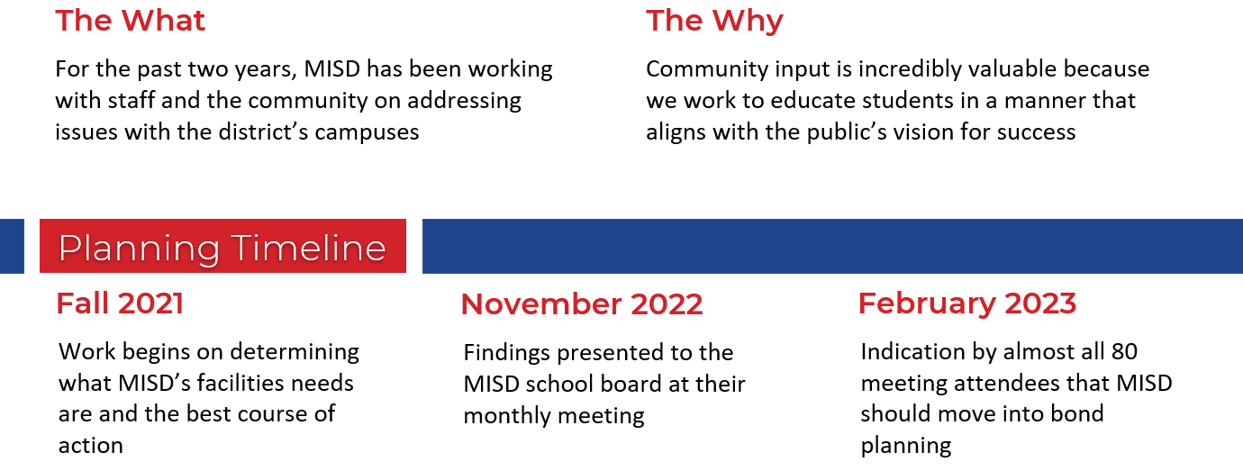
Planning Timeline

Slide 34
Recap of Work
•Demographic study and enrollment projections
•Facilities Assessment
•Grade Reconfiguration
•Community Survey
•Prioritization of Projects
•Financial Implications
•Recommendation to Call a Bond Election

Slide 35
Growth

Slide 36
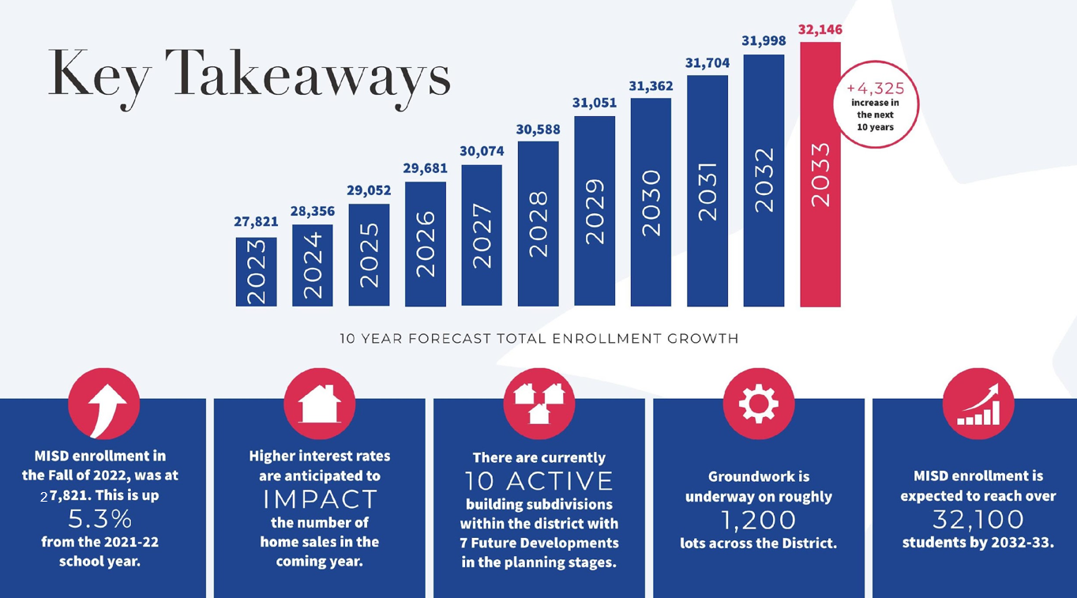
Growth

Slide 37
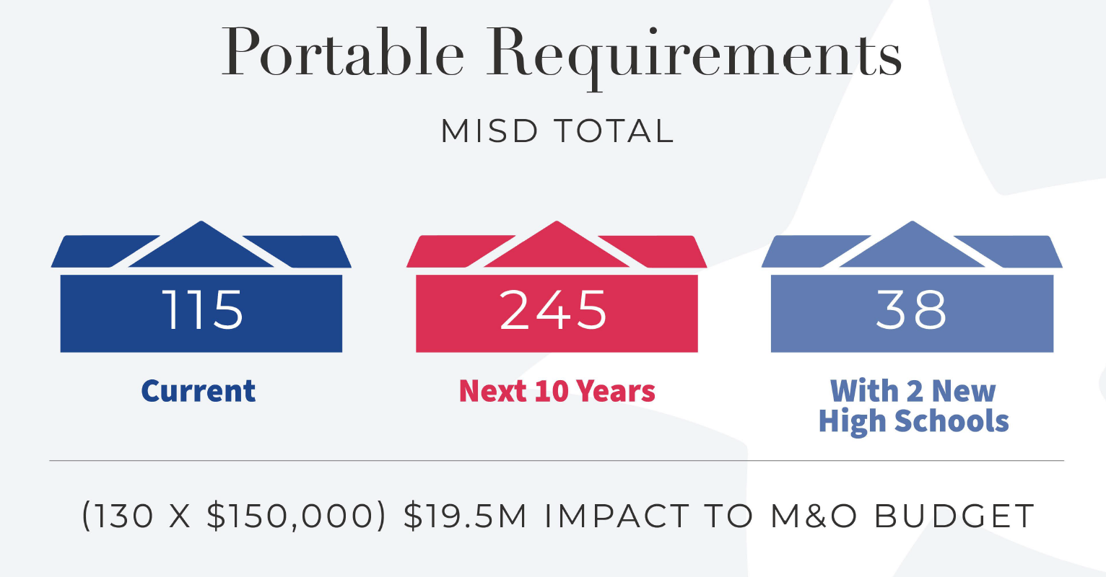
Growth

Slide 38
Peer Comparisons

Slide 39
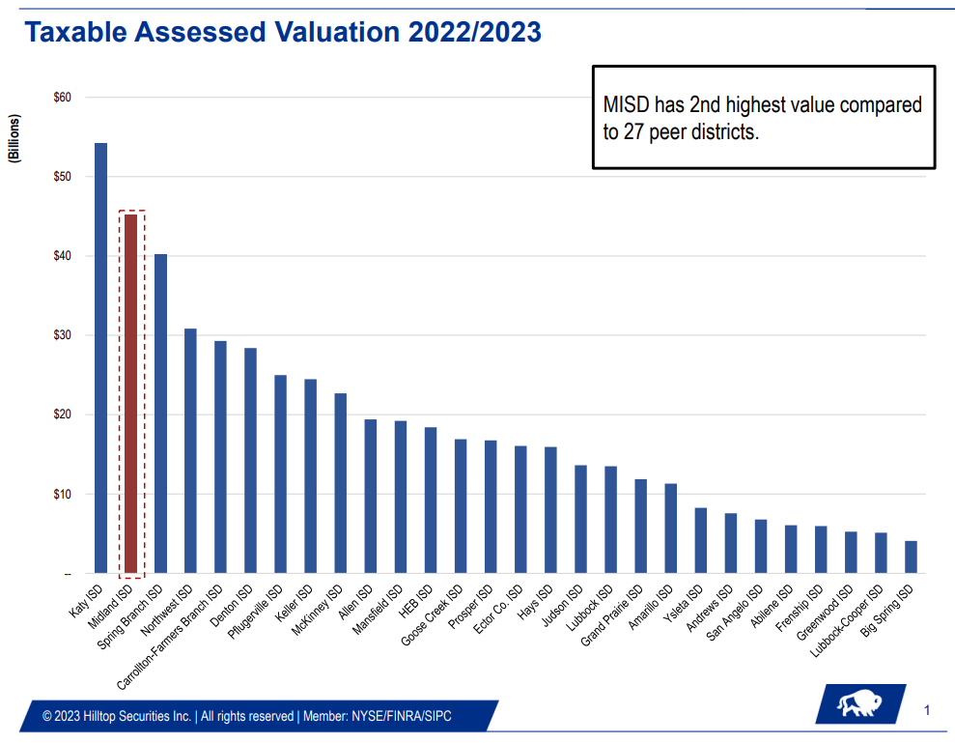

Slide 40
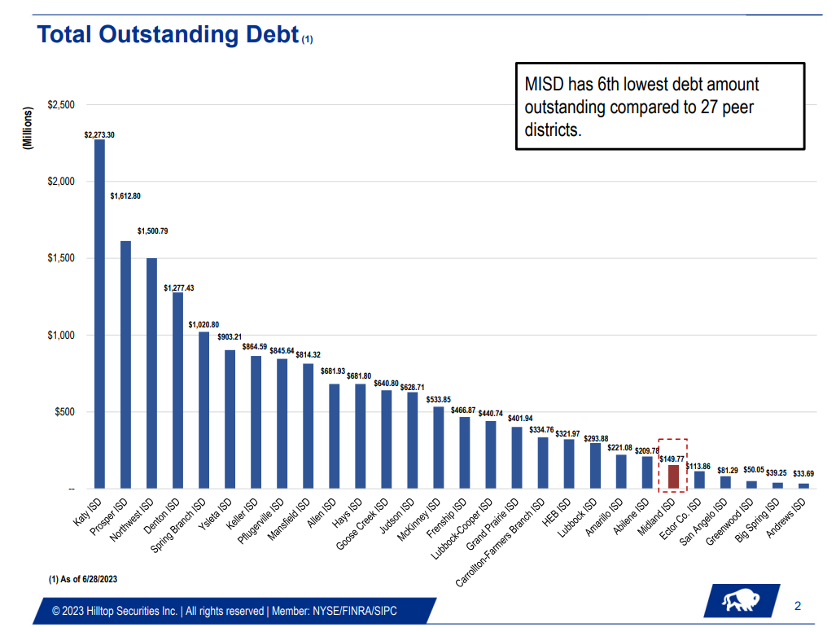

Slide 41
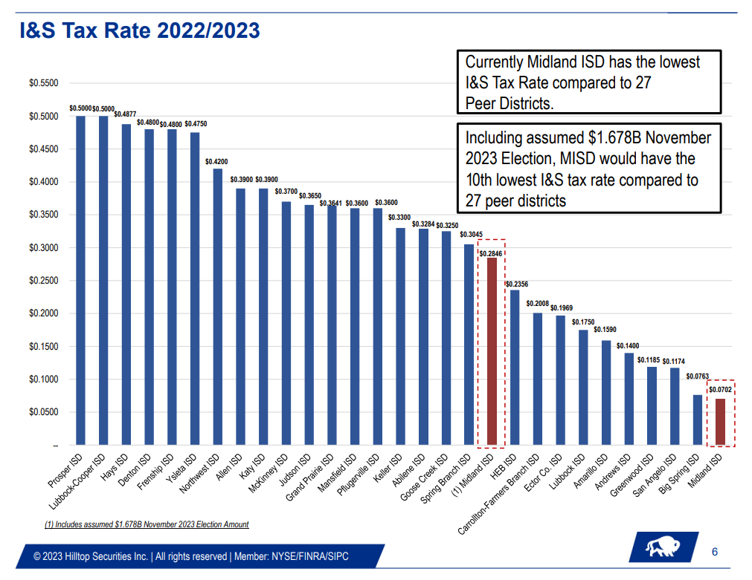

Slide 42
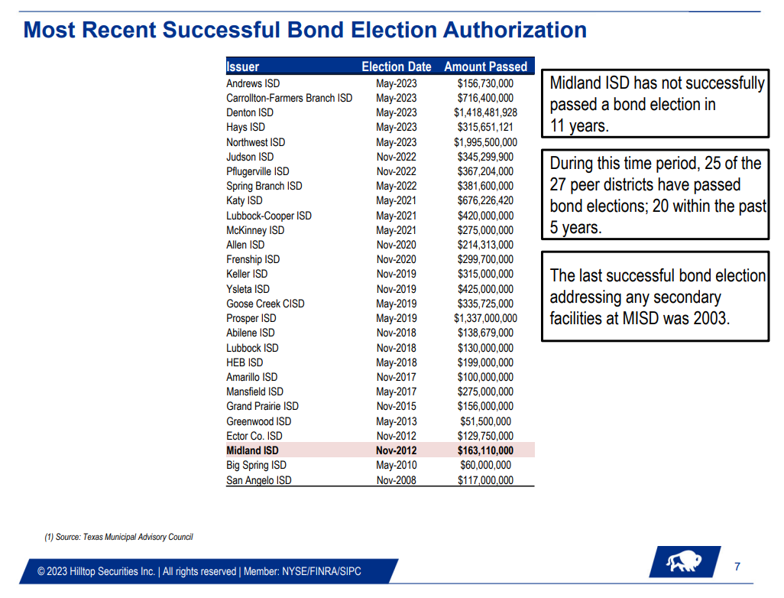

Slide 43
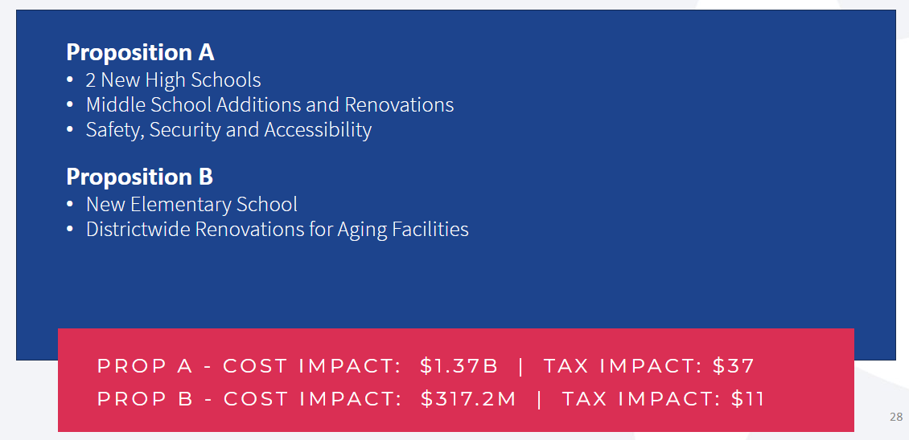

Slide 44
Community Survey
Over 2,100 Responses

Slide 45
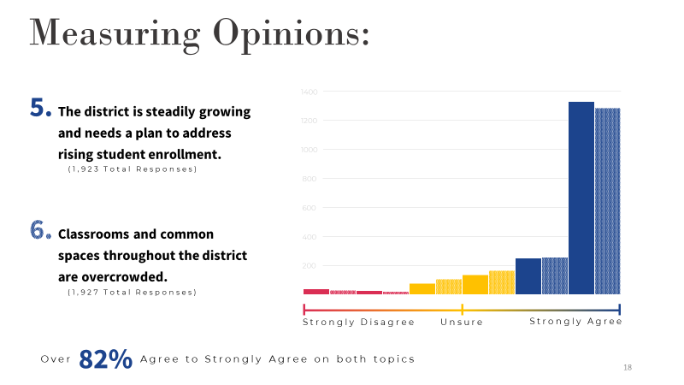

Slide 46
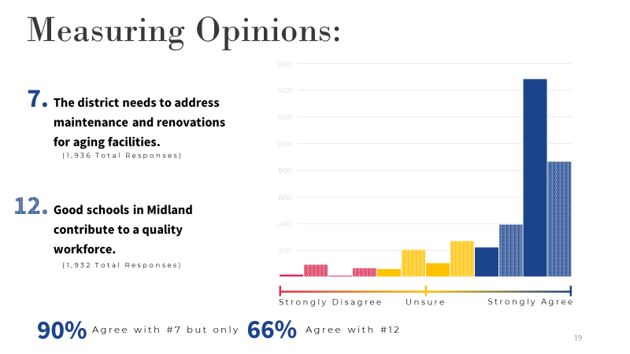

Slide 47
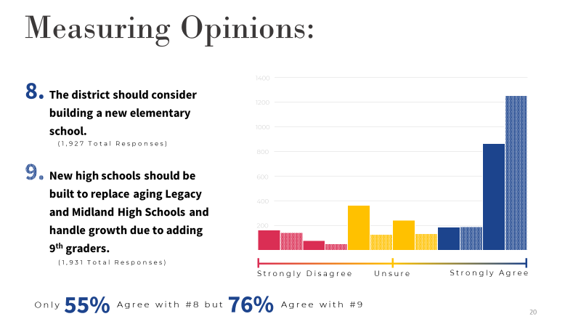

Slide 48
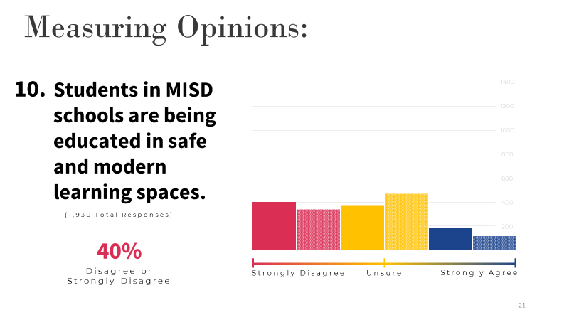

Slide 49
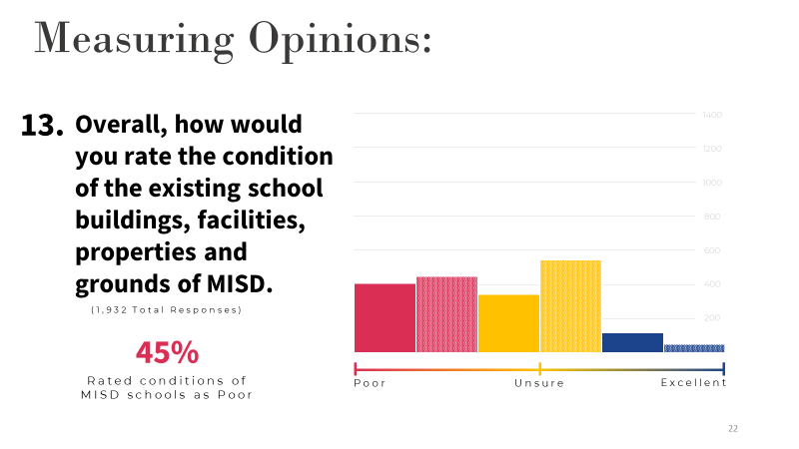

Slide 50
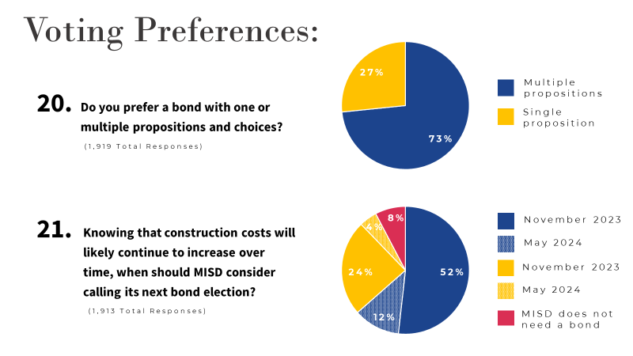

Slide 51
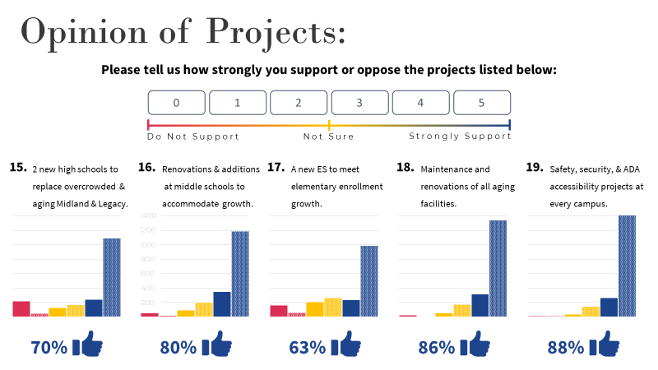

Slide 52
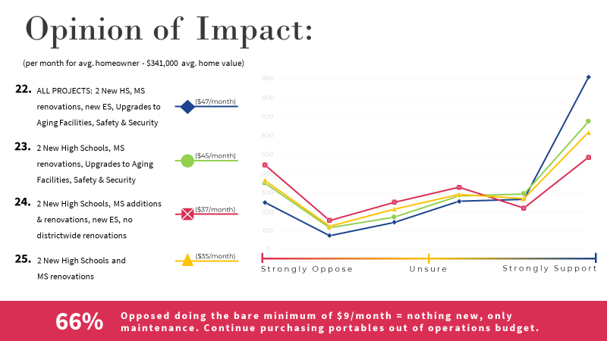

Slide 53
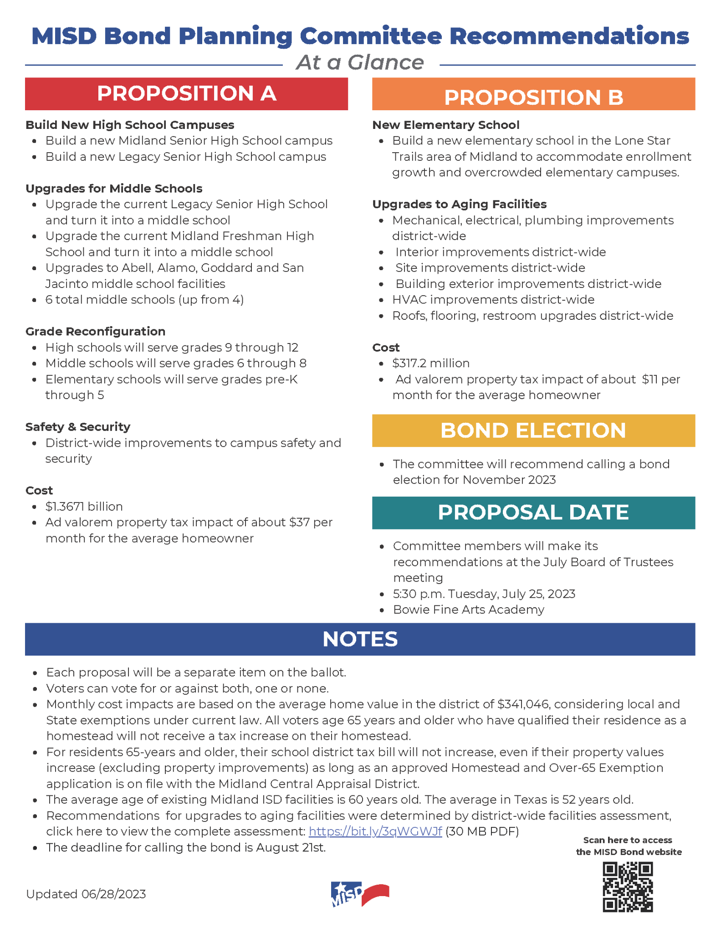
Bond Committee Recommendations

Slide 54
Bond Committee Recommendations

Slide 55
Q&A

Slide 56
Cody Cunningham
Principal, Director of Communications & Community Engagement
cody.cunningham@pflugerarchitects.com
469-865-3300

