Slide 1

Meeting No. 2
Legacy Freshman
April 3, 2023
BOND PLANNING COMMITTEE

Slide 2
Welcome & Agenda
Superintendent Welcome
Committee Charge
Questions/RFI Follow Up
Outcomes for Meeting
Long Range Plan (LRP) Presentation
  Table Discussion
Finance 101
Communication/RFI’s
Next Steps
MISD Bond Planning Committee
Notes:
Superintendent, Ken

Slide 3
Planning Committee Charge
Review the recommendations made by the Long-Range Facility Planning Committee, as a result of their extensive study of the comprehensive facilities assessment, demographic data, and anticipated academic programs.
Review options for existing, renovated and/or new facilities, and their implications for student enrollment, innovative instructional programs, modern learning requirements, technology and educational specifications, staffing, operational effectiveness and fiscal responsibility.
Develop and recommend to the Midland ISD Board of Trustees a Bond Plan that addresses student learning environments for the next 5 years, and prepares the district for future enrollment growth, evolving instructional programs, and preventive maintenance.
MISD Bond Planning Committee
Notes:
Ken

Slide 4
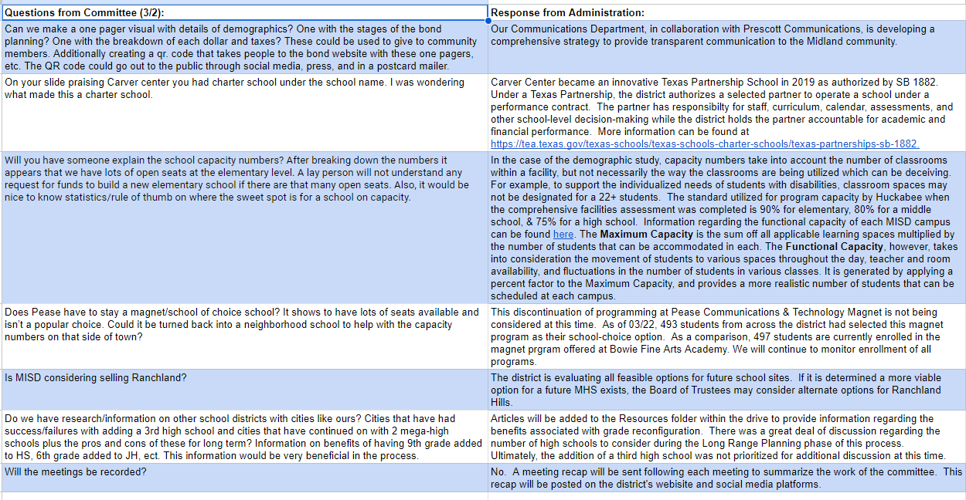
Questions/RFI’s
MISD Bond Planning Committee
Notes:
Staff

Slide 5
Outcomes
  Examine and discuss the LRP
    Table Discussion
  Finance presentation
  April 20 & Beyond
  Next Steps
MISD Bond Planning Committee
Notes:
Ken

Slide 6
Long-Range Plan
Presentation
Table Discussion/Q & A
MISD Bond Planning Committee
Notes:
LRP Presenters

Slide 7
Table Group Discussion
Each table assigned an LRP area.
Groups provided guiding questions
Share with large group
MISD Bond Planning Committee
Notes:
Sheri

Slide 8
Midland ISD
Discussion of Bond Financing

Slide 9
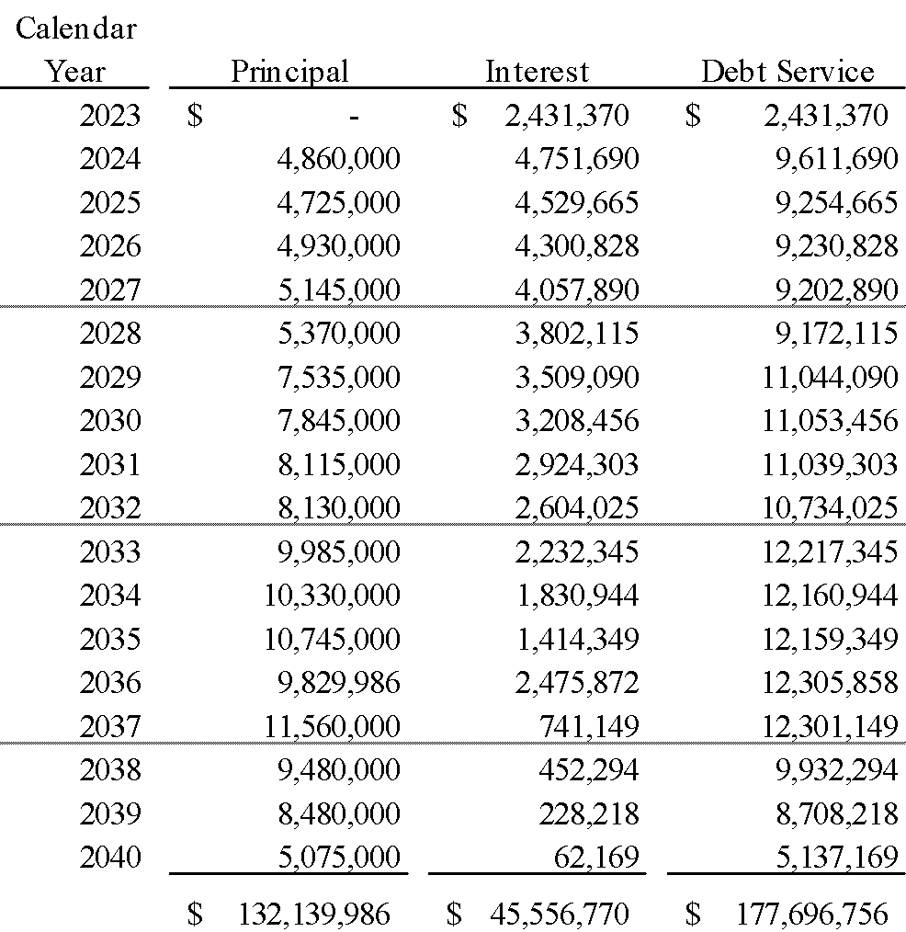
Outstanding Debt Service ⁽¹⁾
(1) Assumes the redemption of Series 2012 in April, and the defeasance of a portion of Series 2015 in June.

Slide 10
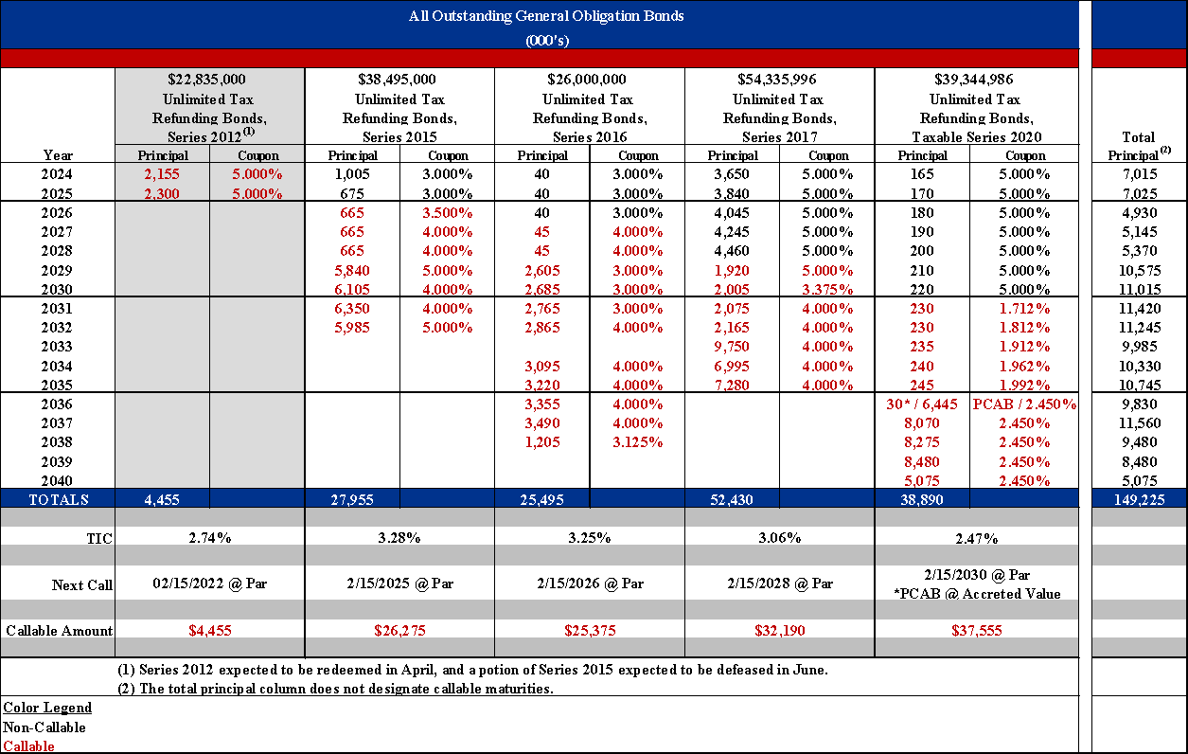
Outstanding Bonds

Slide 11
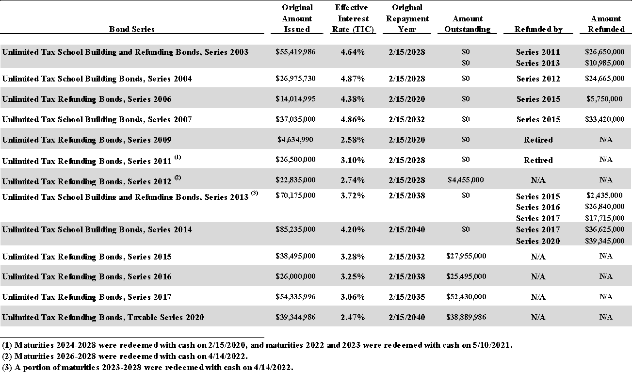
Bond Issuance History

Slide 12
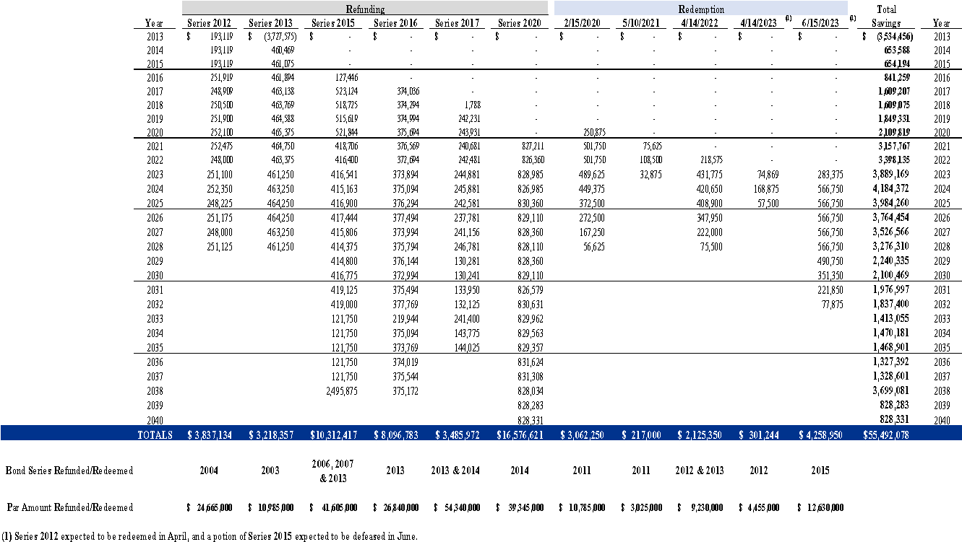
Savings History

Slide 13
Bond Ratings
          Standard & Poor’s: AA
          Moody’s: Aa1

Slide 14
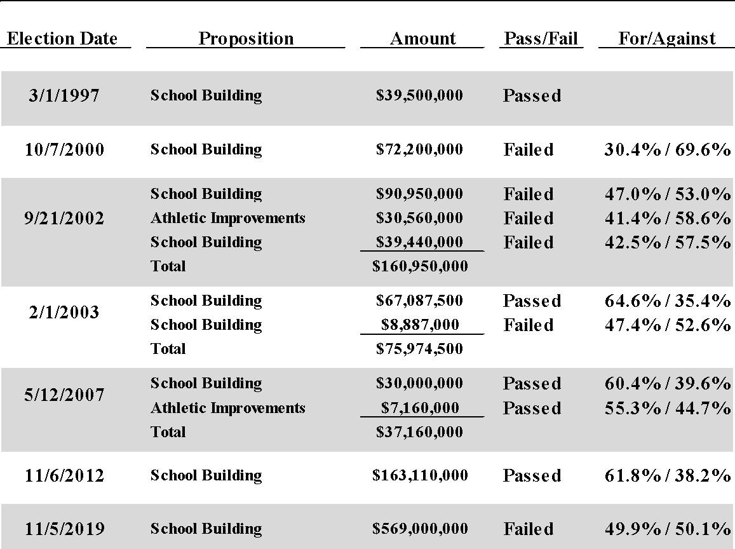
Election History

Slide 15
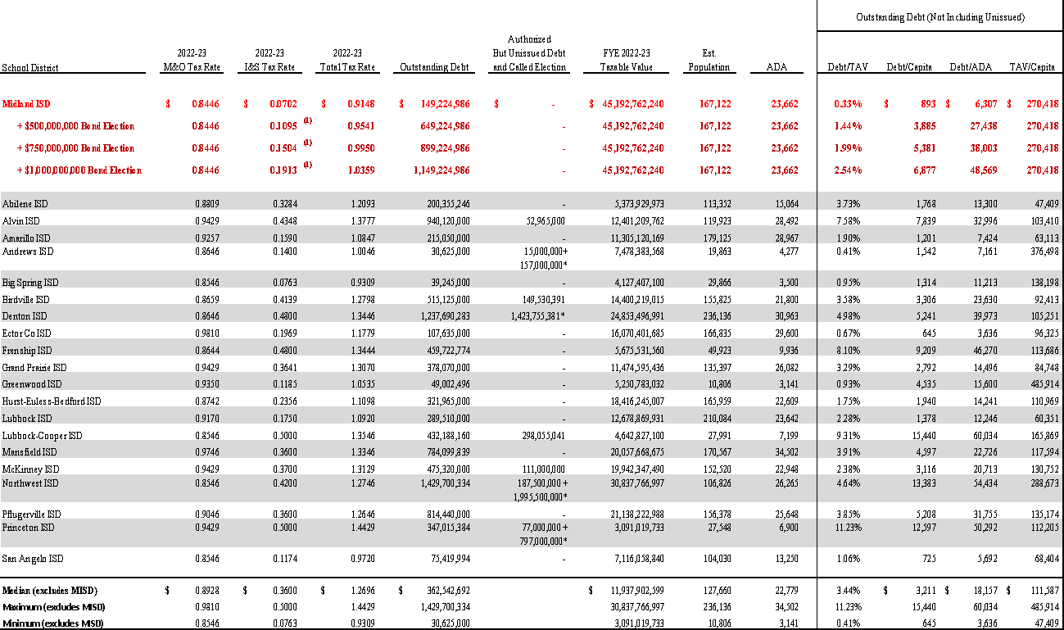
Comparison of Selected Texas School Districts as of April 2023

Slide 16
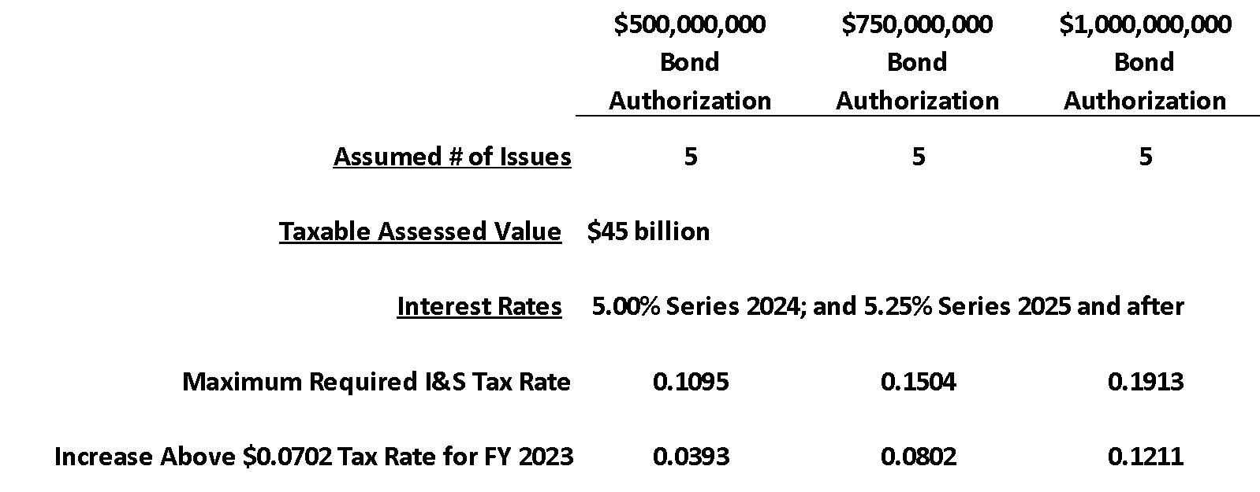
Example Assumptions and Projections

Slide 17
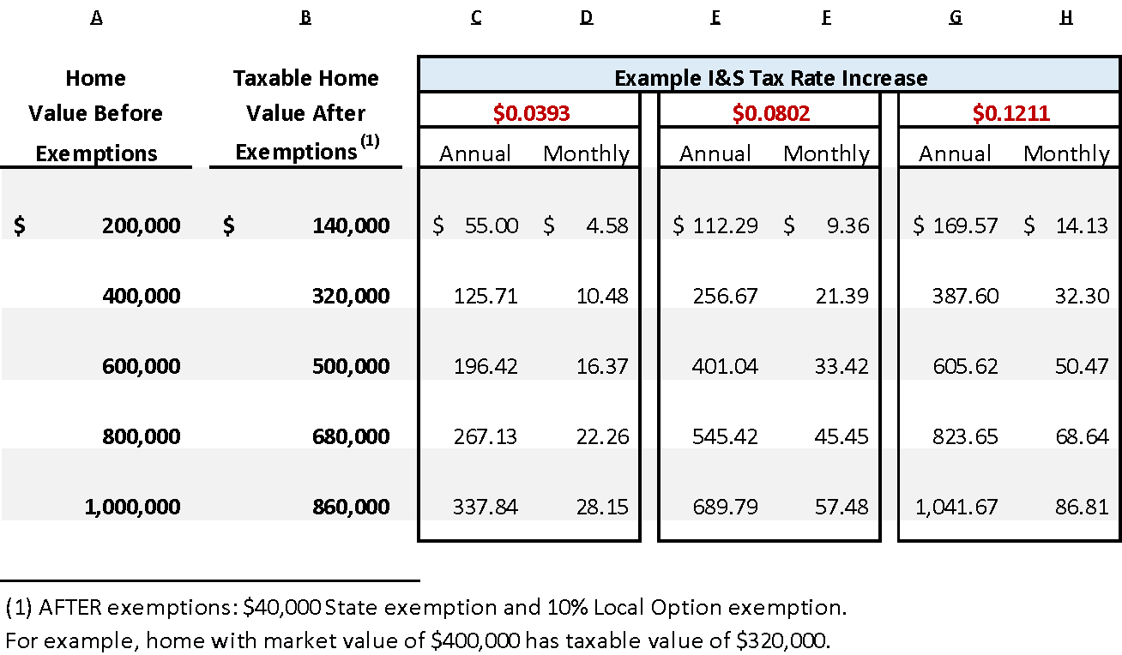
Example Tax Rate Impact on Homeowners

Slide 18
Finance Presentation
Agenda
Property Values and Setting the Maximum Compressed Rates (MCR)
2022 Midland ISD Worksheet
Access to the information in the Comptroller’s website.

Slide 19
Finance Presentation
Property Values and Setting the Maximum Compressed Rate (MCR)
June 30: MISD Budgets must be Approved by Board of Trustees
July 25: MCAD Certifies Property Values
August 7: School District uploads values to TEA
August 25: TEA Approves MCR
Adopt tax rate 60 days from Certified Values (Generally September)
January 31: Comptroller of Texas Releases Property Value Study (PVS)

Slide 20
Finance Presentation
2022 Midland ISD Worksheet
Category | Local Tax Roll Value | 2022 WTD Mean Ratio | 2022 PTAD Value Estimate | 2022 Value Assigned
A - SINGLE-FAMILY | 13,235,382,381 | 0.9623 | 13,753,904,584 | 13,235,382,381
B - MULTIFAMILY | 2,474,186,217 | 0.8533 | 2,899,550,237 | 2,474,186,217
C1 - VACANT LOTS | 267,590,900 | 0.5958 | 449,128,734 | 267,590,900
C2 - COLONIA LOTS | 0 | N/A | 0 | 0
D1 ACRES - QUALIFIED OPEN-SPACE LAND | 10,761,060 | 0.7512 | 14,325,250 | 10,761,060
D2 - FARM & RANCH IMP | 0 | N/A | 0 | 0
E - NON-AG LAND AND IMPROVEMENTS | 367,431,120 | 0.8026 | 457,801,047 | 367,431,120
F1 - COMMERCIAL REAL | 3,200,802,374 | 0.9045 | 3,538,753,316 | 3,200,802,374
F2 - INDUSTRIAL REAL | 536,903,423 | N/A | 536,903,423 | 536,903,423
G - ALL MINERALS | 21,466,828,889 | 1.0030 | 21,402,621,026 | 21,466,828,889
G - ALL MINERALS | 21,466,828,889 | 1.0030 | 21,402,621,026 | 21,466,828,889
Notes:
Info from last year explaining how we were in compliance.
Criteria to spend each one of the PICs

Slide 21
Finance Presentation
2022 Midland ISD Worksheet
Category | Local Tax Roll Value | 2022 WTD Mean Ratio | 2022 PTAD Value Estimate | 2022 Value Assigned
J - ALL UTILITIES | 1,737,127,647 | 0.8934 | 1,944,400,769 | 1,737,127,647
L1 - COMMERCIAL PERSONAL | 1,905,651,840 | 0.9683 | 1,968,038,666 | 1,905,651,840
L2 - INDUSTRIAL PERSONAL | 4,241,026,300 | N/A | 4,241,026,300 | 4,241,026,300
M1 - MOBILE HOMES | 150,002,392 | N/A | 150,002,392 | 150,002,392
N - INTANGIBLE PERSONAL PROPERTY | 0 | N/A | 0 | 0
O - RESIDENTIAL INVENTORY | 45,910 | N/A | 45,910 | 45,910
S - SPECIAL INVENTORY | 76,436,070 | N/A | 76,436,070 | 76,436,070
Subtotal | 49,670,176,523 | 0 | 51,432,937,724 | 49,670,176,523
Less Total Deductions | 2,310,775,086 | 0 | 2,410,791,521 | 2,310,775,086
Total Taxable Value | 47,359,401,437 | 0 | 49,022,146,203 | 47,359,401,437

Slide 22
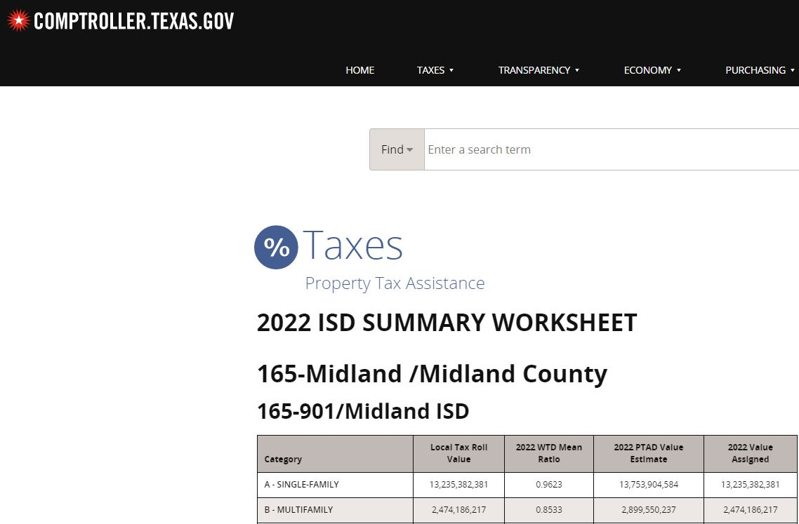
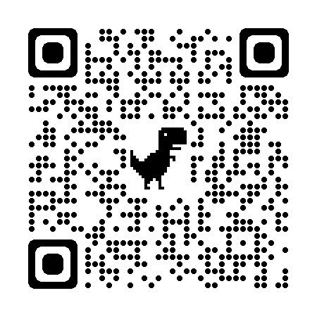
Finance Presentation
Access to Information in the Comptroller’s Website
Link

Slide 23
April 20 & Beyond
Group Work Task
Consider the LRP information and develop a list of projects to be included in the bond referendum.
MISD Bond Planning Committee
Notes:
Ken

Slide 24
April 20 & Beyond
April 20
Reconfiguration Presentation
  Academic focus
  Facility implications
Organize Groups/subgroups
  Planning for Growth/Programs (land, new elementary schools, CTE, core spaces etc.)
  New High Schools, Middle Schools, Repurposing
  General Campus Improvements (Mechanical Electrical Plumbing, interior/exterior, site improvements, technology etc.)
MISD Bond Planning Committee
Notes:
Ken

Slide 25
April 20 & Beyond
May 4
Group work (prioritizing & consensus process)
June 1
Group work continues
Begin preparing group presentations
June 20
Group Presentations (as needed)
Final consensus
Final capital project recommendation
MISD Bond Planning Committee
Notes:
Ken

Slide 26
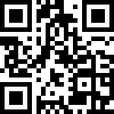
Requests for Information
Committee members generate and record questions and or requests for information (RFI’s) on the electronic form. A link to this form will be emailed in a meeting recap. You may also use the QR code below.
Staff review questions/RFI’s for clarification.
Responses will be shared with committee members before next meeting.
MISD Bond Planning Committee
Notes:
Sheri

Slide 27
Next Steps
Review and reflect on the information presented today
Send any additional questions, comments or RFIs to using the link or to:
Kellie Spencer at kellie.spencer@midlandisd.net
Next meeting April 20, Midland Freshman HS
Shake hands and be friendly!
MISD Bond Planning Committee
Notes:
Ken

