Slide 1
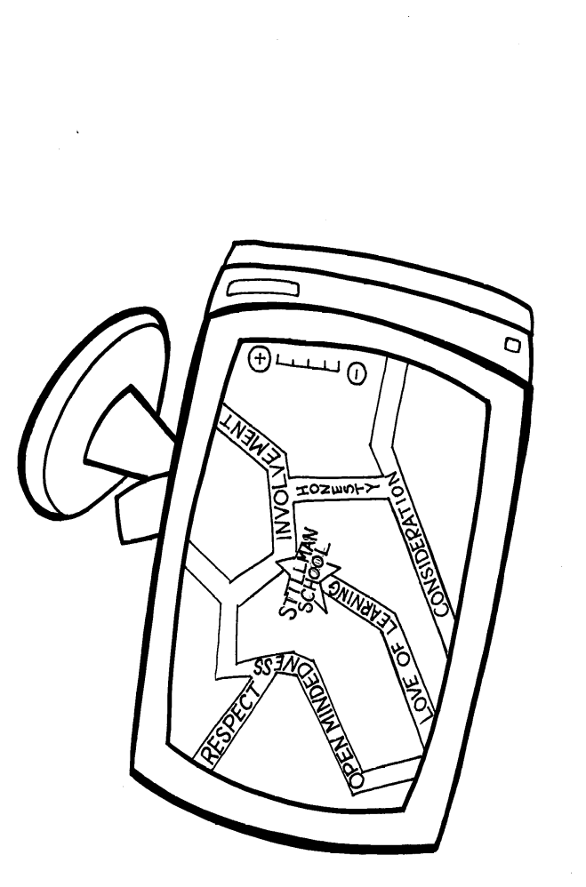
Stillman
G.P.S. Club
Guiding. Positive. Safety.

Slide 2
Responsibilities/Tasks
Attend weekly meetings on Tuesdays
Contribute ideas to committee
Help to model and promote school rules
Assist during school assemblies/events
Classroom announcements/presentations
Demonstrate school pride
Set positive examples – Be a role model
Promote good choices

Slide 3


During meetings we will…
Discuss and implement ideas
Get creative
Plan for upcoming activities
Have fun!
Eat lunch ☺

Slide 4
Members will demonstrate and uphold Stillman School Expectations
Be responsible
Use appropriate language
Settle our differences in a peaceful manner
Move safely and quietly in the school
Follow directions of the adults in charge
Respect other peoples property and personal space
Be sensitive to the needs and feelings of others.

Slide 5
And promote our
Stillman School
Declaration of Values
Love of Learning
Consideration
Respect
Open Mindedness
Involvement
Honesty

Slide 6
WE ARE
Leaders
Role models
Team players

Slide 7
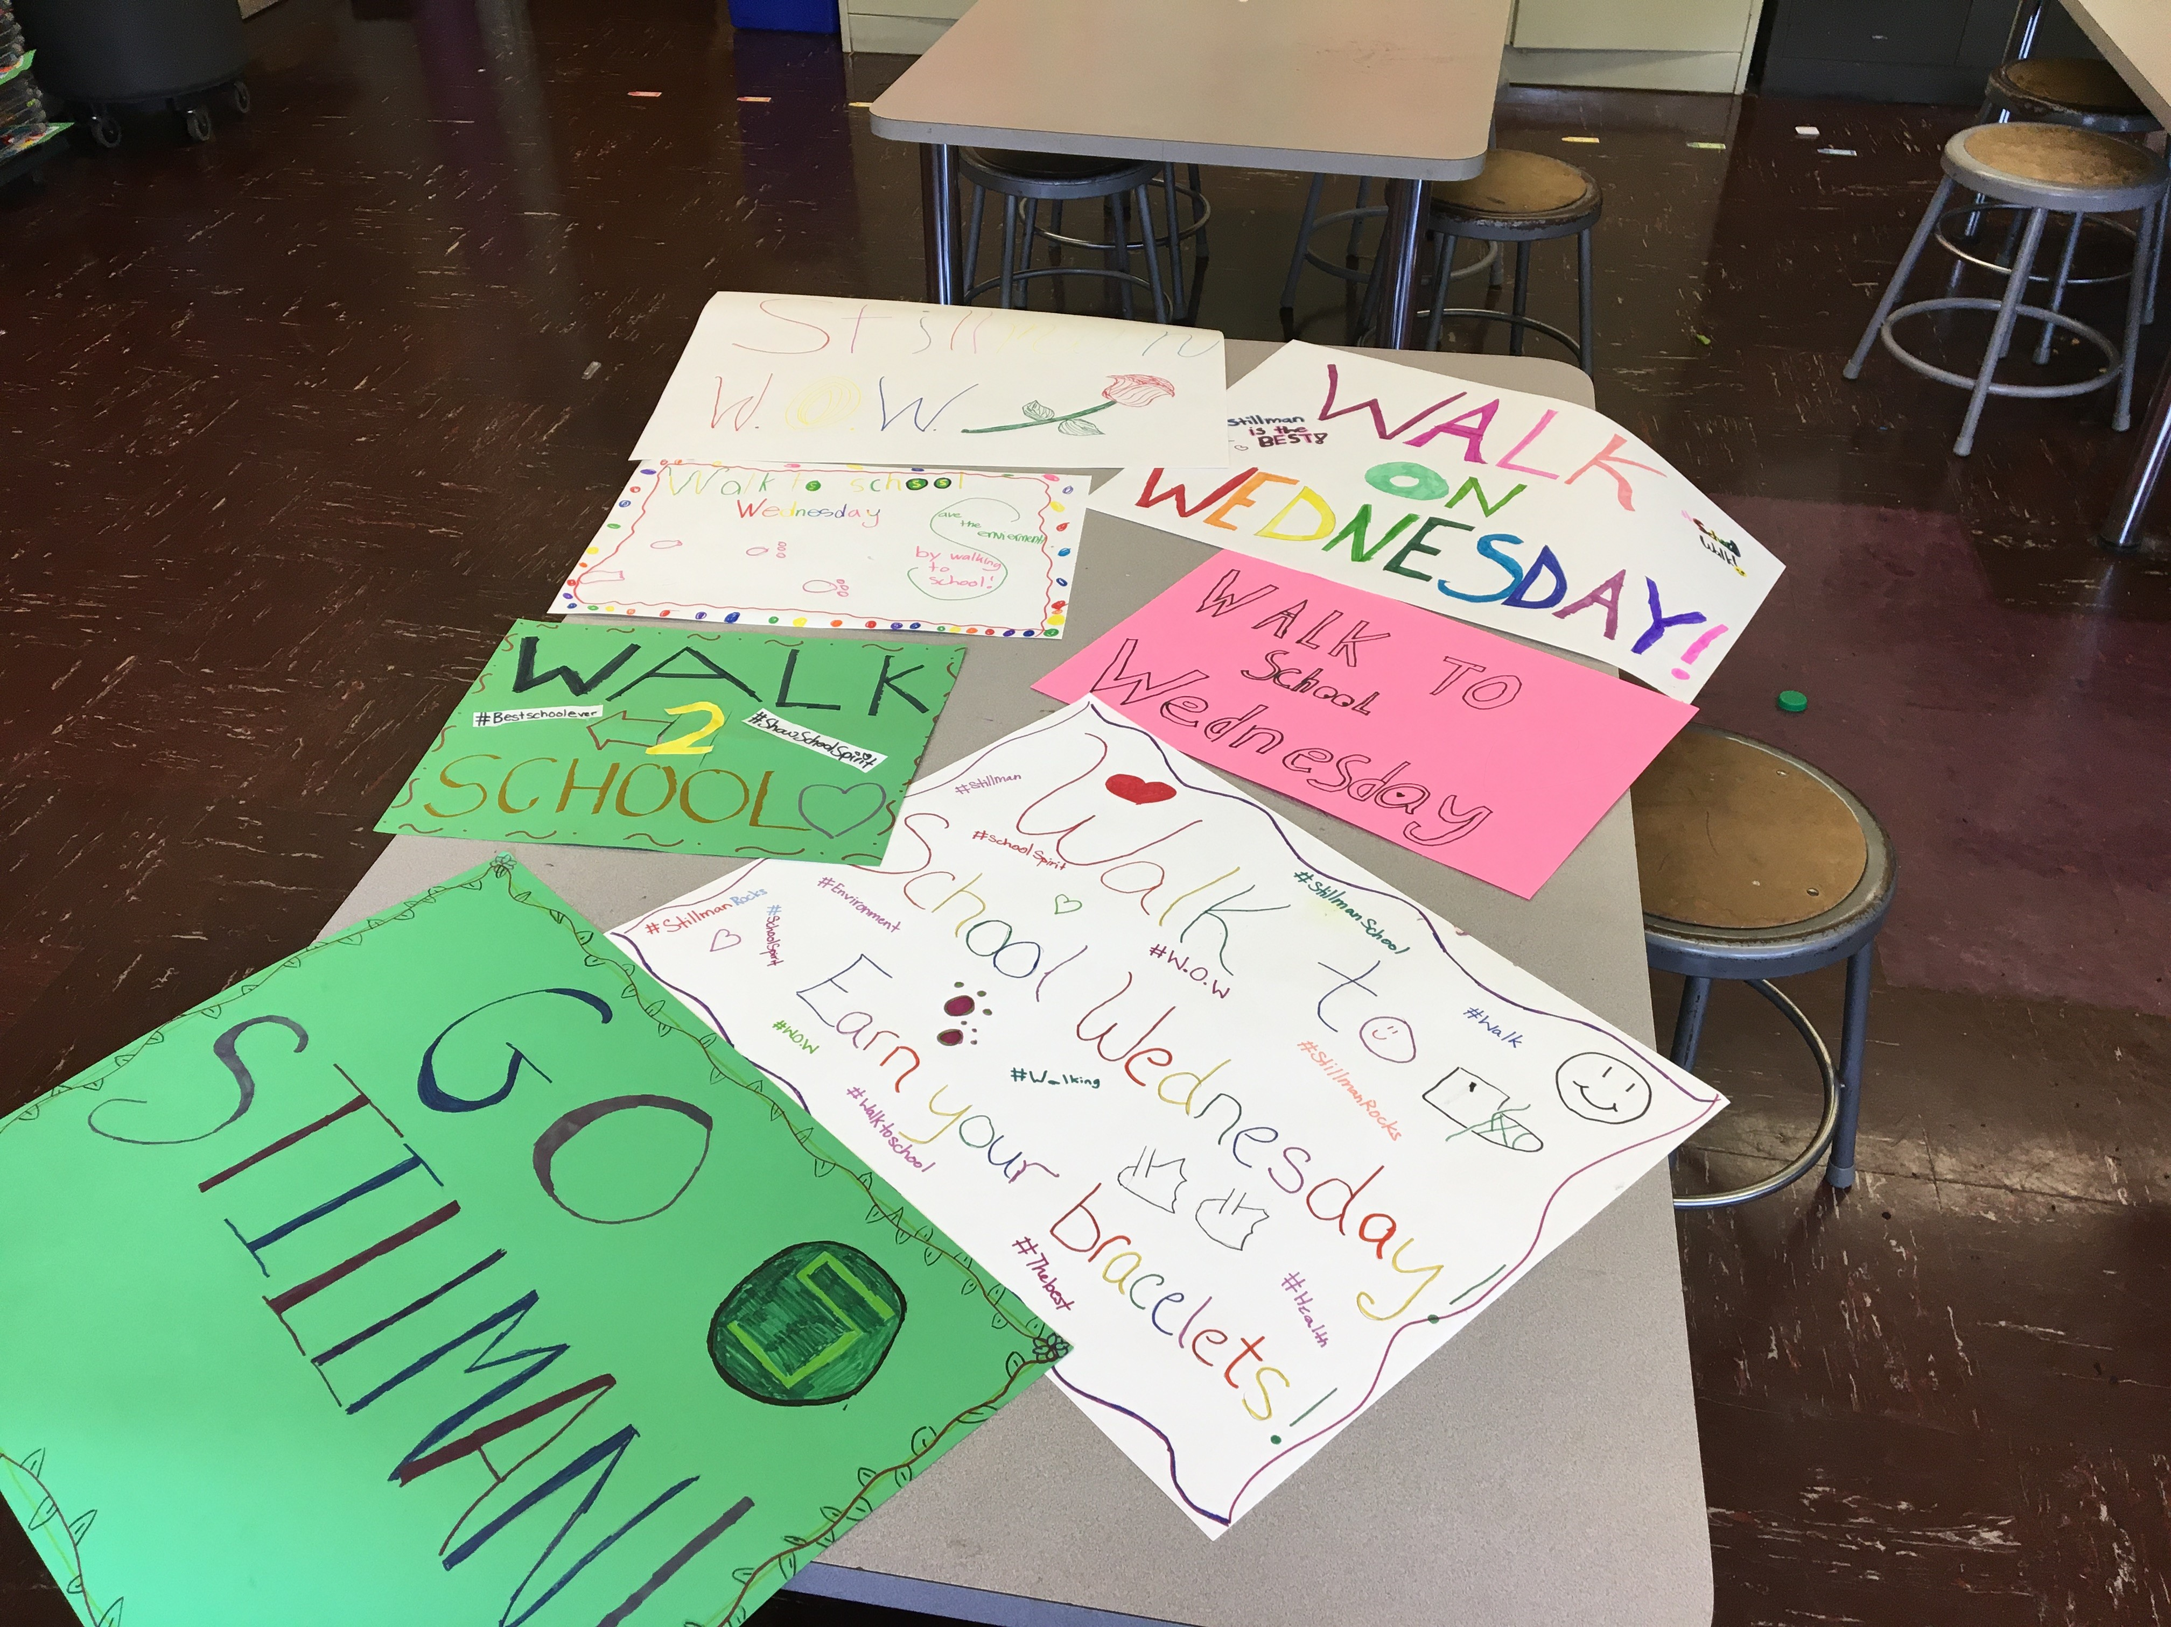
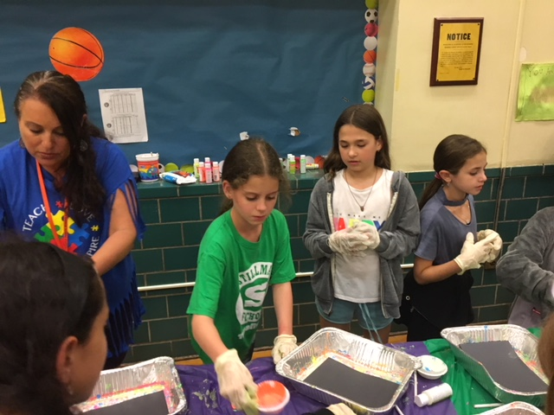
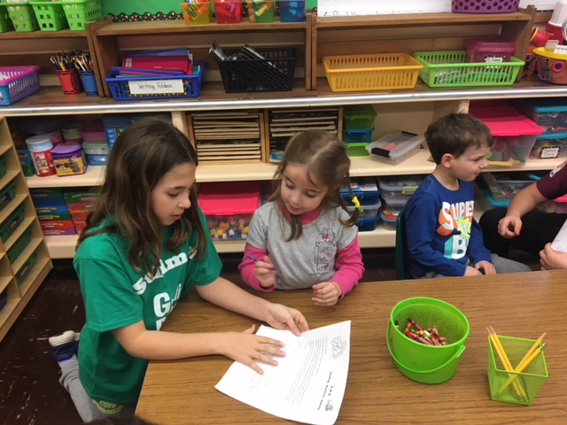
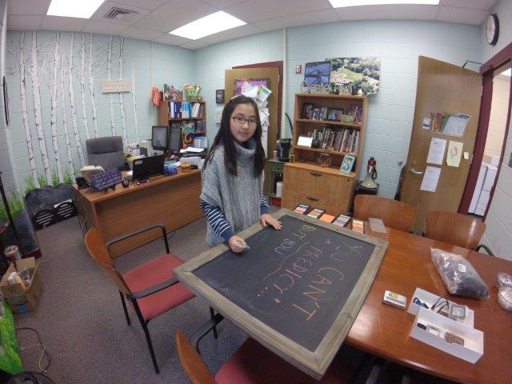
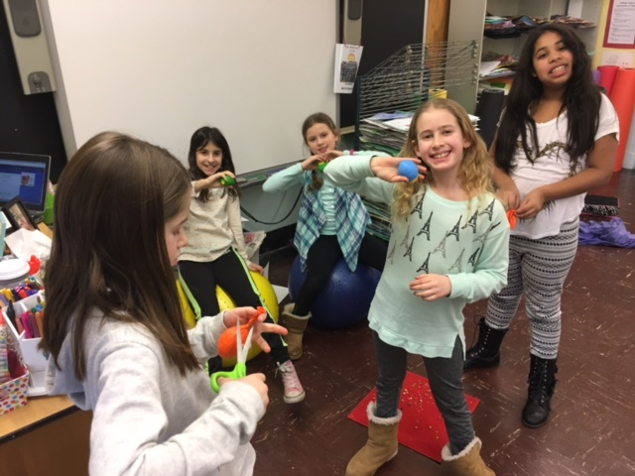
G.P.S. Club

