Slide 1
State Compensatory Education
At-Risk Training
Presented by
The WFISD Federal & State Programs office
Original Presentation By Region ESC 11
September 7, 2017
9:00 – 10:00
Ed. Center Room 302

Slide 2
Agenda
Welcome/Introductions
SCE Power Point: Overview of the Program, At-Risk Criteria, and Required Policies
SCE Templates On Website
Questions/Comments

Slide 3

Intent and Purpose of the SCE Program
Programs and/or services designed to supplement the regular education program for identified at-risk students
The goal for SCE is to reduce the disparity in performance on (a) the state assessment and (b) rates of high school completion between students at-risk of dropping out of school and all other district students.
Activities and expenses must directly impact students

Slide 4



Key Players in the
State Compensatory Education Program
  School Districts
  Administrators
  Business Personnel
  Program Coordinator
  PEIMS Clerk
  Counselors
  Classroom Teachers
  Parents
Education Service Centers
  SCE Consultants
  PEIMS
  Curriculum Specialists
  Counselors Contact
Legislators
Texas Education Agency

Slide 5


Purpose of Identification Process
To determine eligibility of students to receive supplemental educational services
To ensure that the intended beneficiaries are receiving needed support or assistance

Slide 6

Supplement, Not Supplant
Any program activity, program personnel, or program materials required by federal law, state law, or State Board of Education rule may not be funded with SCE funds.
SCE funds must be used to provide support programs and/or services that supplement the regular education program so that students at risk of dropping out of school can succeed in school.

Slide 7

At-Risk Student Eligibility Criteria
Includes each student under the age of 26 who:
Is in prekindergarten, kindergarten or grade 1, 2, or 3 and did not perform satisfactorily on a readiness test or assessment instrument administered during the current school year
Note: Do not use previous year’s score for classification.

Slide 8


At-Risk Student Eligibility Criteria
Includes each student under the age of 26 who:
2. Is in grade 7, 8, 9, 10, 11, or 12 and did not maintain an average equivalent to 70 on a scale of 100 in two or more subjects in the foundation curriculum during a semester in the preceding or current school year or is not maintaining such an average in two or more subjects in the foundation curriculum in the current semester

Slide 9


At-Risk Student Eligibility Criteria
Includes each student under the age of 26 who:
Was not advanced from one grade level to the next for one or more years.
  Note: Student remains at risk of dropping out of school for the remainder of his/her public school education.
  Excludes: a student not advancing from PK or K into the next grade level only as a result of the request of the student’s parents. This is not retroactive.

Slide 10
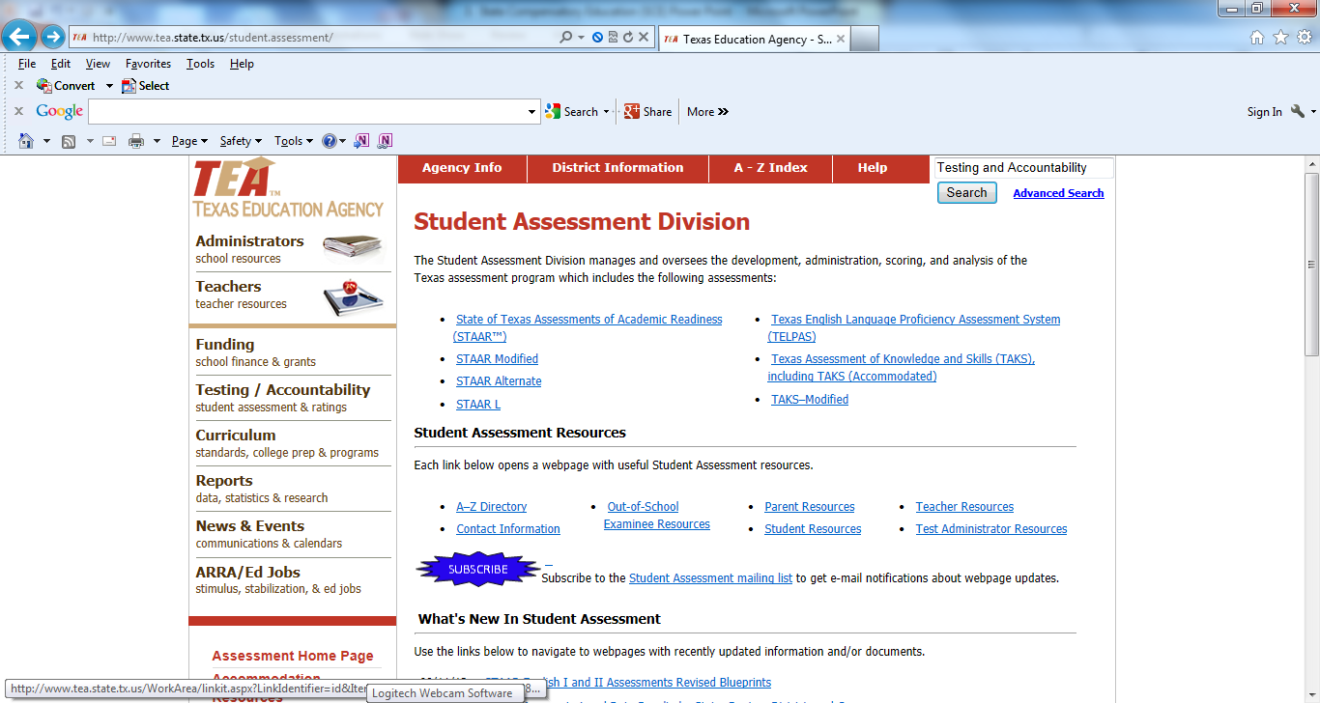
At-Risk Student Eligibility Criteria
Includes each student under the age of 26 who:
Did not perform satisfactorily on an instrument administered to the student under Subchapter B, Chapter 39, and who has not in a previous or current school year subsequently performed on that instrument or another appropriate instrument at a level equal to at least 110% of the level of satisfactory performance on that instrument.
http://www.tea.state.tx.us/student.assessment/
Notes:
Because STAAR scores were not be available until after January, indicator #4 counted only for tests for which districts already had real scores. (TAKS & End of Course)
STAAR test scores were NOT used to determine at-risk eligibility for the 12-13 school year, even after the real scores were released.

Slide 11
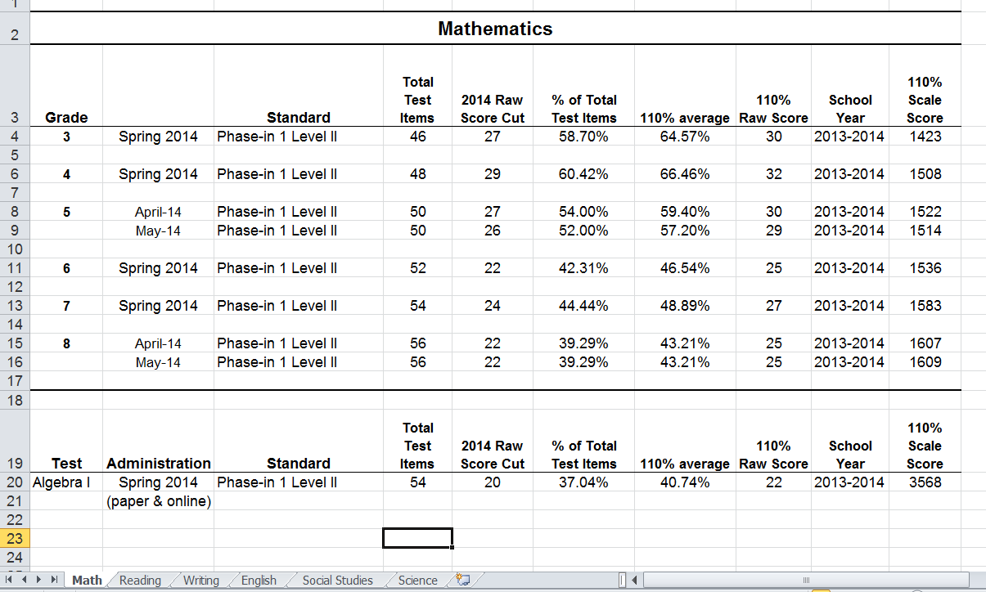
110% Chart
Tabs for
add’l subjects

Slide 12
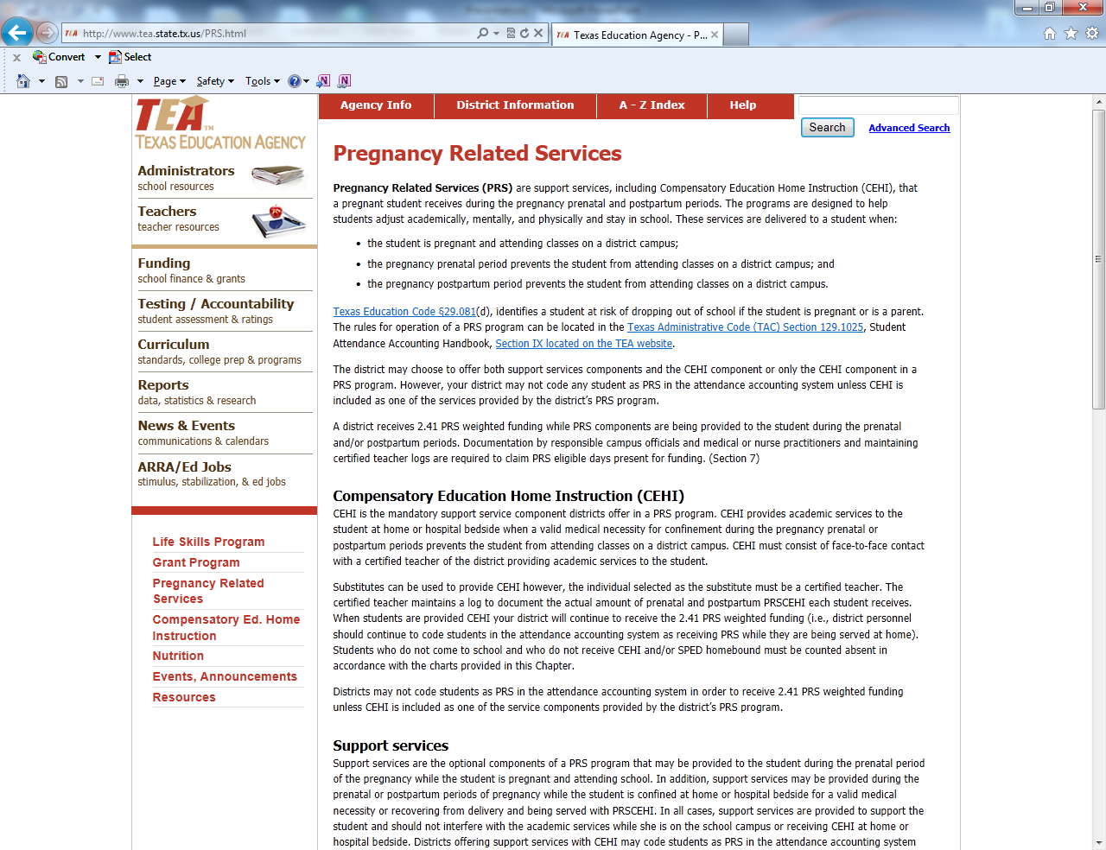
At-Risk Student Eligibility Criteria
Includes each student under the age of 26 who:
5. Is pregnant or is a parent
http://www.tea.state.tx.us/PRS.html

Slide 13

At-Risk Student Eligibility Criteria
Includes each student under the age of 26 who:
Has been placed in an alternative education program in accordance with Section 37.006 during the preceding or current school year
Note: Section 37.006 describes a disciplinary education program NOT an in-school suspension
(ISS) program
7. Has been expelled in accordance with Section 37.007, TEC during the preceding or current school year

Slide 14
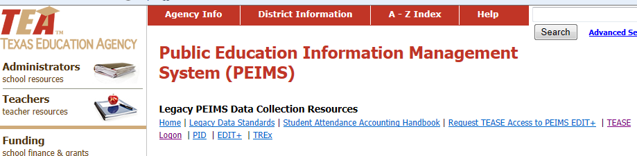
At-Risk Student Eligibility Criteria
Includes each student under the age of 26 who:
Is currently on parole, probation, deferred prosecution, or other conditional release
Was previously reported through PEIMS to have dropped out of school
Note: Student remains at risk of dropping out of school for the remainder of his/her public school education
http://www.tea.state.tx.us/index4.aspx?id=3012

Slide 15
At-Risk Student Eligibility Criteria
Includes each student under the age of 26 who:
Is a student of limited English proficiency, as defined by Section 29.052; Note: The student no longer meets this criteria once the student has been exited from the program.
Students who are LEP are coded by the District’s Bilingual/ESL Coordinator.
11. Is in the custody or care of the Department of Family and Protective Services or has, during the current school year, been referred to the department by a school official, officer of the juvenile court, or law enforcement official

Slide 16
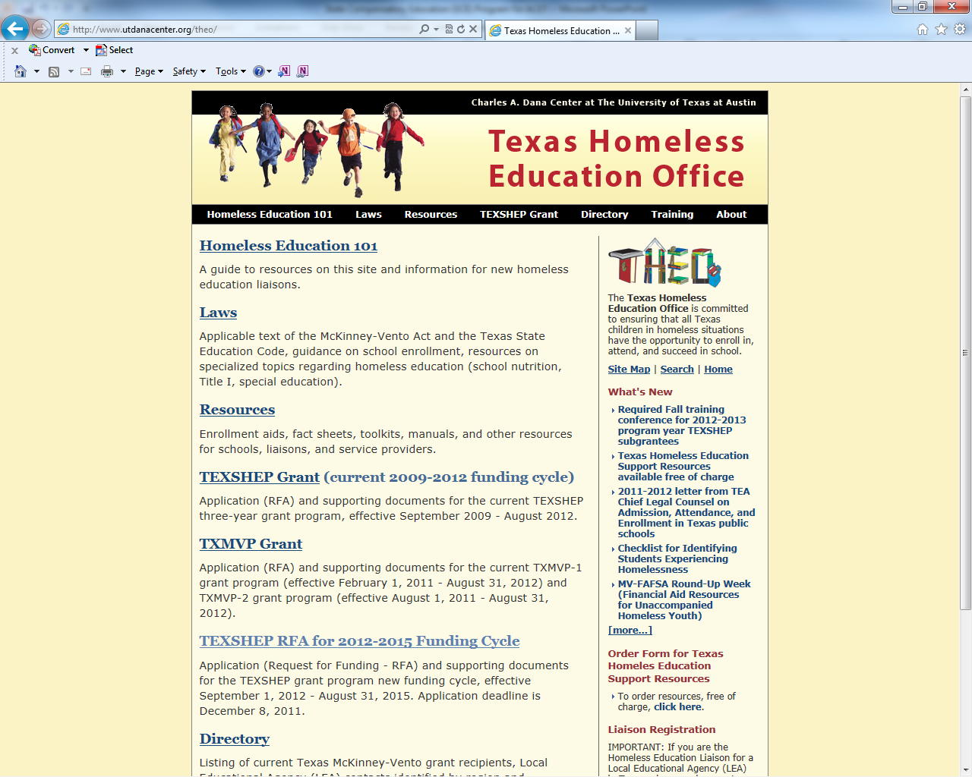
At-Risk Student Eligibility Criteria
Includes each student under the age of 26 who:
Is homeless, as defined by 42 U.S.C. Section 11302, and subsequent amendments. (Refer to McKinney-Vento Homeless Assistance Act of 2001, Section 725.)
Students in a Homeless situation are coded by the District’s Homeless Liaison
Info Snap during the enrollment process and the hard copy of the SRQ during the school year.

Slide 17
At-Risk Student Eligibility Criteria
Includes each student under the age of 26 who:
PEIMS Guidance on Homelessness and
Unaccompanied Youth
http://www.utdanacenter.org/theo/resources/factsheets.php
2012-2013 updated guidance: students that are considered unaccompanied are not automatically considered homeless.
Unaccompanied youth will only be reported to PEIMS if they are also identified as homeless.

Slide 18
At-Risk Student Eligibility Criteria
Includes each student under the age of 26 who:
Resided in the preceding school year or resides in the current school year in a residential placement facility in the district, including a detention facility, substance abuse treatment facility, emergency shelter, psychiatric hospital, halfway house, or foster group home
Note: Student cannot be counted by two districts during the same time period.
Note: An RF is considered a placement where students spend the night.

Slide 19
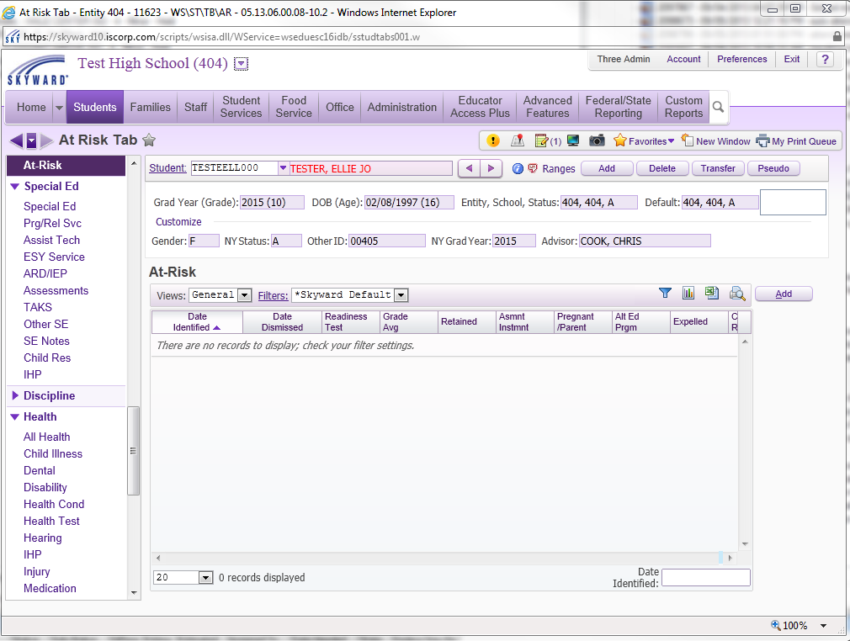
Skyward
Student Management System
Notes:
On this first page, click add, and then data can be entered for student. (See next slide.)

Slide 20
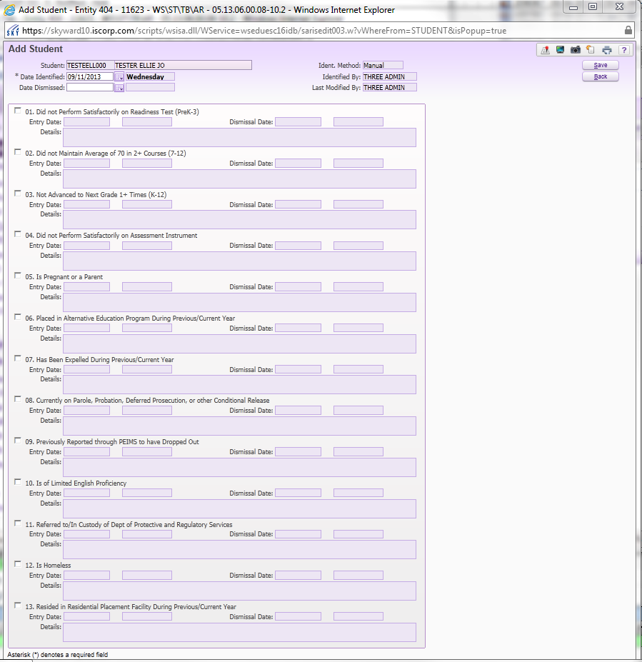
Skyward
Student Management System

Slide 21
Skyward
Student Management System

Slide 22
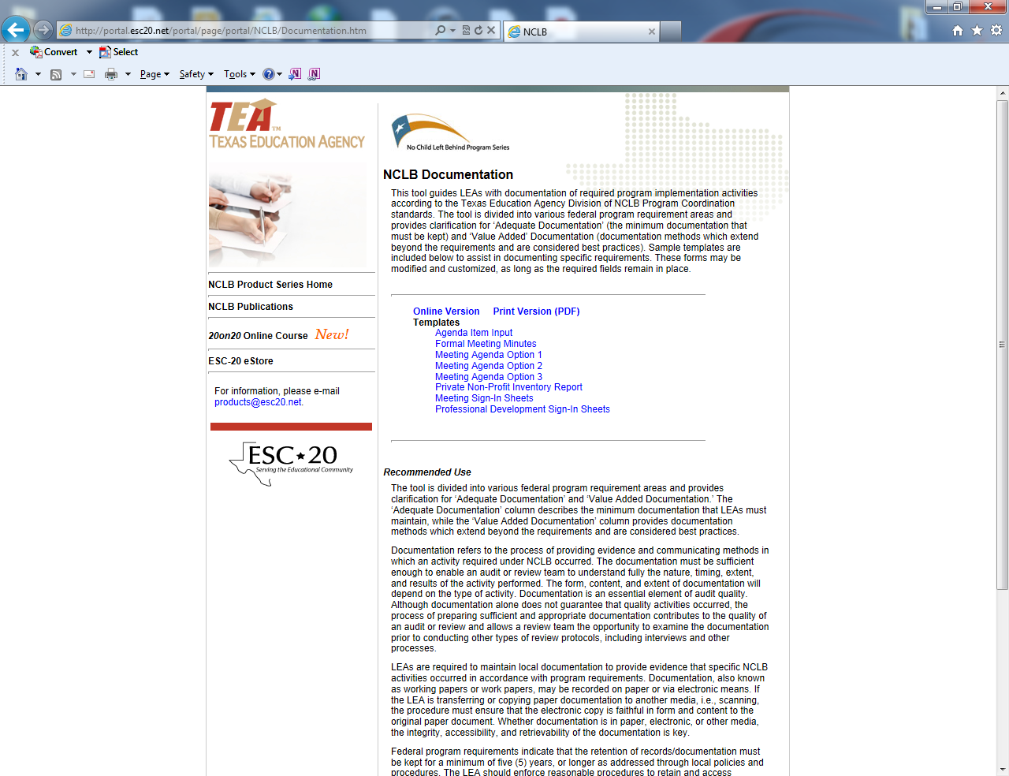
Documentation of the
SCE Program
  Timeline for identification process
  Notification of teachers and other stakeholders
  Existing policies
  Timeline for monitoring and updating documentation for at-risk students
  Retention of records
  Storage of records
  Access to records

Slide 23
Common Audit Findings for SCE
Lack of documentation
No evaluation of SCE program
At-Risk students incorrectly identified
Lack of supporting documentation in district/campus plans
Funding state-mandated rules, programs, or positions
Lack of policies and procedures outlining the SCE program

Slide 24
Website Information
•Program Guidelines
•Other Forms such as SCE Criteria

Slide 25
At-Risk Folders
Should we continue to print and use the At-Risk Folders?

Slide 26

Contact:
Alefia Paris-Toulon @ aparis-toulon@wfisd.net
Shonna Norton @ snorton@wfisd.net

