Slide 1
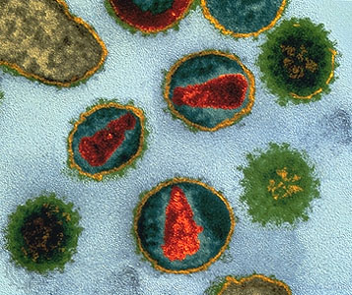
Sexually Transmitted Infections

Slide 3

TOP WAYS TO CONTRACT AN STD
Sexual activity at a young age. The younger a person starts having sex, the greater his or her chances of becoming infected with an STD.
Lots of sex partners. People who have sexual contact — not just intercourse, but any form of intimate activity — with many different partners are more at risk than those who stay with the same partner.

Slide 4

If you don’t have…
The importance of seatbelt safety!
Unprotected sex. Latex condoms are the only form of birth control that reduce your risk of getting an STD. Spermicides, diaphragms, and other birth control methods may help prevent pregnancy, but they don't protect a person against STDs.

Slide 5

Alarming Statistics
Click

Slide 6
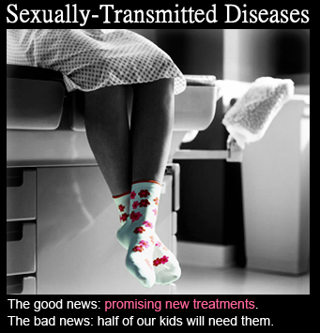

Slide 7
What is a Sexually Transmitted Infection?
Infections you can get by having sex – vaginal, oral, or anal – with someone who is already infected.
Caused by bacteria or viruses that are spread through blood, semen, and vaginal fluids.
Also, spread simply by touching infected skin for certain STIs, like herpes and genital warts.

Slide 8
Types of STIs
Bacterial
  Syphilis
  Gonorrhea
  Chlamydia
Parasitic
  Pubic Lice
  Scabies
Viral
  Genital Herpes
  Human Papilloma Virus (Genital Warts)
  Molluscum Contagiosum
  Hepatitis B &C
  HIV

Slide 9
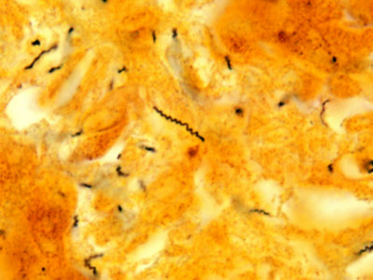
Syphilis
Bacterial STI
36,000 cases in 2006
Called the “Great Imitator” because so many of the signs and symptoms are indistinguishable from those of other diseases
Passed from person to person through direct contact with a syphilis sore
Notes:
Can look like the flu or common cold or a sinus infection

Slide 10
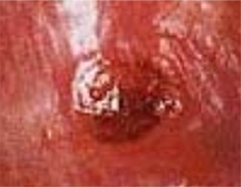
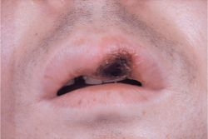
Signs/Symptoms
Primary Stage
- Appearance of a typically painless, single sore (chancre)
- Usually appears about 3 weeks after becoming infected

Slide 11
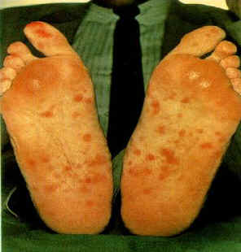
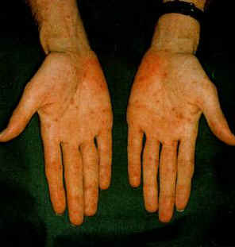
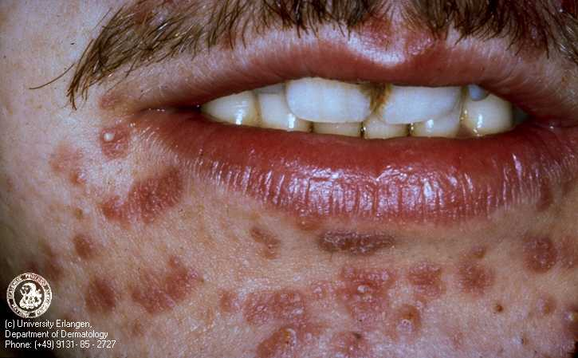
Signs/Symptoms
Secondary Stage
- Non-itchy skin rash and
- Common symptoms include sore throat, fatigue, headache, and swollen lymph glands
- Less frequent symptoms include fever, aches, weight loss, hair loss, aching joints, or lesions (sores) in the mouth or genital area
Notes:
Some people may show faint signs of this and not pay attention. Symptoms go away by themselves.

Slide 12
Signs/Symptoms
Latent Stage
- No symptoms, but infection is still there
Tertiary (Late) Stage
- Mental illness, blindness, deafness, memory loss or other neurological problems, heart disease, and death
Notes:
This can take up to 40 years to kill a person. All internal damage is permanent. Any organ or brain damage stays

Slide 13
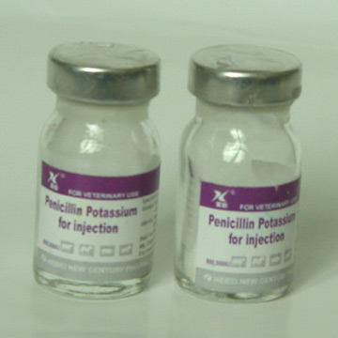
Treatment
A single intramuscular
injection of penicillin,
an antibiotic, will cure a
person who has had
syphilis for less than a
year

Slide 14
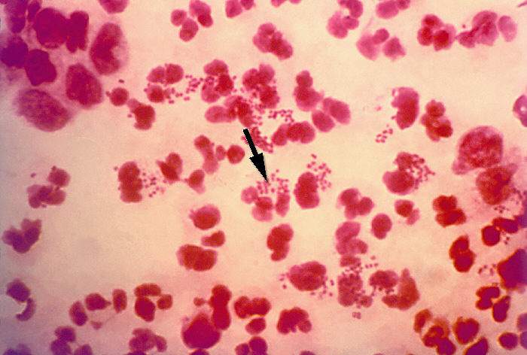
Gonorrhea
Bacterial STI
Caused by bacteria called Neisseria gonorrhoeae
Estimated that 700,000 people acquire each year, but half do not report
Spread through contact with the penis, vagina, mouth, or anus
Notes:
Reported versus the real amount of people that have it.

Slide 15

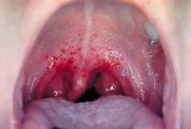
Signs/Symptoms
May take between 2 and 5 days to show
Burning sensation when urinating
White, yellow, or green discharge from the penis
Painful or swollen testicles
Increased vaginal discharge, or vaginal bleeding between periods
Notes:
Oral sex can lead to gono in the throat

Slide 16
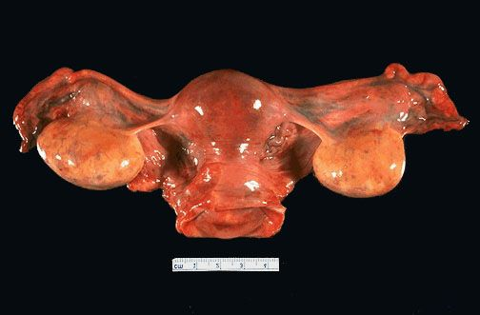
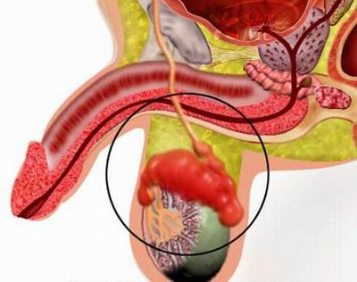
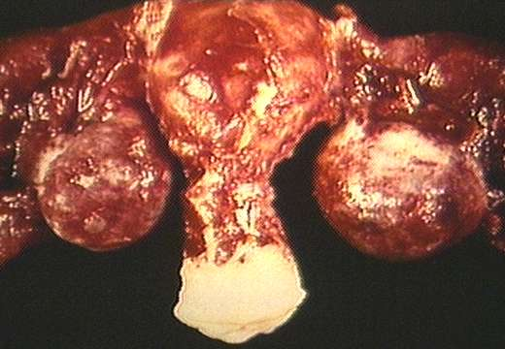
If not treated….
Pelvic Inflammatory Disease
Epididymitis
Notes:
PID…women may not show symptoms for a long time. By that time the damage may already be done and prevent women from being able to have children.

Slide 17
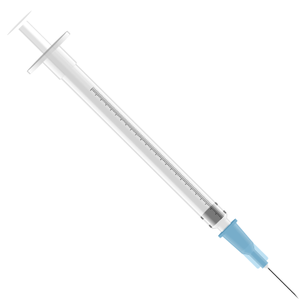
Treatment
Several antibiotics can successfully cure gonorrhea in adolescents and adults
Gonorrhea is becoming more difficult to cure because of the growing resistance to antibiotics

Slide 18
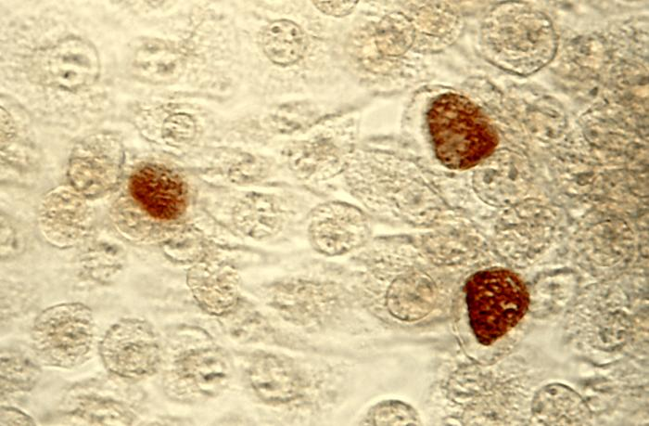
Chlamydia
Bacterial STI
Most frequently reported bacterial sexually transmitted infection in the United States
Known as a "silent" disease because about three quarters of infected women and about half of infected men have no symptoms
Transmitted through vaginal, anal, or oral sex

Slide 19
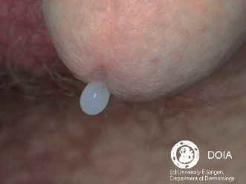
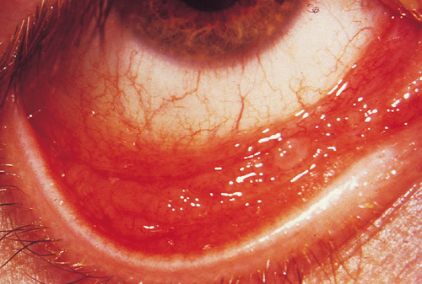
Signs/Symptoms
If there are symptoms, they occur within 1 to 3 weeks after exposure
Abnormal discharge or a burning sensation when urinating
Burning and itching around the opening of the penis
Lower abdominal pain and low back pain
Nausea, fever, pain during intercourse

Slide 20
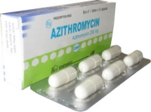
Treatment
Easily treated and cured with antibiotics (azithromycin or doxycycline)
If not treated, it can lead to conditions, such as pelvic inflammatory disease (PID)

Slide 21
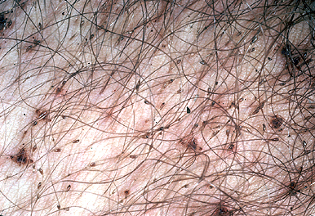
Pubic Lice (Crabs)
Parasitic STI
Small, six-legged creatures that invade the genital hair region and infest it with their eggs
Can be spread through sexual contact or by contact with an individual’s linens or clothing

Slide 22
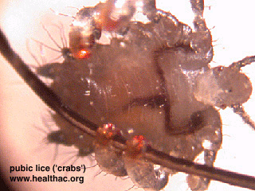
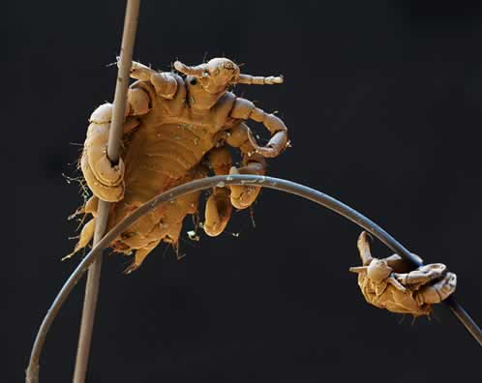
Pubic Lice

Slide 23
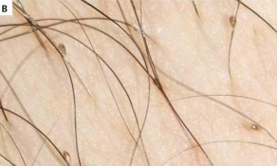
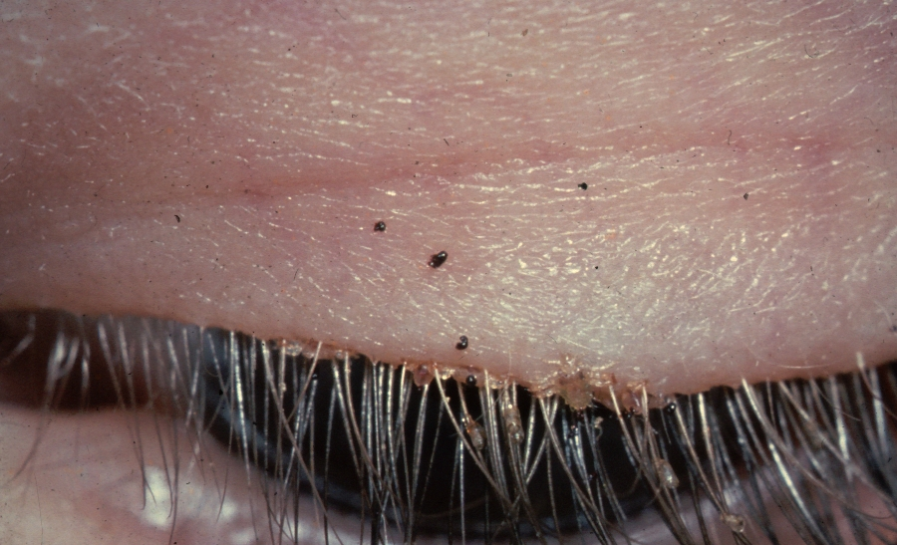
Signs/Symptoms
Itching in the genital area
Visible nits (lice eggs) or crawling lice
Genital lesions due to bites
Lesions caused by constant scratching

Slide 24

Treatment
Can be cured!
Wash thoroughly
Use an over-the-counter or prescription medication
- Lice-killing shampoos (pediculicide)

Slide 25
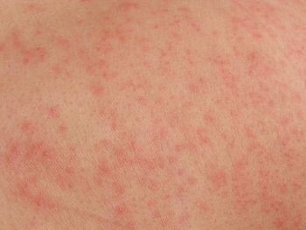
Scabies
Parasitic STI
Contagious, itchy skin condition caused by very small, wingless insects or mites
Found in the crevices of the body such as the armpits, around the nipples for women, beneath nails, belt line, between the fingers, buttocks, elbows, inner thighs, on the penis for men, skin under rings, bracelets or watch bands, wrists

Slide 26
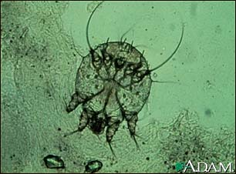
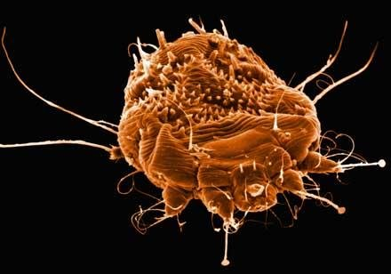
Scabies

Slide 27
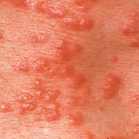
Signs/Symptoms
Itching, especially at night
Pimple-like irritations, burrows, or rashes of the skin
Abrasions of the skin from scratching and digging

Slide 28
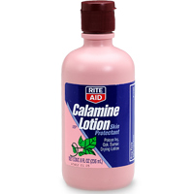
Treatment
Can be cured!
Prescription creams and lotions
Cool soaks and calamine lotion

Slide 29
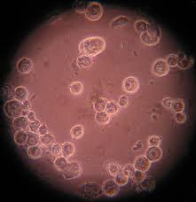
Genital Herpes
Viral STI –
- Herpes Simplex virus type 1 (HSV-1)
* causes cold sores and blisters
- Herpes Simplex virus type 2 (HSV-2)
* causes genital herpes
At least 45 million people ages 12 and older have it in the U.S.
Transmitted through sexual/intimate contact with an individual who has genital herpes

Slide 30
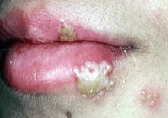
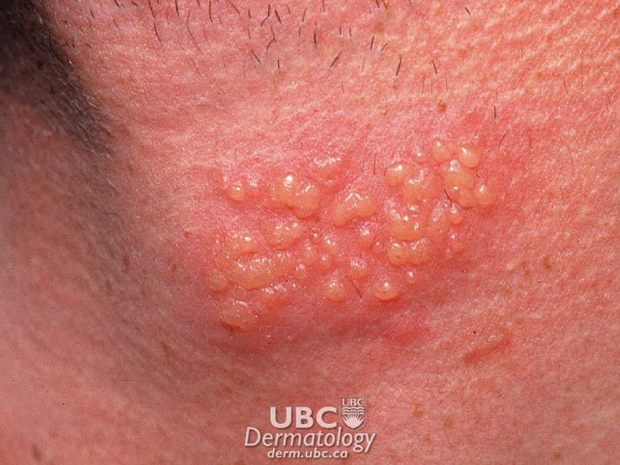
Signs/Symptoms
First outbreak usually occurs within two weeks after the virus is transmitted, and the sores typically heal within two to four weeks
May include a second crop of sores, and flu-like symptoms, including fever and swollen glands
Blisters that can break and become painful, tender ulcers
Diagnosed by taking a sample from a sore and testing it in a laboratory

Slide 31
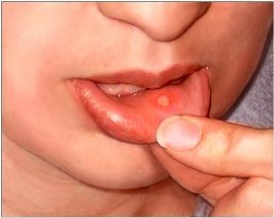
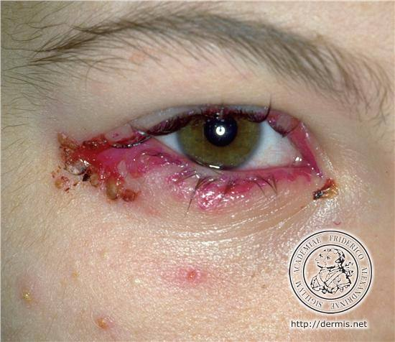
Herpes Can Also Be on Other Parts of the Body…

Slide 32

Treatment
No treatment that can cure herpes, but antiviral medications can shorten and prevent outbreaks during the period of time the person takes the medication
This one is for life!

Slide 33
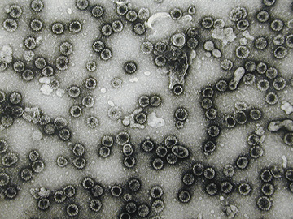
Human Papilloma Virus (HPV)
“Genital Warts”
Viral STI
Approximately 20 million people are currently infected with HPV
100 different strands, more than 30 of these viruses are sexually transmitted

Slide 34
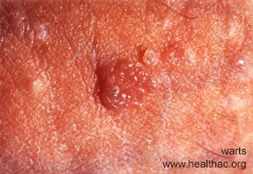
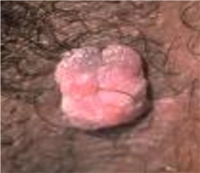
Signs/Symptoms
Most people who have a genital HPV infection do not know they are infected
Genital warts usually appear as soft, moist, pink, or flesh-colored swellings, usually in the genital area
Linked to cervical cancer

Slide 35
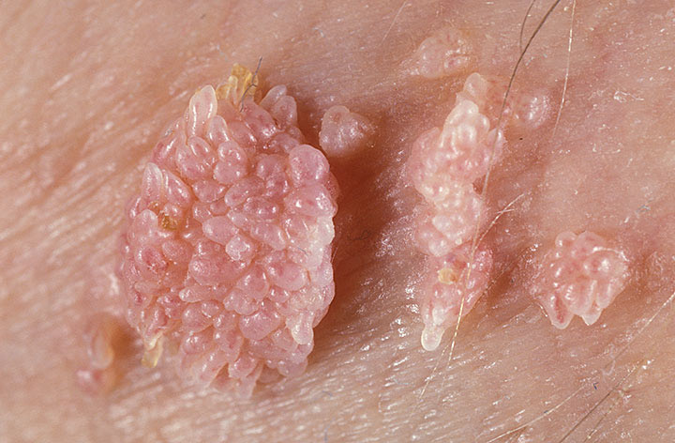
Genital Warts
In some cases, warts can grow quickly into
irregularly shaped cauliflower-like masses

Slide 36
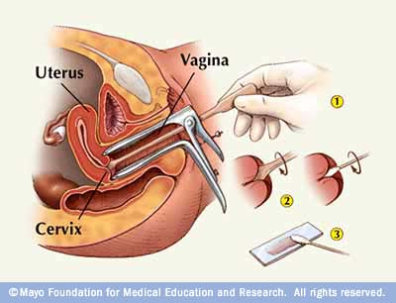
Diagnosis
Pap tests (primary cancer-screening tool for cervical cancer or precancerous changes in the cervix)
Observing the warts (sometimes cannot be seen)

Slide 37
Connections to Cancer
Each year…
12,000 women get cervical cancer in the U.S.
3,700 women get vulvar cancer
1,000 women get vaginal cancer
1,000 men get penile cancer
2,700 women and 1,700 men get anal cancer
2,300 women and 9,000 men get head and neck cancers

Slide 38
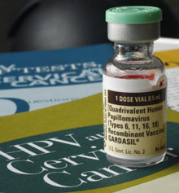
Treatment
No cure for genital warts
In some cases, the infection will clear on its own
Vaccine (Gardasil)

Slide 39
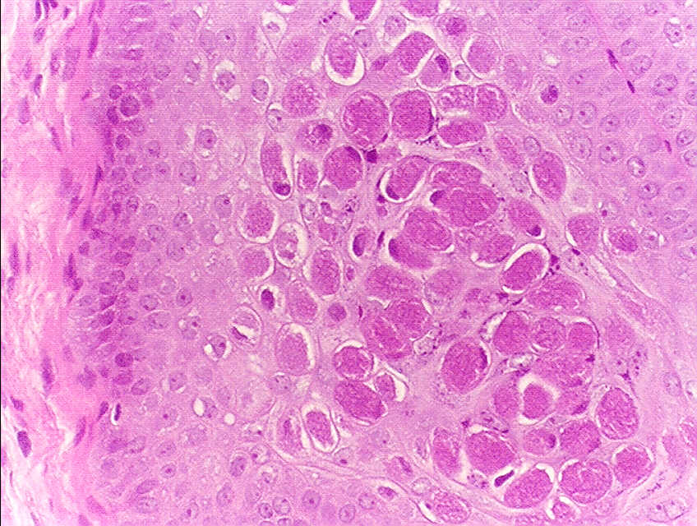
Molluscum Contagiosum
Mild, but common viral skin disease
Touching or scratching a bump and then touching another part of the body
Can be spread through sexual or intimate contact

Slide 40
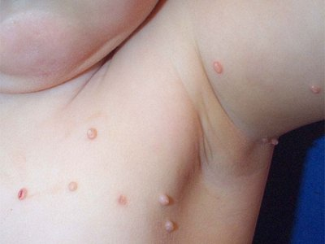
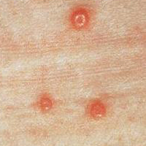
Molluscum Contagiosum
Small white, pink, or flesh-colored bumps or growths with a dimple or pit in the center
Normally disappear within 6 to 12 months without treatment

Slide 41
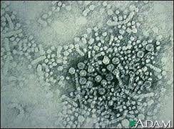
Hepatitis (B & C)
Viral STI
Transmitted through the exchange of fluids during sexual intercourse
Approximately 750,000 people in the United States are living with sexually acquired hepatitis B infection
CDC estimates that nearly 4 million Americans are infected with Hepatitis C

Slide 42
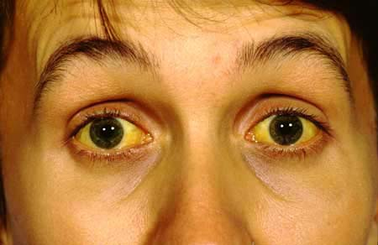
Signs/Symptoms
Jaundice
Fatigue
Abdominal pain
Loss of appetite
Nausea, vomiting
Joint pain
Damage to the liver

Slide 43
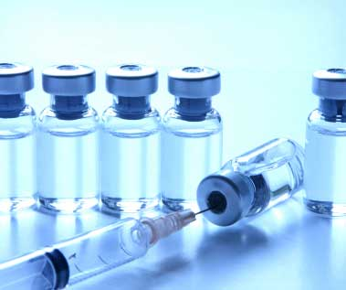
Treatment
Vaccine for Hepatitis B but not for C
Antiviral medication

Slide 44
Should I Get Tested?
Are you showing signs of a STI?
Are you sexually active? Specifically, are you using protection?
Does My Physician Usually Test for Sti’s?
No! You must request STI testing.

Slide 45
Talking about STIs is tough.
Getting one is even tougher.
Nassau County Health Department
STI Testing & Treatment
516-227-9439
Planned Parenthood
516-750-2500
If you’re going to have sex, talk with your partner about prevention BEFORE the act.
If you don’t know your status,
Get Tested!

Slide 46

PRACTICE SAFE SEX!

