Slide 1
THE RISE OF BIG BUSINESS
-OR-
ONE THING LEADS TO ANOTHER

Slide 2
CAPITALISM
AN ECONOMIC SYSTEM WHERE THE MEANS OF PRODUCTION ARE OWNED BY PRIVATE INDIVIDUALS OR CORPORTATIONS WHICH USE THEIR RESOURCES TO MAKE A PROFIT

Slide 3
The Gilded Age (aka – the age of big business)
The time of the industrial age in the US
Characterized by
rapid economic growth, especially in the North and West
an influx of millions of European immigrants
real wage growth of 60% between 1860 and 1890, spread across the ever-increasing labor force. The average annual wage per industrial worker (including men, women, and children) rose from $380 in 1880 to $564 in 1890, a gain of 48%.
an era of abject poverty and inequality

Slide 4
BECAME A BUSINESS GIANT/MONOPOLY
VERTICAL INTEGRATION
  Bought all interests that went into his business
  I.E.
    Coal fields
    Iron mines
    Ore freighters
    RR lines
HORIZONTAL INTEGRATION
  Bought all competing steel producing companies
    Eliminated the competition!

Slide 5
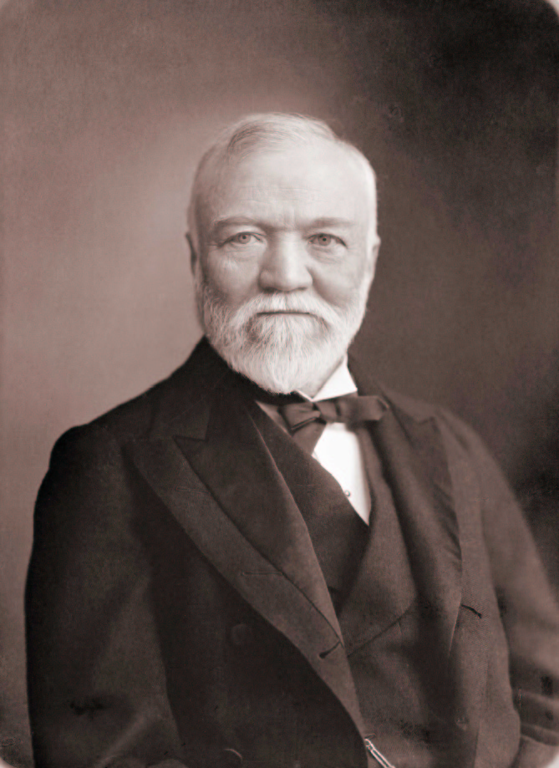
ANDREW CARNEGIE
Born in Scotland
Worked for Pennsylvania RR
Awarded stock options for contributions to the company
Used dividends to enter the steel business in 1899

Slide 6
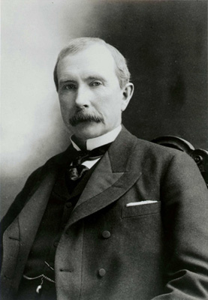
JOHN D. ROCKEFELLER
Owner of Standard Oil
Joined competing companies into a trust
  All participants turned their stock over to a group of trustees
  They ran the separate companies as one
  Companies were entitle to the profits of the trust
  Rockefeller used a trust to gain control of the oil industry

Slide 7
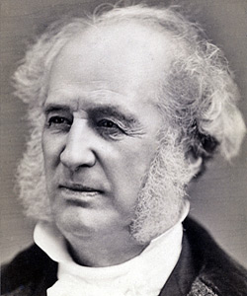
CORNERLIUS VANDERBILT
Left school at age 11 and started first ferry service at age 16
Expanded steam boat lines
Eventually started a RR company
Built Grand Central Station

Slide 8
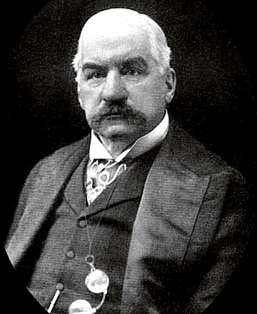
J.P. Morgan
Born into banking family
Started own bank in 1871
Controlled American economy through trusts

Slide 9
GOVERNMENT CONTROL OF BIG BUSINESS
Attitudes towards Big Business
  Laissez-faire
  Social Darwinism
  Robber Barons
  Philanthropists
Regulation
  Interstate Commerce Act, 1887
    Established the Interstate Commerce Commission
  Sherman Anti-Trust Act, 1890

