Slide 1
Today In Class
We learn more about westward expansion and the problems of maintaining both free & slave states

Slide 2
1820- 1853 Manifest Destiny
Atlantic To Pacific & Canada to Mexico

Slide 3
Manifest Destiny 1803-1853
Atlantic To Pacific & Canada to Mexico
  “America belongs to America”
Spread American ideals of….
Land Acquired
  Louisiana, Florida 1819 , Texas 1845, Oregon, 1846
  Mexican Cession 1848, Gadsden purchase 1853

Slide 4
HW Textbook
Due Thursday 12/5/2019
Read pages 240-246 answer terms and Names on p. 246
Monday 12/10 Read 248 – 253 answer terms & Names page 254

Slide 5
Missouri Compromise 1820
The Missouri Compromise (Henry Clay) was a Bill passed in Congress to find a way to determine whether slavery would be legal in new territories admitted as states to the Union. It was the result of complicated and fiery debates, but once enacted the compromise did seem to reduce tension for a time.
“…like a fire bell in the night, awakened and filled me with terror.“ TJ

Slide 6
Missouri Compromise 1820
The compromise held that Maine would enter the Union as a free state, and Missouri would enter as a slave state.
Congress divided along Sectional lines = N v. S
no territory to the north of Missouri’s southern border (the 36° 30' parallel) could enter the Union as a slave state.

Slide 7
Missouri Compromise 1820
set a precedent that Congress could regulate slavery in new territories and states. And that very issue would become a very important topic for debate decades later, especially in the 1850’s.
repealed in 1854 by the Kansas-Nebraska Act, which eliminated the provision that slavery would not extend north of the 30th parallel.

Slide 9
Mexico Breaks from Spain
The Mexican War of Independence (1810–1821) was an armed conflict between the people of Mexico and the Spanish colonial authorities. known as the Mexican War of Independence, was led by Mexican-born Spaniards , Mestizos and Amer-indians who sought independence from Spain.

Slide 10
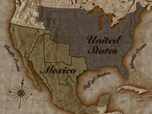
Mexico

Slide 11
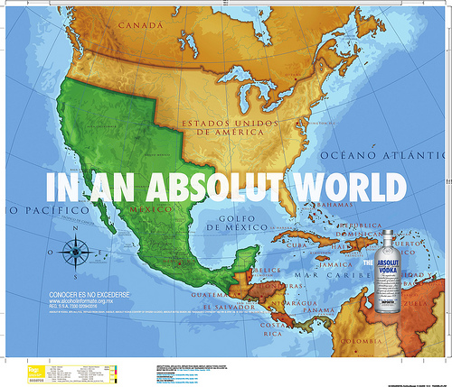
Mexico before 1836

Slide 12
The impact of Mexican independence
Mexico was a huge area-Mexico City- San Francisco, Ca-east to New Mexico & southern Utah & Colorado
Problems = Indians, huge area was difficult to police & administer because of huge land area
Needs an economy: Silver mining, hides, tallow, haciendas
Land grants = immigrants from America wanted slaves & were protestant used Am Rev to demand their unalienable rights from Mexico
In present day San Antonio, Houston, Dallas
See map on pg# 296

Slide 13
Remember the Alamo
1835 battle of the Alamo : Remember the Alamo” San Antonio
Mexican Gen. Santa Anna used brutal tactics to subdue “Texan up rising”
1836 Republic of Texas Pres. Sam Houston
December 29, 1845 Texas becomes the 29th state. Mexico is furious = Mexican American War.

Slide 14
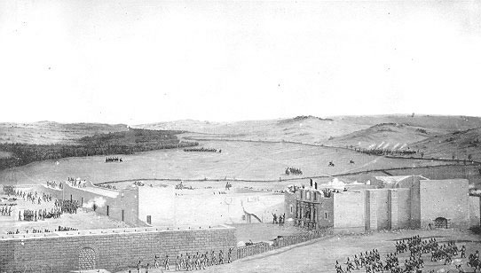
1843--The Alamo

Slide 15
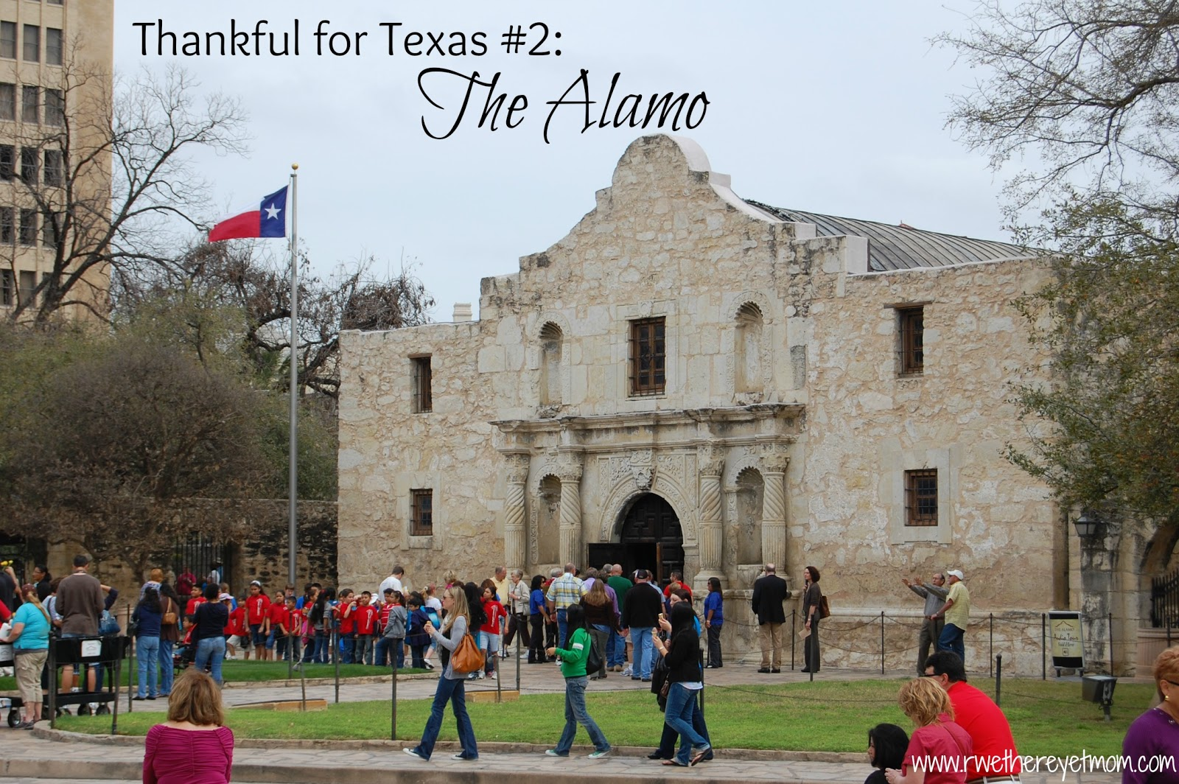
Present Day Alamo

Slide 16
Path to American Civil War 1820-1860
1820 Missouri Compromise divided America along the 36 longitude & 30 latitude
Compromise 1850
  1. California is admitted as a free state
  2. Fugitive Slave law
  3. popular Sovereignty
  Kansas-Nebraska Act 1854 “bleeding Kansas”

Slide 17
HW: Geography & Politics
Gadsden Purchase ( 1853), Homestead Act (1862). The Louisiana Purchase (1803)
Choose 2 topics & Identify the geographical factor that led to these two decisions
Evaluate the impact the government’s action had on the development of the United States.
bring in tomorrow a 1 ½ page outline of each (2) topics

Slide 18
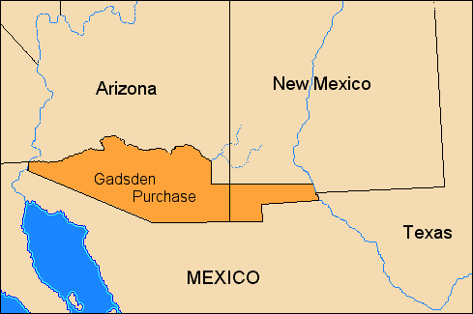
Gadsden Purchase

Slide 19
Path to American Civil War 1820-1860
Missouri Compromise no slavery north of
36 30’ latitude
Justifications of Slavery
  Evolution, Congress has no authority to prevent expansion,
  Kansas-Nebraska Act 1854-let us decide
  Bleeding Kansas
  John Brown

Slide 20
The Ideological divide of North & South
Always is this argument
states rights vs. the federal govt. policies & laws

Slide 21
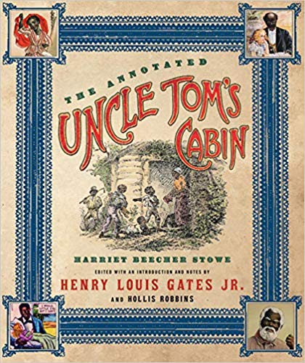
The Book Uncle Tom’s Cabin

Slide 22
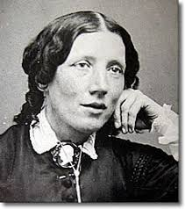
Harriett Beecher Stowe

Slide 23
Abolitionists
Abolitionist minister Henry Ward Beecher lived at his East Main Street mansion in the later 1800s. His sister, Harriet Beecher Stowe, who certainly was in Peekskill at some time, authored “Uncle Tom's Cabin,”

Slide 24
Path to American Civil War 1820-1860
Rise of Republican party
Dred Scott v. Sanford Supreme CT case 1857
  A. overturns Missouri Compromise
  1859 John Brown Raid at Harper’s Ferry
  November 1860 Lincoln is president
  February 1861- 11 southern states succeed to form Confederate states of America

Slide 25
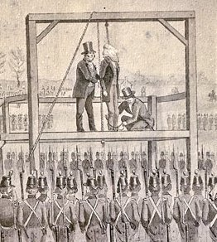
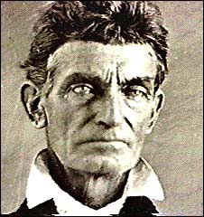
John Brown

Slide 26
1832 the nullification crisis
In response to the Tariff South Carolina legislators claimed the Constitution did not permit a tariff and they threatened to secede from the Union. President Jackson successfully urged congress to pass the 1833 Force Bill. Henry Clay the senator from SC created a compromise, lowering the tariff.

Slide 27
Home work
P.253 abolition, emancipation, nat turner antebellum, Frederick Douglas
P.258 Cult of domesticity, temperance movement, Seneca Falls convention, Sojourner Truth, Elizabeth Cady Stanton
P. 265 cottage industry, national Trades Union
Commonwealth vs. Hunt on page 265
P.279Capitalism, Cyrus McCormack, entrepreneur, market revolution

Slide 28
Homework
P.299 Treaty of Guadalupe Hidalgo
Gadsden purchase
Gold rush
P. 309 Wilmot provisio Compromise 1850
Secession popular sovereignty
Stephen Douglas

Slide 29
Homework p. 316
Kansas-Nebraska Act
Fugitive slave act
John Brown
Bleeding Kansas
P.321
Nativism Free-soil party
Republican party Horace Greeley

Slide 30
The Treaty of Guadalupe Hidalgo
Feb 1842--The Treaty of Guadalupe Hidalgo ends Mexican-American war & gave US California, Nevada, Utah, Arizona, Wyoming and made the Rio Grande river the US- Mexican border
The California Gold Rush May 1848- GOLD, GOLD people from all over the world flocked to Ca “Gold Rush” Toooo Badddd Mexico.

Slide 31
Hw p.331
Dred Scott
Harpers’ ferry
Confederacy
Jefferson Davis
Abraham Lincoln

Slide 32
Road to Civil War
Differences between North & South
North = cities, immigration & industry
South== agrarian cash crops, slavery & sectionalism
Slavery in the territories= Wilmot Provisio no slavery nor involuntary servitude shall ever exist in any new US territory

Slide 33
Statehood for California
Henry Clay “Compromise of 1850”
1. California admitted as a free state the south was granted a more effective fugitive slave law.
2. Fugitive slave Act- required people in free states to help capture & return escaped slaves.
These issues would create demands for disunion =succession= 1860 civil war

Slide 34
Missouri Compromise 1820-1821
The Missouri Compromise was an agreement passed in 1820 between the pro-slavery and anti-slavery factions in Congress involving the regulation of slavery in the western territories.

Slide 35
Fugitive slaves and the underground RxR
Abolitionists, lots of Quakers, helped slaves escape North to freedom.
Harriet Tubman- a former slave
Safe houses.
Abolitionists
The Fugitive Slave Act
1852 Uncle Tom’s Cabin by Harriett Beecher Stowe= a fierce look at the awfulness of slavery

Slide 36
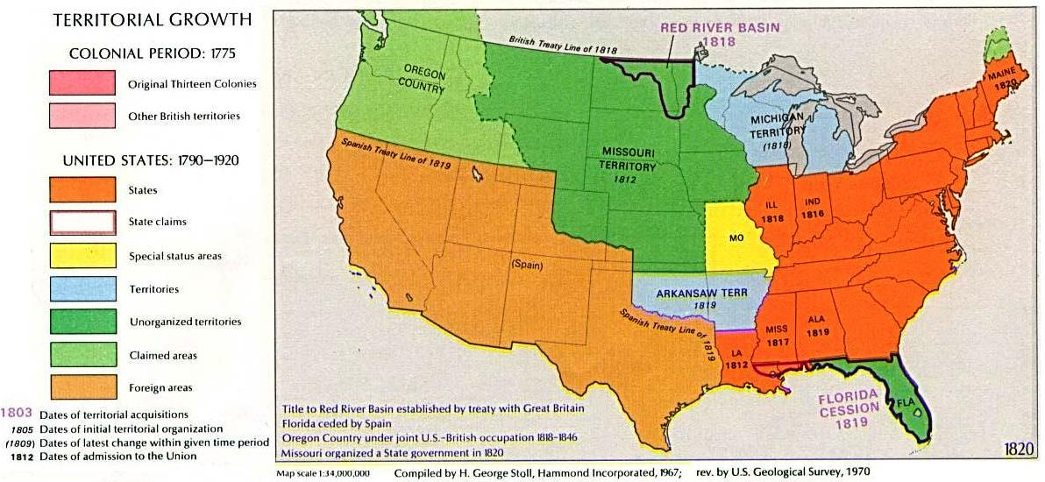

Slide 37
Bleeding Kansas 1856
Thousands of settlers migrating to the Kansas Territory
Slavery or No Slavery?
John Brown- abolitionist who used guns & violence
Free Soilers vs slavery

Slide 38
Birth of new political partys
1848 Free –Soil Party
Republican Party – 1854 opposed expansion of slavery into territories
Democratic party 1840 formerly called the Democratic-Republican party.
Always is the argument states rights vs the federal govt.

Slide 39
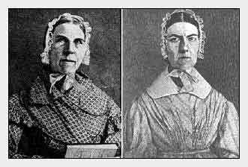
Sarah Grimke (1792-1873) and Angelina Grimke Weld (1805-1879) were raised in the cradle of slavery on a plantation in South Carolina.

Slide 40
1823
Supreme Court holds=decides that----their [Native Americans]"right of occupancy" was subordinate to the United States' "right of discovery."

Slide 41
The Cherokee Loose-the Indian removal Act 1830
The Cherokee went to the Supreme Court again in 1831. The SC court decided in favor of the Cherokee-the Cherokee had the right to self-government, and declared Georgia's extension of state law over them to be unconstitutional. The state of Georgia refused to abide by the Court decision, however, and President Jackson refused to enforce the law.
In 1830, just a year after taking office, Jackson pushed a new piece of legislation called the "Indian Removal Act" through both houses of Congress. It gave the president power to negotiate removal treaties with Indian tribes living east of the Mississippi. Under these treaties, the Indians were to give up their lands east of the Mississippi in exchange for lands to the west.

Slide 42
SC responds to Georgia’s attempt to take away Indian lands
Cherokee Nation v. Georgia, (1831) and Worcester v. Georgia, (1832),
the Court declared the United States relationship to the Cherokee was that of two separate nations, with the Cherokee's status a "denominated domestic dependent nation," giving the federal government the sole right of negotiation with them and creating a duty to protect the Cherokee from Georgia's hostile actions.

Slide 43
President Jackson, & Congress ignore the SC’s ruling
Chief Justice Marshall

Slide 44
Civil War 1861-1865
Causes of Civil war
States rights
Slavery
1860 election of President Lincoln = no political patronage for the South.
SLAVERY

Slide 45
Southern Succession
Election of Lincoln 1860
No electoral votes from the south for Lincoln
Lincoln has sectional support not national
The Confederacy = 11 southern states
“protect slavery in new territories”

Slide 46
Civil War 1861-1865
Ft. Sumter, SC
1863 West Virginia is created
July 21, 1861 Battle of Bull Run (Manassas, VA,)
Confederate General Robert E. Lee

Slide 47
Lincoln’s View of Slavery
Govt. had no authority over slavery
1863 Lincoln signs (executive order) -Emancipation Proclamation aka Presidential decision
1863--Emancipation Proclamation frees slaves ONLY in areas of active rebellion = 11 secessionist states.
But not in 34 states—
California, Connecticut, Delaware, Illinois, Indiana, Iowa, Kansas, Kentucky, Maine, Maryland, Massachusetts, Michigan, Minnesota, Missouri, New Hampshire, New Jersey, New York, Ohio, Oregon, Pennsylvania, Rhode Island, Vermont, and Wisconsin. During the war, Nevada and West Virginia joined as new states of the Union.

Slide 48
Lincoln’s Election 1860
1860 1st win for the Republican party=GOP
Southern Democrats loose political patronage
Lincoln chooses a Northern-Republican cabinet
January 1, 1863 Emancipation Proclamation
  “that all persons held as slaves” within the rebellious areas “are, and henceforward shall be free.”

Slide 49
Lincoln’s view of the Civil War
South Never legally succeeded
make the country re-united as fast as possible
No punishment to the Confederacy or its leaders
Copperheads- 1860s, the Copperheads were a vocal faction of Northern Democrats who opposed the American Civil War, wanting an immediate peace settlement with the Confederates. Northern Republicans started calling anti-war Democrats "Copperheads", likening them to the venomous snake.

Slide 50
Northern Republicans
Punish the South for treason and instruction: punish, imprison and hand Rebel leaders

Slide 51
Civil War Battles
Bull Run = Manassas Junction- North lost
Wilbur Mclean’s farm is destroyed there-He moves to Appomattox court house, Virginia
1863-Vicksburg on the Mississippi-control the river-North wins
Gettysburg July 1,2 & 3rd 1863-Union wins
New weapons- Observation balloon, Gatling Gun, scoped rifle & iron clad boats, Mini ball, cannon chain
Confederates Named battles for bodies of water or other Geographic features--The North used nearby Towns

Slide 52
Civil War
New weapons- Observation balloon, Gatling Gun, scoped rifle & iron clad boats, Mini ball, cannon chain
Confederates Named battles for bodies of water or other Geographic features--The North used nearby Towns

Slide 53
Gettysburg Address
Battle of Gettysburg July 1,2 & 3 1863
This Union victory boxes in the South from Never again trying to attack the North.
Lincoln arrives in November 1863

Slide 54
The Gettysburg Address
this ground. The brave men, living and dead, who struggled here have consecrated it, far above our poor power to add or detract. The world will little note, nor long remember what we say here, but it can never forget what they did here. It is for us the living, rather, to be dedicated here to the unfinished work which they who fought here have thus far so nobly advanced. It is rather for us to be here dedicated to the great task remaining before us — that from these honored dead we take increased devotion to that cause for which they gave the last full measure of devotion — that we here highly resolve that these dead shall not have died in vain — that this nation shall have a new birth of freedom and that government of the people, by the people, for the people, shall not perish from the earth."

Slide 55
President Abraham Lincoln
November 19, 1863
"Fourscore and seven years ago our fathers brought forth on this continent a new nation, conceived in liberty and dedicated to the proposition that all men are created equal.
Now we are engaged in a great civil war, testing whether that nation, or any nation so conceived and so dedicated, can long endure. We are met on a great battlefield of that war. We have come to dedicate a portion of that field as a final resting-place for those who here gave their lives that that nation might live. It is altogether fitting and proper that we should do this. But, in a larger sense, we cannot dedicate — we cannot consecrate — we cannot hallow — This Ground

Slide 56
Address continued
The brave men, living and dead, who struggled here have consecrated it, far above our poor power to add or detract. The world will little note, nor long remember what we say here, but it can never forget what they did here. It is for us the living, rather, to be dedicated here to the unfinished work which they who fought here have thus far so nobly advanced. It is rather for us to be here dedicated to the great task remaining before us — that from these honored dead we take increased devotion to that cause for which they gave the last full measure of devotion — that we here highly resolve that these dead shall not have died in vain — that this nation shall have a new birth of freedom and that government of the people, by the people, for the people, shall not perish from the earth."

Slide 57
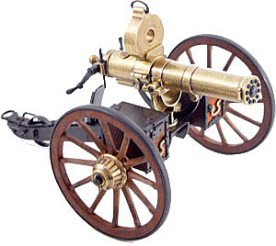
Gatling Gun

Slide 58
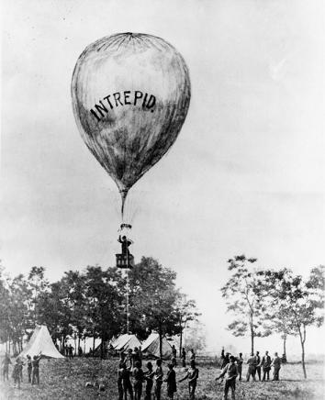
Observation Balloon

Slide 59
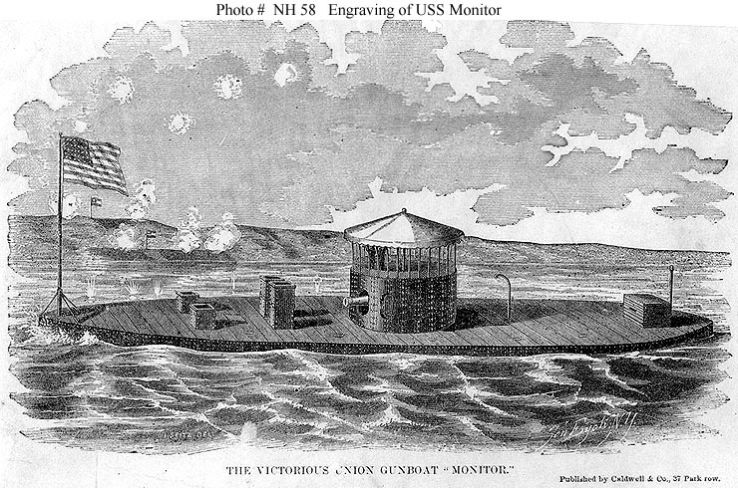
Civil War Iron Clad

Slide 60
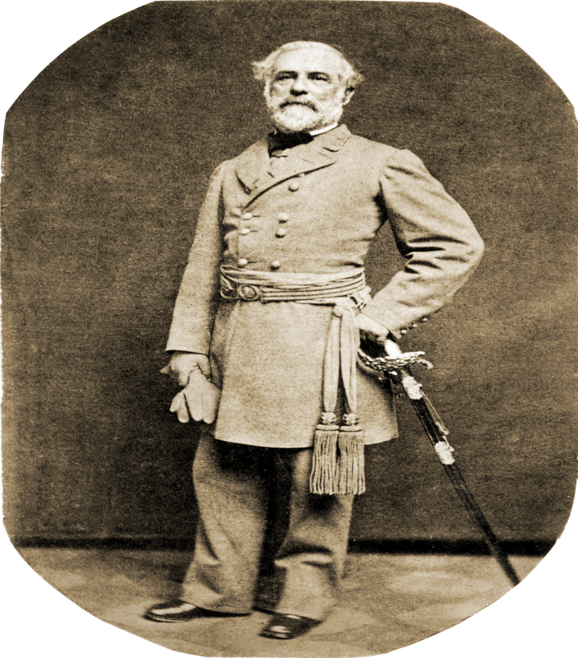
Confederate Gen. Robert E. Lee

Slide 61
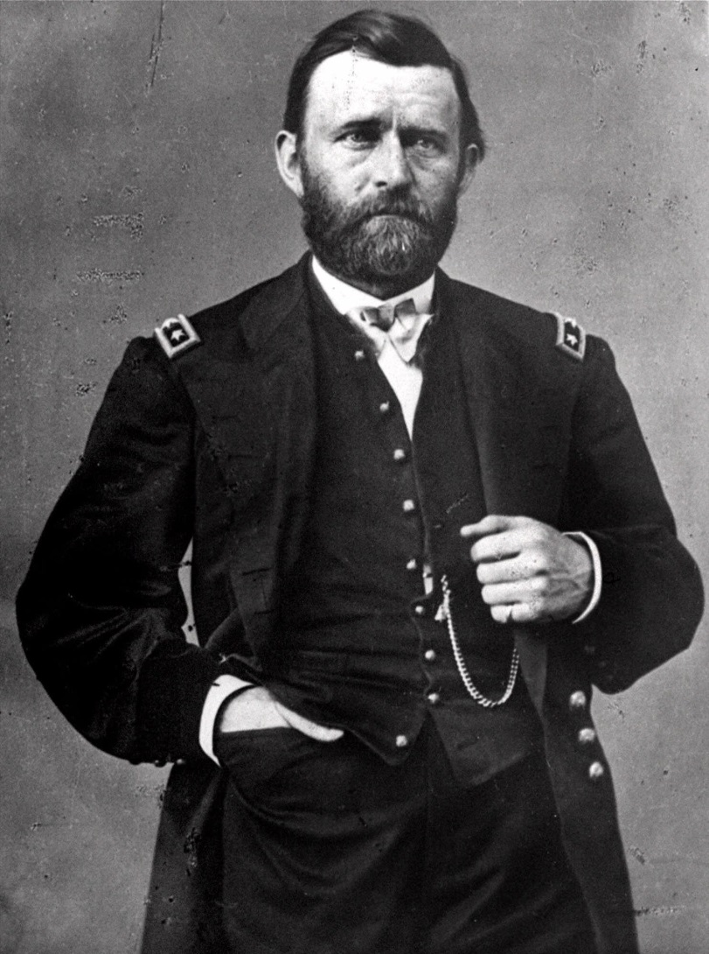
Union Gen. Ulysses S. Grant & President

Slide 62
Gettysburg July 1 - 3, 1863
3 days of bloody hell = a Union victory
51,000 soldiers from both armies were killed, wounded, captured or missing
Confederate Gen. Pickett’s charge
Gettysburg Address – Lincoln speaks at Gettysburg. Delivers the Gettysburg Address
Reaffirms his commitment to reunite the Union.
Notes:
Confed

Slide 63
Nov 8, 1864
President Lincoln is re-elected
no country had ever held elections during a military emergency. Lincoln himself said, "We can not have free government without elections; and if the rebellion could force us to forego, or postpone a national election, it might fairly claim to have already conquered and ruined us." Five months after Lincoln's re-election, the collapse of the Confederacy was complete.

Slide 64
Gen. Lee Surrenders
Appomattox Courthouse on April 9, 1865, In Wilbur Maclean’s new Farm
Union Gen. Grant gives Gen. Lee generous surrender terms

Slide 65
April 14, 1865 Lincoln is Assassinated
John Wilkes Booth- famous actor and Confederate sympathizer
shocked by John Brown's bloody raid on Harper's Ferry, Virginia.
Shoots Lincoln in Ford’s Theater in D.C.
Sic Semper Tyrannis = Thus ever to tyrants

Slide 66
Where is Lincoln murdered
Ford's Theatre in Washington, D.C. on April 14, 1865.

Slide 67
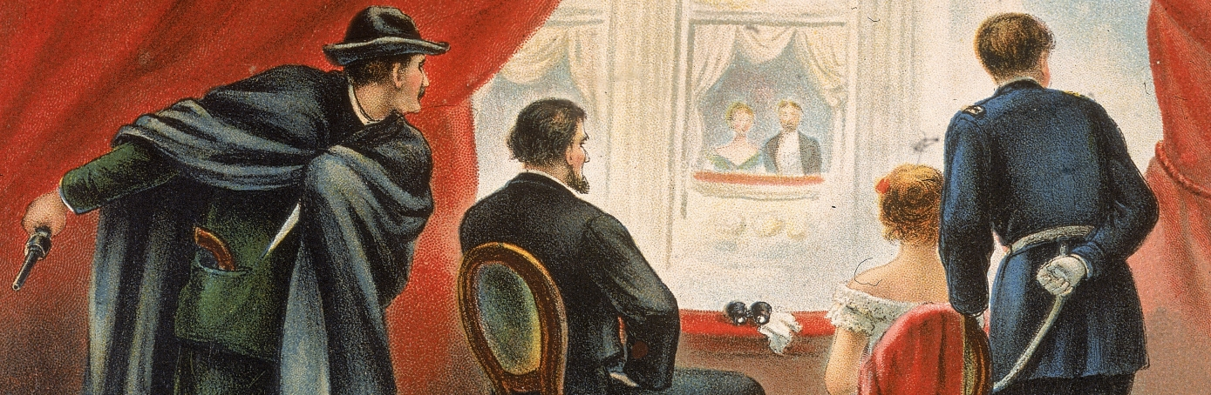
Lincoln’s murder

Slide 68
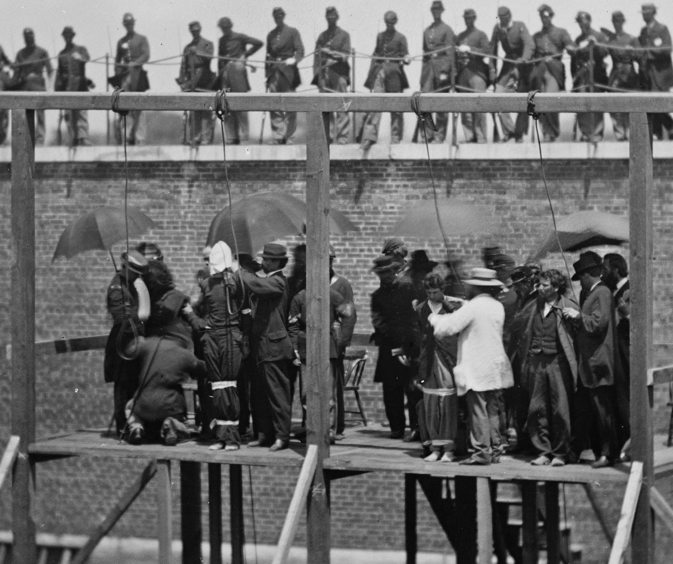
Lincoln’s conspirators are executed

Slide 69
Others targeted by the conspirators
Vice President Andrew Johnson
Secretary of State William H. Seward.
On the night of April 14, a mere two hours before heading inside Ford’s Theatre, Booth met at a boardinghouse with three accomplices—Lewis Powell, David Herold and George Atzerodt—and unveiled his new plan: assassination. Promising to take care of Lincoln himself, he allegedly assigned Secretary of State Seward to Powell and Herold and Vice President Johnson to Atzerodt.

Slide 70
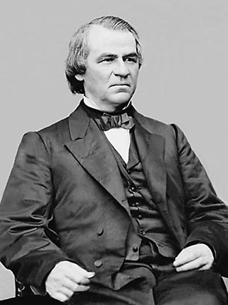
President Andrew Johnson

Slide 71
Johnson as president
1865 to 1869, was the first American president to be impeached. Why? He violated the tenure of Office Act.
restricts the power of the President of the United States to remove certain office-holders without the approval of the Senate. The law was enacted on March 3, 1867, over the veto of President Andrew Johnson.
As a southerner he remained loyal to the Union Johnson took a moderate approach to restoring the South to the Union, and clashed with Radical Republicans. In 1868, he was impeached by Congress, but he was not removed from office. He did not run for a second presidential term.

Slide 73
The Second Great Awakening
19th-C
By the beginning of the 19th century, traditional Christian-catholic beliefs were held in less favor.
Evangelicals follow the Gospels of Jesus in the New Testament & reject the rituals and Dogma of the Catholic church
Evangelicals began to preach across the eastern part of the country
Methodists & Baptists grow in membership

Slide 74
Ethics & Goals of 2nd Awakening
Led by Evangelical Christians who believed in a strong work ethic, frugality and temperance
Evangelicals- believe in the Gospel =the message of Jesus Christ.
individuals could amend (FIX or Change) their lives & society’s problems
reform movements aimed at societal injustice
alleviating suffering—a democratizing effect.

Slide 75
Ethics & Goals of 2nd Awakening
Social activism- to reform society according to the Gospel
abolition
temperance
suffrage

Slide 76
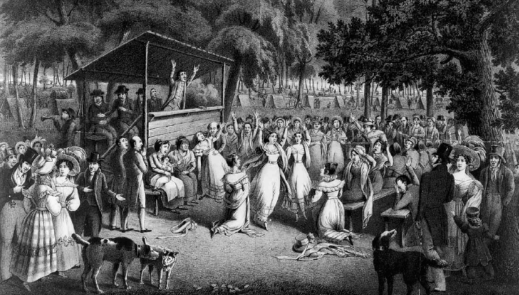
Camp meeting

Slide 77
Civil War Reconstruction 1860-1877
What to do with the South?
What to do with the Contraband = slaves
Col. Henry , Wirz—CSA-commander of a Confederate prison that held Union troops was one of two men tried, convicted, and executed for war crimes during the Civil War
Wirz was hanged at 10:32 a.m. on November 10, 1865,

Slide 78
What to do with the Contraband = slaves
The Freedman’s bureau-the ex-slaves are now called freedman and there are 4,000,000 of them
Gen.O.O. Howard
Schools, courts, voting & the freedman are protected by 11 southern military districts
Carpet Baggers- Northerners looking to buy cheap southern land & businesses

Slide 79
The Civil War Amendments
13th
14th
15th

Slide 80
13th amendment
Neither slavery nor involuntary servitude, except as a punishment for crime whereof the party shall have been duly convicted, shall exist within the United States, or any place subject to their jurisdiction." Formally abolishing slavery in the United States, the 13th Amendment was passed by the Congress on January 31, 1865, and ratified by the states on December 6, 1865.

Slide 81
14th Amendment
All persons born or naturalized in the United States, and subject to the jurisdiction thereof, are citizens of the United States and of the state wherein they reside. No state shall make or enforce any law which shall abridge the privileges or immunities of citizens of the United States; nor shall any state deprive any person of life, liberty, or property, without due process of law; nor deny to any person within its jurisdiction the equal protection of the laws.

Slide 82
15th Amendment
15thright of citizens of the United States to vote shall not be denied or abridged by the United States or by any state on account of race, color, or previous condition of servitude." Although ratified on February 3, 1870,

