Slide 1
Birth of Social Justice in America
The 2nd Great (religious) Awakening – A true Christian helps improve society. Women were actively encouraged to be - ACTIVISTS - involved because of their female nature & physiology.
1. Abolitionism
2. Women’s Temperance movement
3. Women’s Suffrage movement = voting
What about black civil rights?
4. Equal rights Amendment to the constitution 1973
5.
6.

Slide 2
Social Justice Issues in History
Anti-slavery-1830’3 -1861
Anti-Alcohol- 1850’s – the Women’s Christian Temperance Union (WCTU) results in America adding the 18th amendment 1919.
18th was Repealed by the 21 amendment 1933
Suffrage--Women should vote= suffragettes-1890’s -1920 = 19th Amendment gives women the right to vote
1972 ERA- Equal Rights Amendment—Failed 1970’s.
What are other examples of social justice in America?
1. 2. 3.

Slide 3
Today In Class
1. Quiz – Review
Activity: John Brown patriot or terrorist?
2. Lesson - Women & their role in Social Justice issues 1840 - ?

Slide 4
Woman & Social Activism
1830’s Why did society encourage women to be abolitionists & social reformers? Cult of Domesticity!
Cult of Domesticity- A 19th Century belief that women were better suited (physiology) to being nurturing care givers & good Christians who were active in bringing change to society.
What is Physiology - A biological approach from the
molecular level up to & including the behavior of the whole body & mind

Slide 5
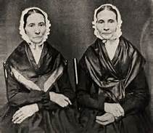
Grimke Sisters

Slide 6
2nd Great Awakening 1820’s - ?
A religious revival that emphasized the individual had a responsibility as a Christian to help their fellow man & society = social Justice
calling for Christian rebirth and societal activism by individuals.
Known as Evangelicals
evangelicalism is a movement that encompasses a variety of denominations and independent traditions.
1840’s -1860’s abolitionism was the big fight by evangelicals
What does an Evangelical believe:? Evangelicals believe the culture is redeemable and can and should be impacted by Christians.

Slide 7
Why The Great Awakening
American society was changing & needed positive change because of
  . Immigration
    Urbanization
    Reject pre-determinism
    Individual can seek their own path to Godly salvation
    Individuals can –must change themselves and society’s problems
    Slaves needed Christian salvation

Slide 8
1800’s The Religious Revival -2nd Great Awakening
Huge gatherings - frenzied and emotional
Religious-Protestant Revivalism swept through 19th-C America
In the South Baptist & Methodist churches began to flourish
Enslaved persons saw Christianity as a promise for their freedom. Because of the Christian message : love they Neighbor, forgive those who sinned against you, save non-believers’ souls, God loved all human beings AND a good Christian protests against social injustice.
This is the beginning of the Abolitionist movement, Temperance movement, Civil Rights movement

Slide 9
Physiology
A biological approach to the human mind and body
molecular level
integrated behavior of the whole body
influence of the external environment

Slide 10
Grimke Sisters

Slide 11
Transcendentalism & Reform mid 1800’s
Transcendentalism- mid 1800’s alternative to the 2nd Great Awakening: Philosophy & literacy emphasized living a simple life, celebrate the truth found in nature. against spirituality of the 2nd Great Awakening.
Transcendentalism is a philosophical movement that developed in the late 1820s and 1830s in the eastern United States. Transcendentalism--American Ideals: The dignity of the individual.
Individualism, freedom, self-reliance-GOD was not going to change your life-ONLY you could. But the Transcendentalist was committed to societal change.
Transcendentalists did not believe in organized religion.

Slide 12
Henry David Thoreau- Walden (1854
Henry David Thoreau- Walden (1854) 2 years alone in the woods near Concord, Mass on Walden Pond. In Walden Thoreau discussed civil disobedience , not to obey un-just laws.
Opposite of 2nd Great Awakening- individual & NOT God! Changes society
Thoreau was a believer in Transcendentalism and civil disobedience, and was a dedicated abolitionist.
The father of environmentalism.
Thoreau was opposed to the Mexican annexation, Slavery & mistreatment of Native Americans.

Slide 13
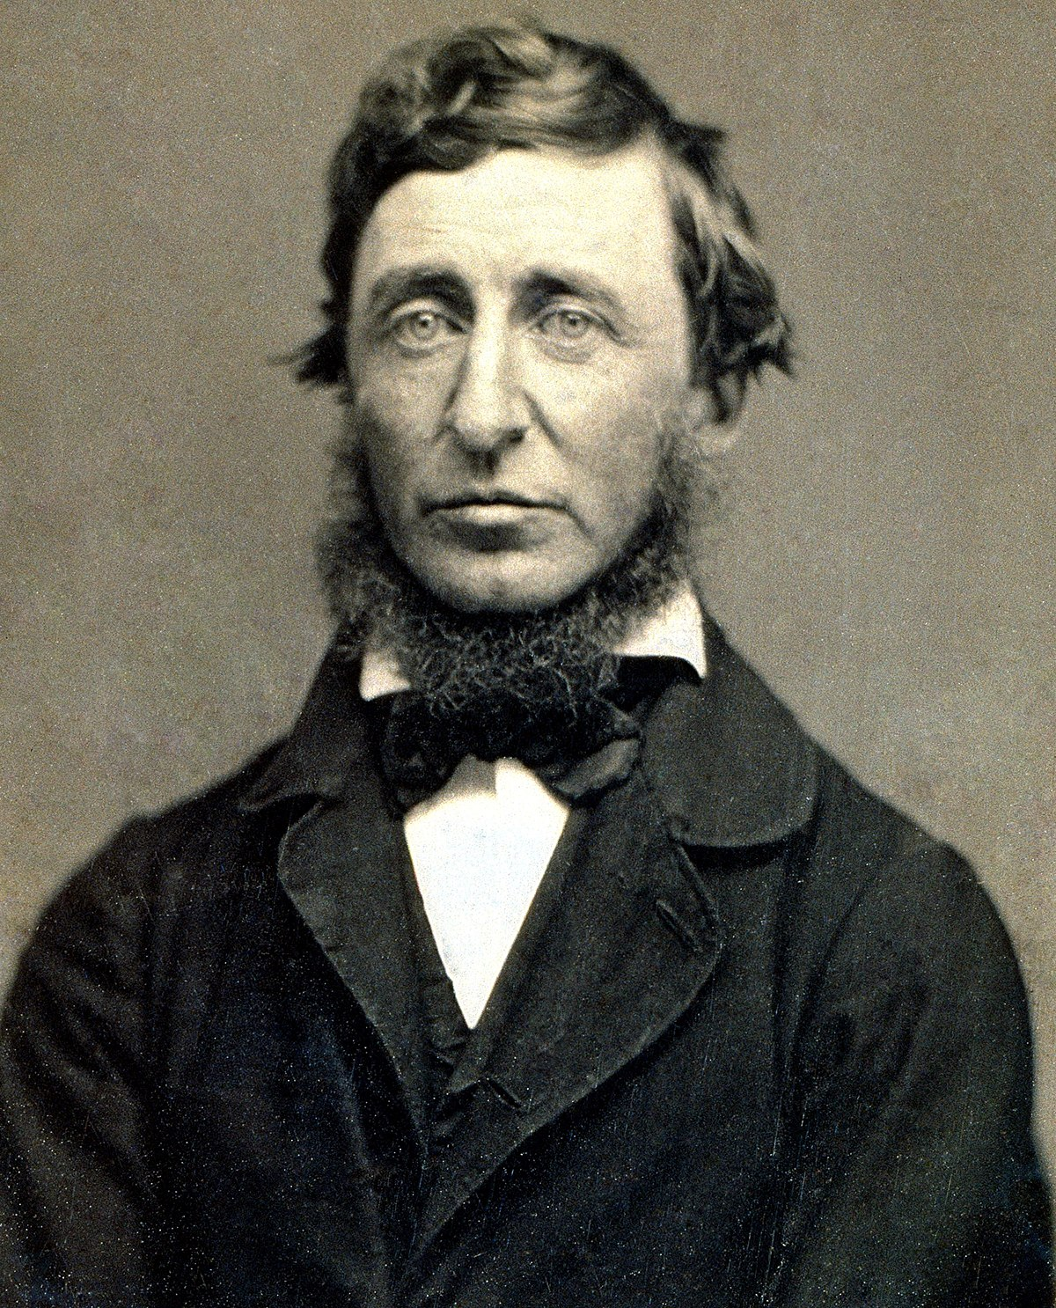
Henry David Thoreau

Slide 14
Thoreau’s views
He spent a night in jail after refusing to pay a poll tax. This experience led him to write one of his best-known and most influential essays, "Civil Disobedience" (also known as "Resistance to Civil Government").
Walden and “Civil disobedience” inspired many leaders of protest movements around the world. This non-violent approach to political and social resistance has influenced American civil rights movement activist Martin Luther King Jr. and Mohandas Gandhi, who helped India win independence from Great Britain, among many others.
On John Brown: "A Plea for Capt. John Brown," calling him "an angel of light" and "the bravest and [sic] humanest man in all the country."

Slide 15
father of environmentalism.

Slide 16
Ralph Waldo Emerson, Father of Transcendentalism
Ralph Waldo Emerson—essayist, minister, poet and philosopher from New England—was the founding father of the transcendentalist movement and the creator of many literary works praising nature and its relationship to humanity and creation.
Emerson acted as a mentor to Thoreau and supported him in many ways. For a time, Thoreau lived with Emerson as a caretaker for his home.

Slide 17
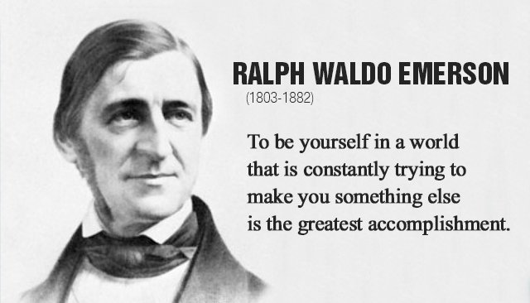

Slide 18
Ralph Waldo Emerson’s Best Work
Emerson's famous essay, “Self-Reliance," in which the writer instructs his listener to examine his relationship with Nature and God, and to trust his own judgment above all others.

