Slide 1
GW & the New Govt 1789-1803
April 16, 1789-
Capitol is NYC-
Govt based on the WILL of the people-

Slide 2
Building an Executive Branch
President’s Washington’s Cabinet: 1789
Thomas Jefferson= secretary of state
Secretary of war- Henry Knox-
Alexander Hamilton= Secretary of the treasury
Edmund Randolph- Post master General
2014---there are 15 cabinet positions

Slide 3
Judiciary Act 1789
Judiciary Act 1789-created Fed courts & a Supreme Court = SC
State court decisions can be appealed to the SC ONLY after exhausting all appeals on the state Court level
Attorney General-

Slide 4
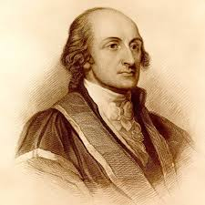
John Jay

Slide 5
John Jay’s accomplishments
The Federalist Papers. The Federalist Papers discussed, and argued in favor of, the principles of government laid out in the Constitution.
1st Chief justice of the Supreme Court
Made the precedent setting decision of judicial review in Marbury v. Madison
Governor of New York state

Slide 6
Building an Executive Branch
President’s Washington’s Cabinet
Thomas Jefferson= secretary of state
Alexander Hamilton= Secretary of the treasury
Other cabinet positions are: War dept, Attorney General, Post master general
2014---there are 15 cabinet positions

Slide 7
Hamilton & Jefferson Opposing ideologies
Alexander Hamilton a Federalist- Report on Manufactures - December 5, 1791, Corporations, Capitalism, Govt. Print paper Money, lots of immigration, assume the states’ Rev-War debt, Bank of the United States , District of Columbia, excise tax, protective tariff & Patent Office of the United States
The Opposite of Hamilton is:
Thomas Jefferson- Anti-Federalist , a member of the Democratic-Republicans, strong state govt, little immigration, small yeoman farms.

Slide 8
1804-Birth of the 2 party system
Federalist vs. Democratic-Republicans

Slide 9
1801 Two-party political systems
Federalist party-Wealthy elites, Manufacturing, shipping & trade, Loose interpretation of Constitution, Protective Tariff, Pro-British
Democratic-Republicans- led by TJ, agrarian economy, pro-French, strict interpretation of Constitution-supported states' rights, limited government, and a strict interpretation of the Constitution.

Slide 10
GW’s Farewell Address 1797
“steer clear of permanent alliances”
remain neutral in foreign affairs

Slide 11
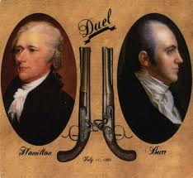
The Duel 7/11/1804

Slide 12
French Revolution
1793 King Louis XVI is beheaded
America declares Neutrality
TJ loves the revolution. WHY??
Edmond Genet

Slide 13
Treaty with Spain
U.S. & the Mississippi river 1795
Spain controls the Louisiana territory
Pinckney’s Treaty 1795-
Jay’s Treaty- Nov, 1794-British gave up territory--West of the Appalachia's= America is growing

Slide 14
1801 Two-party political systems
Federalist party-Wealthy elites, Manufacturing, shipping & trade, Loose interpretation of Constitution, Protective Tariff, Pro-British
Democratic-Republicans- led by TJ, agrarian economy, pro-French, strict interpretation of Constitution-supported states' rights, limited government, and a strict interpretation of the Constitution.

Slide 15
Foreign Policy 1800-1823 &
GW’s legacy
1793-GW Proclamation of Neutrality
1796--GW farewell Address “neutrality avoid war at all cost”
GW-2 term presidency
GW-Neutrality
GW & AH--America must be free to trade with all of Europe
XYZ Affair-insulted America
1798--Alien & sedition Act- Pres John Adams

Slide 16
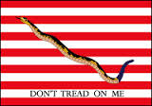
Early American Colonial Flag

Slide 17
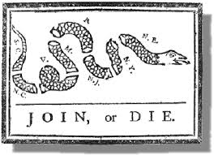
Early American Colonial Flag

Slide 18
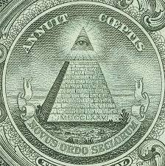
Annuit Coeptis

Slide 19
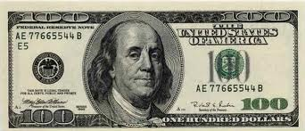
Ben Franklin

Slide 20
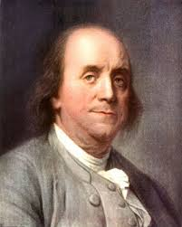
Ben Franklin

Slide 21

Great Seal of The U.S.A.

Slide 22

Great seal of United States

Slide 23


A New Country needs a national symbol

Slide 24
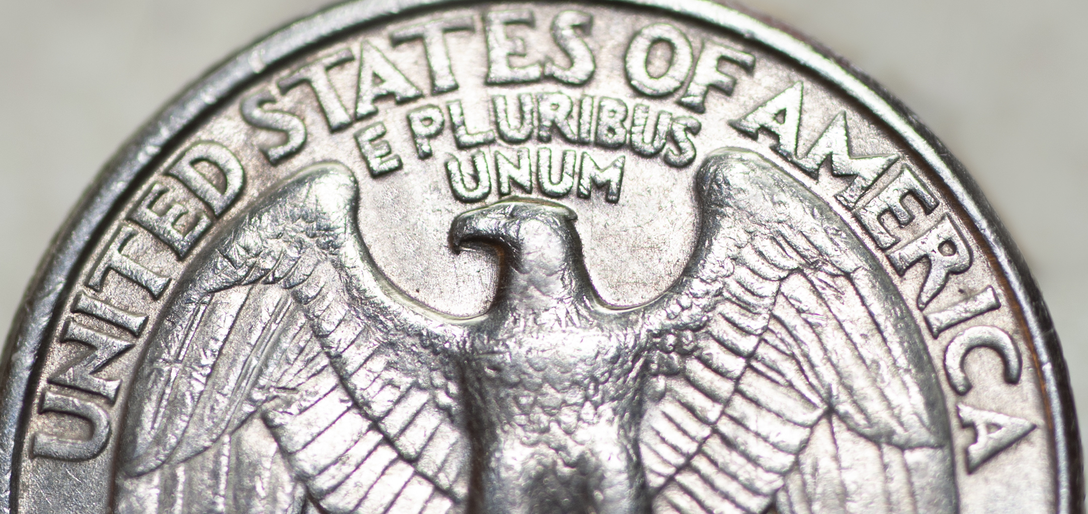
E PLURIBUS UNUM
A Latin term meaning---
“One From many" – a phrase that captures the symbolism on the
Great Shield of the U.S.A. and the American nation.

Slide 26
Examples of Judicial review
Under Chief Justice John Marshall 1801-1835
Marbury vs. Madison= Supreme Court has the power to rule on the Constitutionality of a law-Declare acts-laws of Congress un-constitutional.
“ Midnight Judges”
1819 McCulloch v. Maryland- upheld the creation of the 2nd national bank of the United States
1824 Gibbons v. Ogden-congress has the power to regulate interstate commerce = Article I, sec 8

Slide 27
What is the role of the Supreme Court?
Judicial Activism
OR
Judicial Restraint

Slide 28
Jefferson’s Presidency
Elected 1800
Decentralized govt, reduce expenses, save $$
1st president to serve in D.C.
Louisiana Purchase 1803---- 828,000 square miles
“ Midnight Judges” TJ Refused to appoint Marbury as a Federal Judge

Slide 29
Today’s lesson: 2 parts
NO TALKING
Lesson # 1-Regent’s practice ---
NO TALKING :
Think about 2 inventions that have helped/hurt America write the 2 inventions down and briefly explain each invention: who it helped/ hurt –Explain the economic, historic and or political impact of each invention.

Slide 30
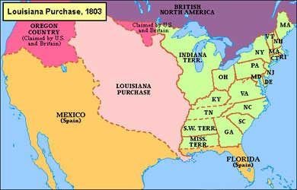
Louisiana territory

Slide 31
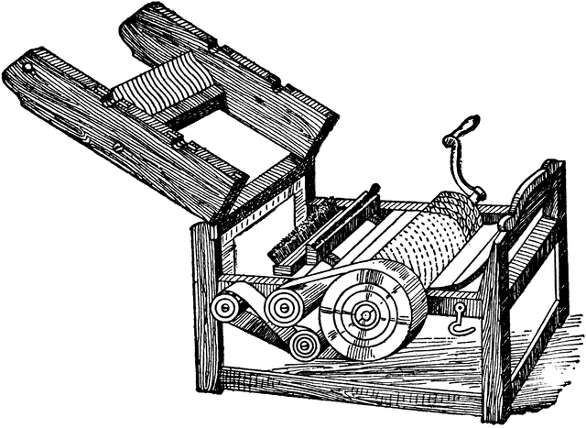
Cotton Gin--1793

Slide 32
Lesson # 2
Missouri Compromise –1818
The issues of slavery is here to stay
“…we have a wolf by the ears.” TJ

Slide 33
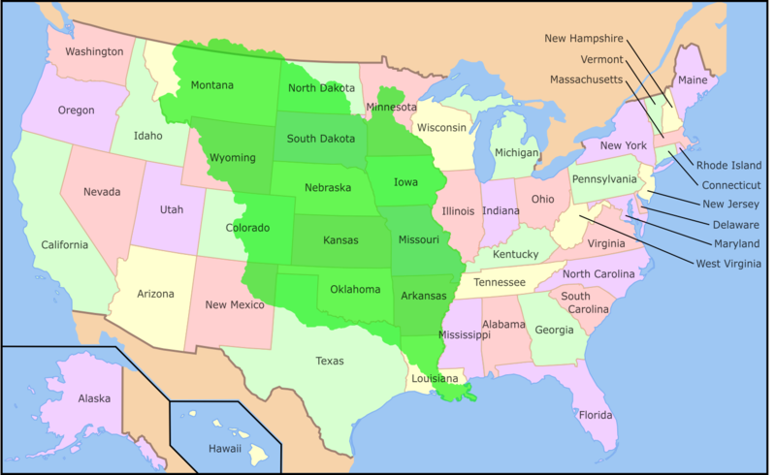
Louisiana Purchase 2012

Slide 35
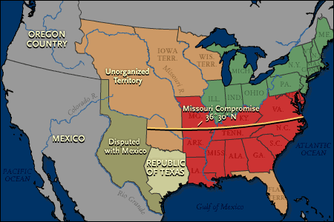
Slavery & No Slavery 1819

Slide 36
Missouri Compromise 1819
1818 =10 X 10 =10 free & 10 slave states
Maintain the balance between slave and free states
“…we have a wolf by the ears.” TJ
Divide the country 36 30 north latitude

Slide 37
Missouri Compromise
Congress devised a two part compromise. It granted Missouri statehood as a slave state and admitted Maine as a free state, restoring the political balance. It also drew an imaginary line west of the Mississippi and North of the 36 degrees 30 minutes latitude in which slavery would not be allowed after 1820.

Slide 38
America is becoming a market economy 1800
From the cottage system to an industrial economy-
Cottage system 1600- 1800 at home by family members using their own equipment to produce goods like, soap, clothes, maple syrup, candles, tools, etc....
The Industrial revolution begins 1800-1890

Slide 39
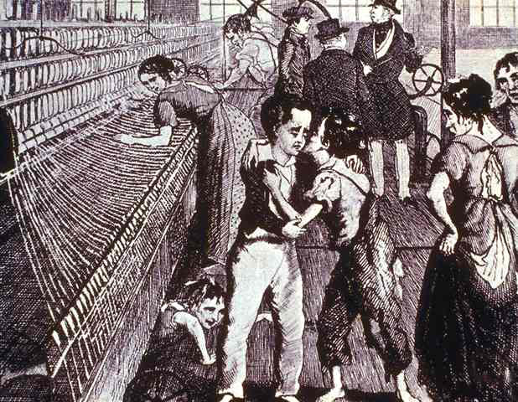
Child Labor

Slide 40
How much of the American Continent belongs to the U.S. ?
Manifest Destiny-
Nationalism vs. Sectionalism-
1823-Monroe Doctrine

Slide 41
Monroe Doctrine
The Monroe Doctrine was a United States policy of opposing European colonialism in the Americas beginning in 1823. ... At the same time, the doctrine noted that the U.S. would recognize and not interfere with existing European colonies nor meddle in the internal concerns of European countries.

Slide 42
Industrial Revolution 1800-1890
Manufactured goods are sold on the open market
Capitalism – Free Market Economy, free exchange of Goods for profit

Slide 43
No Industry for the South
King Cotton 1800-1860

Slide 44
King Cotton 1800 – 1860
Short Staple Cotton
Long StapleCotton

Slide 45
Why Come to America?
Immigrants come from Europe
Irish potato famine 1840 - 1860
Manifest Destiny

Slide 46
Anti-immigrant backlash
Nativism-anti-immigrant feelings
“know Nothings”

Slide 47
Transportation systems 1800 - 1850
1825 Erie Canal
RxR’s
Roads & Turnpikes
Robert Fulton- Clermont Hudson River Steam ship
1824 Gibbons v. Ogden-The power of regulating commerce extends to the regulation of navigation

Slide 48
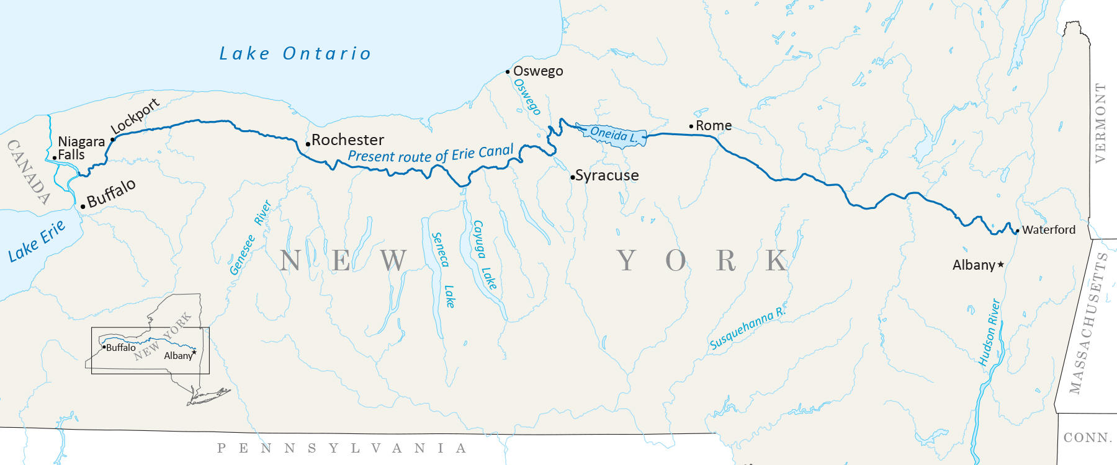
Erie Canal

Slide 49

Otters, Beavers, Seals & Whales

