Slide 1

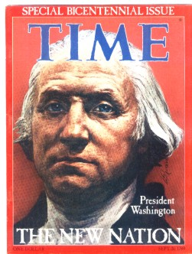


List everything you know about George Washington

Slide 2
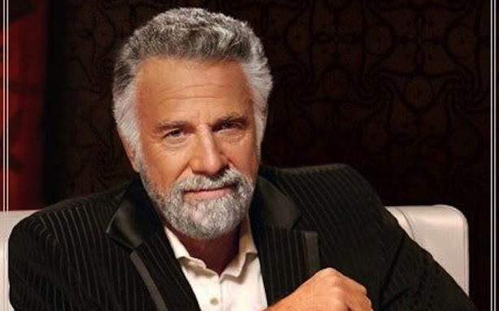
How important was George Washington?
He stopped a revolution by putting on his glasses. True story

Slide 3
Who is George Washington?
Virginia plantation owner. Mt Vernon
General and commander-in-chief of the colonial armies during the American Revolutionary War.
1st president of the United States 1789 to 1797.

Slide 4
Washington’s Contributions
2x as President
Farewell Speech “urged Americans to avoid excessive political party spirit
geographical distinctions.
In foreign affairs, he warned against long-term alliances with other nations. The address was printed in Philadelphia's American Daily Advertiser on September 19, 1796.

Slide 5
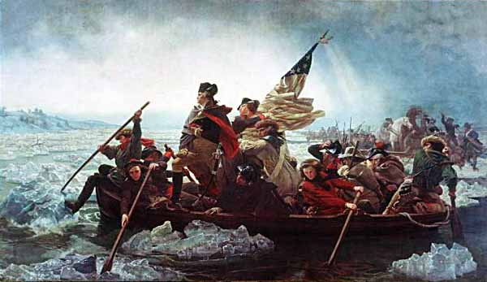

Slide 6
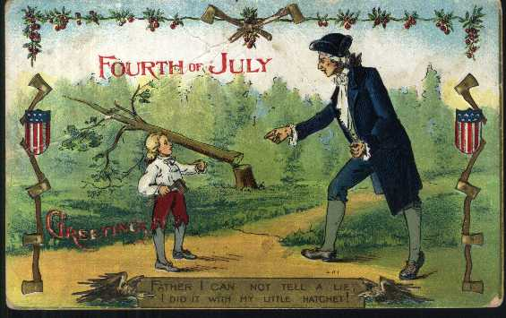

Slide 7
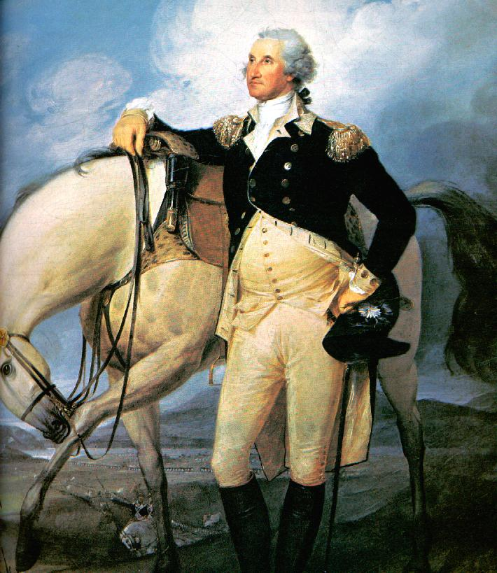
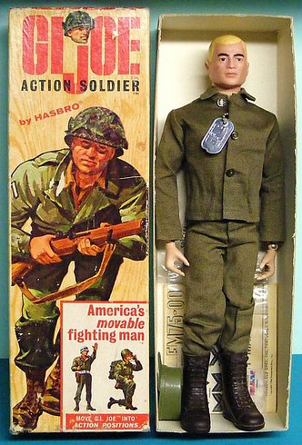

Slide 8
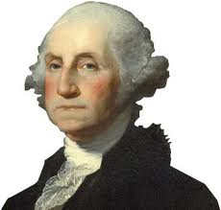

Slide 9
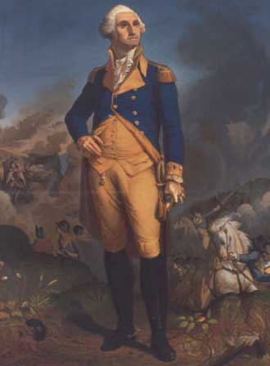

Slide 10
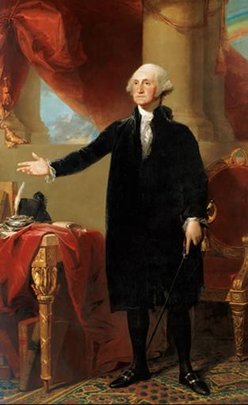
WHO WAS
GEORGE WASHINGTON?
The First President of the United States
Former commander of the Continental Army
Unanimously Elected-he was unopposed in both elections
Generally thought of as the most important Founding Father

Slide 11
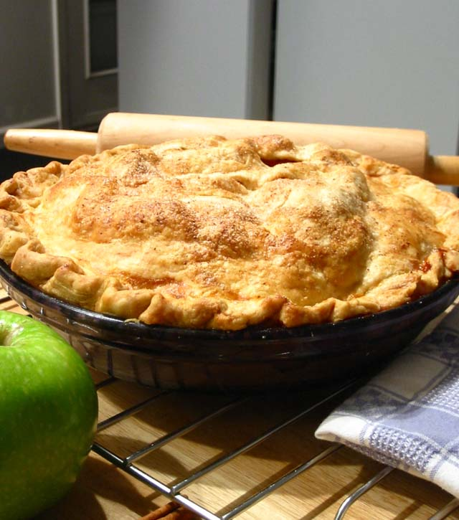
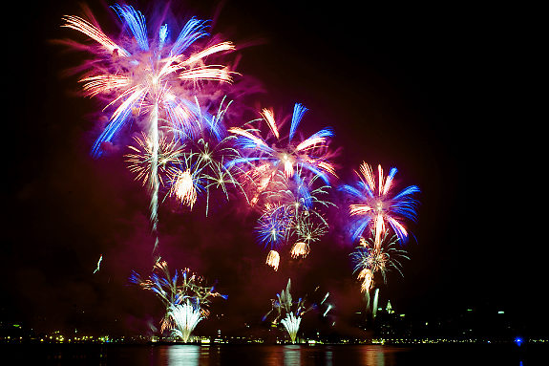
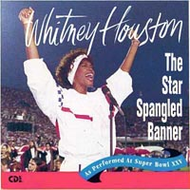
What is a “precedent?”

Slide 12
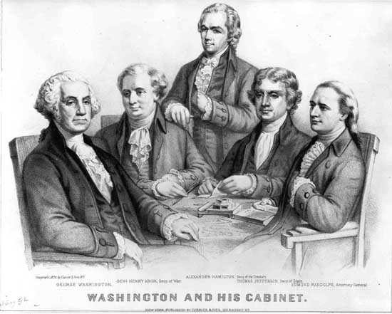
Precedent# 1: The Presidential Cabinet
The Cabinet is the President’s top advisors on various issues in society.
4 Original Positions
-State
-Treasury
-War
-Attorney General

Slide 13
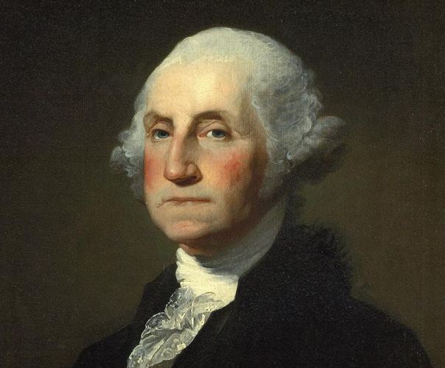
Precedent # 2: “You can call me…”
Emperor Washington?
Your Majesty?
King George?
(Sounds too familiar)
Your Excellence?
“MR. PRESIDENT”

Slide 14
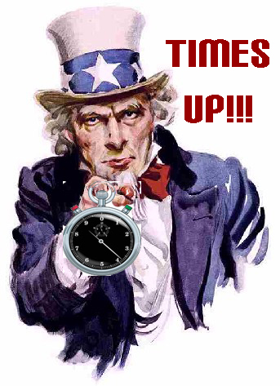
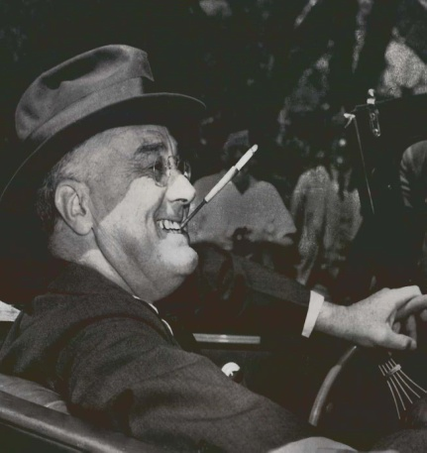
George Washington’s Presidential Precedents # 3:
Is too much of something a bad thing?
Washington certainly thought so, as he only served two terms while in office.
This led to the establishment of the TWO TERM LIMIT, a custom that would be followed by every president until FDR in 1933.
In 1951, Congress ratified the 22nd Amendment, officially making the two term limit a law.

Slide 15
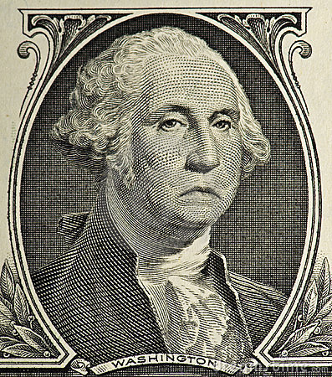
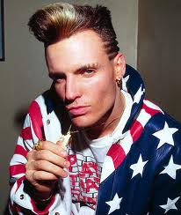
Precedent # 4: The Farewell Address
(REALLY IMPORTANT)
ICE-ICE-ISOLATED!
Do you know what George Washington’s favorite
song was?
(WAIT FOR IT)
In this Farewell Letter he advocated ISOLATIONISM, as well as warning the U.S. to stay NEUTRAL in FOREIGN AFFAIRS, and to AVOID ALLIANCES with FOREIGN NATIONS

Slide 16

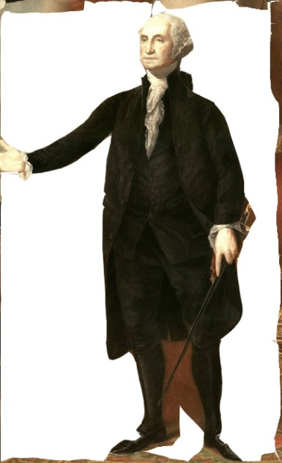

Slide 17
Why Stay Isolated?

Slide 18
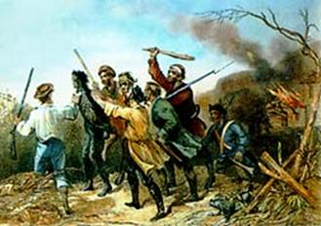

The Whiskey Rebellion (1794)
In 1794, Secretary of the Treasury Alexander Hamilton convinced Congress to pass an excise tax on non-essential goods, such as Whisky.
Farmers all over the United States began to riot, refused to pay taxes in Pennsylvania

Slide 19
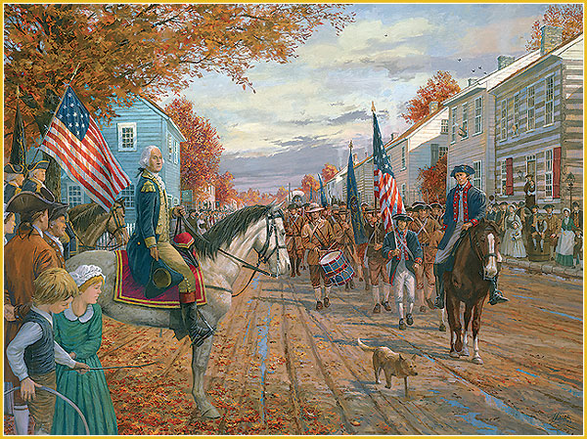
The Whiskey Rebellion (1794)
Washington refused to stand for this
He organized an army of 10,000 men and marched down to Pennsylvania, to personally put down the revolt
By the time he arrived, there was no one in sight, the rebellion was over

Slide 20
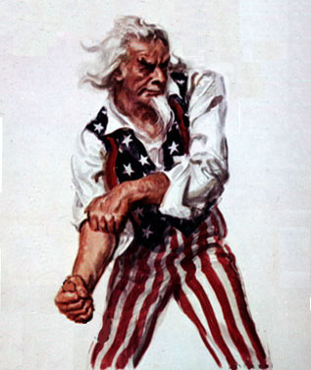
The Whiskey Rebellion (1794)
THIS REBELLION SHOWED THAT THE NATIONAL GOVERNMENT WAS NOT AFRAID TO USE FORCE TO ENFORCE FEDERAL LAWS
THIS IS WHY IT WAS DIFFERENT THAN SHAY’S REBELLION

Slide 21
...” As a very important source of strength and security, cherish public credit. One method of preserving it is, to use it as sparingly as possible; avoiding occasions of expense by cultivating peace, but remembering also that timely disbursements to prepare for danger frequently prevent much greater disbursements to repel it; avoiding likewise the accumulation of debt, not only by shunning occasions of expense, but by vigorous exertions in time of peace to discharge the debts, which unavoidable wars may have occasioned, not ungenerously throwing upon posterity the burthen, which we ourselves ought to bear…”
Main idea?

Slide 22
“…Citizens by birth or choice of a common country, that country has a right to concentrate your affections. The name of American, which belongs to you, in your national capacity, must always exalt the just pride of Patriotism, more than any appellation derived from local discriminations…”
Main idea?

Slide 23
…It is our true policy to steer clear of permanent alliances with any portion of the foreign world; so far, I mean, as we are now at liberty to do it; for let me not be understood as capable of patronizing infidelity to existing engagements. I hold the maxim no less applicable to public than to private affairs, that honesty is always the best policy. I repeat it, therefore, let those engagements be observed in their genuine sense. But, in my opinion, it is unnecessary and would be unwise to extend them….
Main idea?

Slide 24
…I have already intimated to you the danger of parties in the state, with particular reference to the founding of them on geographical discriminations. Let me now take a more comprehensive view, and warn you in the most solemn manner against the baneful effects of the spirit of party, generally…The alternate domination of one faction over another, sharpened by the spirit of revenge, natural to party dissension, which in different ages and countries has perpetrated the most horrid enormities, is itself a frightful despotism. But this leads at length to a more formal and permanent despotism. The disorders and miseries, which result, gradually incline the minds of men to seek security and repose in the absolute power of an individual; and sooner or later the chief of some prevailing faction, more able or more fortunate than his competitors, turns this disposition to the purposes of his own elevation ruins of Public Liberty…Without looking forward to an extremity of this kind, (which nevertheless ought not to be entirely out of sight,) the common and continual mischiefs of the spirit of party are sufficient to make it the interest and duty of a wise people to discourage and restrain it…”
Main idea?

Slide 25
President George Washington pursued a foreign policy of neutrality during his administration primarily because he believed that
the United States needed time to gain economic and military strength
treaties were prohibited by the Constitution
the United States should not expand by force
alliances should be established with both France and England

Slide 26
Which feature of the Presidency is a result of a constitutional amendment?
power to appoint ambassadors
duty to act as Commander in Chief
responsibility to nominate Justices to the Supreme Court
two-term limit in office

Slide 27
The decision of President Washington to use the state militia to put down the Whiskey Rebellion in 1794 demonstrated that
States were still the dominant power in the new nation
President was becoming a military dictator
New National Government intended to enforce Federal Laws
Federal Government had no authority to impose an excise tax.

