Slide 1
GW’s Successes
GW serves 2 Terms and creates the foundation of what the Presidency is about

Slide 2
GW’s Successes
Pinckney’s Treaty 1795
Neutrality
2 terms
Indian Wars- in Indiana Territory
Hamilton’s Financial Plans- Bank of US, Payoff States war debts, Excise & Tariff taxes, Support manufacturing & Industry, US Treasury Dept – Gold Standard = Specie

Slide 5
Birth Of 2 Party system
GW is out of office after 2 terms

Slide 6
Ideology of the 2 Parties: 1789-1815
Federalist Democratic-Republicans

Slide 7
President’s Cabinet = Head of govt. agencies
A cabinet is not mandated by either the Constitution or established law.
While there are currently sixteen cabinet level positions, George Washington’s original cabinet consisted of only four members.

Slide 8
Birth Of 2 Party Political System
1789-Federalist – Adams, Hamilton
1791-Democratic Republicans- Jefferson, James Madison
Sectionalism-
North v. South
Unwritten Constitution- Oh Yeah!!

Slide 9
1st 5 Presidents
George Washington (1789–1797)
John Adams (1797–1801)
Thomas Jefferson (1801–1809)
James Madison (1809–1817)
James Monroe (1817–1825)

Slide 10
Un written constitution
based chiefly on custom and precedent as
expressed in statutes and judicial decisions
The Cabinet - George Washington's first task to appoint Secretaries (heads) of each of the executive departments. He appointed Alexander Hamilton Secretary of the Treasury, Thomas Jefferson Secretary of State. Henry Knox Secretary of War & Edmund Randolph Attorney general = 4 cabinet positions
2019 we have 15 cabinet Positions

Slide 11
Un written constitution continued
not embodied in a single document but based chiefly on custom and precedent as expressed in statutes and judicial decisions.

Slide 12
Supreme Court Has the Power
Judicial Review - The power of the Supreme Court to declare laws unconstitutional is not in the constitution yet it has become one of the basic tenants of the checks and balances system. As previously discussed judicial review is a result of precedent set in the Marbury v Madison decision 1804

Slide 13
Un Written Constitution cont:
Judicial Review - The power of the Supreme Court to declare laws unconstitutional is not in the constitution yet it has become one of the basic tenants of the checks and balances system- judicial review is a result of precedent set in the Marbury v Madison decision.

Slide 14
Un Written Constitution cont:
Political Parties - While today we rely on political parties to help us choose candidates for president and all other offices there is no mention Political parties in the constitution.
Term Limits for President
Only In 1951 the 22nd amendment was ratified setting a two term limit. In doing this we made a part of the unwritten constitution a part of the written constitution. Prior it was the precedent set by GW to serve only 2 terms

Slide 15
Pinckney’s Treaty 1795
Spain gave up all claims of territory east of Mississippi & North of Florida
Port of New Orleans
Use the Mississippi
Spain was a rival of Britain’s = Huge…
Big Victory of GW

Slide 16
Federalist Era 1789-1815
1796--2nd President---John Q. Adams—a Federalist
Who are the federalists? –
What do they want?
Jefferson is Adams’ VP
Keep America out of War: French or British
1798--Alien & Sedition Act-made it easy to deport any non-citizen & more difficult to become a citizen
Adams used Alien & sedition Act to strengthen the Federalist party

Slide 18
Federalist Era 1789-1815
Adams negotiates Jay’s Treaty 1794 with England
Who will control territory west of the Appalachian mountains?
Western settlers were angry that the British were allowed to continue the fur trade south of the Canadian-US border.
People Protest

Slide 19
Adam’s Presidency
1798--Alien & Sedition Act-made it east to deport any non-citizen & more difficult to become a citizen
Sedition- speaking against ones country.
Adams used Alien & sedition Acts to strengthen the Federalist party And to stop the protests of his administration’s Jay’s Treaty agreement to allow Great Britain to fur--trap in America.

Slide 20
A Political Rivalry is Born
Jefferson--Democratic-Republican party.
Adams- Federalist party

Slide 21
Reaction to Adams’ Presidency
Jefferson Resigns-
Democratic Republicans become the 2nd Political Party- Who is a member of this Party?

Slide 22
Vice President
Jefferson is Adams’ VP

Slide 23
1800-America is divided
The French Revolution : whose side should America take?
Federalist = Neutrality
Democratic Republicans – Help the Revolutionary govt of France

Slide 24
Advantages of 2 Party System
There are a few advantages of the American two-party system:
Stability: Two-party systems are more stable than multiparty systems
Moderation: The two parties must appeal to the middle to win elections, so the parties tend to be moderate.
Ease: Voters have only to decide between two parties.

Slide 25
Disadvantages of 2 Party system
Lack of choice: Both parties tend to be very similar, limiting voters’ options.
Less democratic: A percentage of people will always feel marginalized by the system.

Slide 26
Election of Thomas Jefferson 1800
New--Separate electoral votes for President and VP.
TJ believes in:
Simple Govt.
Decentralize power
Reduced the size of the …
Free Trade no taxes
1st Pres. To live in Washington, D.C.

Slide 27
Southerners begin to dominate
Jefferson, Madison, & Monroe
From Virginia!

Slide 28
Jefferson & the Louisiana Purchase
1804. TJ pays $ 15 mil for the Louisiana territory
2x the size of US= allow for expansion of slavery = King Cotton = $$
But did the Constitution say it was ok to acquire new territory?
TJ was a strict constructionist- hoe does he rationalize buying it ?
On October 20, 1803, Senate ratifies the purchase
Port of New Orleans, Mississippi rive rbelongs to USA

Slide 29
Chattel Slavery
Chattel slavery. Chattel slavery, also called traditional slavery, is so named because people are treated as the chattel (personal property) of the owner and are bought and sold as commodities. Typically, under the chattel slave system, slave status was imposed on children of the enslaved at birth.

Slide 30
Jefferson Orders the Louisiana Purchase explored & mapped
Lewis & Clark – set offon May 1804-April 1806
How far to the Pacific. Native Americans, apex predators & can river systems provide a transportation system west?
The corp of Discovery takes 3 years to make it to the Pacific

Slide 31
John Marshall
1st SC Chief Justice- 30 years
Marbury v. Madison 1803.
Affirms Judicial Review- an act of Congress could be declared as unconstitutional by the SC.
Marbury v. Madison

Slide 32
War of 1812
Britain wants America
Jefferson serves 2 terms 1801-1809
Kept America out of War with Britain & France
But Both B & F seize American ships-especially whalers
Impressment– USS Sailors kidnapped & forced to serve on British & or French Naval ships.
How can USA remain neutral?

Slide 33
America reacts Embargo--
Embargo Act of 1807-
No exports to Europe & Britain

Slide 34
Indian Problems
1810-

Slide 35
Monroe Doctrine
Proclamation in 1823 by President James Monroe. Basically, it warned European nations not to get involved in political matters in Central and South America.

Slide 36
Monroe Doctrine
The Monroe Doctrine was a U.S. foreign policy regarding domination of the American continent in 1823. It stated that further efforts by European nations to colonize land or interfere with states in North or South America would be viewed as acts of aggression, requiring U.S. intervention.

Slide 37
Era of Good feelings
After the war of 1812—America settled into a period of rule by one party, the Democratic-Republicans of James Monroe which had their roots in the Jeffersonian Republicans.
During this time the “Era of God feelings”
No political battles between federalist and Democratic-Republicans and the start of the American system.

Slide 38
American system/Era of good feelings
American System-Henry clay’s idea to modernize America
The American System was an economic plan that played a prominent role in American policy during the first half of the 19th century.
National Road-East to West
Erie Canal
diversified American economy Farm & Industry

Slide 39
Annexation & manifest destiny
the forcible transition of one state's territory by another state.
America annexes territory during the 1800’s both legally and by force.
Texas by force
LP buy $

Slide 40
Manifest destiny
Factors Encouraging Westward Settlement
1. California-Gold Rush 1849
2. Homestead Act – 1862-160 acres of western land was given to every head of family who settled out west.
3. Completion of transcontinental railroad 1869.

Slide 41
Manifest Destiny
Annexation of new Territory is part of Manifest destiny.
Louisiana Purchase-800,000 square miles from the Gulf of Mexico to the Canada border
Texas and Florida-southwestern United States and Florida belonged to Spain. Florida became a state in 1845.
Texas- annexed by the United States in March of 1845 and became a state by the end of December. Northern politicians objected to the annexation of such a large slave-holding state, while the South welcomed it.

Slide 43
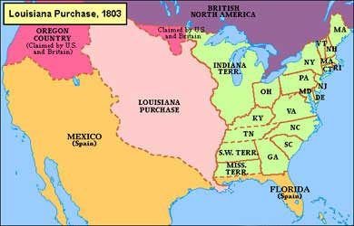
annexation map 1800's

Slide 44
Annexation territories 1800’s
Texas- annexed by the United States in March of 1845 and became a state by the end of December. Northern politicians objected to the annexation of such a large slave-holding state, while the South welcomed it.
Alaska-From Russia 1867
Mexican Cession
Hawaii, the Philippines and Puerto Rico-1898

Slide 45
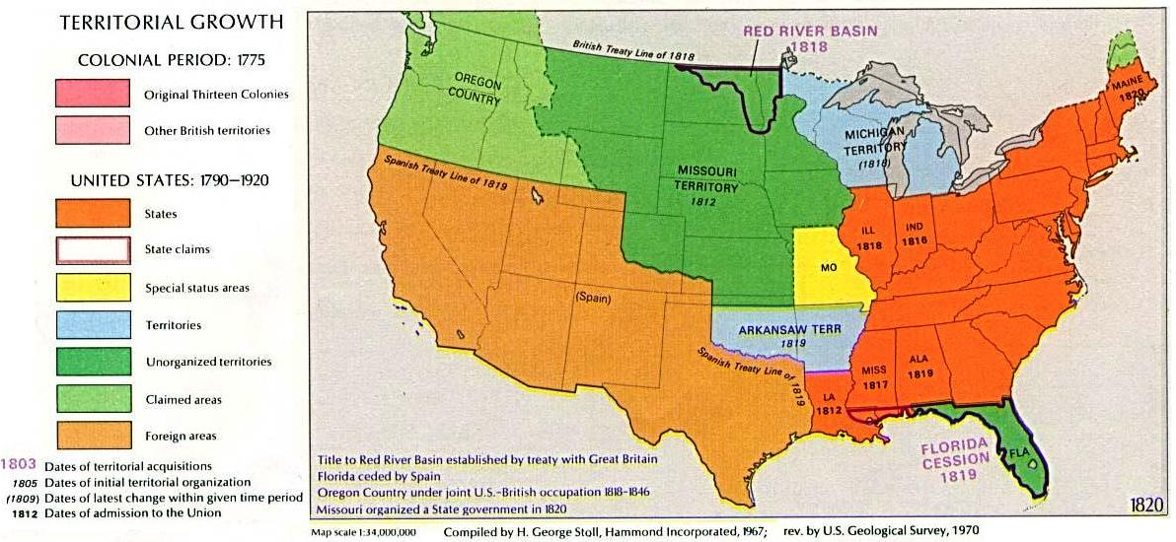

Slide 46
The Nullification Crisis
1830s leaders of South Carolina advanced the idea that a state did not have to follow a federal law and could, in effect, "nullify" the law.
Hated the Tariff system
The idea that "states' rights" superseded federal law was promoted by John C. Calhoun
1828 tariff was Called the Tariff of Abominations
Showed sectional division North v South

Slide 47
Clay’s ideas to finance the American System
protective tariffs
internal improvements
a 2nd national bank should help develop the nation's economy.

Slide 48
President Jackson hates the 2nd Bank of the US
2nd Bank of the United States 1816
Pay for debts the government had taken on during the War of 1812.
The 2nd Bank was created because the 1st bank of the United States (Hamilton) did not have its 20-year charter renewed by Congress in 1811.
Various scandals and controversies plagued the Second Bank of the United States in the first years of its existence, and it was blamed for helping to cause the Panic of 1819, a major economic crisis in the United States.

Slide 49
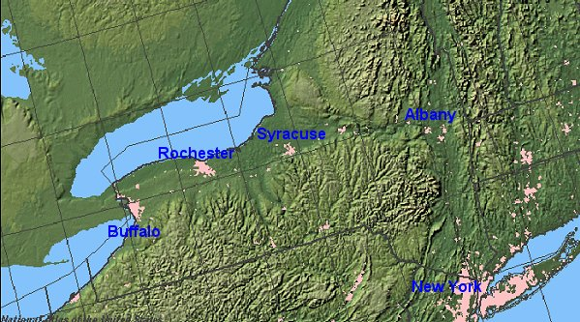
Erie Canal

