Slide 1
T The Columbian Exchange
The meeting of New World and European world created the Columbian exchange
Plants, animals, spices, fruits and tobacco were exchanged between Europe, Africa and the New World.

Slide 2
Colonial Era Timeline
1499 to 1763
1565 The first permanent European colony in North America is founded at St. Augustine (Florida) by the Spanish.

Slide 3
Why did Europeans come to the New World?
Europe needed new resources, Reached the point of domestic saturation
By BY Silk Road
Scientific revolution- Astrolabe, compass and Gravity
Age of Enlightenment-Inalienable rights, self Government.
Escape religious Persecution: Catholics & Puritans (Pilgrims) out of England. Catholics out of France = Huguenots.
English Prisoners to the Carolinas
Trade winds

Slide 4
Why did Europeans come to the New World?
Europe needed new resources, Reached the point of domestic saturation
Scientific revolution
Age of Enlightenment
Astrolabe, compass, Trade winds

Slide 5
How did Europeans know how to sail to the New World
Trade Winds---The trans-Atlantic currents and winds that provided the fastest route across the Atlantic ocean brought sailing ships to the southern Caribbean Islands aka Windward Islands.

Slide 6
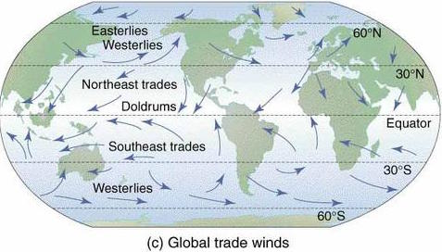
Trade Winds

Slide 7
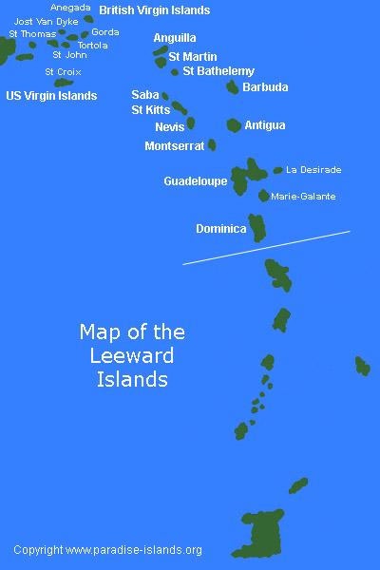
Windward & Leeward Islands

Slide 8
Same Meaning
What is the difference between inalienable and unalienable?
To start, the words mean the same thing. "Inalienable" has gained a stronger foothold in modern times, but both appear without distinction on the Merriam-Webster Dictionary website, which defines them as signifying that which is "incapable of being alienated, surrendered, or transferred. "Jan 6, 2016

Slide 9
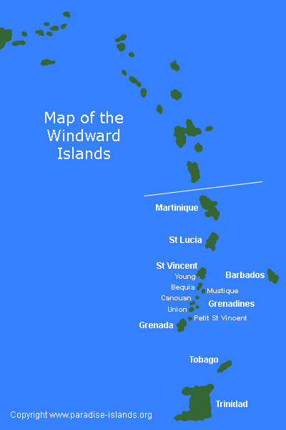
Windward Islands R windier and wetter side of the Lesser Antilles

Slide 10
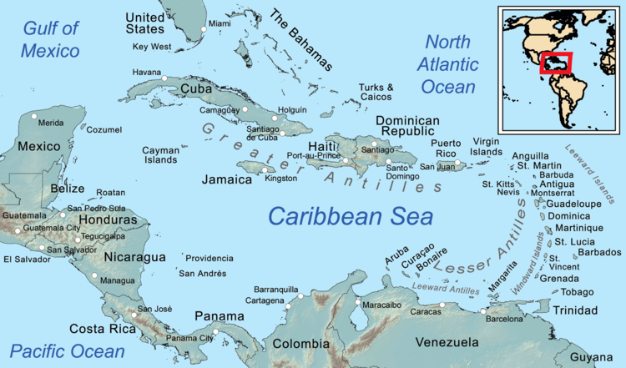
Map of Caribbean

Slide 11
Windward direction & Leeward direction
Windward into the wind=toward the wind
Lee ward =down wind

Slide 12
What made Europeans come to the New World
Religion-Puritans leave England = aka Separatists left the Church of England ( Anglican Church) and went to Plymouth Massachusetts = Catholics go to Maryland = Quakers Pennsylvania with William Penn
Economics- Make $ own land be a Yeoman farmer grow Cash crops, Tobacco, cotton, Indigo, Cochineal, rice & cotton
Political reasons - convicts sent to the Carolinas.
Lost the English Civil war – Cavaliers come to Virginia

Slide 13
Economic reasons
Virginia =Jamestown a joint stock company
New York = Harbor & Hudson river
Lots of land & resources
Political reasons=those not in favor with Royalty. England was the primary European power settling North America
France= Canada, Ohio River Valley
Spain in Florida & South west

Slide 14
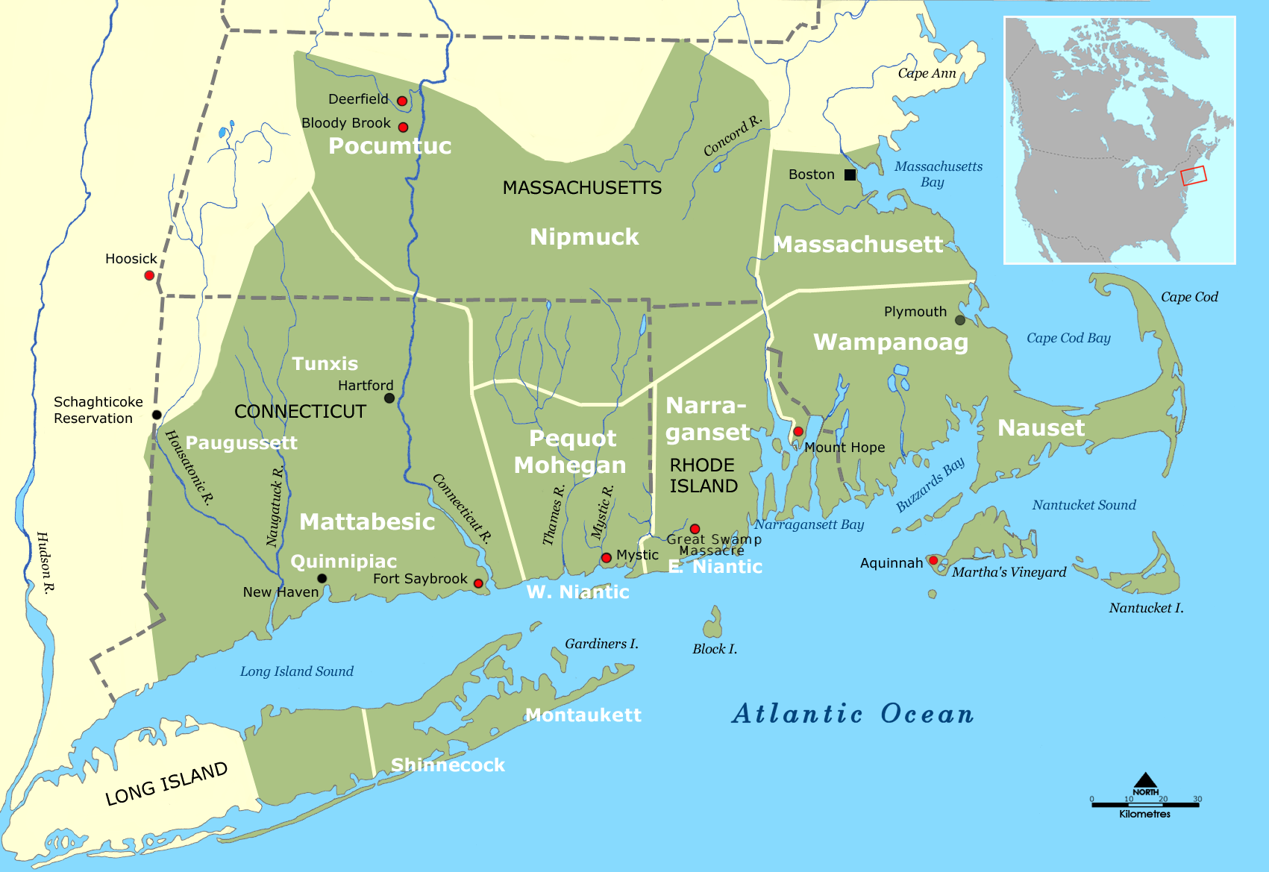

Slide 15
North American Geography
New England= Rocky, small farms, cold, Lumber, ship building
Middle Colonies= NY, NJ, Delaware, Penn. longer growing season, horses, farms, wheat fertile soil long growing seasons
Southern Colonies=CASH CROPS + rich soil LONGEST growing season & inland rivers=known as the tide water system settlements went as far as the tide would take a ship.

Slide 16
Why did Europeans come to the New World?
Europe needed new resources, Reached the point of domestic saturation
Scientific revolution
Age of Enlightenment
Astrolabe, compass, Trade winds

Slide 17
Tide Water System

Slide 18
Royal Colonial settlements
1584 Sir Walter Raleigh lands on Roanoke Island –Virginia--and names the surrounding area Virginia, in honor of Queen Elizabeth I of England.

Slide 19
Tide water system-Southern region
Tide water system-southern rivers were deep & went from the ocean far up into the interior of America & this allowed for by ocean going sailing ships could go as far as the tide went up the river.
Southern colonies were more isolated and thus the plantations were isolated and self sufficient.
FARM-Plantation based economy

Slide 20
Triangular Trade
Africa, Caribbean & 13 Colonies
New England shipping went to Africa for slaves, then to the Caribbean sugar Islands dropped off the slaves and or brought them to the colonies, & also brought back molasses, sugar and in New England made into Rum-Rum, salted Cod from New England was shipped to Europe and throughout North & South America. Tea was also shipped and was part of the British East India Company’s trade network.

Slide 21
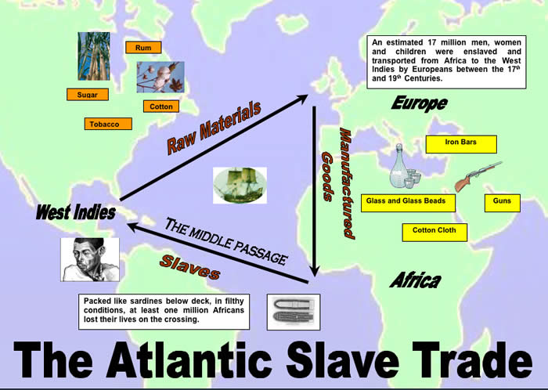
Triangular Trade

Slide 22
Middle Passage
Slave voyage from Africa to America
Slave rebellions== Nat Turner --Turner’s rebellion
African foods, language and especially music influenced American culture.

Slide 23
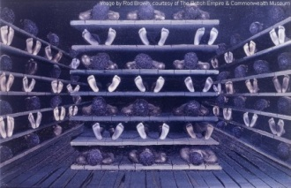
Middle Passage

Slide 24
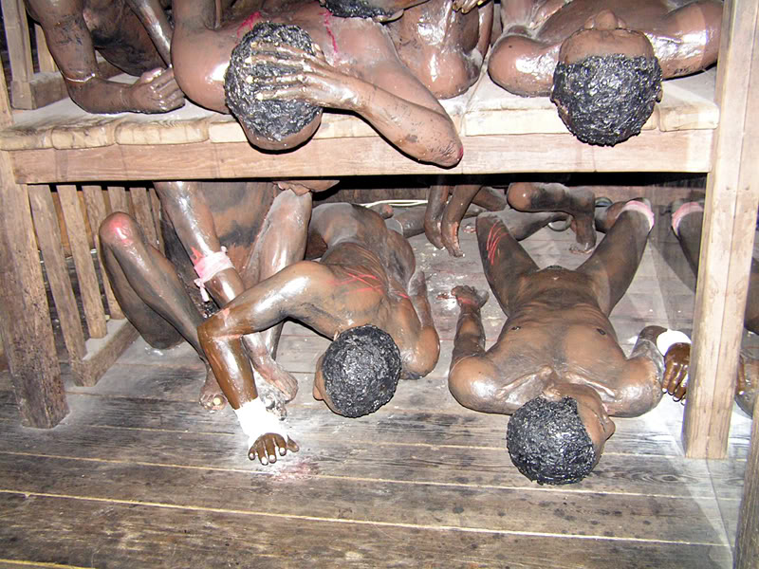
Racking on Slave ship Middle Passage

Slide 25
Diaspora
The purposeful dispersion by FORCE by Govt. of a group of people from their original homeland.
Romans remove the Jews from Palestine
Africans-slavery
Armenians-Turkish Genocide & pushed out of Crimea Region region of
US Govt removes native Americans to reservations

Slide 26
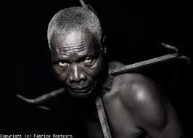
Slave no Run collar

Slide 27
England needs to purge itself of trouble makers
King James I in 1606 gave territory to religious zealots known as Puritans to the Plymouth Company. They were heading to Virginia but were blown off course and ended up in Cape Cod!!
May Flower Compact: The beginning of self government, representative democracy signed on board the Mayflower in Provincetown Harbor near Cape Cod, Massachusetts

Slide 28
The Mayflower Compact
The Mayflower Compact was drawn up with fair and equal laws, for the general good of the settlement and with the will of the majority
All 41 of the adult male members on the Mayflower signed the Compact. Being the first written laws for the new land, the Compact determined authority within the settlement and was the observed as such until 1691. This established that the colony (mostly persecuted Separatists), was to be free of English law. It was devised to set up a government from within themselves and was written by those to be governed.

Slide 29
First English settlements in Virginia
1587 – Lost Colony of Roanoke
1587 - The first English child, Virginia Dare is born in Roanoke, August 18th.
1606 - The London Company sponsors a colonizing expedition to Virginia==Jamestown

Slide 30
Why did England seek colonies in America?
To Queen Elizabeth New World colonies could serve two purposes.
  A. challenge Spanish domination of the New World. B. England’s ever-growing poorer classes could be transported to America easing England's population pressures.
British cities were growing with out of work agrarian workers.

Slide 31
The Joint Stock Company is created
The Virginia Company becomes a Joint-Stock Company a JSC is the forerunner of the modern corporation. In a joint-stock venture, stock is sold to investors who provide capital==$$$$-- limits risk and potentially great profits. Jamestown becomes a joint stock company 1609 known as the Virginia Company.
Headright system:

Slide 32
joint stock company
invest money in one, and in return they would get a percentage of the profits these companies made from trade in the new world. the most well known joint stock company was the Virginia Company (Founded Jamestown, Virginia)

Slide 33
Headwright System
immigrant colonists who paid for their own passage to America were given one headwright= land-, and if they paid for someone to go would receive one headwright each time they paid for the passage of another individual.

Slide 34
Home work
Read txt book pg.38-48
Define the following terms
1.Joint Stock Company
2. Headright system
3.Indentured servant
4. Royal colony
Q what was the result of Jamestown’s ‘tobacco economy?

Slide 35
3 Types of British Colonies in America
There were proprietary colonies: land grants given to individuals or small groups.
Chartered colonies: which were land grants (or charters) given to private companies.
Royal colonies: Crown had complete control over governmental actions (they appointed the governor and the council). Often chartered colonies became royal colonies after their charter was revoked.

Slide 36
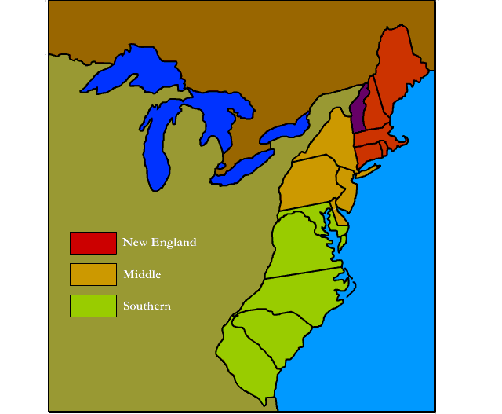
British 13 colonies

Slide 37
Religion in the New England colonies
The New England colonies were dominated by the Puritans, reformers seeking to “purify” Christianity, who came over from England to practice religion without persecution. Puritans followed strict rules and were intolerant of other religions, eventually absorbing the separatist Pilgrims in Massachusetts by 1629. Life in New England was dominated by church, and there were severe consequences for those who failed to attend, or, those who spoke out against the Puritan ways. Singing and celebrating holidays were among things prohibited in Puritan New England.

Slide 38
New England’s economy
New England’s economy was largely dependent on the ocean. Fishing (especially codfish) was most important to the New England economy, though whaling, trapping, shipbuilding, and logging were important also.
Many New England shippers grew wealthy buying slaves from West Africa in return for rum, and selling the slaves to the West Indies in return for molasses. This process was called the “triangular trade.”

Slide 39
Religion in the Middle Colonies
Religion in the Middle Colonies was varied as no single religion seemed to dominate the entire region. Religious tolerance attracted immigrants from a wide-range of foreign countries who practiced many different religions. Quakers, Catholics, Jews, Lutherans and Presbyterians were among those religious groups that had significant numbers in the middle colonies.

Slide 40
Religion Re-cap
New England= Puritans= strict interpretation of old Testament– believed in Pre-determinism
Middle colonies-- Quakers, Catholics, Jews, Lutherans and Presbyterians Anglican (Baptist or Presbyterian), no single religion seemed to dominate the entire region. Religious tolerance attracted immigrants from a wide-range of foreign countries who practiced many different religions.
Southern Colonies--Anglican (Baptist or Presbyterian), though most of the original settlers from the Maryland colony were Catholic, as Lord Baltimore founded it as a refuge for English Catholics. Religion did not have the same impact on communities as in the New England colonies or the Mid-Atlantic colonies because people lived on plantations that were often distant and spread out from one another.

Slide 41
The Middle Colonies Economy
The Middle Colonies enjoyed a successful and diverse economy. Largely agricultural, farms in this region grew numerous kinds of crops, most notably grains and oats. Logging, shipbuilding, textiles production, and papermaking were also important in the Middle Colonies. Big cities such as Philadelphia and New York were major shipping hubs, and craftsmen such as blacksmiths, silversmiths, cobblers, wheelwrights, wigmakers, milliners, and others contributed to the economies of such cities.
Harbors=NY, Batimore, Chesapeake bay

Slide 42
Religion in the Southern Colonies
Most people in the Southern Colonies were Anglican (Baptist or Presbyterian), though most of the original settlers from the Maryland colony were Catholic, as Lord Baltimore founded it as a refuge for English Catholics. Religion did not have the same impact on communities as in the New England colonies or the Mid-Atlantic colonies because people lived on plantations that were often distant and spread out from one another.

Slide 43
Southern Economies
Economy – The Southern economy was almost entirely based on farming. Rice, indigo, tobacco, sugarcane, and cotton were cash crops. Crops were grown on large plantations where slaves and indentured servants worked the land. In fact, Charleston, South Carolina became one of the centers of the American slave trade in the 1700′s.
Harbors, Charleston, SC, Savannah, GA
Lots of rivers going inland=tide water system

Slide 44
The 13 Colonies
11 of the 13 colonies were founded as proprietorships.
The Proprietorship was a sort of middle thing between the royal province and the self-governing colony. Between the king and the settlers stood the proprietor, a man or a small group of men, generally courtiers, to whom the king had granted the province.

Slide 45
The Dutch Divide Britain’s Colonies
Henry Hudson sailed up the majestic river which bears his name in 1609, he was trespassing on the territory granted by King James I in 1606 to the Plymouth Company.

Slide 46
US History HW due on Monday October 2nd
Answer/define & explain the terms on page 102 in your textbook

Slide 47
Navigation Acts
After 1765 no more salutary Neglect
Taxation & control of colony
Navigation Acts 1700’s
Jones Act Puerto Rico -- limiting shipping by foreign vessels 100 year old law supplies carried to Puerto Rico must be on US Ships

Slide 48
Representative Govt in Jamestown
House of Burgesses-white men, Land holders

Slide 49
Video of Colonial settlement
http://www.youtube.com/watch?v=qiMCXWMvRJc

Slide 50
NY Colony
September, 1664--English fleet sent out by King Charles' brother, the Duke of York, sailed into New York Harbor and demanded the surrender of the feebly garrisoned Dutch fort on Manhattan Island–
Peter Stuyvesant, director general of the Dutch colony of New Netherland, which had been founded fifty years before and was governed by the Dutch West India Company. The company established fortified trading posts at New Amsterdam (New York City) and Fort Orange (near Albany), but they did not make a success of the colony

Slide 51
Jamestown
1607 - Jamestown is founded in Virginia by the colonists of the London Company. By the end of the year, starvation and disease reduce the original 105 settlers to just 32 survivors. Capt. John Smith is captured by Native American Chief Powhatan and saved from death by the chief's daughter, Pocahontas.

Slide 52
Captain John Smith
1607 - Captain John Smith, a leader of Jamestown, led expeditions in Virginia. The next year he sailed north to explore the Chesapeake Bay and the Potomac river. In 1614 he spent a summer on Monhegan Island, off the coast of Maine, and mapped the coast south to Cape Cod. He called the area New England.
1608 - In January, 110 additional colonists arrive at Jamestown. In December, the first items of export trade are sent from Jamestown back to England and include lumber and iron ore.

Slide 53
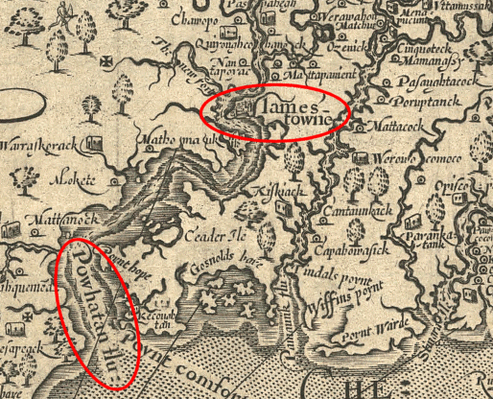
1607 Jamestown

Slide 54
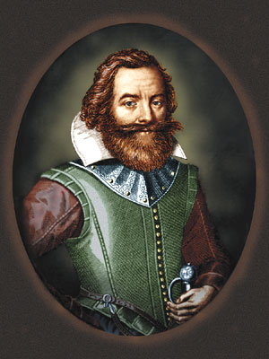
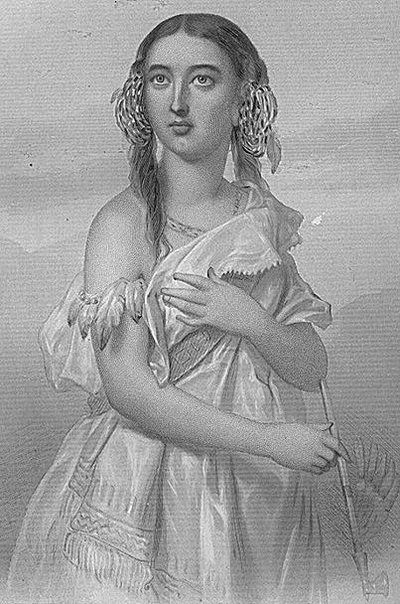
John Smith Pocahontas

Slide 55
Pennsylvania
William Penn was the greatest of the founders of the American colonies.
He was far in advance of his age in humanity. At a time when scores of offenses were punishable by death in England he made murder the only capital crime in his colony.
Prisons generally were filthy dungeons, but Penn made his prisons workhouses for the education and correction of malefactors. His province was the first to raise its voice against slavery in the Germantown protest of 1688, and his humane treatment of the Indians
1712, disputes increased between governor and assembly over taxes, land transfers, trade, and defense; but the colony remained in the possession of the Penn family throughout the American colonial period.

Slide 56
For Profit Colonies
Crown is broke
1601 England’s King James I Grants a Charter to the Virginia Company. A Joint stock company.
Jamestown April, 1607 150 “We want gold”
Problems
Powhatan Indians
John Smith

Slide 57
Finally a profit in Jamestown
1619
John Rolfe = tobacco
“we need workers”
1618 Headright system is introduced by the Virginia Company.
Indentured servants

Slide 58
House of Burgesses 1619
Burgess = the privileges of a citizen
Landowning males made decisions on how to best manage Jamestown and the outer area of growing tobacco farms

Slide 59
Colonial Self Govt Representative Govt.
Enlightenment ideas convinced colonists that they had Inalienable rights, natural rights, God given rights, consent of the governed
Pursuit of life, liberty & property
John Locke's--Second Treatise of Government (1689)
Jean-Jacques Rousseau-social contract
Social Contract, Mayflower Compact,
House of Burgesses,
New England Town meetings
Lead to self-govt, representative govt, equality before the law
Sovereignty is derived form the consent of the governed

Slide 60
Rousseau & Locke
Jean Jacques Rousseau and John Locke each took the social contract theory one step further.
Rousseau wrote in 1762The Social Contract, or Principles of Political Right government is based on the idea of popular sovereignty. Thus the will of the people as a whole gives power and direction to the state.
John Locke –NATURAL RIGHTS--- 1690 He stressed the individual AND revolution was not just a right but an obligation if the state abused their given power. Obviously these ideas had a huge impact on the America’s Founding Fathers especially Thomas Jefferson and James Madison.
“Life, liberty & property”
Sovereignty- a country's independent authority and the right to govern itself
Citizen participation in Govt
Govt gets its power form the governed

