Slide 1
IV. Climate
Climate – weather conditions of a large area, for a long period of time
  Measured by temperature and humidity
  Annually –average of year, highs and lows, monthly average
  P = Average Annual Precipitation
  Ep = Average Annual Temperatue
  P / Ep Ratio = climate Type

Slide 2
1. Latitude
Latitude determines Angle of Insolation
The higher the latitude, the lower the Angle of Insolation
Higher Latitudes = Colder Temperatures
Lower Latitudes = Warmer Temperatures

Slide 3
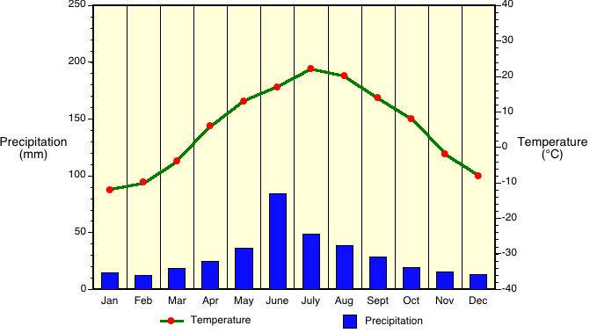

Slide 4
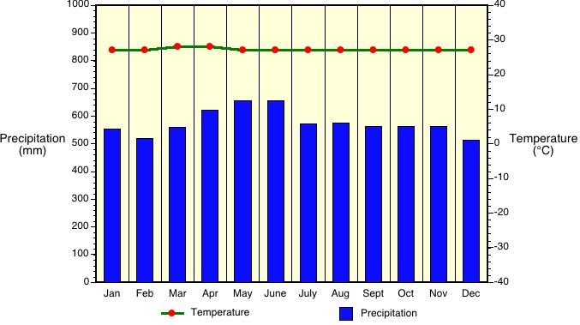

Slide 5
2. Altitude / Elevation
An increase in altitude, decrease in temperature.
Higher altitudes tend to have more moisture.

Slide 6
3. Mountain Ranges
Adiabatic Lifting = cooling
Air rises on the windward side
Air sinks on the Leeward side
Windward side of the mountain – cool and moist
Leeward side of the mountain – hot and dry

Slide 7
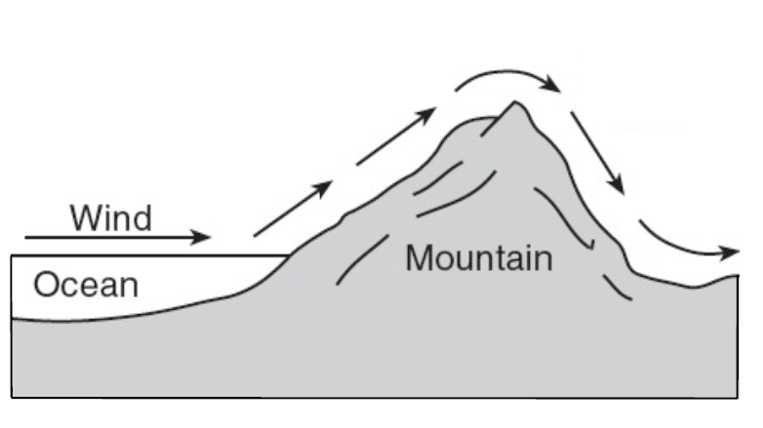

WINDWARD SIDE
COOL, MOIST CLIMATE
LEEWARD SIDE
HOT AND DRY
Condensation, clouds, precipitation
Air sinks
Expands & cools
Compresses & warms
Air rises

Slide 8


Slide 9
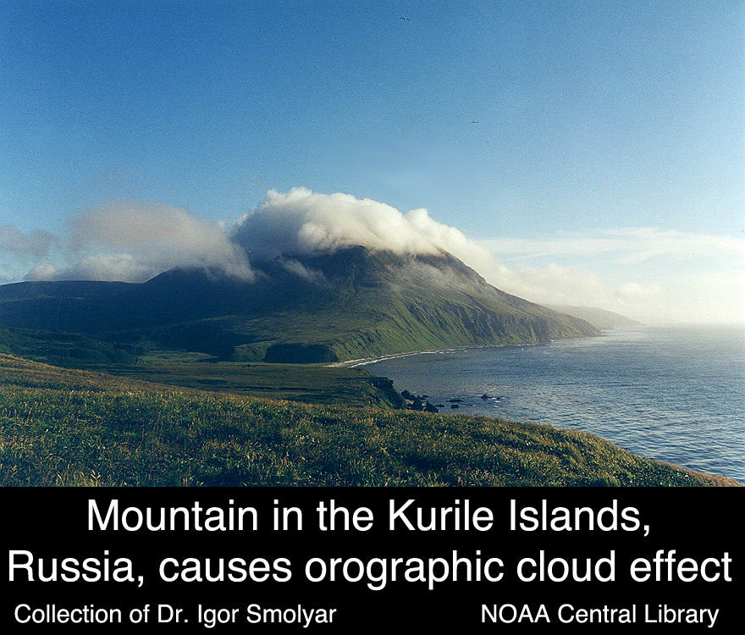

Slide 10
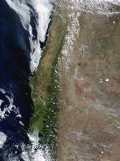

Slide 11
4. Oceans or Large Bodies of Water
Humid, marine climate (temperature will be moderated)
Less of a temperature range
Cooler summers, warmer winters

Slide 12
5. Middle of the continent- (Landlocked)
Will be continental climate (extreme temperatures)
Land Heats up and cools off fast
Greater temperature range
Hotter summers, colder winters

Slide 13
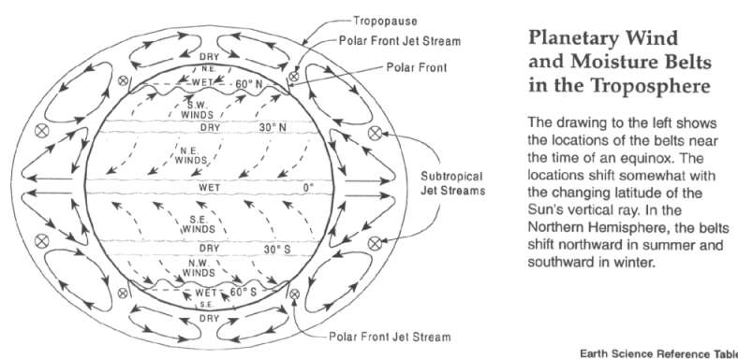
6. Planetary Wind Belts-
Drive weather systems
Storm tracks follow planetary wind belts

Slide 14
7. Surface Ocean Currents-
Page 4 in Earth Science Reference Table
Can bring cool water therefore cool down
Can bring warm water to cooler areas therefore warm up

Slide 15
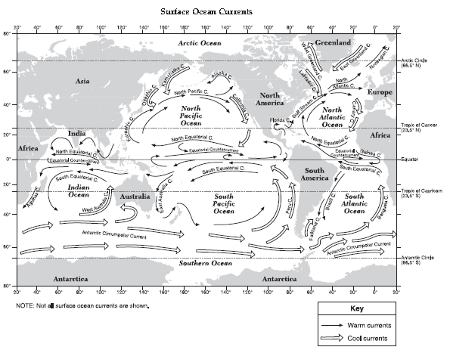

Slide 16
Climate Types:
P/Ep Ratio | Climate Type
Less Than .4 | Arid
0.4 – 0.8 | Semiarid
0.9 – 1.2 | Subhumid
Greater Than 1.2 | Humid

